Slide 1
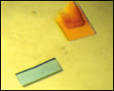
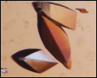
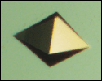
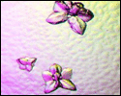
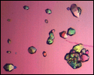
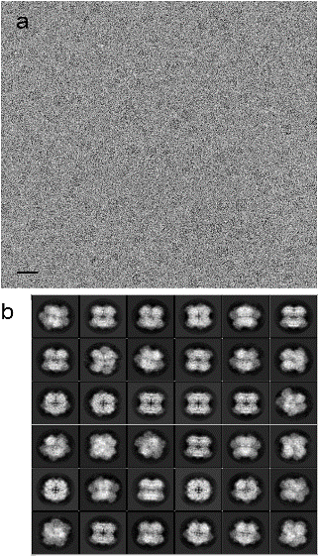
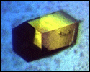
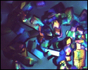
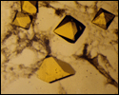
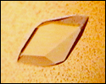
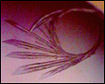
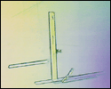
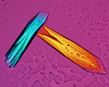
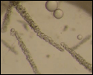
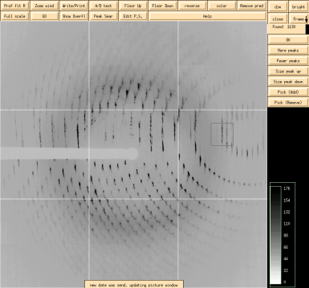
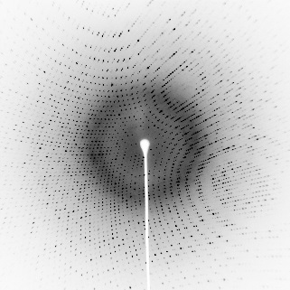
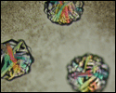
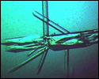
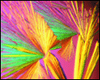
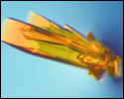
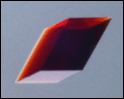
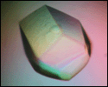
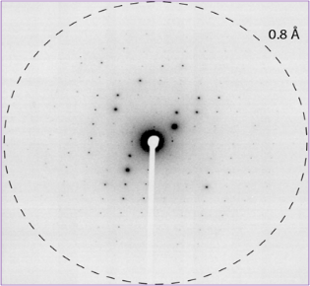
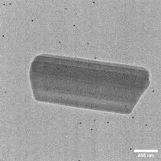
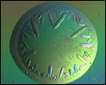
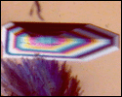
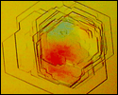
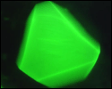
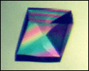
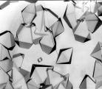
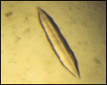
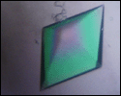
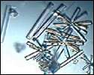
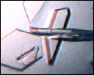
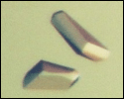
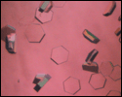
Introduction to Structural Biology
C269A– Fall 2023
Duilio Cascio (cascio@mbi.ucla.edu)

Slide 2
Why is it so important to know the 3D structure of a protein?
Proteins are the building blocks of life.
Proteins form the basis for biological processes.
The structure of a protein is closely related to its function.
Biological function operates through structure
Organisms adapt to their environments by evolution of their substructures
If you know the structure of a protein, you can better understand what it does and how it works.
Disease mutations cause structural change.

Slide 3
How do you solve the structure of a macromolecule in 2023 ?
CRYSTALLOGRAPHIC METHODS:
Clone + Express +Purify
Crystallize + Optimize
Data collection of Diffraction Data
Build Model into Electron Density
CryoEM METHODS:
Clone + Express +Purify
Optimize and collect CryoEM data
CryoEM reconstruction
Build Model into Electron Density
180K structures
NMR METHODS
17K structures
(ML) MACHINE LEARNING METHODS: ALPHAFOLD
AI Applied to Biology
Training using 200+K structures in the PDB
Produces 3D protein structures from:
Aminoacid sequence, Multiple Sequence Alignments, and
Homologous Proteins
https://alphafold.ebi.ac.uk/ (200M predicted structures)

Slide 4
Points covered in this tutorial
1. Introduction: Why Scientists Study Structure
2. Diffraction demo
3. Browse the Protein Data Bank (PDB)
4. Viewing and manipulating 3-D Structures
Structure of a Simple Protein-DNA complex
Building atomic models into experimental maps

Slide 5
Points briefly covered in this tutorial but fully covered in CHEM230A (Lecture) and M230D (Lab) (Winter quarter. Starts 1/8/2024)
Xray + electron-diffraction + cryoEM
Growing crystals and Diffraction Basics
From Crystals to Diffraction Data
Reconstruction of electron density and Building Atomic Models
CryoEM: Grid+Sample preparation
Data collection, Image Processing
3D Reconstruction and Refinement

Slide 6
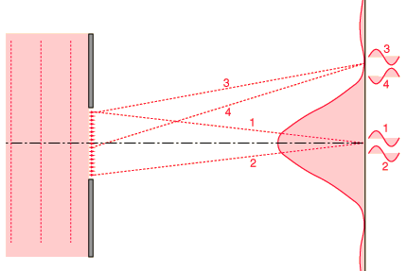
Diffraction: Single slit diffraction

Slide 7
Diffraction: Interference Patterns Thomas Young’s Slit experiments (1801)

Slide 8
Visible Light Diffraction Demo
Diffraction Grating
1 um or 1,000 nm
Green Laser = 532 nm

Slide 9
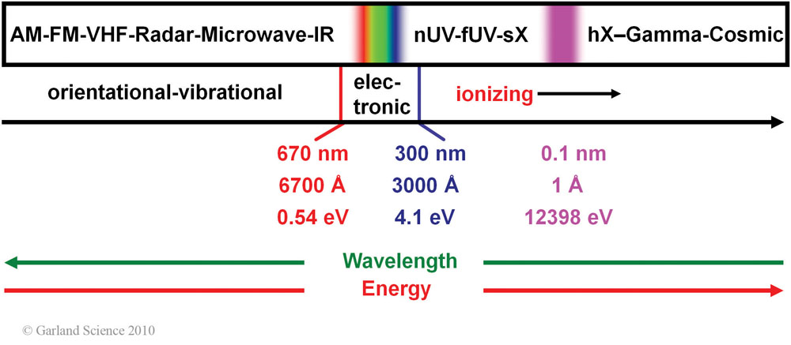
The Electromagnetic Spectrum
Green Laser = 532 nm

Slide 10
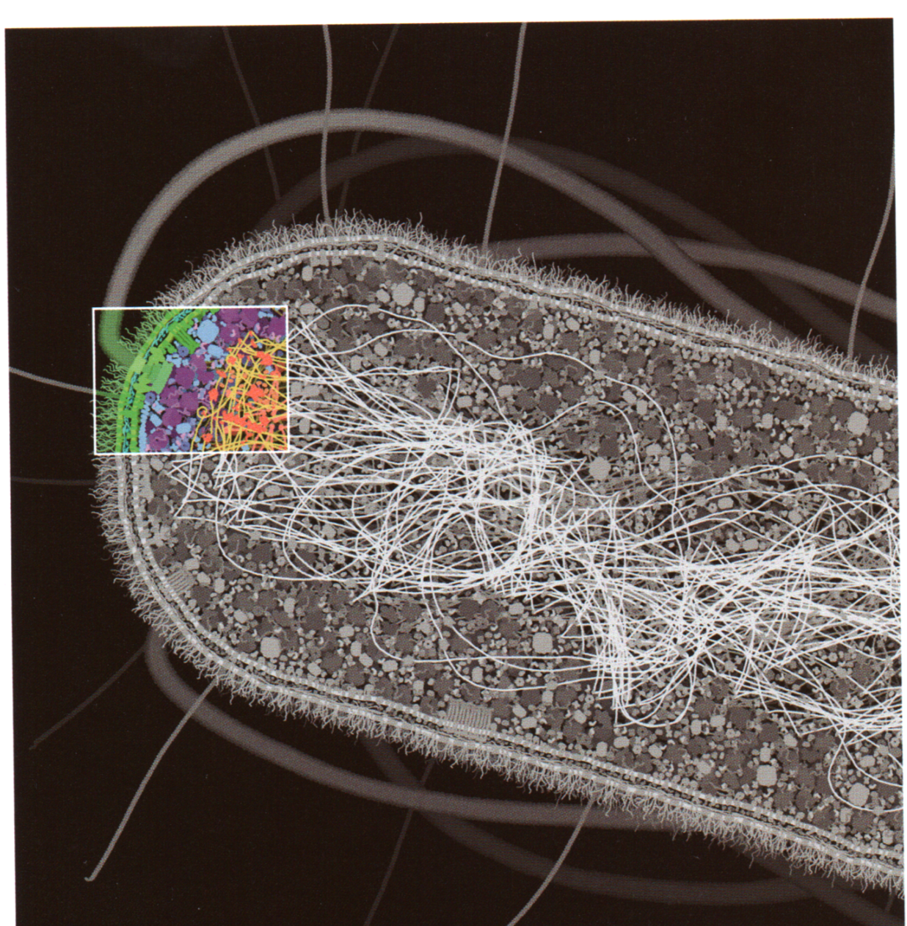
Visible light is ~3000 times too long to resolve interatomic distances (~1.5 Å)
Visible light 5000 Å
Tiny blue speck is a molecule of 10,000 atoms. The distance between atoms is too short to see on this scale.
Visible light scattered from different atoms would experience virtually no relative phase shift. Light recorded on the detector would appear to have not been affected by the scattering event.

Slide 11
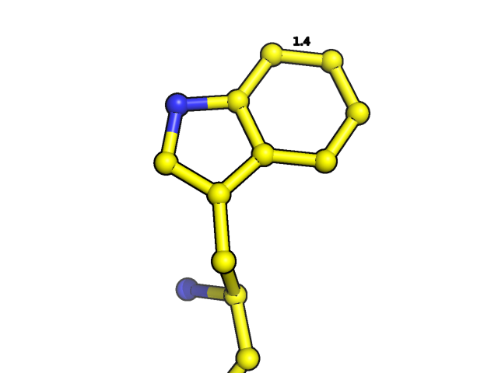
X-rays are appropriate for resolving interatomic distances (0.1nm or 1 Å)
Visible 0.5x10⁻⁶ m
UV 1x10⁻⁸ m
X-rays 1x10⁻¹⁰ m
Gamma rays 10⁻¹² m
Other options are neutron (~1Å) or electron beams (0.025 Å).

Slide 12
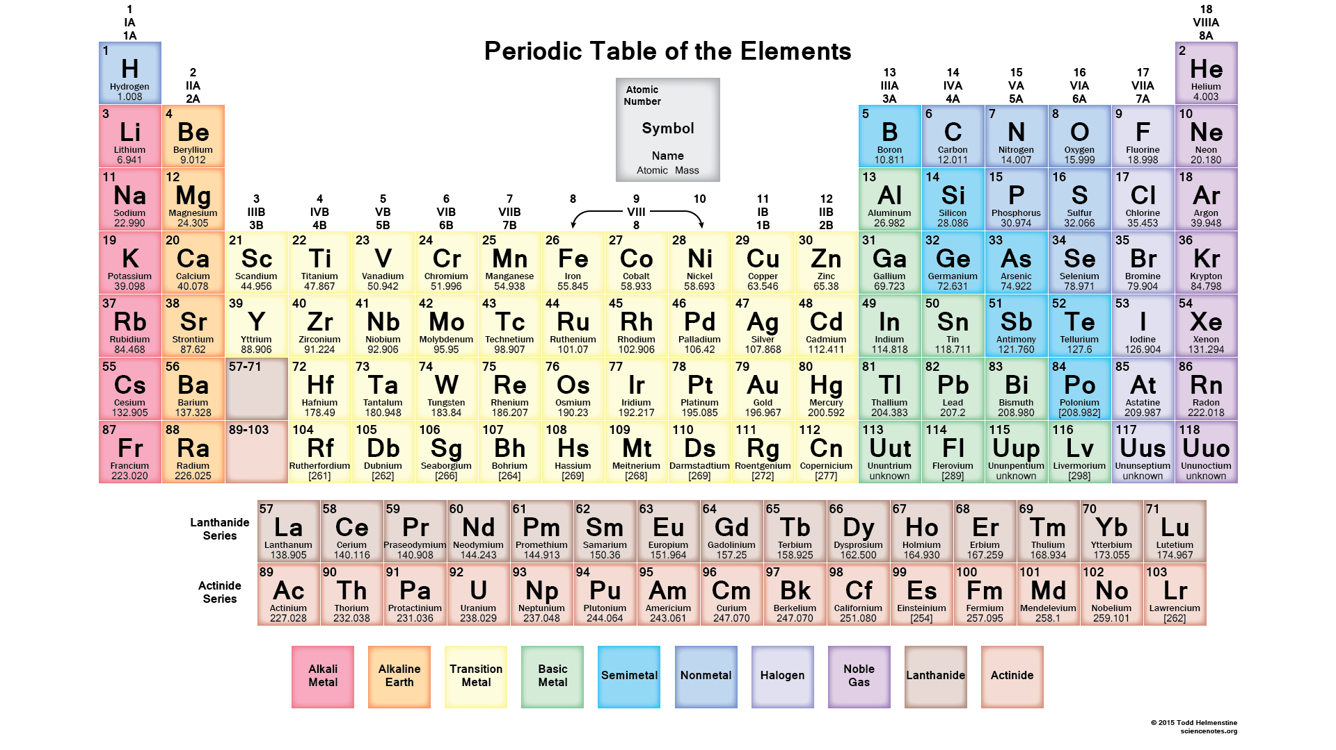

Slide 13
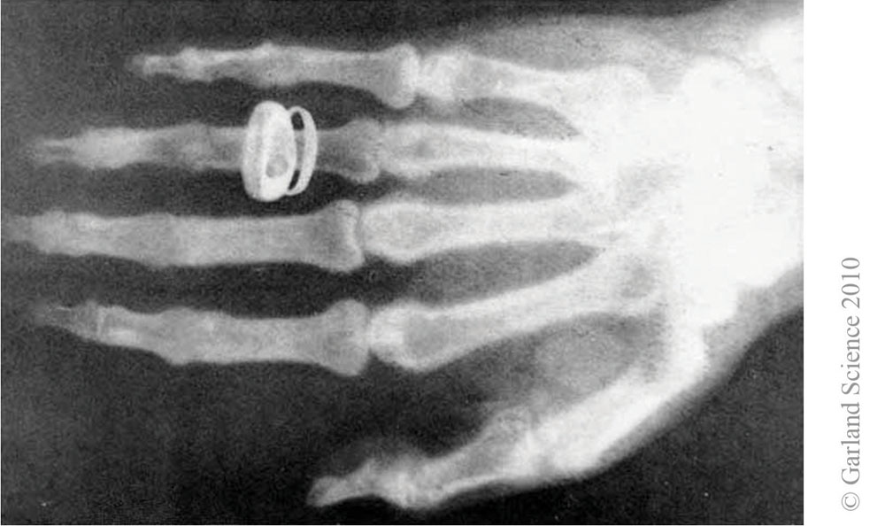

Slide 14
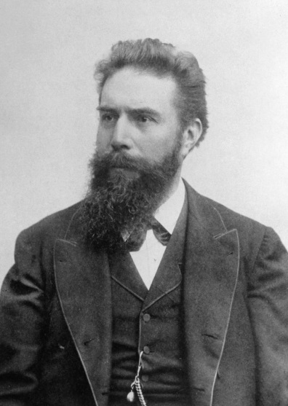
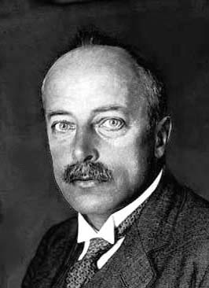
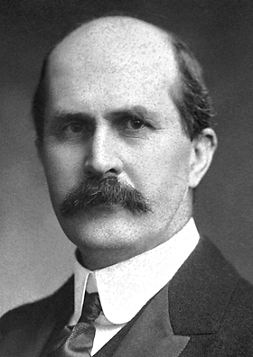
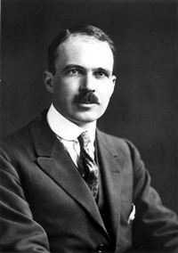
X-ray Diffraction History
Wilhelm Conrad Röntgen
Max Von Laue
Discovers X-rays in 1895
Nobel Prize in 1901
Discovers diffraction of X-rays by crystals
In 1912.
(CuSO4 and ZnS)
Nobel Prize for Physics in 1914
Sir William Henry Bragg
Sir William Lawrence Bragg
Father and son solve the structure of NaCl, KCl, ice and diamond
Nobel Prize for Physics in 1915

Slide 15
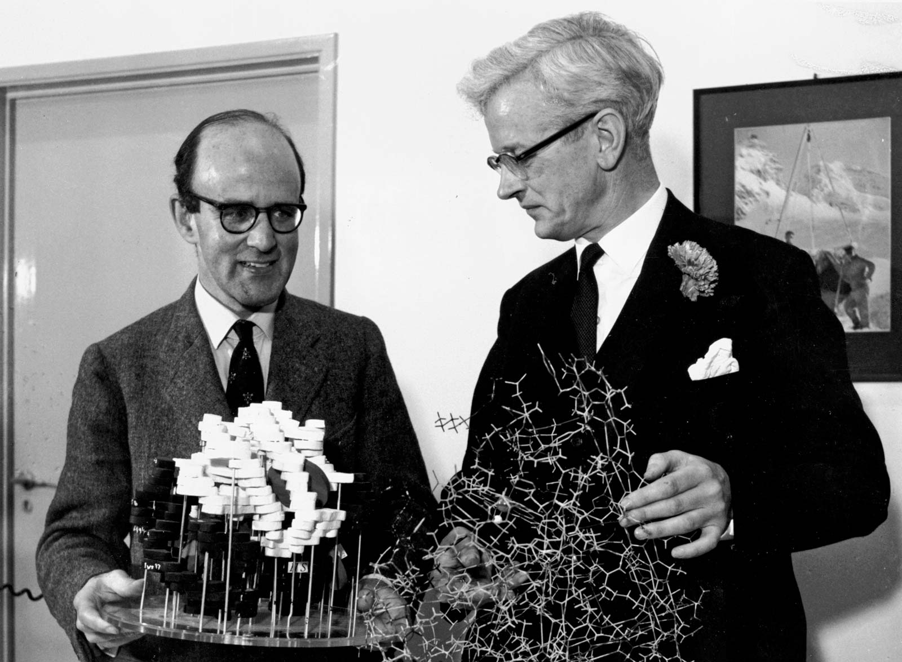
X-ray Diffraction History
Max Perutz and John Kendrew
Nobel Prize for Chemistry in 1962
For Solving the Structure of Globular Proteins
(Myoglobin and Hemoglobin)

Slide 16
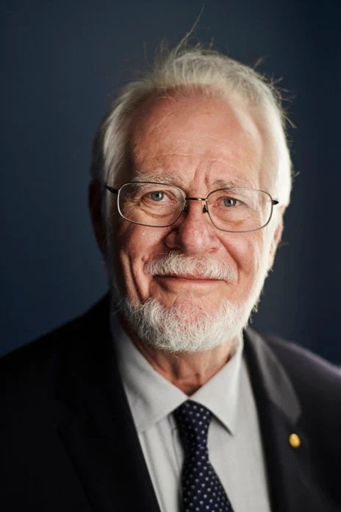
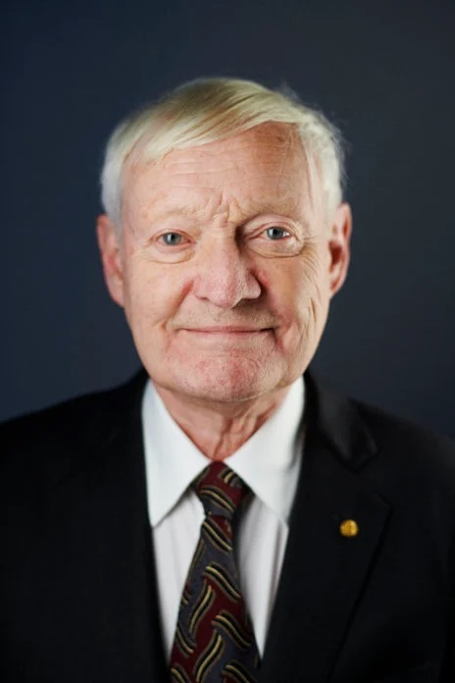
The Nobel Prize in Chemistry 2017
"for developing cryo-electron microscopy for the high-resolution structure determination of biomolecules in solution"
Jacques Dubochet
Joachim Frank
Richard Henderson
Sample Vitrification
Structure determination from ensembles of particles in solution
First atomic resolution structure of a Protein

Slide 17
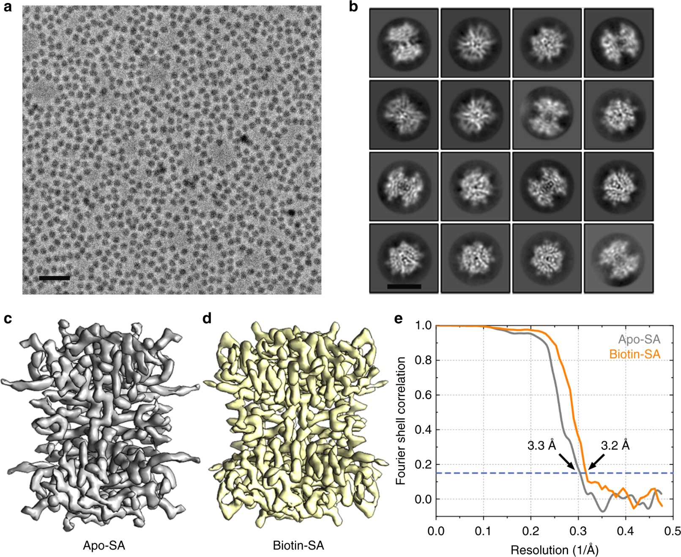
Single particle cryo-EM reconstruction

Slide 18
Crystal Structure Determination
Electron density
Diffraction
experiment
Model Building &
Atomic Refinement
Crystal growth and freezing
Diffraction
pattern
Structure

Slide 19
Calculating an Electron Density map from diffraction data

Slide 20
GOALS OF THIS TUTORIAL
Learn how to find and analyze atomic structure files from X-ray, NMR, Electron Diffraction, CryoEM (PDB= Protein Data Bank )
Learn how to visualize PDB files
Learn how to highlight areas of interest
Learn how to mutate residues
Learn how to built atomic models into electron density maps

Slide 21
ATOM SELECTION
Object Hierarchy:
PDB file
Chain-ID
Residue-ID or Residue-Name
Atom_name-ID
Examples:
First Read PDB file:
load gpcr1.pdb
select CHAINS_AB, chain A+B
select R23, resid 23 and chain A
select LOOP1, resid 40:50 and chain B
Select ALL_VALINES, resname VAL
Select ZINC_ATOM, name ZN

Slide 22
STRUCTURE REPRESENTATION
Lines
Sticks
Ribbons
Spheres
Surface
Cartoon
EXAMPLES: (Make OBJECTS that contain parts of the whole macromolecule)
select DNA, chains D+E
color red, DNA
show ribbon, DNA
select ZINC, resname ZN
show spheres, ZINC
color yellow, ZINC

Slide 23
ADDITIONAL SLIDES

Slide 24
X-ray and Electron diffraction: Instrumentation and data collection
An intense source of X-rays in the 5-25 Kev range
(or an electron microscope 200-400 Kev)
Optics to select monochromatic X-rays and focusing
A goniostat: A mechanical device to orient the crystal in the X-ray beam.
A 2-D detector to record the diffracted X-rays.
Crystal Cryo-cooler and Microscope

Slide 25
IN-HOUSE X-RAY DIFFRACTION INSTRUMENT ($ 1-2M)

Slide 26
Schematic View of a Synchrotron
Advanced Light Source in Chicago (~$1B)

Slide 29
Linac Coherent Light Source at Stanford (~$2B) X-FEL ( X-ray free electron laser)

Slide 30
Crystallizing Macromolecules:
Purity (>99%)
Must be monodisperse (all monomers or dimers, etc)
(Protein must have a consistent size, shape and mass)
3) Add cofactors, change pH or crystallize as complex with interacting proteins

Slide 31
Crystallization By Vapor Diffusion:
Hanging Drop

Slide 32
Crystal Harvesting

Slide 33
Points covered in this lecture
0. Introduction: Why Scientists Study Structure
1. Instrumentation
2. Growing and Harvesting crystals
NEXT
3. From Crystals to Data

Slide 34
Data quality determines structural detail and accuracy

Slide 35
The Intensities are measured from each image by integrating the area under each dark spot F(h,k,l,) =$√$Intensity(h,k,l)

Slide 36
Points covered so far
0. Introduction: Why Scientists Study Structure
1. Crystals and Symmetry
2. Crystal Geometry and Diffraction Basics
3. From Crystals to Data
NEXT
4. Reconstruction of electron density

Slide 37
The crystal as a sum of waves (Fourier synthesis)
F(h) is the amplitude of wave h, half the peak-trough distance α(h) is the phase of wave h, the displacement of peak from the origin
Sum = ρ(x), the electron density
Waves of small h (low resolution) place molecule in cell
Waves of large h (high resolution) show details
F
α
ρ(x)=

Slide 38
Diatomic and triatomic molecules as sums of waves
Notice that both molecules are formed from the same waves, but with different F(h) and α(h) values
If we know F(h) and α(h) values for every wave h, we can sum the waves with the electron density equation to get ρ(x).
F(h) = [I(h)]^{1/2}
=ρ(x)
=ρ(x)

Slide 39
Fourier Transform (FT) of Structure factors (F,phase) into electron density

Slide 40
Points covered so far
1. Introduction: Why Scientists Study Structure
2. Crystal Geometry and Diffraction Basics
3. From Crystals to Data
4. Reconstruction of electron density
5. Building the Atomic Model

Slide 41
Crystal
Model
F_{c}(h,k,l)
I_{o} (h,k,l)
F_{o}(h,k,l)
Σ |F_{o}-F_{c}|
Σ F_{o}
R =
The R-factor gives the deviation of the calculated F’s from the model from the observed F’s from the crystal

Slide 42
GAL4-TABLE1
 | Gal4/DNA (Zn MAD) |  |  | Native
Data Collection | peak | Edge | Remote
Space group | C2 | C2 | C2 | C2
Cell Parameters (Å) a b c | 126.2 40.7 89.7 | 126.2 40.7 89.7 | 126.2 40.7 89.7 | 126.5 40.8 90.4
Wavelength | 1.2823 | 1.2830 | 1.2448
Resolution range | 50-3.3 | 50-3.3 | 50-3.3 | 50-2.6
Total reflections | 44842 | 45415 | 46761
Unique reflections | 6798 | 6839 | 6892
Completeness | 95.6 (76.4) | 96.1 (80.4) | 97.4 (89.7)
I/σ | 16.2 (5.7) | 20.3 (6.1) | 18.1 (6.8)
Rmerge(%) | 8.4 (19.1) | 7.2 (18.1) | 7.6 (20.0)
Refinement Parameters
Number of atoms
Nonhydrogen atoms |  |  |  | 2311
Waters |  |  |  | 33
Zinc atoms |  |  |  | 4
Rfactor (%) |  |  |  | 23.0
Rfree (%) |  |  |  | 27.5
Rmsds
Bond length (Å) |  |  |  | 0.014
Bond angles (°) |  |  |  | 1.567
Table 1
Crystallographic Data Statistics for the Gal4(1-100)/DNA Complex
rmsd = root-mean-square deviation.
Values for the outer resolution shell are given in parentheses.
Rmerge= ΣΣi | II − <I>Σ/ | <I>, where <I> is the mean intensity of the N reflections with intensities Ii and common indices h,k,l for the native and derivative crystals, respectively.
R factor = Σhkl | | Fobs − | k | Fcal/ | | Σhkl | Fobs |, where Fobs and Fcal Are observed and calculated structure factors,respectively.
For Rfree the sum is extended over a subset of reflections (10%) that were excluded from all stages of refinement.

