Slide 1
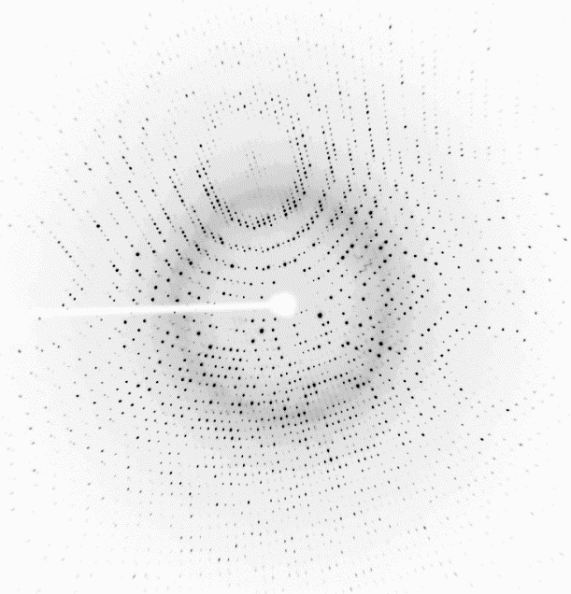
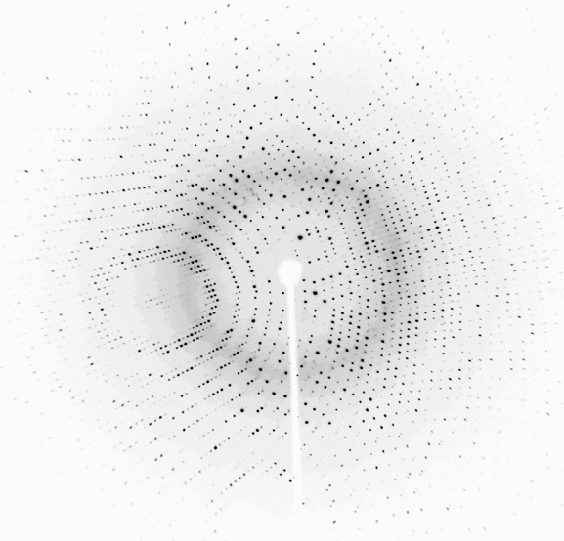
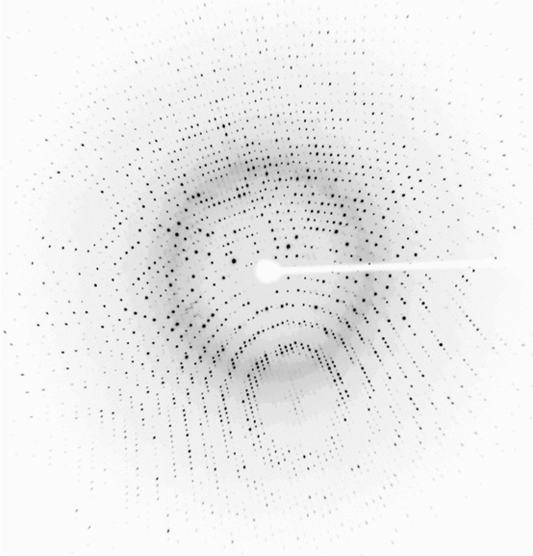
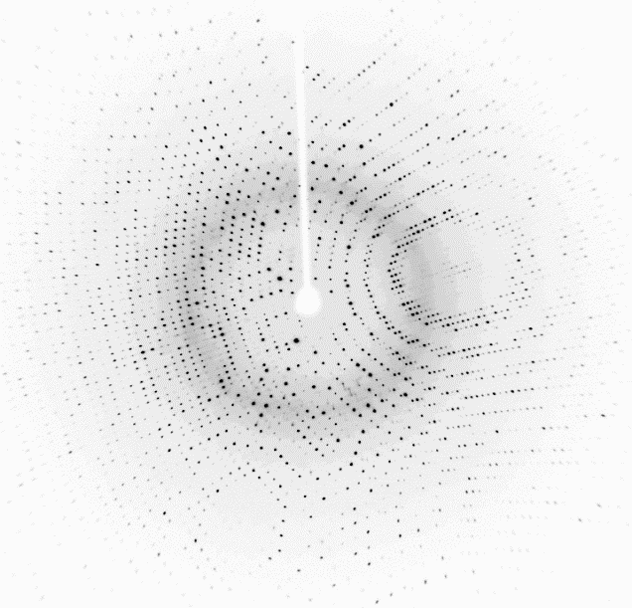
Data Reduction Goals
From a series of diffraction images, measure reflection intensities (I_{hkl}) and standard deviation (σ_{hkl}) for each reflection, hkl. Store the values in a file.
716
Final intensities
717
Set of 720 images.
Each image covers 0.5°
718
H K L I σ
0 0 4 3295.4 174.0
0 0 8 482.1 28.7
0 0 12 9691.0 500.7
0 0 16 1743.9 67.4
0 0 20 5856.0 221.0
0 0 24 14066.5 436.2
0 0 28 9936.3 311.7
0 0 36 8409.8 273.4
0 0 40 790.5 32.8
0 0 44 103.4 18.4
. . . . .
. . . . .
. . . . .
37 7 0 28.5 16.2
37 7 1 110.1 10.9
37 7 2 337.4 13.3
37 7 3 98.5 10.6
37 7 4 25.9 10.7
719
Index
Integrate
Merge
720
13,000 Mb
2 Mb

Slide 2
Along the way, we will determine the crystal’s unit cell parameters & space group
Unit cell parameters must be determined
Lengths a, b, c
Angles α, β, γ
Space group must be assigned
The collection of operations leave a crystal apparently unchanged (invariant).
May include rotational, translational, and mirror symmetry elements, alone or in combination.
Here is an example of a crystal in space group P2.
x, y, z
-x, y,-z
Knowing the space group can reduce the labor of atomic model building and enable improvement of intensity measurements by averaging reflections related by symmetry.
Crystal of left hands in space group P2
Unit cell (enlarged)
c
b
x,y,z
-x,y,-z
a

Slide 3
We begin the space group determination by ruling out 165 impossible choices.
There are 230 space groups possible.
Hence, the appearance of “230” in our course name “Chem230A.”
We can rule out the165 space groups that contain mirror symmetry because mirrors are incompatible with natural proteins like ProK.
In order for a crystal to have mirror symmetry, left AND right handed versions of the molecule must be present.
Proteinase K is produced using only L-amino acids (left).
Therefore, our sample of ProK could not crystallize in a space group with mirror symmetry
ProK can crystallize only in one of the 65 space groups that lack mirrors, (i.e. chiral space groups, or Sohncke space groups).
Unit cell of a crystal with Pm symmetry requires left & right hands.
left
right
Mirror plane

Slide 4
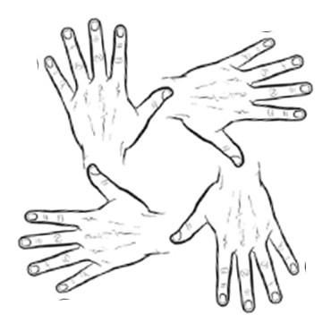
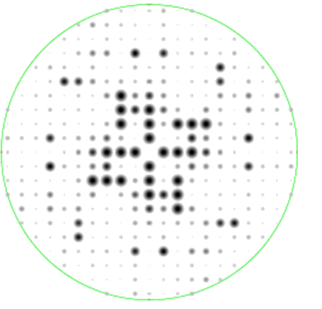
Choose among remaining space groups by recognizing symmetry in the diffraction pattern.
Crystal space
Diffraction space
The Bravais lattice type can be identified by recognizing the spatial arrangement of reflections in 3D.
Point group symmetry in the crystal can be identified by recognizing rotational symmetry in the pattern of reflection intensities.
Square lattice
Square lattice
4-fold symmetry
4-fold symmetry

Slide 5
Summary: Space group determination is a stepwise process of elimination.
1
System | Bravais lattice | Point group | 65 Chiral Space Groups
Triclinic | P | 1 | P1
Monoclinic | P | 2 | P2 | P2₁
 | C |  | C2
Orthorhombic | P | 222 | P222 | P222₁ | P2₁2₁2 | P2₁2₁2₁
 | C |  | C222₁ | C222
 | F |  | F222
 | I |  | I222 | I2₁2₁2₁
Tetragonal | P | 4 | P4 | P4₁ | P4₂ | P4₃
 | I |  | I4 | I4₁
 | P | 422 | P422 | P42₁2 | P4₁22 | P4₁2₁2 | P4₂22 | P4₂2₁2
 |  |  |  |  | P4₃22 | P4₃2₁2
 | I |  | I422 | I4₁22
Trigonal/ Rhombo-hedral | P | 3 | P3 | P31 | P32
 | R |  | R3
 | P | 32 | P312 | P321 | P3₁12 | P3₁21 | P3₂12 | P3₂21
 | R |  | R32
Hexagonal | P | 6 | P6 | P6₁ | P6₂ | P6₃ | P6₄ | P6₅
 |  | 622 | P622 | P6₁22 | P6₂22 | P6₃22 | P6₄22 | P6₅22
Cubic | P | 23 | P23 | P2₁3
 | F |  | F23
 | I |  | I23 | I2₁3
 | P | 432 | P432 | P4₂32 | P4₃32 | P4₁32
 | F |  | F432 | F4₁32
 | I |  | I432 | I4₁32
Choose among 65 chiral space groups. Only these are compatible with a pure enantiomer of ProK.
Choose among 14 Bravais lattices: examine the geometrical arrangement of reflections.
Choose a point group consistent with the symmetry among measured intensities: examine the rotational symmetry in the pattern of diffraction intensities.
Choose either rotation or screw axis symmetry: examine systematic absences in reflection intensities.
2
3
4

Slide 6
Review Data Collection
Let’s be familiar with the geometry of data collection so that we can interpret the diffraction patterns.
Keep in mind: one main goal of data collection is to measure the intensity of each reflection (i.e. each reciprocal lattice point).

Slide 7
Ewald’s sphere of reflection
Simulated Data Collection
Reciprocal
lattice
Crystal
X-ray beam
Diffracted rays
Detector

Slide 8
How can we index diffraction patterns when the lattice appears discontinuous?
2,0,0
3,0,-1
4,0,-2
5,0,-3
5,0,-4
5,0,-5
4,0,-6
Indices h,k,l are coordinates of the reflections, analogous to how atom positions are described by coordinates x,y,z.
3,0,-7
2,0,-7
1,0,-8
0,0,-8
-1,0,-8

Slide 9
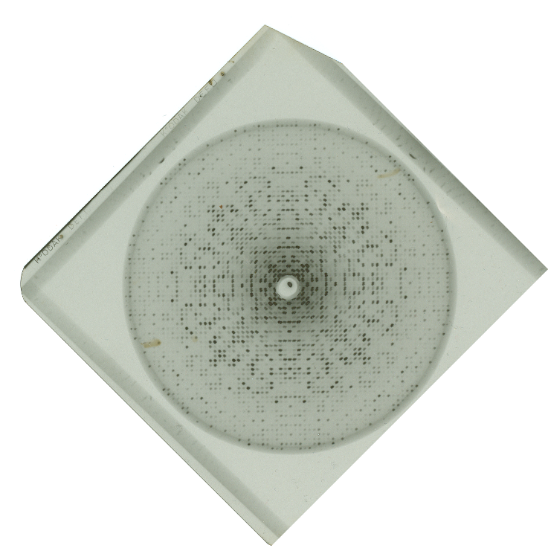
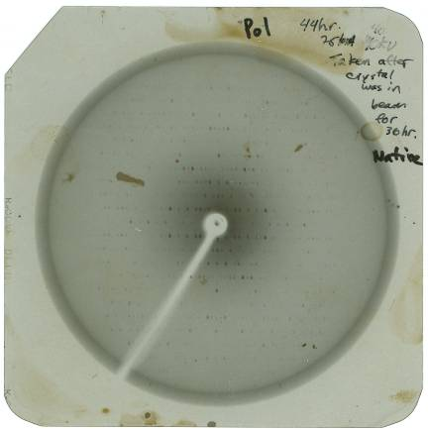
Indexing is conceptually simple with precession photographs
Provides an undistorted view of one plane of the reciprocal lattice
Taken in early 1990s.

Slide 10
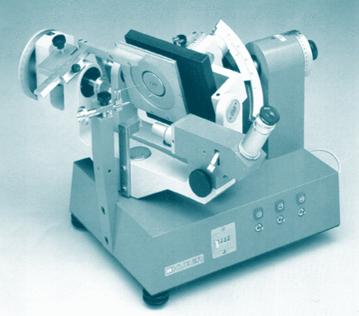
Buerger Precession Camera

Slide 11
How to Index by Inspection
Recall that spots are arrayed on a reciprocal lattice.
Count how many steps the given reflection is displaced from the origin.
h=Number of steps of a*.
k=Number of steps of b*.
l=Number of steps of c*.

Slide 12
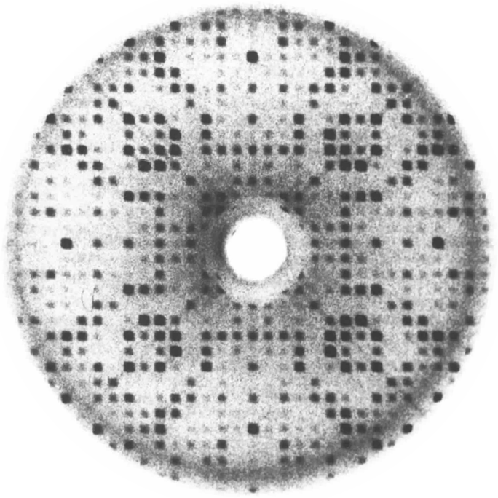
Index the reflection circled in cyan.
What pieces of information are required to index this reflection?
1) Define lattice points
2) Define a*,b*, c* direction & length
3) Locate origin.

Slide 13
Mark lattice points with red circles.
Note the spacing between reflections is periodic.
Draw evenly spaced lines through the spots to define the spacings a* & b*

Slide 14
Draw evenly spaced lines thru spots
A wider reciprocal spacing gives smaller (better) real cell spacing.
Draw another set of evenly spaced lines at 90° or 120°, if possible.

Slide 15
These lines cross at non-special angle
A wider reciprocal spacing gives smaller (better) real cell spacing.
Draw another set of evenly spaced lines at 90° or 120°, if possible.

Slide 16
This crossing angle is better. 90˚ is special

Slide 17
Weak reflections not detected previously can be predicted at lattice points. Note: we didn’t need to identify the position of every spot to get the lattice.

Slide 18
Locate origin of reciprocal lattice
Origin is located where direct x-ray beam intercepts image. To see it, briefly remove beam-stop.

Slide 19
Origin is defined. Now, label a* & b*
b*
What is the index of the spot?
b*
a*
a*

Slide 20
Reflection h,k,l is 3,8,0
3rd column on the right side of the origin.
8th row above the origin
b*
b*
b*
b*
b*
b*
b*
b*
b*
a*
a*
a*
a*

Slide 21
Which Bravais Lattice fits this pattern?
a* and b* have the same length.
They are perpendicular to each other.
b*
b*
a*
a*

Slide 22
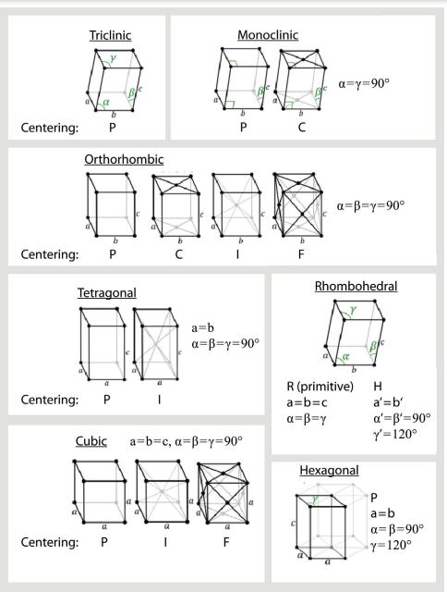
Which Bravais Lattice fits this pattern?
a=b and γ=90°

Slide 23
Next, index spots on an oscillation image.
This is easy!
But, what about this?
Confusing! 3D reciprocal lattice projected on 2D detector.

Slide 24
Use Ewald Sphere construction to map 2D spots back to 3D reciprocal lattice.
a*
b*
c*
detector
In an undistorted view of the reciprocal lattice, recorded reflections would reside on the surface of a sphere, not a plane.

Slide 25
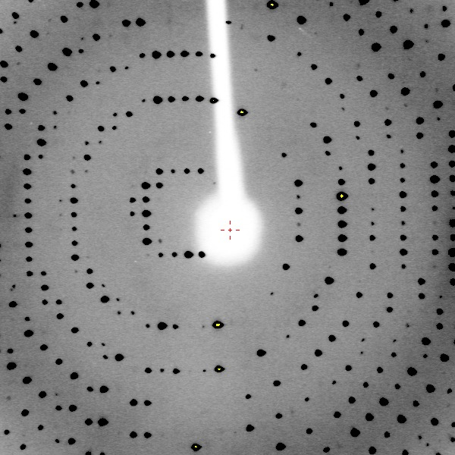
A distortion-corrected representation of the reflections a single image reveals all 6 unit cell parameters

Slide 26
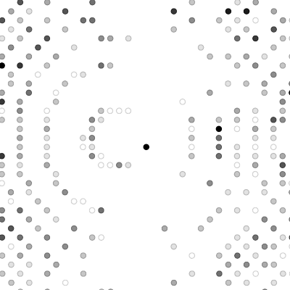
Restored depth of the diffraction pattern is evident from an orthogonal view

Slide 27
The automatic indexing algorithm in XDS can automatically identify spot positions, interpret crystal orientation, and unit cell dimensions.
Kabsch, W. (1988a) Automatic Indexing of Rotation Diffraction Patterns. J. Appl. Cryst. 21, 67–72.

Slide 28
Locate spot positions with COLSPOT
XDS.INP file specifies automatic indexing instructions
!====================== JOB CONTROL PARAMETERS ===============================
JOB= ALL !XYCORR INIT COLSPOT IDXREF DEFPIX XPLAN INTEGRATE CORRECT
!====================== GEOMETRICAL PARAMETERS ===============================
ORGX=1506.23 ORGY=1503.91 !Detector origin (pixels). Calibrated by DC 03/01/2019
DETECTOR_DISTANCE=-74 !(mm)
ROTATION_AXIS= 0.0 1.0 0.0
OSCILLATION_RANGE=0.5 !degrees (>0)
X-RAY_WAVELENGTH=1.5418 !Angstrom
INCLUDE_RESOLUTION_RANGE=100.0 1.4
!==================== SELECTION OF DATA IMAGES ==============================
NAME_TEMPLATE_OF_DATA_FRAMES=i/prok_gd_angela????.osc DIRECT RAXIS
DATA_RANGE= 1 720 !First and last diffraction images collected
BACKGROUND_RANGE=1 4 !First and last data image for background
SPOT_RANGE= 1 10 !First and last data image number for finding spots
SPOT_RANGE= 171 180 !First and last data image number for finding spots
!============================================================================

Slide 29
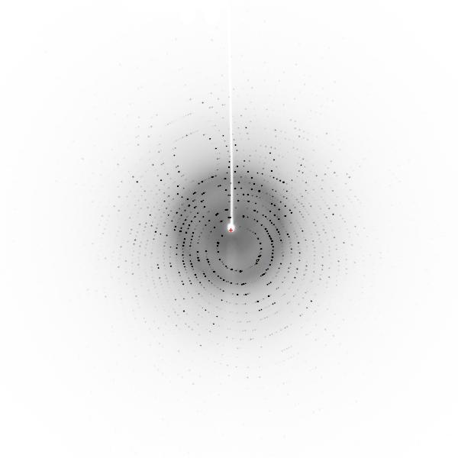
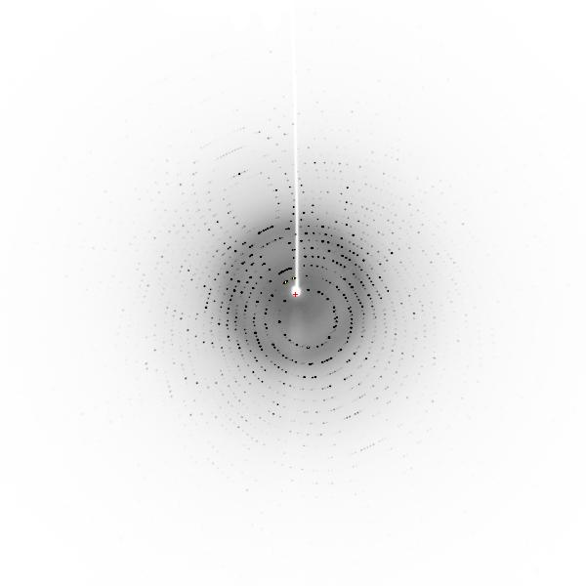
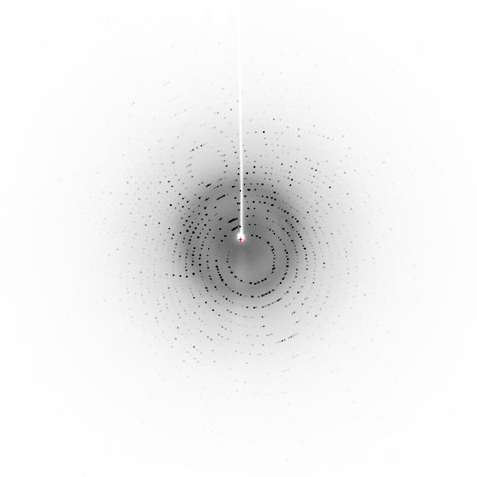
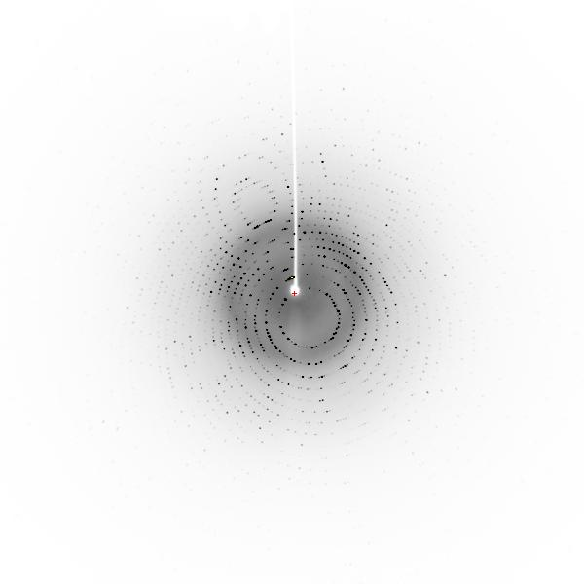
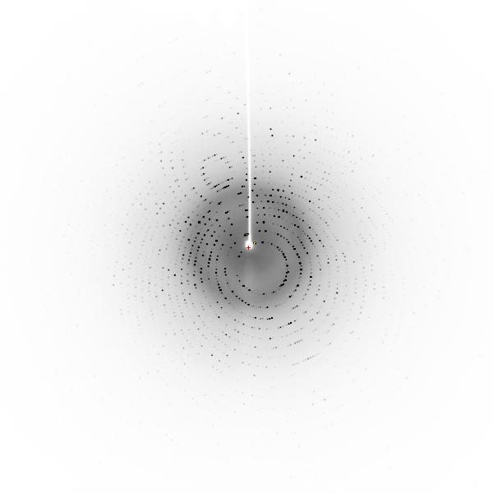
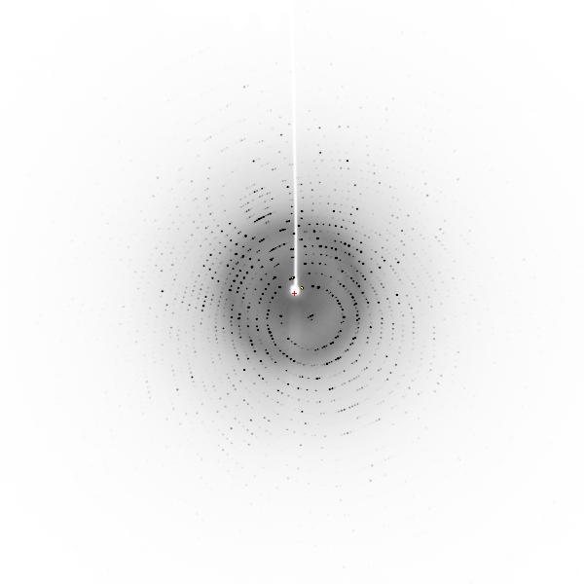
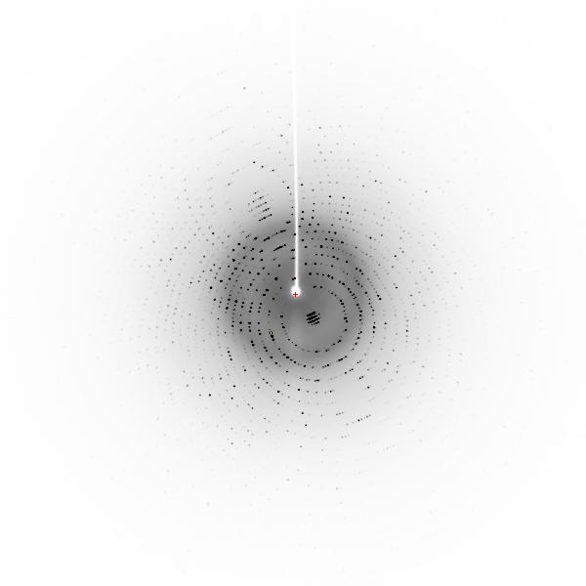
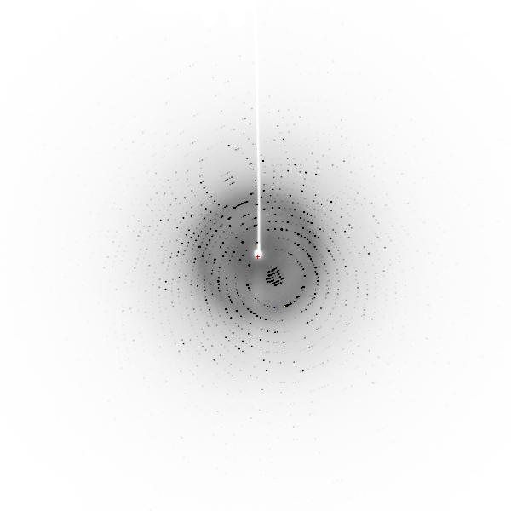
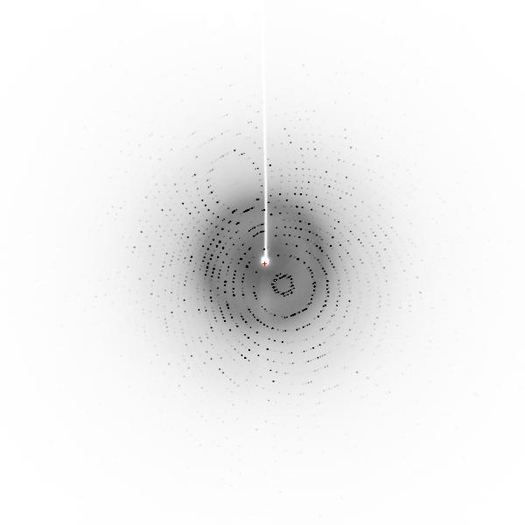
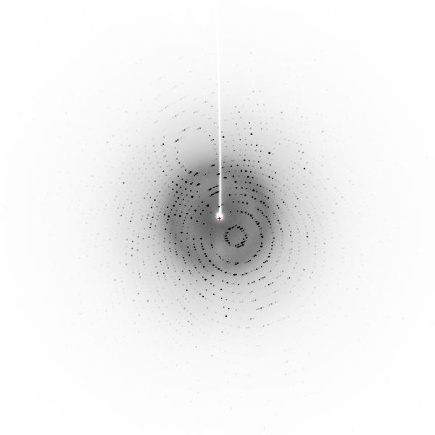
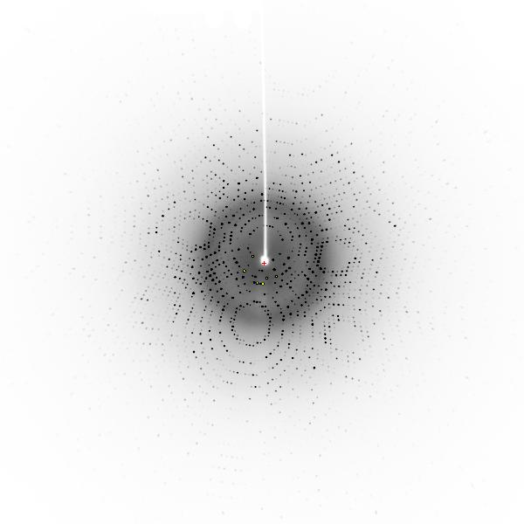
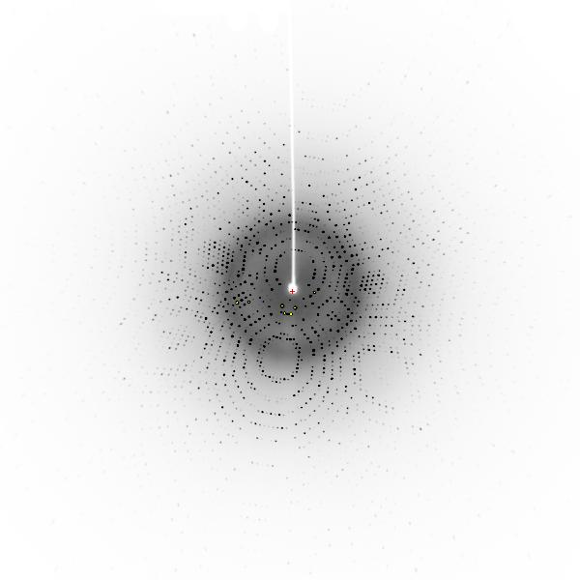
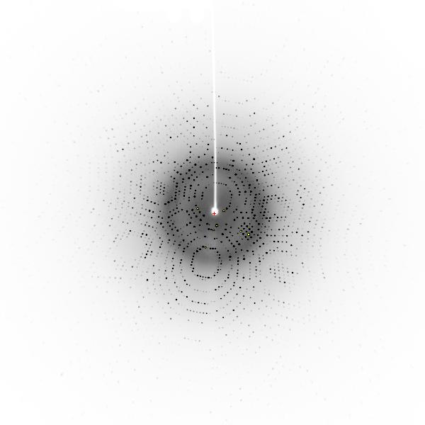
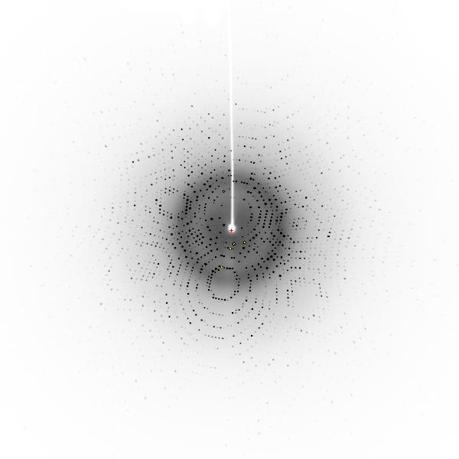
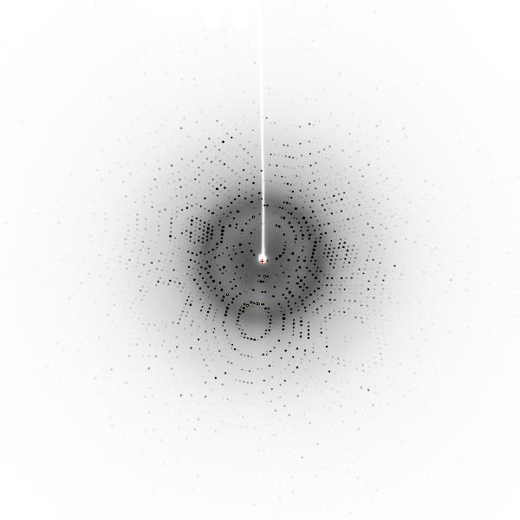
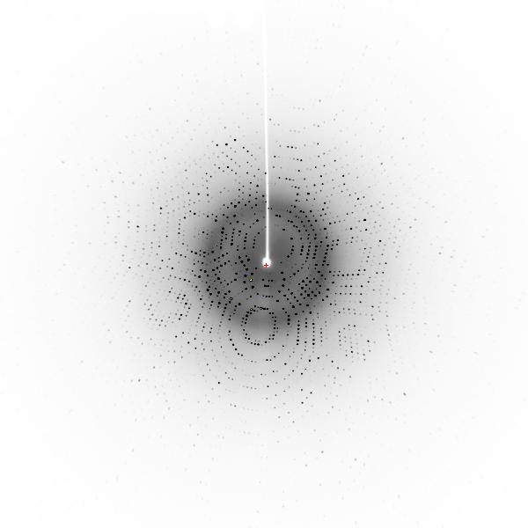
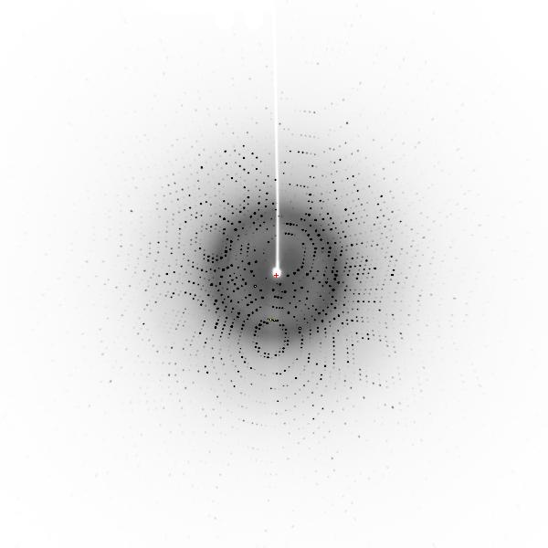
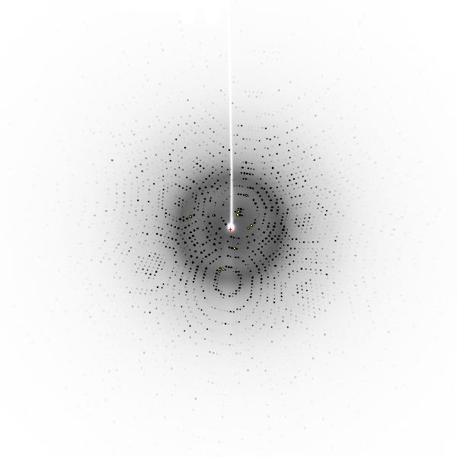
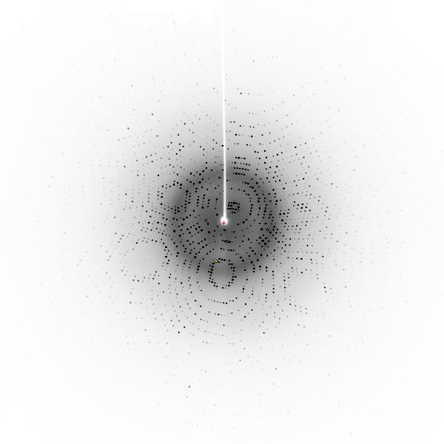
001 002 003 004 005
006 007 008 009 010
171 172 173 174 175
176 177 178 179 180

Slide 30
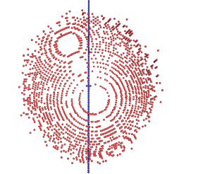
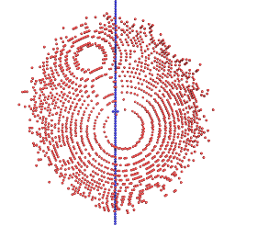
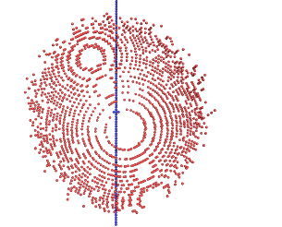
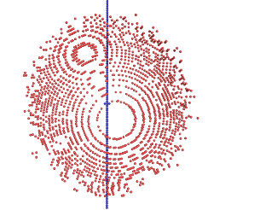
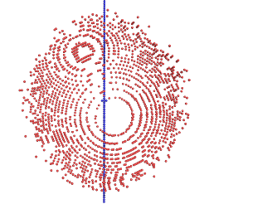
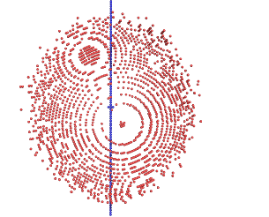
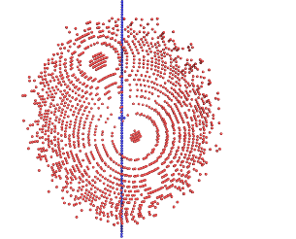
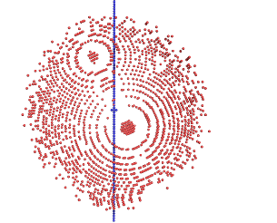
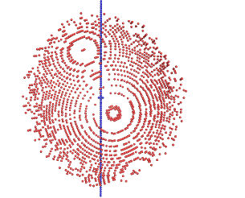
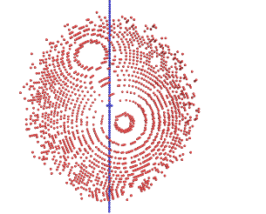
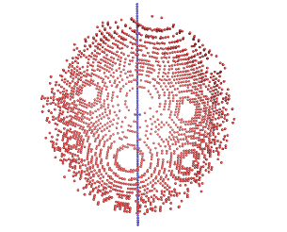
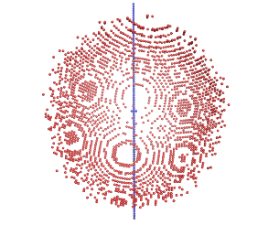
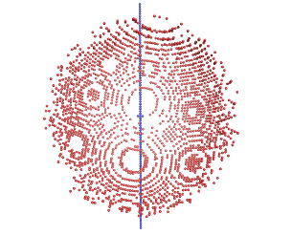
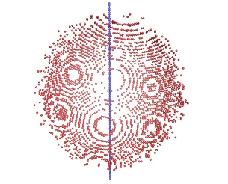
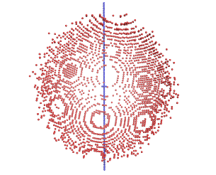
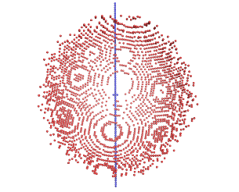
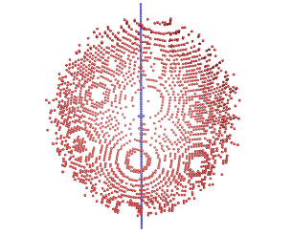
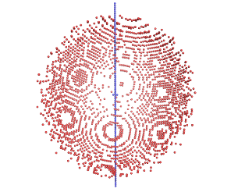
001 002 003 004 005
006 007 008 009 010
171 172 173 174 175
176 177 178 179 180

Slide 31
001 002 003 004 005
006 007 008 009 010
171 172 173 174 175
176 177 178 179 180

Slide 32
SPOT.XDS
Spot position intens-
X Y phi ity
1504.01 1378.41 173.66 4537.
1526.45 1409.21 172.51 4485.
1499.41 1575.97 3.49 4395.
1499.77 1247.89 175.02 4004.
1482.28 1251.21 175.64 3430.
1460.42 1235.69 178.37 3111.
1515.65 1235.92 4.29 2099.
1516.82 1246.26 175.68 2043.
1494.83 1721.10 5.95 2002.
1460.63 1751.46 173.68 1935.
1496.21 1889.74 173.68 1869.
1536.70 1371.16 178.43 1775.
1509.20 1578.62 5.50 1705.
1520.18 1374.85 177.59 1695.
1480.15 1261.73 3.54 1664.
1471.50 1863.84 7.45 1649.
1470.76 1382.48 171.31 1644.
1500.62 1680.58 6.31 1643.
1563.73 1808.92 2.41 1613.
1460.22 1420.42 171.54 1604.
1472.21 1173.36 7.24 1589.
1510.04 1148.16 5.10 1539.
1448.42 1257.31 173.54 1534.
1511.90 1318.37 173.95 1452.
1560.73 1612.72 178.46 1448.
1532.31 1222.84 173.71 1417.
1491.13 1159.51 6.08 1363.
1551.09 1095.47 176.33 1360.
1574.56 1223.31 1.50 1278.
1510.01 1802.89 5.71 1266.
1548.82 1523.06 5.03 1213.
1426.96 1242.19 174.81 1210.
NUMBER OF DIFFRACTION SPOTS LOCATED 25118
IGNORED BECAUSE OF SPOT CLOSE TO UNTRUSTED REGION 13
WEAK SPOTS OMITTED 22
NUMBER OF DIFFRACTION SPOTS ACCEPTED 25083

Slide 33
Draw vectors between reciprocal lattice points. For simplicity, only points from image 8 are shown.

Slide 34
Vectors of same length & direction are grouped together
65 vectors like this:

Slide 35
Vectors of same length & direction are grouped together
53 vectors like this:

Slide 36
Algorithm for best choice of a*, b*, c*
Difference vector clusters are accumulated in a 3D histogram. These vectors represent all candidate reciprocal lattice vectors. For example:
Choose the shortest three linear independent real-space lattice vectors forming a right-handed set.
# COORDINATES OF VECTOR CLUSTER FREQUENCY CLUSTER INDICES
1 -0.0026247 0.0170582-0.0027500 2025. 0.99 -0.00 -0.99
2 -0.0060520-0.0130311 0.0026847 1878. -1.00 0.00 0.01
3 -0.0086356 0.0040538-0.0000834 1832. -0.00 -0.00 -0.99
4 -0.0034720-0.0301176 0.0054258 1536. -1.99 0.00 1.00
5 -0.0052358 0.0342473-0.0054914 1414. 2.00 -0.00 -1.99
6 -0.0015319 0.0195839 0.0114708 1380. 1.00 0.99 -1.00
7 0.0045649 0.0325816 0.0088457 1372. 2.00 1.00 -1.00
. . . . . . . .
60 0.0044282-0.0816564 0.0136375 685. -5.00 -0.00 4.00

Slide 37
Choose the lattice of highest symmetry and quality of fit<10
LATTICE- BRAVAIS- QUALITY UNIT CELL CONSTANTS (ANGSTROEM & DEGREES)
CHARACTER LATTICE OF FIT a b c alpha beta gamma
* 44 aP 0.0 68.2 68.4 102.9 90.1 90.2 90.1
* 31 aP 0.7 68.2 68.4 102.9 90.1 89.8 89.9
* 33 mP 1.4 68.2 68.4 102.9 90.1 90.2 90.1
* 34 mP 3.2 68.2 102.9 68.4 90.1 90.1 90.2
* 35 mP 3.3 68.4 68.2 102.9 90.2 90.1 90.1
* 32 oP 3.9 68.2 68.4 102.9 90.1 90.2 90.1
* 14 mC 5.5 96.5 96.7 102.9 89.9 90.2 89.8
* 10 mC 6.3 96.5 96.7 102.9 90.1 90.2 90.2
* 13 oC 6.9 96.5 96.7 102.9 89.9 90.2 89.8
* 11 tP 7.6 68.2 68.4 102.9 90.1 90.2 90.1
37 mC 248.2 216.5 68.2 68.4 90.1 90.1 71.8
36 oC 248.9 68.2 216.5 68.4 89.9 90.1 108.2
28 mC 249.2 68.2 216.5 68.4 90.1 90.1 71.8
39 mC 251.8 152.8 68.2 102.9 90.2 90.1 63.6
29 mC 251.8 68.2 152.8 102.9 90.1 90.2 63.6
41 mC 251.9 216.8 68.4 68.2 90.1 90.2 71.6
38 oC 252.4 68.2 152.8 102.9 89.9 90.2 116.4
40 oC 252.6 68.2 216.5 68.4 89.9 90.1 108.2
30 mC 252.9 68.2 216.5 68.4 90.1 90.1 71.8
12 hP 256.1 68.2 68.4 102.9 90.1 90.2 90.1

Slide 38
Choose the lattice of highest symmetry and quality of fit<10
LATTICE- BRAVAIS- QUALITY UNIT CELL CONSTANTS (ANGSTROEM & DEGREES)
CHARACTER LATTICE OF FIT a b c alpha beta gamma
* 44 aP 0.0 68.2 68.4 102.9 90.1 90.2 90.1
* 31 aP 0.7 68.2 68.4 102.9 90.1 89.8 89.9
* 33 mP 1.4 68.2 68.4 102.9 90.1 90.2 90.1
* 34 mP 3.2 68.2 102.9 68.4 90.1 90.1 90.2
* 35 mP 3.3 68.4 68.2 102.9 90.2 90.1 90.1
* 32 oP 3.9 68.2 68.4 102.9 90.1 90.2 90.1
* 14 mC 5.5 96.5 96.7 102.9 89.9 90.2 89.8
* 10 mC 6.3 96.5 96.7 102.9 90.1 90.2 90.2
* 13 oC 6.9 96.5 96.7 102.9 89.9 90.2 89.8
* 11 tP 7.6 68.2 68.4 102.9 90.1 90.2 90.1
37 mC 248.2 216.5 68.2 68.4 90.1 90.1 71.8
36 oC 248.9 68.2 216.5 68.4 89.9 90.1 108.2
28 mC 249.2 68.2 216.5 68.4 90.1 90.1 71.8
39 mC 251.8 152.8 68.2 102.9 90.2 90.1 63.6
29 mC 251.8 68.2 152.8 102.9 90.1 90.2 63.6
41 mC 251.9 216.8 68.4 68.2 90.1 90.2 71.6
38 oC 252.4 68.2 152.8 102.9 89.9 90.2 116.4
40 oC 252.6 68.2 216.5 68.4 89.9 90.1 108.2
30 mC 252.9 68.2 216.5 68.4 90.1 90.1 71.8
12 hP 256.1 68.2 68.4 102.9 90.1 90.2 90.1
aP
mP
mC
oP
oC
oI
oF
hR
tP
tI
hP
cP
cI
cF

Slide 39
Integration of intensity for a reflection (image 004)
001 002 003 004 005 006 007 008 009 010
001 002 003 004 005 006 007 008 009 010
1) Draw boundaries of each reflection
2) Sum the intensities recorded on each pixel within boundary.
3) Repeat for each spot on each image.

Slide 40
Intensity of this reflection is spread over the first 10 images
001 002 003 004 005 006 007 008 009 010
001 002 003 004 005 006 007 008 009 010
001 002 003 004 005 006 007 008 009 010
001 002 003 004 005 006 007 008 009 010
001 002 003 004 005 006 007 008 009 010
001 002 003 004 005 006 007 008 009 010
001 002 003 004 005 006 007 008 009 010
001 002 003 004 005 006 007 008 009 010
001 002 003 004 005 006 007 008 009 010
001 002 003 004 005 006 007 008 009 010
001 002 003 004 005 006 007 008 009 010
001 002 003 004 005 006 007 008 009 010
001 002 003 004 005 006 007 008 009 010
001 002 003 004 005 006 007 008 009 010
001 002 003 004 005 006 007 008 009 010
001 002 003 004 005 006 007 008 009 010
001 002 003 004 005 006 007 008 009 010
001 002 003 004 005 006 007 008 009 010
001 002 003 004 005 006 007 008 009 010
001 002 003 004 005 006 007 008 009 010
1) Draw boundaries of each reflection
2) Sum the intensities recorded on each pixel within boundary.
3) Repeat for each spot on each image.

Slide 41
Merging is next

Slide 42
Output integrated intensities
INTEGRATE.HKL file has 1,238,805 lines from this 1.4 Å data set ProK
!UNIT_CELL_CONSTANTS= 67.918 67.918 102.177 90.000 90.000 90.000
! H, K, L, IOBS, SIGMA, XCAL, YCAL, ZCAL, RLP, PEAK,CORR,MAXC,XOBS, YOBS, ZOBS, ALF0,BET0,ALF1,BET1,PSI,ISEG
-47 -11 -7 2.545E+02 2.788E+02 2995.1 2344.0 604.8 1.38699 77.12746 4 33 2978.5 2336.6 605.0 45.91 0.07 -29.44 66.81 -118.54 1
-47 -11 -6 1.002E+03 3.147E+02 22.1 2318.8 94.9 1.39114 78.49145 10 32 29.5 2311.6 95.0 31.25 0.09 -151.27 66.62 95.30 1
-47 -11 -6 1.366E+02 2.771E+02 2994.8 2329.0 603.0 1.39049 79.95720 4 29 2987.3 2329.6 603.1 45.91 0.07 -29.01 66.72 -118.77 1
-47 -11 -5 1.872E+03 3.339E+02 21.5 2304.4 93.7 1.39492 92.47218 23 35 25.3 2304.5 93.7 31.25 0.09 -151.71 66.54 94.48 1
-47 -11 -5 1.204E+03 2.971E+02 2995.5 2314.6 601.1 1.39429 78.44115 15 30 2986.6 2311.4 601.0 45.91 0.07 -28.57 66.64 -118.99 1
-47 -11 -4 6.058E+02 3.242E+02 20.0 2290.6 92.4 1.39900 96.87422 12 77 27.5 2290.6 92.4 31.25 0.09 -152.15 66.47 93.68 1
-47 -11 -4 4.104E+02 2.919E+02 2992.3 2298.0 599.2 1.39845 80.31631 6 31 2982.4 2288.8 598.7 111.48 0.07 -28.13 66.51 -119.18 1
-47 -11 -3 2.735E+03 3.281E+02 17.5 2277.3 91.2 1.40337 95.48840 30 34 19.2 2279.0 91.4 31.25 0.09 -152.59 66.42 92.90 1
-47 -11 -3 9.144E+02 3.109E+02 2994.8 2284.8 597.4 1.40283 75.93009 17 32 2983.7 2282.7 597.4 111.48 0.07 -27.69 66.46 -119.37 1
-47 -11 -2 3.644E+02 2.749E+02 14.1 2264.4 89.9 1.40808 92.92796 6 35 19.6 2264.0 89.8 31.81 0.09 -153.04 66.39 92.13 1 -47 -11 .-47 -11 -1 1.441E+03 2.964E+02 9.7 2252.0 88.6 1.41308 87.63616 23 33 14.4 2252.3 88.7 32.14 0.09 -153.48 66.36 91.39 1
-47 -11 0 3.293E+02 2.450E+02 4.4 2240.0 87.3 1.41836 80.78474 7 31 12.0 2236.6 87.0 32.14 0.09 -153.93 66.36 90.67 1
-47 -10 -9 1.047E+03 3.427E+02 22.3 2316.5 100.7 1.39148 81.59772 16 32 23.3 2318.8 100.7 27.88 0.08 -151.33 66.60 97.62 1
-47 -10 -9 1.153E+02 2.993E+02 2994.5 2326.5 608.7 1.39095 80.67455 4 31 2987.2 2325.2 608.4 45.91 0.07 -28.94 66.70 -116.36 1
-47 -10 -8 4.724E+03 3.767E+02 25.0 2300.6 99.5 1.39410 96.97063 44 49 24.9 2301.0 99.2 31.13 0.08 -151.77 66.48 96.75 1
-47 -10 -8 2.220E+03 3.363E+02 2992.0 2310.8 606.8 1.39349 84.59594 24 33 2988.1 2309.9 606.5 45.91 0.07 -28.51 66.58 -116.63 1
-47 -10 -7 6.914E+03 3.802E+02 26.6 2285.5 98.3 1.39692 99.42799 57 56 29.5 2287.8 98.5 31.25 0.09 -152.20 66.37 95.90 1
-47 -10 -7 3.098E+03 3.250E+02 2990.5 2295.6 604.9 1.39632 86.71242 35 35 2985.3 2294.3 604.7 45.91 0.07 -28.08 66.47 -116.87 1
-47 -10 -6 1.589E+03 2.980E+02 27.3 2271.0 97.1 1.40004 99.54026 16 32 29.5 2272.9 97.1 31.25 0.09 -152.63 66.28 95.07 1
-47 -10 -6 9.778E+02 3.015E+02 2989.9 2281.0 603.0 1.39944 87.42934 11 33 2984.9 2278.8 602.7 45.91 0.07 -27.65 66.38 -117.11 1
-47 -10 -5 1.086E+03 3.186E+02 27.1 2257.0 95.8 1.40345 99.49097 13 33 23.1 2258.3 95.7 31.25 0.09 -153.06 66.20 94.25 1
-47 -10 -5 7.046E+02 3.209E+02 2990.2 2267.0 601.2 1.40285 86.86985 8 33 2986.2 2270.9 601.7 45.91 0.07 -27.22 66.30 -117.33 1
-47 -10 -4 5.056E+03 3.658E+02 25.9 2243.5 94.6 1.40716 99.29475 48 45 27.0 2247.1 94.5 31.25 0.09 -153.50 66.14 93.46 1
-47 -10 -4 2.003E+03 3.387E+02 2986.7 2250.9 599.3 1.40664 89.14124 26 34 2985.0 2252.7 599.2 111.36 0.07 -26.79 66.17 -117.53 1
-47 -10 -3 8.050E+02 3.299E+02 23.8 2230.4 93.3 1.41117 98.79202 16 44 24.0 2225.9 92.9 31.25 0.09 -153.93 66.09 92.69 1
-47 -10 -3 7.560E+02 3.407E+02 2988.8 2237.9 597.5 1.41066 86.07878 7 31 2984.3 2240.7 597.5 111.48 0.07 -26.35 66.12 -117.73 1
-47 -10 -2 3.435E+03 3.298E+02 20.8 2217.9 92.0 1.41550 97.47218 30 44 23.3 2220.1 92.1 31.25 0.09 -154.37 66.05 91.93 1
-47 -10 -2 1.502E+03 3.296E+02 2991.9 2225.3 595.7 1.41499 81.04167 19 38 2987.7 2223.9 595.6 111.48 0.07 -25.91 66.08 -117.92 1
-47 -10 -1 1.185E+03 3.234E+02 16.8 2205.7 90.7 1.42013 94.89558 14 34 23.3 2203.6 91.0 31.25 0.09 -154.81 66.03 91.20 1
-47 -10 0 4.880E+02 3.137E+02 11.8 2193.8 89.4 1.42512 90.43126 12 35 17.5 2193.4 89.6 32.13 0.09 -155.26 66.02 90.47 1
-47 -10 1 7.198E+02 2.775E+02 6.1 2182.4 88.1 1.43037 82.80218 15 34 14.4 2180.9 88.0 32.14 0.09 -155.70 66.03 89.77 1
-47 -9 -11 1.625E+04 5.170E+02 16.5 2302.1 105.2 1.39783 89.53320 83 75 18.8 2303.5 105.5 27.87 0.08 -151.85 66.58 99.11 1
-47 -9 -10 3.139E+03 3.181E+02 21.4 2285.6 104.0 1.39940 97.73439 28 45 23.9 2286.7 104.1 27.87 0.08 -152.27 66.43 98.22 1
-47 -9 -10 1.502E+03 2.902E+02 2994.5 2294.9 610.6 1.39895 79.06115 25 34 2985.4 2292.3 610.5 56.07 0.07 -27.99 66.52 -114.47 1
-47 -9 -9 1.269E+03 3.169E+02 25.2 2269.7 102.8 1.40127 99.12431 15 33 24.9 2272.3 102.7 27.87 0.08 -152.69 66.30 97.34 1
-47 -9 -9 3.660E+02 3.163E+02 2991.9 2279.6 608.7 1.40076 84.73209 6 31 2980.7 2278.0 608.8 45.91 0.07 -27.58 66.40 -114.75 1
-47 -9 -8 3.405E+02 2.993E+02 28.1 2254.4 101.6 1.40342 99.61732 5 36 33.8 2251.4 101.8 27.87 0.08 -153.12 66.17 96.49 1
-47 -9 -8 5.246E+02 3.242E+02 2989.1 2264.3 606.9 1.40292 88.66219 7 31 2979.4 2256.8 606.8 45.91 0.07 -27.15 66.27 -115.01 1

Slide 43
Intensity weighted reciprocal lattice, sectioned along c*, cutoff at 8 Å resolution for clarity
L=-8
L=-7
L=-6
L=-10
L=-9
L=-12
L=-11
L=-5
L=-4
L=-3
L=-2
L=-1
L=-0
L=+1
L=+2
L=+3
L=+4
L=+5
L=+6
L=+7
L=+8
L=+9
L=+10
L=+11
L=+12

Slide 44
Intensity weighted reciprocal lattice, sectioned along c*, cutoff at 8 Å resolution for clarity
L=+1
L=-1
L=+2
L=-2
L=+3
L=-3
L=-4
L=+4
L=+5
L=-5
L=+6
L=-6
L=-0
L=+7
L=-7
L=+8
L=-8
L=+9
L=-9
L=+10
L=-10
L=-11
L=+11
L=-12
L=+12

Slide 45
Determine the point group symmetry of our intensity-weighted reciprocal lattice.
System | Bravais lattice | Point group | 65 Chiral Space Groups
Triclinic | P | 1 | P1
Monoclinic | P | 2 | P2 | P2₁
 | C |  | C2
Orthorhombic | P | 222 | P222 | P222₁ | P2₁2₁2 | P2₁2₁2₁
 | C |  | C222₁ | C222
 | F |  | F222
 | I |  | I222 | I2₁2₁2₁
Tetragonal | P | 4 | P4 | P4₁ | P4₂ | P4₃
 | I |  | I4 | I4₁
 | P | 422 | P422 | P42₁2 | P4₁22 | P4₁2₁2 | P4₂22 | P4₂2₁2
 |  |  | P4₃22 | P4₃2₁2
 | I |  | I422 | I4₁22
Trigonal/ Rhombo-hedral | P | 3 | P3 | P31 | P32
 | R |  | R3
 | P | 32 | P312 | P321 | P3₁12 | P3₁21 | P3₂12 | P3₂21
 | R |  | R32
Hexagonal | P | 6 | P6 | P6₁ | P6₂ | P6₃ | P6₄ | P6₅
 |  | 622 | P622 | P6₁22 | P6₂22 | P6₃22 | P6₄22 | P6₅22
Cubic | P | 23 | P23 | P2₁3
 | F |  | F23
 | I |  | I23 | I2₁3
 | P | 432 | P432 | P4₂32 | P4₃32 | P4₁32
 | F |  | F432 | F4₁32
 | I |  | I432 | I4₁32
Both 4 and 422 can be accommodated by a primitive tetragonal lattice
4
422

Slide 46
What rotational symmetry do you see?
90° rotational symmetry around axis normal to this plane.
L=0

Slide 47
2-fold rotation around vertical axis
L=0

Slide 48
How many symmetry copies of this reflection do you see?
L=0
3,7,0

Slide 49
8 symmetry equivalents
L=0
What are their indices?
3,7,0

Slide 50
Is this symmetry consistent with point group 422?
L=0
-3,7,0
3,7,0
-7,3,0
7,3,0
-7,-3,0
7,-3,0
-3,-7,0
3,-7,0

Slide 51
Reciprocal lattice symmetry operators of point group 422
L=0
point group 422
1) h, k,0
2)-h, k,0
3) h,-k,0
4)-h,-k,0
5) k, h,0
6)-k, h,0
7) k,-h,0
8)-k,-h,0
h,k,0
-h,k,0
3,7,0
-3,7,0
7,3,0
-k,h,0
k,h,0
-7,3,0
-k,-h,0
k,-h,0
-7,-3,0
7,-3,0
-3,-7,0
3,-7,0
-h,-k,0
h,-k,0

Slide 52
The last step in data reduction is merging.
We can improve our estimate of the intensity of reflection h,k,l by averaging (merging) the intensities of all its symmetry-related reflections.
We quantify how well the pattern obeys a certain point group symmetry by calculating R_{merge}.
These match
the sym-ops of
point group 422
1) h, k,0
2)-h, k,0
3) h,-k,0
4)-h,-k,0
5) k, h,0
6)-k, h,0
7) k,-h,0
8)-k,-h,0

Slide 53
j observations of the reflection 30 22 6
Discrepancy
between symmetry related reflections
j | H | K | L | I
1 | 30 | 22 | 6 | 550
2 | -30 | -22 | 6 | 500
3 | 30 | -22 | -6 | 543
?
H, K, L=
-H,-K, L=
H,-K,-L
R_{merge}= Σ|I_{j}-<I>|
ΣI_{j}
<I>= (550 + 500 + 543) / 3
= 531
Σ|I_{j}-<I>| = |550-531|+|500-531|+|543-531|
= 19 + 31 + 12
= 62
ΣI_{j} = 550 + 500 + 543
= 1593
R_{merge} = 62/1593 = 0.039 = 3.9%

Slide 54
Point group 4 is a subset of 422.
Point group 4
Point group 422
4-fold symmetry
4-fold symmetry &
perpendicular 2-folds
P422
P4
H, K,L
-H,-K,L
-K, H,L
K,-H,L
-H, K,-L
H,-K,-L
K, H,-L
-K,-H,-L

Slide 55
If the point group were truly “4”, then R_{merge} would be low in point group “4” but high in “422”
Point group 4
Point group 4
R_{merge P4} <20%
R_{merge P422} >50%
Red indicates worst R_{merge} outliers

Slide 56
If the point group were truly “422”, then R_{merge} would be low in both “4” and “422”
Point group 4
Point group 422
R_{merge P4} <20%
R_{merge P4}<20%

Slide 57
Merge symmetry-related measurements
Plane L=0
b*
Plane L=0
b*
-K,H,L
K, H,-L
-H, K,-L
H,K,L
a*
a*
true?
H, K, L=
-K, H, L=
-H, K, L=
K,-H, L=
K, H,-L=
-H, K,-L=
-K,-H,-L=
H,-K,-L=
Asymmetric unit of reciprocal space.
-H,-K,L
H,-K, -L
-K,-H,-L
K, -H,L
Average together intensity values of reflections related by these reciprocal space symmetry operators.

Slide 58
Statistics are analyzed as a function of resolution (N shells).
Discrepancy between symmetry related reflections (R_{merge} or R_{sym}) increases with higher resolution. Why?
Shell | R_{merge}
100-5.0Å | 0.04
5.0-3.0Å | 0.06
3.0-2.0Å | 0.08
2.0-1.7Å | 0.15
Overall | 0.07

Slide 59
Correlation Coefficient (CC_{½})
CC_{½} measures the correlation between symmetry-related halves of the unmerged data set.
CC_{½} decreases with increasing resolution.
Diederichs & Karplus say resolution shells with CC _{½} > 0.30 have usable information content.
Shell | CC _{½}
100-5.0 Å | 0.99
5.0-3.0 Å | 0.99
3.0-2.0 Å | 0.97
2.0-1.7 Å | 0.55
Overall | 0.98

Slide 60
SIGNAL TO NOISE RATIO (I/σ)
Average I/σ decreases with increasing resolution
Conservatives would say high resolution shells with I/σ <2 should be discarded.
Shell | I/σ_{Ι}
100-5.0 Å | 20.0
5.0-3.0 Å | 10.0
3.0-2.0 Å | 7.0
2.0-1.7 Å | 3.0
Overall | 8.2

Slide 61
COMPLETENESS?
What percentage of reciprocal
Lattice was measured for a given
Resolution limit?
Better than 90% I hope.
Shell | completeness
100-5.0Å | 99.9%
5.0-3.0Å | 95.5%
3.0-2.0Å | 89.0%
2.0-1.7Å | 85.3%
Overall | 92.5%
Missing wedges of data.

Slide 62
Prepare a table of data collection statistics & learn to evaluate quality.

Slide 63
Assignment

Slide 64
The End

