Slide 1
Data Reduction: Big Picture Concepts
The goal of data reduction is to extract the intensities I_{hkl} for each unique reflection h,k,l (spot) from a set of diffraction images (data set).
Later, we take the square root of each I_{hkl} value in the data set to obtain the set of |F_{hkl}| values; these are the (structure factor) amplitudes of the Fourier waves we need to construct an electron density map.
F_{hkl} values are related to electron density of the crystal ρ(x,y,z) by the Fourier transform operation.

Slide 2
Data Reduction: Three steps in practice
Indexing –assign hkl values to each spot on each diffraction image.
Integration –sum up the intensity values of each pixel in a reflection to obtain integrated intensity of the reflection I_{hkl}.
Merging –average together the intensity measurements that are related by symmetry.

Slide 3
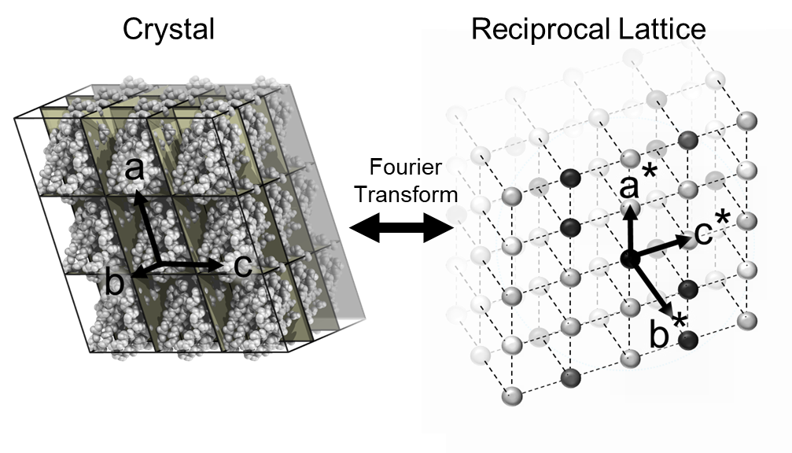
Indexing: The Reciprocal Lattice provides a coordinate system for assigning hkl values to each reflection.
Since the molecules in a crystal are arrayed on a 3D lattice, the Fourier transform of the crystal (manifested in the diffraction pattern) is also arrayed on a 3D lattice, which we call the reciprocal lattice.
Molecules in a crystal are arrayed on a lattice characterized by integer translations along lattice vectors a, b, and c.
Spots (reflections) are arrayed on a lattice characterized by integer translations along reciprocal cell vectors a*, b*, and c*. One spot is located at each reciprocal lattice point.
The index of a reflection (h,k,l value) corresponds to the integer number of steps of a*, b*, c* one must take from the reciprocal lattice origin to arrive at the position of the reflection. That is, h,k, and l are the integer coordinates of the reflection position on the reciprocal lattice.

Slide 4
Indexing: Real and Reciprocal lattices are related by a set of rules.
Reciprocal lattice lengths a*, b*, c* are inversely related to the crystal unit cell lengths, a, b, c, respectively.
a* is oriented normal to the bc plane.
b* is oriented normal to the ac plane.
c* is oriented normal to the ab plane.
The reciprocal lattice rotates as the crystal rotates.
If we knew the values of the unit cell parameters and how a, b, and c were oriented during the diffraction experiment, then we could map a*, b*, and c* onto the diffraction pattern and index each spot on a diffraction image (i.e. count the number of steps of a*, b*, c* one must take from the origin to arrive at the position of the reflection).

Slide 5
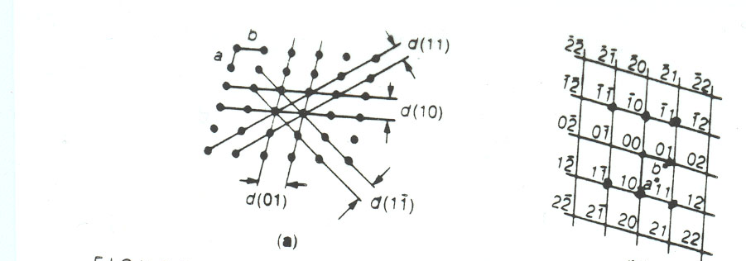
Relationship of Crystal Lattice and Reciprocal Lattice
r = xa+yb+zc r is a vector to point (x,y,z) in real space
s = ha*+kb*+lc* s is a vector to point (h,k,l) in reciprocal space
Because a* is perpendicular to b and c, b* to a and c, etc.
r.s = hx+ky+lz

Slide 6
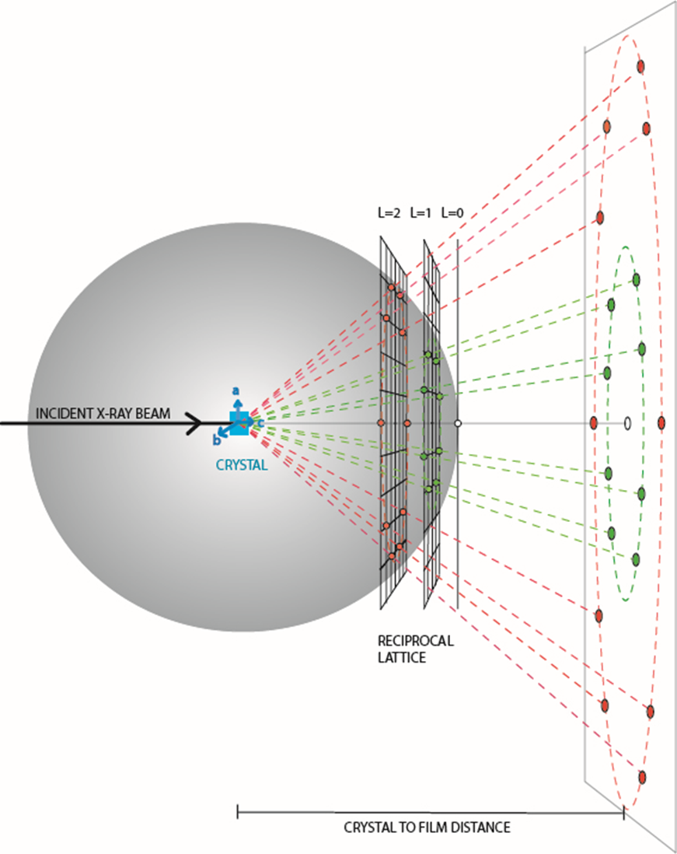
Indexing: Obstacles.
In general, we don’t know the unit cell parameters of the crystal before the diffraction experiment (a, b, c, α, β, γ).
In general, we don’t know how the unit cell vectors a, b, and c are aligned with the laboratory axes before the diffraction experiment.
Our recorded diffraction image is distorted by the fact that 3-dimensional arrangement of spots is projected on a 2-dimensional image.
Only a small fraction of the reflections of the reciprocal lattice appear on a diffraction image. Those reflections that are visible appear to be arranged in a pattern of concentric circles. Those spots that are absent disrupt the continuity of the reciprocal lattice array and confuses our ability to visually recognize the directions of the three principle cell axes, a, b, and c.

Slide 7
Indexing & Integration: Overcoming Obstacles.
Bragg’s law explains why spots in a diffraction pattern appear arranged as concentric circles and informs us that each spot within a circle shares an index value (either h, or k, or l).
Bragg’s law allows us to calculate the unit cell dimensions from measurements of the spacings between spots.
Once we discover the unit cell parameters and orientations of a, b, and c, we can use the relationships defined two slides ago to predict a*, b*, and c*, and hence the location of each reflection h,k,l on each image. This discovery allows us to index and integrate the intensities of each reflection.

Slide 8
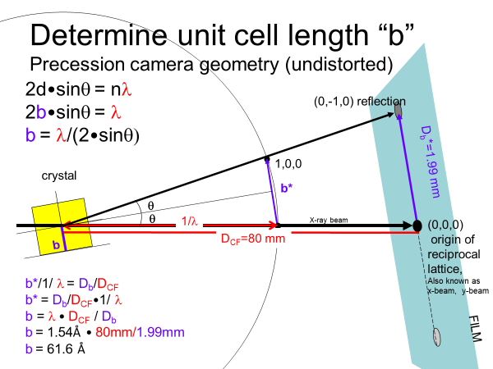
The Ewald Sphere of Reflection relates crystal space and reciprocal space

Slide 9
Merging
The unit cell parameters that we obtain must fit one of the 14 types of crystal lattice patterns possible in 3-dimensions, called Bravais lattices.
Identification of the Bravais lattice narrows down the point group symmetry of the diffraction pattern from 11 choices to 2 or less.
We verify our choice of point group by calculating an R_{merge} which measures the discrepancy of intensity measurements for reflections related by our hypothetical point group symmetry laws.
Identification of the point group symmetry narrows down the plausible choices of space group from 65 chiral space groups to less than 12.

Slide 10
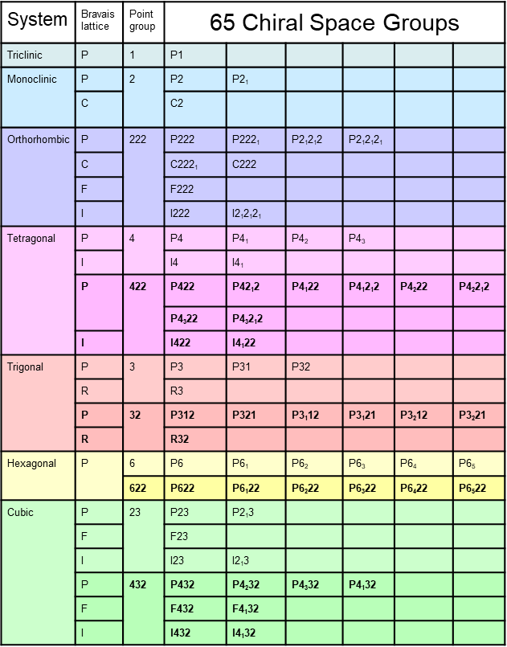
14 Bravais Lattices in 3D
Three axes, two pairs at right angles, one at 120°.
a=b≠c; α=β=90 °, γ=120°

Slide 11
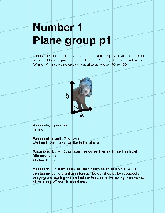
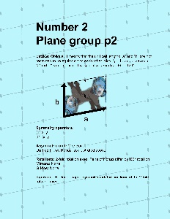
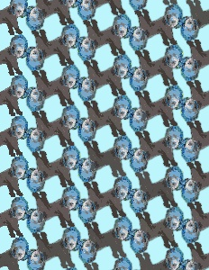
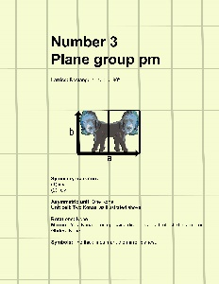
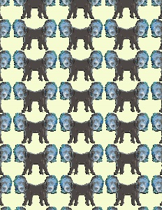
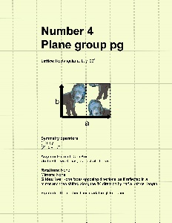
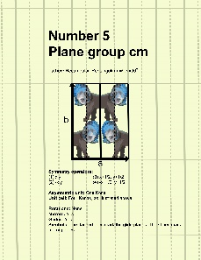
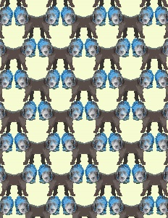
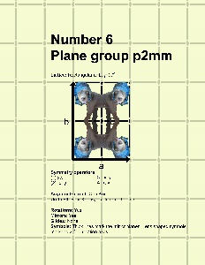
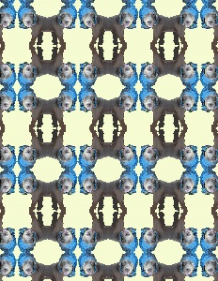
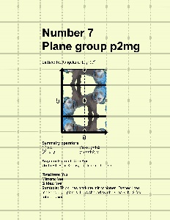
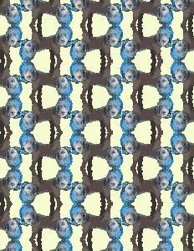
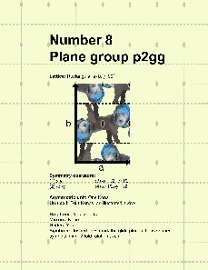
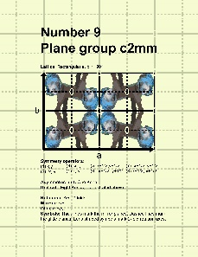
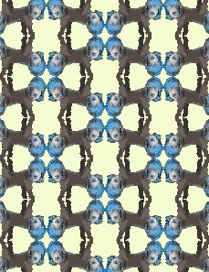
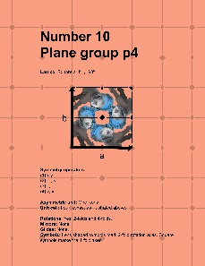
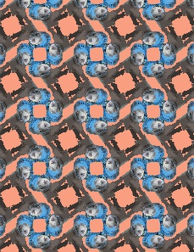
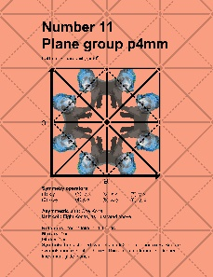
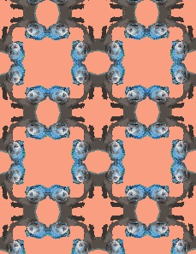
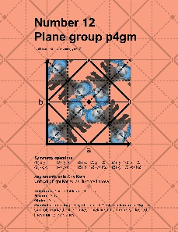
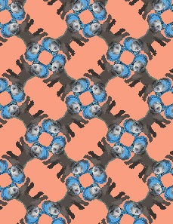
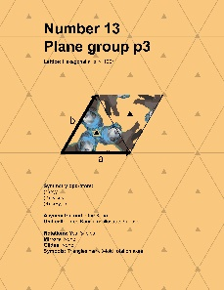
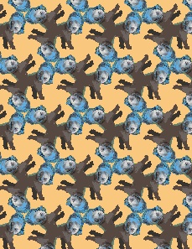
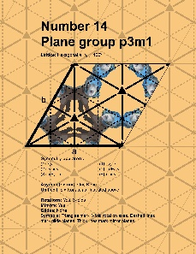
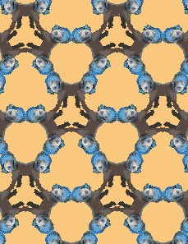
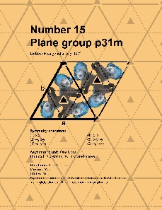
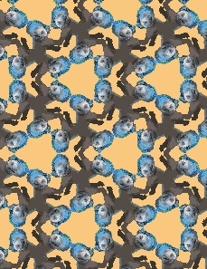
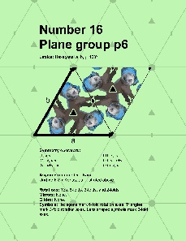
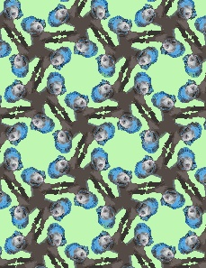
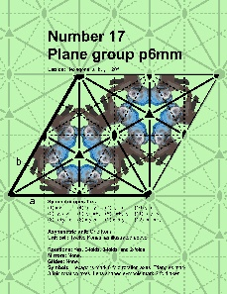
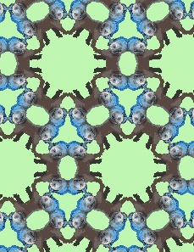
For those interested in visualizing crystal symmetry, check out these 17 plane groups in 2-dimensions.

