Slide 1
Refinement & Validation Goals
Finish building initial model of Proteinase K.
02.pdb
03.pdb
04.pdb
5.pdb
1.pdb
Better map
Better map
Better map
Better map
Cycle between automated and manual refinement until all errors are corrected.
Automated Refinement (Phenix)
Manual Refinement (Coot)
2-coot.pdb
3-coot.pdb
4-coot.pdb
5-coot.pdb
Better phases
Better phases
Better phases
Better phases
final.pdb
Upload “final” coordinates to wwPDB, get validation statistics and report in Google Spreadsheet.

Slide 2
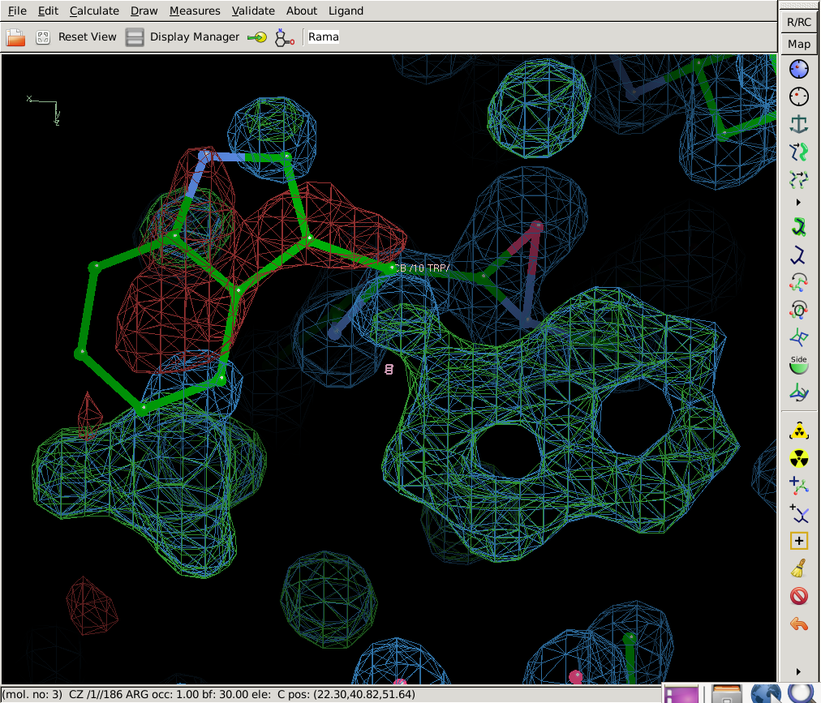
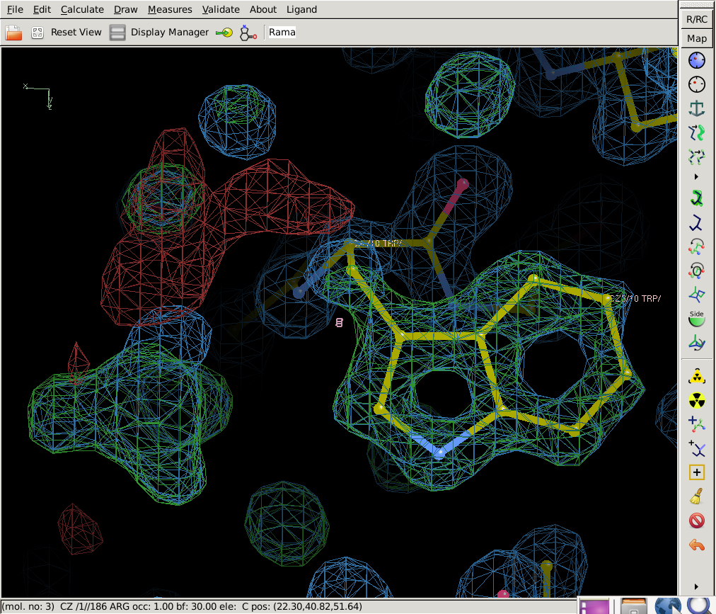
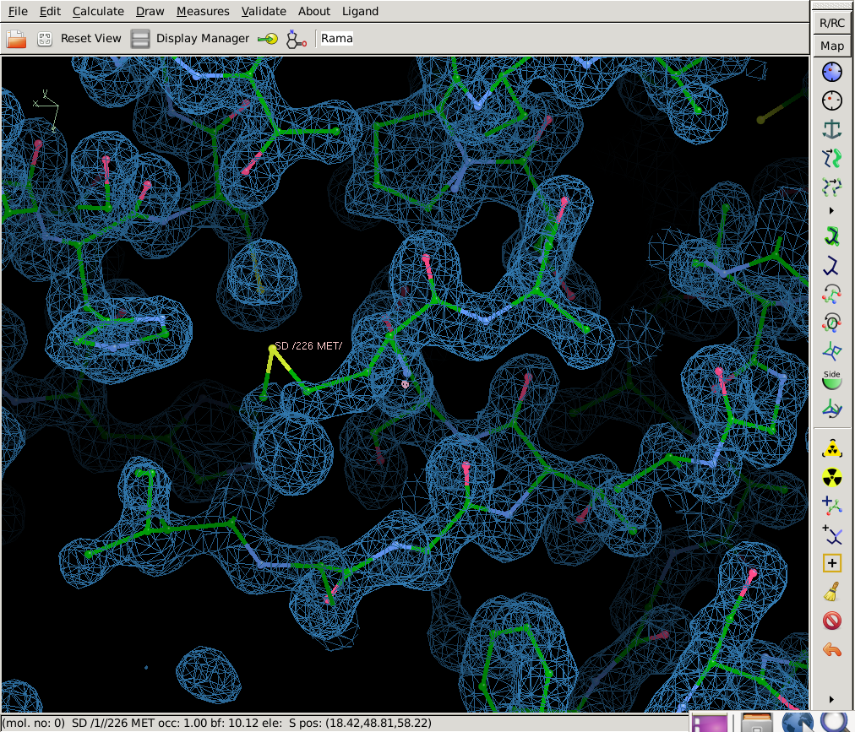
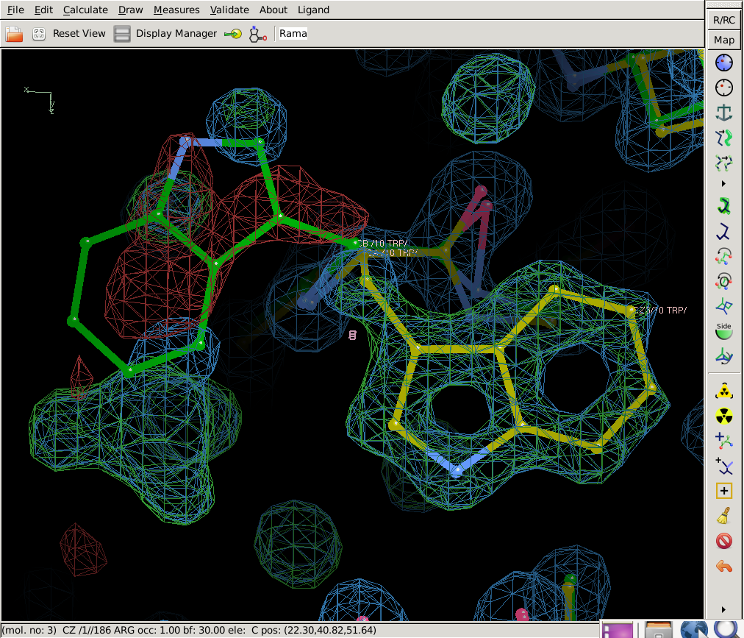
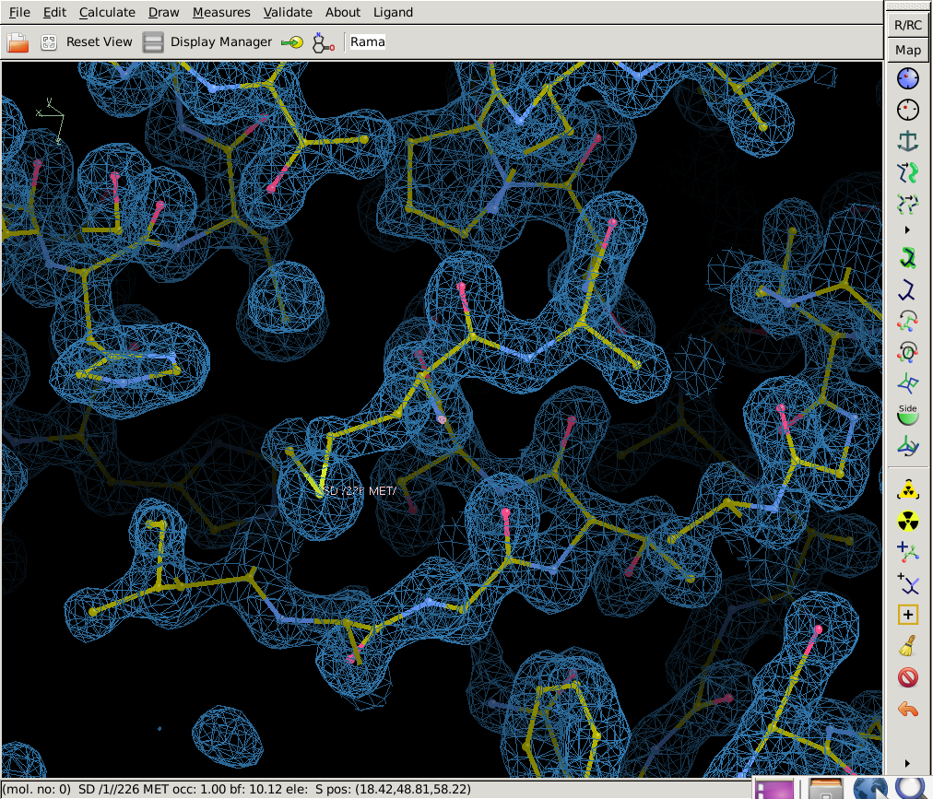
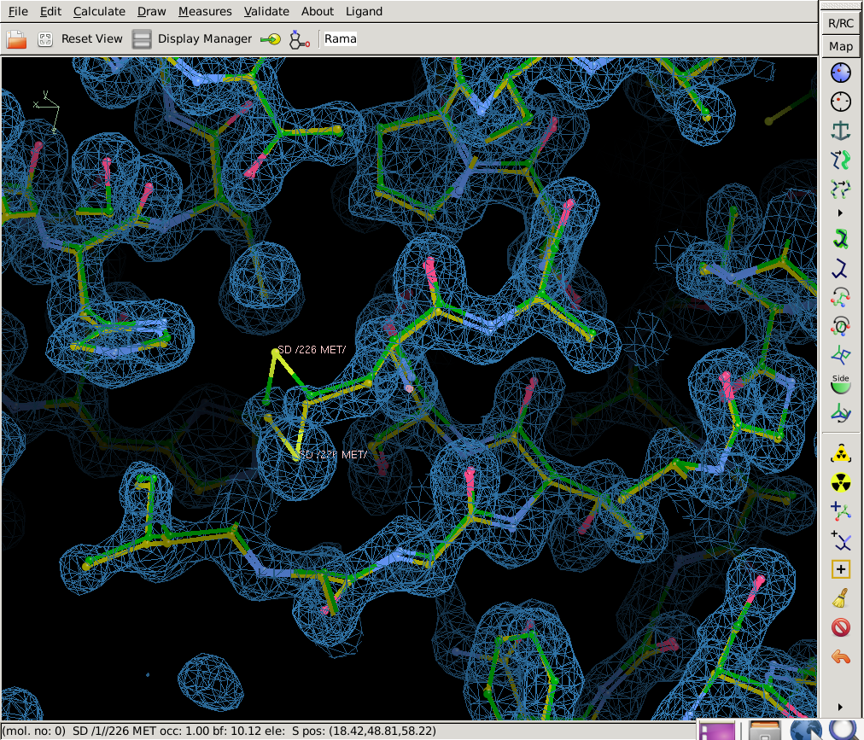
Manual and Automated Refinement have complementary functions
Automated Refinement (Phenix)
Performed in reciprocal space
Performed over all atoms
Does not add or remove atoms
Small radius of convergence
Manual Refinement (Coot)
Performed in real space
Performed over atoms in local region only
Can add or remove atoms
Large radius of convergence
Cycle between automated and manual refinement until all errors are corrected.
Before
After
Before
After

Slide 3
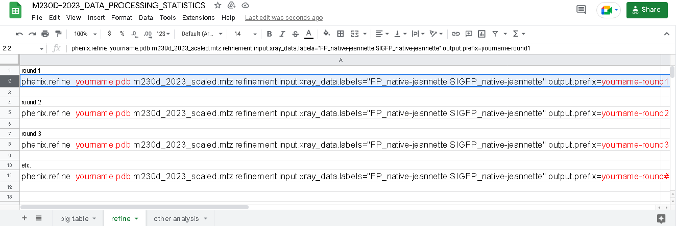

Perform your first round of automated refinement… other rounds to follow
Your best coordinates of proteinase K
File containing structure factor amplitudes, |FP|
Please specify “FP_native-jeannette” as your choice of structure factor amplitudes to use for refinement.
All output files will begin with
Click on “refine” tab to get this template

Slide 4
Perform your first round of automated refinement… other rounds to follow
Terminal
[1] phenix.refine aadhishre-coot-88.pdb m230d_2023_scaled.mtz refinement.input.xray_data.labels="FP_native-jeannette SIGFP_native-jeannette“ output.prefix=aadhishre-round1
=========================== phenix.refine: finished ===========================
# Date 2023-02-13 Time 19:48:52 PST -0800 (1676346532.17 s)
Start R-work = 0.2878, R-free = 0.2931
Final R-work = 0.2311, R-free = 0.2452

Slide 5
Products of automated refinement
R_{work}
R_{free}
Geometric quality stats
native-round1_001.pdb
native-round1_001.mtz
← Indicates discrepancy between model and data (F_{obs} & F_{calc}) calculated over working reflections (90-95% of data).
← Same as above, but calculated over free reflections (5-10% of reflections not used in refinement). Less model biased.
← Indicates deviation from ideal geometry.
← Refined coordinates.
← Structure factors with updated phases.
Σ|F_{obs}-F_{calc}|
Σ|F_{obs}|
R=
hkl
hkl

Slide 6
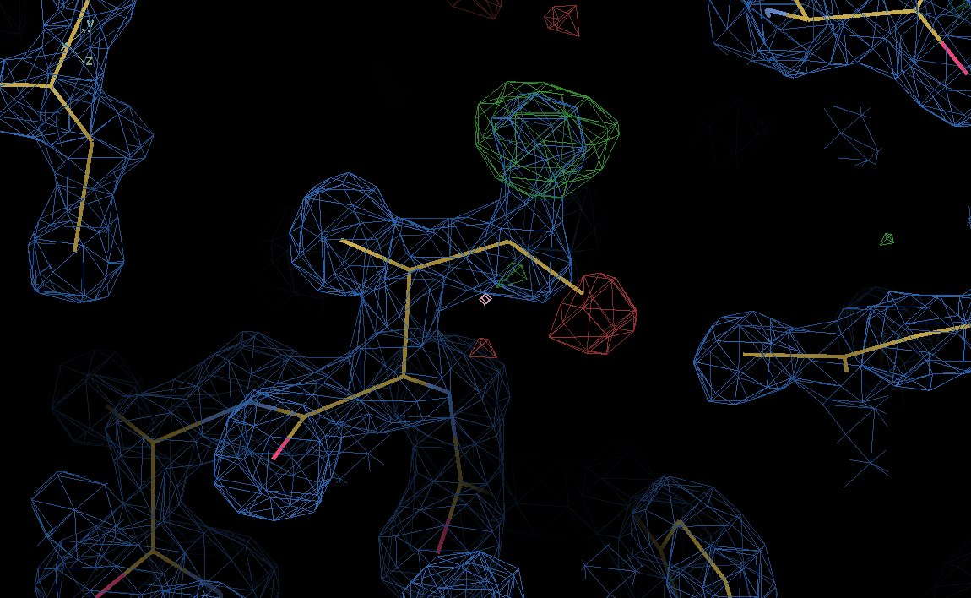
F_{o}-F_{c} Difference Fourier map
ρ(x,y,z)=1/V*Σ|F_{obs}-F_{calc}|e^{-2πi(hx+ky+lz-φ}_{calc}⁾
Here, F_{obs} = FP_native_jeannette.
F_{calc} are calculated from the current model of the protein.
Positive contours correspond to features present in the crystal that are not in the current model.
Negative contours correspond to features present in the native structure that should be removed from the current model.
Address all peaks in the difference Fourier map greater than 5 sigma.

Slide 7
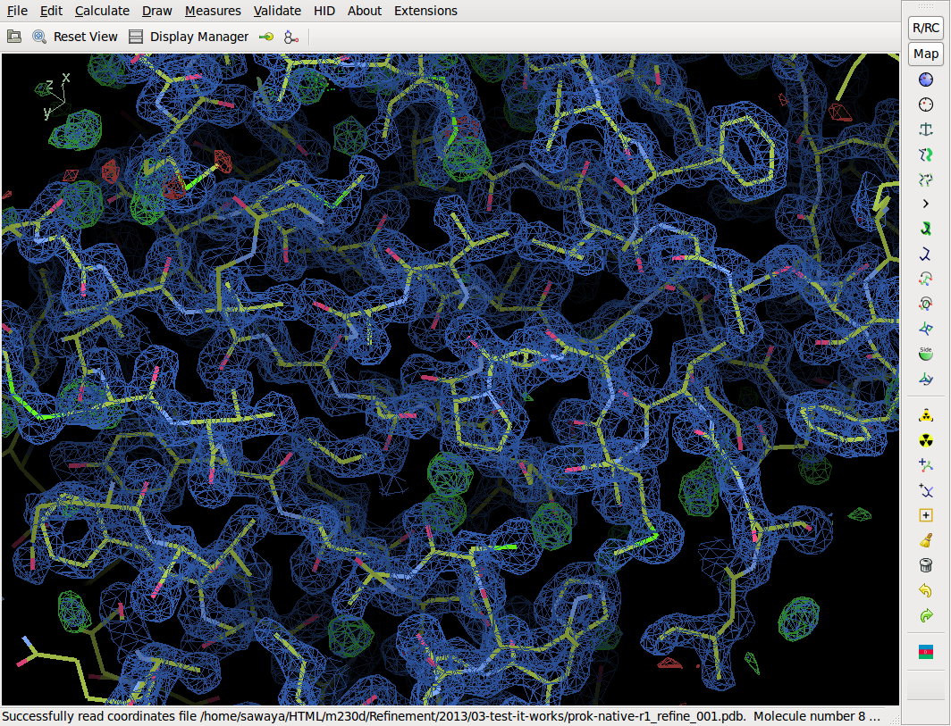
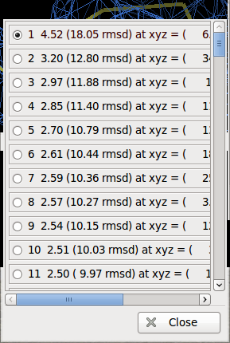
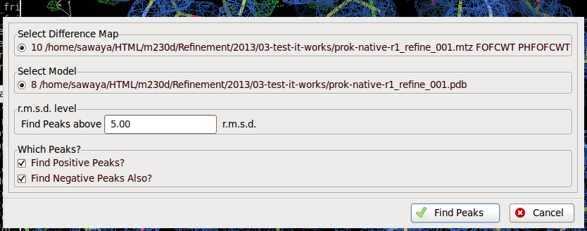
Get a sorted list of F_{obs}-F_{calc} peaks
Ramachandran plot
Kleywegt plot
Incorrect Chiral Volumes
Unmodeled Blobs
Difference Map peaks
Check/Delete Waters
Geometry Analysis
Peptide Omega Analysis
Rotamer Analysis
Density Fit Analysis
Probe Clashes
NCS differences
Pukka Puckers
Alignment vs. PIR

Slide 8
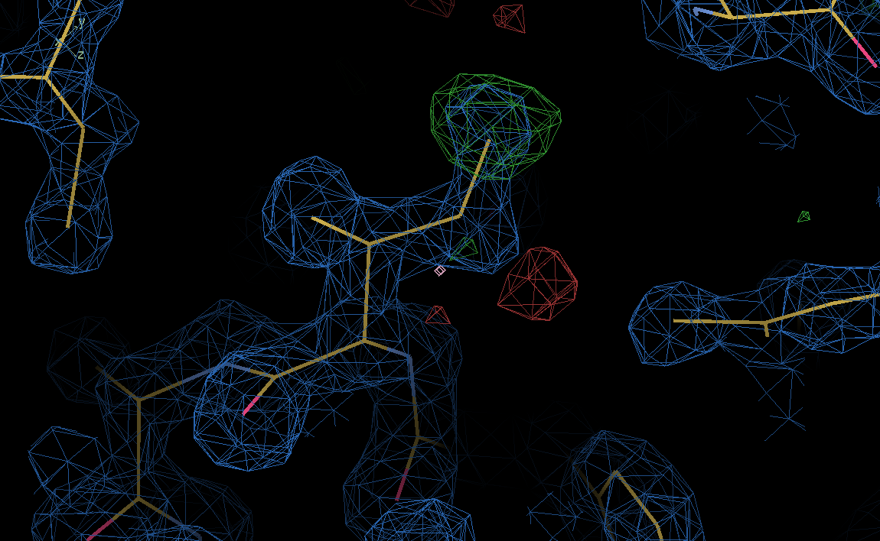
F_{obs}-F_{calc} reveals errors in model
Positive density
Negative density
Real Space Refine and drag
Or Autofit Rotamer

Slide 9
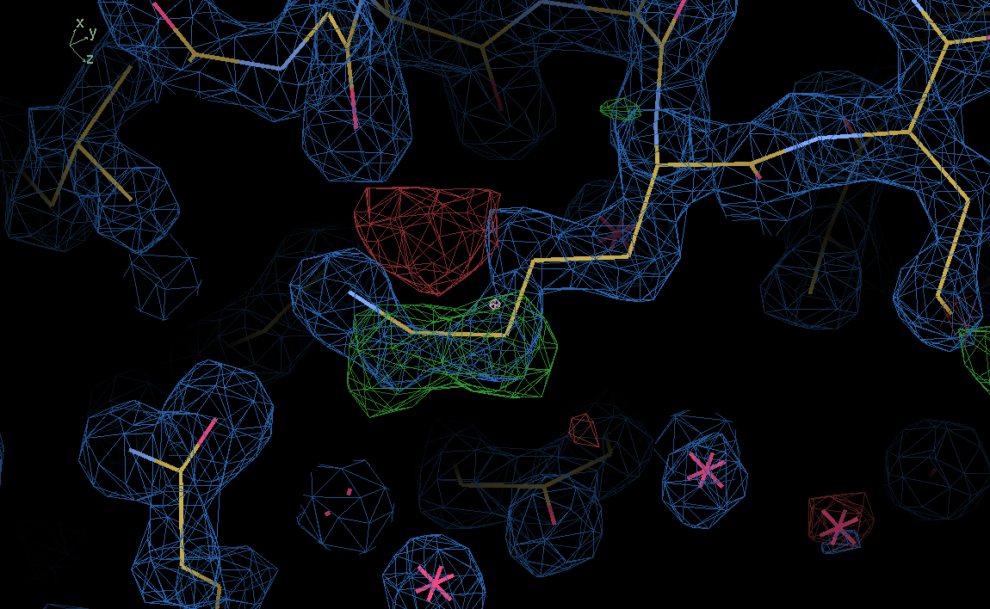
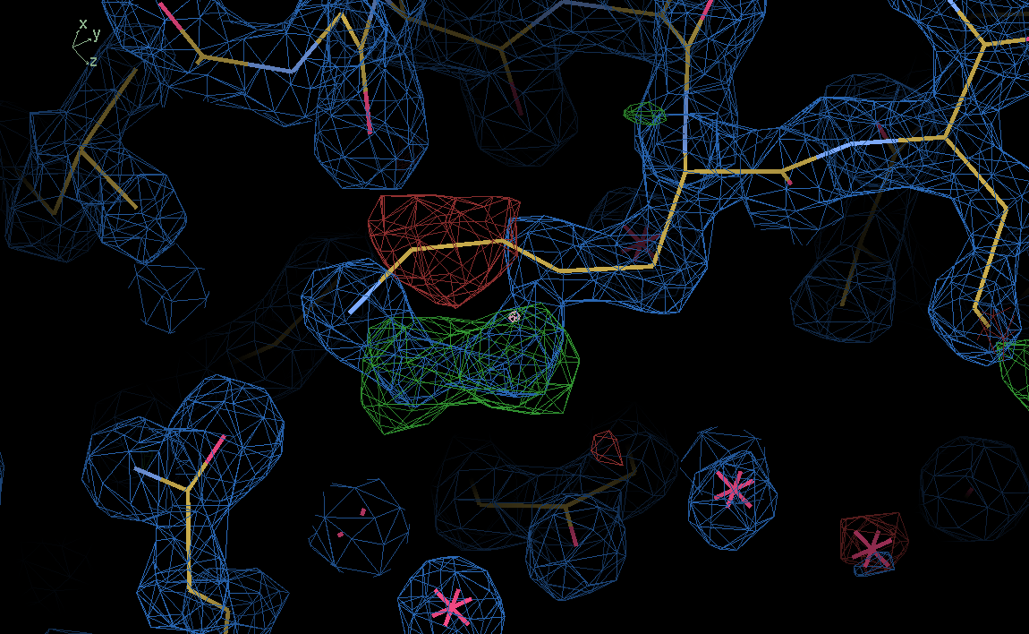
F_{obs}-F_{calc} reveals errors in model
Real Space Refine and drag
Or Autofit Rotamer

Slide 10
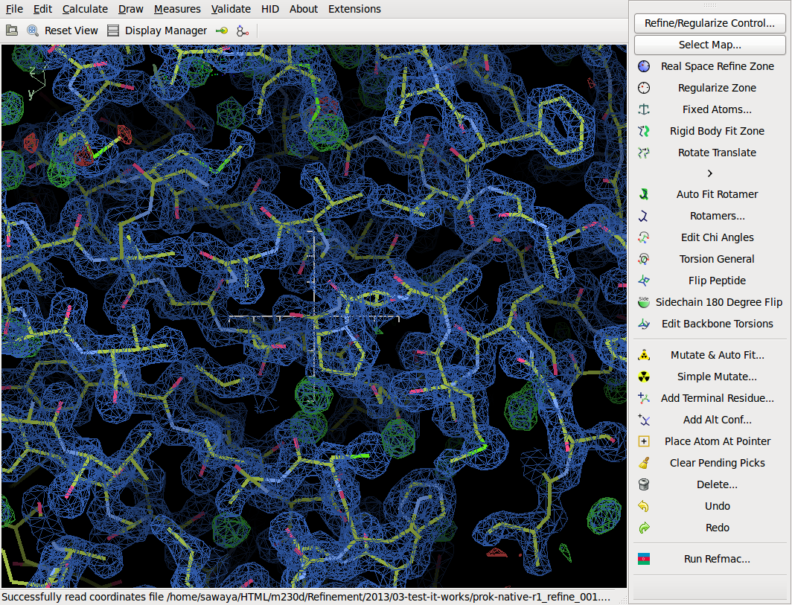
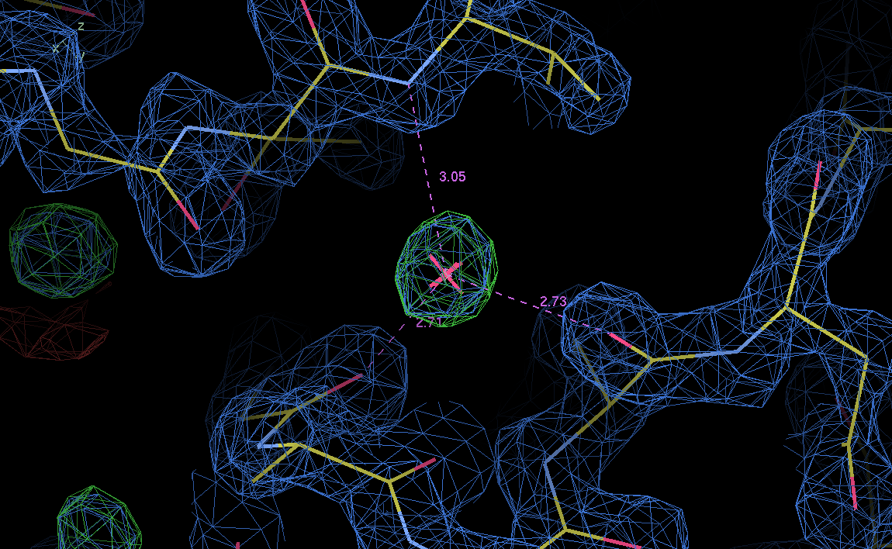

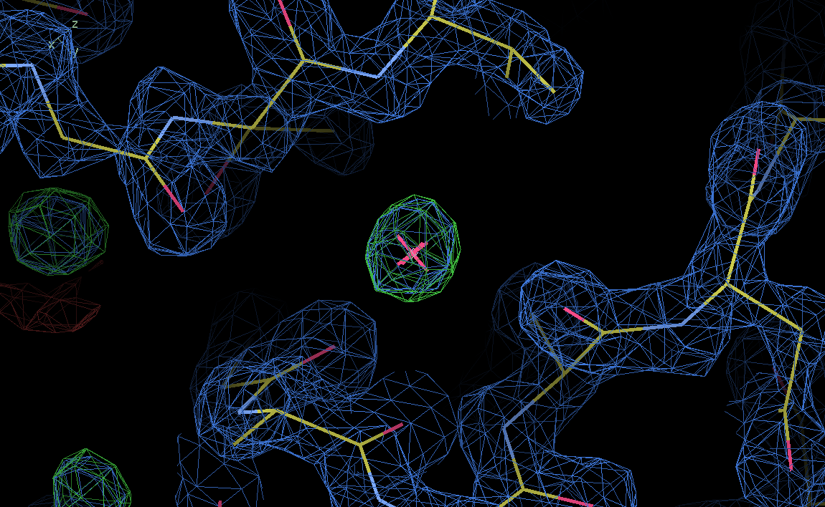
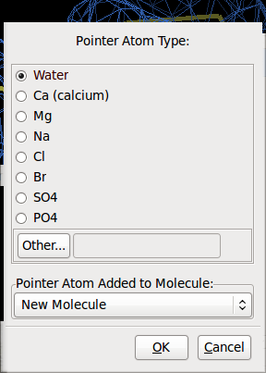
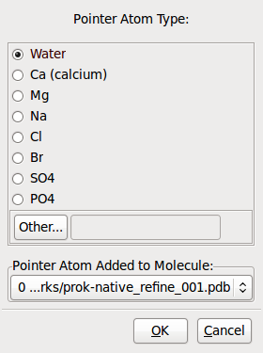
water

Slide 11
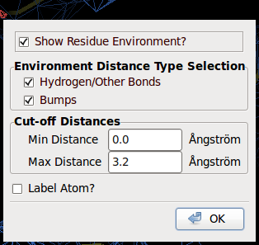
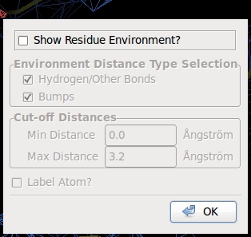
water

Slide 12
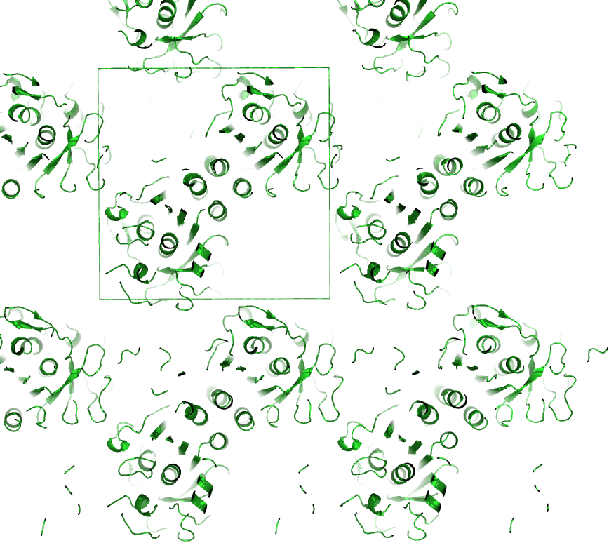
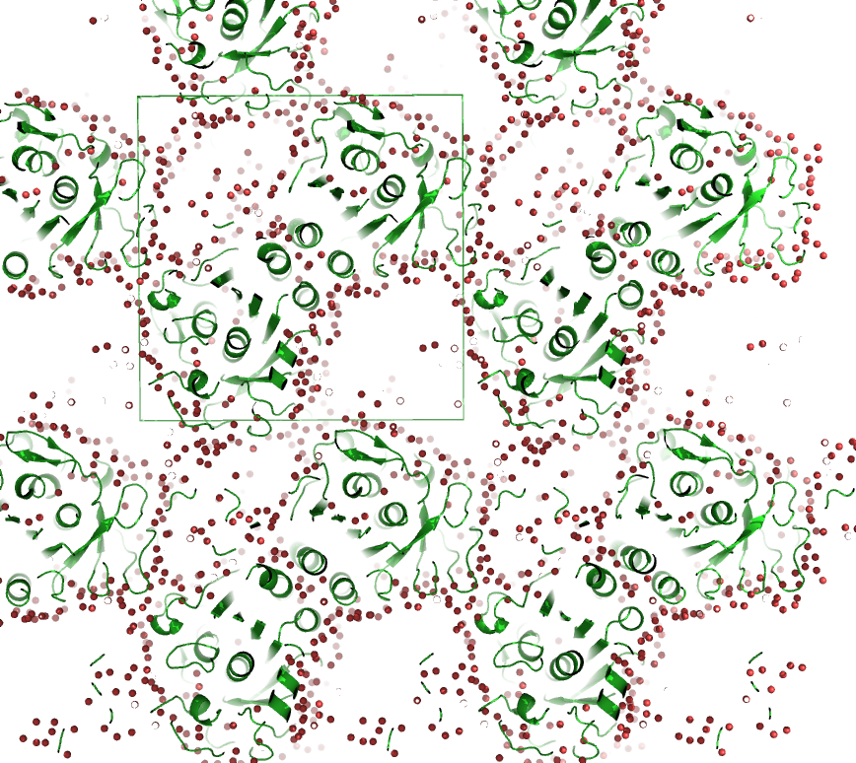
Water, Water everywhere, and not a drop to drink.
About 50% of the volume of our crystals is water. But, only a small fraction of those water molecules are visible in electron density maps. We see only those waters that are ordered by hydrogen-bonds formed with nitrogen and oxygen atoms on the protein.
At 1.4 Å you might expect to see ~1.3 water molecules per protein residue (rule of thumb).
  280 protein residues *1.3 waters/residue=364 waters
  Poorer resolution means fewer waters (none at 3.0 Å).
Don’t despair. This is not a fruitless task. When modeled correctly waters improve our phases which improves the map, which allows us to resolve the protein atoms more clearly.
Inserting waters in noise density might lower R_{work}, but not R_{free}.
  Careless insertion of waters might prevent you from catching errors in modelling protein atoms.
Rime of the Ancient Mariner, 1834 Samuel Taylor Coleridge

Slide 13
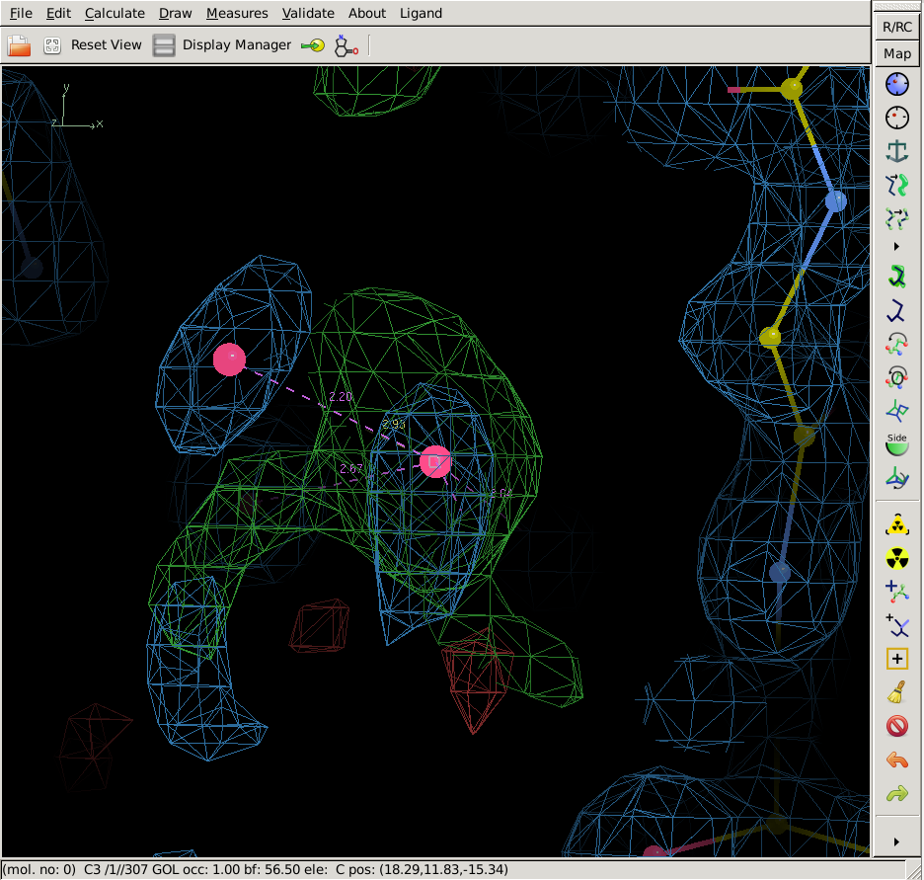
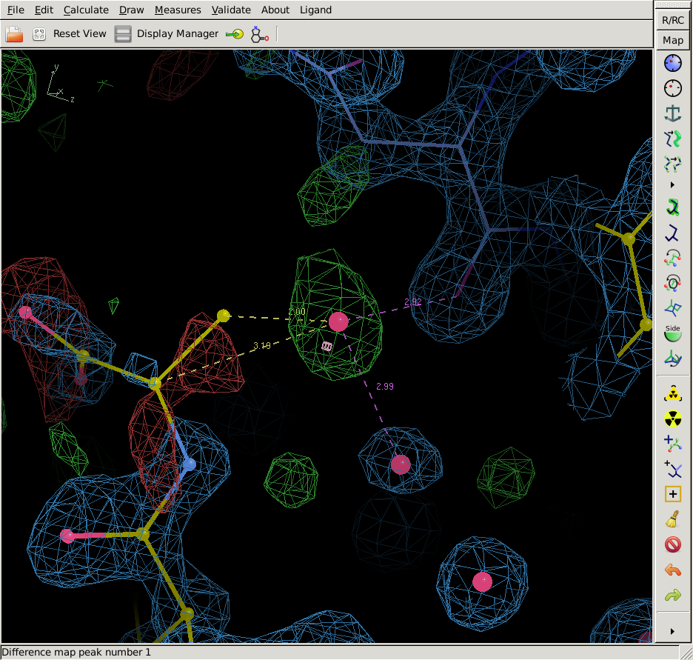
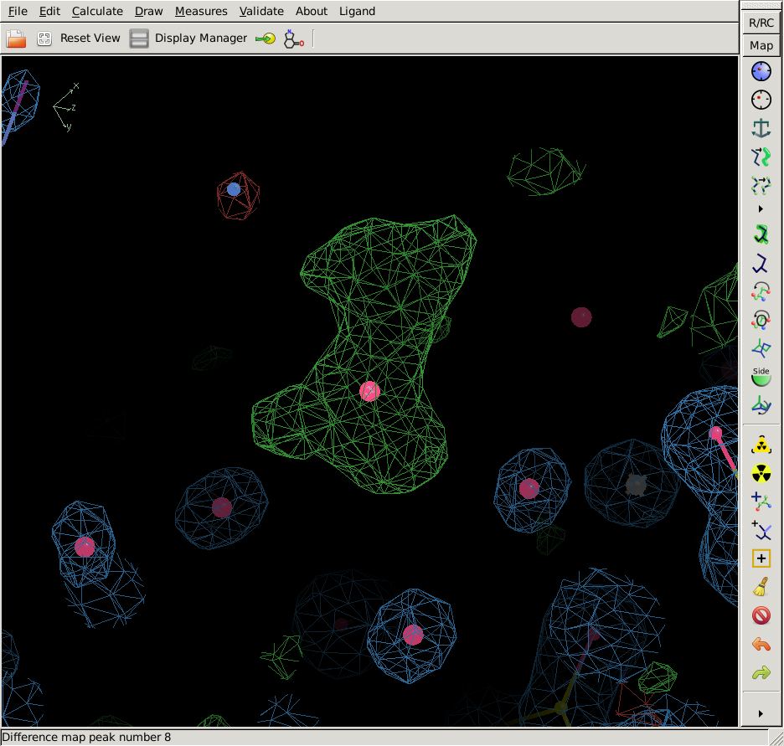
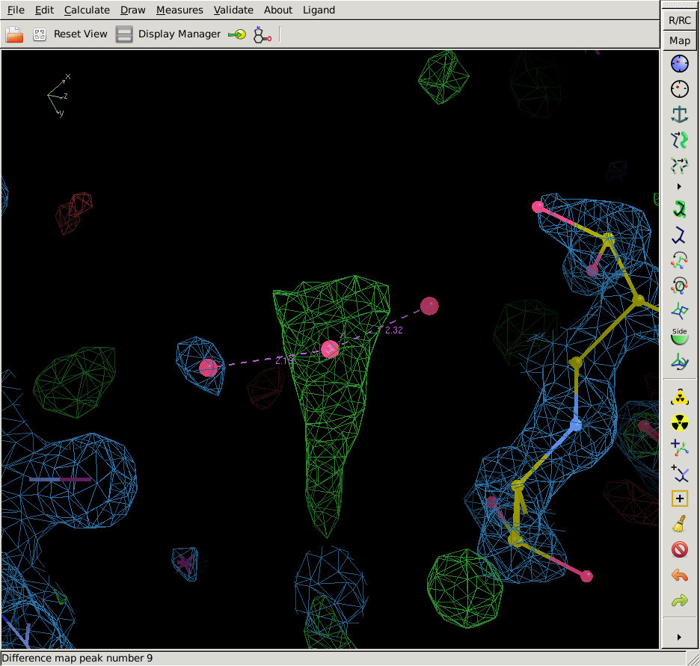
Insert water molecules only in density that looks like water & is in a chemical environment that supports water.
Density should appear roughly spherical.
  We expect water to appear spherical (not boomerang shape) because can see density for only the oxygen of water. Hydrogen atoms are not resolvable at this resolution
  If density is not spherical, it probably originates from a molecule other than water (protein or other components of crystallization buffer).
Density should be located within 2.3-3.2 Å of one or more hydrogen bond partners.
  For example, N, O, or S from protein or another water.
  Dashed lines drawn by “residue environment” will be colored magenta for these favorable contacts.
  Distances shorter than 2.3 Å might indicate cations (or noise).
  Distances longer than 3.2 Å are too weak to be a hydrogen bond.
Density should be greater than 3.0 Å from carbon atoms.
  Carbon is hydrophobic and does not form stable interfaces with water.
  Dashed lines drawn by “residue environment” will be colored yellow for these unfavorable contacts.

Slide 14
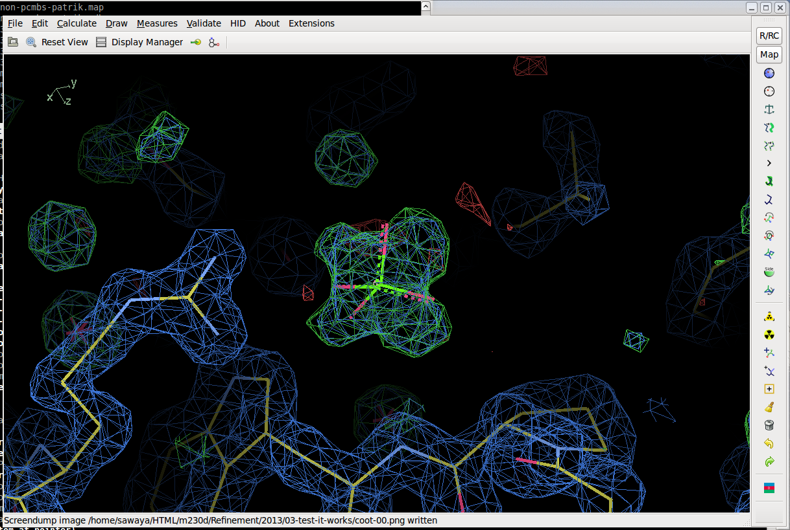
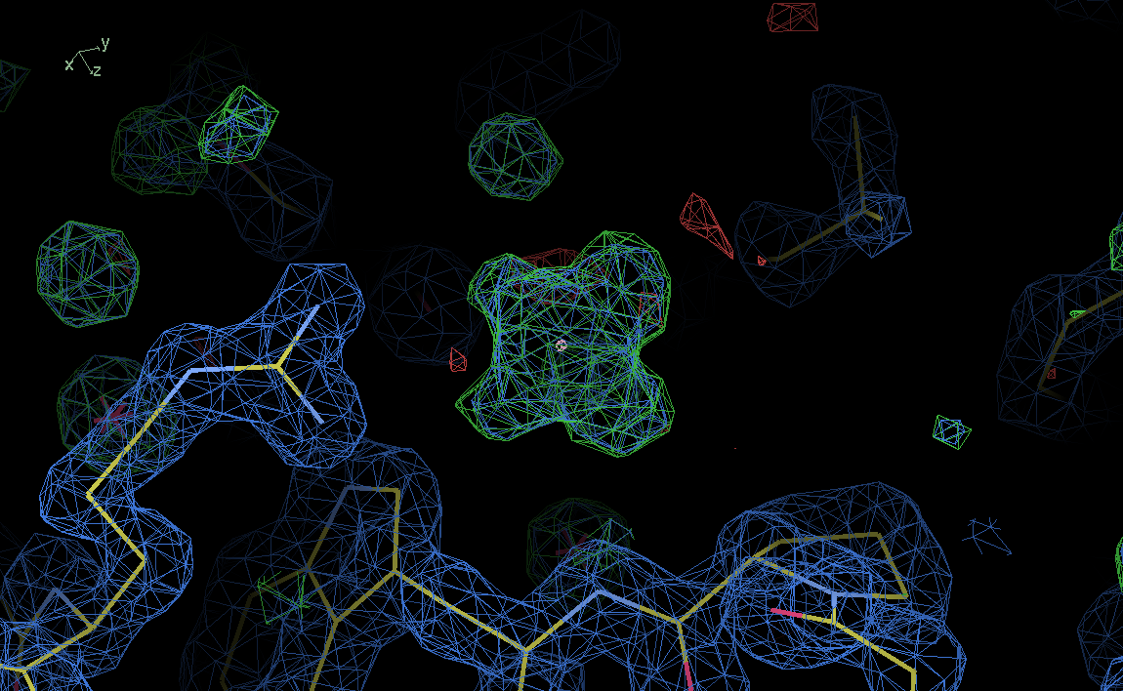
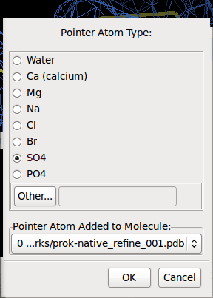
Other solvent

Slide 15

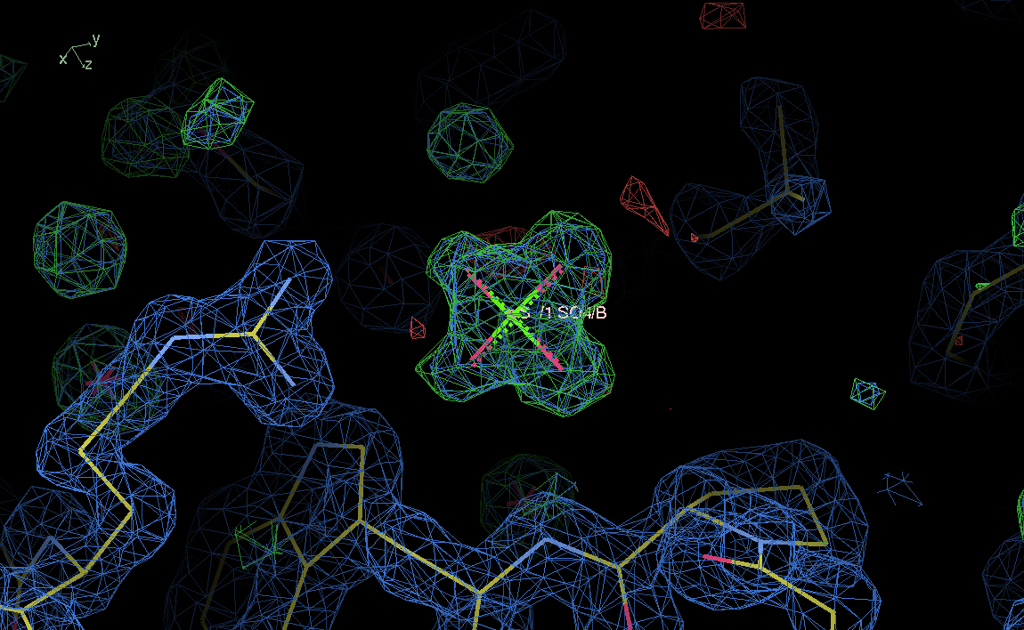
Other solvent

Slide 16
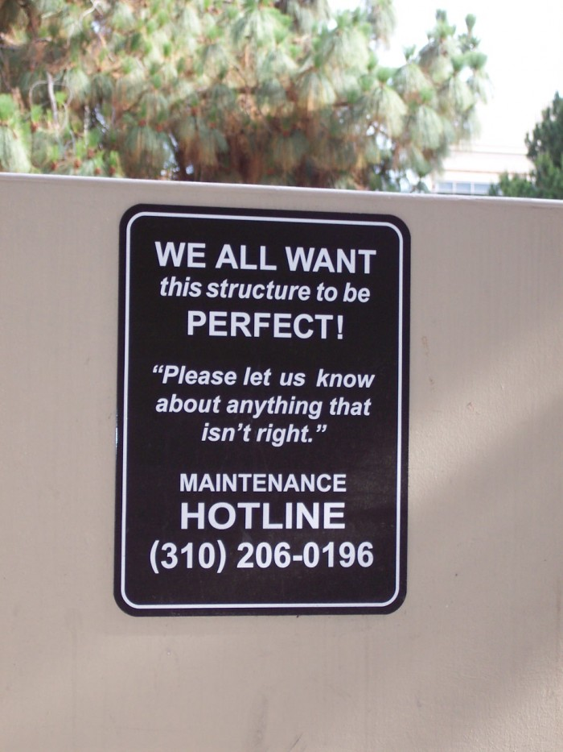
email sawaya@mbi.ucla.edu

Slide 17
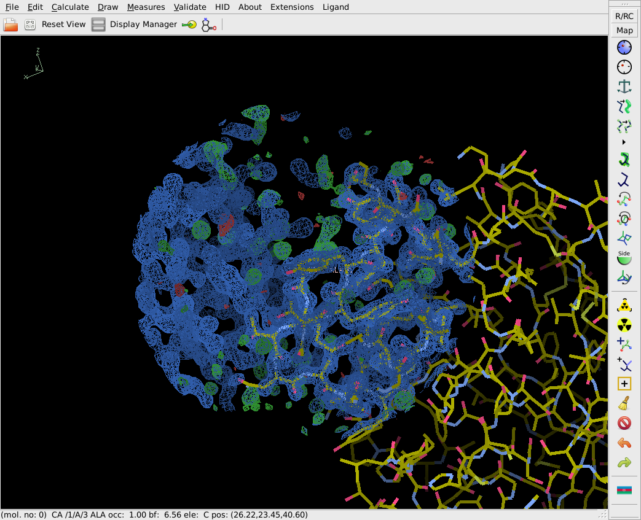
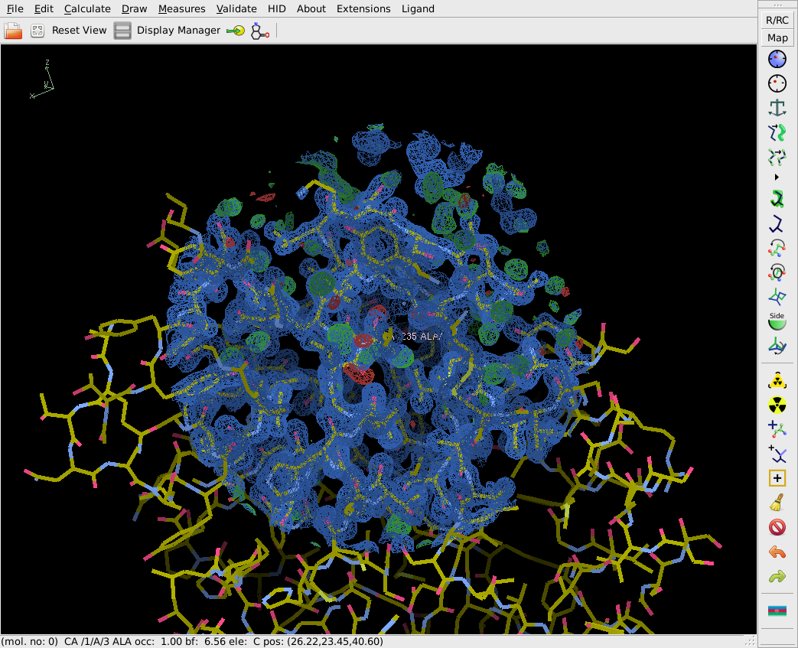
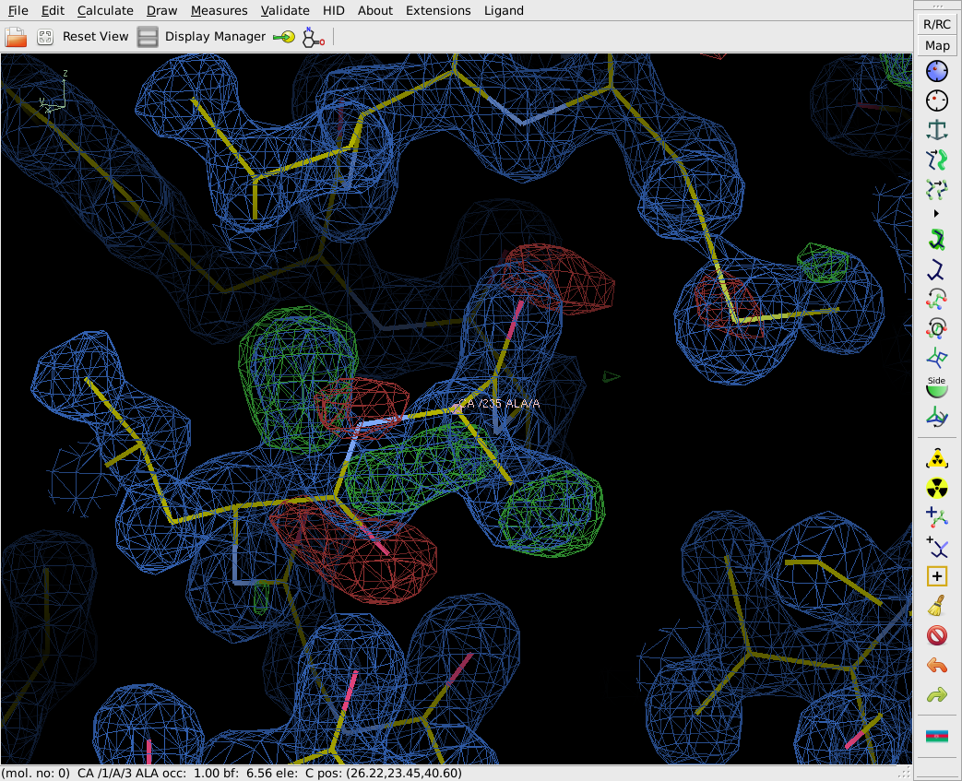

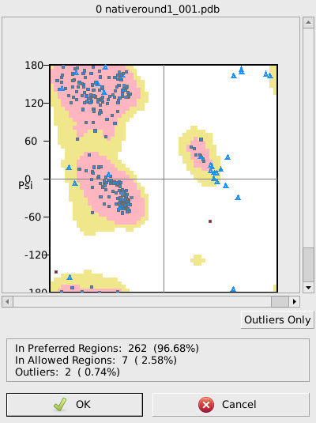
Fix Ramachandran Outliers
Ramachandran plot
Kleywegt plot
Incorrect Chiral Volumes
Unmodeled Blobs
Difference Map peaks
Check/Delete Waters
Geometry Analysis
Peptide Omega Analysis
Rotamer Analysis
Density Fit Analysis
Probe Clashes
NCS differences
Pukka Puckers
Alignment vs. PIR
235 A Ala

Slide 18

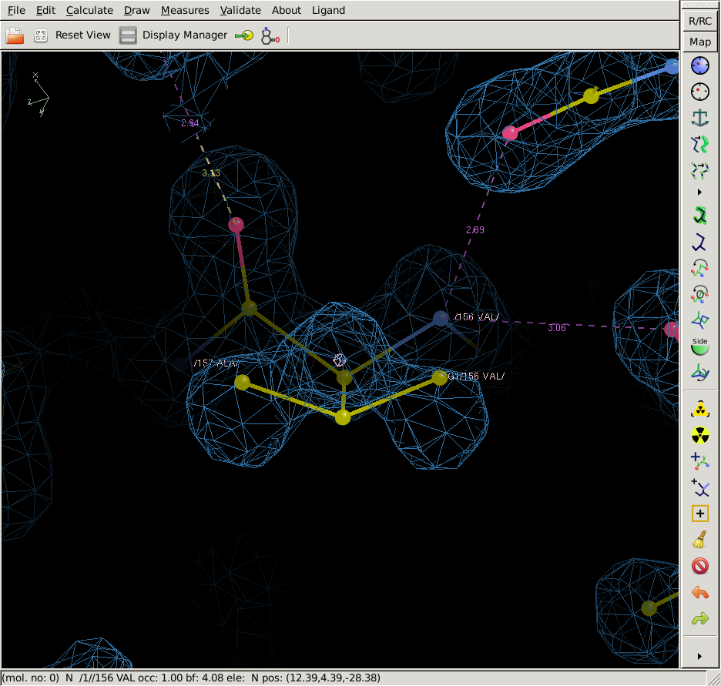
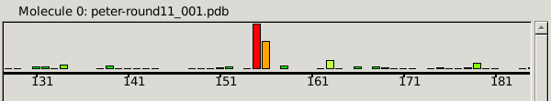
Fix Rotamer Outliers
Ramachandran plot
Kleywegt plot
Incorrect Chiral Volumes
Unmodeled Blobs
Difference Map peaks
Check/Delete Waters
Geometry Analysis
Peptide Omega Analysis
Rotamer Analysis
Density Fit Analysis
Probe Clashes
NCS differences
Pukka Puckers
Alignment vs. PIR
Protein sidechains prefer to adopt certain torsion angle values (yielding rotamers )
Preferences for certain torsion angles arise for the same reason that backbone torsion angles have certain preferences—that is avoidance of steric clash.
One could imagine a plot for side chain torsion angles, analogous to the Ramachandran plot for backbone angles.
Coot produces only a bar graph indicating whether the torsion angles are outliers.

Slide 19
Fix Rotamer Outliers
Protein sidechains prefer to adopt certain torsion angle values (yielding rotamers )
Preferences for certain torsion angles arise for the same reason that backbone torsion angles have certain preferences—that is avoidance of steric clash.
One could imagine a plot for side chain torsion angles, analogous to the Ramachandran plot for backbone angles.
Coot produces only a bar graph indicating whether the torsion angles are outliers.
clash

Slide 20
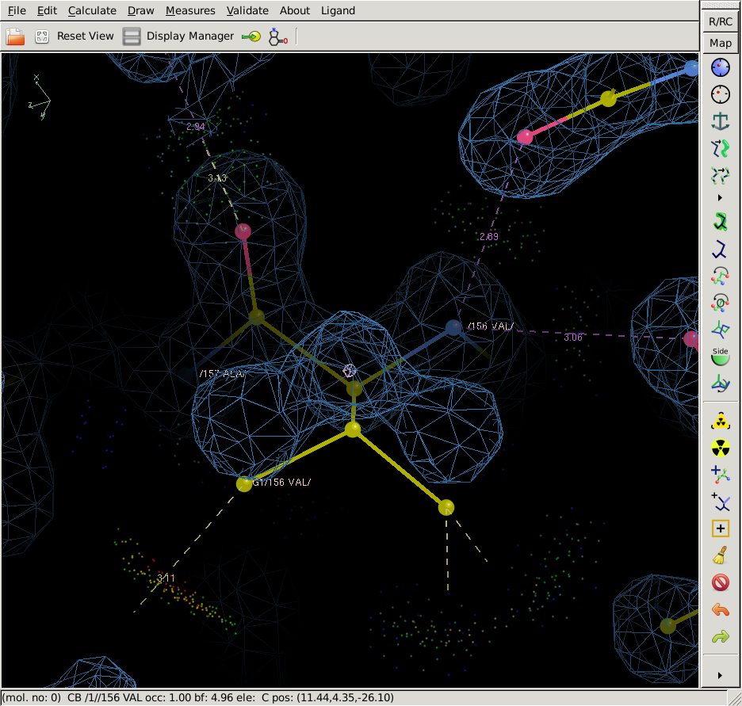
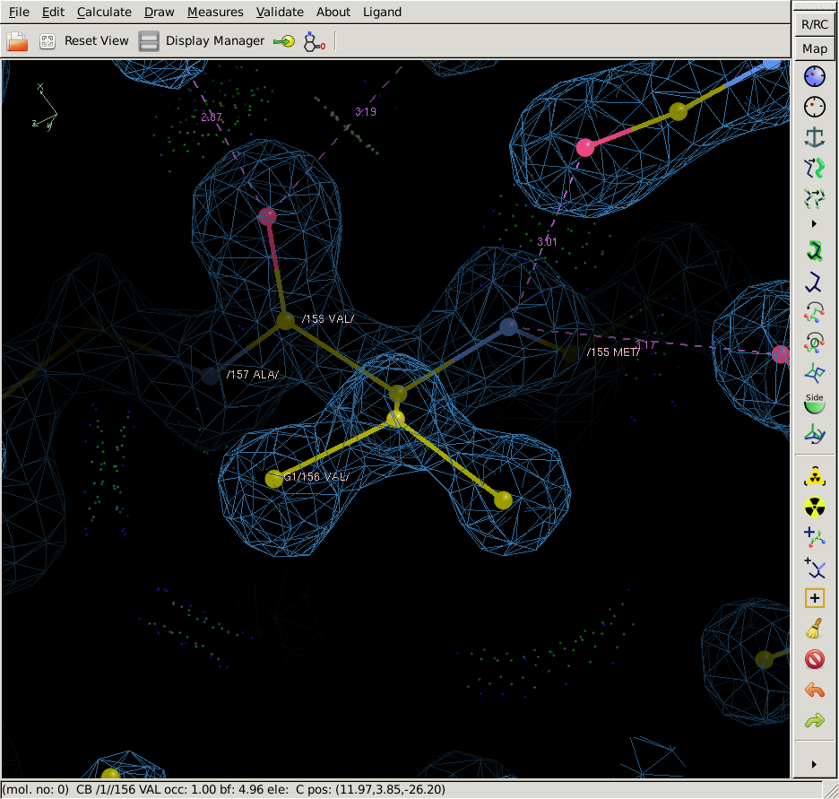
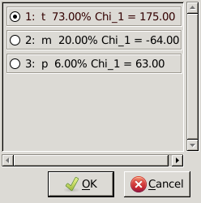
Fix Rotamer Outliers
Protein sidechains prefer to adopt certain torsion angle values (yielding rotamers )
Preferences for certain torsion angles arise for the same reason that backbone torsion angles have certain preferences—that is avoidance of steric clash.
One could imagine a plot for side chain torsion angles, analogous to the Ramachandran plot for backbone angles.
Coot produces only a bar graph indicating whether the torsion angles are outliers.

Slide 21
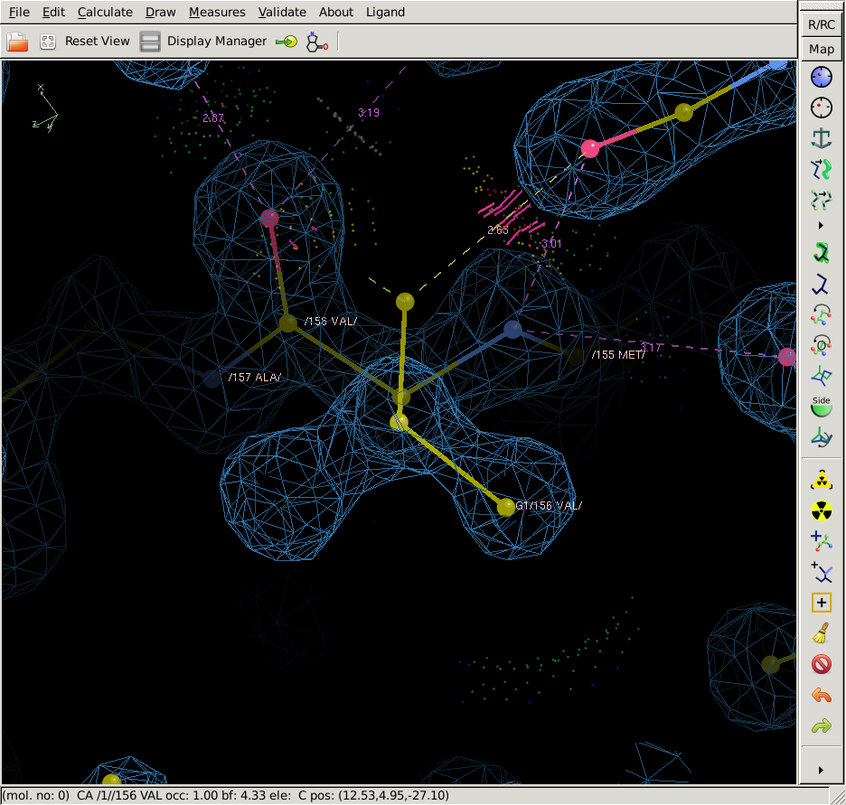
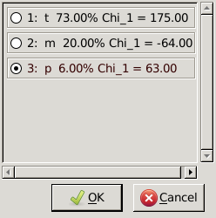
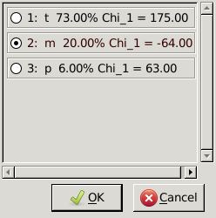
Fix Rotamer Outliers
Protein sidechains prefer to adopt certain torsion angle values (yielding rotamers )
Preferences for certain torsion angles arise for the same reason that backbone torsion angles have certain preferences—that is avoidance of steric clash.
One could imagine a plot for side chain torsion angles, analogous to the Ramachandran plot for backbone angles.
Coot produces only a bar graph indicating whether the torsion angles are outliers.

Slide 22
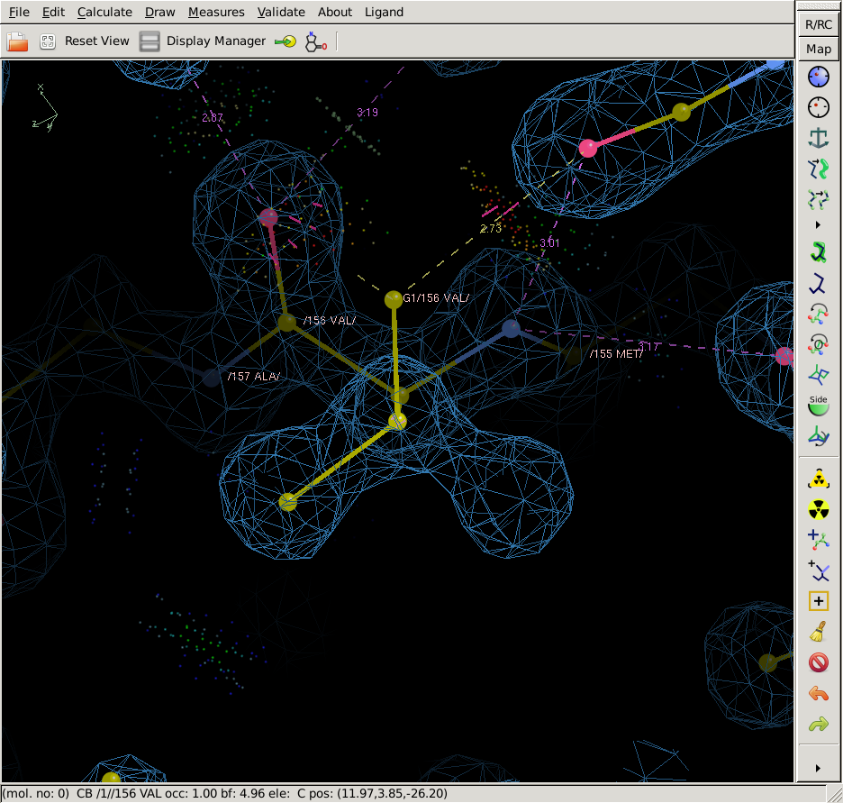
Fix Rotamer Outliers
Protein sidechains prefer to adopt certain torsion angle values (yielding rotamers )
Preferences for certain torsion angles arise for the same reason that backbone torsion angles have certain preferences—that is avoidance of steric clash.
One could imagine a plot for side chain torsion angles, analogous to the Ramachandran plot for backbone angles.
Coot produces only a bar graph indicating whether the torsion angles are outliers.

Slide 23
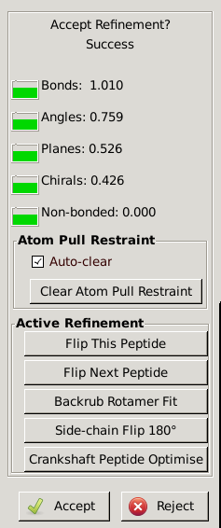
Fix Rotamer Outliers
Protein sidechains prefer to adopt certain torsion angle values (yielding rotamers )
Preferences for certain torsion angles arise for the same reason that backbone torsion angles have certain preferences—that is avoidance of steric clash.
One could imagine a plot for side chain torsion angles, analogous to the Ramachandran plot for backbone angles.
Coot produces only a bar graph indicating whether the torsion angles are outliers.

Slide 24
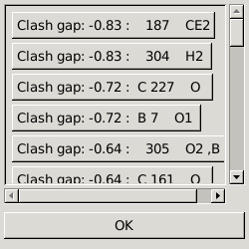
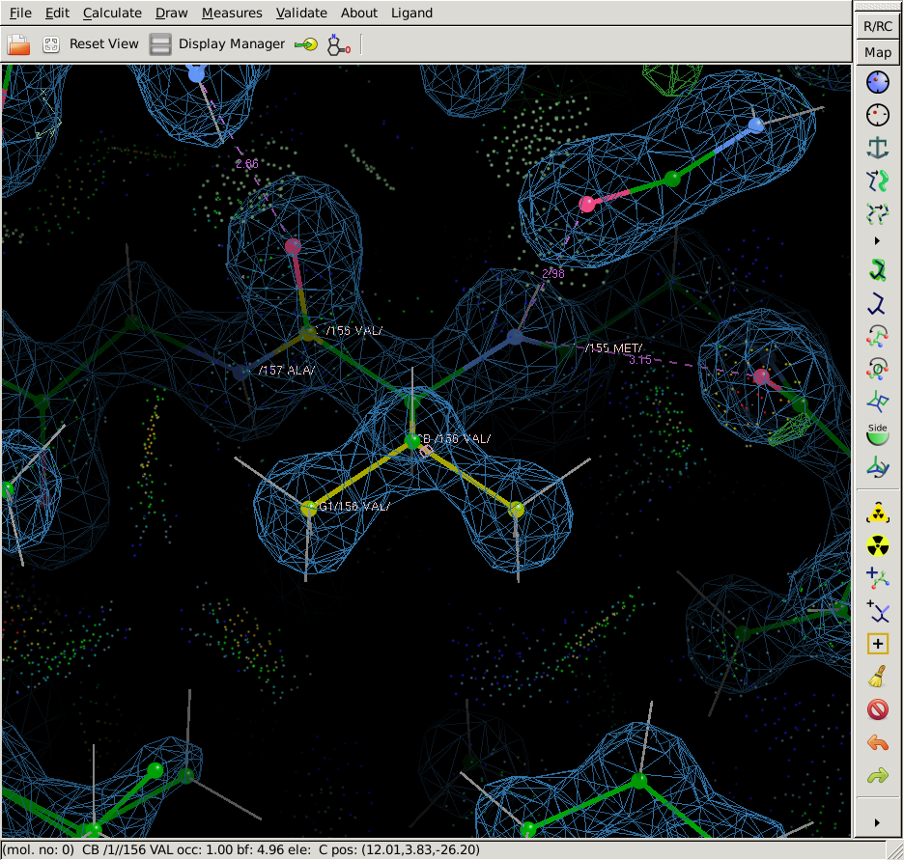
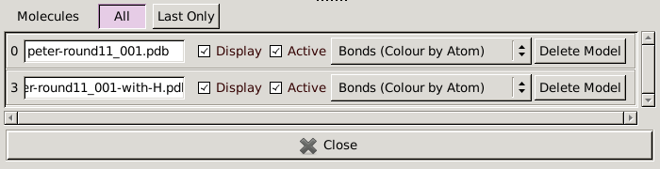
Fix Clashes
Click on Validate menu
Select “Probe Clashes”
A new model appears with hydrogens.
I suggest that you delete that new “model-with-H” through Display Manager so you don’t accidently start editing that model.
Click on highest “Clash gap” to see worst clash.

Slide 25
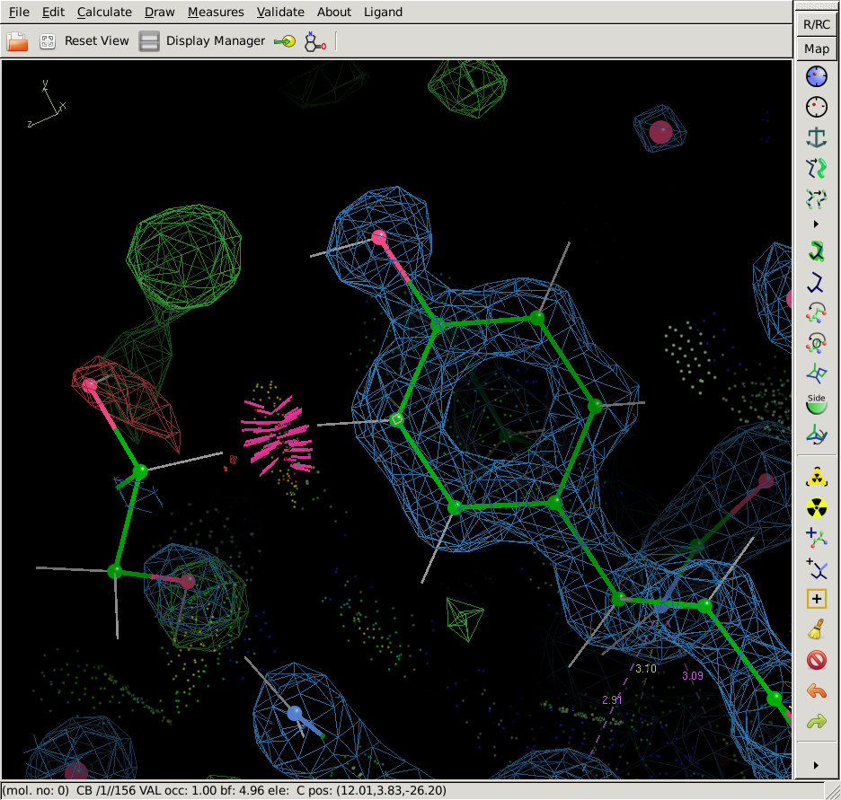
Fix Clashes
Move atoms to avoid clash.

Slide 26
Perform your next round of automated refinement… other rounds to follow
A root name for refinement output files
Your best coordinates of native proteinase K
Advance to higher round numbers for subsequent refinement rounds
Click on “refine” tab to get this template

Slide 27






Structure Refinement Schematic
Automatic Refinement
|F_{obs-native} |
|F_{obs-EuCl3} |
α_{obs}
Move atoms to
Σ|F_{obs}-F_{calc}|
Σ|F_{obs}|
Fit
|F_{obs}|
Σ|F_{obs}-F_{calc}|
Σ|F_{obs}|
|F_{obs-PCMBS} |
|F_{calc}|^{out}
|F_{calc} |^{in}
α_{calc}
|F_{calc} |^{in}
Reciprocal Space
FT (Coot)
FT (Phenix)
FT (Coot)
FT (Phenix)
Real Space
2F_{obs}-F_{calc}
map
experimental map
coordinates
(name-coot-83.pdb)
coordinates
(native-round1_001.pdb)
coordinates
(native-round1_001-coot.pdb)
Build atoms to
Fit Map
F_{obs}-F_{calc}
map
Manual Building Round 1
Manual Building Round 2

Slide 28
How to get Structure Validation Statistics
Report Validation statistics in the 2022 Google Sheet
https://docs.google.com/spreadsheets/d/1wZmUcWTsdU9MCJ1SysXm2LtnWRRALqlOgYg9y1mPR4Q/edit#gid=0

Slide 29
Procedures
Locate your final copy of the .pdb file and .mtz file
E-mail the .pdb and .mtz files to sawaya@mbi.ucla.edu
Open the Google spreadsheet for 2023 https://docs.google.com/spreadsheets/d/1smETnCyXJiTsUsGnh44zXCzqhV3fx0cyr7ljVWOcsh8/edit#gid=0
Follow the instructions on the remaining slides.

Slide 30

Find R_{work} and R_{free}
View the header of the last refined .pdb file:
  If you are using a laptop, open the .pdb file with word editor of your choice (e.g. notepad or wordpad).
  If you are using a linux computer, type “head -100 my.pdb”
About 25 lines from top of the .pdb file see the line
“R VALUE (WORKING SET)” and “FREE R VALUE”,
as shown here →
Enter R_{work} and R_{free} values in the Google spreadsheet (columns BG and BH).
Aim for R_{work} <20% and R_{free}-R_{work}<5%

Slide 31

Find RMSD Bond Lengths & Angles
Scroll down about 40 lines to find these words:
“DEVIATIONS FROM IDEAL VALUES for BOND and ANGLE”
  as shown here →
Enter RMSD BOND and ANGLE values in the Google spreadsheet (columns BM and BN).
Aim for RMSD bond <0.02 Å and RMSD angle <2°

Slide 32

Find Clashscore
Scroll down about 6 lines to find these words:
  “MOLPROBITY STATISTICS” and “ALL-ATOM CLASHSCORE”
  as shown here →
Enter ALL-ATOM CLASHSCORE value in the Google spreadsheet (column BO).
Clashscore is the number or such clashes per thousand atoms.
Clashscore/10 should be less than the resolution in Å. So for 1.4 Å resolution, aim for clashscore <14.

Slide 33

Find Ramachandran Statistics
Scroll down 2 lines to find these words:
“RAMACHANDRAN PLOT:” and “OUTLIERS”, “ALLOWED”, and “FAVORED” as shown here →
Enter these values in the Google spreadsheet (columns BP, BQ, and BR).
Aim for “FAVORED” > 90%.

Slide 34

Find Rotamer Outliers
Scroll down 1 lines to find these words:
“ROTAMER OUTLIERS”
as shown here →
Enter these values in the Google spreadsheet (columns BS).
Aim for “ROTAMER OUTLIERS” < 2%.

Slide 35

Find Number of Residues
Scroll down 13 lines to find these words:
“WHOLE:” and “RESIDUES”
as shown here→
Enter the number of residues in the Google spreadsheet (column BT).

Slide 36

Find Number of SOLVENT atoms
Scroll down 6 lines to find these words:
“WATER:” and “OTHER”
as shown here→
Add up the number of WATER and OTHER atoms and enter the value in the Google spreadsheet (column BU).

Slide 37

Calculate the Errat Score
In a browser window, enter the URL https://saves.mbi.ucla.edu/
Use the “Choose File” button to upload your .pdb file.
Push the “Run programs” button.
Continue to next slide please…
Aim for Errat score > 90%.

Slide 38

Calculate the Errat Score
Push the “Start” button for ERRAT.
The Errat score will appear a few seconds after you pushed “Start”
Continue to next slide please…

Slide 39

Calculate the Errat Score
Report the Errat score in column BV of the Google Spreadsheet.

Slide 40


Each bar represents the confidence of error in a range of 7 consecutive residues.
The region near residue 91 needs inspection.
99% confident of an error.

Slide 41




ERRAT examines distances between non-bonded atoms. Reports the deviations of C-C, C-N, C-O, N-N, N-O, O-O distances from distributions characteristic of reliable structures.

Slide 42
BAD
BACKBONE AMIDE
O
N
2.8 Å
H
H
N
O
H
Asn

Slide 43
GOOD
BACKBONE AMIDE
O
N
2.8 Å
H
H
O
N
H
Asn

Slide 44

Find Number of Excessively close contacts
In a browser window, enter the URL https://qc-check.usc.edu/QC/qc_check.pl
Use the “Choose File” button to upload your .pdb file.
Push the “Submit” button.
Wait ~1 minute for validation to complete.
Continue to next slide please…

Slide 45

Find Number of Excessively close contacts
Click on “ADIT results”
Continue to next slide please….

Slide 46

Find Number of Excessively close contacts
Find the words “Close contacts in same asymmetric unit. Note the number given.
Find the words :Close contacts based on crystal symmetry. Note the number given.
Add up these two numbers and enter the sum in column BW of the Google Spreadsheet.

Slide 47
Find Number of Floating Waters
Look just a few lines above your previous location in the report to find the words “The following solvent molecules are further away than 3.5 Angstroms”. Note the number of waters given.
On the next paragraph, find the words “The coordinates for water molecules which could be translated back” Note the number given.
Subtract the 2nd number from the 1st number and enter this difference in column BX of the Google Spreadsheet.

Slide 48


Submit your atomic model and structure factors to wwPDB validation server https://validate-rcsb-2.wwpdb.org/validservice
Every atomic model submitted to the PDB or EMDB is evaluated by this validation software.
You are required to submit this validation report whenever you submit a manuscript for review by a journal.
This report gives reviewers criteria for evaluating your atomic model.
It ranks the quality of your atomic model relative to thousands of other structures previously deposited in the PDB.
It is helpful for you to get familiar with its format.

Slide 49


Compare the quality of your atomic model to others in the PDB at the same resolution (1.4 Å).
The slider graphics provides a summary of key quality indicators.
The farther to the right the slider is, the better is the quality relative to other structures at that resolution.
In general, one would like all sliders to lie far to the right in the blue areas (especially for recently determined structures, and especially the resolution-specific sliders).
Slider graphics help non-experts see whether there are serious issues with the structure.
https://www.wwpdb.org/validation/XrayValidationReportHelp

Slide 50
Sidechain outliers
The sidechain outlier score is the percentage of residues with an unusual sidechain conformation with respect to the total number of residues for which the assessment is available.
i.e. Rotamer outliers
https://www.wwpdb.org/validation/XrayValidationReportHelp

Slide 51
RSRZ outliers
Real-space R-value (RSR) is a measure of the quality of fit between the atoms of a residue and the map.
A residue is considered an RSRZ outlier if its RSRZ value is greater than 2.
https://www.wwpdb.org/validation/XrayValidationReportHelp

Slide 52

Request a validation ID and password.
Go to https://validate-rcsb-2.wwpdb.org/validservice
Enter your e-mail address
Make up a simple password.
Select “United States”
Select “X-ray Diffraction”
Copy the numerical code
Click the box
Press “Start Validation session”
Check you e-mail.
You will get a 10-digit validation ID in e-mail from noreply@mail.wwpdb.org
1
2
3
4
5
6
7

Slide 53
Log in with your validation ID and password.
Enter the 10-digit Validation ID
Enter the Password you selected
Push the button “Log in”
1
2
3

Slide 54

Push the button “Continue to file upload”
1

Slide 55



Push the button “Choose File”
Select you last, best-refined coordinates output by phenix.
Coordinates must be in mmcif format (not pdb format).
2
1

Slide 56

Select file type“Coordinates (mmcif format)”
1

Slide 57


Push the button “Choose File” again
Select the corresponding .mtz file output by phenix.
The .mtz file has structure factors necessary for calculating the electron density map and evaluating the fit of the atomic model.
2
1

Slide 58

Select file type “Structure Factors (mtz format)”
1

Slide 59

Press Button “Continue validation”
2
1

Slide 60

Wait 1 minute for initial checks.

Slide 61

Wait 1 minute for initial checks.

Slide 62

Continue to next section
1

Slide 63

It might take 5 minutes before the validation report is completed.
1

Slide 64

Inside validation report, see which residues are offenders and fix them.

Slide 65


Thank you for participating in M230D in 2023!
Link to class photos from 2023:
We enjoyed getting to know you!
Your inquisitiveness and enthusiasm show us that you are a bright group of young scientists.
We wish you much success and many fascinating molecular structures in your future.
Duilio and Mike
https://photos.app.goo.gl/E25iKaXbXYcTXofX9
We have one copy of each of these two books to offer as awards this year.

Slide 66
Why R_{free} is necessary
Our goal is to obtain an atomic model that accurately represents the molecule.
Obtaining a match between F_{calc} and F_{obs} is neccessary, but insufficient.
With poorer map resolution, the number of incorrect models that can fit the data increases.
Danger of overfitting.
Analogy to fitting a curve to a Bradford assay calibration points
Absorbance measurements are analogous to intensity measurements.
The equations are “models”.
Absorbance
Concentration
y=a*x + b
y=a*x⁴ + bx³ + cx² + dx + e

Slide 67
Why R_{free} is necessary
The more data you collect, the more incorrect models you can eliminate.
Here, we see the 4th order polynomial is obviously incorrect and resulted from overfitting with too little data.
Absorbance
Concentration
y=a*x + b
y=a*x⁴ + bx³ + cx² + dx + e

Slide 68
Products of refinement
R_{work}
R_{free}
Geometric quality stats
native-round1_001.pdb
native-round1_001.mtz
← Indicates discrepancy between model and data (Fobs and Fcalc).
← Same as above, but unbiased.
← Indicates deviation from ideal geometry.
← Refined coordinates.
← Structure factors with updated phases.

Slide 69
What to do with this info
R_{work}
R_{free}
Geometric quality stats
native-round1_001.pdb
native-round1_001.mtz
← Note it’s value. It should decrease in subsequent rounds.
← Note it’s value. Maintain R_{free} < R_{work}+5%
← Note values. RMSD bonds <0.02 Å. RMSD angles < 2.5°
← Load in COOT.
← Load in COOT. Calculate and view improved map (new phases). Adjust coordinates to fit the improved map. Write out revised coordinates. Begin refinement round 2.

Slide 70
What to expect in the refined coordinates and new maps
R_{work}quality stats
native-round1_001.pdb
native-round1_001.mtz
← Changes to the structure (a.k.a. “the model”) will be small, barely noticeable. But, the output model will have greatly improved geometry and fit to data providing the input structure was within the radius of convergence of refinement.
2F_{obs}-F_{calc} map will have clearer features.
F_{obs}-F_{calc} map will highlight the errors in your current model

Slide 71
Be careful with phenix versions. The type of statistics reported varies from version to version.
Hi Alex,
Thank you for the files and performing the validation.
I looked for the number of residues or solvent in the .pdb file header, but I couldn't find it either. My explanation is that the type of statistics reported in the header differ between versions of phenix. It looks like the version of phenix you used on your computer is different than the version I used for making the tutorial. I apologize for the confusion. In this case, I suggest that the number of residues could be obtained by opening the .pdb file in coot and going to the Draw menu and selecting "sequence view". Then you will get a pop up window with the sequence of amino acids built. You could substract the first residue number from the last residue number and add one. I got 278 residues when I did it for your pdb file.
Getting the number of solvent atoms is a little trickier. The waters are listed in the "sequence view" window. Each water is represented by the symbol "~". Each water is given a residue number. You could subtract the first water residue number from the last water residue number. But be careful to account for any gaps in the water numbering. You might have deleted waters, leaving a gap in the sequence of numbered waters. You can tell if there is a gap by seeing a missing "~" symbol. Also, if you have sulfate, you have to add 5 atoms. If you have glycerol, you have to add 7 atoms. I know this sounds tedious. When I counted the number of solvent atoms in your pdb file, I got 216.
On a linux computer, you could count the number of solvent atoms by using the following "grep" command followed by word count (wc):
grep HETATM Alex_Model5_refine_001.pdb | wc
The reports that there are 216 "HETATM" records in your PDB file (that is solvent atoms).
I reported these numbers for you in the spreadsheet so you don't have to do it. But, if you check my work and find I made a mistake, please correct it.
Mike

Slide 72
Validation statistics
Biased | Unbiased (Cross validation)
R_{work} | R_{free}
RMSD from ideal bond lengths and angles | Report the number of Ramachandran outliers
 | Verify3D score
 | Errat score

Slide 73
Refinement
Refinement is the process of improving an atomic model so as to resemble the true structure.
Refinement cannot be completed in one session—experimental phases are not good enough to reveal all structural features at once. In fact, experimental phases are routinely abandoned when model is >65% complete. Phases are adopted from the model—more accurate than experimental phases.
Refinement is preformed in iterations (rounds). Phases will improve stepwise as we eliminate errors from the model. Corrections in one part of the model will improve entire map→Improved map will reveal new features to include in your model. Bootstrapping procedure. Ends when no new features observed.
  Tools to fit the atoms to a map.
    Manual Refinement with Coot.
  Tools to improve model’s agreement with |F_{obs}|.
    Automated refinement with Phenix
  Tools to indicate which atoms are inconsistent with |F_{obs}|.
    R factor
    Difference Fourier map.
  Tools to indicate atoms which deviate from ideal geometry.
    Saves server
Σ|F_{obs}-F_{calc}|
Σ|F_{obs}|
hkl
hkl

Slide 74
Importance of the geometric restraints in boosting the
Data to Parameter Ratio
PARAMETERS
Each atom has 4 parameters (variables) to refine:
x coordinate
y coordinate
z coordinate
B factor
In proteinase K there are approximately 2000 atoms to refine.
This corresponds to
2000*4= 8000 variables.
DATA
At 2.5 Å resolution we have 8400 observations (data points) (Fobs).
Warning: with 8000 variables and only 8400 observations a perfect fit can be obtained irrespective of the accuracy of the model. (overfitting)
At 1.4 Å resolution we have 48,000 observations. About 6 observations per variable. Less chance of overfitting.
Adding stereochemical restraints is equivalent to adding observations

Slide 75

Geometry
Monitor RMS Deviations
  from ideal bond lengths
    (We want RMSD less than or equal to 0.02 Å)
  From ideal bond angles
    (We want RMSD less than or equal to 2.0°).

Slide 76

Automated Refinement
Two TERMS:
E_{total} = E_{data}(w_{data})+ E_{geometry}
w_{data} is a weight to shift the balance.
E_{geometry} minimizes deviation from:
ideal bond lengths
ideal bond angles
planarity (for aromatics)
& repels Van der Waals overlaps.
E_{data} minimizes discrepancy between |F_{obs}| & |F_{calc}|.

Slide 77


Jeopardy clue:
The appearance of the atomic model when stereochemical restraints are not included in crystallographic refinement.
E_{total} =E_{stereochemistry} + w_{data*}E_{data}
What is spaghetti, Alex?

Slide 78


restrained not restrained

Slide 79

2nd Jeopardy clue:
The value of the R-factor resulting when stereochemical restraints are not included in crystallographic refinement.
E_{total} =E_{stereochemistry} + w_{data}E_{data}
What is zero, Alex?

Slide 80



Ramachandran plot offers a means of Cross Validation.
β-sheet
α-helix
Residues in most favored regions 208 90.4%
Residues in additional allowed reg 21 9.1%
Residues in generously allowed reg 1 0.4%
Residues in disallowed regions 0 0.0%
Notes:
Side chains of neighboring residues point in different directions. Avoid steric clash.

Slide 81
Native Structure Refinement
Automated Refinement—Round 1
  Phenix
  R_{work} and R_{free} for your model.
Validate the structure with web server
  Do this now.
  Type “procheck nativeround1_001.pdb 1.5”
  Type “evince nativeround1_001_01.ps”
  Report Ramachandran statistics on spreadsheet.
Manual Refinement
  correct errors with Coot
Automated Refinement– Round 2
  Phenix
  Report R_{work} and R_{free} for your model on spreadsheet.
Awards

Slide 82
Native Structure Refinement
Automated Refinement—Round 1
  Phenix
  R_{work} and R_{free} for your model.
Validate the structure with web server
  Do this now.
  Google search “UCLA saves”
  Report Ramachandran statistics on spreadsheet.
Manual Refinement
  correct errors with Coot
Automated Refinement– Round 2
  Phenix
  Report R_{work} and R_{free} for your model on spreadsheet.
Awards

Slide 83
Refinement procedure for native structure
On one line, type the following:
Your best coordinates of native proteinase K
phenix.refine yourcoords.pdb m230d_2018_scaled.mtz refinement.input.xray_data.labels="FP_native-kyle SIGFP_native-kyle“ output.prefix=nativeround1
COMPLETED
COMPLETED
Report Ramachandran statistics in spreadsheet.
NOW
Then, address difference map peaks:
coot nativeround1_001.pdb nativeround1_001.mtz
NEXT
NOW
Pause here for 25 minutes for manual refinement with coot.

Slide 84
At 6:15 PM stop building. Save coordinates.
Start 2nd round of automated refinement of the native structure
On one line, type the following:
Coordinates of native protein after last round of model building
phenix.refine nativeround1_001-coot-#.pdb m230d_2017_scaled.mtz refinement.input.xray_data.labels="FP_native-cris SIGFP_native-cris“ output.prefix=nativeround2
Report Rwork and Rfree, RMSD bonds and angles in the spreadsheet.

Slide 85
Plan for later today: Solve structure of ProK-inhibitor complex
Methoxysuccinyl-Ala-Ala-Pro-Val-chloromethyl ketone
O
O
O
Ala-Ala-Pro-Val–
H
O
F
O
Cl
ProK
active site
Ser225

Slide 86
Plan for later today: Solve structure of ProK-inhibitor complex
Covalent complex
O
O
O
Ala-Ala-Pro-Val–
O
F
O
Cl
ProK
active site
Ser225

Slide 87
The benefit of isomorphism
ρ(x,y,z)=1/V*Σ|F_{inhibitor}-F_{native}|e^{-2πi(hx+ky+lz-φ}_{calc}⁾
amplitudes: Use |F_{inhibitor}-F_{native}| data measured earlier in the course
phases: phases from native proteinase K structure φ_{calc}.
protein | a (Å) | b (Å) | c (Å) | α | β | γ
ProK | 67.7 | 67.7 | 101.8 | 90° | 90° | 90°
ProK+inhibitor | 68.0 | 68.0 | 102.4 | 90° | 90° | 90°
R_{iso}=21.3%
What is maximum possible R_{iso}?
What is minimum possible R_{iso}?
Why don’t we have to use Heavy atoms?
Why don’t we have to use Molecular Replacement?

Slide 88


F_{o}-F_{c} Difference Fourier map
ρ(x,y,z)=1/V*Σ|F_{inhibitor}-F_{native}|e^{-2πi(hx+ky+lz-φ}_{calc}⁾
Here, F_{inhibitor} is the observed structure factors of the protein-inhibitor complex.
F_{native} is calculated from the model of the native protein after a few cycles of automated refinement.
Positive contours correspond to atoms in the inhibitor complex that are not in the native structure.
Negative contours correspond to atoms present in the native structure that should be removed in the inhibitor complex.
After model building, do more automated refinement and then validate.
Choose File menu→ Get Monomer→ type PRO

Slide 89

Verify 3D plot
Indicates if the sequence has been improperly threaded through the density.
It measures the compatibility of a model with its sequence.
Evaluate for each residue in the structure:
Surface area buried
(2) Fraction of side-chain area covered by polar atoms
(3) Local secondary structure
and compare to ideal library values for each amino acid type.
Correct trace
Backwards trace
Report the fraction of residues with score greater than 0.2

