Slide 1
Aβ
26 residues ordered per chain
ΔH_{sol}= -30.8 kcal/mol/chain (-1.19 kcal/aa)
ΔG_{o} = -19.8 kcal/mol/chain (-0.76 kcal/aa)

Slide 2
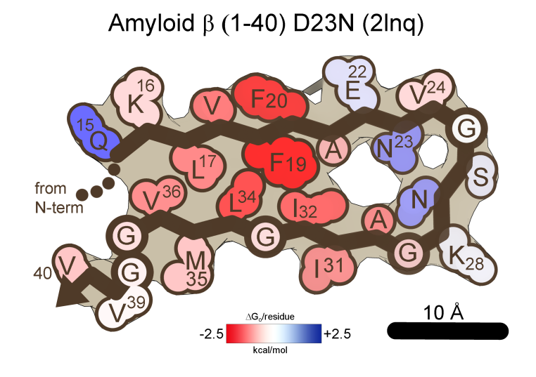
Aβ
26 residues ordered per chain
ΔH_{sol}= -23.1 kcal/mol/chain (-0.89 kcal/aa)
ΔG_{o} = -12.4 kcal/mol/chain (-0.48 kcal/aa)

Slide 3
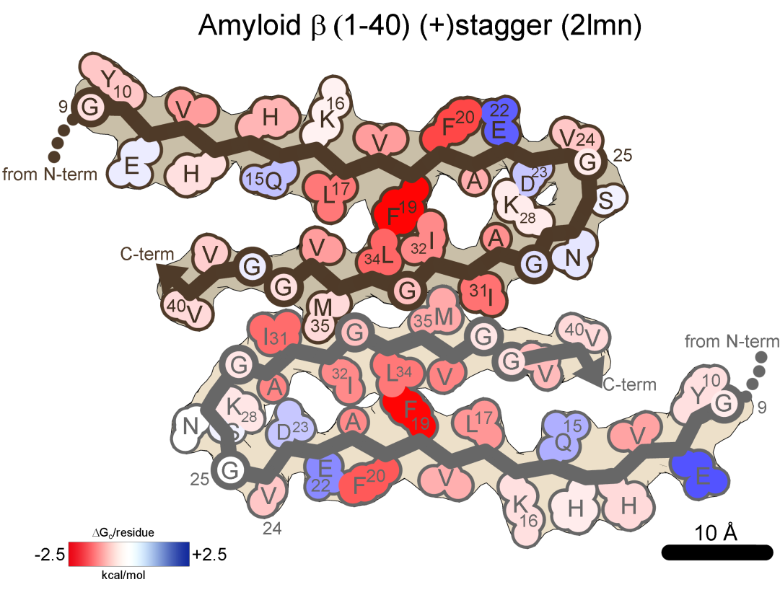
Aβ
32 residues ordered per chain
ΔH_{sol}= -30.1 kcal/mol/chain (-0.94 kcal/aa)
ΔG_{o} = -15.7 kcal/mol/chain (-0.49 kcal/aa)

Slide 4
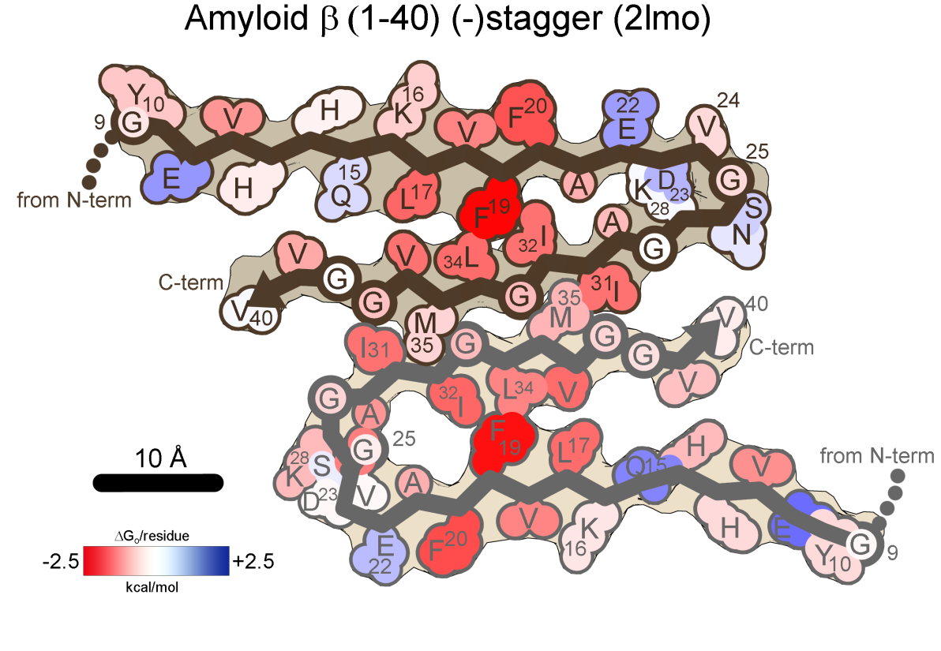
Aβ
32 residues ordered per chain
ΔH_{sol}= -31.2 kcal/mol/chain (-0.98 kcal/aa)
ΔG_{o} = -15.9 kcal/mol/chain (-0.50 kcal/aa)

Slide 5
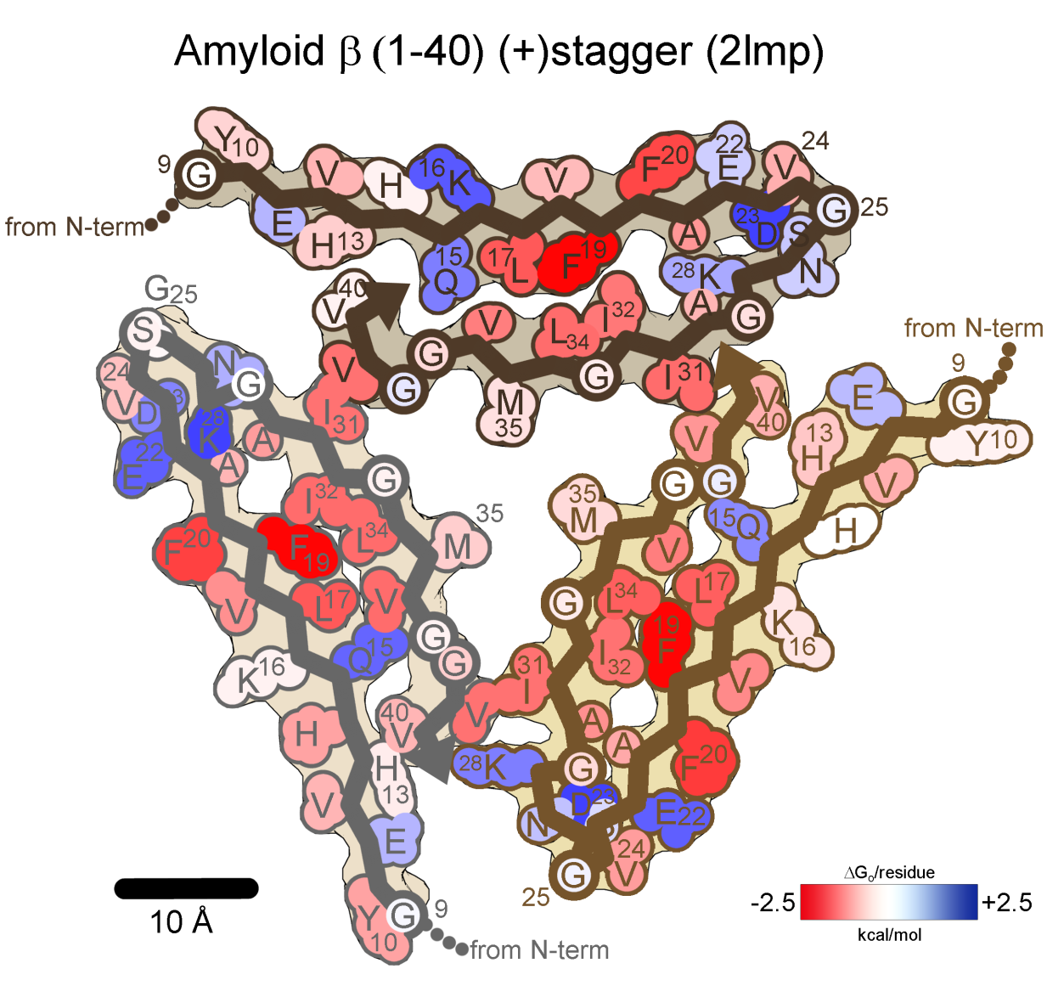
Aβ
32 residues ordered per chain
ΔH_{sol}= -26.9 kcal/mol/chain (-0.84 kcal/aa)
ΔG_{o} = -10.7 kcal/mol/chain (-0.33 kcal/aa)

Slide 6
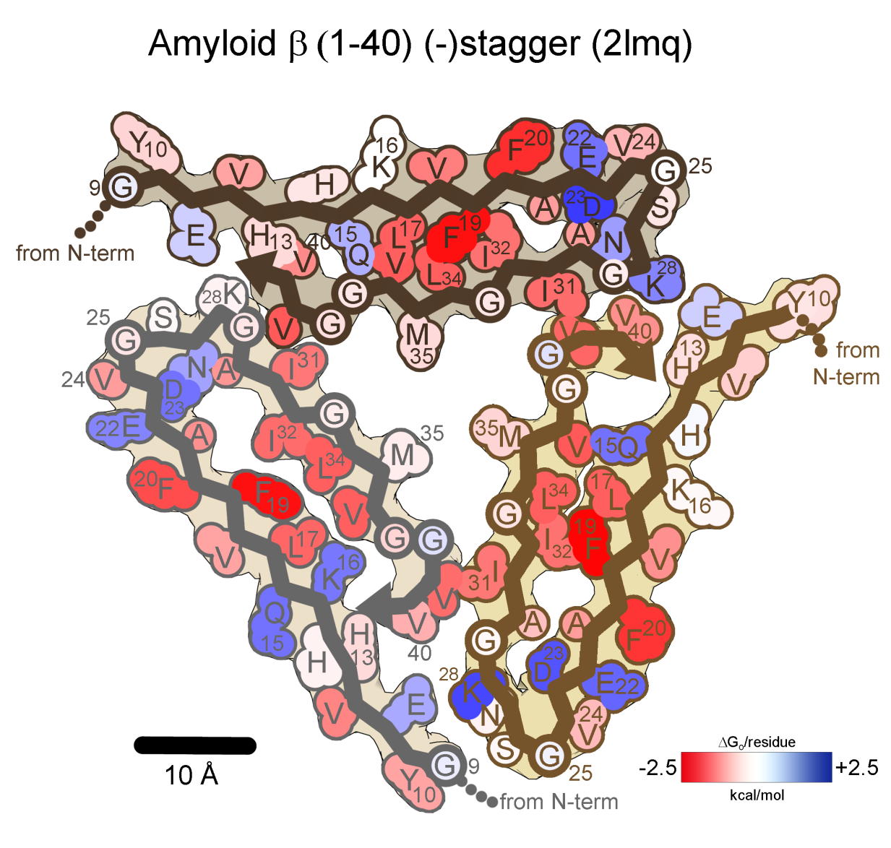
Aβ
32 residues ordered per chain
ΔH_{sol}= -31.1 kcal/mol/chain (-0.97 kcal/aa)
ΔG_{o} = -15.0 kcal/mol/chain (-0.47 kcal/aa)

Slide 7
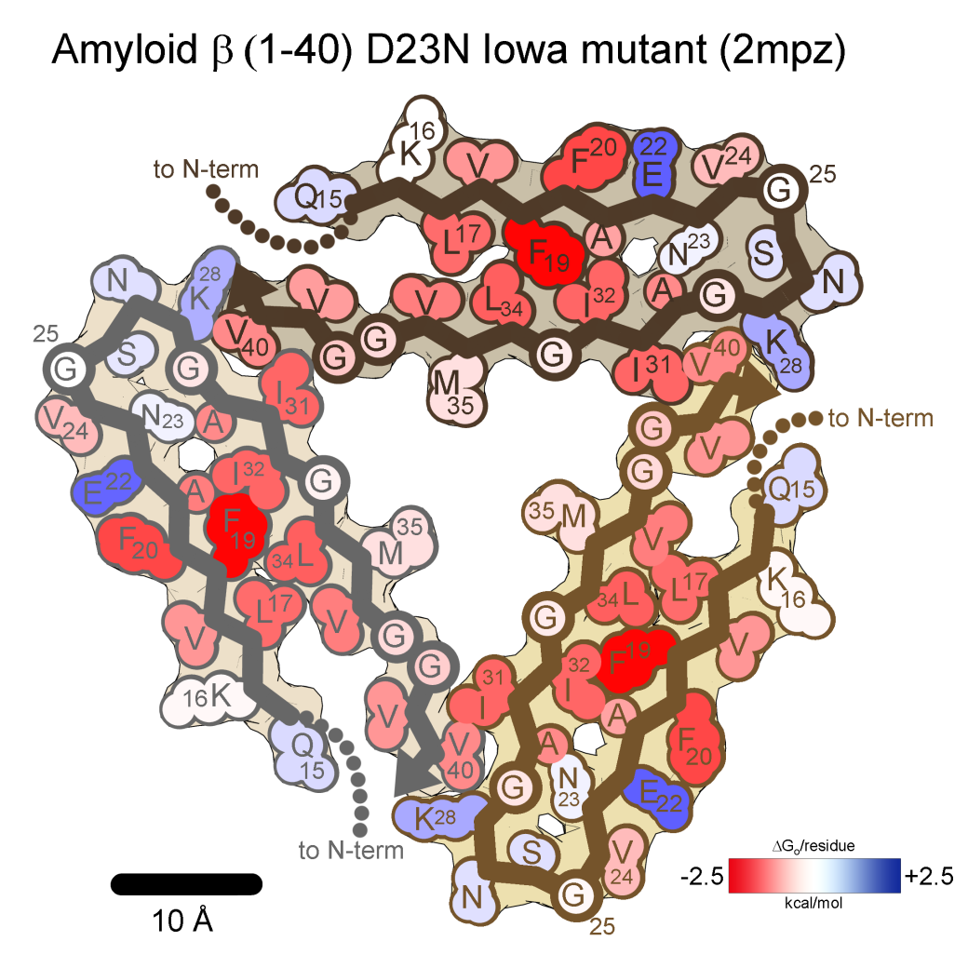
Aβ
26 residues ordered per chain
ΔH_{sol}= -28.3 kcal/mol/chain (-1.09 kcal/aa)
ΔG_{o} = -15.5 kcal/mol/chain (-0.60 kcal/aa)

Slide 8
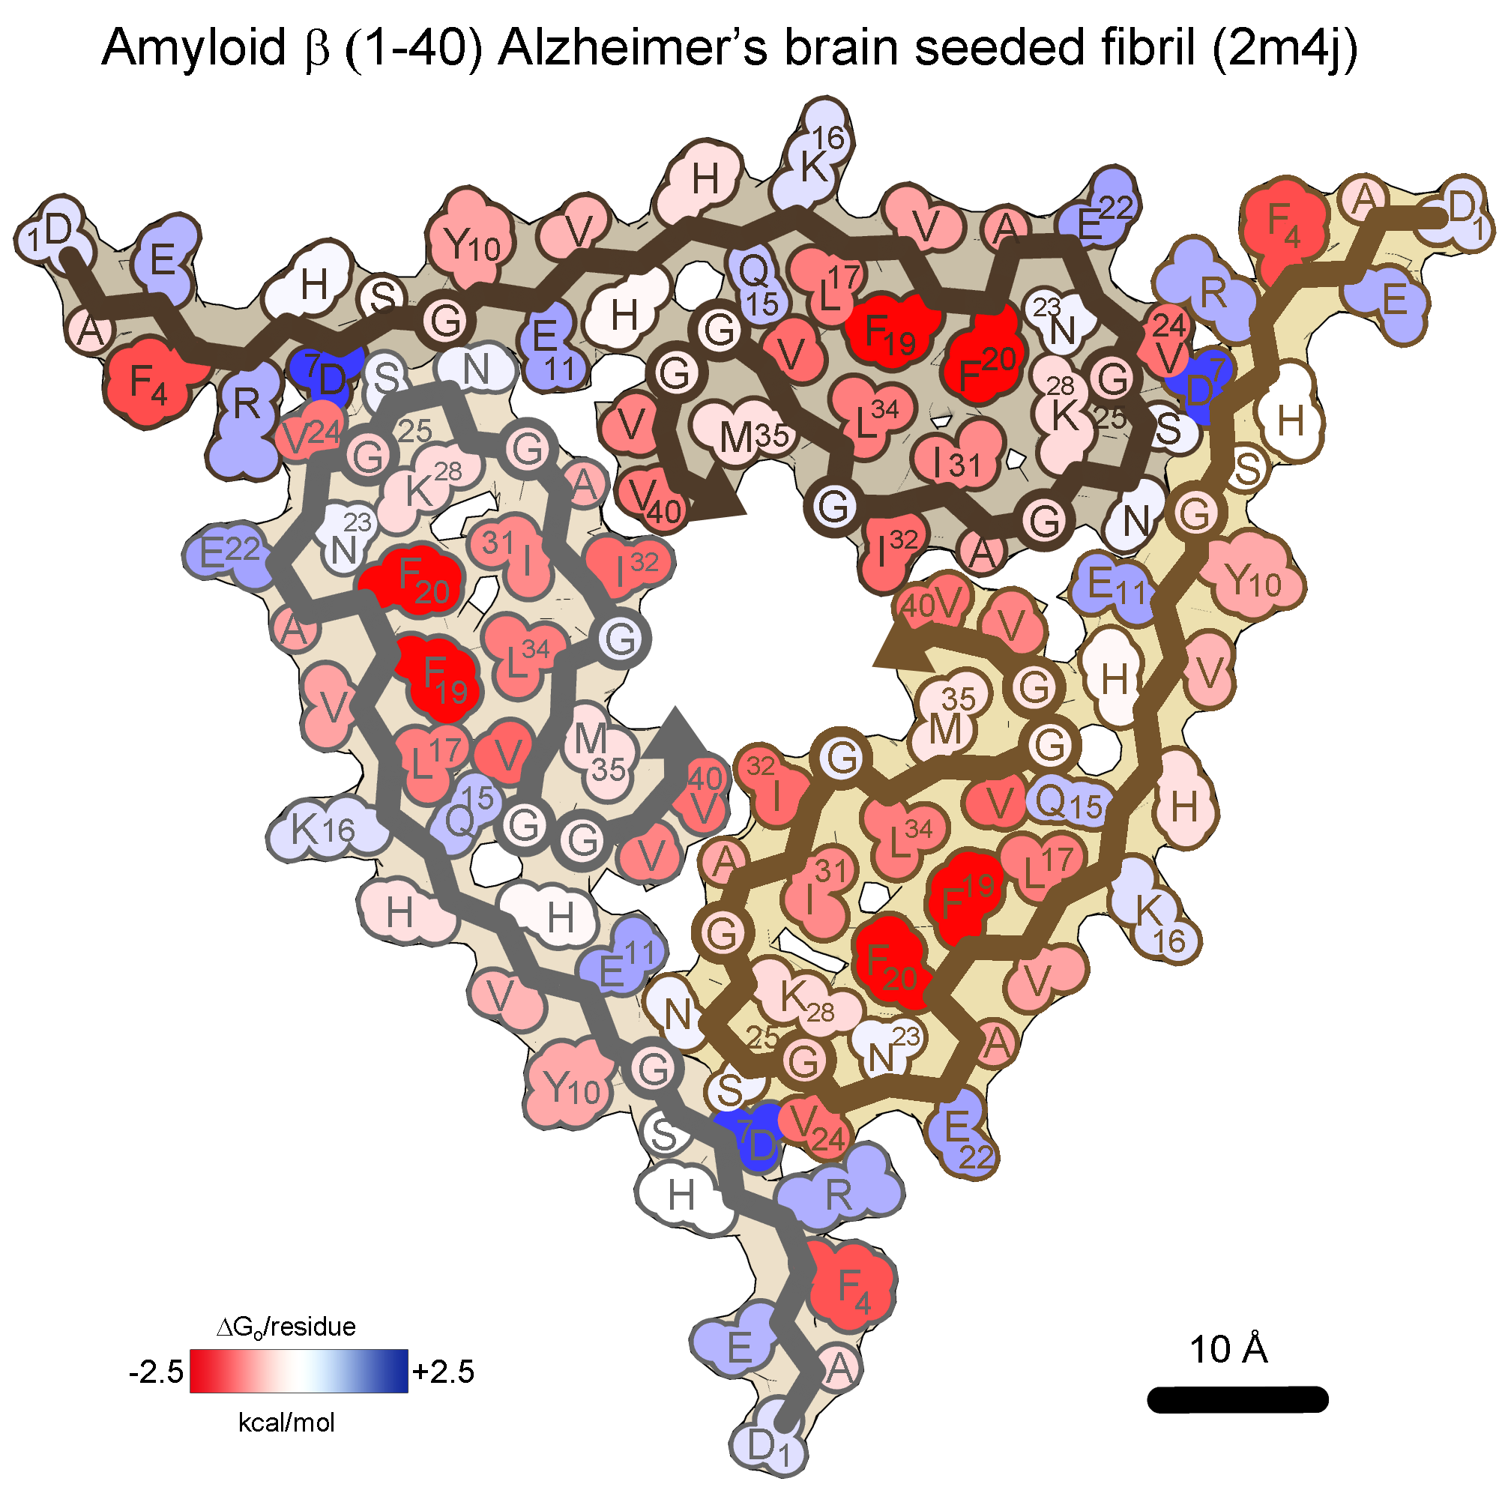
Aβ
32 residues ordered per chain
ΔH_{sol}= -39.0 kcal/mol/chain (-0.98 kcal/aa)
ΔG_{o} = -17.5 kcal/mol/chain (-0.44 kcal/aa)

Slide 9
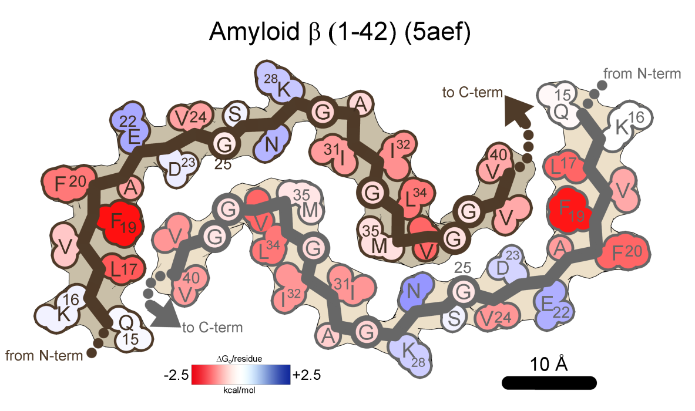
Aβ
26 residues ordered per chain
ΔH_{sol}= -25.1 kcal/mol/chain (-0.97 kcal/aa)
ΔG_{o} = -14.4 kcal/mol/chain (-0.55 kcal/aa)

Slide 10
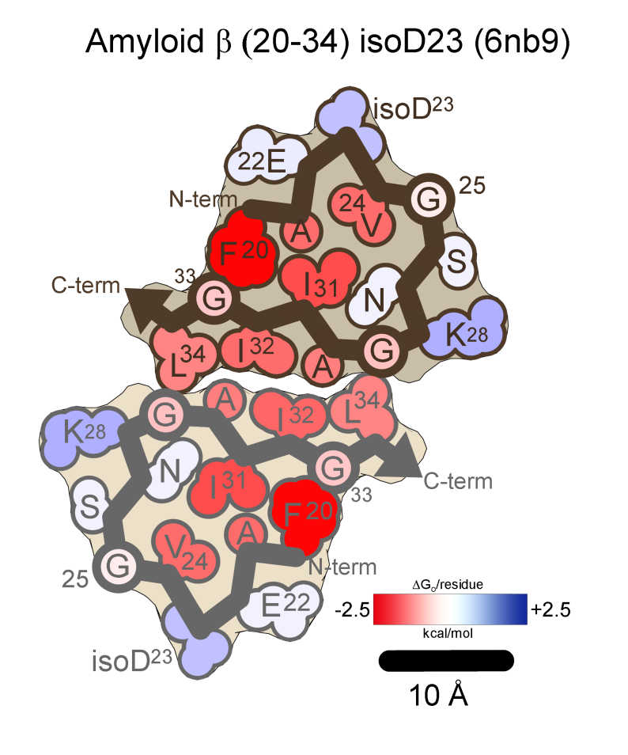
Aβ
15 residues ordered per chain
ΔH_{sol}= -17.1 kcal/mol/chain (-1.14 kcal/aa)
ΔG_{o} = -10.5 kcal/mol/chain (-0.70 kcal/aa)

Slide 11
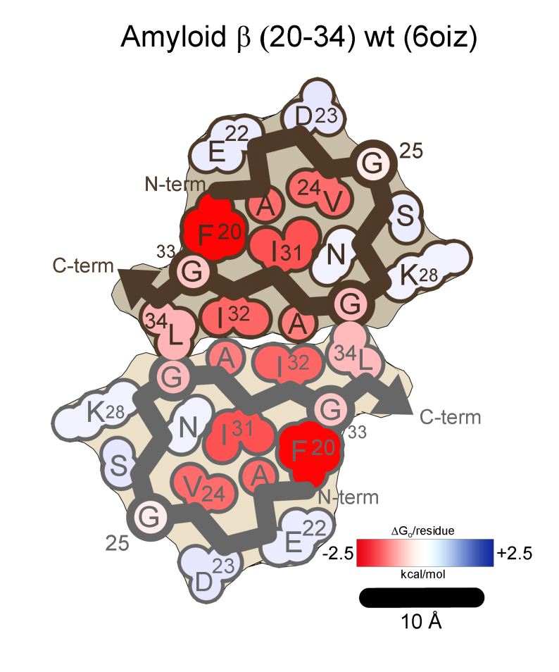
Aβ
15 residues ordered per chain
ΔH_{sol}= -18.0 kcal/mol/chain (-1.20 kcal/aa)
ΔG_{o} = -11.2 kcal/mol/chain (-0.74 kcal/aa)

Slide 12
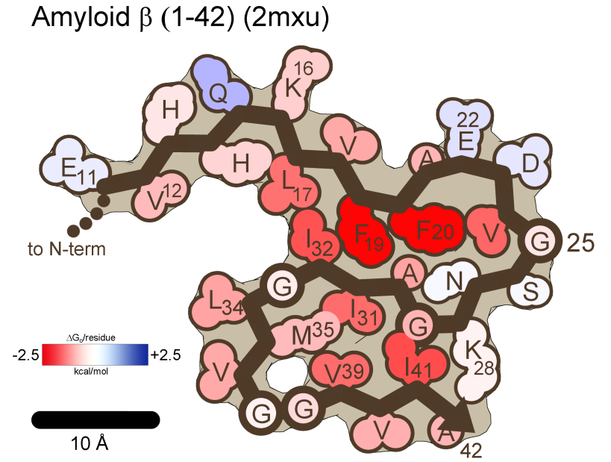
Aβ
32 residues ordered per chain
ΔH_{sol}= -38.0 kcal/mol/chain (-1.19 kcal/aa)
ΔG_{o} = -22.5 kcal/mol/chain (-0.70 kcal/aa)

Slide 13
Aβ
28 residues ordered per chain
ΔH_{sol}= -37.6 kcal/mol/chain (-1.34 kcal/aa)
ΔG_{o} = -22.3 kcal/mol/chain (-0.80 kcal/aa)

Slide 14
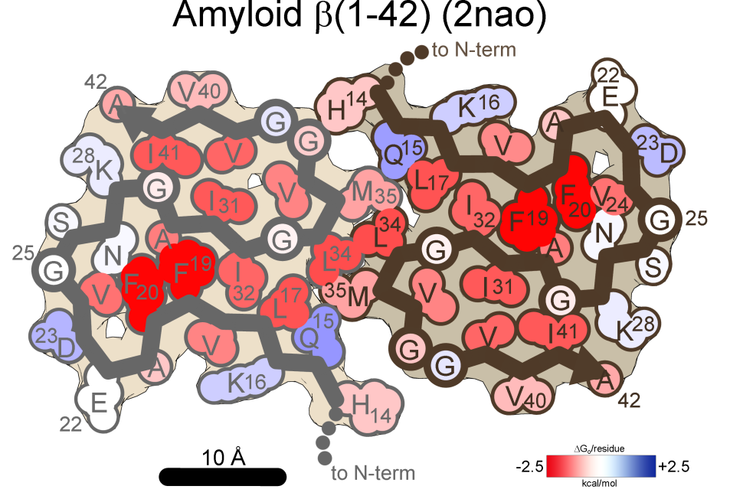
Aβ
29 residues ordered per chain
ΔH_{sol}= -36.4 kcal/mol/chain (-1.26 kcal/aa)
ΔG_{o} = -21.0 kcal/mol/chain (-0.72 kcal/aa)

Slide 15
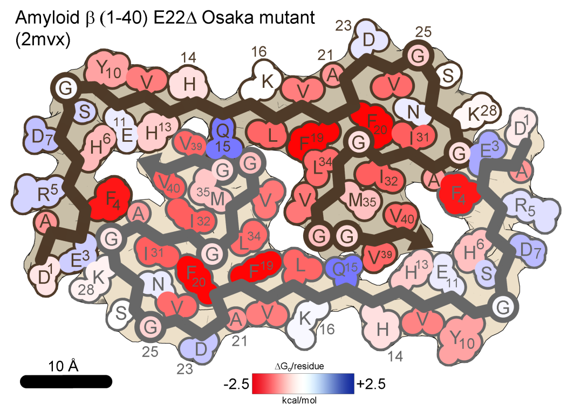
Aβ
39 residues ordered per chain
ΔH_{sol}= -47.7 kcal/mol/chain (-1.22 kcal/aa)
ΔG_{o} = -25.4 kcal/mol/chain (-0.65 kcal/aa)

Slide 16
Aβ
42 residues ordered per chain
ΔH_{sol}= -49.0 kcal/mol/chain (-1.17 kcal/aa)
ΔG_{o} = -25.8 kcal/mol/chain (-0.62 kcal/aa)

Slide 17
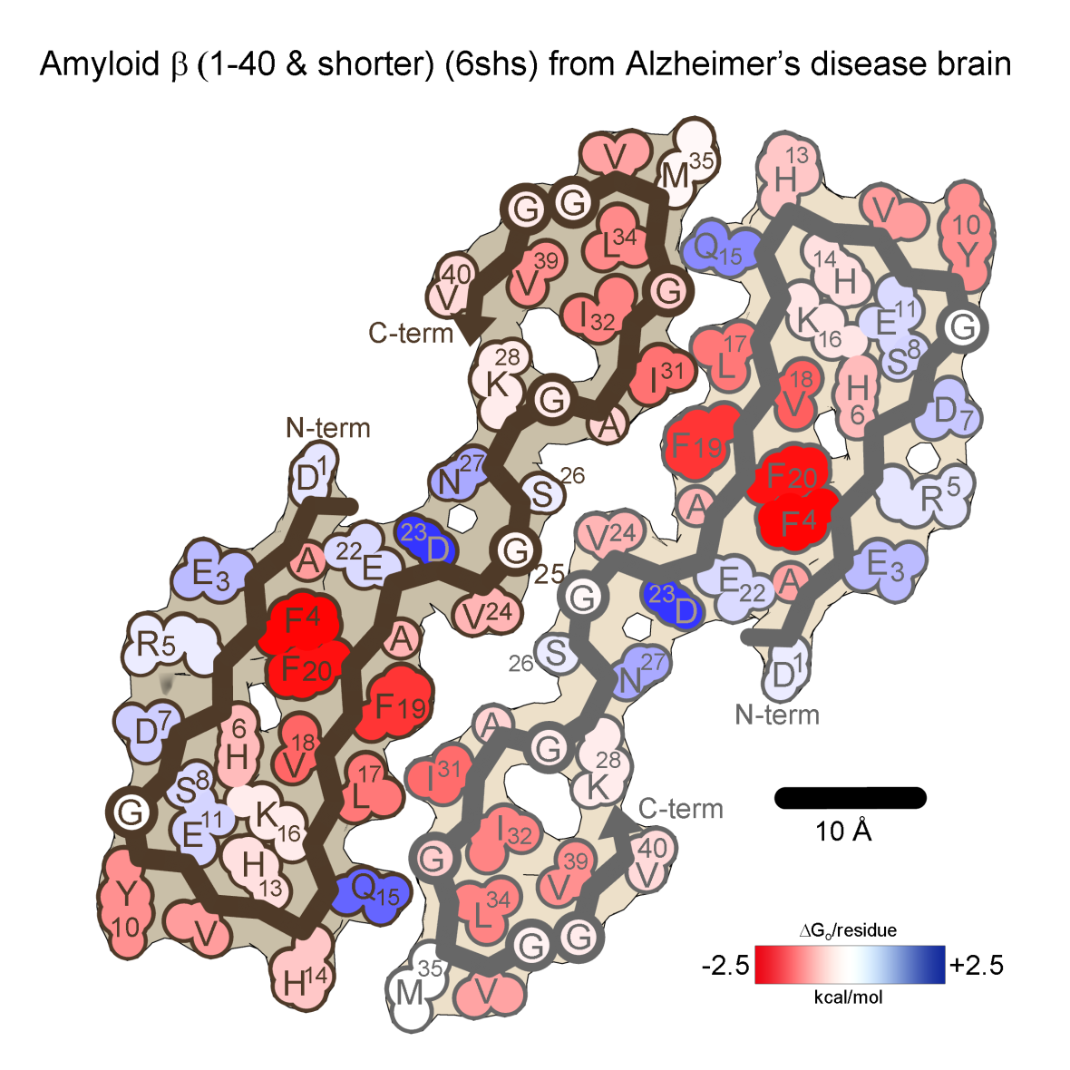
Aβ
42 residues ordered per chain
ΔH_{sol}= -38.1 kcal/mol/chain (-0.95 kcal/aa)
ΔG_{o} = -16.6 kcal/mol/chain (-0.42 kcal/aa)

Slide 18
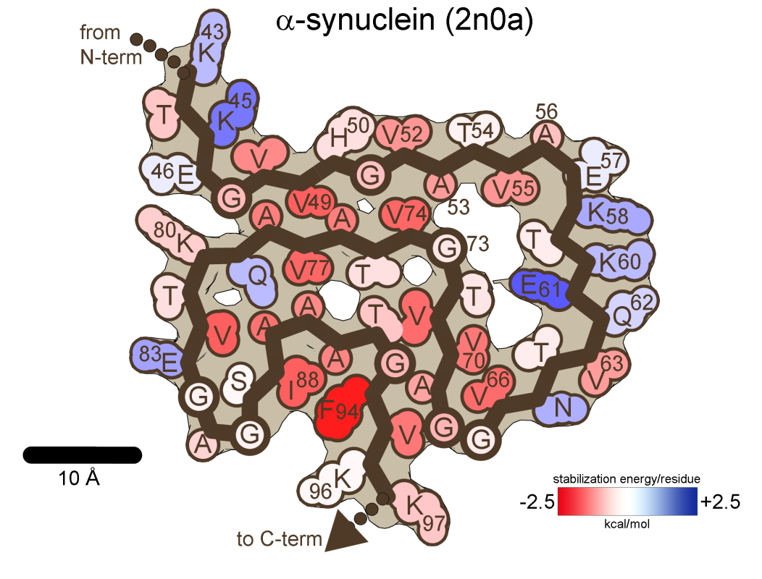
αsyn
55 residues ordered per chain
ΔH_{sol}= -52.8 kcal/mol/chain(-0.96 kcal/aa)
ΔG_{o} = -27.3 kcal/mol/chain(-0.50 kcal/aa)

Slide 19
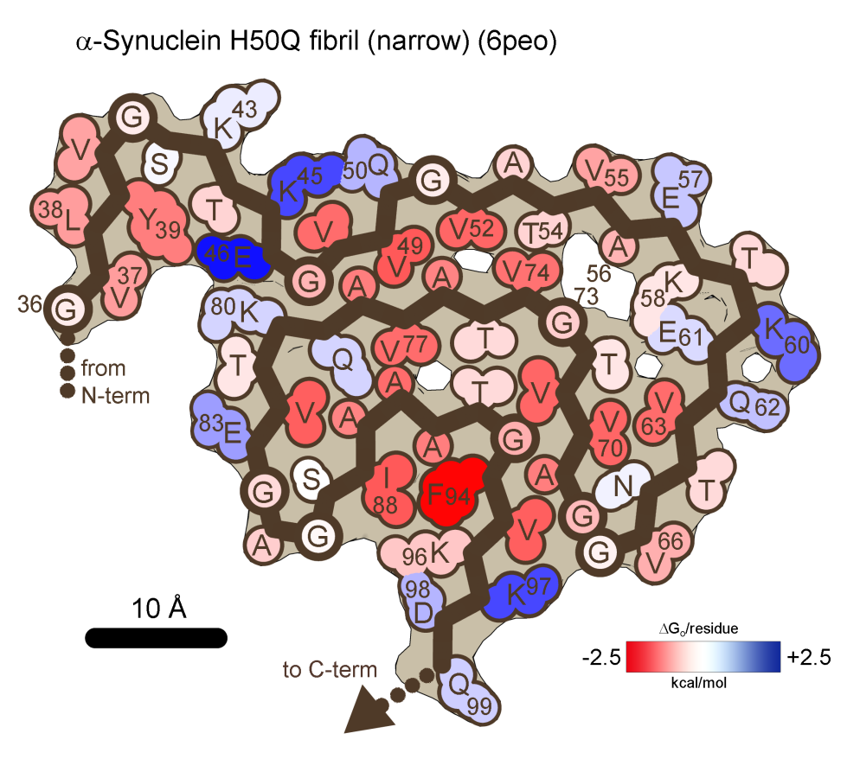
αsyn
64 residues ordered per chain
ΔH_{sol}= -60.5 kcal/mol/chain(-0.95 kcal/aa)
ΔG_{o} = -29.1 kcal/mol/chain(-0.46 kcal/aa)

Slide 20
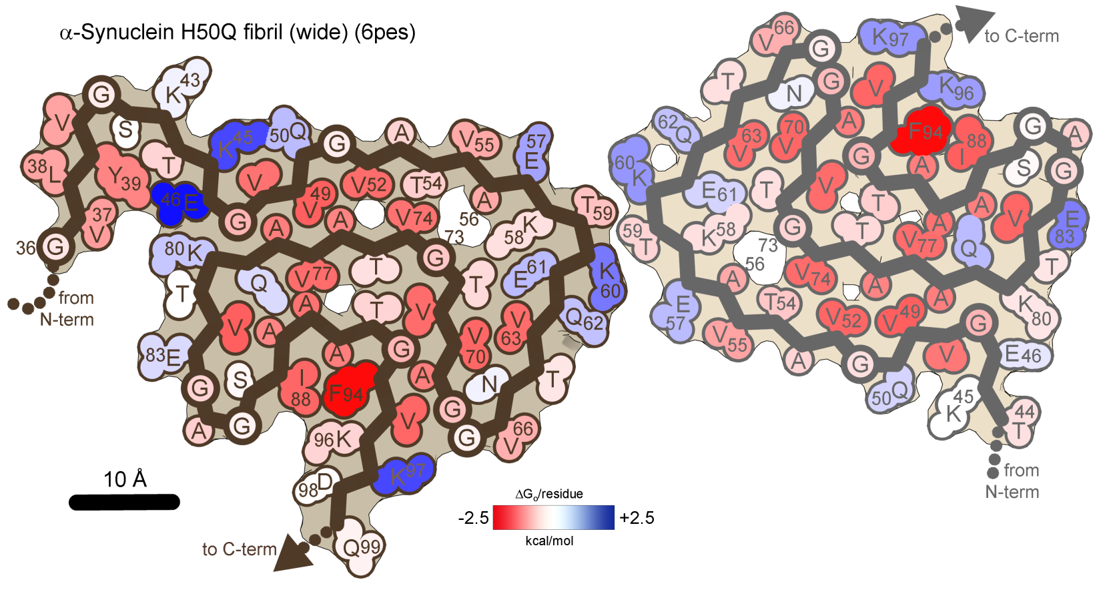
αsyn
64 residues ordered per chain
ΔH_{sol}= -61.8 kcal/mol/chain(-0.97 kcal/aa)
ΔG_{o} = -29.1 kcal/mol/chain(-0.46 kcal/aa)

Slide 21
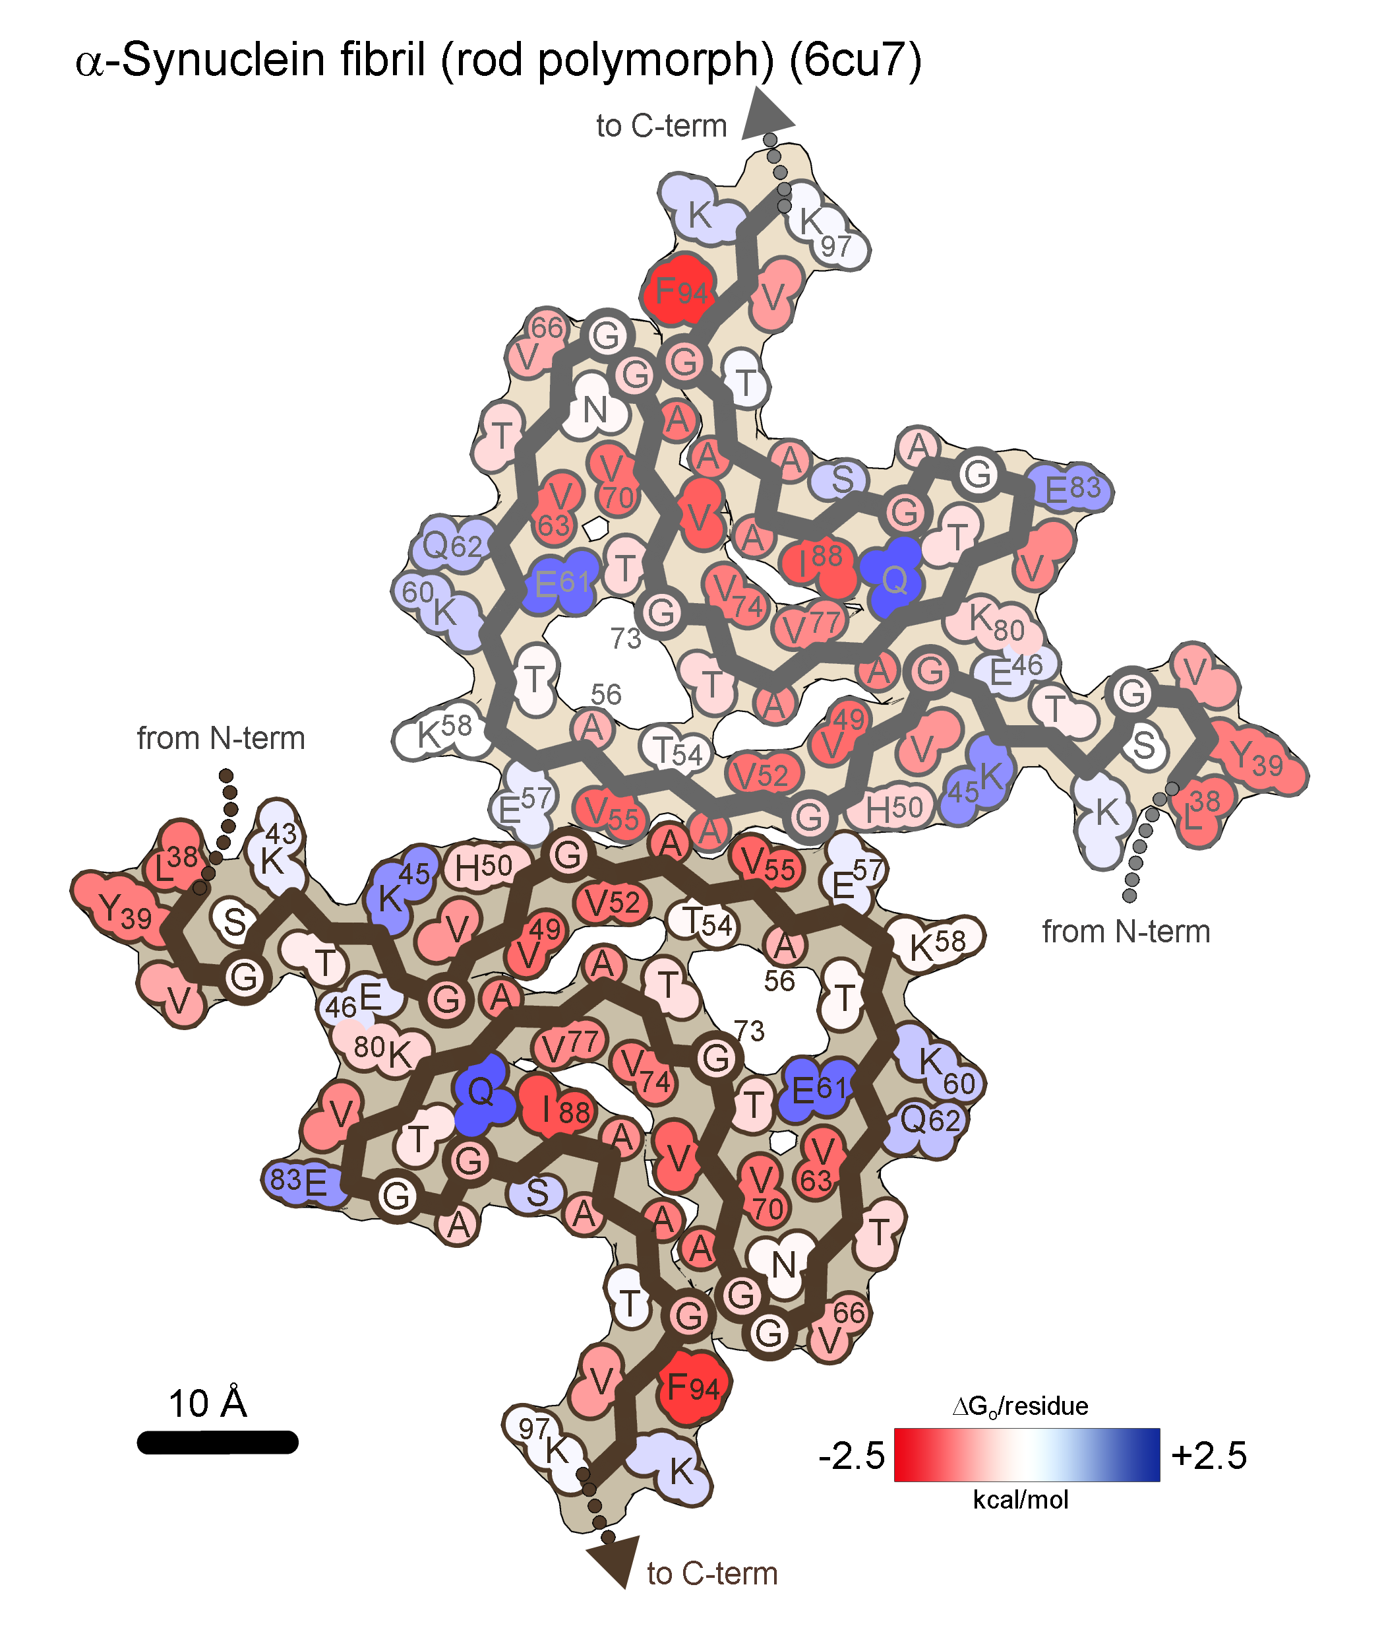
αsyn
60 ordered residues per chain
ΔH_{sol}= -57.7 kcal/mol/chain(-0.96 kcal/aa)
ΔG_{o} = -29.3 kcal/mol/chain(-0.49 kcal/aa)

Slide 22
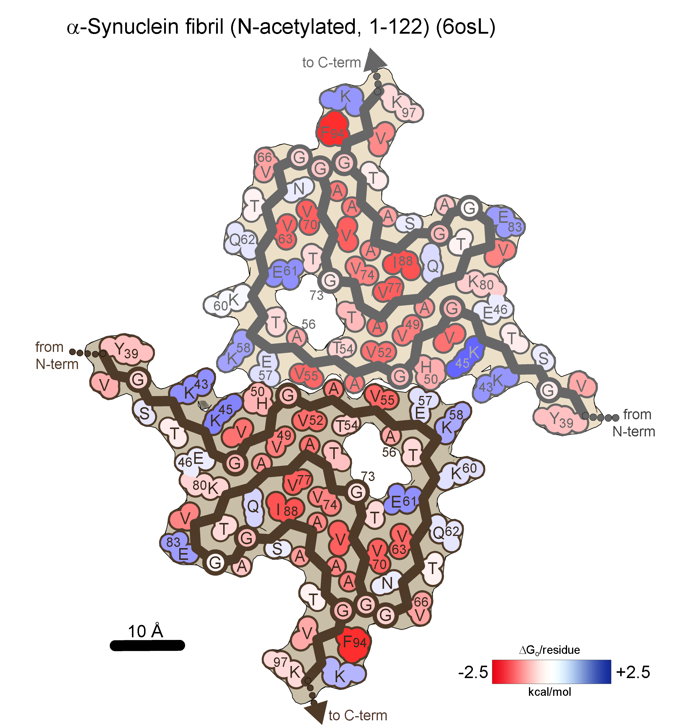
αsyn
59 residues ordered per chain
ΔH_{sol}= -59.7 kcal/mol/chain(-1.01 kcal/aa)
ΔG_{o} = -31.1 kcal/mol/chain(-0.53 kcal/aa)

Slide 23
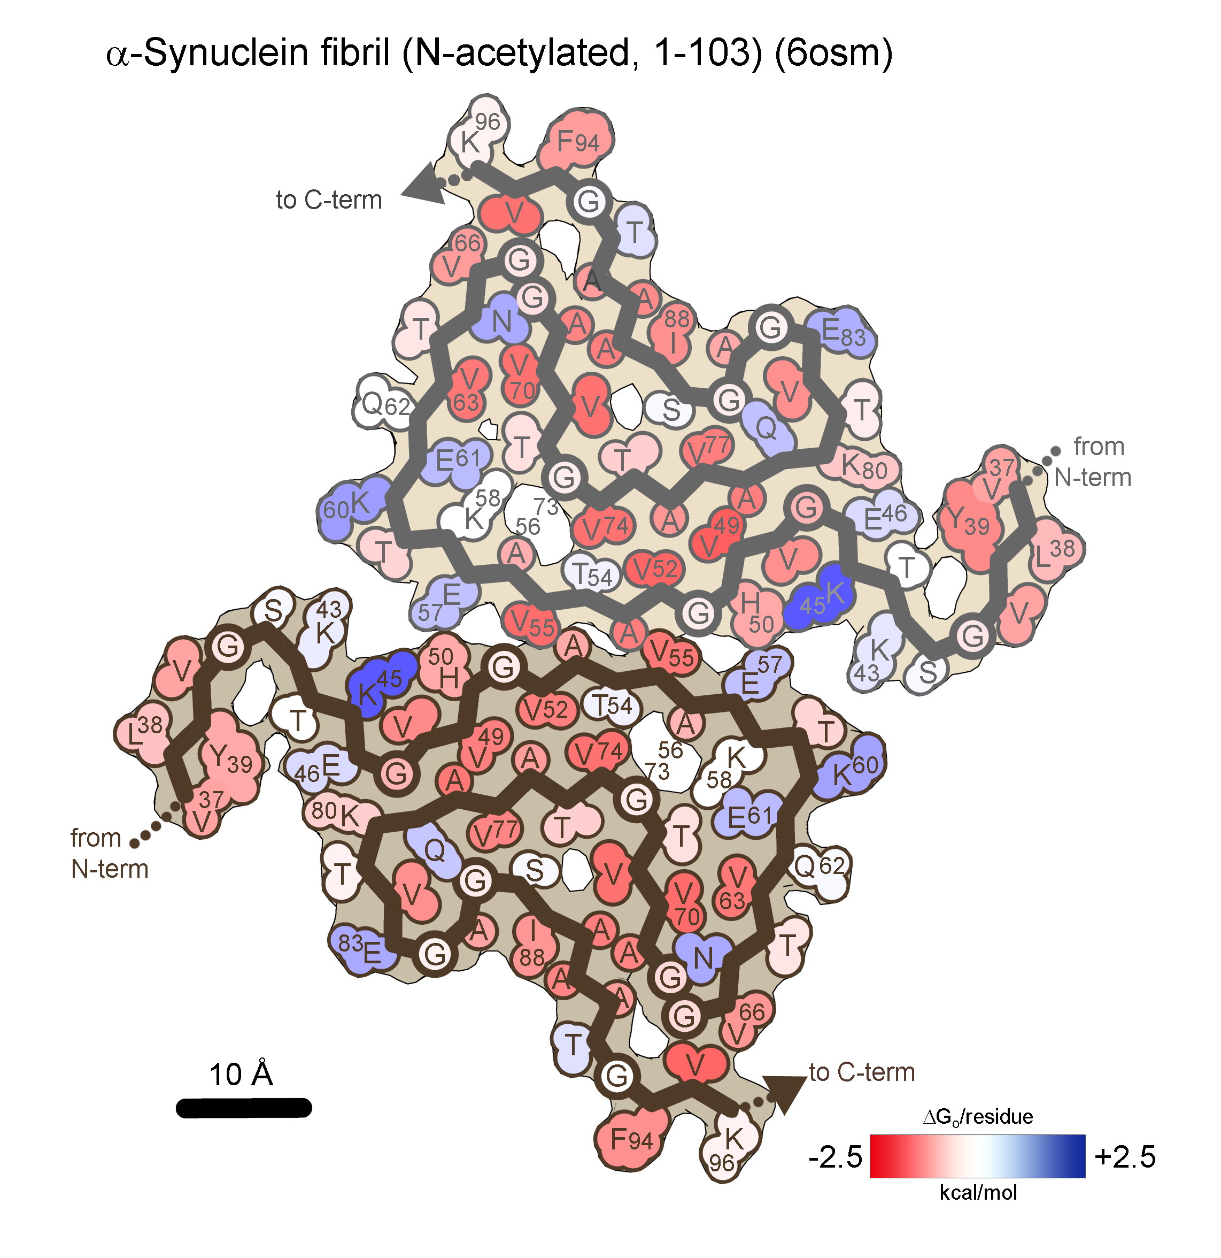
αsyn
60 residues ordered per chain
ΔH_{sol}= -56.7 kcal/mol/chain (-0.95 kcal/aa)
ΔG_{o} = -28.1 kcal/mol/chain (-0.47 kcal/aa)

Slide 24
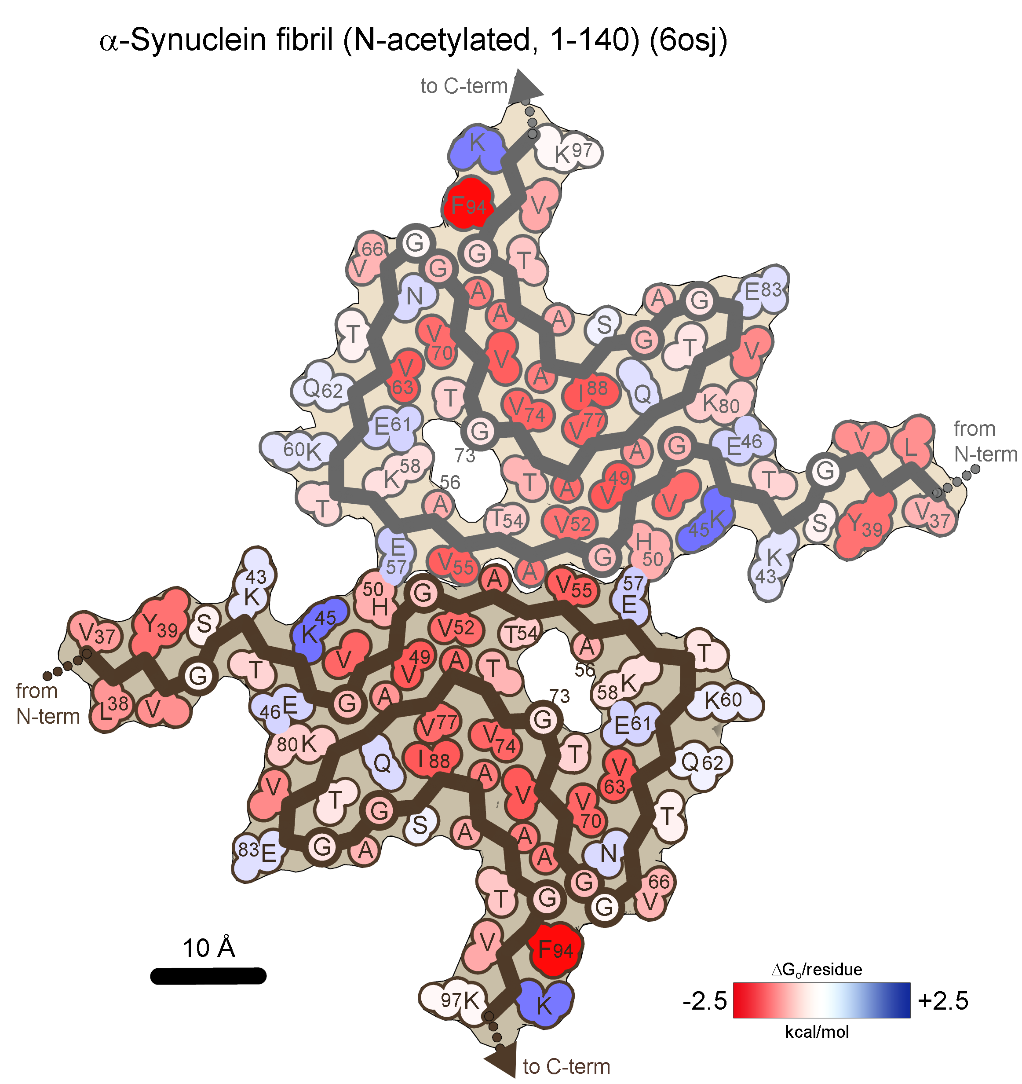
αsyn
61 residues ordered per chain
ΔH_{sol}= -66.6 kcal/mol/chain (-1.09 kcal/aa)
ΔG_{o} = -36.9 kcal/mol/chain (-0.60 kcal/aa)

Slide 25
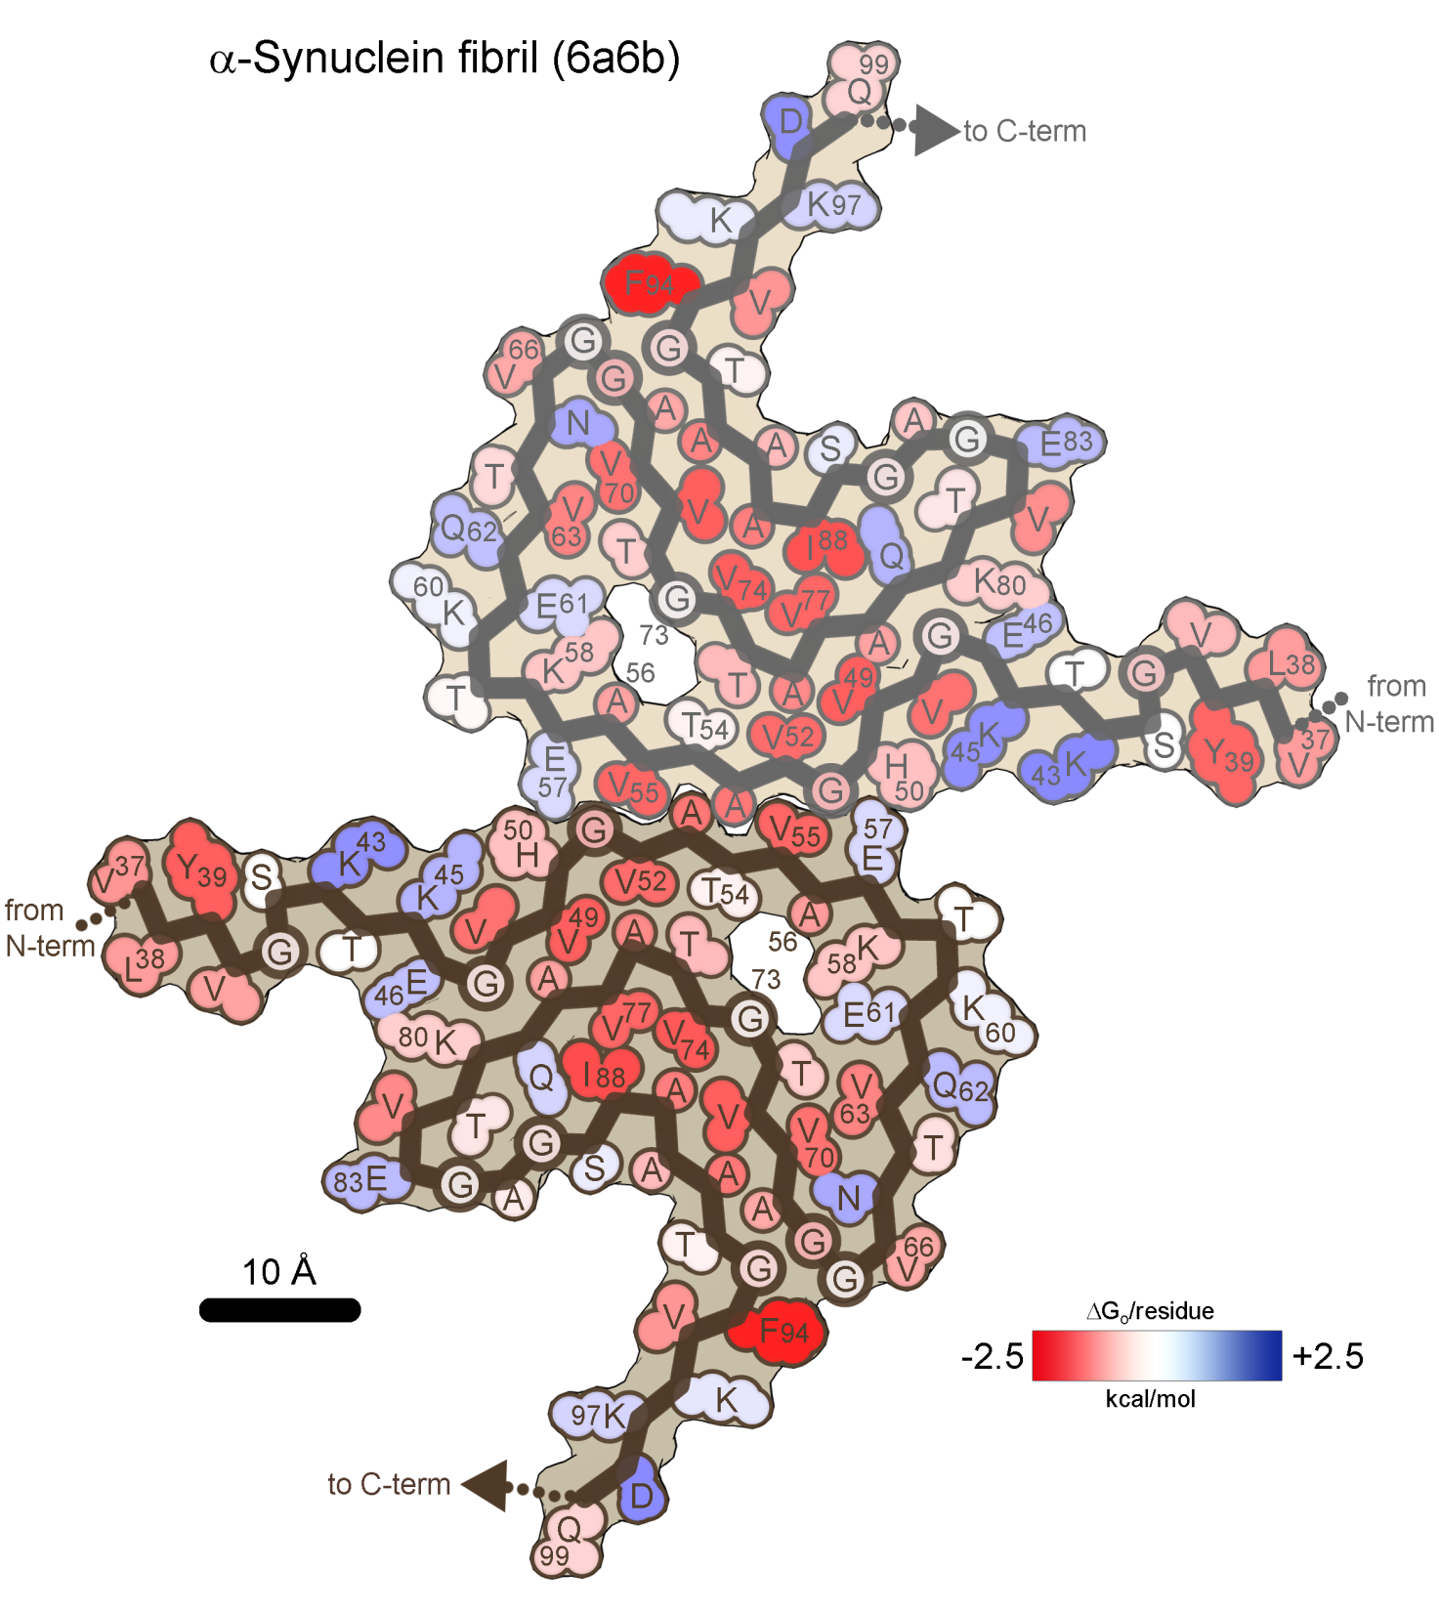
αsyn
63 residues ordered per chain
ΔH_{sol}= -61.9 kcal/mol/chain(-0.98 kcal/aa)
ΔG_{o} = -30.6 kcal/mol/chain(-0.49 kcal/aa)

Slide 26
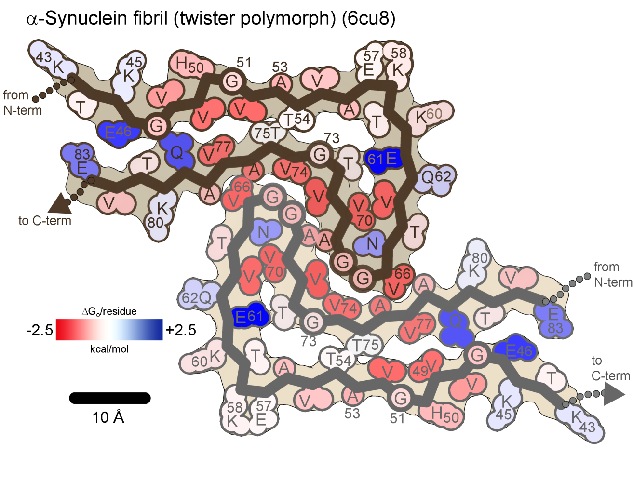
αsyn
41 residues ordered per chain
ΔH_{sol}= -33.3 kcal/mol/41aa (-0.81 kcal/aa)
ΔG_{o} = -12.4 kcal/mol/chain (-0.30 kcal/aa)

Slide 27
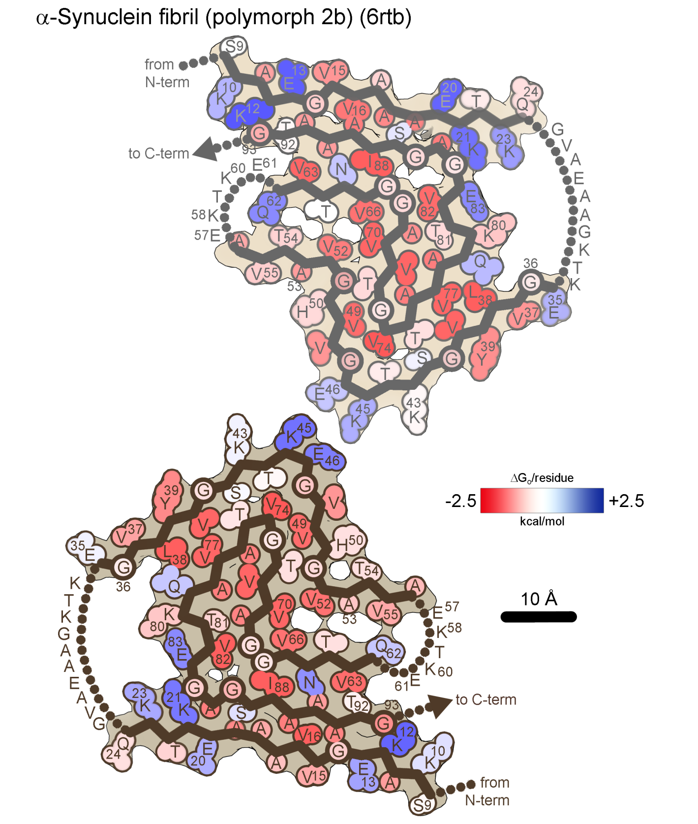
αsyn
70 residues ordered per chain
ΔH_{sol}= -63.7 kcal/mol/chain (-0.91 kcal/aa)
ΔG_{o} = -33.0 kcal/mol/chain (-0.47 kcal/aa)

Slide 28
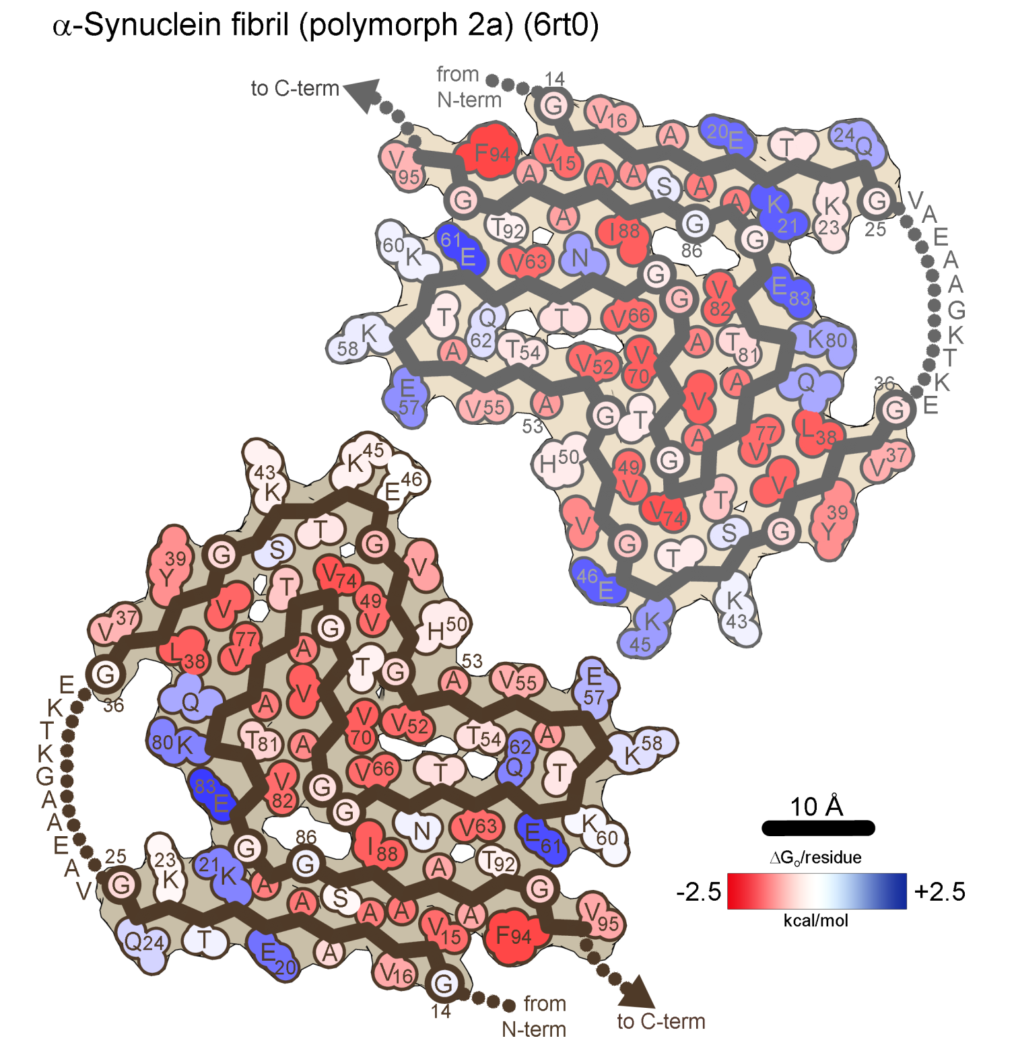
αsyn
72 residues ordered per chain
ΔH_{sol}= -63.5 kcal/mol/chain (-0.88 kcal/aa)
ΔG_{o} = -31.0 kcal/mol/chain (-0.43 kcal/aa)

Slide 29
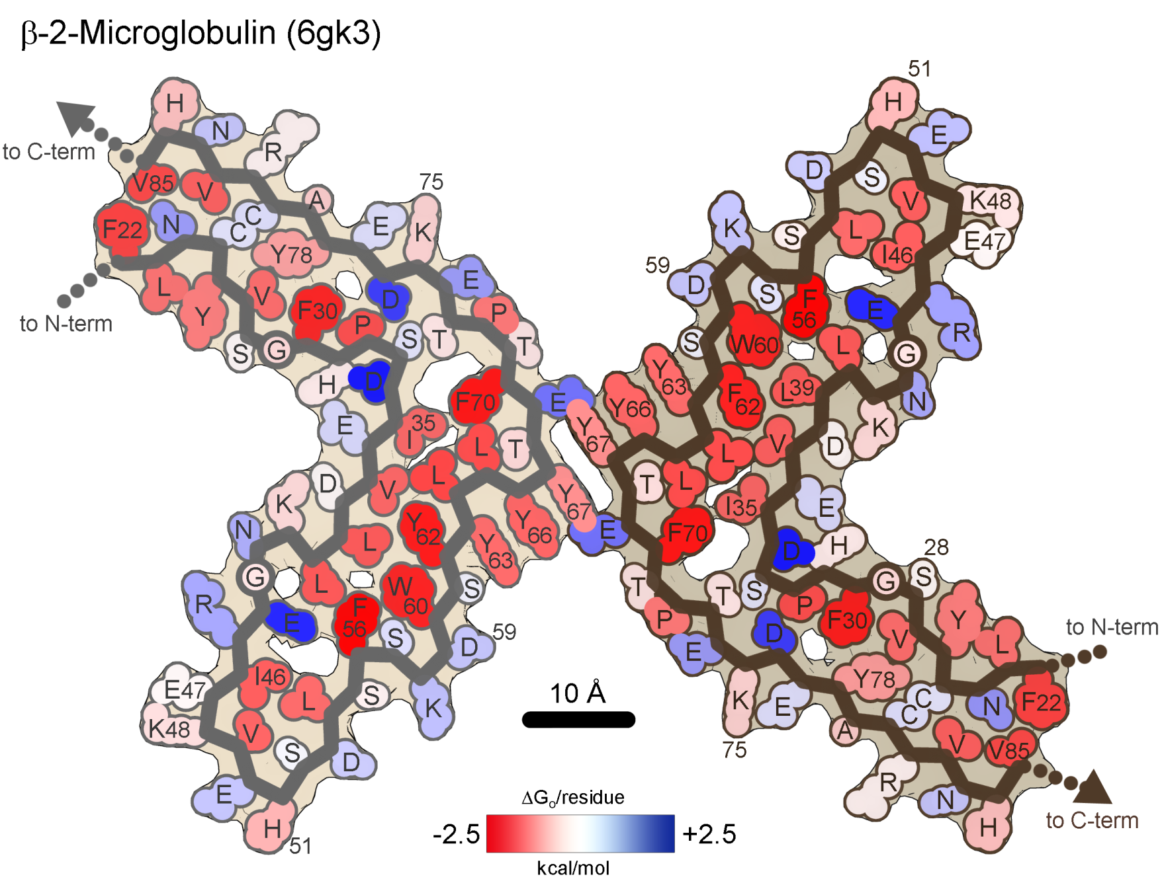
β2m
64 residues ordered per chain
ΔH_{sol}= -74.0 kcal/mol/chain (-1.16 kcal/aa)
ΔG_{o} = -31.5 kcal/mol/chain (-0.49 kcal/aa)

Slide 30
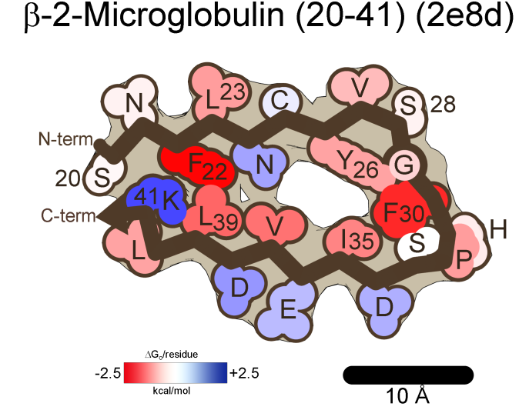
β2m
22 residues ordered per chain
ΔH_{sol}= -20.1 kcal/mol/chain (-0.92 kcal/aa)
ΔG_{o} = -8.4 kcal/mol/chain (-0.38 kcal/aa)

Slide 31
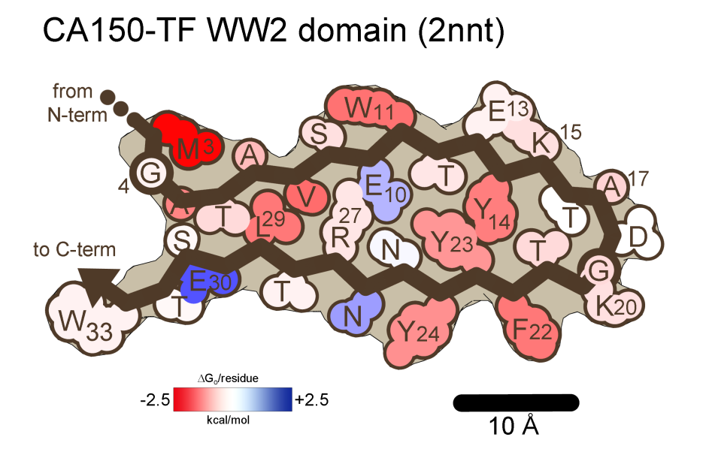
CA150
31 residues ordered per chain
ΔH_{sol}= -33.6 kcal/mol/chain (-1.08 kcal/aa)
ΔG_{o} = -16.0 kcal/mol/chain (-0.52 kcal/aa)

Slide 32
FUS
FUS
61 residues ordered per chain
ΔH_{sol}= -41.6 kcal/mol/chain (-0.68 kcal/aa)
ΔG_{o} = -12.2 kcal/mol/chain (-0.20 kcal/aa)

Slide 33
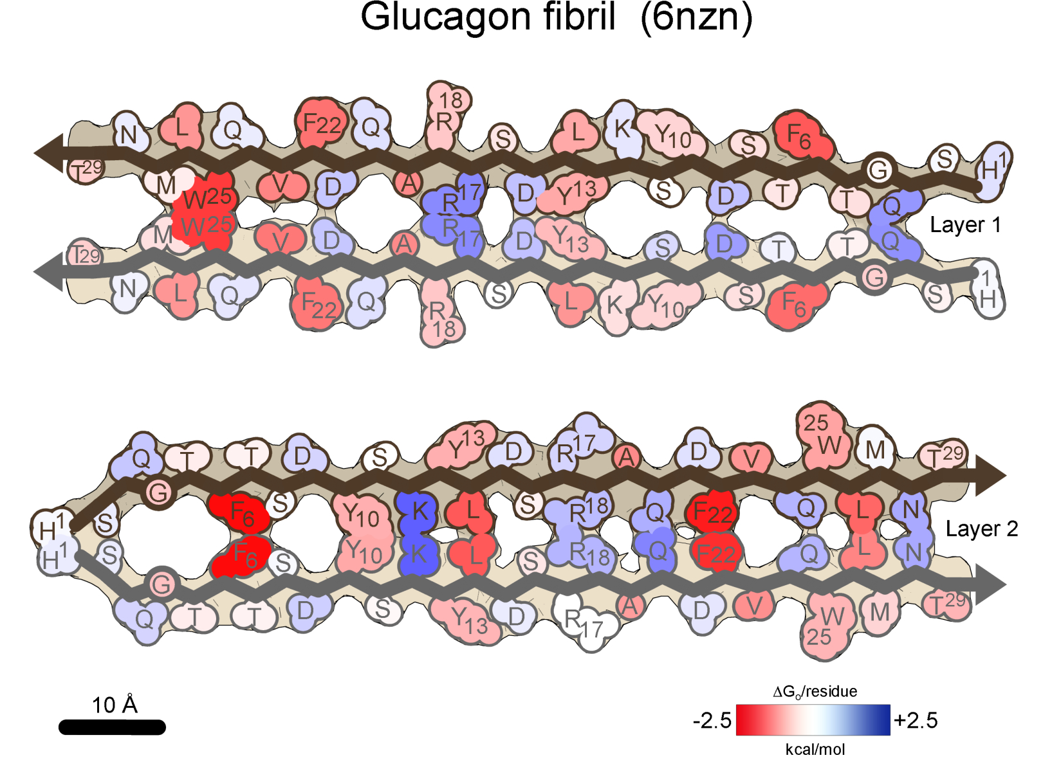
FUS
Glucagon
29 residues ordered per chain
ΔH_{sol}= -21.0 kcal/mol/chain (-0.73 kcal/aa)
ΔG_{o} = -5.0 kcal/mol/chain (-0.17 kcal/aa)

Slide 34
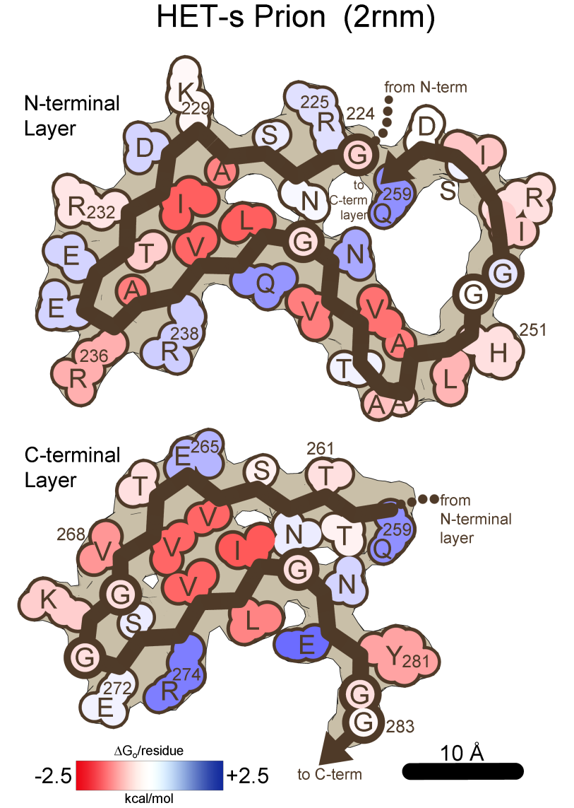
FUS
HETs
60 residues ordered per layer
ΔH_{sol}= -45.4 kcal/mol/chain (-0.76 kcal/aa)
ΔG_{o} = -18.2 kcal/mol/chain (-0.30 kcal/aa)

Slide 35
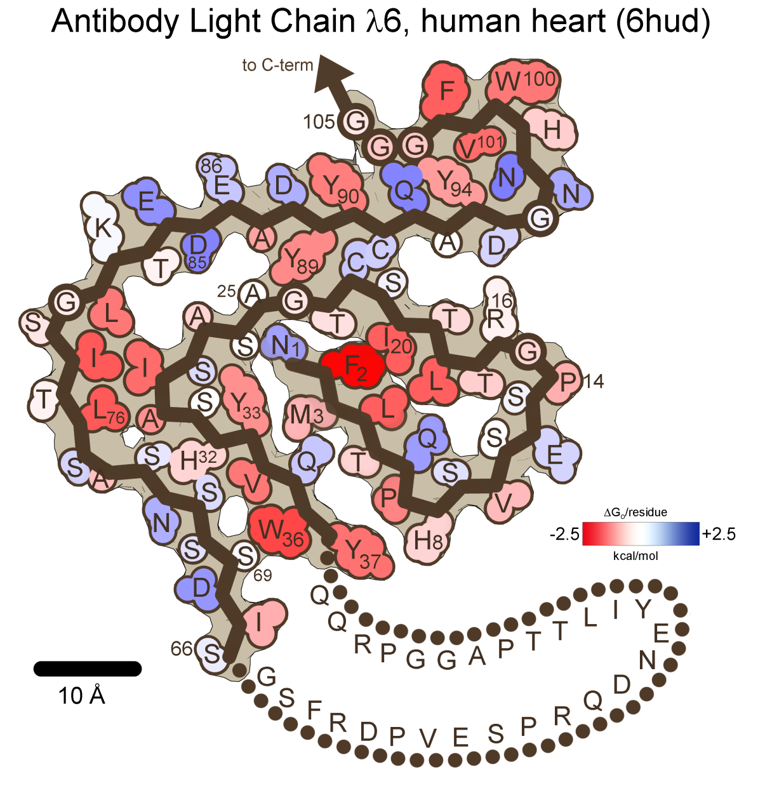
LC
77 residues ordered per chain
ΔH_{sol}= -63.1 kcal/mol/chain (-0.82 kcal/aa)
ΔG_{o} = -23.3 kcal/mol/chain (-0.30 kcal/aa)

Slide 36
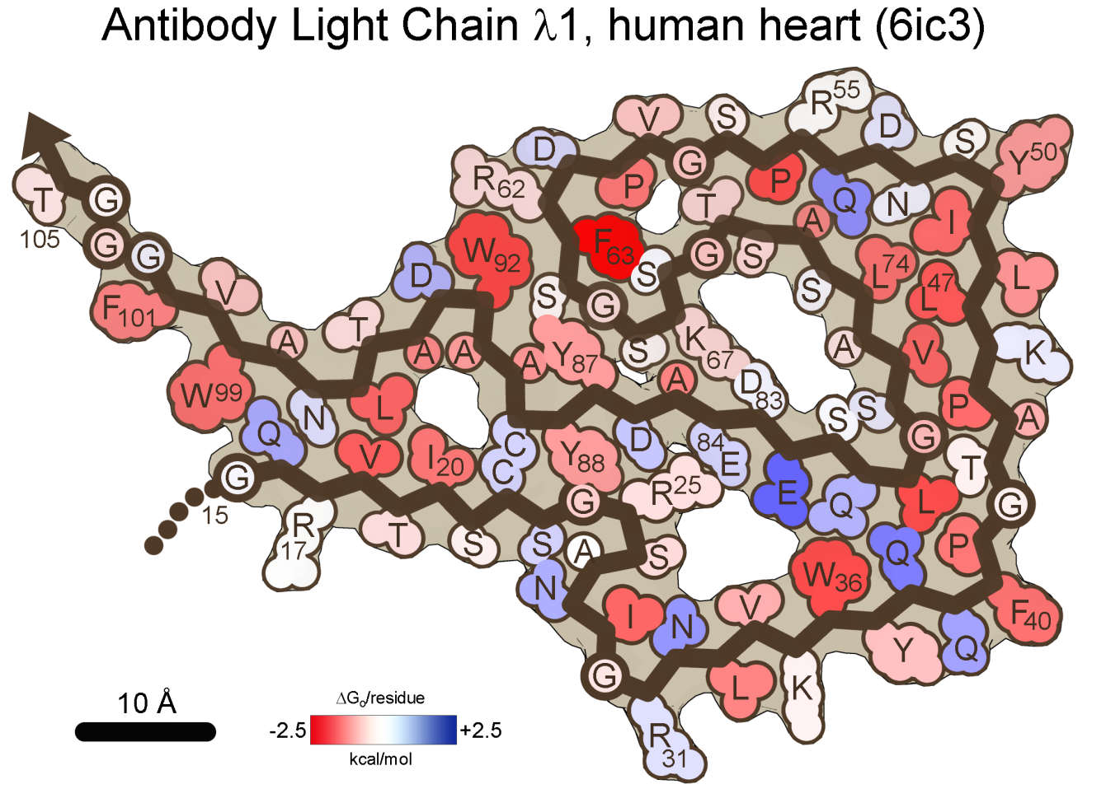
LC
91 residues ordered per chain
ΔH_{sol}= -84.7 kcal/mol/chain (-0.93 kcal/aa)
ΔG_{o} = -37.5 kcal/mol/chain (-0.41 kcal/aa)

Slide 37
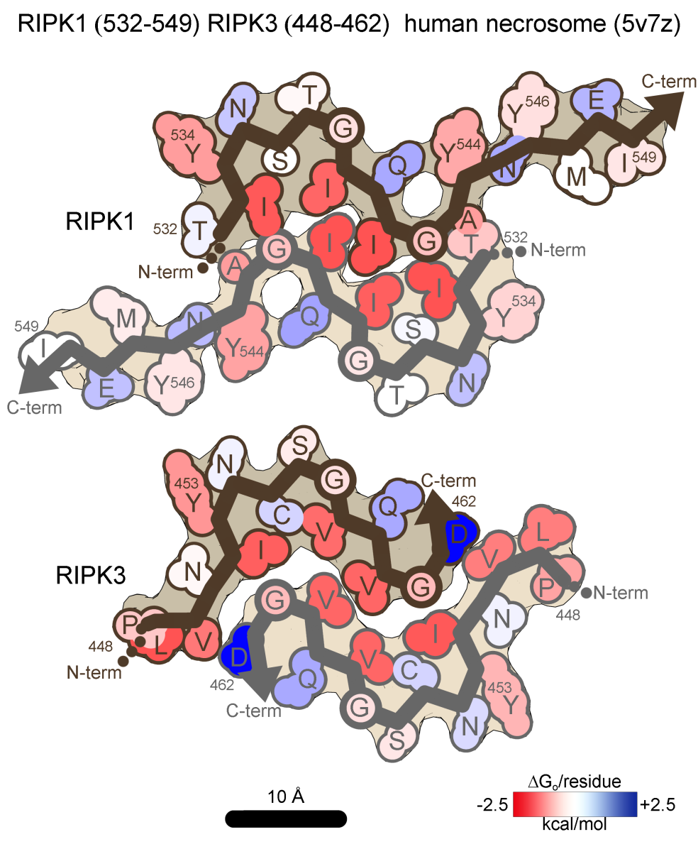
RIPK1 RIPK3
RIPK1 18aa residues ordered per chain
ΔH_{sol}= -14.5 kcal/mol/chain (-0.80 kcal/aa)
ΔG_{o} = -6.1 kcal/mol/chain (-0.34 kcal/aa)
RIPK3 15aa residues ordered per chain
ΔH_{sol}= -12.5 kcal/mol/chain (-0.84 kcal/aa)
ΔG_{o} = -5.3 kcal/mol/chain (-0.35 kcal/aa)

Slide 38
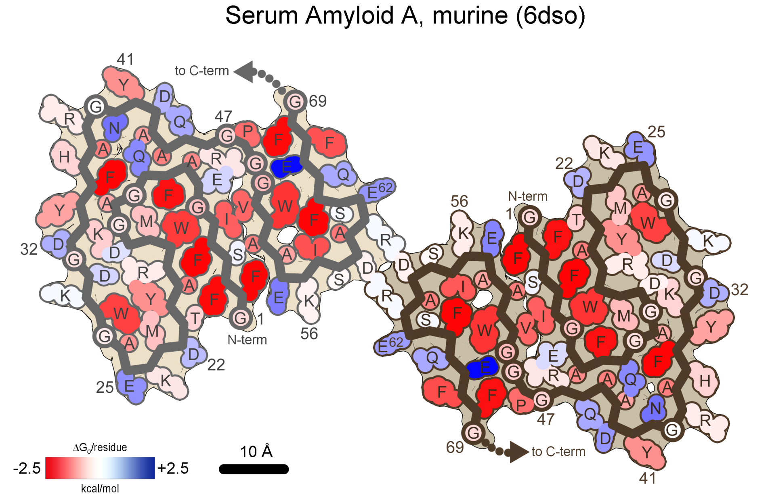
SAA
69 residues ordered per chain
ΔH_{sol}= -77.5 kcal/mol/chain (-1.12 kcal/aa)
ΔG_{o} = -39.4k cal/mol/chain (-0.57 kcal/aa)

Slide 39
SAA
54 residues ordered per chain
ΔH_{sol}= -65.5 kcal/mol/chain (-1.21 kcal/aa)
ΔG_{o} = -36.2 kcal/mol/chain (-0.67 kcal/aa)

Slide 40
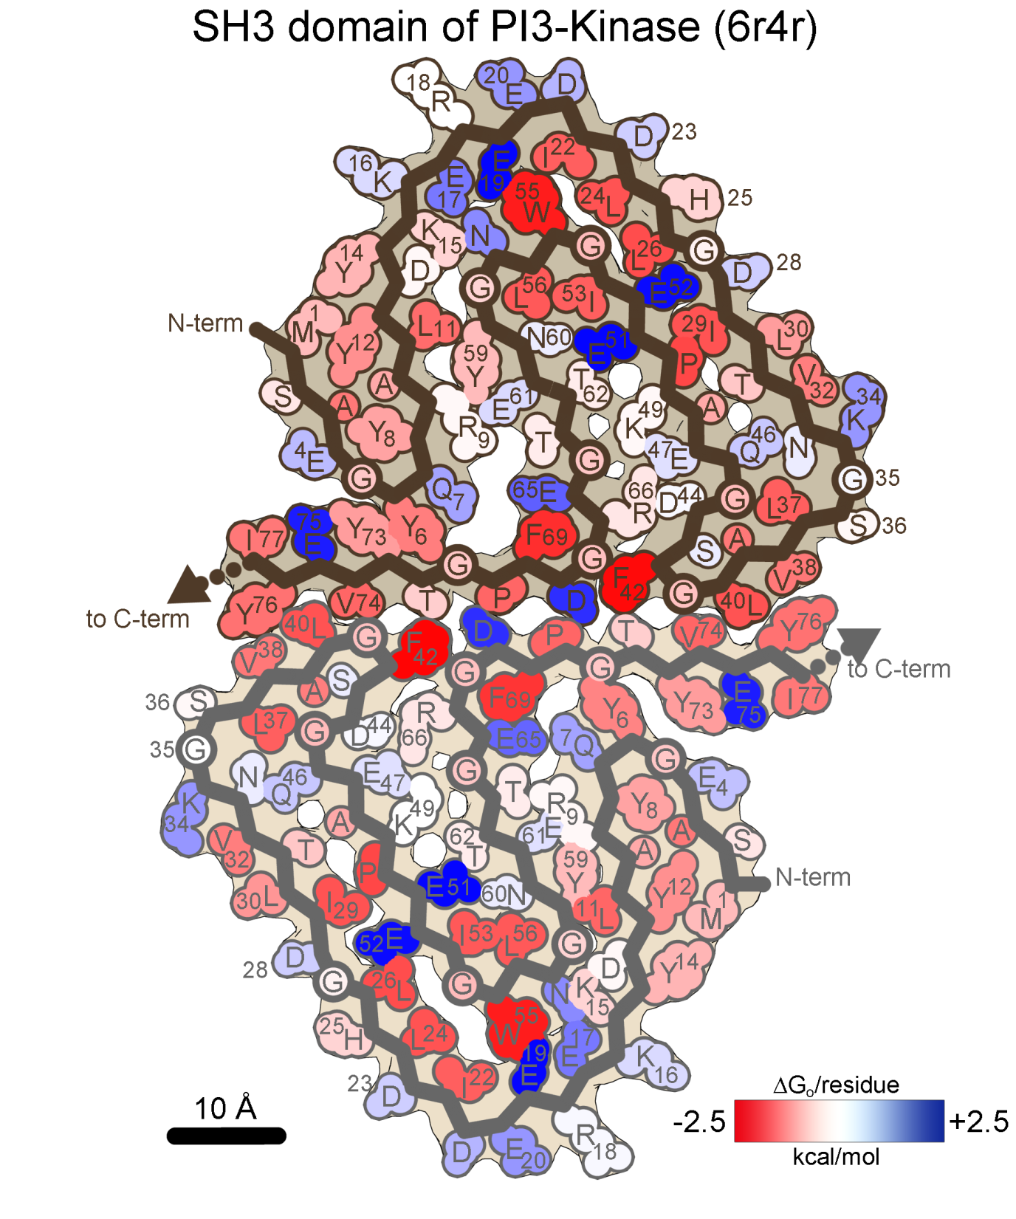
SAA
77 residues ordered per chain
ΔH_{sol}= -79.4 kcal/mol/chain (-1.03 kcal/aa)
ΔG_{o} = -27.1 kcal/mol/chain (-0.35 kcal/aa)

Slide 41
Tau
73 residues ordered per chain
ΔH_{sol}= -76.9 kcal/mol/chain (-1.05 kcal/aa)
ΔG_{o} = -31.4 kcal/mol/chain (-0.43 kcal/aa)

Slide 42
Tau
73 residues ordered per chain
ΔH_{sol}= -73.9 kcal/mol/chain (-1.01 kcal/aa)
ΔG_{o} = -28.9 kcal/mol/chain (-0.40 kcal/aa)

Slide 43
Tau
94 residues ordered per chain
ΔH_{sol}= -103.1 kcal/mol/chain (-1.10 kcal/aa)
ΔG_{o} = -44.8 kcal/mol/chain (-0.48 kcal/aa)

Slide 44
Tau
75 residues ordered per chain
ΔH_{sol}= -79.0 kcal/mol/chain (-1.05 kcal/aa)
ΔG_{o} = -33.7 kcal/mol/chain (-0.45 kcal/aa)

Slide 45
Tau
75 residues ordered per chain
ΔH_{sol}= -71.2 kcal/mol/chain (-0.95 kcal/aa)
ΔG_{o} = -25.7 kcal/mol/chain (-0.34 kcal/aa)

Slide 46
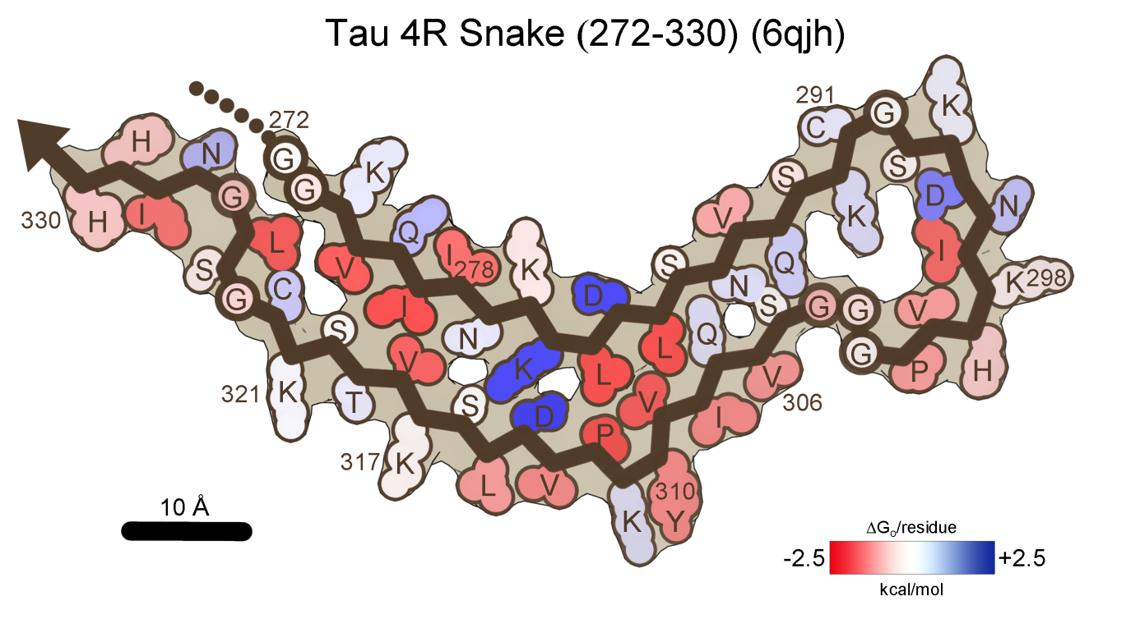
Tau
59 residues ordered per chain
ΔH_{sol}= -50.7 kcal/mol/chain (-0.86 kcal/aa)
ΔG_{o} = -17.7 kcal/mol/chain (-0.30 kcal/aa)

Slide 47
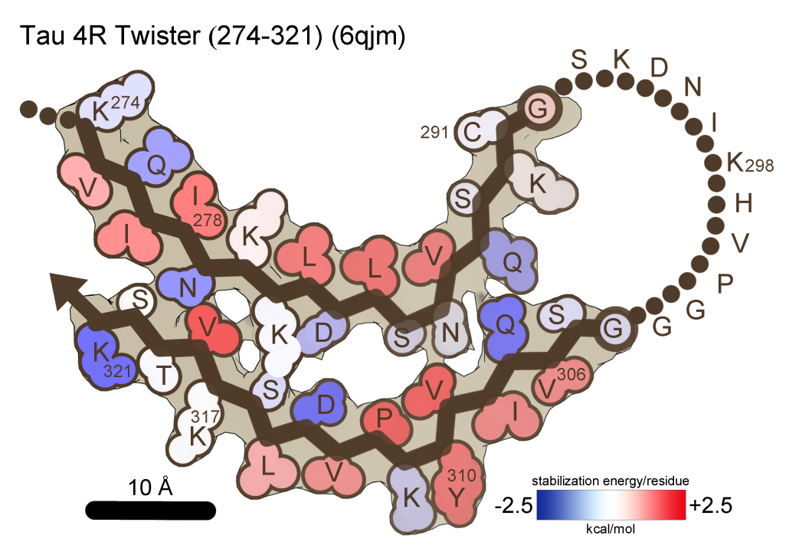
Tau
37 residues ordered per chain
ΔH_{sol}= -30.3 kcal/mol/chain (-0.82 kcal/aa)
ΔG_{o} = -7.3 kcal/mol/chain (-0.20 kcal/aa)

Slide 48
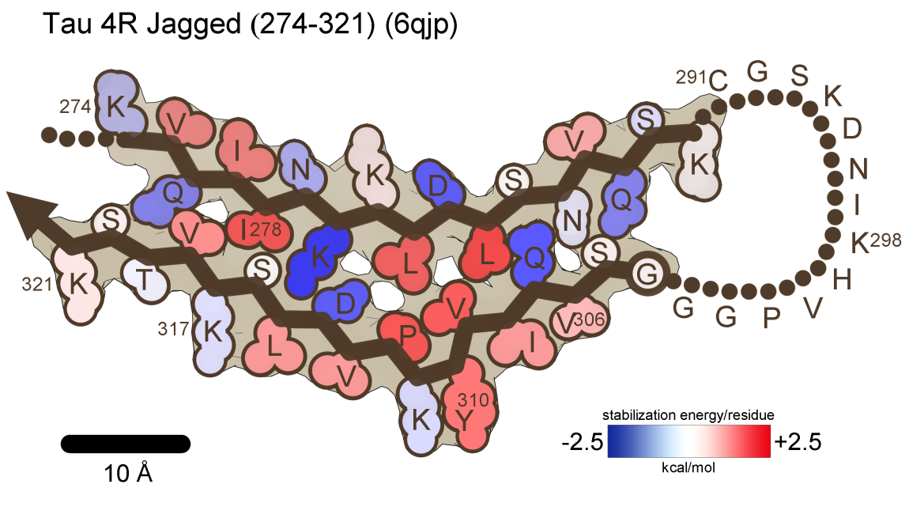
Tau
35 residues ordered per chain
ΔH_{sol}= -29.2 kcal/mol/chain (-0.83 kcal/aa)
ΔG_{o} = -6.1 kcal/mol/chain (-0.17 kcal/aa)

Slide 49
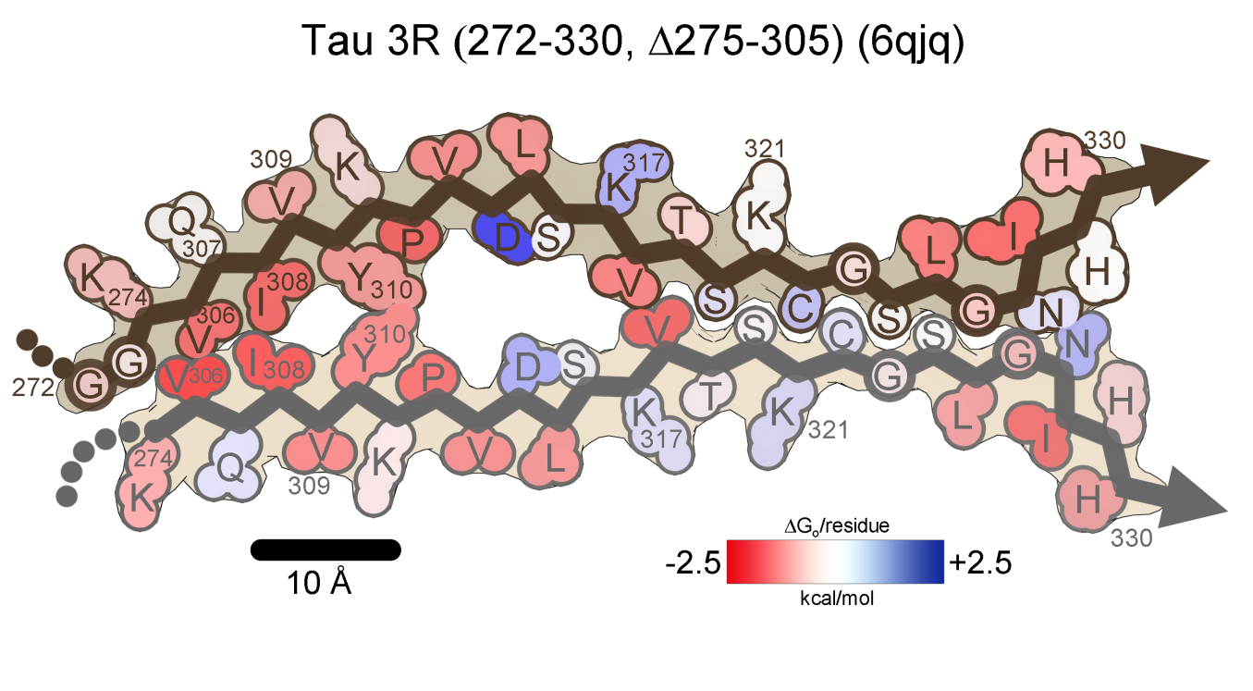
Tau
35 residues ordered per chain
ΔH_{sol}= -25.2 kcal/mol/chain (-0.90 kcal/aa)
ΔG_{o} = -10.8 kcal/mol/chain (-0.39 kcal/aa)

Slide 50
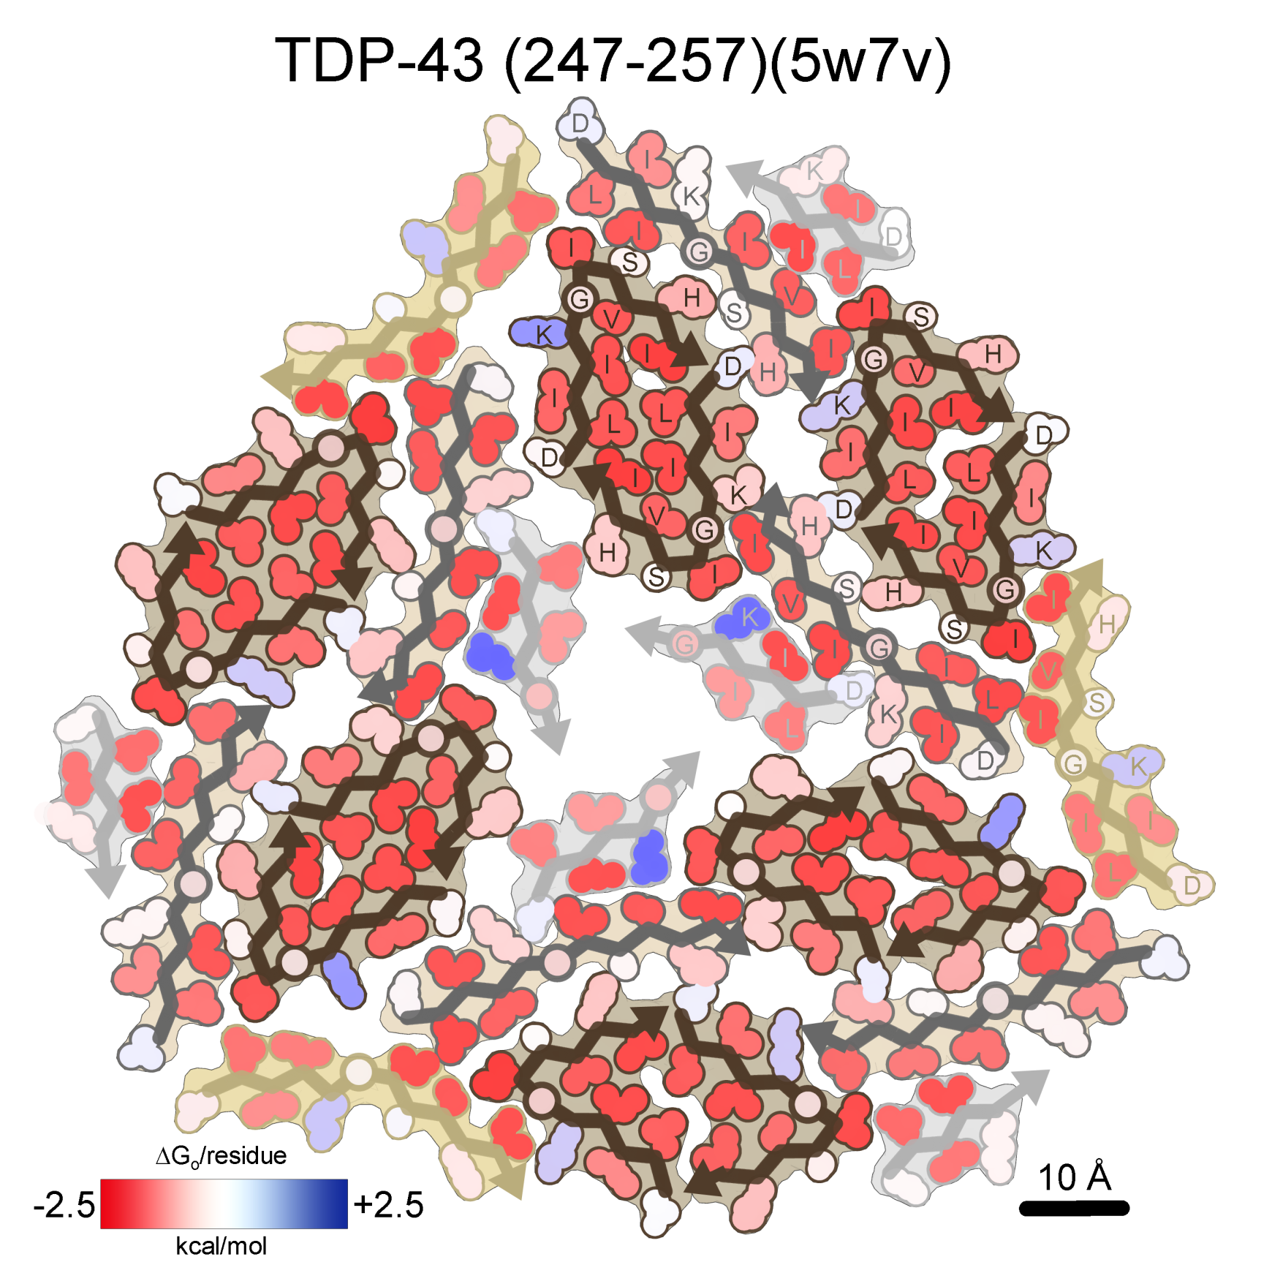
TDP-43
11 residues ordered per chain
ΔH_{sol}= -18.8 kcal/mol/chain (-1.71 kcal/aa)
ΔG_{o} = -10.7 kcal/mol/chain (-0.97 kcal/aa)

Slide 51
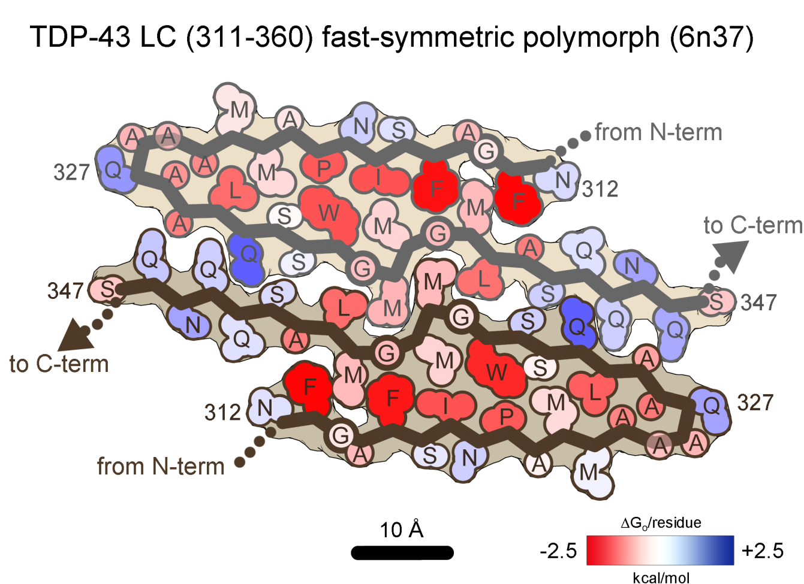
TDP-43
36 residues ordered per chain
ΔH_{sol}= -36.4 kcal/mol/chain (-1.01 kcal/aa)
ΔG_{o} = -17.1 kcal/mol/chain (-0.47 kcal/aa)

Slide 52
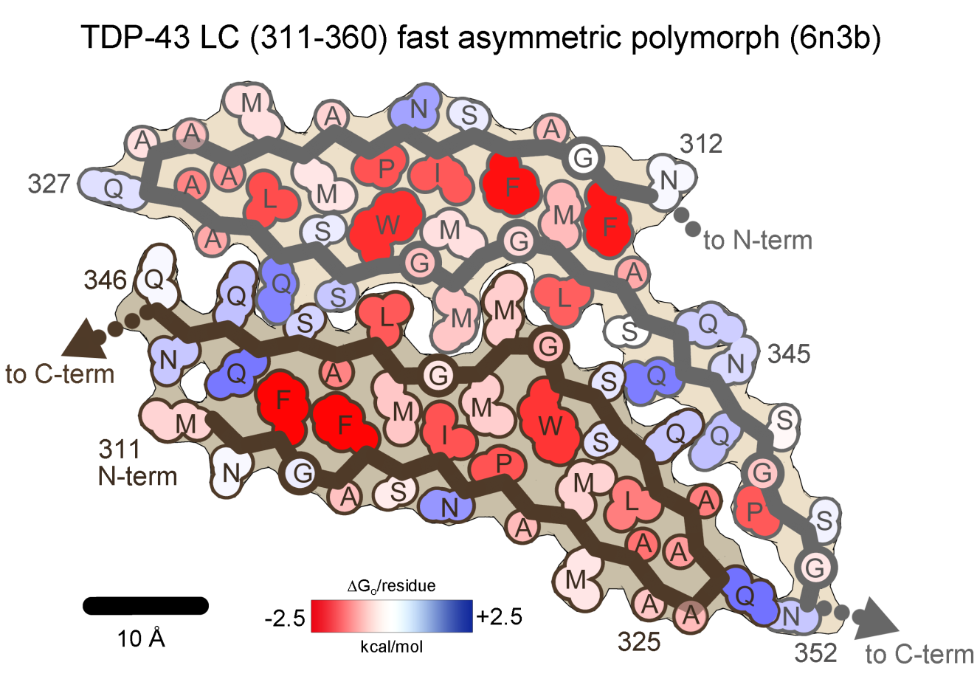
TDP-43
36 residues ordered per chain
ΔH_{sol}= -38.4 kcal/mol/chain (-1.07 kcal/aa)
ΔG_{o} = -17.6 kcal/mol/chain (-0.49 kcal/aa)
41 residues ordered per chain
ΔH_{sol}= -37.7 kcal/mol/chain (-0.92 kcal/aa)
ΔG_{o} = -17.6 kcal/mol/chain (-0.43 kcal/aa)

Slide 53
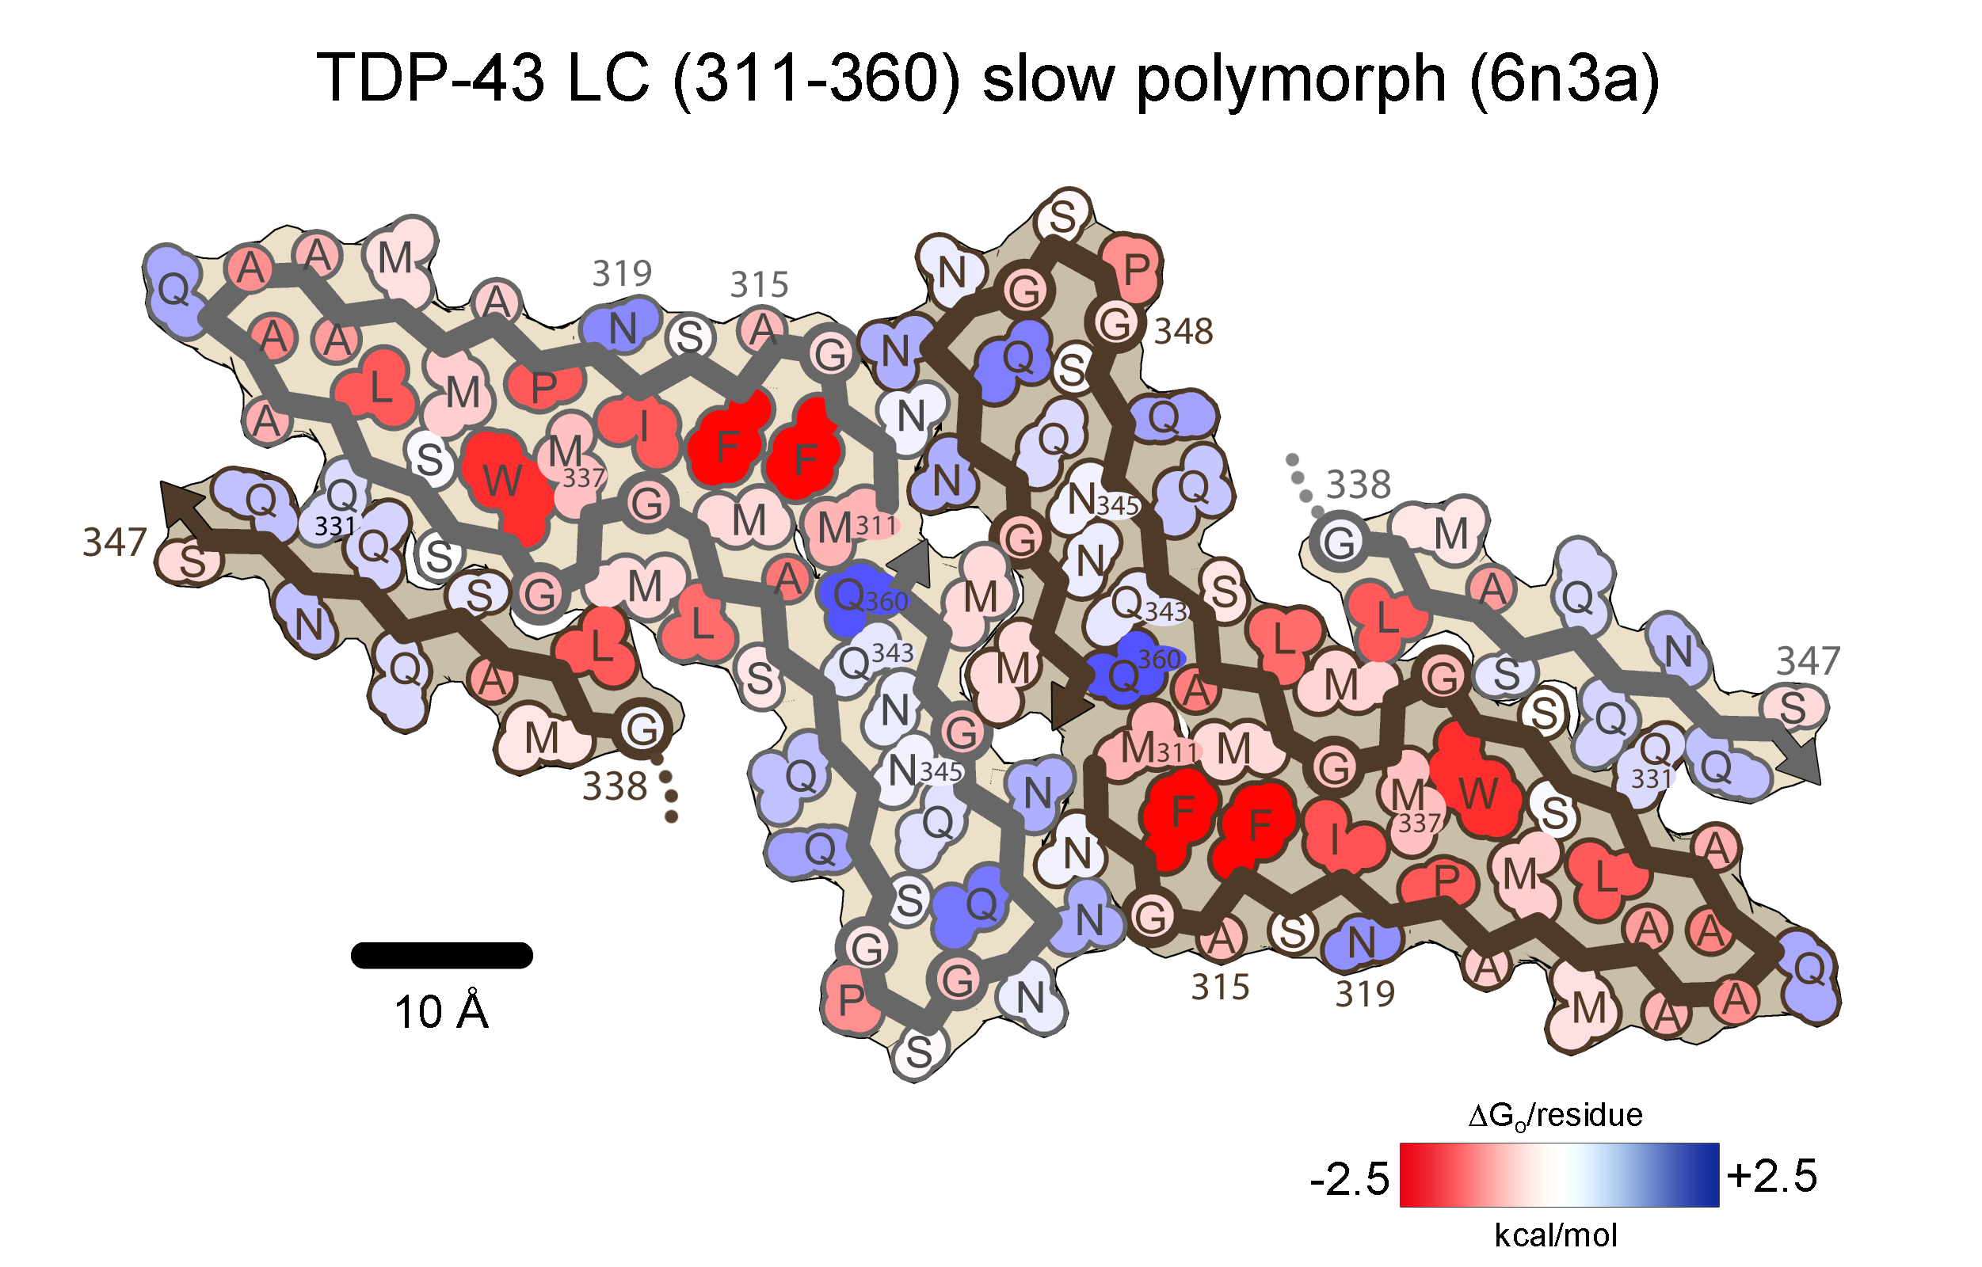
TDP-43
50 residues ordered per chain
ΔH_{sol}= -47.9 kcal/mol/chain (-0.96 kcal/aa)
ΔG_{o} = -18.8 kcal/mol/chain (-0.38 kcal/aa)
10 residues ordered per chain
ΔH_{sol}= -6.5 kcal/mol/chain (-0.65 kcal/aa)
ΔG_{o} = -0.8 kcal/mol/chain (-0.08 kcal/aa)

Slide 54
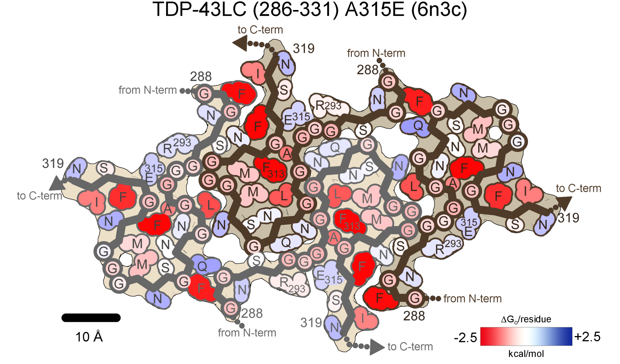
TDP-43
32 residues ordered per layer
ΔH_{sol}= -31.3 kcal/mol/chain (-0.98 kcal/aa)
ΔG_{o} = -17.0 kcal/mol/chain (-0.53 kcal/aa)

Slide 55
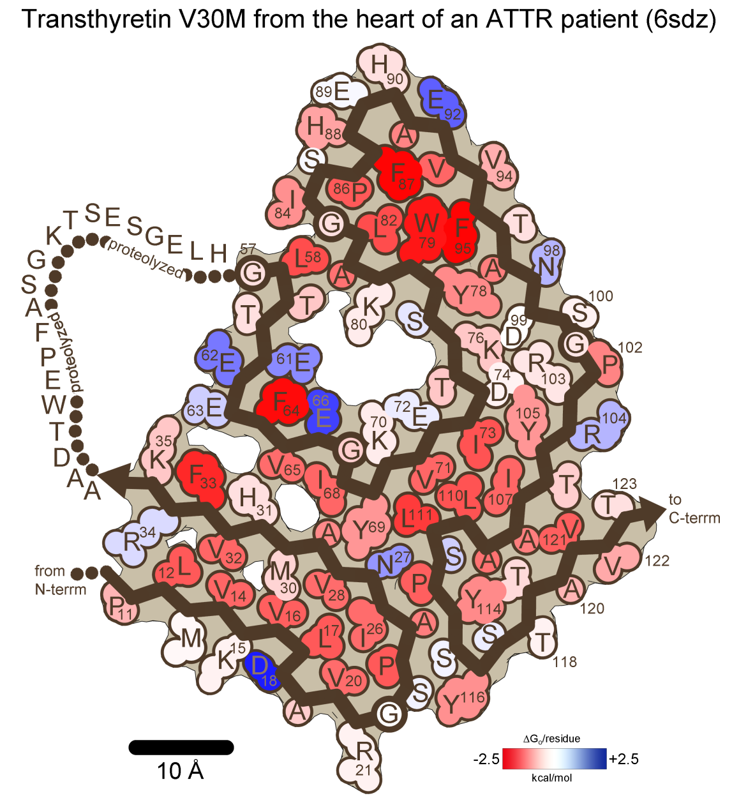
TTR
92 residues ordered per layer
ΔH_{sol}= -117.9 kcal/mol/chain (-1.28 kcal/aa)
ΔG_{o} = -62.1 kcal/mol/chain (-0.68 kcal/aa)

