Slide 1
Proteinase K amino acid sequence
001_MAAQTNAPWG_LARISSTSPG_TSTYYYDESA_GQGSCVYVID
041_TGIEASHPEF_EGRAQMVKTY_YYSSRDGNGH_GTHCAGTVGS
081_RTYGVAKKTQ_LFGVKVLDDN_GSGQYSTIIA_GMDFVASDKN
121_NRNCPKGVVA_SLSLGGGYSS_SVNSAAARLQ_SSGVMVAVAA
161_GNNNADARNY_SPASEPSVCT_VGASDRYDRR_SSFSNYGSVL
201_DIFGPGTDIL_STWIGGSTRS_ISGTSMATPH_VAGLAAYLMT
241_LGKTTAASAC_RYIADTANKG_DLSNIPFGTV_NLLAYNNYQA
280 aa
280

Slide 2
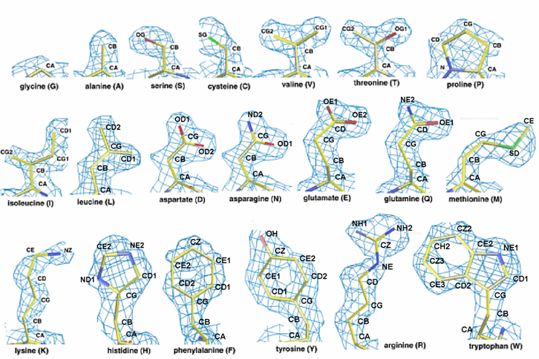
The 20 amino acids in order of increasing size

Slide 3
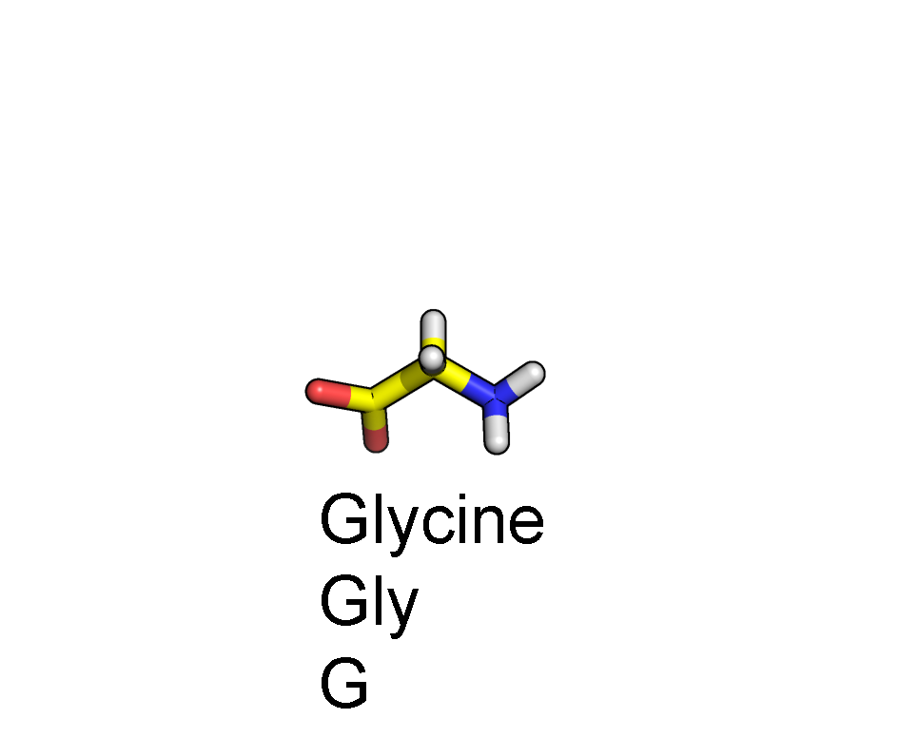
Amino acid anatomy
CA
C
N
O

Slide 4
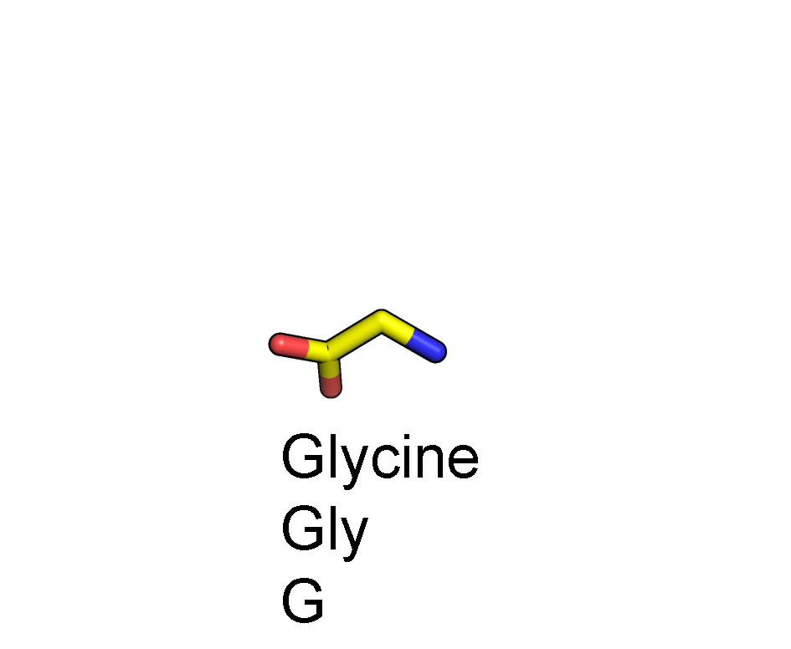
Amino acid anatomy
CA
C
N
O

Slide 5
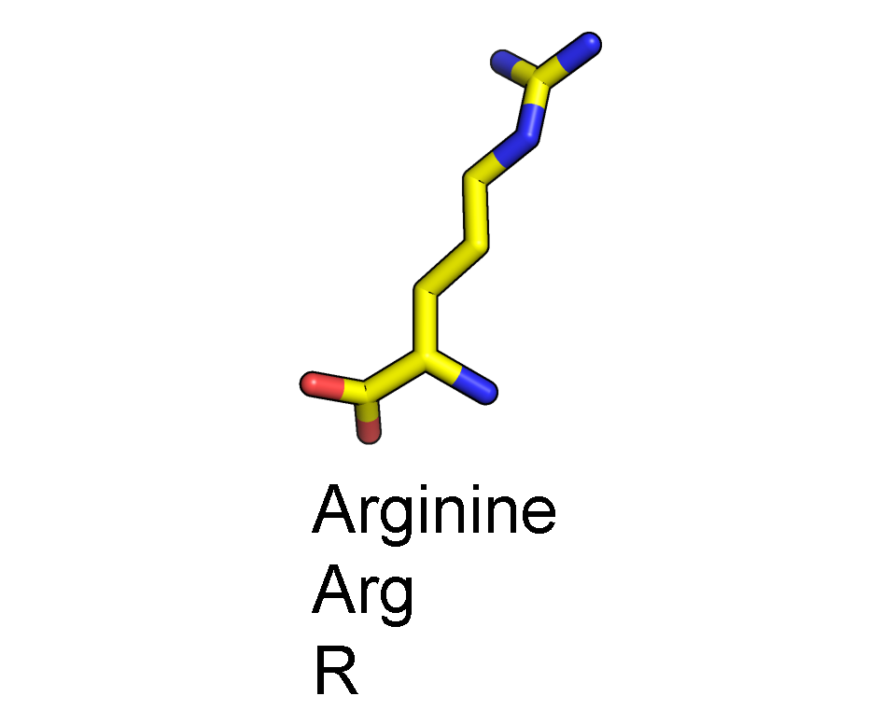
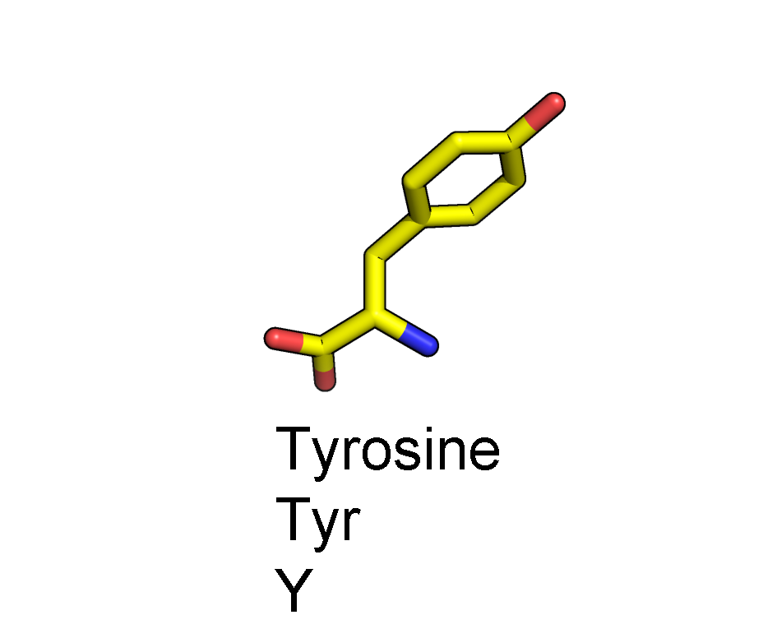
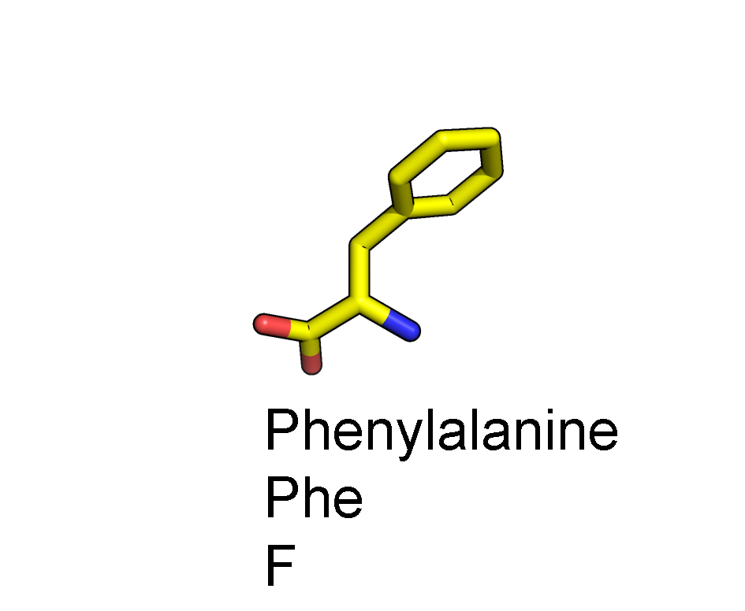
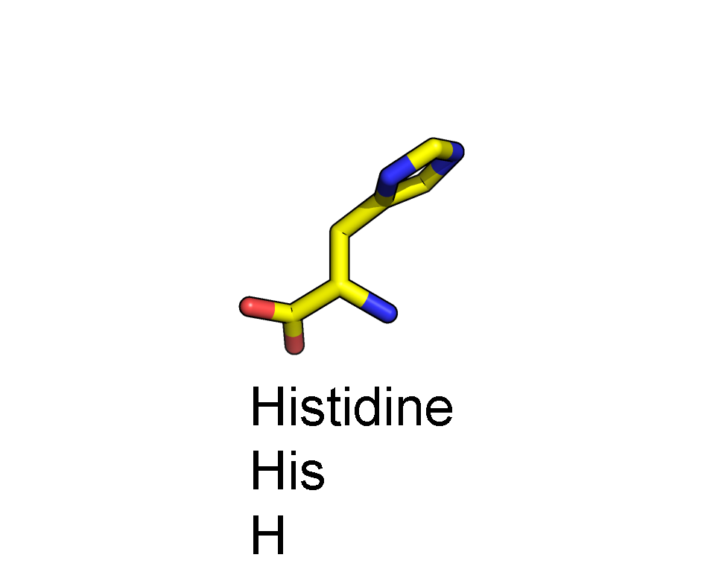
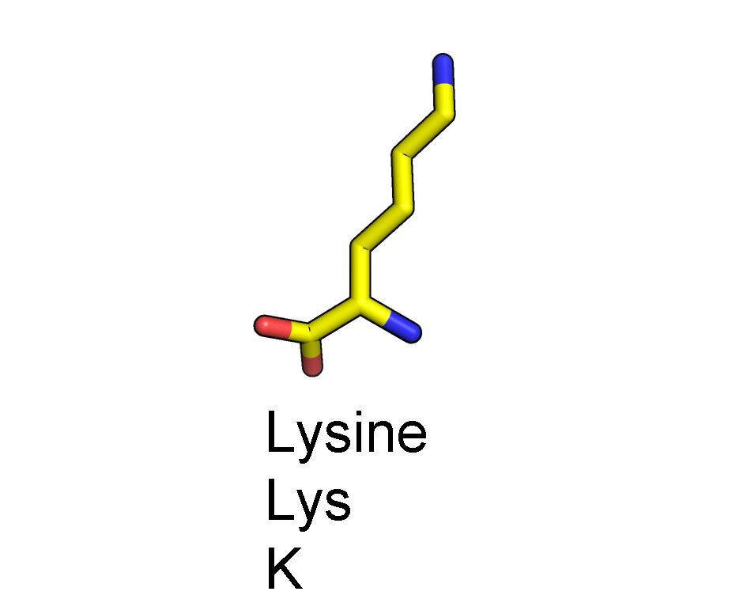
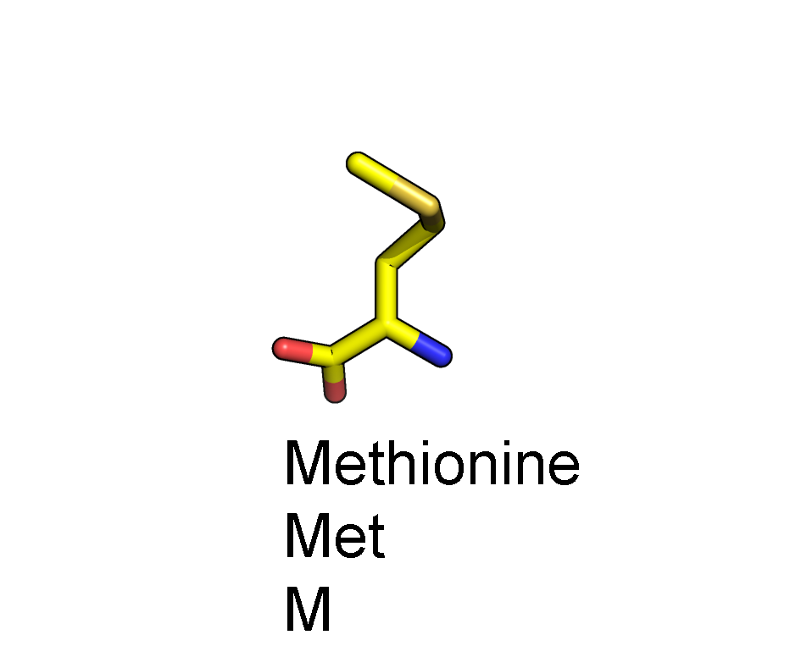
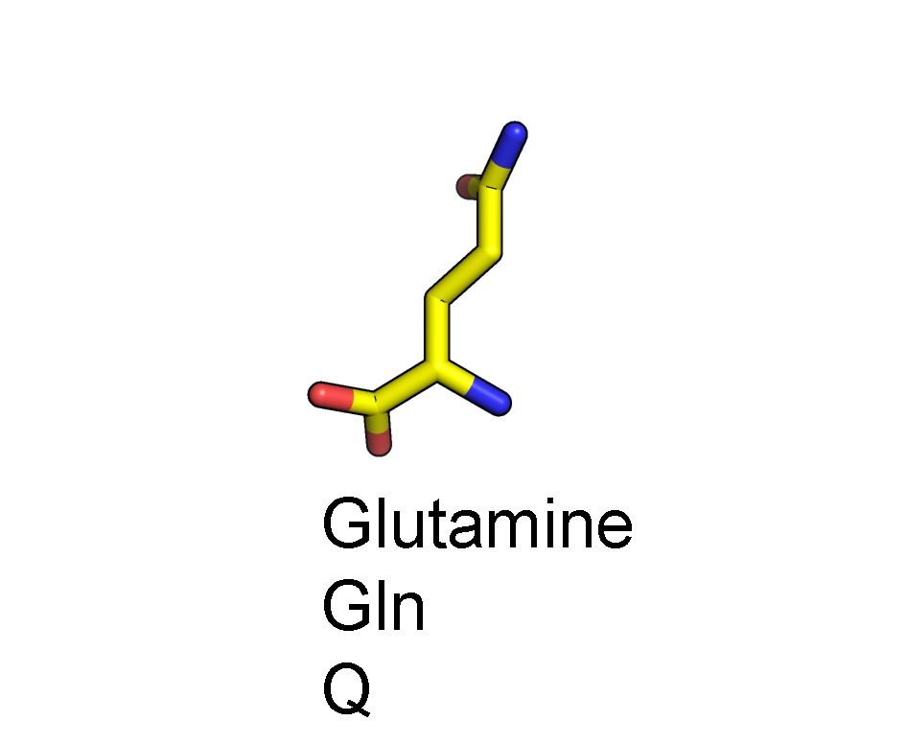
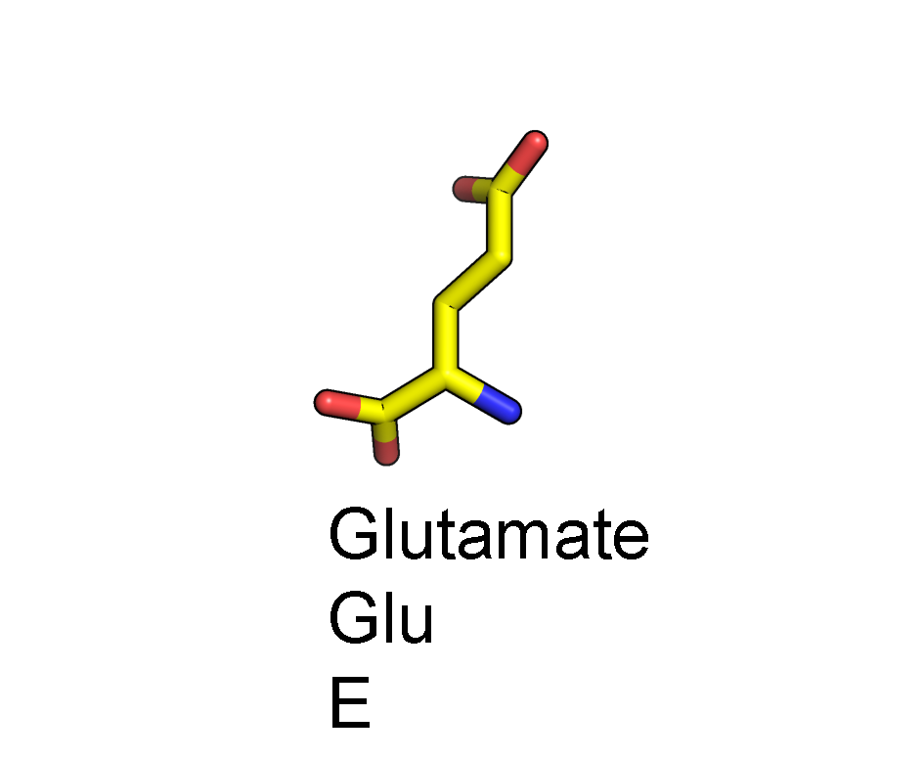
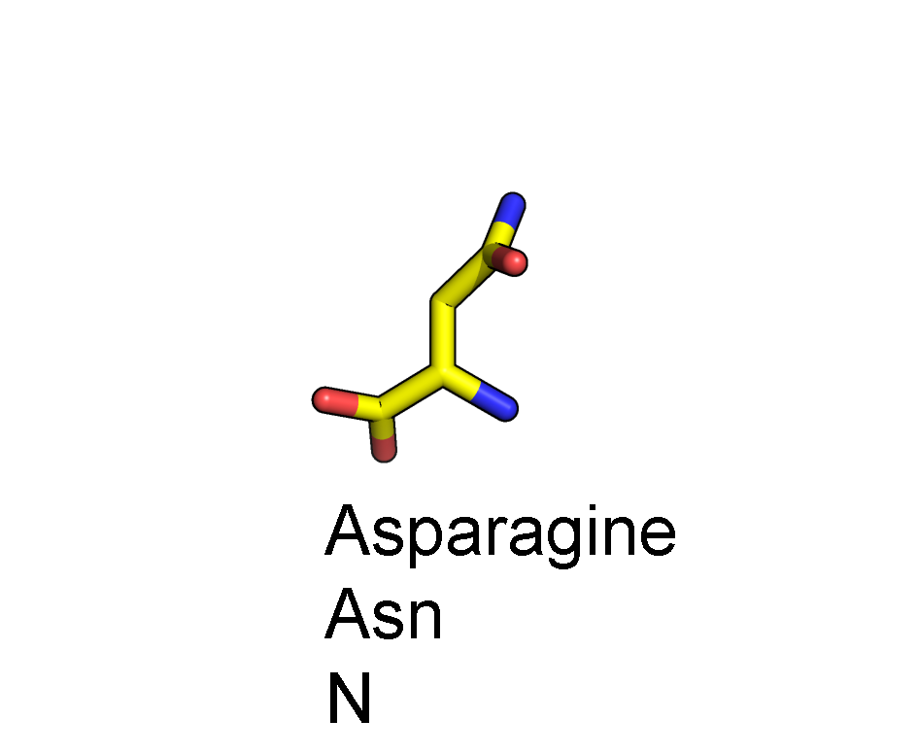
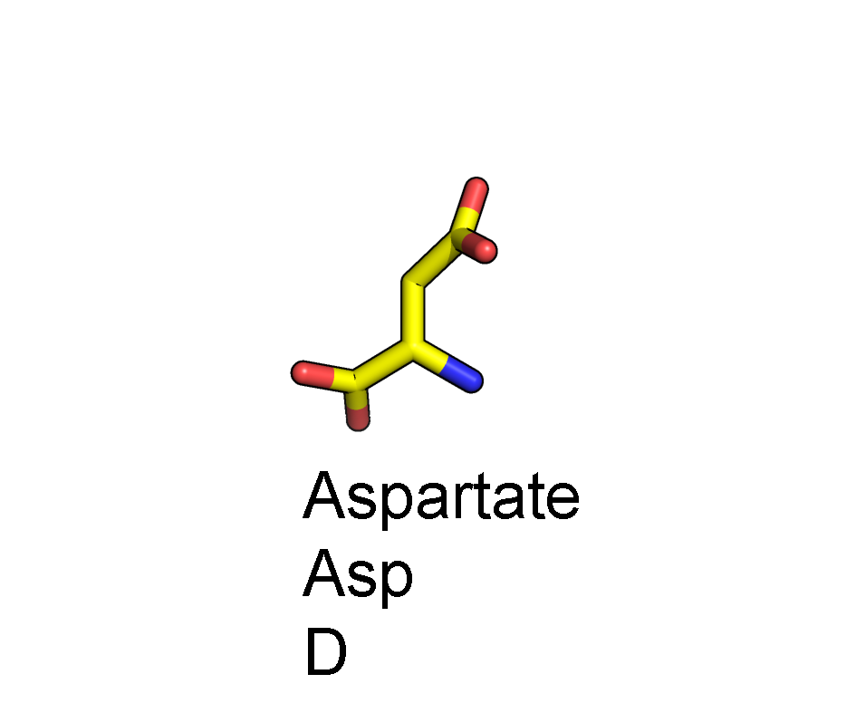
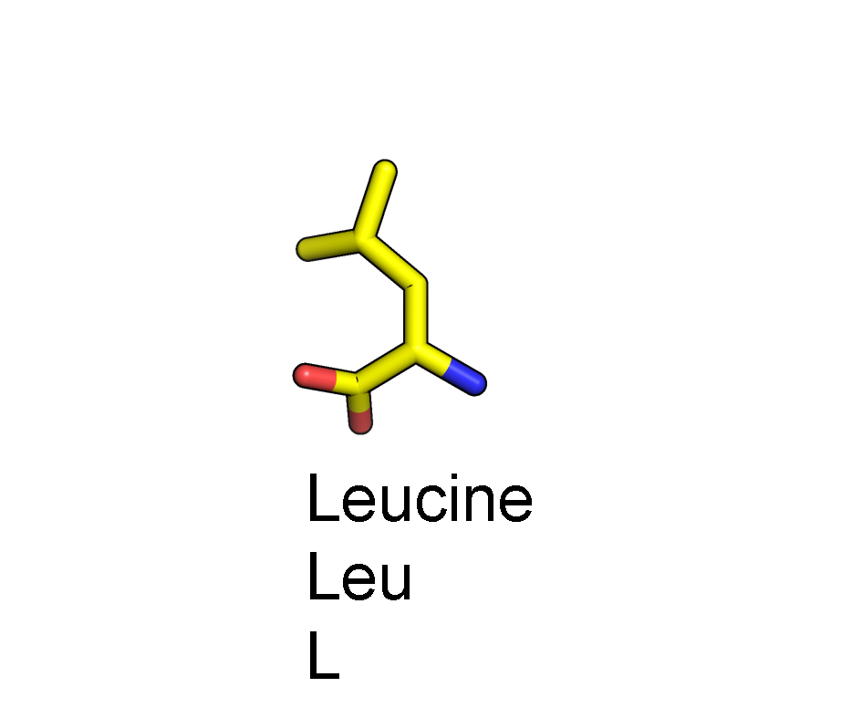
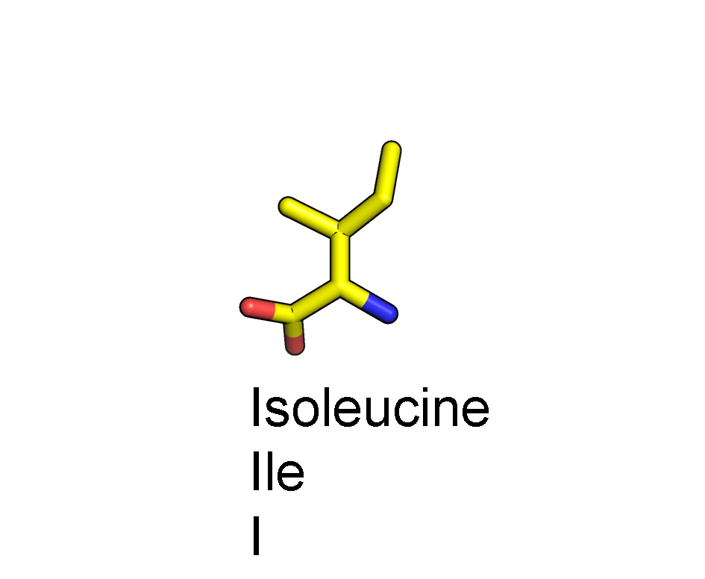
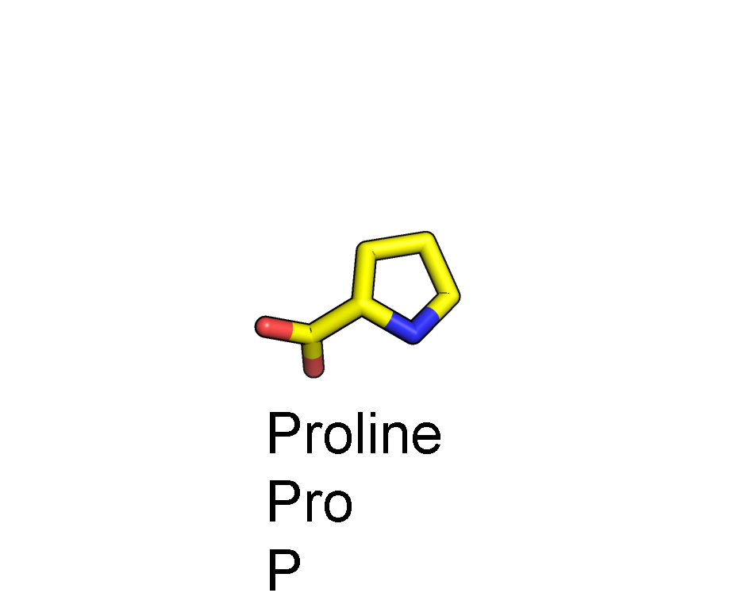
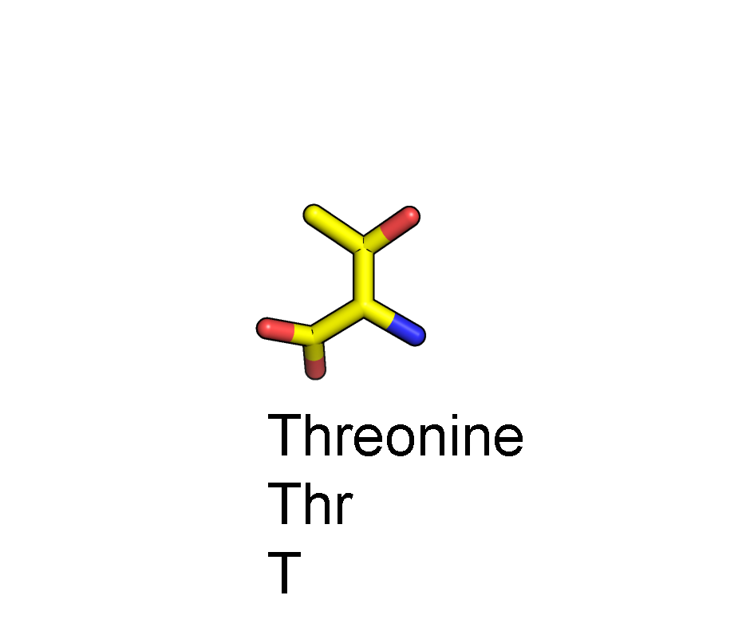
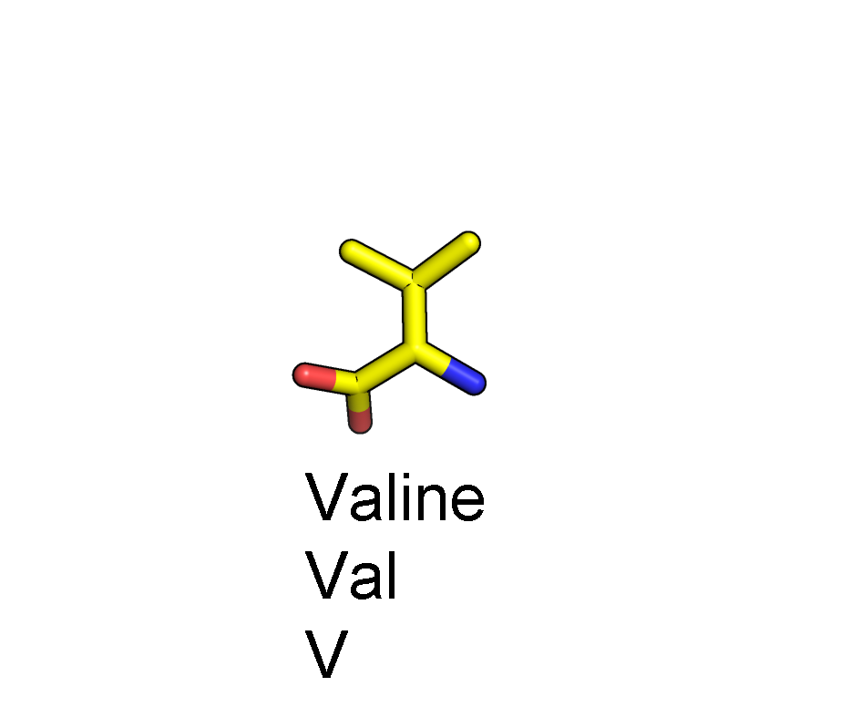
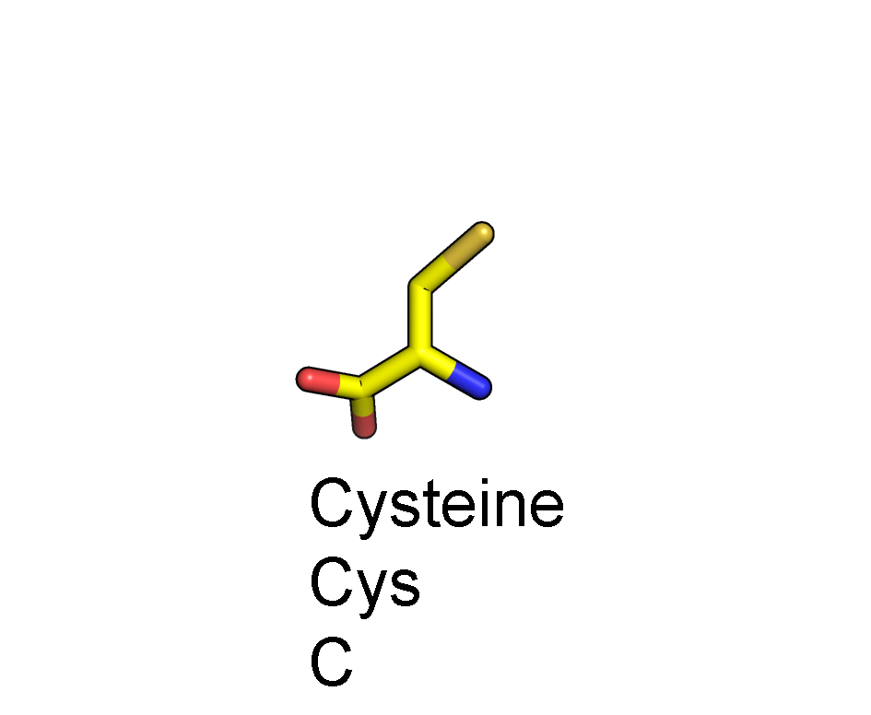
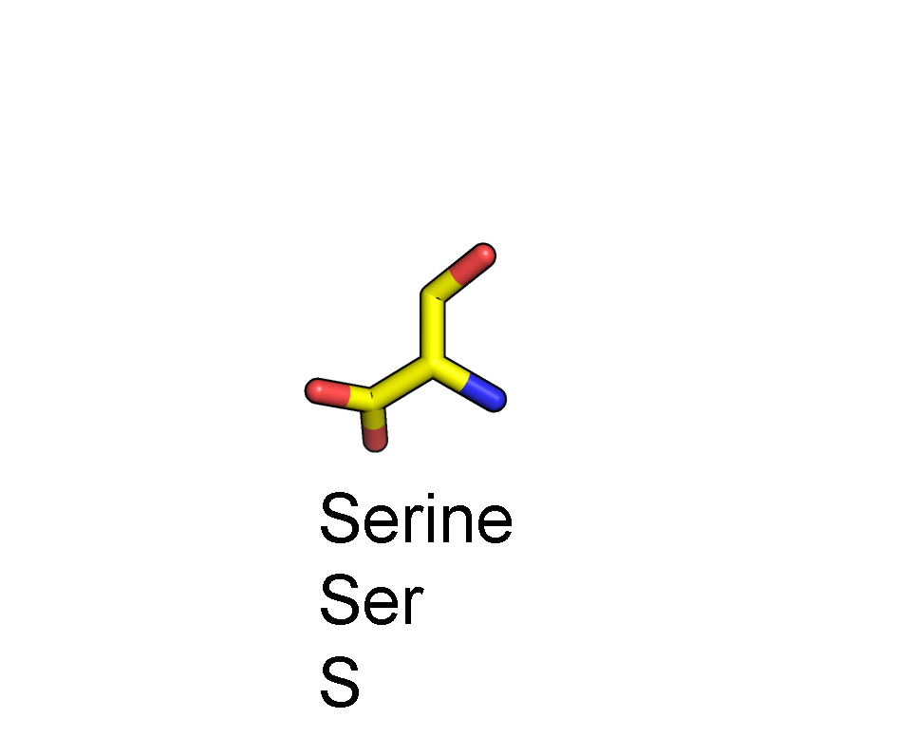
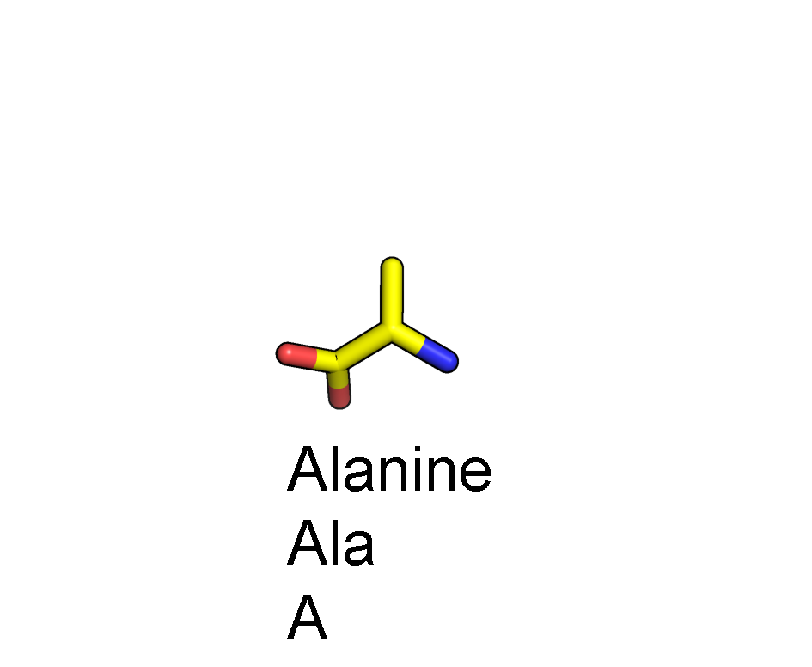
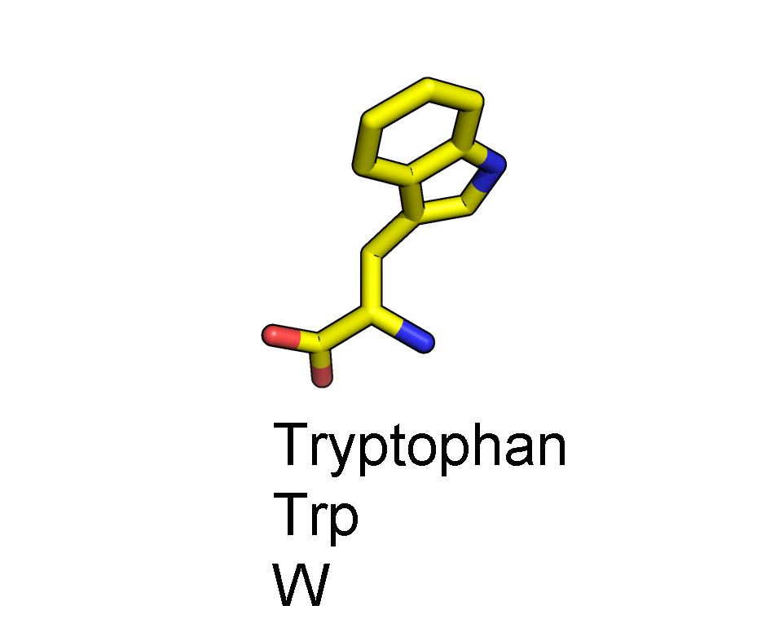
Amino Acid anatomy
CA
C
N
O

Slide 6
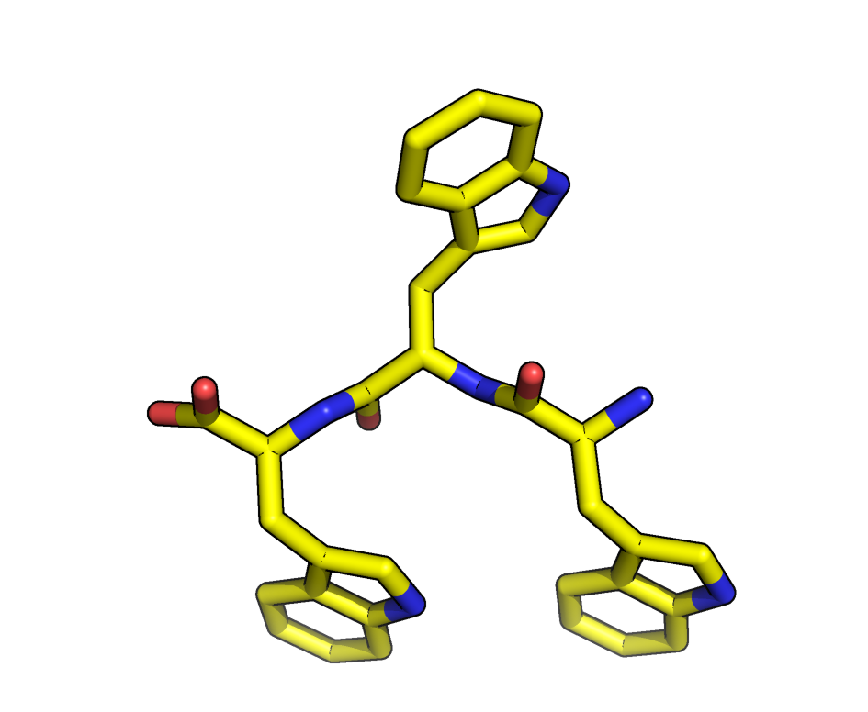
Peptide bond
O
CA
N-terminus
C-terminus
N
C
CA

Slide 7
Peptide bond
C
N
CA
N-terminus
C-terminus
CA
O

Slide 8
Main chain torsion angles
ψ
φ
psi
phi
CA
C
N

Slide 9
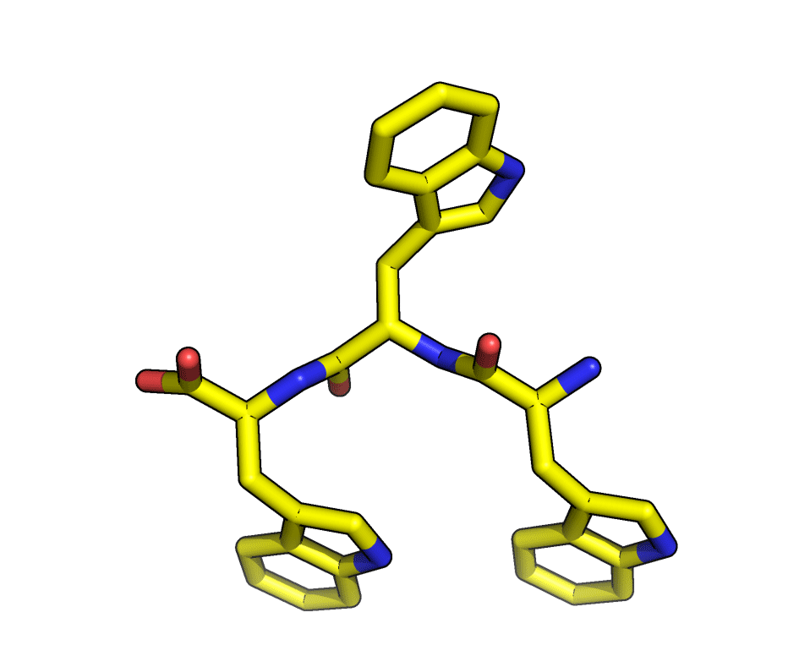
Peptide bond
ψ
φ
psi
phi
CA

Slide 10
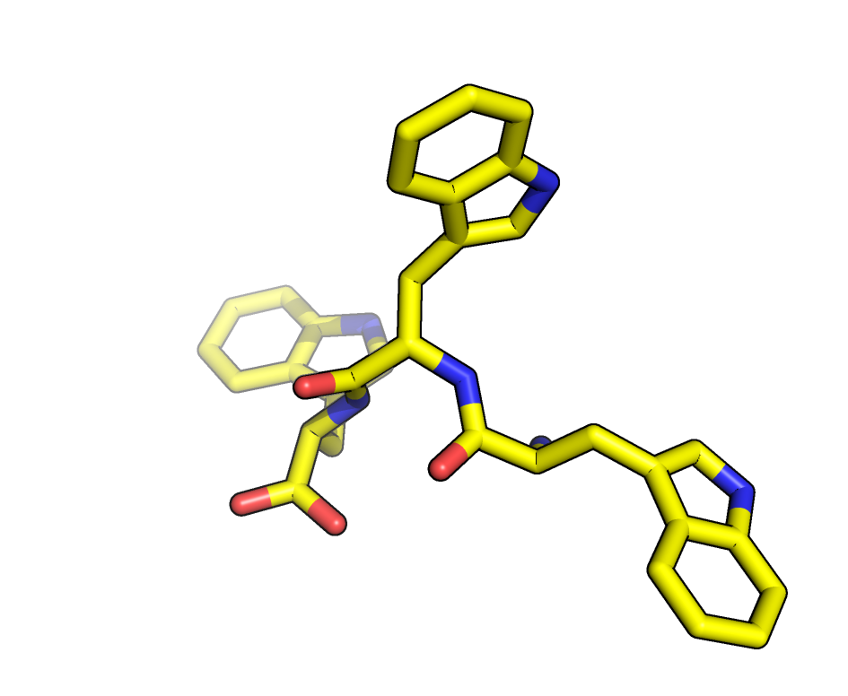
Peptide bond
ψ
φ
psi
phi
CA

Slide 11
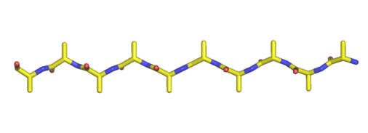
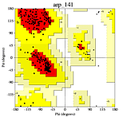
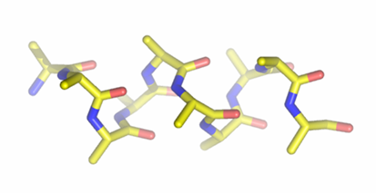
Lowest energy φ,ψ angles correspond to α-helices and β-sheets
β-sheet
α-helix
Ramachandran plot
If you fit density correctly there will be less than 1% Ramachandran outliers
Notes:
Side chains of neighboring residues point in different directions. Avoid steric clash.

Slide 12
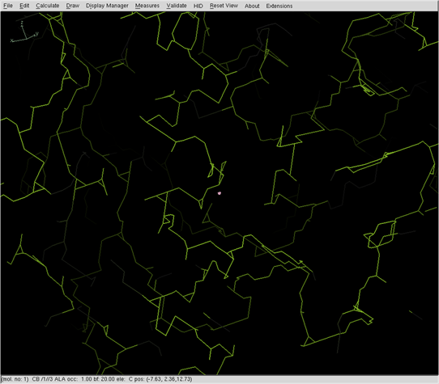
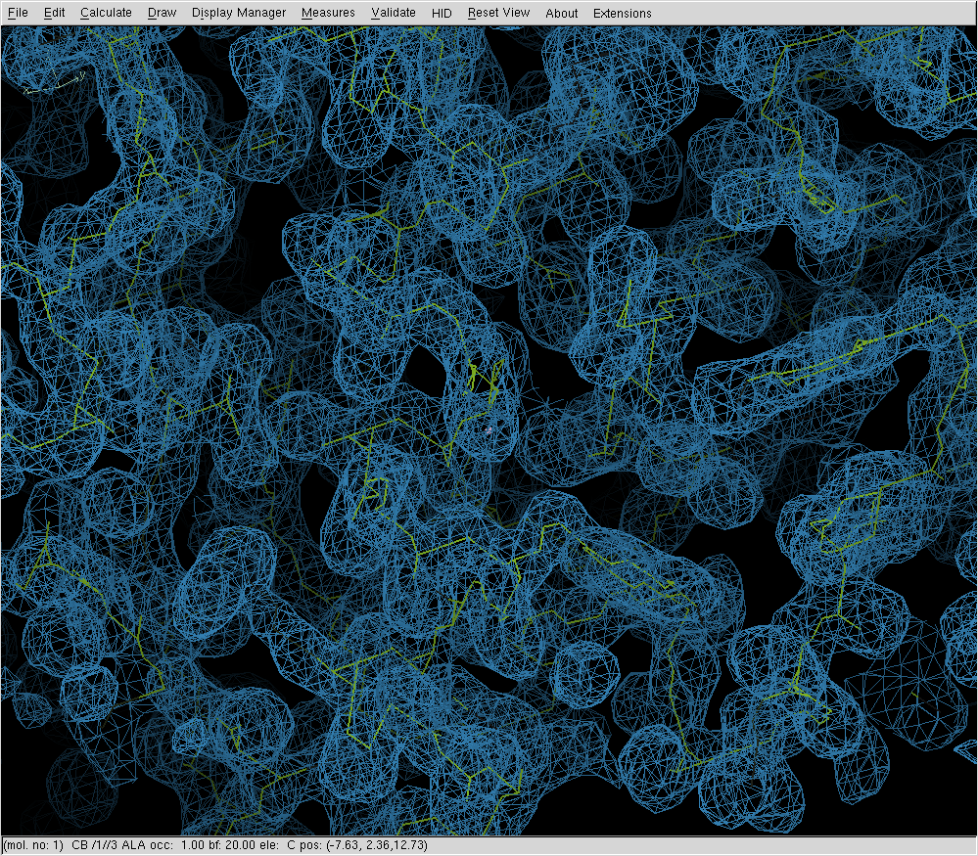
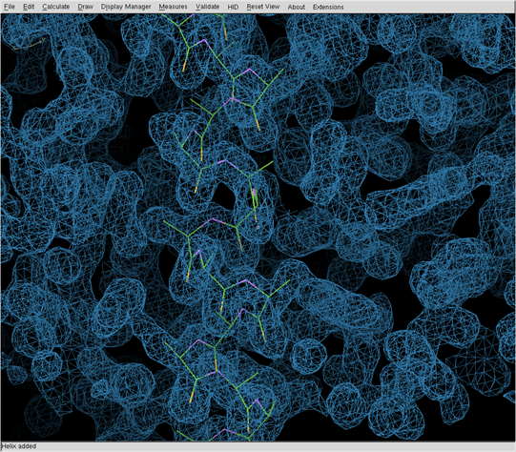
In which direction am I building? N or C?
Carbonyl oxygens point to C-terminal end of a helix

Slide 13
Assigning the sequence
You built a helix last week.
It corresponds to some segment of the 280 aa sequence. Which segment is it?
Find a stretch of 5-10 residues with well defined side chain density.
Fit the side chain density by trial and error. (Mutate & Autofit)
Check the proteinase K amino acid sequence for a matching sequence of residues.

Slide 14
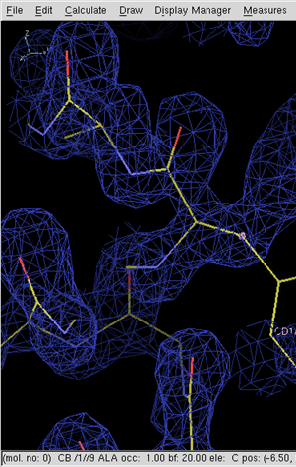
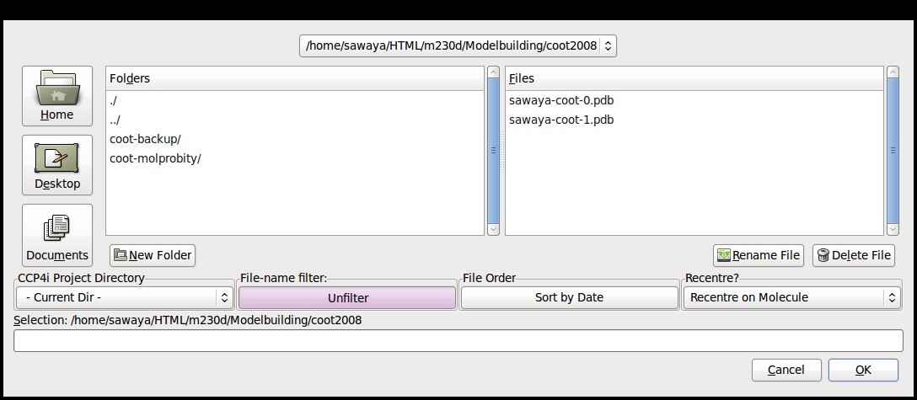
Load Coordinates
File -> Open Coordinates--browse window opens
  Click “filter” (will show only .pdb files)
  Click “sort by date” (will place the lastest coordinates at the top of browser)
  Select the .pdb file (e.g. sawaya-coot-0.pdb)
Open Coordinates
Auto Open MTZ
Open MTZ, mmcif, fcf, or phs

Slide 15
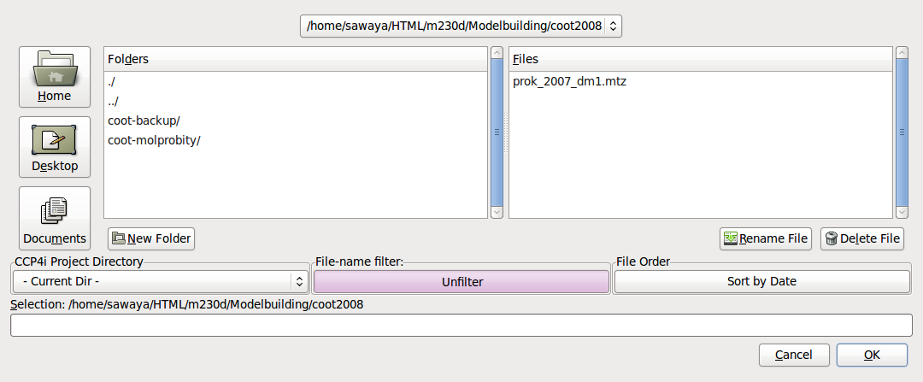
Load Structure Factors (map)
File -> Open mtz, mmcif, fcf, or phs
  Click “filter”
  Click “sort by date”
  Select output from dm m230d_2015_scaled2_dm1.mtz
Open Coordinates
Auto Open MTZ
Open MTZ, mmcif, fcf, or phs
m230d_2015_scaled2_dm1.mtz

Slide 16
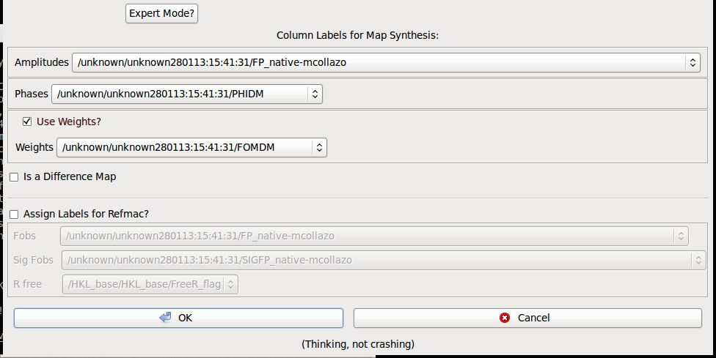
Load Structure Factors (map)
Assign column labels for Map Synthesis
  Amplitudes: Select “FP_native-joshua”
  Phases: Select “PHIDM”
  Weights: Select “FOMDM”
FP_native-joshua

Slide 17
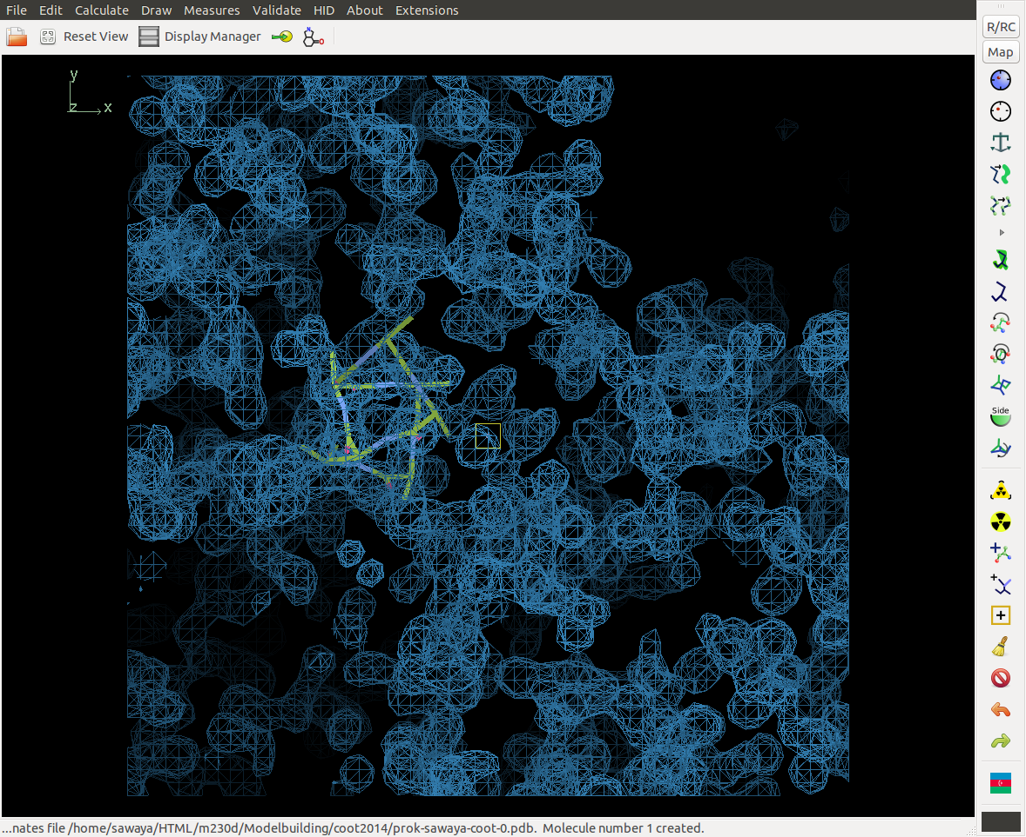
A map and some coordinates should appear

Slide 18
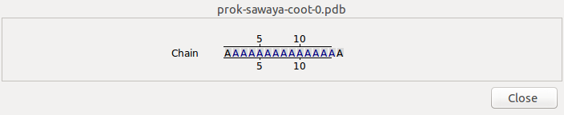
Center on a particular amino acid using sequence view
Blah1
Blah2
Blah3
Sequence View
Blah5
Blah6
Blah7

Slide 19
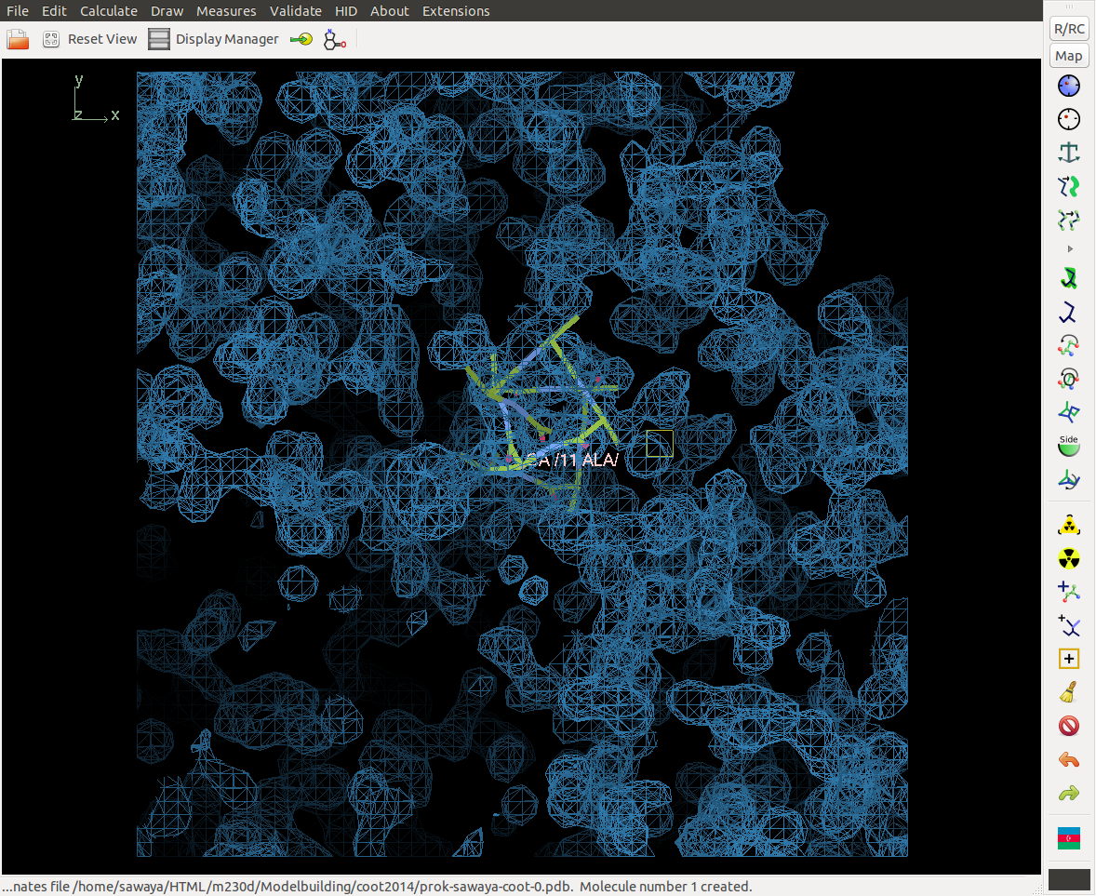
Center on a particular amino acid using sequence view

Slide 20
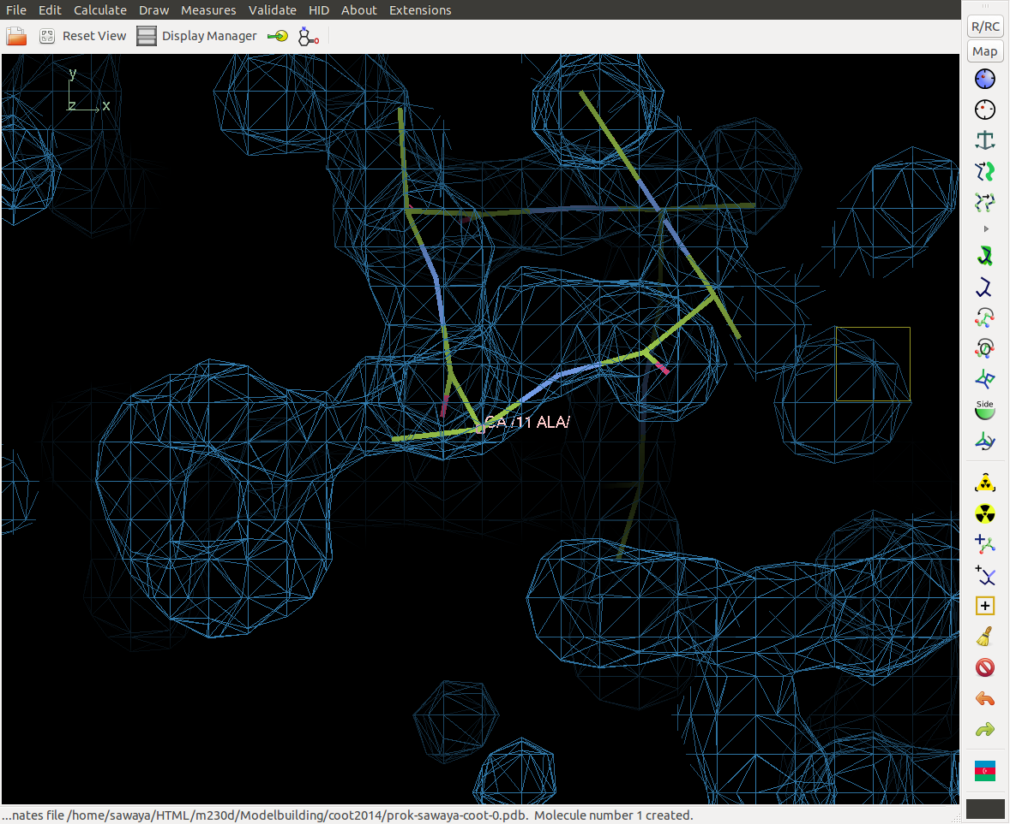
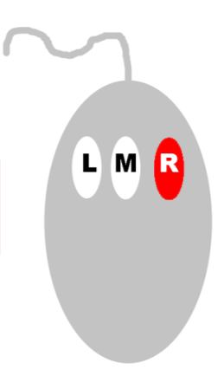
Zoom. Right click. Drag toward you.

Slide 21

Zoom in on a distinctive side chain.
Mutate and autofit
Use this

Slide 22
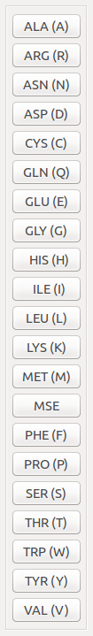
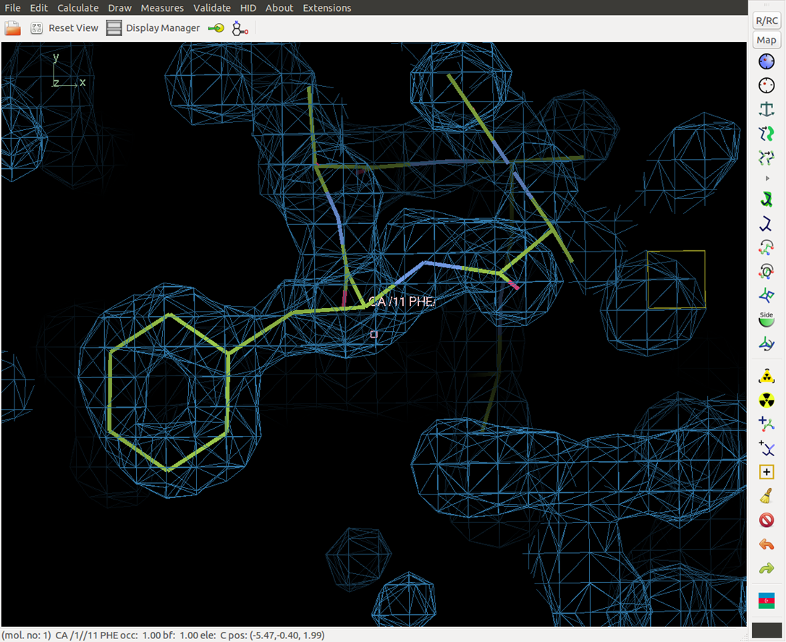
Select amino acid type

Slide 23
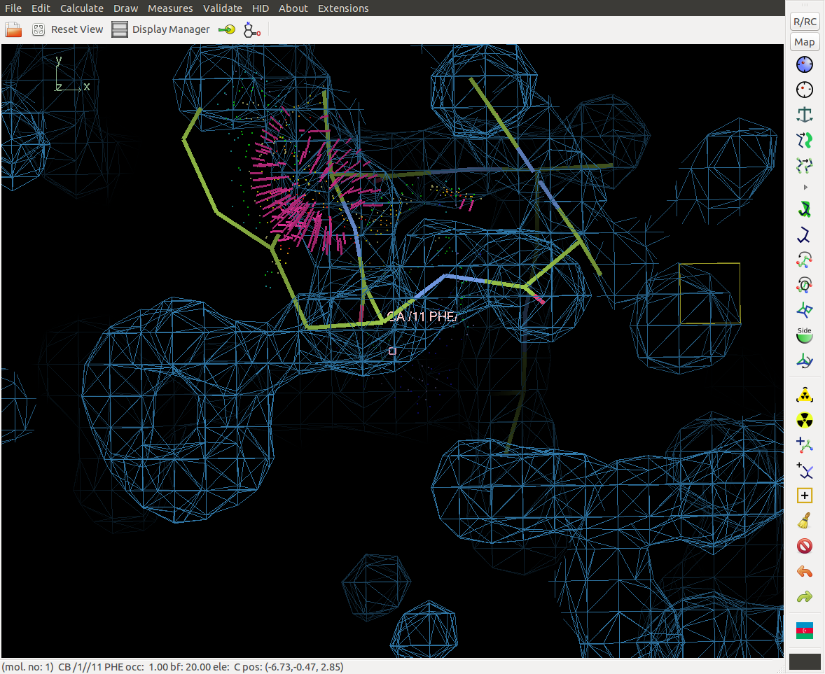
What to do if side chain doesn’t fit.
First, adjust view to see full picture

Slide 24
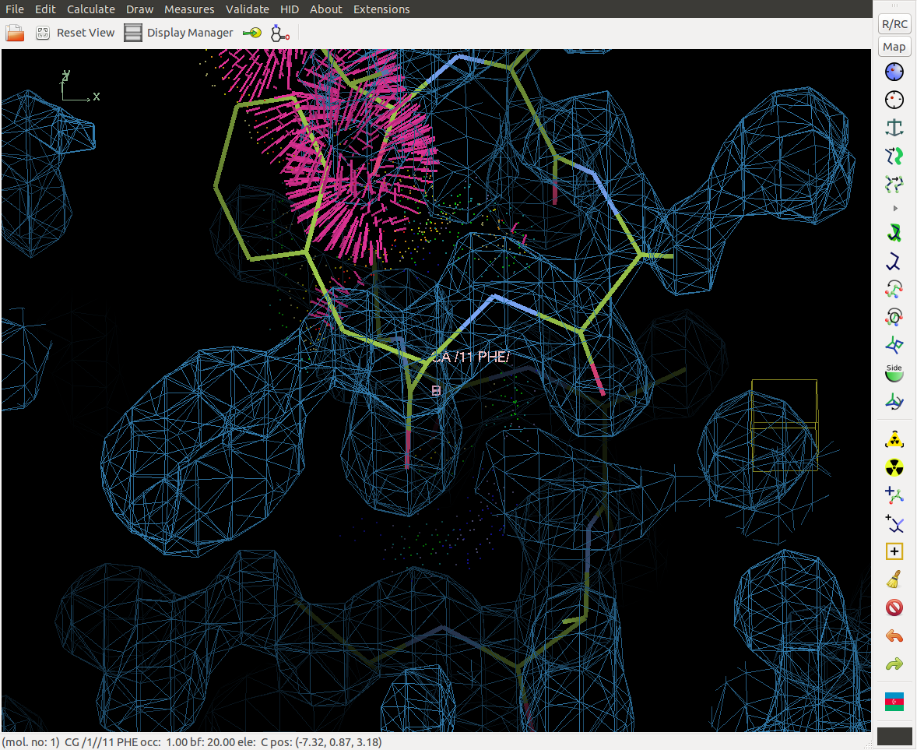

Try Real Space Refine. But first adjust view

Slide 25
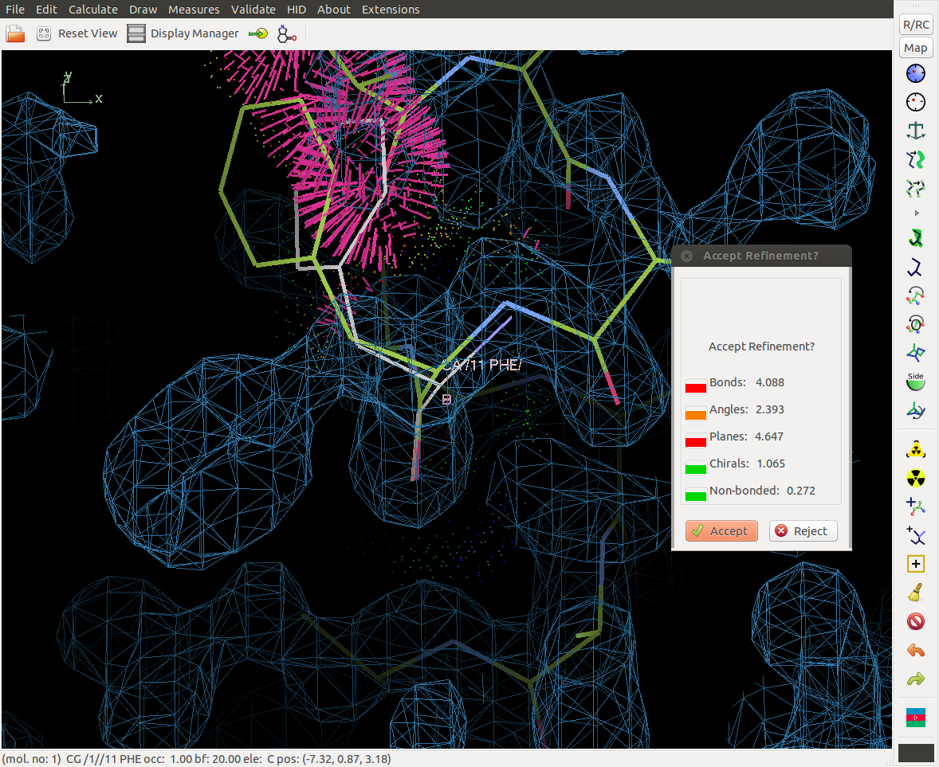
Specify residue range for refinement by Clicking on beginning and ending residue

Slide 26

Drag ghost into density. Accept (or not).

Slide 27
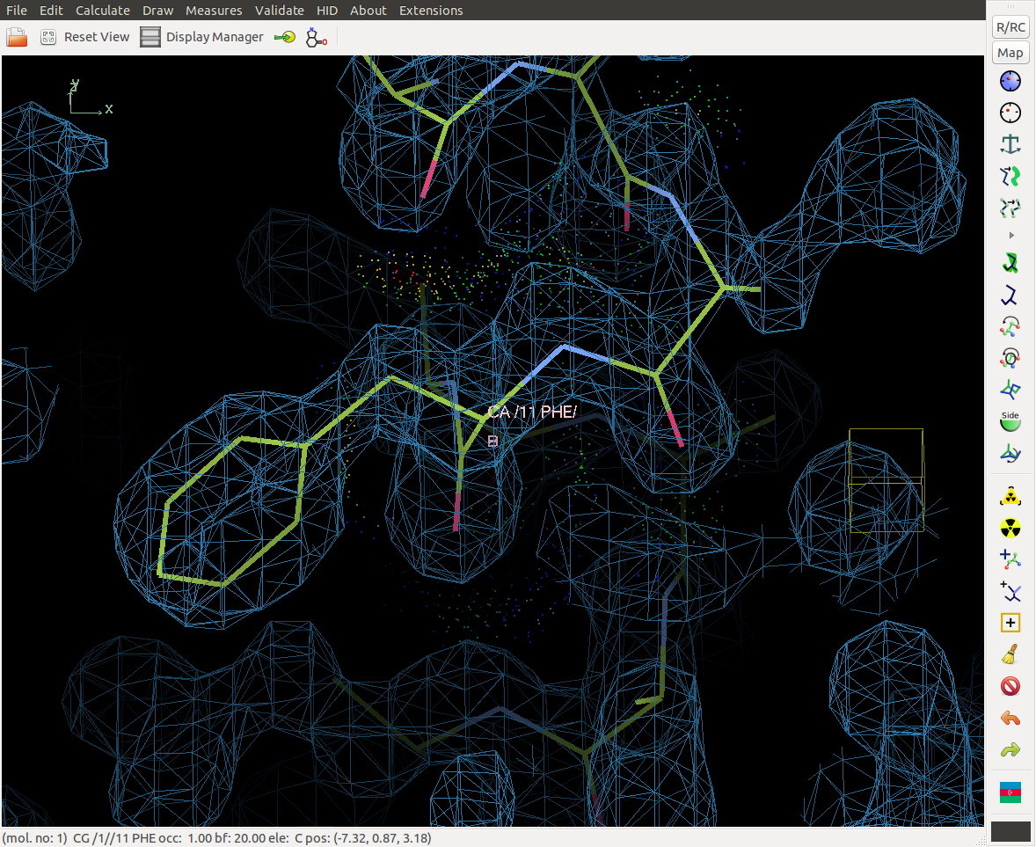
Drag ghost into density. Accept (or not).
If you accidentally accepted, then, “undo”
If you want to revert to old model, then, “undo”

Slide 28

A Valuable Lesson
For each adjustment
you make to the model,
view it from two angles--
~90° apart.

Slide 29
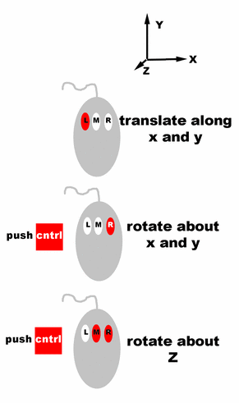
To control objects
Rotate
around x or y
Translate
in x or y

Slide 30
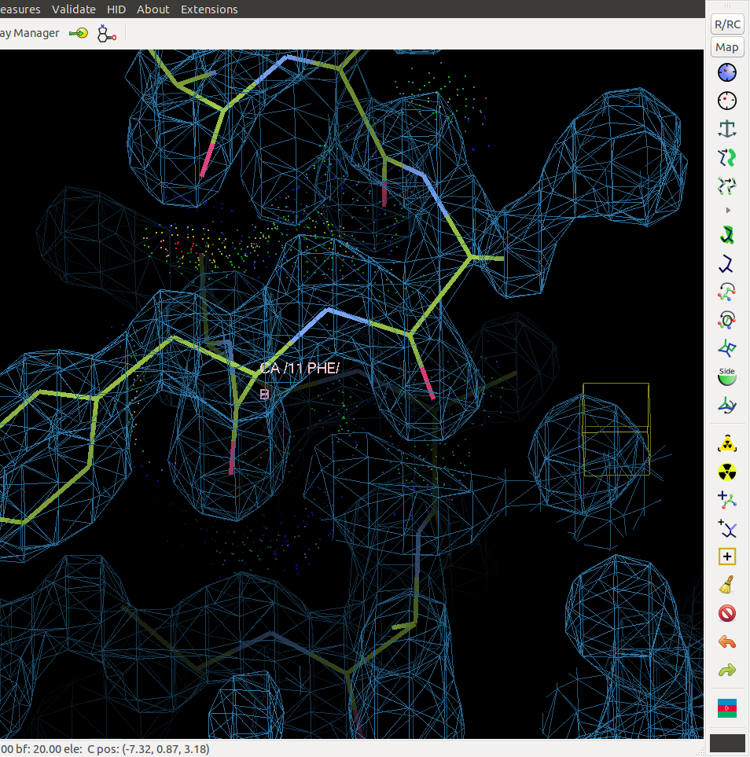
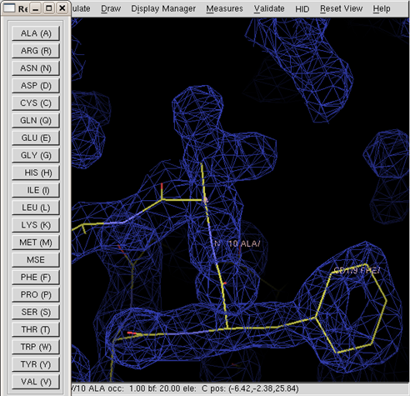
Move to next residue. Mutate & Auto Fit.

Slide 31
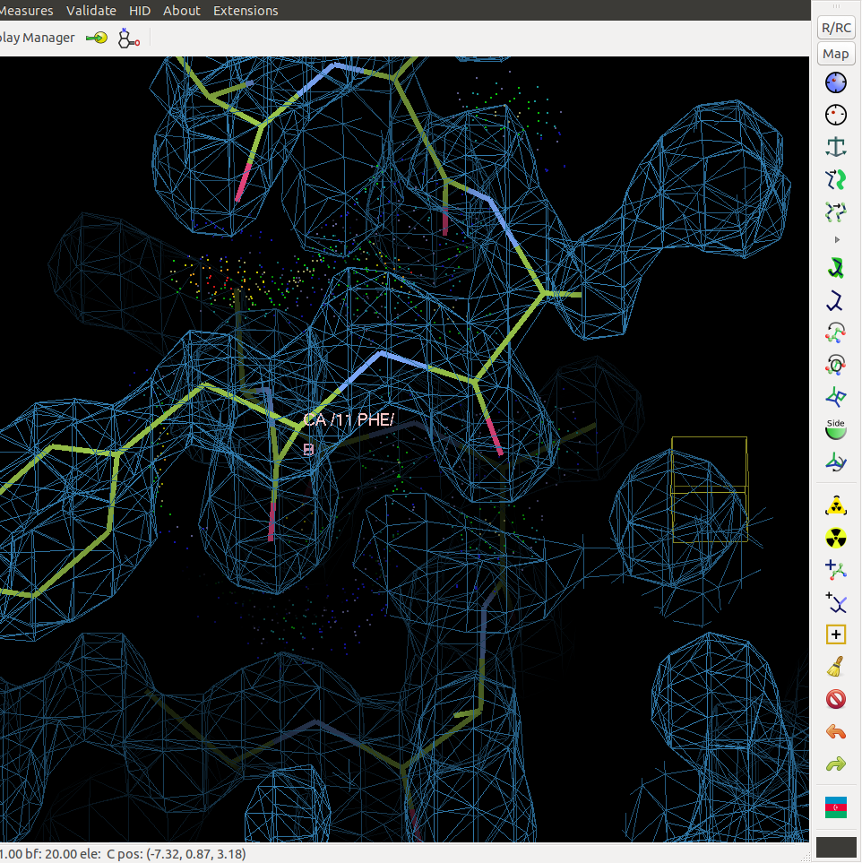
Which amino acid is this?

Slide 32
Assigning the sequence
Keep in mind some residues are isosteric. For example threonine and valine.
Check the proteinase K amino acid sequence for a matching sequence of residues.

Slide 33
Some amino acids have distinctive shapes, others are isosteric.
When in doubt, consider the protein environment.

Slide 34

What is the sequence of these three amino acids?
F T A
Or
F V A
?????

Slide 35
Proteinase K (Tritirachium album) amino acid sequence
001_MAAQTNAPWG_LARISSTSPG_TSTYYYDESA_GQGSCVYVID
041_TGIEASHPEF_EGRAQMVKTY_YYSSRDGNGH_GTHCAGTVGS
081_RTYGVAKKTQ_LFGVKVLDDN_GSGQYSTIIA_GMDFVASDKN
121_NRNCPKGVVA_SLSLGGGYSS_SVNSAAARLQ_SSGVMVAVAA
161_GNNNADARNY_SPASEPSVCT_VGASDRYDRR_SSFSNYGSVL
201_DIFGPGTDIL_STWIGGSTRS_ISGTSMATPH_VAGLAAYLMT
241_LGKTTAASAC_RYIADTANKG_DLSNIPFGTV_NLLAYNNYQA
114

Slide 36

Adjust residue numbers
Find your current residue range.
Open a new “sequence view window”
Here it is 1 to 15.

Slide 37



Adjust residue numbers
Click on: Calculate menu
Choose: Renumber residues
Specify current residue range to change (1 to 15)
Specify offset (103)
Originally, Phe was residue 11. Its correct sequence number is 114. need to add 103

Slide 38



Extend N and C termini one amino acid at a time
Center on the N or C-terminus of the helix
Click on “Add Terminal Residue”
Accept or drag to better location.

Slide 39



Saving first set of coordinates.
File menu
  Save coordinates
Select which coordinate set you want to save.
  1 Helix
Auto suggestion:
  Helix-coot-0.pdb
Change to:
  sawaya-coot-0.pdb
1
version number

Slide 40
Updated coordinates? Save with incremented version number.
Select save.
  1 sawaya-coot-0.pdb
Auto suggestion: sawaya-coot-1.pdb
Accept .
Next time:
  sawaya-coot-2.pdb,
  sawaya-coot-3.pdb, etc.
1 sawaya-coot-0.pdb
sawaya-coot-1.pdb

Slide 41
Results
sawaya1-coot-0.pdb
sawaya1-coot-1.pdb
sawaya1-coot-2.pdb
sawaya1-coot-3.pdb
sawaya1-coot-4.pdb
sawaya1-coot-5.pdb
sawaya1-coot-6.pdb
sawaya1-coot-7.pdb
sawaya1-coot-8.pdb
The last version number of each baton build session represent your best effort at modeling that segment of the protein chain.
Next week, we will concatenate these segments of chain into one file and refine them, calculate R_{work} and R_{free}.

Slide 42
Save coordinates frequently
1) Every 5 minutes.
2) When you have done some modeling that you are especially pleased with.
3) When you are fear that the next step is going to destroy your previous work.

Slide 43

A Valuable Lesson
For each adjustment
you make to the model,
view it from two angles--
~90° apart.

Slide 44
Other Valuable tips
Change contour levels if side chain density not visible
Look out for disulfide bonds between cysteine side chains.

Slide 45


Remember
Do not use maximize button to expand the Coot window to full screen mode. It will hide “pop up” dialog boxes.
  Coot will be waiting for a response, but you’ll never see the question because it is hidden behind the full screen window.
  Instead, stretch window by dragging corner.
X
X
X
NO!
drag corner

Slide 46


Save coordinates frequently or suffer set backs!

