Slide 1
Model Building Assignment
Build an atomic model of proteinase K into your electron density map.
Build all 280 amino acids manually.
The quality of your map will be good. How good is it?
Most atoms could be automatically traced in minutes.
So why build manually? That takes hours!
Take this opportunity to learn how to recognize density features (helices, sheets, chain direction, sidechain shapes) that can help you in your future projects when density is not so clear.

Slide 2
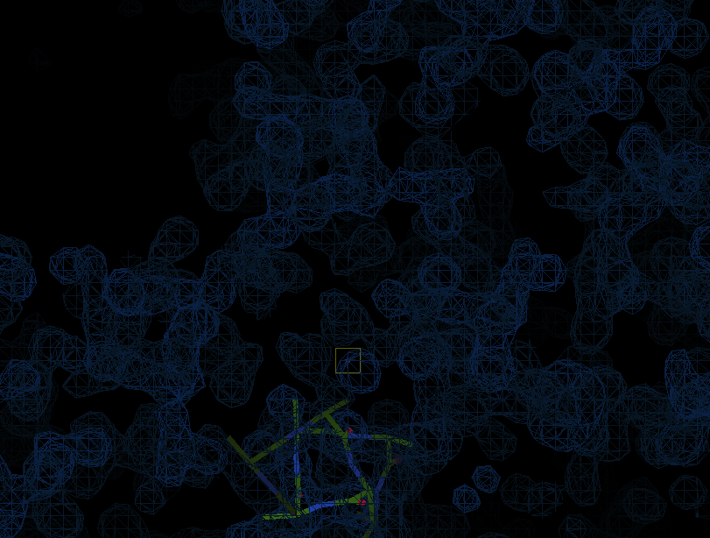
Model Building Procedures
Load and view an electron density map of proteinase K, an enzyme composed of 280 amino acids.
Display an outline of the unit cell.
Recognize the boundary between protein and solvent.
Display a “skeleton” representation of the map.
Identify density of an α-helix.
Build the main chain of the α-helix.
Mutate the side chains to fit the density.
Locate your model’s sequence within the given sequence.
Extend the chain at either end, one residue at a time.

Slide 3
Load map into COOT
Open a terminal window.
Load and view an electron density map of proteinase K.
type “coot m230d_2020_scaled_dm1.mtz”
coot m230d_2020_scaled_dm1.mtz

Slide 4
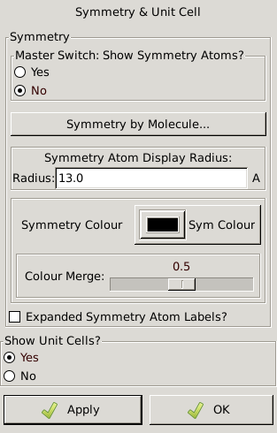
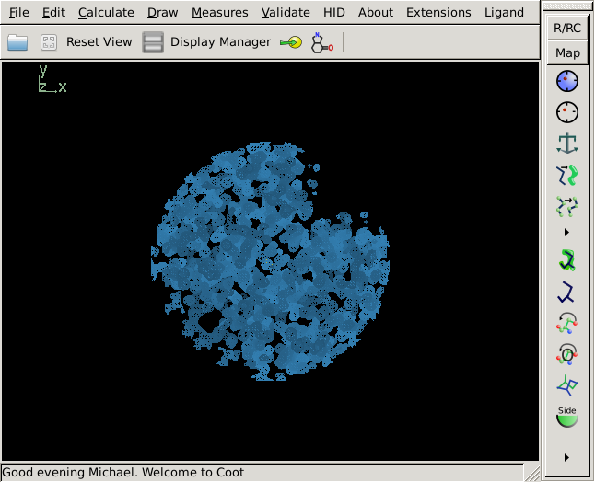
Display unit cell outline
Blah1
Blah2
Blah3
Cell & Symmetry
Blah5
Blah6
Blah7

Slide 5
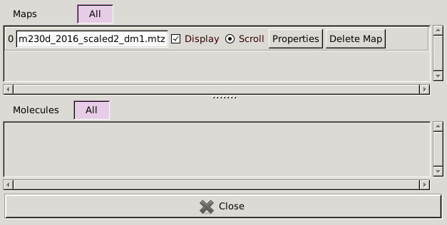
Open “display manager”

Slide 6
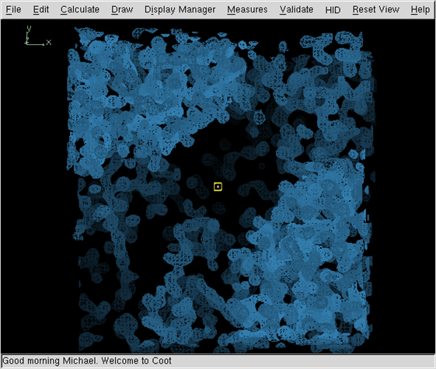
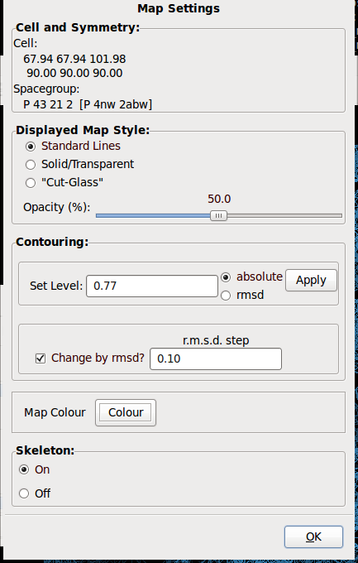
Display skeleton

Slide 7
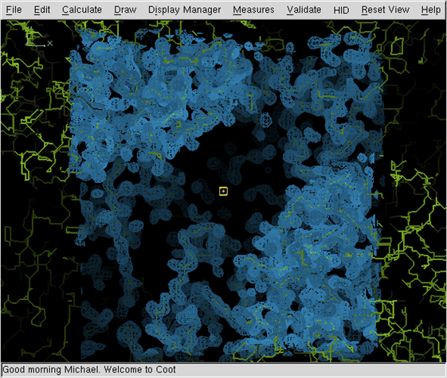
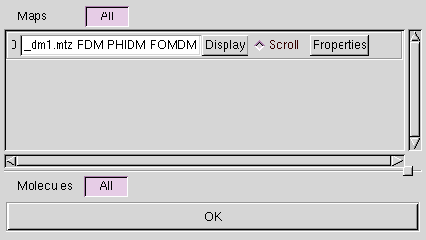
Hide map, search for helix

Slide 8
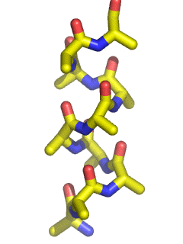
Be able to recognize a helix from different perspectives
90º
Viewed down helical axis
Viewed perpendicular to
helical axis

Slide 9
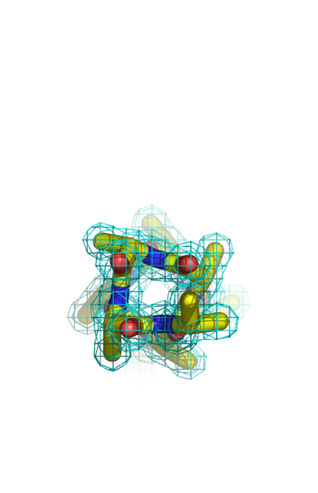
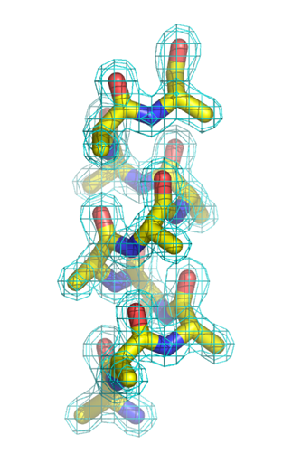
The hole through the center of a helix is the most distinctive feature of α-helix density.
Viewed down helical axis
Often it is easier to recognize helical density when viewed down the helical axis due to the distinctive hole through the center of the helix.
Viewed perpendicular to
helical axis

Slide 10
Translate helix center to screen center (pink box)
To translate
in x or y

Slide 11
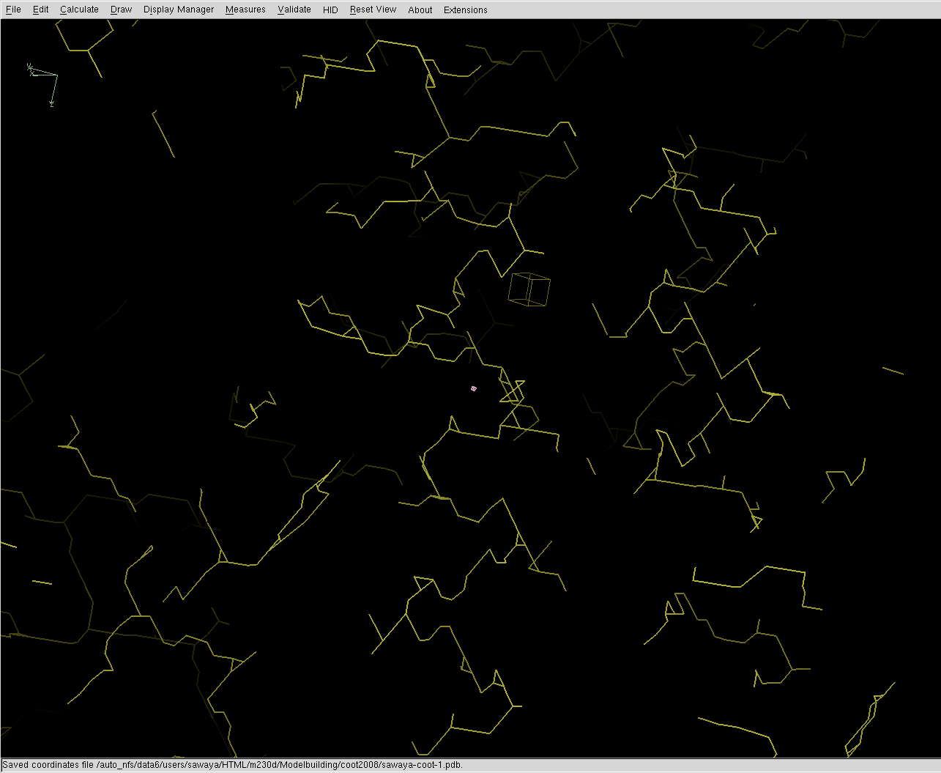
Zoom and center skeleton helix
Small pink box marks center of screen

Slide 12
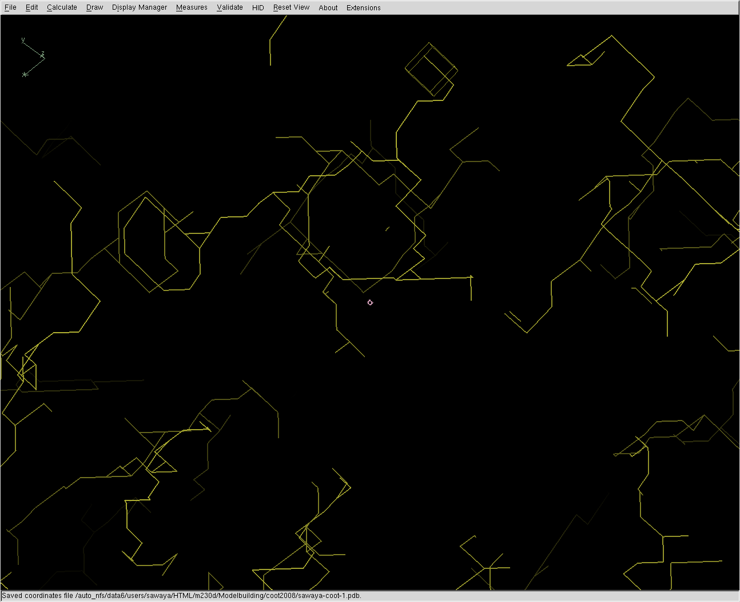
Rotate View (90°)to look down helix axis and re-center helix
Small pink box marks center of screen

Slide 13
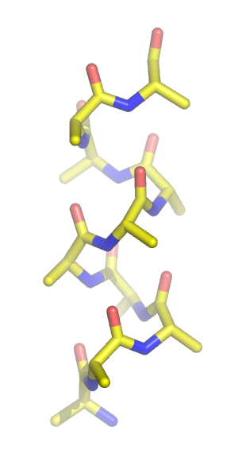
Helix directionality
C-terminus
Protein models are always numbered from N-terminus to C-terminus as shown here. So it is easy to tell the directionality of a helix.
But, electron density isn’t labeled with residue numbers.
What structural features are present in the electron density map to help you determine which direction to place the helix?
Backbone
oxygens
10
9
8
7
6
5
4
Backbone
nitrogens
3
2
1
N-terminus

Slide 14
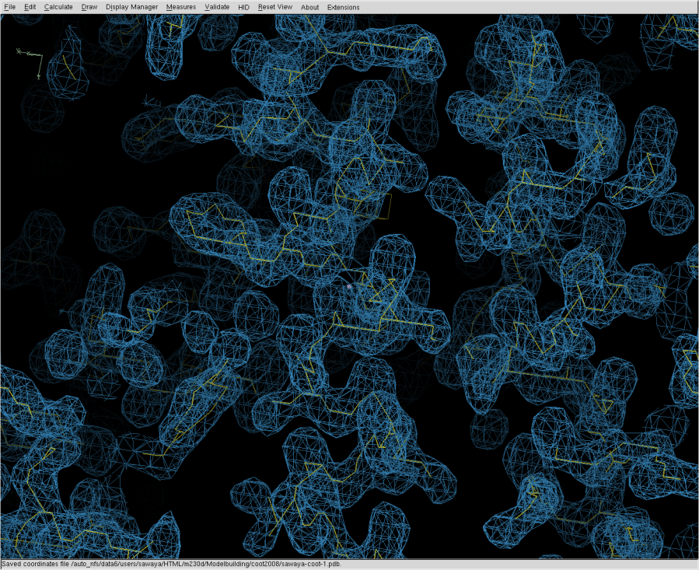
Return to original view. Turn on map. Which direction is the C-term of helix pointed?

Slide 15
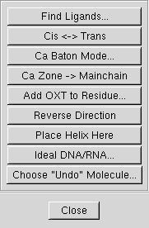
Calculate->Other Modeling Tools Place Helix Here.

Slide 16
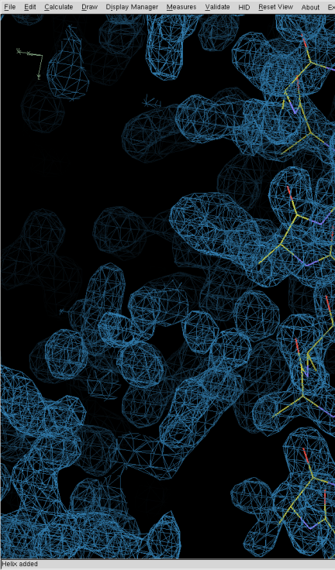
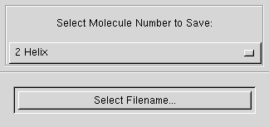
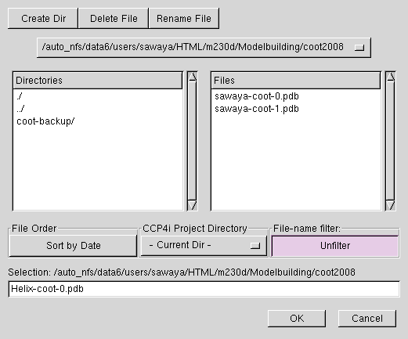
Saving first set of coordinates.
File menu
Save coordinates
Select which coordinate set you want to save.
1 Helix
Auto suggestion:
Helix-coot-0.pdb
Change to:
sawaya-coot-0.pdb
1
version number

Slide 17
Save coordinates frequently
1) Every 5 minutes.
2) When you have done some modeling that you are especially pleased with.
3) When you are fear that the next step is going to destroy your previous work.

Slide 18
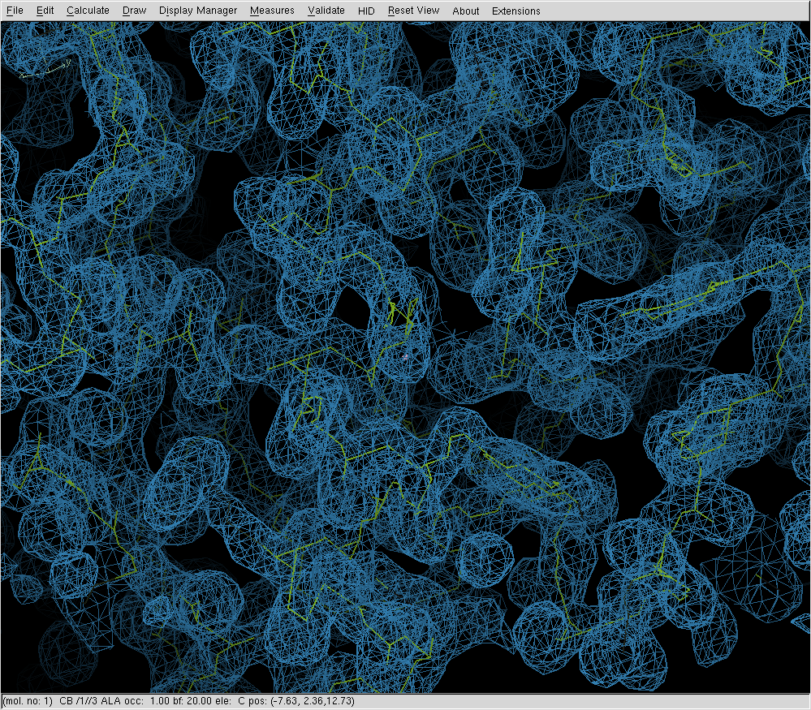
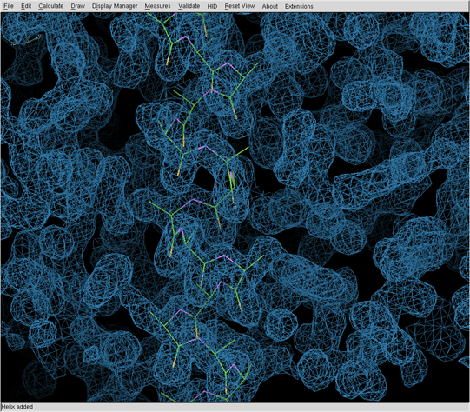
In which direction am I building? N or C? Carbonyl oxygens point to C-terminal end of a helix

Slide 19
Assigning the sequence
You just built the backbone of a helix.
It corresponds to some segment of the 280 aa sequence. Which segment is it?
Give me a hint!!!!!!!

Slide 20
Proteinase K amino acid sequence
001_MAAQTNAPWG_LARISSTSPG_TSTYYYDESA_GQGSCVYVID
041_TGIEASHPEF_EGRAQMVKTY_YYSSRDGNGH_GTHCAGTVGS
081_RTYGVAKKTQ_LFGVKVLDDN_GSGQYSTIIA_GMDFVASDKN
121_NRNCPKGVVA_SLSLGGGYSS_SVNSAAARLQ_SSGVMVAVAA
161_GNNNADARNY_SPASEPSVCT_VGASDRYDRR_SSFSNYGSVL
201_DIFGPGTDIL_STWIGGSTRS_ISGTSMATPH_VAGLAAYLMT
241_LGKTTAASAC_RYIADTANKG_DLSNIPFGTV_NLLAYNNYQA
280 aa
280

Slide 21
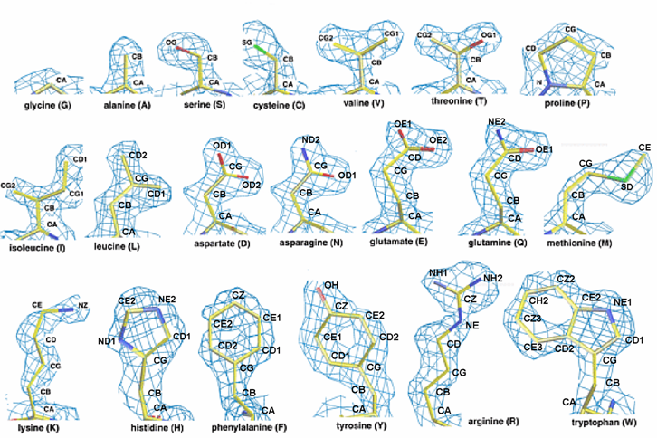
The 20 amino acids in order of increasing size

Slide 22
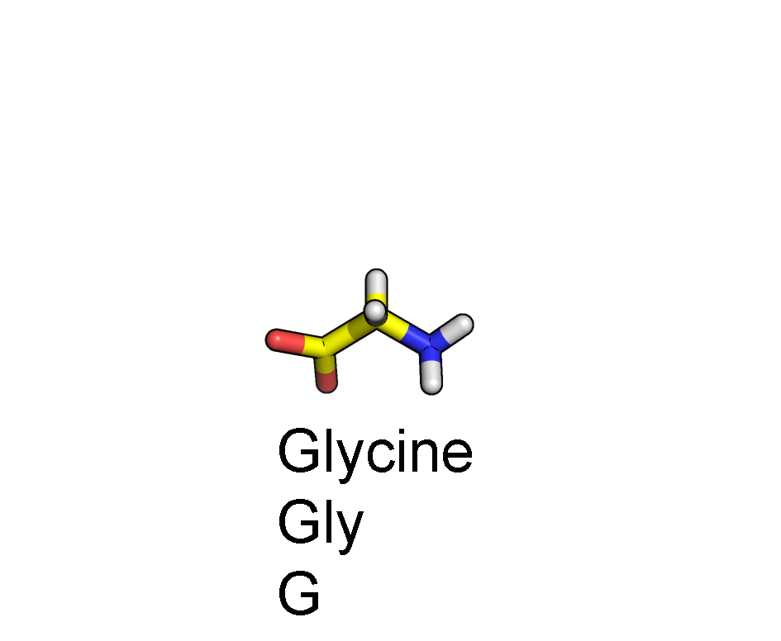
Amino acid anatomy
Side chain
CA
C
N
Backbone
O

Slide 23
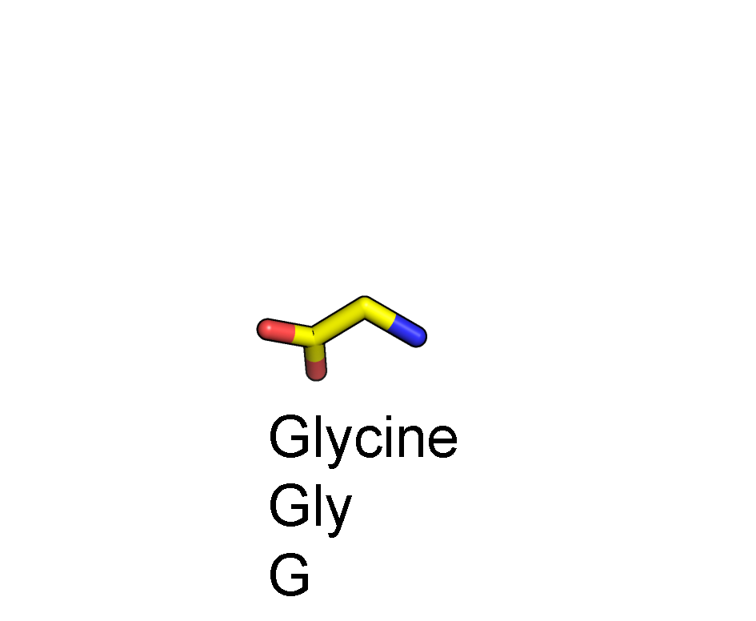
Amino acid anatomy
Side chain
CA
C
N
Backbone
O

Slide 24
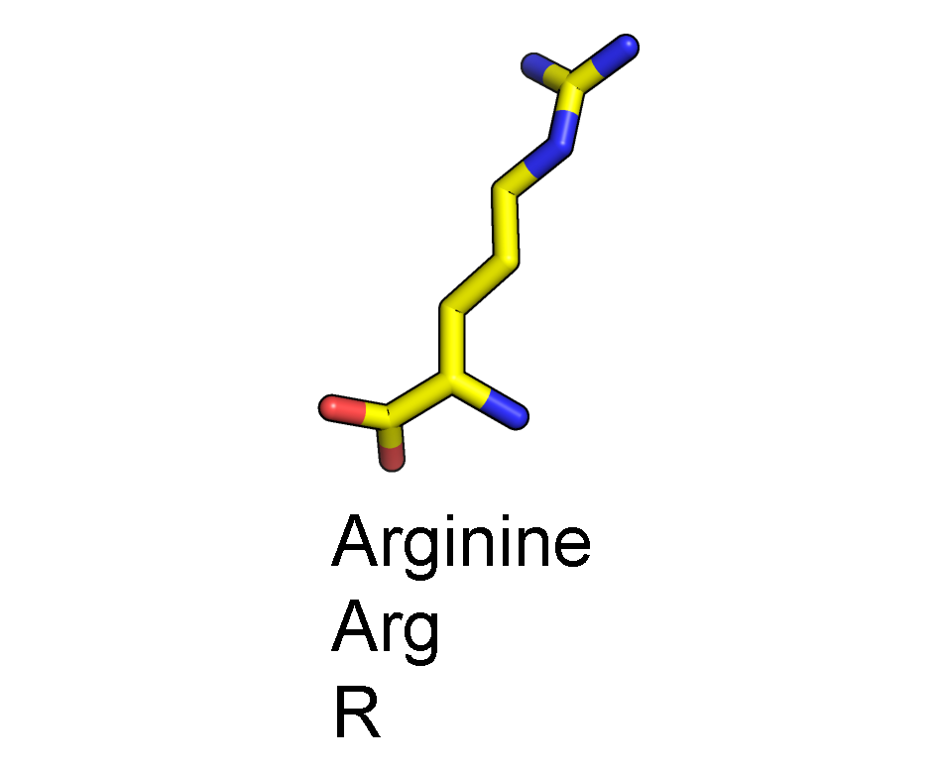
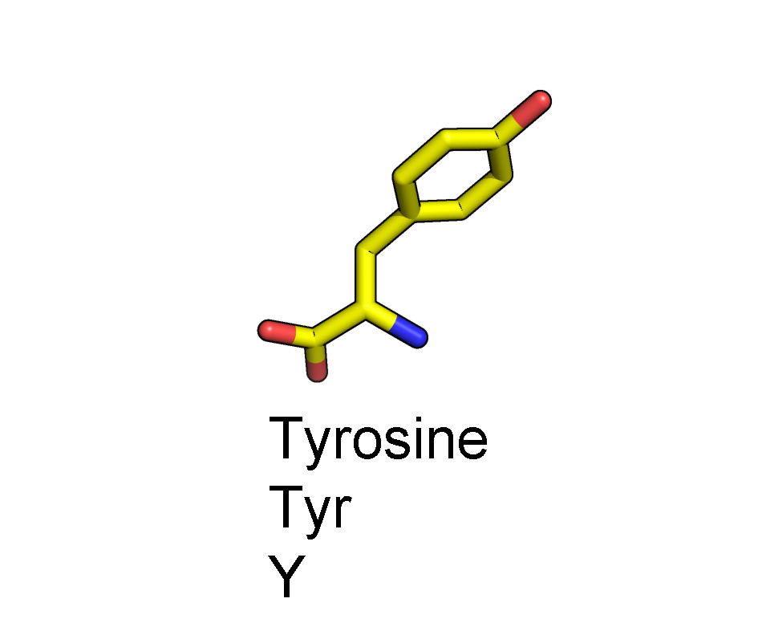
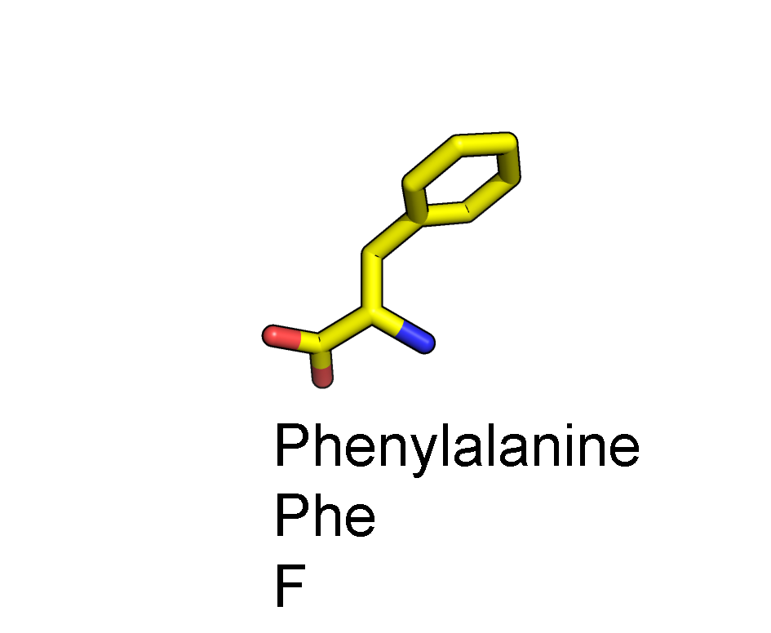
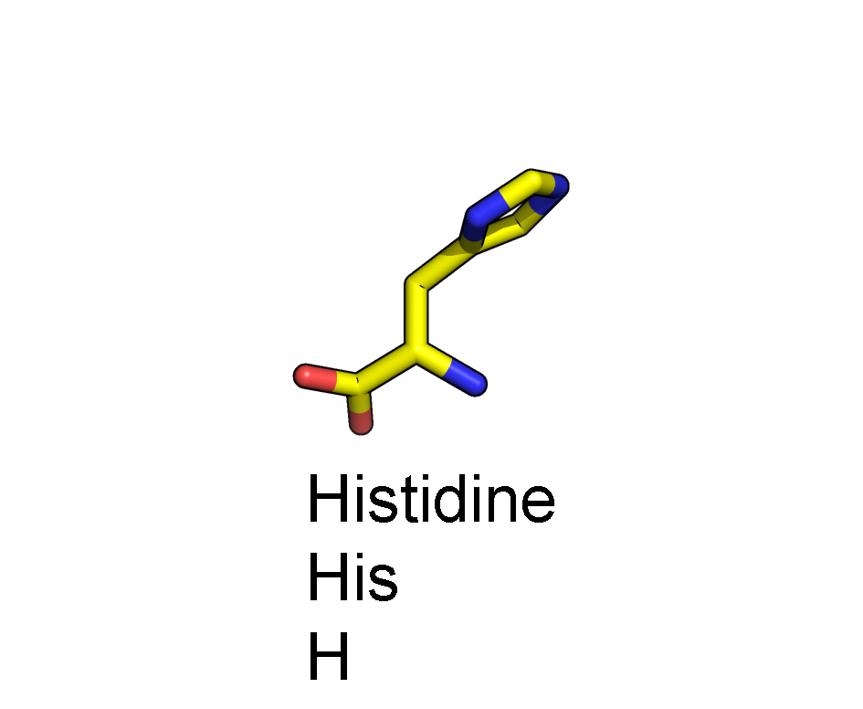
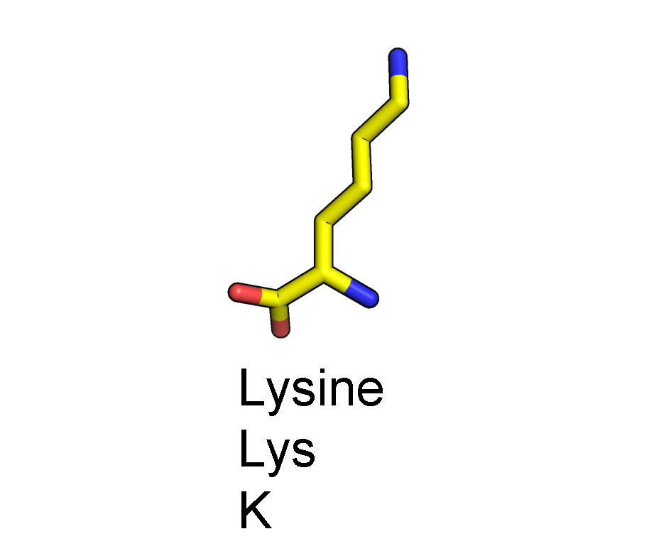
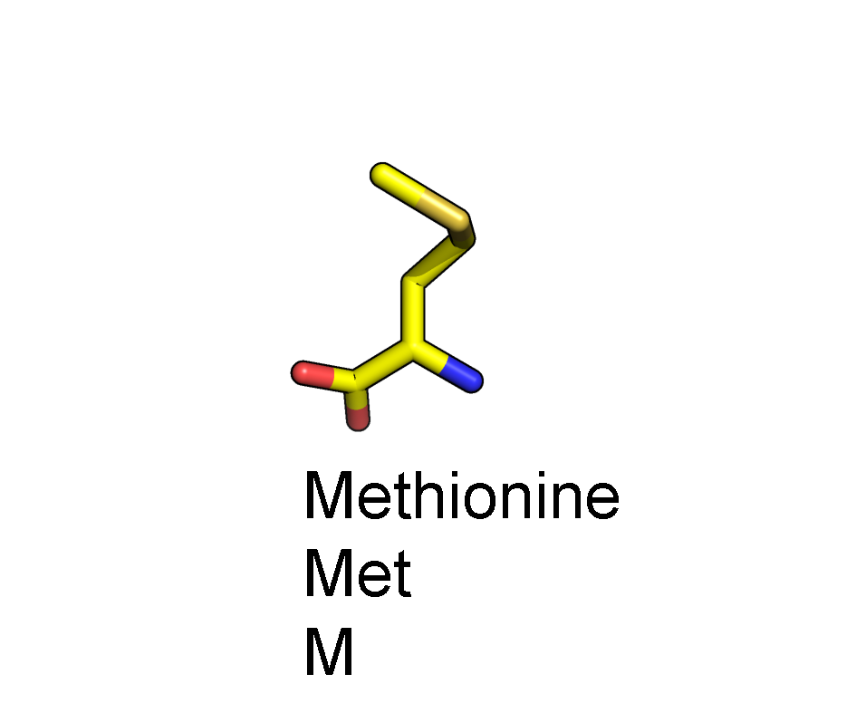
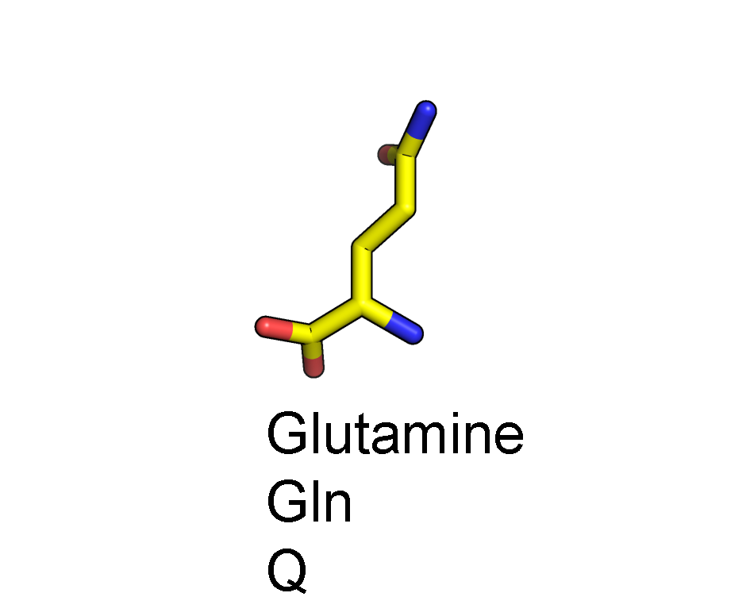
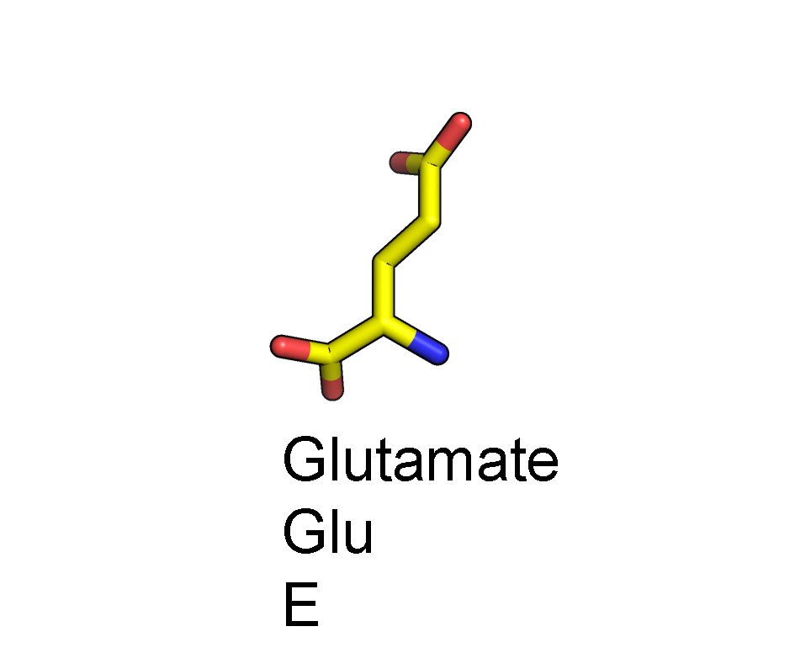
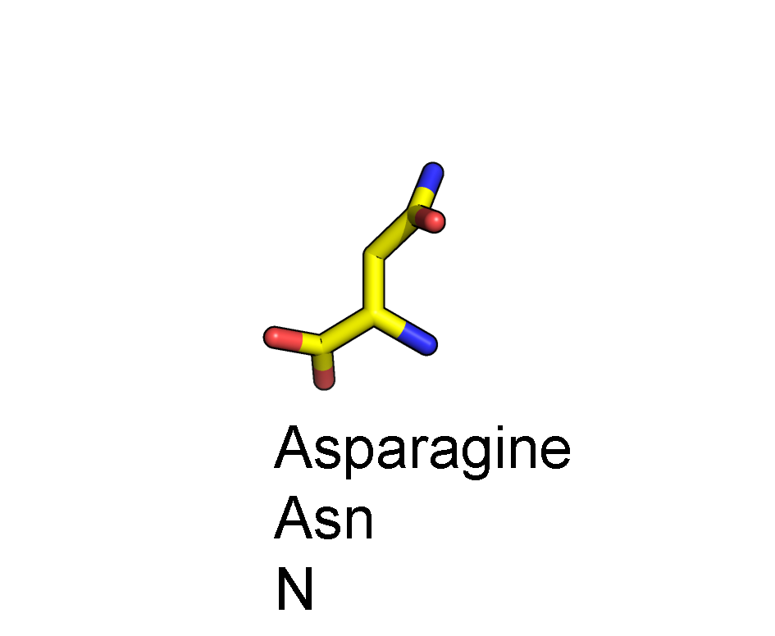
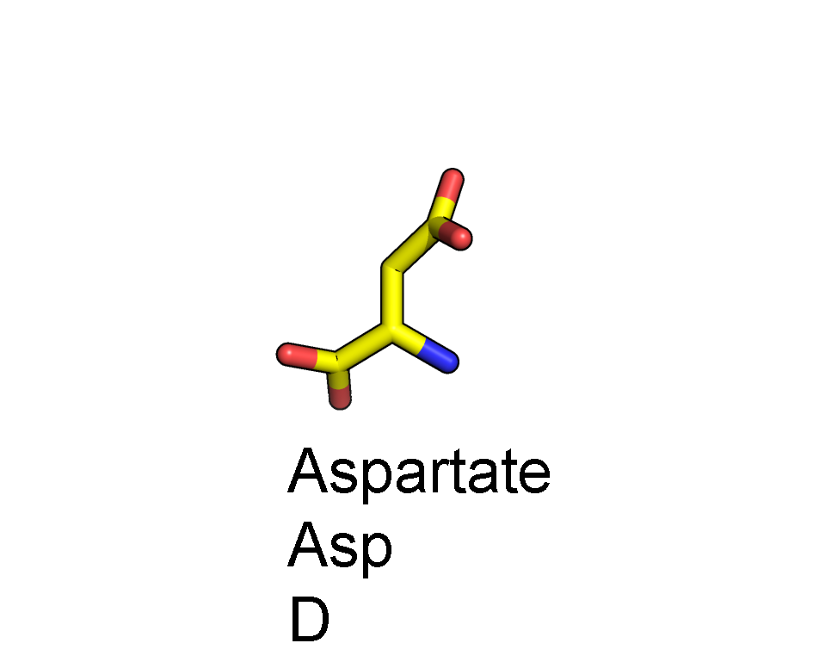
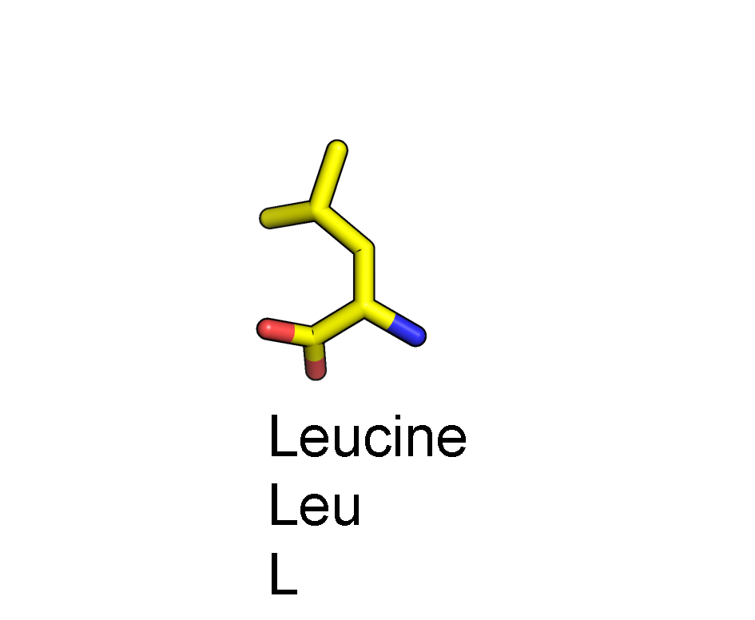
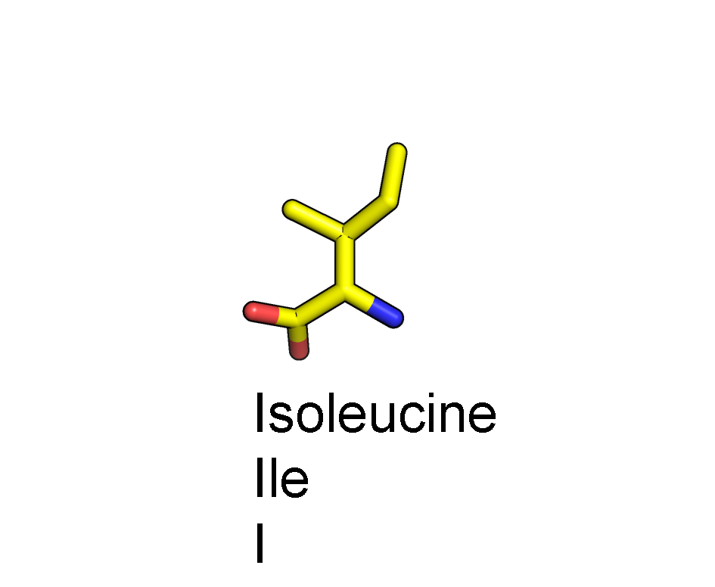
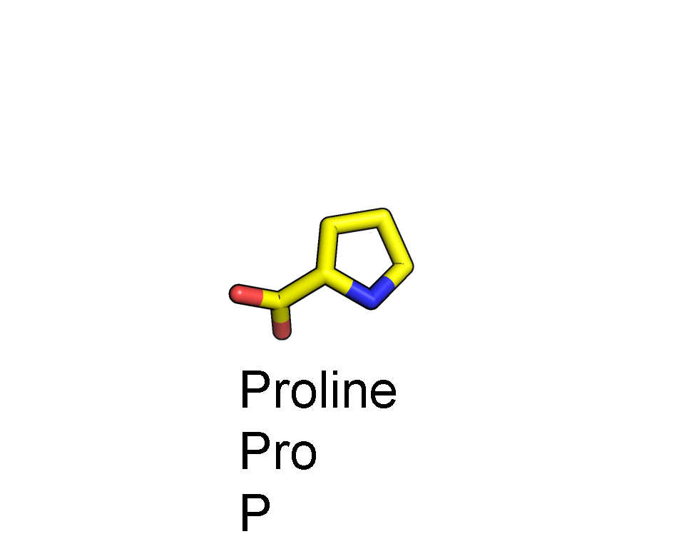
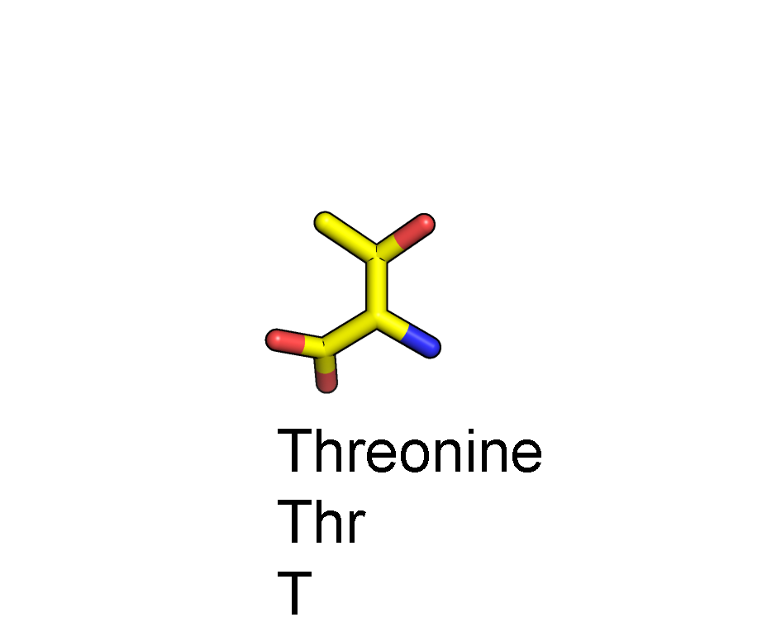
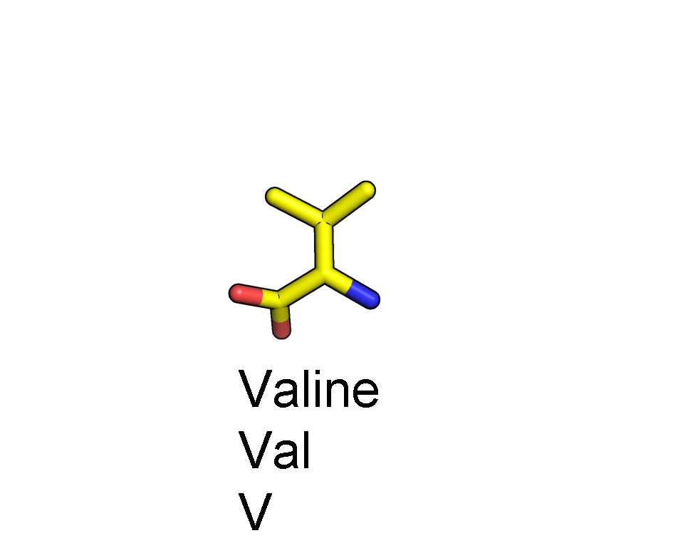
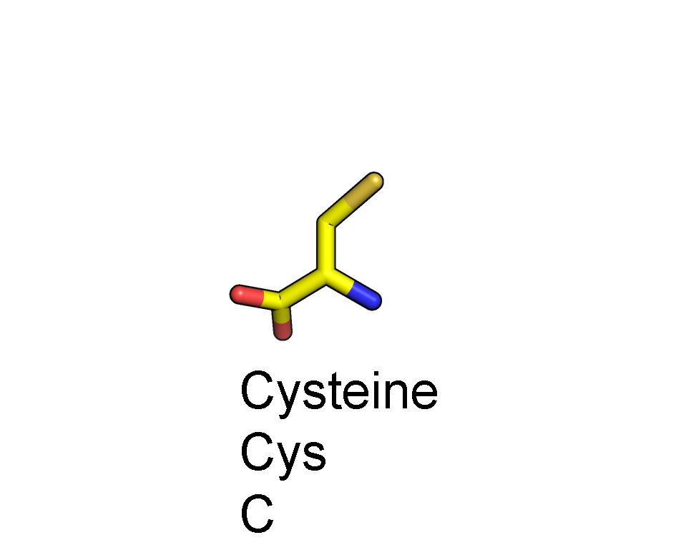
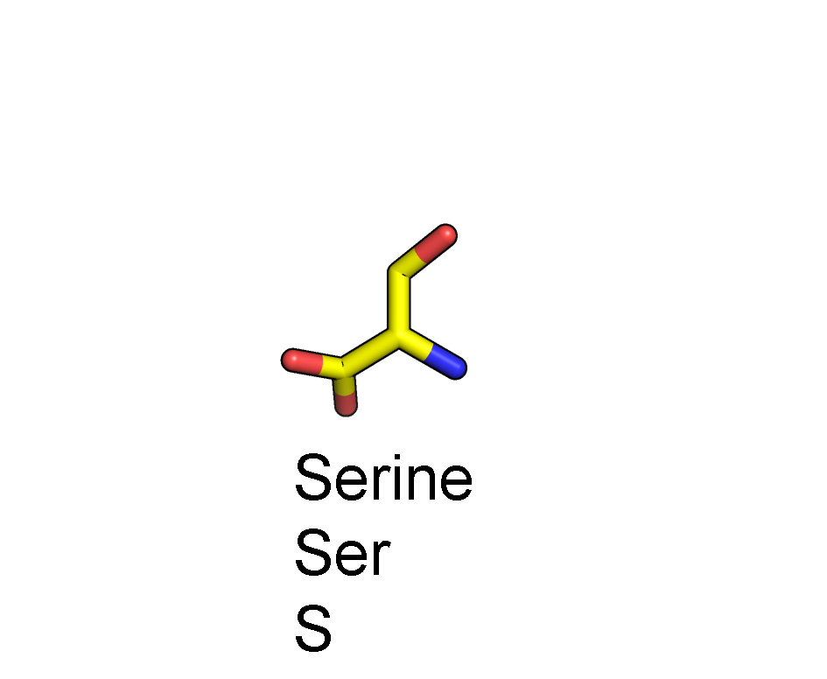
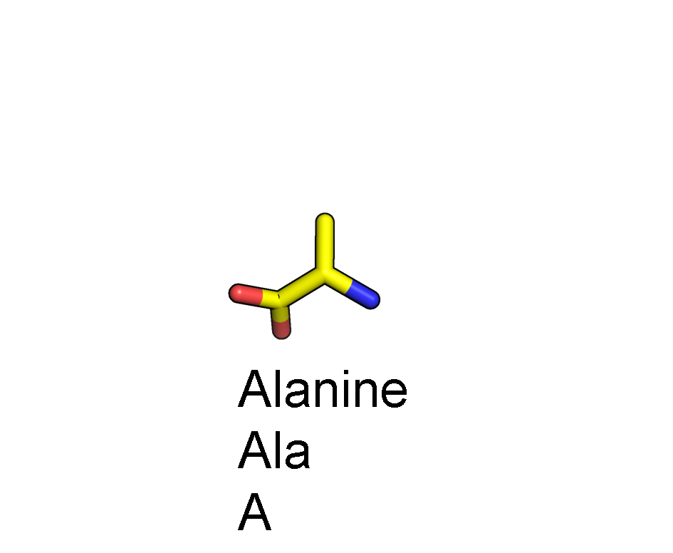
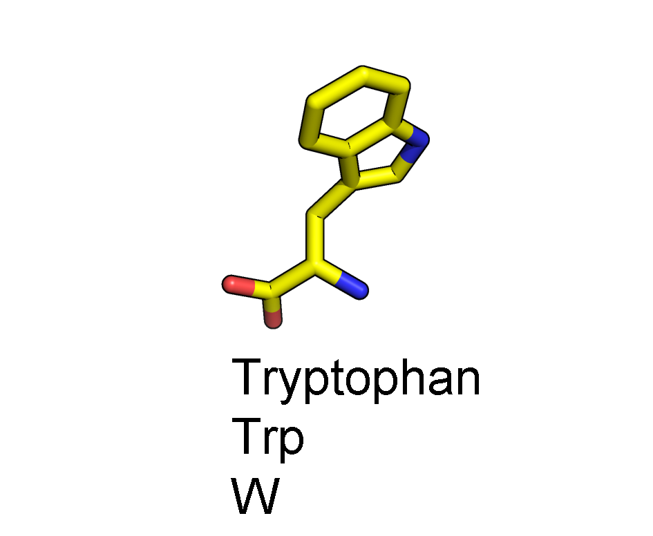
Amino acid anatomy
Side chain
CA
C
N
Backbone
O

Slide 25
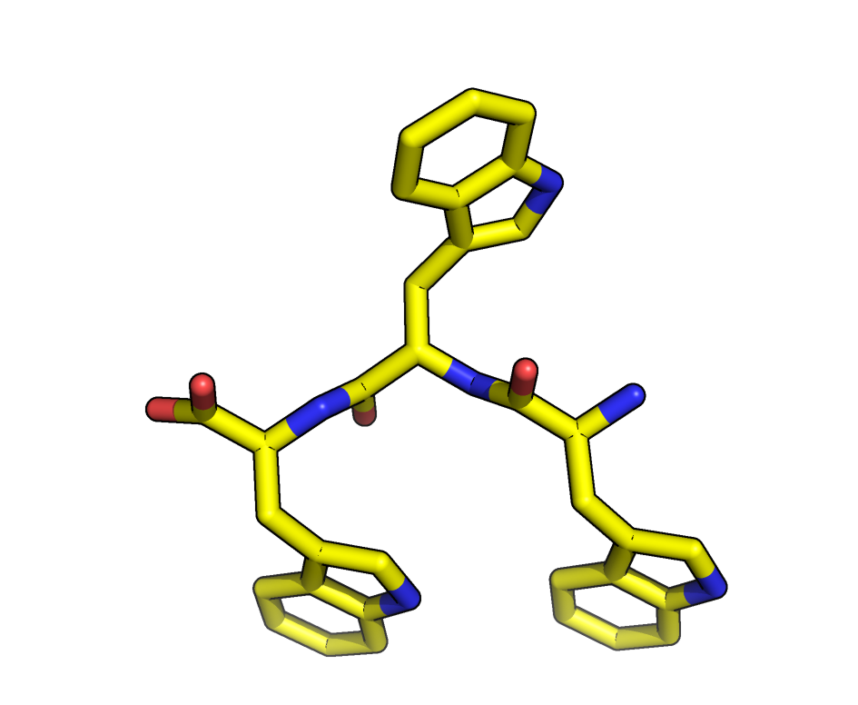
Peptide bond
O
CA
N-terminus
C-terminus
N
C
CA

Slide 26
Peptide bond
C
N
CA
N-terminus
C-terminus
CA
O

Slide 27
Main chain torsion angles
ψ
φ
psi
phi
CA
C
N

Slide 28
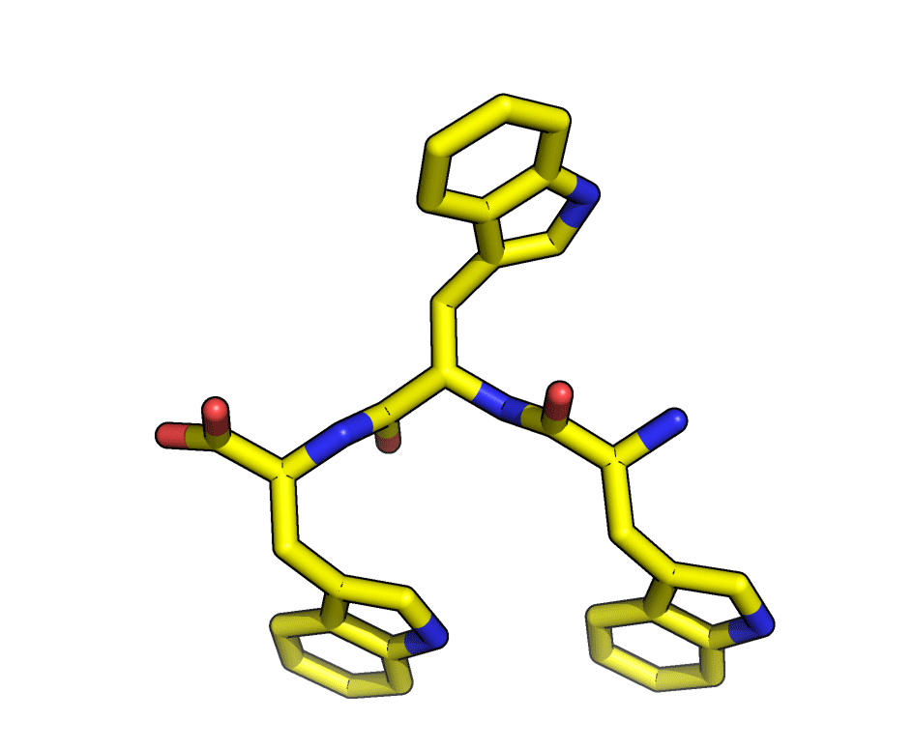
Peptide bond
ψ
φ
psi
phi
CA

Slide 29
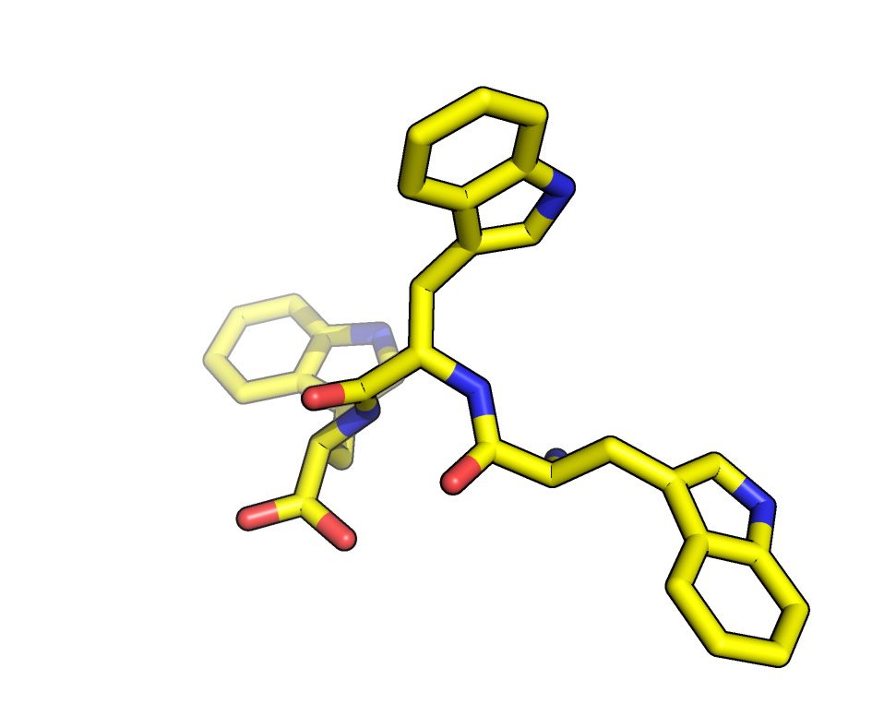
Peptide bond
ψ
φ
psi
phi
CA

Slide 30
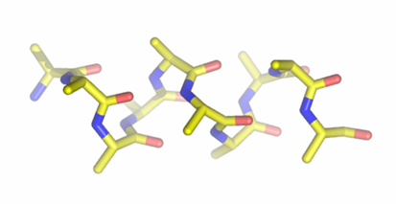
Lowest energy φ,ψ angles correspond to α-helices and β-sheets
β-sheet
α-helix
Ramachandran plot
If you fit density correctly there will be less than 1% Ramachandran outliers
Notes:
Side chains of neighboring residues point in different directions. Avoid steric clash.

Slide 31
Assigning the sequence
You just built the backbone of a helix.
It corresponds to some segment of the 280 aa sequence. Which segment is it?
Find a stretch of 5-10 residues with well defined side chain density.
Fit the side chain density by trial and error. (Mutate & Autofit)
Check the proteinase K amino acid sequence for a matching sequence of residues.

Slide 32
Center on a particular amino acid using sequence view
Blah1
Blah2
Blah3
Sequence View Blah5
Blah6
Blah7

Slide 33
Center on a particular amino acid using sequence view

Slide 34
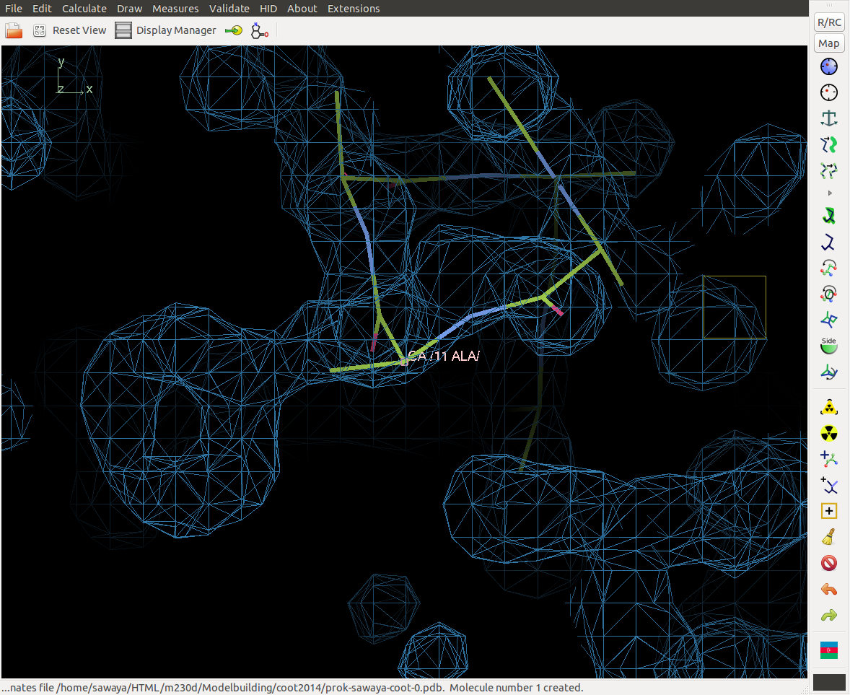
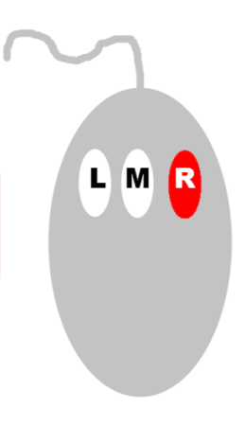
Zoom. Right click. Drag toward you.

Slide 35
Zoom in on a distinctive side chain. Mutate and autofit
Use this

Slide 36
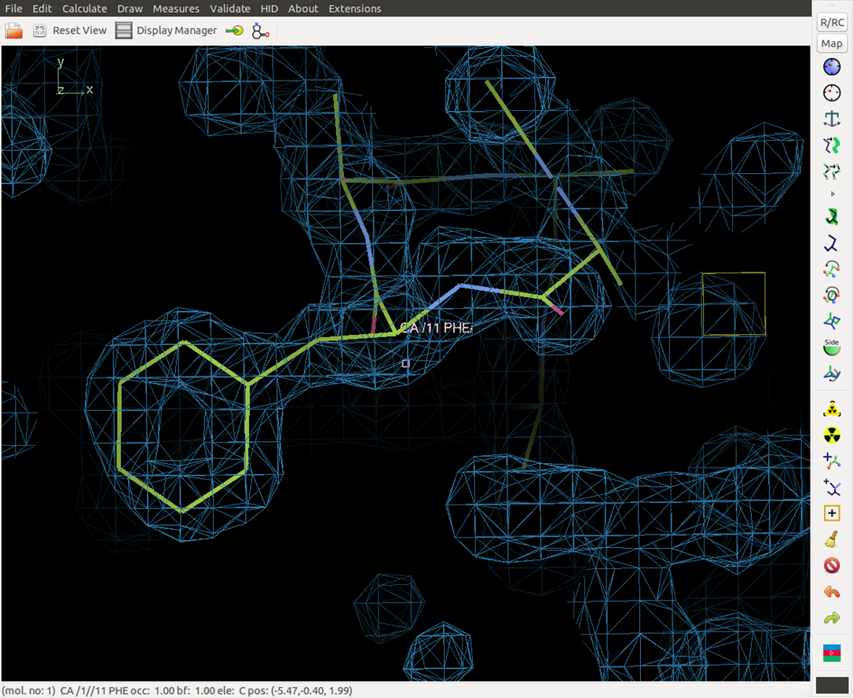
Select amino acid type

Slide 37
What to do if side chain doesn’t fit. First, adjust view to see full picture
Front clipping plane hides atoms.
You cant drag atoms out of the plane of the screen!

Slide 38
Try Real Space Refine. But first adjust view

Slide 39
Specify residue range for refinement by Clicking on beginning and ending residue

Slide 40
Drag ghost into density. Accept (or not).

Slide 41
Drag ghost into density. Accept (or not).
If you accidentally accepted, then, “undo”
If you want to revert to old model, then, “undo”

Slide 42
A Valuable Lesson
For each adjustment
you make to the model,
view it from two angles--
~90° apart.

Slide 43
To control objects
Rotate
around x or y
Translate
in x or y

Slide 44
Move to next residue. Mutate & Auto Fit.

Slide 45
Which amino acid is this?

Slide 46
Assigning the sequence
Keep in mind some residues are isosteric. For example threonine and valine.
Check the proteinase K amino acid sequence for a matching sequence of residues.

Slide 47
Some amino acids have distinctive shapes, others are isosteric.
When in doubt, consider the protein environment.

Slide 48
What is the sequence of these three amino acids?
F T A
Or
F V A
?????

Slide 49
Proteinase K (Tritirachium album) amino acid sequence
001_MAAQTNAPWG_LARISSTSPG_TSTYYYDESA_GQGSCVYVID
041_TGIEASHPEF_EGRAQMVKTY_YYSSRDGNGH_GTHCAGTVGS
081_RTYGVAKKTQ_LFGVKVLDDN_GSGQYSTIIA_GMDFVASDKN
121_NRNCPKGVVA_SLSLGGGYSS_SVNSAAARLQ_SSGVMVAVAA
161_GNNNADARNY_SPASEPSVCT_VGASDRYDRR_SSFSNYGSVL
201_DIFGPGTDIL_STWIGGSTRS_ISGTSMATPH_VAGLAAYLMT
241_LGKTTAASAC_RYIADTANKG_DLSNIPFGTV_NLLAYNNYQA
114

Slide 50
Adjust residue numbers
Find your current residue range.
Open a new “sequence view window”
Here it is 1 to 15.

Slide 51
Adjust residue numbers
Click on: Calculate menu
Choose: Renumber residues
Specify current residue range to change (1 to 15)
Specify offset (103)
Originally, Phe was residue 11. Its correct sequence number is 114. need to add 103

Slide 52
Extend N and C termini one amino acid at a time
Center on the N or C-terminus of the helix
Click on “Add Terminal Residue”
Accept or drag to better location.
Keyboard shortcut: add the following line to .coot, then type “y” to add a residue
(add-key-binding "Add terminal residue" "y" (lambda ()

Slide 53
Updated coordinates? Save with incremented version number.
Select save.
1 sawaya-coot-0.pdb
Auto suggestion: sawaya-coot-1.pdb
Accept .
Next time:
sawaya-coot-2.pdb,
sawaya-coot-3.pdb, etc.
1 sawaya-coot-0.pdb
sawaya-coot-1.pdb

Slide 54
Results
sawaya1-coot-0.pdb
sawaya1-coot-1.pdb
sawaya1-coot-2.pdb
sawaya1-coot-3.pdb
sawaya1-coot-4.pdb
sawaya1-coot-5.pdb
sawaya1-coot-6.pdb
sawaya1-coot-7.pdb
sawaya1-coot-8.pdb
The last version number of each build session representd your best effort at modeling that segment of the protein chain.
Next week, we will refine them, calculate R_{work} and R_{free}.

Slide 55
Save coordinates frequently
1) Every 5 minutes.
2) When you have done some modeling that you are especially pleased with.
3) When you are fear that the next step is going to destroy your previous work.

Slide 56
A Valuable Lesson
For each adjustment
you make to the model,
view it from two angles--
~90° apart.

Slide 57
Other Valuable tips
2.5 σ
Adjust contour levels if side chain density is not clear (for example for surface side chains). Roll scroll wheel on mouse. Usual values are between 0.8 σ and1.2 σ.
Look out for disulfide bonds between cysteine side chains.
1.1 σ
0.1 σ

Slide 58
Remember
Do not use maximize button to expand the Coot window to full screen mode. It will hide “pop up” dialog boxes.
Coot will be waiting for a response, but you’ll never see the question because it is hidden behind the full screen window.
Instead, stretch window by dragging corner.
X
X
X
NO!
drag corner

Slide 59
Save coordinates frequently or suffer set backs!

Slide 60
Load Coordinates
File -> Open Coordinates--browse window opens
Click “filter” (will show only .pdb files)
Click “sort by date” (will place the lastest coordinates at the top of browser)
Select the .pdb file (e.g. sawaya-coot-0.pdb)
Open Coordinates
Auto Open MTZ
Open MTZ, mmcif, fcf, or phs

Slide 61
Load Structure Factors (map)
File -> Open mtz, mmcif, fcf, or phs
Click “filter”
Click “sort by date”
Select output from dm m230d_2019_scaled_dm1.mtz
Open Coordinates
Auto Open MTZ
Open MTZ, mmcif, fcf, or phs
m230d_2017_scaled_dm1.mtz

Slide 62
Load Structure Factors (map)
Assign column labels for Map Synthesis
Amplitudes: Select “FP_native-jeannette”
Phases: Select “PHIDM”
Weights: Select “FOMDM”
FP_native-jeannette

Slide 63
A map and some coordinates should appear

