Slide 1
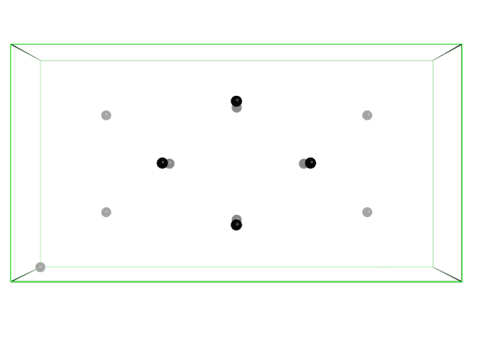
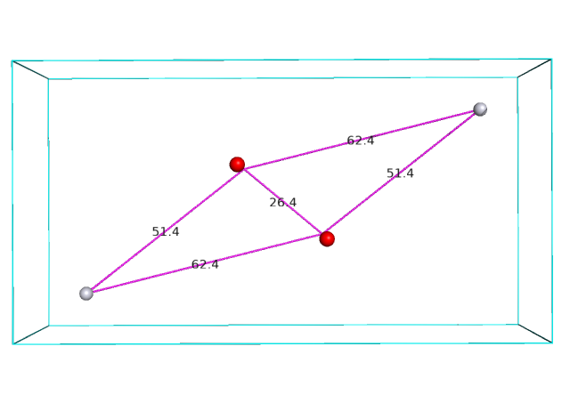
Shining a light on heavy atoms
A tale of how graduate student, Huguette Pelletier located the position of a Pt atom using only clues from a difference Patterson map (a mystery story from 1992 as recounted by Mike).
?
?
?
v
y
u
z
x
w

Slide 2
Motivation for locating heavy atom coordinates
In 1992, Huguette wanted to see the electron density of DNA polymerase β, a protein molecule containing nearly 2000 atoms (not including hydrogen).
She measured diffraction intensities (|F_{P}|)² from a native crystal, but had no phases to calculate an electron density map.
To solve the phase problem, she soaked a crystal with platinum chloride, measured diffraction intensities (|F_{PH}|)² and calculated differences from the native crystal (|F_{PH}|-|F_{P}|)² to approximate the scattering from only Pt atoms.
She calculated a difference Patterson map by taking the Fourier transform of the differences:
P(uvw)=Σ (|F_{PH}|-|F_{P}|) ² cos2π(hx+ky+lz -α_{hkl}) where α_{hkl}=0
The difference Patterson map provided clues to help her determine the coordinates (x,y,z) of the heavy atoms. I recount how Huguette followed the trail of clues to reveal the heavy atom coordinates. I hope this story prepares us to solve an analogous mystery with Proteinase K.
_{hkl}

Slide 3
13 peaks in the Isomorphous Difference Patterson Map (i.e. Treasure Map)
Count Site Height Fractional coordinates
u v w
1 1 1777.67 0.0000 0.0000 0.0000
2 2 442.65 0.5000 0.7658 0.8501
3 2 442.65 0.5000 0.2342 0.1499
4 2 442.65 0.5000 0.7658 0.1499
5 2 442.65 0.5000 0.2342 0.8501
6 3 439.89 0.1678 0.2658 0.0000
7 3 439.89 0.8322 0.7342 0.0000
8 3 439.89 0.8322 0.2658 0.0000
9 3 439.89 0.1678 0.7342 0.0000
10 4 439.66 0.3322 0.5000 0.1499
11 4 439.66 0.6678 0.5000 0.8501
12 4 439.66 0.6678 0.5000 0.1499
13 4 439.66 0.3322 0.5000 0.8501
v
w
u
Huguette counted 13 peaks in the difference Patterson map unit cell. Then how many Pt atoms are expected in the unit cell?
What is the relationship between the number of Patterson peaks and the number of Pt atoms in the unit cell?
Each Patterson peak represents a vector between a pair of Pt atoms.
There is a vector (peak) for every pair of Pt atoms in the unit cell.
If there are “n” atoms in a unit cell, then there should be n² Patterson peaks. But “n” of these n² peaks would be at the origin (self peaks).

Slide 4
How many Pt atoms are in the unit cell given there are 12 Patterson peaks off-origin?
Count Site Height Fractional coordinates
u v w
1 1 1777.67 0.0000 0.0000 0.0000
2 2 442.65 0.5000 0.7658 0.8501
3 2 442.65 0.5000 0.2342 0.1499
4 2 442.65 0.5000 0.7658 0.1499
5 2 442.65 0.5000 0.2342 0.8501
6 3 439.89 0.1678 0.2658 0.0000
7 3 439.89 0.8322 0.7342 0.0000
8 3 439.89 0.8322 0.2658 0.0000
9 3 439.89 0.1678 0.7342 0.0000
10 4 439.66 0.3322 0.5000 0.1499
11 4 439.66 0.6678 0.5000 0.8501
12 4 439.66 0.6678 0.5000 0.1499
13 4 439.66 0.3322 0.5000 0.8501
v
w
u
So, the number of off-origin peaks would be n²-n.
We have 12 off-origin peaks, so n²-n = 12, solve for n.
Solve quadratic equation n²-n-12 = 0
n=-b+/-[sqrt(b²-4ac)]/2a where a=1, b=-1 c=-12
n=4
Huguette expects 4 Pt atoms in the unit cell

Slide 5
How do the Patterson peak positions inform us about the Pt positions?
Count Site Height Fractional coordinates
u v w
1 1 1777.67 0.0000 0.0000 0.0000
20 2 442.65 0.5000 0.7658 0.8501
5 2 442.65 0.5000 0.2342 0.1499
19 2 442.65 0.5000 0.7658 0.1499
6 2 442.65 0.5000 0.2342 0.8501
7 3 439.89 0.1678 0.2658 0.0000
16 3 439.89 0.8322 0.7342 0.0000
8 3 439.89 0.8322 0.2658 0.0000
15 3 439.89 0.1678 0.7342 0.0000
11 4 439.66 0.3322 0.5000 0.1499
14 4 439.66 0.6678 0.5000 0.8501
12 4 439.66 0.6678 0.5000 0.1499
13 4 439.66 0.3322 0.5000 0.8501
v
w
u
The first, and strongest Patterson peak on the list is located at the origin (0,0,0).
It represents the vector between each Pt atom and itself.
Its not informative because even an incorrect Pt(x,y,z) model will predict a peak at 0,0,0.
No matter what x,y,z you assign to the Pt atom, it has a vector of 0 length from itself.

Slide 6
The remaining 12 vectors describe the relative positions of the 4 Pt atoms.
Count Site Height Fractional coordinates
u v w
1 1 1777.67 0.0000 0.0000 0.0000
2 2 442.65 0.5000 0.7658 0.8501
3 2 442.65 0.5000 0.2342 0.1499
4 2 442.65 0.5000 0.7658 0.1499
5 2 442.65 0.5000 0.2342 0.8501
6 3 439.89 0.1678 0.2658 0.0000
7 3 439.89 0.8322 0.7342 0.0000
8 3 439.89 0.8322 0.2658 0.0000
9 3 439.89 0.1678 0.7342 0.0000
10 4 439.66 0.3322 0.5000 0.1499
11 4 439.66 0.6678 0.5000 0.8501
12 4 439.66 0.6678 0.5000 0.1499
13 4 439.66 0.3322 0.5000 0.8501
v
w
u

Slide 7
Each difference Patterson map reveals the relative positions of a pair of atoms in the unit cell
Count Site Height Fractional coordinates
u v w
1 1 1777.67 0.0000 0.0000 0.0000
2 2 442.65 0.5000 0.7658 0.8501
3 2 442.65 0.5000 0.2342 0.1499
4 2 442.65 0.5000 0.7658 0.1499
5 2 442.65 0.5000 0.2342 0.8501
6 3 439.89 0.1678 0.2658 0.0000
7 3 439.89 0.8322 0.7342 0.0000
8 3 439.89 0.8322 0.2658 0.0000
9 3 439.89 0.1678 0.7342 0.0000
10 4 439.66 0.3322 0.5000 0.1499
11 4 439.66 0.6678 0.5000 0.8501
12 4 439.66 0.6678 0.5000 0.1499
13 4 439.66 0.3322 0.5000 0.8501
The relative position between atoms is described as a vector.
The vectors between atoms are encoded in the coordinates of the difference Patterson peak (u,v,w).
For example, the peak at u=0.168, v=0.266, w=0.00 means that there are two atoms in the unit cell separated by a vector that is:
0.168 × a in the x-direction.
0.266 × b in the y-direction.
0.000 × c in the z-direction.
This is helpful information, but it doesn’t tell is the positions of the atoms relative to the unit cell origin.
Unit cell dimensions:
a=120.5 Å, b=63.5 Å, c=38.2 Å, α=β=γ=90˚
x
0.168*120.5 Å = 20.2 Å
y
_
0.266*63.5 Å = 16.9 Å
_
0.000*38.2 Å = 0.0 Å

Slide 8
A way to fix the position of the Pt atoms relative to the origin.
Count Site Height Fractional coordinates
u v w
1 1 1777.67 0.0000 0.0000 0.0000
2 2 442.65 0.5000 0.7658 0.8501
3 2 442.65 0.5000 0.2342 0.1499
4 2 442.65 0.5000 0.7658 0.1499
5 2 442.65 0.5000 0.2342 0.8501
6 3 439.89 0.1678 0.2658 0.0000
7 3 439.89 0.8322 0.7342 0.0000
8 3 439.89 0.8322 0.2658 0.0000
9 3 439.89 0.1678 0.7342 0.0000
10 4 439.66 0.3322 0.5000 0.1499
11 4 439.66 0.6678 0.5000 0.8501
12 4 439.66 0.6678 0.5000 0.1499
13 4 439.66 0.3322 0.5000 0.8501
A light flashed on over Huguette’s head.
The w coordinate = 0 must mean that the two Pt atoms connected by this vector x₁,y₁,z₁ and x₂,y₂,z₂ have the same z-coordinate.
What crystallographic symmetry operations leave a z-coordinate unchanged?
2-fold rotation around z
3-fold rotation around z
4-fold rotation around z
6-fold rotation around z
Do any of these operations belong to the space group of this crystal?
Huguette had determined the space group was P2₁2₁2 from careful analysis of symmetry in diffraction pattern intensities.
Unit cell dimensions:
a=120.5 Å, b=63.5 Å, c=38.2 Å, α=β=γ=90˚
x
dx =20.2 Å
y
_
Pt x₂,y₂,z₂
dy=16.9 Å
_
Pt x₁,y₁,z₁
dz=0 Å

Slide 9
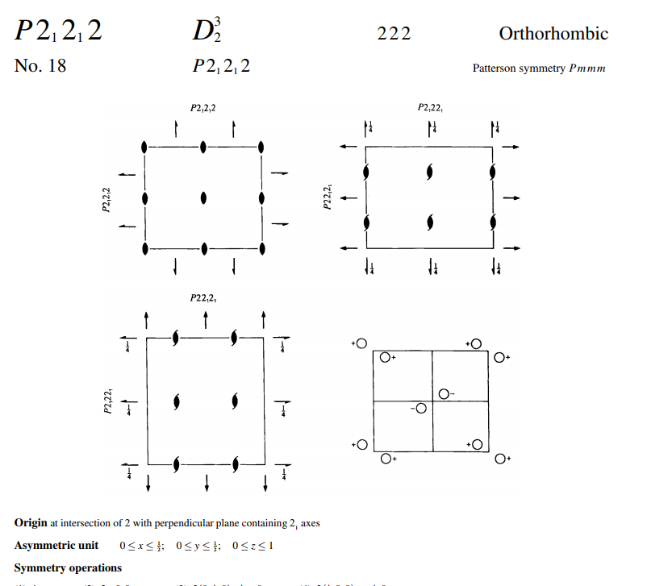
Symmetry operators describe the positions of atoms relative to the origin.
In P2₁2₁2 , there are four symmetry operators.
(1) x, y, z
(2)-x, -y, z
(3)-x+½, y+½,-z
(4) x+½,-y+½,-z
For example, an atom located at x,y,z coordinate 0.1, 0.2, 0.3, must have symmetry copies located at the following 3 sites
-0.1,-0.2, 0.3
0.4, 0.7, -0.3
0.5, 0.3, -0.3

Slide 10
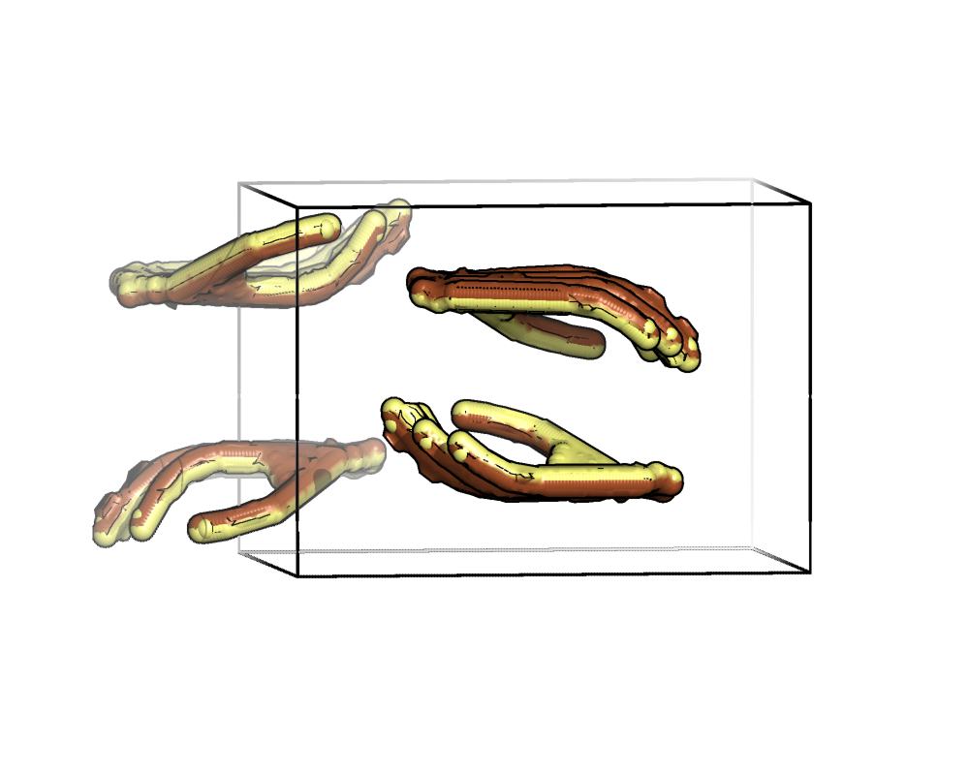
Pt derivative DNA polymerase β
P2₁2₁2
(3) -x + 1/2, y + 1/2, -z
x, y, z (reference)
(2) -x, -y, z (2-fold around z)
(3) -x + 1/2, y + 1/2, -z (2₁ parallel to y )
(4) x + 1/2, -y + 1/2, -z (2₁ parallel to x)
(2) -x, -y, z
x, y, z
Illustrate with
asymmetric unit=
Right hand
(4) x + 1/2, -y + 1/2, -z
y
How many Patterson peak are expected for a single heavy atom site in P2₁2₁2 asymmetric unit?
List the difference vectors expressions in P2₁2₁2.
x
z

Slide 11
Differences between symmetry equivalent positions equate Patterson vectors to the atomic coordinates.
Count Site Height Fractional coordinates
u v w
1 1 1777.67 0.0000 0.0000 0.0000
2 2 442.65 0.5000 0.7658 0.8501
3 2 442.65 0.5000 0.2342 0.1499
4 2 442.65 0.5000 0.7658 0.1499
5 2 442.65 0.5000 0.2342 0.8501
6 3 439.89 0.1678 0.2658 0.0000
7 3 439.89 0.8322 0.7342 0.0000
8 3 439.89 0.8322 0.2658 0.0000
9 3 439.89 0.1678 0.7342 0.0000
10 4 439.66 0.3322 0.5000 0.1499
11 4 439.66 0.6678 0.5000 0.8501
12 4 439.66 0.6678 0.5000 0.1499
13 4 439.66 0.3322 0.5000 0.8501
P2₁2₁2 symmetry equivalent positions:
(1) x, y, z
(2)-x, -y, z
(3)-x+½, y+½,-z
(4) x+½,-y+½,-z
To define the vector between an atom at position 1 and position 2 we simply take the difference between their symmetry equivalent positions 1 and 2:
+
X, Y, Z
-X, -Y, Z
u=2x, v=2y, w=0
Plug in u to solve for x
0.168=2x
0.084=x
Now we have an equation relating the Patterson peak coordinate u,v,w to the heavy atom position in the unit cell, x,y,z.
Plug in v to solve for y
0.266=2y
0.133=y
The only remaining task is to determine
the coordinate, z.

Slide 12
What is the value of z?
0.084=x
X, Y, Z
-X, -Y, Z
u=2x, v=2y, w=0
0.133=y
a)Zero
b) x/y
c) not specified by this map section.

Slide 13
What is the value of z?
0.084=x
X, Y, Z
-X, -Y, Z
u=2x, v=2y, w=0
0.133=y
a)Zero
b) x/y
c) not specified by this map section.
How can we determine the z coordinate?

Slide 14
Knowing the space group symmetry allows you to anticipate where to expect a Patterson peak to exist.
P2₁2₁2 symmetry equivalent positions:
(1) x, y, z
(2)-x, -y, z
(3)-x+½, y+½,-z
(4) x+½,-y+½,-z
+
X, Y, Z
-X, -Y, Z
u=2x, v=2y, w=0
If the space group is P2₁2₁2 we know there should be a Patterson peak with w=0.
The list of all potential (u,v,w) with w=0 is a plane (the w=0 plane).
All such special planes in the Patterson map are called Harker planes. They are predicted to have Patterson peaks based on known symmetry laws.

Slide 15
What other Harker planes exist in space group P2₁2₁2?
 |  | 1 | 2 | 3 | 4
 | Symmetry ops | x y z | -x -y z | -x+½ y+½ -z | x+½ -y+½ -z
1 | x y z | 1-1 | 2-1 | 3-1 | 4-1
2 | -x -y z | 1-2 | 2-2 | 3-2 | 4-2
3 | -x+½ y+½ -z | 1-3 | 2-3 | 3-3 | 4-3
4 | x+½ -y+½ -z | 1-4 | 2-4 | 3-4 | 4-4

Slide 16
How many of these peaks are off-origin?
 |  | 1 | 2 | 3 | 4
 | Symmetry ops | x y z | -x -y z | -x+½ y+½ -z | x+½ -y+½ -z
1 | x y z | x y z -x -y -z 0 0 0 | -x -y z -x -y -z -2x -2y 0 | -x+½ y+½ -z -x -y -z -2x+½ ½ -2z | x+½ -y+½ -z -x -y -z ½ -2y+½ -2z
2 | -x -y z | x y z +x +y -z 2x 2y 0 | -x -y z +x +y -z 0 0 0 | -x+½ y+½ -z +x +y -z ½ 2y+½ -2z | x+½ -y+½ -z +x +y -z 2x+½ ½ -2z
3 | -x+½ y+½ -z | x y z X-½ -y-½ z 2x-½ -½ 2z | -x -y z X-½ -y-½ z -½ -2y-½ 2z | -x+½ y+½ -z X-½ -y-½ z 0 0 0 | x+½ -y+½ -z X-½ -y-½ z 2x -2y 0
4 | x+½ -y+½ -z | x y z -X-½ y-½ z -½ 2y-½ 2z | -x -y z -X-½ y-½ z -2x-½ -½ 2z | -x+½ y+½ -z -X-½ y-½ z -2x 2y 0 | x+½ -y+½ -z -X-½ y-½ z 0 0 0

Slide 17
In what planes do we expect difference Patterson peaks in P2₁2₁2?
 |  | 1 | 2 | 3 | 4
 | Symmetry ops | x y z | -x -y z | -x+½ y+½ -z | x+½ -y+½ -z
1 | x y z | 0 0 0 | -2x -2y 0 | -2x+½ ½ -2z | ½ -2y+½ -2z
2 | -x -y z | 2x 2y 0 | 0 0 0 | ½ 2y+½ -2z | 2x+½ ½ -2z
3 | -x+½ y+½ -z | 2x-½ -½ 2z | -½ -2y-½ 2z | 0 0 0 | 2x -2y 0
4 | x+½ -y+½ -z | -½ 2y-½ 2z | -2x-½ -½ 2z | -2x 2y 0 | 0 0 0

Slide 18
In what planes do we expect difference Patterson peaks in P2₁2₁2?
 |  | 1 | 2 | 3 | 4
 | Symmetry ops | x y z | -x -y z | -x+½ y+½ -z | x+½ -y+½ -z
1 | x y z | 0 0 0 | -2x -2y 0 | -2x+½ ½ -2z | ½ -2y+½ -2z
2 | -x -y z | 2x 2y 0 | 0 0 0 | ½ 2y+½ -2z | 2x+½ ½ -2z
3 | -x+½ y+½ -z | 2x-½ -½ 2z | -½ -2y-½ 2z | 0 0 0 | 2x -2y 0
4 | x+½ -y+½ -z | -½ 2y-½ 2z | -2x-½ -½ 2z | -2x 2y 0 | 0 0 0

Slide 19
The utility of Harker sections
A Harker section is a plane where we expect to find Patterson peaks arising from crystallographic symmetry such as rotation or screw axes.
Harker sections are indicated whenever a difference between symmetry operators defines a plane (i.e. produces a constant for one of the coordinate dimensions).
Harker sections are helpful because they can eliminate the ambiguity of assigning a Patterson peak to its corresponding symmetry equivalent positions.
We have 6 Patterson peaks and 6 pairs of symmetry operators –chances for an incorrect assignment are high if we made the assignments randomly.
Incorrect assignment would lead to incorrect x,y,z coordinates.

Slide 20
Which of these difference vectors is likely to correspond to the difference Patterson peak shown here?
X, Y, Z
-X, -Y, Z
u=2x, v=2y, w=0
a)
b)
c)
d) They are all equally likely.
v=½
1. X, Y, Z
3. ½-X,½+Y,-Z
u=2x-½,v=-½,w=2z
1. X, Y, Z
4. ½+X,½-Y,-Z
u=-½,v=2y-½,w=2z

Slide 21
Which of these difference vectors is likely to correspond to the difference Patterson peak shown here?
X, Y, Z
-X, -Y, Z
u=2x, v=2y, w=0
a)
b)
c)
d) They are all equally likely.
v=½
1. X, Y, Z
3. ½-X,½+Y,-Z
u=2x-½,v=-½,w=2z
1. X, Y, Z
4. ½+X,½-Y,-Z
u=-½,v=2y-½,w=2z

Slide 22
Harker Section v=½
v=½
V=1/2
1. X, Y, Z
3. ½-X,½+Y,-Z
u=2x-½,v=-½,w=2z
Plug in u to solve for x
Plug in w to solve for z
0.333=2x-1/2
0.833=2x
0.416=x
0.150=2z
0.075=z

Slide 23
What are the coordinates (x,y,z) for this heavy atom?
W=0
V=1/2
+
0.333=2x-1/2
0.833=2x
0.416=x
0.168=2x
0.084=x
0.266=2y
0.133=y
0.150=2z
0.075=z
x=0.084, y=0.133, z=0.075
x=0.416, y=0.133, z=0.075
Either a or b is OK.

Slide 24
What are the coordinates x,y,z for this heavy atom?
W=0
V=1/2
+
0.333=2x-1/2
0.833=2x
0.416=x
0.168=2x
0.084=x
0.266=2y
0.133=y
0.150=2z
0.075=z
x=0.084, y=0.133, z=0.075
x=0.416, y=0.133, z=0.075
Either a or b is OK.

Slide 25
Draw the unit cell for this crystal
y
x

Slide 26
This is one valid choice of unit cell
x=0.084, y=0.133, z=0.075
y
x

Slide 27
This choice of cell gives
x=0.584, y=0.133, z=0.075
y
x

Slide 28
This choice of cell gives
x=0.084, y=0.633, z=0.075
y
x

Slide 29
This choice of cell gives
x=0.584, y=0.633, z=0.075
y
x

Slide 30
There is an ambiguity in the choice of origin

Slide 31
There is an ambiguity in the choice of origin

Slide 32
Cheshire operators
There are multiple valid numerical values for x,y,z.
Students with different valid x,y,z will produce maps with identical in features, just shifted in space by a constant.
The operators that relate valid choices of x,y,z are called Cheshire operators.
There are 64 Cheshire operators for P2₁2₁2.

Slide 33
Cheshire symmetry allows either choice of x,y,z values
Combo 1 x_{(from w=0)}=0.084, y_{(from w=0)}=0.133, z _{(from v=½)}=0.075
Combo 2 x_{(from v=½)}=0.416, y_{(from w=0)}=0.133, z _{(from v=½)}=0.075
1) X= 0.084, y= 0.133, z= 0.075
2) X=-0.084, y=-0.133, z= 0.075
3) X=-0.084, y= 0.133, z=-0.075
4) X= 0.084, y=-0.133, z=-0.075
5) X=-0.084, y=-0.133, z=-0.075
6) X= 0.084, y= 0.133, z=-0.075
7) X= 0.084, y=-0.133, z= 0.075
8) X=-0.084, y= 0.133, z= 0.075
9) X= 0.584, y= 0.133, z= 0.075
10) X= 0.416, y=-0.133, z= 0.075
11) X= 0.416, y= 0.133, z=-0.075
12) X= 0.584, y=-0.133, z=-0.075
13) X= 0.416, y=-0.133, z=-0.075
14) X= 0.584, y= 0.133, z=-0.075
15) X= 0.584, y=-0.133, z= 0.075
16) X= 0.416, y= 0.133, z= 0.075
17) X= 0.084, y= 0.633, z= 0.075
18) X=-0.084, y= 0.367, z= 0.075
19) X=-0.084, y= 0.633, z=-0.075
20) X= 0.084, y= 0.367, z=-0.075
21) X=-0.084, y= 0.367, z=-0.075
22) X= 0.084, y= 0.633, z=-0.075
23) X= 0.084, y= 0.367, z= 0.075
24) X=-0.084, y= 0.633, z= 0.075
25) X= 0.084, y= 0.133, z= 0.575
26) X=-0.084, y=-0.133, z= 0.575
27) X=-0.084, y= 0.133, z= 0.425
28) X= 0.084, y=-0.133, z= 0.425
29) X=-0.084, y=-0.133, z= 0.425
30) X= 0.084, y= 0.133, z= 0.425
31) X= 0.084, y=-0.133, z= 0.575
32) X=-0.084, y= 0.133, z= 0.575
1/2+X,1/2+Y, Z
1/2-x,1/2-Y, Z
1/2-X,1/2+Y, -Z
1/2+X,1/2-Y, -Z
1/2-X,1/2-Y, -Z
1/2+X,1/2+Y, -Z
1/2+X,1/2-Y, Z
1/2-X,1/2+Y, Z
1/2+X, Y,1/2+Z
1/2-X, -Y,1/2+Z
1/2-X, Y,1/2-Z
1/2+X, -Y,1/2-Z
1/2-X, -Y,1/2-Z
1/2+X, Y,1/2-Z
1/2+X, -Y,1/2+Z
1/2-X, Y,1/2+Z
X,1/2+Y,1/2+Z
-X,1/2-Y,1/2+Z
-X,1/2+Y,1/2-Z
X,1/2-Y,1/2-Z
-X,1/2-Y,1/2-Z
X,1/2+Y,1/2-Z
X,1/2-Y,1/2+Z
-X,1/2+Y,1/2+Z
1/2+X,1/2+Y,1/2+Z
1/2-X,1/2-Y,1/2+Z
1/2-X,1/2+Y,1/2-Z
1/2+X,1/2-Y,1/2-Z
1/2-X,1/2-Y,1/2-Z
1/2+X,1/2+Y,1/2-Z
1/2+X,1/2-Y,1/2+Z
1/2-X,1/2+Y,1/2+Z
33) X= 0.584, y= 0.633, z= 0.075
34) X= 0.416, y= 0.367, z= 0.075
35) X= 0.416, y= 0.633, z=-0.075
36) X= 0.584, y= 0.367, z=-0.075
37) X= 0.416, y= 0.367, z=-0.075
38) X= 0.584, y= 0.633, z=-0.075
39) X= 0.584, y= 0.367, z= 0.075
40) X= 0.416, y= 0.633, z= 0.075
25) X= 0.584, y= 0.133, z= 0.575
26) X= 0.416, y=-0.133, z= 0.575
27) X= 0.416, y= 0.133, z= 0.425
28) X= 0.584, y=-0.133, z= 0.425
29) X= 0.416, y=-0.133, z= 0.425
30) X= 0.584, y= 0.133, z= 0.425
31) X= 0.584, y=-0.133, z= 0.575
32) X= 0.416, y= 0.133, z= 0.575
49) X= 0.084, y= 0.633, z= 0.575
50) X=-0.084, y= 0.367, z= 0.575
51) X=-0.084, y= 0.633, z= 0.425
52) X= 0.084, y= 0.367, z= 0.425
53) X=-0.084, y= 0.367, z= 0.425
54) X= 0.084, y= 0.633, z= 0.425
55) X= 0.084, y= 0.367, z= 0.575
56) X=-0.084, y= 0.633, z= 0.575
57) X= 0.584, y= 0.633, z= 0.575
58) X= 0.416, y= 0.367, z= 0.575
59) X= 0.416, y= 0.633, z= 0.425
60) X= 0.584, y= 0.367, z= 0.425
61) X= 0.416, y= 0.367, z= 0.425
62) X= 0.584, y= 0.633, z= 0.425
63) X= 0.584, y= 0.367, z= 0.575
64) X= 0.416, y= 0.633, z= 0.575
X, Y, Z
-X, -Y, Z
-X, Y, -Z
X, -Y, -Z
-X, -Y, -Z
X, Y, -Z
X, -Y, Z
-X, Y, Z
1/2+X, Y, Z
1/2-X, -Y, Z
1/2-X, Y, -Z
1/2+X, -Y, -Z
1/2-X, -Y, -Z
1/2+X, Y, -Z
1/2+X, -Y, Z
1/2-X, Y, Z
X,1/2+Y, Z
-X,1/2-Y, Z
-X,1/2+Y, -Z
X,1/2-Y, -Z
-X,1/2-Y, -Z
X,1/2+Y, -Z
X,1/2-Y, Z
-X,1/2+Y, Z
X, Y,1/2+Z
-X, -Y,1/2+Z
-X, Y,1/2-Z
X, -Y,1/2-Z
-X, -Y,1/2-Z
X, Y,1/2-Z
X, -Y,1/2+Z
-X, Y,1/2+Z

Slide 34
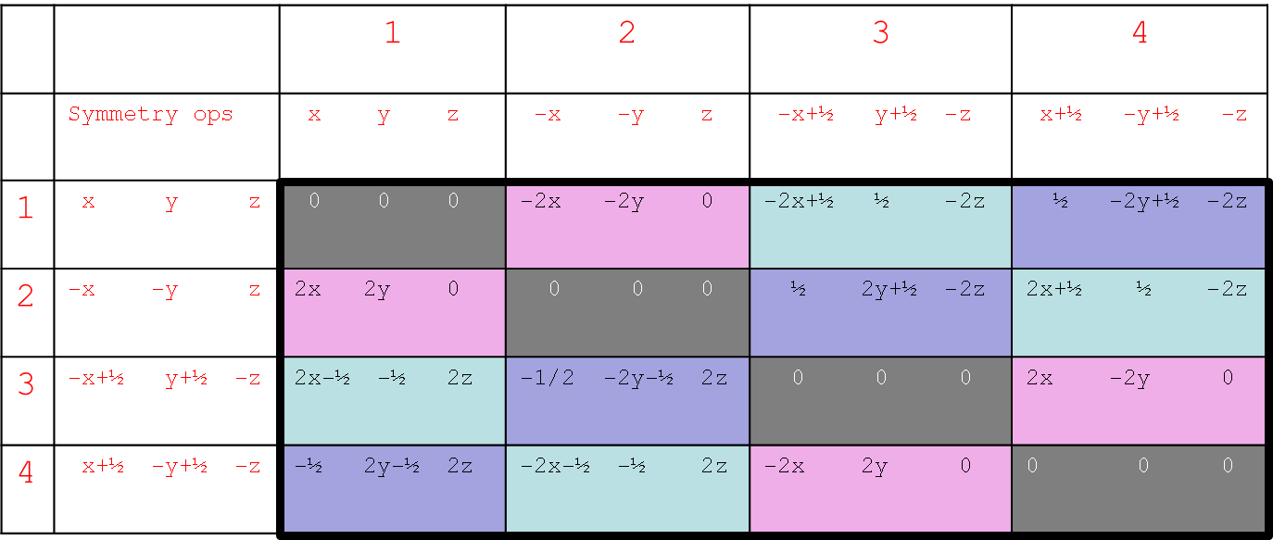
Check your algebra by predicting (u,v,w) of the remaining Patterson peak
Combo 1 x=0.084, y=0.133, z=0.075
W=0
V=½
U=½
Plug in values of x,y,z and solve for u,v,w
U=½
.
.
U=½
v=-2y+½
v=-2(0.133) +½
v=-0.266+½
v=0.234
w=-2z
.
w=-2(0.075)
w=-0.140

Slide 35
Check your algebra by predicting (u,v,w) of the remaining Patterson peak
Combo 1 x=0.084, y=0.133, z=0.075
W=0
V=½
U=½
Plug in values of x,y,z and solve for u,v,w
U=½
.
.
U=½
v=-2y+½
v=-2(0.133)+½
v=-0.266+½
v=0.234
w=-2z
.
w=-2(0.075)
w=-0.140

Slide 36
Is the prediction (½,0.234,-0.140) a match with recorded peak (½,0.234, 0.140)?
Patterson symmetry operators for P2₁2₁2 (Pmmm)
U, V, W
-U,-V, W
-U, V,-W
U,-V,-W
-U,-V,-W
U, V,-W
U,-V, W
-U, V, W
W=0
V=½
U=½
U=½
.
.
U=½
v=-2y+½
v=-2(0.133) +½
v=-0.266+½
v=0.234
w=-2z
.
w=-2(0.075)
w=-0.140
Yes, by Patterson symmetry operator u,v,-w we confirm that (u=½,v=0.234,w=-0.140)
equals (u=½,v=0.234,w= 0.140)

Slide 37
Mission Accomplished!
This concludes Huguette’s successful determination of the heavy atom substructure for the Pt derivative of DNA polymerase β.
Now, you are ready to calculate phases and then a map, and this will reveal shape of the protein.
x=0.084, y=0.133, z=0.075

Slide 38
Our heavy atom soaks
We soaked ProK crystals in heavy atom compounds PCMBS, EuCl₃, or GdCl₃ in hope the metals would bind to proteinase K.
3 native data sets
8 PCMBS data sets
2 EuCl₃ data sets
3 GdCl₃ data sets
Follow the trail of clues to reveal the heavy atom coordinates.

Slide 39
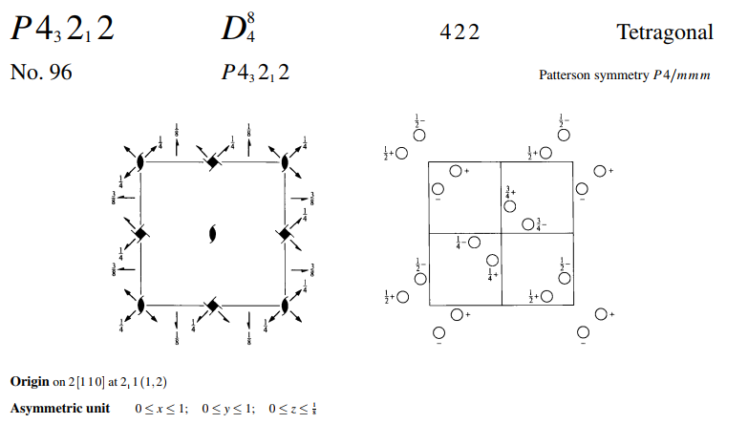
Advanced case,Proteinase K in space group P4₃2₁2
How many Patterson peaks?
Where are Harker sections?
8*8=64 Patterson peaks
8 peaks are at located at the origin
64-8 = 56 non-origin peaks
56/2 = 28 peaks are related to the remaining 28 peaks by center of inversion
28 unique Patterson peaks are expected

Slide 41
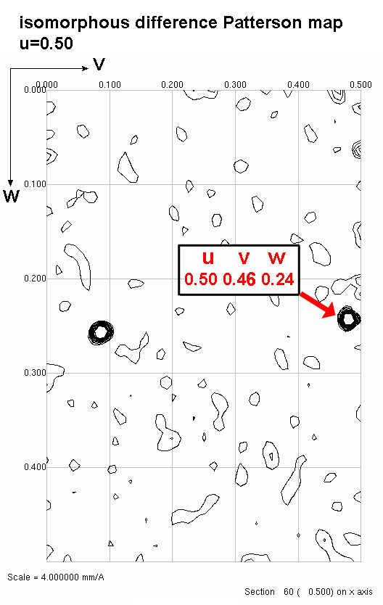
Symmetry operator 3
-Symmetry operator 6
½-y ½+x ¾+z
-( -y -x ½-z)
u=½, v=½+2x, w=¼+2z
Plug in v, solve for x:
Plug in w, solve for z:
u v w
0.500 0.460 0.240
v = ½ + 2x
0.460 = ½ + 2x
-0.040 = 2x
-0.020 = x
w = ¼ + 2z
0.240 = ¼ + 2z
-0.010 = 2z
-0.005 = z

Slide 42
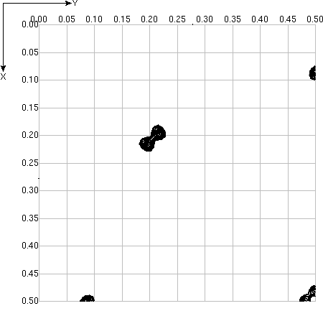
Symmetry operator 2
-Symmetry operator 4
2) -x -y ½+z
4) -(½+y ½-x ¼+z)
u=-½-x-y, v=-½+x-y, w=¼
v
u
Plug in u and solve for x.
Plug in v and solve for y.
u = -½ -x -y
0.180 = -½ -x -y
0.680 = -x –y
Subtract equations
0.680 = -x –y
-0.720 = -x +y
-0.040 = -2x
0.020 = x
v = -½ +x -y
0.220 = -½ +x -y
0.720 = x -y
Add equations
0.720 = x -y
0.680 = -x -y
1.400 = -2y
-0.700 = y
u v w
0.180 0.220 0.250

Slide 43
How to merge atom coordinates x, y, and z from two Harker sections
From Harker section u=½ we get: X₁= -0.020 y₁= ______ z₁= -0.005
From Harker section w=¼ we get: X₂= +0.020 y₂= -0.700 z₂= ______
Note x₁ and x₂ are unequal: -0.020 ≠ +0.020.
Both coordinate sets are correct; they describe different atoms in the unit cell (related by P4₃2₁2 symmetry) or different origin choices.
Sadly, both coordinate sets are incomplete; y₁ and z₂ are unknown.
We must combine coordinates (x₁, z₁) and (x₂, y₂) to get a complete triplet: either (x₁, y₁, z₁) or (x₂, y₂, z₂).
Search for a Cheshire operator that relates (x₁, y₁, z₁) to (x₂, y₂, z₂)
In this case, we need a Cheshire operator that negates x
(i.e. transforms X₂= 0.020 to X₁=-0.020).
Apply this Cheshire operator to (x₂, y₂, z₂) to get value of y₁, completing the set (x₁, y₁, z₁).

Slide 44
Cheshire Symmetry Operators for space group P4₃2₁2
1 X, Y, Z
2 -X, -Y, Z
3 -Y, X, 1/4+Z
4 Y, -X, 1/4+Z
5 Y, X, -Z
6 -Y, -X, -Z
7 X, -Y, 1/4-Z
8 -X, Y, 1/4-Z
09 1/2+X, 1/2+Y, Z
10 1/2-X, 1/2-Y, Z
11 1/2-Y, 1/2+X, 1/4+Z
12 1/2+Y, 1/2-X, 1/4+Z
13 1/2+Y, 1/2+X, -Z
14 1/2-Y, 1/2-X, -Z
15 1/2+X, 1/2-Y, 1/4-Z
16 1/2-X, 1/2+Y, 1/4-Z
17 X, Y, 1/2+Z
18 -X, -Y, 1/2+Z
19 -Y, X, 3/4+Z
20 Y, -X, 3/4+Z
21 Y, X, 1/2-Z
22 -Y, -X, 1/2-Z
23 X, -Y, 3/4-Z
24 -X, Y, 3/4-Z
25 1/2+X, 1/2+Y, 1/2+Z
26 1/2-X, 1/2-Y, 1/2+Z
27 1/2-Y, 1/2+X, 3/4+Z
28 1/2+Y, 1/2-X, 3/4+Z
29 1/2+Y, 1/2+X, 1/2-Z
30 1/2-Y, 1/2-X, 1/2-Z
31 1/2+X, 1/2-Y, 3/4-Z
32 1/2-X, 1/2+Y, 3/4-Z
From Harker section u=½
X₁= -0.020, y₁=_______, z₁= -0.005
From Harker section w=¼
X₂= +0.020, y₂= -0.700, Z₂= ______
This operator will do what we want: negate x
-x,-y, z
Apply Cheshire operator (2)
X₂= -0.020, y₂= +0.700, Z₂=_______
Now, we can merge x₂,y₂,z₂ with x₁,y₁,z₁
Arriving at complete heavy atom coordinate set:
x₁= -0.020, y₁= +0.700, z₁= -0.005

Slide 45
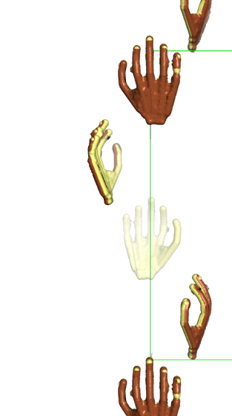
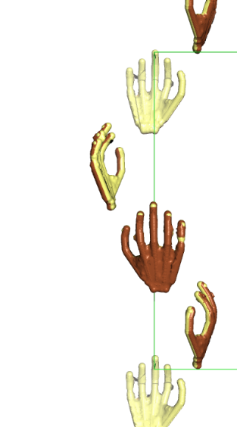
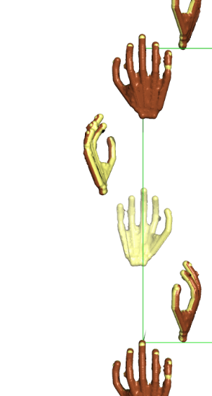
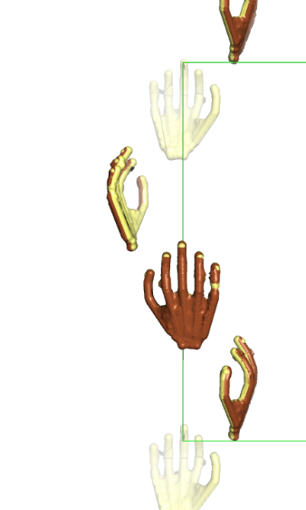
Verify your answer x,y,z is consistent with space group P4₃2₁2.
There is only a 50% probability that our heavy atom coordinates (x,y,z) are consistent with space group P4₃2₁2. The remaining 50% probability is that x,y,z is consistent with space group P4₁2₁2, even though we used P4₃2₁2 symmetry operators to derive our coordinates and our algebra is faultless.
Space group P4₃2₁2 is chiral, meaning that it contains symmetry elements of a particular hand. For example, the 4₃ axis in P4₃2₁2 is a left handed screw.
Space group P4₁2₁2 is also chiral, and its symmetry elements are the mirror image of space group P4₃2₁2.
Crystals in chiral space groups P4₁2₁2 and P4₃2₁2 share the same Patterson symmetry group, P4/mmm, which is not chiral, but centrosymmetric.
All Patterson maps (including P4/mmm) are centrosymmetric because their peaks represent vectors between atoms. Every pair of atoms is connected by two vectors of equal length and opposite direction: atom1→atom2 and atom1←atom2, thereby creating centrosymmetry.
The 50% chance of space group inconsistency arises from our unavoidable dependence on a centrosymmetric map to derive coordinates in a chiral space group.
Among the 230 space groups, only 22 are chiral. How did we get so lucky to stumble one of these?
The heavy atom coordinates (x,y,z) are verified to be consistent with space group P4₃2₁2 if (x,y,z) if it can be used to successfully predict coordinates (u,v,w) of a non-Harker Patterson peak.
If prediction is unsuccessful, invert the hand of the heavy atom solution by negating x to make it compatible with P4₃2₁2.
4₁
4₃
Right hand screw
Left hand screw

Slide 46
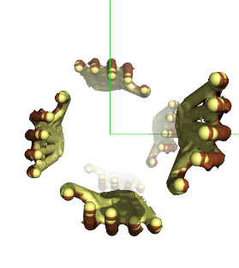
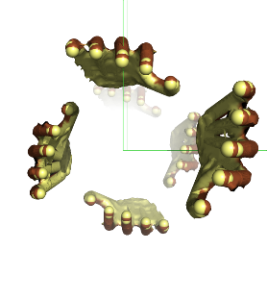
Verify your answer x,y,z is consistent with space group P4₃2₁2.
4₁
4₃
Right hand screw
Left hand screw

Slide 47
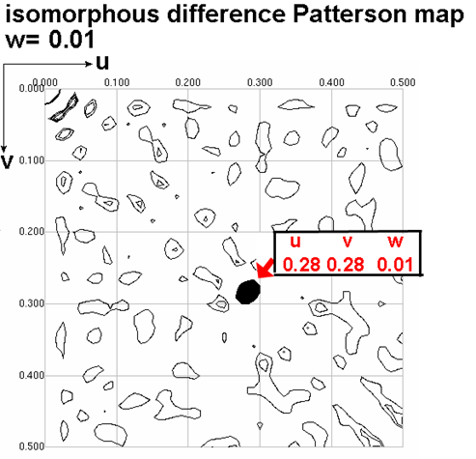
Which Pair of symmetry-equivalent positions in space group P4₃2₁2 could have produced this non-Harker peak?

Slide 48
Plug in x,y,z and solve for u,v,w of a non-Harker Patterson peak
Original x,y,z
x=-0.020,y=+0.700,z=-0.005
x y z
-(y x -z)
u=x-y v=-x+y w=2z
symop 1
-symop 5
u=x-y
u=-0.020-0.700
u=-0.720
v=-x+y
v=+0.020+0.700
v=+0.720
w=2z
w=2(-0.005)
w=-0.010
Note: u,v,w values lay outside the section drawn. u= -0.72, v= 0.72, w= -0.01
Apply Patterson symmetry to transform coordinates to values between 0.0 and 0.5.
(1) U, V, W (2)-U,-V, W (3) U, V,-W (4)-U,-V,-W
(5)-U, V, W (6) U,-V, W (7)-U, V,-W (8) U,-V,-W
(9)-V, U, W (10) V,-U, W (11)-V, U,-W (12) V,-U,-W
(13) V, U, W (14)-V,-U, W (15) V, U,-W (16)-V,-U,-W
Apply operation 1+u,1-v,-w
u= 0.28,v=0.28,w= 0.01 which matches the peak shown here.
Thus, x=-0.02, y=0.70, z=-0.005 is correct. Hurray! We are finished!

Slide 49
An example when the x,y,z does not predict u,v,w.
Original x,y,z
x=+0.020,y=+0.700,z=-0.005
x y z
-(y x -z)
u=x-y v=-x+y w=2z
symop 1
-symop 5
u=x-y
u= 0.020-0.700
u=-0.680
v=-x+y
v=-0.020+0.700
v= 0.680
w=2z
w=2(-0.005)
w=-0.010
Note: u,v,w values lay outside the section drawn. u= -0.68, v= 0.68, w= -0.01
Apply Patterson symmetry to transform coordinates to values between 0.0 and 0.5.
(1) U, V, W (2)-U,-V, W (3) U, V,-W (4)-U,-V,-W
(5)-U, V, W (6) U,-V, W (7)-U, V,-W (8) U,-V,-W
(9)-V, U, W (10) V,-U, W (11)-V, U,-W (12) V,-U,-W
(13) V, U, W (14)-V,-U, W (15) V, U,-W (16)-V,-U,-W
Apply operation 1+u,1-v,-w
u= 0.32,v=0.32,w= 0.01 which does not match the peak shown here.
In this case we would negate x and recalculate u,v,w again. Then you should find the match.

Slide 50
In Lab next week
We have several native data sets and several Hg, Eu, and Gd derivative data sets.
Each person will calculate a difference Patterson map involving the data they collected.
Anomalous difference Patterson map
Isomorphous difference Patterson map
We will record the height of the highest peak on the w=0.5 section for each map.
The native-derivative pair with the highest peak will be used by the whole class.
We will all interpret the difference Patterson map to calculate coordinates x,y,z for the heavy atom.
Perform the calculations carefully. Incorrect x,y,z will produce an uninterpretable electron density map.
Bring your correct choice of x,y,z to Phasing lab the following week and we will calculate and view an electron density map.

Slide 51
Caution
Algebra is simple.
You will feel compelled to abbreviate your algebraic steps in order to finish early.
Abbreviating algebra is the kiss of death.
Write each step, don’t combine steps.
Write neatly.
Keep track of negative signs.
Use worksheets.

