Slide 1
Our goal is to determine the heavy atom locations (x,y,z) in the asymmetric unit.
Use Difference Patterson map synthesis P(u,v,w)=$\sum_{hkl}{\text{(}\text{|}\text{F}\text{PH}\text{|−|}\text{F}\text{P}\text{|}\text{)}2 cos2π(hu+kv+lw)}$
$\text{|}\text{F}\text{P}\text{|}$ is the structure factor amplitude of the native macromolecule (P=“Parent”).
$$\text{|}\text{F}\text{PH}\text{| }\text{is} \text{the} \text{structure} \text{factor} \text{amplitude} \text{of} \text{the} \text{derivative} \text{crystal}$$
$\text{(}\text{PH}\text{="}\text{P}\text{arent}\text{ \& }\text{H}\text{eavy}$ atom).
$\text{|}\text{F}\text{PH}\text{|−|}\text{F}\text{P}\text{|}$approximates the structure factor amplitude of what type of atom?
The features in this difference Patterson map arise from what type of atom?
How are the features in this map related to the atom positions in the crystal?

Slide 2
Outline of methods
We soaked Proteinase K crystals in heavy atom compounds Eu, Gd, or Hg, in hope the metals would bind to proteinase K, specifically.
In lab, we will calculate difference Patterson maps, note the heights of peaks in the map.
Higher peaks mean better phasing signal.
Here in lecture, we will review how to determine the heavy atom coordinates manually (algebra) from a difference Patterson map for the specific case of proteinase K.
Now, follow the trail of clues to reveal the atomic coordinates of a Mercury derivative

Slide 3
Difference Patterson Map
Unit cell of Patterson Map
W=1.0
P(u,v,w)=$\sum_{hkl}{\text{(}\text{|}\text{F}\text{P}\text{roK}\text{+}\text{H}\text{g}\text{|−|}\text{F}\text{P}\text{roK}\text{|}\text{)}2 cos2π(hu+kv+lw)}$
W=0.9
The whole unit cell is represented as 2D sections stacked along “w”.
Some sections have peaks, some don’t.
I am confident that the heavy atom is bound because:
The peaks are strong.
All peaks shown exceed a threshold of 20 times higher than background (i.e. 20 σ).
If no heavy atom were bound, I would expect that most peaks would be under a height of 5 σ.
There are about 60 Patterson peaks in the unit cell. How many heavy atoms would this likely be in the unit cell given ~60 peaks?
W=0.8
W=0.7
W=0.6
W=0.5
W=0.4
W=0.3
w
W=0.2
v
W=0.1
u
W=0.0

Slide 4
How many Patterson peaks are expected for n atoms?
Patterson peaks arise from vectors between atoms in the unit cell.
If there is only one atom in the unit cell, how many vectors can you draw?
1 vector = the atom to itself = zero length.
Unit cell of crystal
“n” atoms | Peaks total
1 | 1
1

Slide 5
How many Patterson peaks are expected for n atoms?
Patterson peaks arise from vectors between atoms in the unit cell.
If there are two atoms in the unit cell, how many vectors can you draw?
4 vectors (2 of zero length, 2 non-zero)
Unit cell of crystal
“n” atoms | Peaks total | Peaks zero length | Peaks non-zero length
1 | 1 | 1 | 0
2 | 4 | 2 | 2
1
2

Slide 6
How many Patterson peaks are expected for n atoms?
Patterson peaks arise from vectors between atoms in the unit cell.
If there are three atoms in the unit cell, how many vectors can you draw?
9 vectors (3 of zero length, 6 non-zero)
Unit cell of crystal
“n” atoms | Peaks total | Peaks zero length | Peaks non-zero length
1 | 1 | 1 | 0
2 | 4 | 2 | 2
3 | 9 | 3 | 6
1
2
3

Slide 7
How many Patterson peaks are expected for n atoms?
Patterson peaks arise from vectors between atoms in the unit cell.
If there are four atoms in the unit cell, how many vectors can you draw?
16 vectors (4 of zero length, 12 non-zero)
Unit cell of crystal
“n” atoms | Peaks total | Peaks zero length | Peaks non-zero length
1 | 1 | 1 | 0
2 | 4 | 2 | 2
3 | 9 | 3 | 6
4 | 16 | 4 | 12
n | n² | n | n²-n
1
2
4
3

Slide 8
How many Patterson peaks are expected for n atoms?
Patterson peaks arise from vectors between atoms in the unit cell.
If there are four atoms in the unit cell, how many vectors can you draw?
16 vectors (4 of zero length, 12 non-zero)
Unit cell of crystal
“n” atoms | Peaks total | Peaks zero length | Peaks non-zero length
1 | 1 | 1 | 0
2 | 4 | 2 | 2
3 | 9 | 3 | 6
4 | 16 | 4 | 12
n | n² | n | n²-n
1
2
4
3
In general

Slide 9
8 atoms would be consistent with the appearance of ~60 peaks
Unit cell of crystal
5
“n” atoms | Peaks total | Peaks zero length | Peaks non-zero length
n | n² | n | n²-n
7 | 49 | 7 | 42
8 | 64 | 8 | 56
9 | 81 | 9 | 72
1
2
8
6
4
3
7

Slide 10
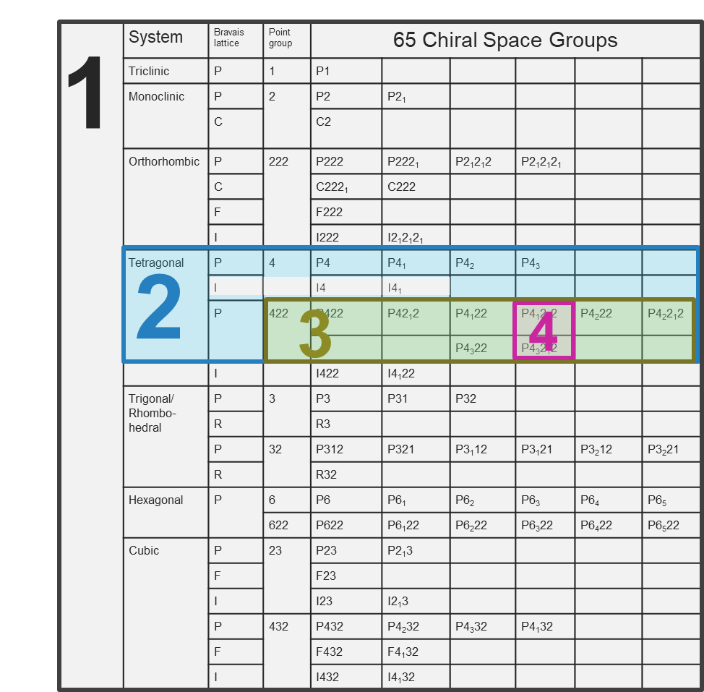
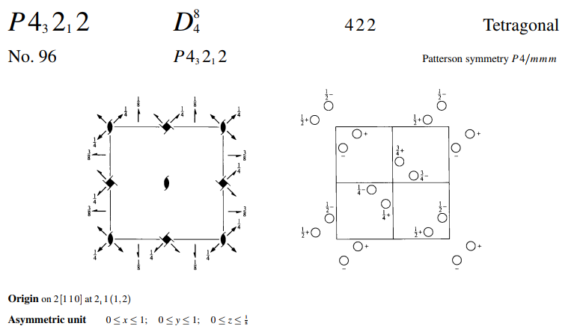
How many heavy atoms exist in the asymmetric unit?
An asymmetric unit is the smallest part of the unit cell from which the whole unit cell could be constructed by symmetry operations.
The number of asymmetric units in a unit cell is defined by the space group.
We deduced that the space group must be either P4₁2₁2 or P4₃2₁2 at the end of our data processing lab.
These space groups have 8 symmetry equivalent positions, which means there are 8 asymmetric units in the unit cell.
We estimated that the unit cell contains 8 heavy atoms.
This means there is probably only one heavy atom in the asymmetric unit.
We need to find coordinates x,y,z for only one heavy atom. The other 7 heavy atoms are defined by symmetry.

Slide 11
Patterson peak positions offer clues about the arrangement of atoms in the unit cell.
Our list of peaks from the difference Patterson map
Order Height/Rms Fractional coordinates
u v w
1 377.52 0.0000 0.0000 0.0000
2 33.12 0.4415 0.5585 0.1267
3 33.12 0.4415 0.4415 0.1267
4 33.12 0.5585 0.4415 0.1267
5 33.12 0.5585 0.5585 0.1267
6 33.12 0.4415 0.4415 0.8733
7 33.12 0.5585 0.4415 0.8733
8 33.12 0.4415 0.5585 0.8733
9 33.12 0.5585 0.5585 0.8733
10 32.05 0.0081 0.5000 0.6229
11 32.05 0.5000 0.0081 0.6229
12 32.05 0.9926 0.5000 0.6229
13 32.05 0.5000 0.9926 0.6229
14 32.05 0.5000 0.9926 0.3771
15 32.05 0.5000 0.0081 0.3771
16 32.05 0.0081 0.5000 0.3771
17 31.30 0.4525 0.0586 0.2500
18 31.30 0.9414 0.4525 0.2500
19 31.30 0.4525 0.0586 0.7500
20 31.30 0.9414 0.4525 0.7500
21 31.30 0.9414 0.5475 0.2500
22 31.30 0.5475 0.0586 0.7500
23 31.30 0.9414 0.5475 0.7500
24 31.30 0.5475 0.0586 0.2500
25 31.30 0.0586 0.4525 0.2500
26 31.30 0.0586 0.5475 0.2500
27 31.30 0.4525 0.9414 0.2500
28 31.30 0.5475 0.9414 0.2500
29 31.30 0.0586 0.4525 0.7500
30 31.30 0.0586 0.5475 0.7500
31 31.30 0.4525 0.9414 0.7500
32 31.30 0.5475 0.9414 0.7500
33 30.79 0.3954 0.4941 0.5000
34 30.79 0.6046 0.4941 0.5000
35 30.79 0.4941 0.3954 0.5000
36 30.79 0.5059 0.3954 0.5000
37 30.79 0.3954 0.5059 0.5000
38 30.79 0.6046 0.5059 0.5000
39 30.79 0.4941 0.6046 0.5000
40 30.79 0.5059 0.6046 0.5000
41 28.98 0.1060 0.5000 0.1229
42 28.98 0.8940 0.5000 0.1229
43 28.98 0.5000 0.1060 0.1229
44 28.98 0.5000 0.8940 0.1229
45 28.98 0.1060 0.5000 0.8771
46 28.98 0.5000 0.1060 0.8771
47 28.98 0.8940 0.5000 0.8771
48 28.98 0.5000 0.8940 0.8771
49 27.88 0.0470 0.9521 0.6269
50 27.88 0.9530 0.9521 0.6269
51 27.88 0.9530 0.9521 0.3731
52 27.88 0.9521 0.9530 0.3731
53 27.88 0.9521 0.0470 0.6269
54 27.88 0.0470 0.0479 0.6269
55 27.88 0.9530 0.0479 0.6269
56 27.88 0.9521 0.0470 0.3731
57 27.88 0.0470 0.0479 0.3731
58 27.88 0.9530 0.0479 0.3731
59 27.88 0.0470 0.9521 0.3731
60 27.88 0.0479 0.9530 0.3731
61 9.30 0.0000 0.0170 0.0205
62 9.30 0.0170 0.0000 0.9795
63 9.30 0.0000 0.9830 0.9795
64 9.30 0.9830 0.0000 0.0205
65 9.30 0.9830 0.0000 0.9795
66 9.30 0.0000 0.0170 0.9795
67 9.30 0.0000 0.9830 0.0205
68 8.86 0.4639 0.4639 0.8690
69 8.86 0.5361 0.4639 0.8690
70 8.86 0.4639 0.4639 0.1310
71 8.86 0.5361 0.4639 0.1310
72 8.86 0.4639 0.5361 0.1310
73 8.86 0.5361 0.5361 0.1310
74 8.86 0.4639 0.5361 0.8690
75 8.86 0.5361 0.5361 0.8690
76 8.60 0.0223 0.0223 0.0000
77 8.35 0.0145 0.9926 0.9800
78 8.35 0.9926 0.0145 0.0200
79 8.35 0.9855 0.9926 0.9800
80 8.35 0.9855 0.9926 0.0200
81 6.48 0.7929 0.9504 0.4401
82 6.48 0.7929 0.0496 0.5599
83 6.48 0.2071 0.0496 0.4401
84 6.48 0.7929 0.0496 0.4401
85 6.48 0.9504 0.2071 0.4401
86 6.48 0.9504 0.7929 0.4401
87 6.48 0.2071 0.9504 0.4401
88 6.48 0.2071 0.0496 0.5599
89 6.48 0.0496 0.2071 0.5599
90 6.48 0.0496 0.7929 0.5599
91 6.48 0.2071 0.9504 0.5599
92 6.48 0.7929 0.9504 0.5599
93 6.48 0.0496 0.2071 0.4401
94 6.48 0.0496 0.7929 0.4401
95 6.48 0.9504 0.2071 0.5599
96 6.48 0.9504 0.7929 0.5599
97 6.27 0.2927 0.0362 0.1836
98 6.27 0.2927 0.9638 0.1836
99 6.27 0.2927 0.0362 0.8164
100 6.27 0.7073 0.0362 0.8164
The coordinates (u,v,w) of a Patterson peak specify the relative position of one heavy atom to another.
For example, peak #2 (tells us that there are a pair of heavy atoms.
separated in x by 0.4415*a
separated in y by 0.5585*b
separated in z by 0.1267*c
z
1
y
x
0.4415*a
2
0.1267*c
0.5585*b

Slide 12
Each of the ~60 u,v,w values corresponds to a vector between a pair of heavy atoms.
Order Height/Rms Fractional coordinates
u v w
1 377.52 0.0000 0.0000 0.0000
2 33.12 0.4415 0.5585 0.1267
3 33.12 0.4415 0.4415 0.1267
4 33.12 0.5585 0.4415 0.1267
5 33.12 0.5585 0.5585 0.1267
6 33.12 0.4415 0.4415 0.8733
7 33.12 0.5585 0.4415 0.8733
8 33.12 0.4415 0.5585 0.8733
9 33.12 0.5585 0.5585 0.8733
10 32.05 0.0081 0.5000 0.6229
11 32.05 0.5000 0.0081 0.6229
12 32.05 0.9926 0.5000 0.6229
13 32.05 0.5000 0.9926 0.6229
14 32.05 0.5000 0.9926 0.3771
15 32.05 0.5000 0.0081 0.3771
16 32.05 0.0081 0.5000 0.3771
17 31.30 0.4525 0.0586 0.2500
18 31.30 0.9414 0.4525 0.2500
19 31.30 0.4525 0.0586 0.7500
20 31.30 0.9414 0.4525 0.7500
21 31.30 0.9414 0.5475 0.2500
22 31.30 0.5475 0.0586 0.7500
23 31.30 0.9414 0.5475 0.7500
24 31.30 0.5475 0.0586 0.2500
25 31.30 0.0586 0.4525 0.2500
26 31.30 0.0586 0.5475 0.2500
27 31.30 0.4525 0.9414 0.2500
28 31.30 0.5475 0.9414 0.2500
29 31.30 0.0586 0.4525 0.7500
30 31.30 0.0586 0.5475 0.7500
31 31.30 0.4525 0.9414 0.7500
32 31.30 0.5475 0.9414 0.7500
33 30.79 0.3954 0.4941 0.5000
34 30.79 0.6046 0.4941 0.5000
35 30.79 0.4941 0.3954 0.5000
36 30.79 0.5059 0.3954 0.5000
37 30.79 0.3954 0.5059 0.5000
38 30.79 0.6046 0.5059 0.5000
39 30.79 0.4941 0.6046 0.5000
40 30.79 0.5059 0.6046 0.5000
41 28.98 0.1060 0.5000 0.1229
42 28.98 0.8940 0.5000 0.1229
43 28.98 0.5000 0.1060 0.1229
44 28.98 0.5000 0.8940 0.1229
45 28.98 0.1060 0.5000 0.8771
46 28.98 0.5000 0.1060 0.8771
47 28.98 0.8940 0.5000 0.8771
48 28.98 0.5000 0.8940 0.8771
49 27.88 0.0470 0.9521 0.6269
50 27.88 0.9530 0.9521 0.6269
51 27.88 0.9530 0.9521 0.3731
52 27.88 0.9521 0.9530 0.3731
53 27.88 0.9521 0.0470 0.6269
54 27.88 0.0470 0.0479 0.6269
55 27.88 0.9530 0.0479 0.6269
56 27.88 0.9521 0.0470 0.3731
57 27.88 0.0470 0.0479 0.3731
58 27.88 0.9530 0.0479 0.3731
59 27.88 0.0470 0.9521 0.3731
60 27.88 0.0479 0.9530 0.3731
61 9.30 0.0000 0.0170 0.0205
62 9.30 0.0170 0.0000 0.9795
63 9.30 0.0000 0.9830 0.9795
64 9.30 0.9830 0.0000 0.0205
65 9.30 0.9830 0.0000 0.9795
66 9.30 0.0000 0.0170 0.9795
67 9.30 0.0000 0.9830 0.0205
68 8.86 0.4639 0.4639 0.8690
69 8.86 0.5361 0.4639 0.8690
70 8.86 0.4639 0.4639 0.1310
71 8.86 0.5361 0.4639 0.1310
72 8.86 0.4639 0.5361 0.1310
73 8.86 0.5361 0.5361 0.1310
74 8.86 0.4639 0.5361 0.8690
75 8.86 0.5361 0.5361 0.8690
76 8.60 0.0223 0.0223 0.0000
77 8.35 0.0145 0.9926 0.9800
78 8.35 0.9926 0.0145 0.0200
79 8.35 0.9855 0.9926 0.9800
80 8.35 0.9855 0.9926 0.0200
81 6.48 0.7929 0.9504 0.4401
82 6.48 0.7929 0.0496 0.5599
83 6.48 0.2071 0.0496 0.4401
84 6.48 0.7929 0.0496 0.4401
85 6.48 0.9504 0.2071 0.4401
86 6.48 0.9504 0.7929 0.4401
87 6.48 0.2071 0.9504 0.4401
88 6.48 0.2071 0.0496 0.5599
89 6.48 0.0496 0.2071 0.5599
90 6.48 0.0496 0.7929 0.5599
91 6.48 0.2071 0.9504 0.5599
92 6.48 0.7929 0.9504 0.5599
93 6.48 0.0496 0.2071 0.4401
94 6.48 0.0496 0.7929 0.4401
95 6.48 0.9504 0.2071 0.5599
96 6.48 0.9504 0.7929 0.5599
97 6.27 0.2927 0.0362 0.1836
98 6.27 0.2927 0.9638 0.1836
99 6.27 0.2927 0.0362 0.8164
100 6.27 0.7073 0.0362 0.8164
5
For example:
0.4414, 0.5585, 0.1267 could be the vector between heavy atoms 1 & 6.
1
2
8
6
4
3
We want to find what arrangement of 8 atoms would explain these ~60 vectors.
7
Unit cell of crystal

Slide 13
Symmetry operators enable us to write an algebraic expression to solve for x,y,z.
5
1
2
8
6
4
3
7
Substitute heavy atom positions with symmetry operators
Unit cell of crystal

Slide 14
Symmetry operators enable us to write an algebraic expression to solve for x,y,z.
5
½+x,½-y,¼-z
Each pairwise difference between symmetry operators corresponds to u,v,w of a Patterson peak.
x,y,z
2
-x,-y,½+z
8
6
y,x,-z
½-x,½+y,¾-z
4
3
½+y,½-x,¼+z
½-y,½+x,¾+z
7
-y,-x,½-z
Unit cell of crystal

Slide 15
2-3) -½+x+y, -½-x-y, -¼
3-2) ½-x-y, ½+x+y, ¼
1-4) -½+x-y, -½+x+y, -¼
4-1) ½-x+y, ½-x-y, ¼
6-7) -½+x-y, -½-x-y, -¼
7-6) ½-x+y, ½+x+y, ¼
5-8) -½-x+y, -½+x+y, -¼
8-5) ½+x-y, ½-x-y, ¼
1-3) -½+x+y, -½-x+y, -¾
3-1) ½-x-y, ½+x-y, ¾
2-4) -½-x-y, -½+x-y, ¼
4-2) ½+x+y, ½-x+y, -¼
5-7) -½+x+y, -½+x-y, -¾
7-5) ½-x-y, ½-x+y, ¾
6-8) ½-x-y, -½-x+y, ¼
8-6) -½+x+y, ½+x-y, -¼
3-5) ½-2y, ½, -¼+2z
5-3) -½+2y, -½, ¼-2z
4-6) ½+2y, ½, -¼+2z
6-4) -½-2y, -½, ¼-2z
1-7) -½+2x, -½, -¾+2z
7-1) ½-2x, ½, ¾-2z
2-8) -½-2x, -½, ¼+2z
8-2) ½+2x, ½, -¼-2z
4-5) ½, ½-2x, ¼+2z
5-4) -½, -½+2x, -¼-2z
3-6) ½, ½+2x, ¼+2z
6-3) -½, -½-2x, -¼-2z
2-7) -½, -½-2y, -¼+2z
7-2) ½, ½+2y, ¼-2z
1-8) -½, -½+2y, -¼+2z
8-1) ½, ½-2y, ¼-2z
1-2) 2x, 2y, -½
2-1) -2x, -2y, ½
3-4) -2y, 2x, ½
4-3) 2y, -2x, -½
5-6) 2y, 2x, -½
6-5) -2y, -2x, ½
7-8) -2x, 2y, ½
8-7) 2x, -2y, -½
1-5) x-y, -x+y, 2z
5-1) -x+y, x-y, -2z
2-5) -x-y, -x-y, ½+2z
5-2) x+y, x+y, -½-2z
etc

Slide 16
Match the u,v,w with appropriate vector equation and solve for x,y,z algebraically.
Order Height/Rms Fractional coordinates
u v w
1 377.52 0.0000 0.0000 0.0000
2 33.12 0.4415 0.5585 0.1267
3 33.12 0.4415 0.4415 0.1267
4 33.12 0.5585 0.4415 0.1267
5 33.12 0.5585 0.5585 0.1267
6 33.12 0.4415 0.4415 0.8733
7 33.12 0.5585 0.4415 0.8733
8 33.12 0.4415 0.5585 0.8733
9 33.12 0.5585 0.5585 0.8733
10 32.05 0.0081 0.5000 0.6229
11 32.05 0.5000 0.0081 0.6229
12 32.05 0.9926 0.5000 0.6229
13 32.05 0.5000 0.9926 0.6229
14 32.05 0.5000 0.9926 0.3771
15 32.05 0.5000 0.0081 0.3771
16 32.05 0.0081 0.5000 0.3771
17 31.30 0.4525 0.0586 0.2500
18 31.30 0.9414 0.4525 0.2500
19 31.30 0.4525 0.0586 0.7500
20 31.30 0.9414 0.4525 0.7500
21 31.30 0.9414 0.5475 0.2500
22 31.30 0.5475 0.0586 0.7500
23 31.30 0.9414 0.5475 0.7500
24 31.30 0.5475 0.0586 0.2500
25 31.30 0.0586 0.4525 0.2500
26 31.30 0.0586 0.5475 0.2500
27 31.30 0.4525 0.9414 0.2500
28 31.30 0.5475 0.9414 0.2500
29 31.30 0.0586 0.4525 0.7500
30 31.30 0.0586 0.5475 0.7500
31 31.30 0.4525 0.9414 0.7500
32 31.30 0.5475 0.9414 0.7500
33 30.79 0.3954 0.4941 0.5000
34 30.79 0.6046 0.4941 0.5000
35 30.79 0.4941 0.3954 0.5000
36 30.79 0.5059 0.3954 0.5000
37 30.79 0.3954 0.5059 0.5000
38 30.79 0.6046 0.5059 0.5000
39 30.79 0.4941 0.6046 0.5000
40 30.79 0.5059 0.6046 0.5000
41 28.98 0.1060 0.5000 0.1229
42 28.98 0.8940 0.5000 0.1229
43 28.98 0.5000 0.1060 0.1229
44 28.98 0.5000 0.8940 0.1229
45 28.98 0.1060 0.5000 0.8771
46 28.98 0.5000 0.1060 0.8771
47 28.98 0.8940 0.5000 0.8771
48 28.98 0.5000 0.8940 0.8771
49 27.88 0.0470 0.9521 0.6269
50 27.88 0.9530 0.9521 0.6269
51 27.88 0.9530 0.9521 0.3731
52 27.88 0.9521 0.9530 0.3731
53 27.88 0.9521 0.0470 0.6269
54 27.88 0.0470 0.0479 0.6269
55 27.88 0.9530 0.0479 0.6269
56 27.88 0.9521 0.0470 0.3731
57 27.88 0.0470 0.0479 0.3731
58 27.88 0.9530 0.0479 0.3731
59 27.88 0.0470 0.9521 0.3731
60 27.88 0.0479 0.9530 0.3731
61 9.30 0.0000 0.0170 0.0205
62
Symm
Op# u v w
2-3) -½+x+y, -½-x-y, -¼
3-2) ½-x-y, ½+x+y, ¼
1-4) -½+x-y, -½+x+y, -¼
4-1) ½-x+y, ½-x-y, ¼
6-7) -½+x-y, -½-x-y, -¼
7-6) ½-x+y, ½+x+y, ¼
5-8) -½-x+y, -½+x+y, -¼
8-5) ½+x-y, ½-x-y, ¼
1-3) -½+x+y, -½-x+y, -¾
3-1) ½-x-y, ½+x-y, ¾
2-4) -½-x-y, -½+x-y, ¼
4-2) ½+x+y, ½-x+y, -¼
5-7) -½+x+y, -½+x-y, -¾
7-5) ½-x-y, ½-x+y, ¾
6-8) ½-x-y, -½-x+y, ¼
8-6) -½+x+y, ½+x-y, -¼
3-5) ½-2y, ½, -¼+2z
5-3) -½+2y, -½, ¼-2z
4-6) ½+2y, ½, -¼+2z
6-4) -½-2y, -½, ¼-2z
1-7) -½+2x, -½, -¾+2z
7-1) ½-2x, ½, ¾-2z
2-8) -½-2x, -½, ¼+2z
8-2) ½+2x, ½, -¼-2z
4-5) ½, ½-2x, ¼+2z
5-4) -½, -½+2x, -¼-2z
3-6) ½, ½+2x, ¼+2z
6-3) -½, -½-2x, -¼-2z
2-7) -½, -½-2y, -¼+2z
7-2) ½, ½+2y, ¼-2z
1-8) -½, -½+2y, -¼+2z
8-1) ½, ½-2y, ¼-2z
1-2) 2x, 2y, -½
2-1) -2x, -2y, ½
3-4) -2y, 2x, ½
4-3) 2y, -2x, -½
5-6) 2y, 2x, -½
6-5) -2y, -2x, ½
7-8) -2x, 2y, ½
8-7) 2x, -2y, -½
1-5) x-y, -x+y, 2z
5-1) -x+y, x-y, -2z
2-5) -x-y, -x-y, ½+2z
5-2) x+y, x+y, -½-2z
etc
Match the u,v,w value from Patterson map.
with the appropriate algebraic expression for u,v,w obtained by subtracting symmetry operators.

Slide 17
Match the u,v,w with appropriate vector equation and solve for x,y,z algebraically.
Order Height/Rms Fractional coordinates
u v w
17 31.30 0.4525 0.0586 0.2500
18 31.30 0.9414 0.4525 0.2500
21 31.30 0.9414 0.5475 0.2500
24 31.30 0.5475 0.0586 0.2500
25 31.30 0.0586 0.4525 0.2500
26 31.30 0.0586 0.5475 0.2500
27 31.30 0.4525 0.9414 0.2500
28 31.30 0.5475 0.9414 0.2500
19 31.30 0.4525 0.0586 0.7500
20 31.30 0.9414 0.4525 0.7500
22 31.30 0.5475 0.0586 0.7500
23 31.30 0.9414 0.5475 0.7500
29 31.30 0.0586 0.4525 0.7500
30 31.30 0.0586 0.5475 0.7500
31 31.30 0.4525 0.9414 0.7500
32 31.30 0.5475 0.9414 0.7500
11 32.05 0.5000 0.0081 0.6229
13 32.05 0.5000 0.9926 0.6229
14 32.05 0.5000 0.9926 0.3771
15 32.05 0.5000 0.0081 0.3771
43 28.98 0.5000 0.1060 0.1229
44 28.98 0.5000 0.8940 0.1229
46 28.98 0.5000 0.1060 0.8771
48 28.98 0.5000 0.8940 0.8771
10 32.05 0.0081 0.5000 0.6229
12 32.05 0.9926 0.5000 0.6229
16 32.05 0.0081 0.5000 0.3771
41 28.98 0.1060 0.5000 0.1229
42 28.98 0.8940 0.5000 0.1229
45 28.98 0.1060 0.5000 0.8771
47 28.98 0.8940 0.5000 0.8771
33 30.79 0.3954 0.4941 0.5000
34 30.79 0.6046 0.4941 0.5000
35 30.79 0.4941 0.3954 0.5000
36 30.79 0.5059 0.3954 0.5000
37 30.79 0.3954 0.5059 0.5000
38 30.79 0.6046 0.5059 0.5000
39 30.79 0.4941 0.6046 0.5000
40 30.79 0.5059 0.6046 0.5000
1 377.52 0.0000 0.0000 0.0000
2 33.12 0.4415 0.5585 0.1267
3 33.12 0.4415 0.4415 0.1267
4 33.12 0.5585 0.4415 0.1267
5 33.12 0.5585 0.5585 0.1267
6 33.12 0.4415 0.4415 0.8733
7 33.12 0.5585 0.4415 0.8733
8 33.12 0.4415 0.5585 0.8733
9 33.12 0.5585 0.5585 0.8733
49 27.88 0.0470 0.9521 0.6269
50 27.88 0.9530 0.9521 0.6269
51 27.88 0.9530 0.9521 0.3731
52 27.88 0.9521 0.9530 0.3731
53 27.88 0.9521 0.0470 0.6269
54 27.88 0.0470 0.0479 0.6269
55 27.88 0.9530 0.0479 0.6269
56 27.88 0.9521 0.0470 0.3731
57 27.88 0.0470 0.0479 0.3731
58 27.88 0.9530 0.0479 0.3731
59 27.88 0.0470 0.9521 0.3731
60 27.88 0.0479 0.9530 0.3731
61 9.30 0.0000 0.0170 0.0205
62
Symm
Op# u v w
2-3) -½+x+y, -½-x-y, -¼
3-2) ½-x-y, ½+x+y, ¼
1-4) -½+x-y, -½+x+y, -¼
4-1) ½-x+y, ½-x-y, ¼
6-7) -½+x-y, -½-x-y, -¼
7-6) ½-x+y, ½+x+y, ¼
5-8) -½-x+y, -½+x+y, -¼
8-5) ½+x-y, ½-x-y, ¼
1-3) -½+x+y, -½-x+y, -¾
3-1) ½-x-y, ½+x-y, ¾
2-4) -½-x-y, -½+x-y, ¼
4-2) ½+x+y, ½-x+y, -¼
5-7) -½+x+y, -½+x-y, -¾
7-5) ½-x-y, ½-x+y, ¾
6-8) ½-x-y, -½-x+y, ¼
8-6) -½+x+y, ½+x-y, -¼
3-5) ½-2y, ½, -¼+2z
5-3) -½+2y, -½, ¼-2z
4-6) ½+2y, ½, -¼+2z
6-4) -½-2y, -½, ¼-2z
1-7) -½+2x, -½, -¾+2z
7-1) ½-2x, ½, ¾-2z
2-8) -½-2x, -½, ¼+2z
8-2) ½+2x, ½, -¼-2z
4-5) ½, ½-2x, ¼+2z
5-4) -½, -½+2x, -¼-2z
3-6) ½, ½+2x, ¼+2z
6-3) -½, -½-2x, -¼-2z
2-7) -½, -½-2y, -¼+2z
7-2) ½, ½+2y, ¼-2z
1-8) -½, -½+2y, -¼+2z
8-1) ½, ½-2y, ¼-2z
1-2) 2x, 2y, -½
2-1) -2x, -2y, ½
3-4) -2y, 2x, ½
4-3) 2y, -2x, -½
5-6) 2y, 2x, -½
6-5) -2y, -2x, ½
7-8) -2x, 2y, ½
8-7) 2x, -2y, -½
1-5) x-y, -x+y, 2z
5-1) -x+y, x-y, -2z
2-5) -x-y, -x-y, ½+2z
5-2) x+y, x+y, -½-2z
etc
Match the u,v,w value from Patterson map.
with the appropriate algebraic expression for u,v,w obtained by subtracting symmetry operators.

Slide 18
The utility of Harker sections
A Harker section is a plane where we expect to find Patterson peaks arising from crystallographic symmetry such as rotation or screw axes.
Harker sections are indicated whenever a difference between symmetry operators defines a plane (i.e. produces a constant for one of the coordinate dimensions).
Harker sections are helpful because they can eliminate the ambiguity of assigning a Patterson peak to its corresponding symmetry equivalent positions.
chances for an incorrect assignment would be high if we made the assignments randomly.
Incorrect assignment would lead to incorrect x,y,z coordinates.

Slide 19
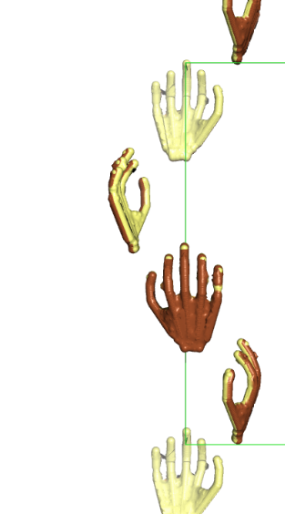
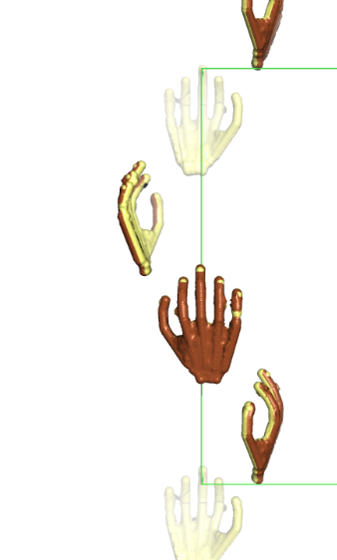
Why is there a Harker section on w=¼?
4₃
Along 4₃ axis, symmetry equivalent molecules are translated by a quarter of the unit cell.
So, vectors between successive symmetry equivalent atoms along this screw axis always have a “z” component of ¼ of the unit cell length, c.
So, w = ¼
¼
¼
¼
w
¼
v
u

Slide 20
Match the u,v,w with appropriate vector equation and solve for x,y,z algebraically.
Order Height/Rms Fractional coordinates
u v w
17 31.30 0.4525 0.0586 0.2500
18 31.30 0.9414 0.4525 0.2500
21 31.30 0.9414 0.5475 0.2500
24 31.30 0.5475 0.0586 0.2500
25 31.30 0.0586 0.4525 0.2500
26 31.30 0.0586 0.5475 0.2500
27 31.30 0.4525 0.9414 0.2500
28 31.30 0.5475 0.9414 0.2500
19 31.30 0.4525 0.0586 0.7500
20 31.30 0.9414 0.4525 0.7500
22 31.30 0.5475 0.0586 0.7500
23 31.30 0.9414 0.5475 0.7500
29 31.30 0.0586 0.4525 0.7500
30 31.30 0.0586 0.5475 0.7500
31 31.30 0.4525 0.9414 0.7500
32 31.30 0.5475 0.9414 0.7500
11 32.05 0.5000 0.0081 0.6229
13 32.05 0.5000 0.9926 0.6229
14 32.05 0.5000 0.9926 0.3771
15 32.05 0.5000 0.0081 0.3771
43 28.98 0.5000 0.1060 0.1229
44 28.98 0.5000 0.8940 0.1229
46 28.98 0.5000 0.1060 0.8771
48 28.98 0.5000 0.8940 0.8771
10 32.05 0.0081 0.5000 0.6229
12 32.05 0.9926 0.5000 0.6229
16 32.05 0.0081 0.5000 0.3771
41 28.98 0.1060 0.5000 0.1229
42 28.98 0.8940 0.5000 0.1229
45 28.98 0.1060 0.5000 0.8771
47 28.98 0.8940 0.5000 0.8771
33 30.79 0.3954 0.4941 0.5000
34 30.79 0.6046 0.4941 0.5000
35 30.79 0.4941 0.3954 0.5000
36 30.79 0.5059 0.3954 0.5000
37 30.79 0.3954 0.5059 0.5000
38 30.79 0.6046 0.5059 0.5000
39 30.79 0.4941 0.6046 0.5000
40 30.79 0.5059 0.6046 0.5000
1 377.52 0.0000 0.0000 0.0000
2 33.12 0.4415 0.5585 0.1267
3 33.12 0.4415 0.4415 0.1267
4 33.12 0.5585 0.4415 0.1267
5 33.12 0.5585 0.5585 0.1267
6 33.12 0.4415 0.4415 0.8733
7 33.12 0.5585 0.4415 0.8733
8 33.12 0.4415 0.5585 0.8733
9 33.12 0.5585 0.5585 0.8733
49 27.88 0.0470 0.9521 0.6269
50 27.88 0.9530 0.9521 0.6269
51 27.88 0.9530 0.9521 0.3731
52 27.88 0.9521 0.9530 0.3731
53 27.88 0.9521 0.0470 0.6269
54 27.88 0.0470 0.0479 0.6269
55 27.88 0.9530 0.0479 0.6269
56 27.88 0.9521 0.0470 0.3731
57 27.88 0.0470 0.0479 0.3731
58 27.88 0.9530 0.0479 0.3731
59 27.88 0.0470 0.9521 0.3731
60 27.88 0.0479 0.9530 0.3731
61 9.30 0.0000 0.0170 0.0205
62
Symm
Op# u v w
2-3) -½-x+y, -½-x-y, -¼
3-2) ½+x-y, ½+x+y, ¼
1-4) -½+x-y, -½+x+y, -¼
4-1) ½-x+y, ½-x-y, ¼
6-7) -½+x-y, -½-x-y, -¼
7-6) ½-x+y, ½+x+y, ¼
5-8) -½-x+y, -½+x+y, -¼
8-5) ½+x-y, ½-x-y, ¼
1-3) -½+x+y, -½-x+y, -¾
3-1) ½-x-y, ½+x-y, ¾
2-4) -½-x-y, -½+x-y, ¼
4-2) ½+x+y, ½-x+y, -¼
5-7) -½+x+y, -½+x-y, -¾
7-5) ½-x-y, ½-x+y, ¾
6-8) ½-x-y, -½-x+y, ¼
8-6) -½+x+y, ½+x-y, -¼
3-5) ½-2y, ½, -¼+2z
5-3) -½+2y, -½, ¼-2z
4-6) ½+2y, ½, -¼+2z
6-4) -½-2y, -½, ¼-2z
1-7) -½+2x, -½, -¾+2z
7-1) ½-2x, ½, ¾-2z
2-8) -½-2x, -½, ¼+2z
8-2) ½+2x, ½, -¼-2z
4-5) ½, ½-2x, ¼+2z
5-4) -½, -½+2x, -¼-2z
3-6) ½, ½+2x, ¼+2z
6-3) -½, -½-2x, -¼-2z
2-7) -½, -½-2y, -¼+2z
7-2) ½, ½+2y, ¼-2z
1-8) -½, -½+2y, -¼+2z
8-1) ½, ½-2y, ¼-2z
1-2) 2x, 2y, -½
2-1) -2x, -2y, ½
3-4) -2y, 2x, ½
4-3) 2y, -2x, -½
5-6) 2y, 2x, -½
6-5) -2y, -2x, ½
7-8) -2x, 2y, ½
8-7) 2x, -2y, -½
1-5) x-y, -x+y, 2z
5-1) -x+y, x-y, -2z
2-5) -x-y, -x-y, ½+2z
5-2) x+y, x+y, -½-2z
etc
I see eight obvious matches for peak #17. Which equation should I use?

Slide 21
Symmetry operator 3
-Symmetry operator 2
½-y ½+x ¾+z
-( -x -y ½+z)
u=½+x-y v=½+x+y w=¼
Plug in u and solve for x.
Plug in v and solve for y.
u v w
0.4525 0.0586 0.2500
u = ½ +x -y
0.4525 = -½ +x -y
0.9525 = x –y
Add equations
0.9525 = x –y
+(0.5856 = x +y)
1.5831= 2x
0.7691 = x
v = -½ +x +y
0.0586 = -½ +x +y
0.5856 = x +y
Subtract equations
0.9525 = x –y
-(0.5856 = x +y)
0.3669= -2y
-0.1835 = y
0.8165 = y

Slide 22
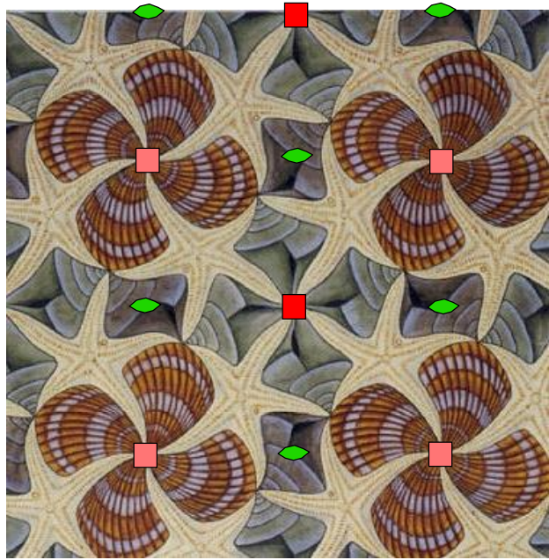
Choice of unit cell origin
X= 0.77 y=0.82
y
x

Slide 23
Choice of unit cell origin
X= 0.27 y=0.32
y
x

Slide 24
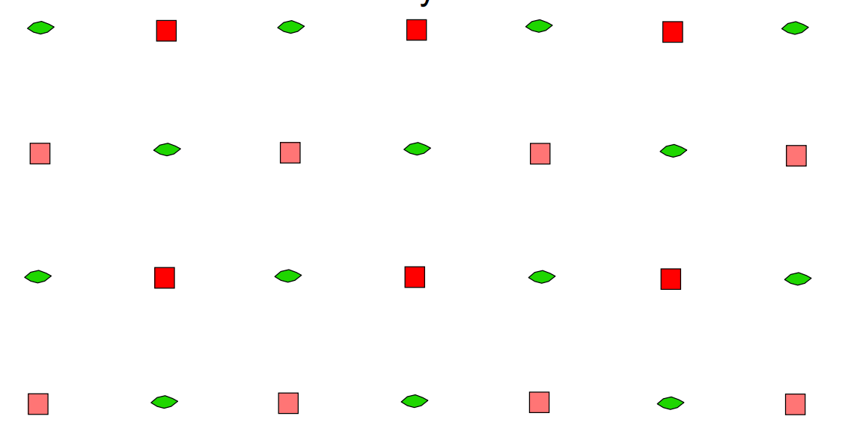
Cheshire symmetry
X= 0.27 y=0.32
y
x

Slide 25
Find another equation to solve for z.
Order Height/Rms Fractional coordinates
u v w
17 31.30 0.4525 0.0586 0.2500
18 31.30 0.9414 0.4525 0.2500
21 31.30 0.9414 0.5475 0.2500
24 31.30 0.5475 0.0586 0.2500
25 31.30 0.0586 0.4525 0.2500
26 31.30 0.0586 0.5475 0.2500
27 31.30 0.4525 0.9414 0.2500
28 31.30 0.5475 0.9414 0.2500
19 31.30 0.4525 0.0586 0.7500
20 31.30 0.9414 0.4525 0.7500
22 31.30 0.5475 0.0586 0.7500
23 31.30 0.9414 0.5475 0.7500
29 31.30 0.0586 0.4525 0.7500
30 31.30 0.0586 0.5475 0.7500
31 31.30 0.4525 0.9414 0.7500
32 31.30 0.5475 0.9414 0.7500
11 32.05 0.5000 0.0081 0.6229
13 32.05 0.5000 0.9926 0.6229
14 32.05 0.5000 0.9926 0.3771
15 32.05 0.5000 0.0081 0.3771
43 28.98 0.5000 0.1060 0.1229
44 28.98 0.5000 0.8940 0.1229
46 28.98 0.5000 0.1060 0.8771
48 28.98 0.5000 0.8940 0.8771
10 32.05 0.0081 0.5000 0.6229
12 32.05 0.9926 0.5000 0.6229
16 32.05 0.0081 0.5000 0.3771
41 28.98 0.1060 0.5000 0.1229
42 28.98 0.8940 0.5000 0.1229
45 28.98 0.1060 0.5000 0.8771
47 28.98 0.8940 0.5000 0.8771
33 30.79 0.3954 0.4941 0.5000
34 30.79 0.6046 0.4941 0.5000
35 30.79 0.4941 0.3954 0.5000
36 30.79 0.5059 0.3954 0.5000
37 30.79 0.3954 0.5059 0.5000
38 30.79 0.6046 0.5059 0.5000
39 30.79 0.4941 0.6046 0.5000
40 30.79 0.5059 0.6046 0.5000
1 377.52 0.0000 0.0000 0.0000
2 33.12 0.4415 0.5585 0.1267
3 33.12 0.4415 0.4415 0.1267
4 33.12 0.5585 0.4415 0.1267
5 33.12 0.5585 0.5585 0.1267
6 33.12 0.4415 0.4415 0.8733
7 33.12 0.5585 0.4415 0.8733
8 33.12 0.4415 0.5585 0.8733
9 33.12 0.5585 0.5585 0.8733
49 27.88 0.0470 0.9521 0.6269
50 27.88 0.9530 0.9521 0.6269
51 27.88 0.9530 0.9521 0.3731
52 27.88 0.9521 0.9530 0.3731
53 27.88 0.9521 0.0470 0.6269
54 27.88 0.0470 0.0479 0.6269
55 27.88 0.9530 0.0479 0.6269
56 27.88 0.9521 0.0470 0.3731
57 27.88 0.0470 0.0479 0.3731
58 27.88 0.9530 0.0479 0.3731
59 27.88 0.0470 0.9521 0.3731
60 27.88 0.0479 0.9530 0.3731
61 9.30 0.0000 0.0170 0.0205
62
Symm
Op# u v w
2-3) -½-x+y, -½-x-y, -¼
3-2) ½+x-y, ½+x+y, ¼
1-4) -½+x-y, -½+x+y, -¼
4-1) ½-x+y, ½-x-y, ¼
6-7) -½+x-y, -½-x-y, -¼
7-6) ½-x+y, ½+x+y, ¼
5-8) -½-x+y, -½+x+y, -¼
8-5) ½+x-y, ½-x-y, ¼
1-3) -½+x+y, -½-x+y, -¾
3-1) ½-x-y, ½+x-y, ¾
2-4) -½-x-y, -½+x-y, ¼
4-2) ½+x+y, ½-x+y, -¼
5-7) -½+x+y, -½+x-y, -¾
7-5) ½-x-y, ½-x+y, ¾
6-8) ½-x-y, -½-x+y, ¼
8-6) -½+x+y, ½+x-y, -¼
4-5) ½, ½-2x, ¼+2z
5-4) -½, -½+2x, -¼-2z
3-6) ½, ½+2x, ¼+2z
6-3) -½, -½-2x, -¼-2z
2-7) -½, -½-2y, -¼+2z
7-2) ½, ½+2y, ¼-2z
1-8) -½, -½+2y, -¼+2z
8-1) ½, ½-2y, ¼-2z
3-5) ½-2y, ½, -¼+2z
5-3) -½+2y, -½, ¼-2z
4-6) ½+2y, ½, -¼+2z
6-4) -½-2y, -½, ¼-2z
1-7) -½+2x, -½, -¾+2z
7-1) ½-2x, ½, ¾-2z
2-8) -½-2x, -½, ¼+2z
8-2) ½+2x, ½, -¼-2z
1-2) 2x, 2y, -½
2-1) -2x, -2y, ½
3-4) -2y, 2x, ½
4-3) 2y, -2x, -½
5-6) 2y, 2x, -½
6-5) -2y, -2x, ½
7-8) -2x, 2y, ½
8-7) 2x, -2y, -½
1-5) x-y, -x+y, 2z
5-1) -x+y, x-y, -2z
2-5) -x-y, -x-y, ½+2z
5-2) x+y, x+y, -½-2z
etc
I see eight obvious matches for peak 11. Which equation should I use?
Use the equation that yields the previously obtained value of “x” or “y”

Slide 26
Symmetry operator 3
-Symmetry operator 6
½-y ½+x ¾+z
-( -y -x ½-z )
u= ½ v=½+2x w= ¼+2z
u v w
0.5000 0.0081 0.6229
Plug in v, solve for x:
Plug in w, solve for z:
v = ½ + 2x
0.0081 = ½ + 2x
-0.4919 = 2x
-0.2460 = x
0.7541 = x
w = ¼ + 2z
0.6229 = ¼ + 2z
0.3729 = 2z
0.1865 = z

Slide 27
Combine answers from two Harker sections to get heavy atom x,y,z coordinates
From w=¼ x=0.7691 y=0.8165
From u=½ x=0.7541 z=0.1865
Combined x=0.7541 y=0.8165 z=0.1865
Other 7 sites in unit cell can be obtained by applying space group symmetry operations

Slide 28
Check that this x,y,z can predict all peaks in the difference Patterson map
Combined x=0.7541 y=0.8165 z=0.1865
Solve for each u,v,w. Overlay predictions on Patterson map
Symm
Op# u v w
2-3) -½-x+y, -½-x-y, -¼
3-2) ½+x-y, ½+x+y, ¼
1-4) -½+x-y, -½+x+y, -¼
4-1) ½-x+y, ½-x-y, ¼
6-7) -½+x-y, -½-x-y, -¼
7-6) ½-x+y, ½+x+y, ¼
5-8) -½-x+y, -½+x+y, -¼
8-5) ½+x-y, ½-x-y, ¼
1-3) -½+x+y, -½-x+y, -¾
3-1) ½-x-y, ½+x-y, ¾
2-4) -½-x-y, -½+x-y, ¼
4-2) ½+x+y, ½-x+y, -¼
5-7) -½+x+y, -½+x-y, -¾
7-5) ½-x-y, ½-x+y, ¾
6-8) ½-x-y, -½-x+y, ¼
8-6) -½+x+y, ½+x-y, -¼
4-5) ½, ½-2x, ¼+2z
5-4) -½, -½+2x, -¼-2z
3-6) ½, ½+2x, ¼+2z
6-3) -½, -½-2x, -¼-2z
2-7) -½, -½-2y, -¼+2z
7-2) ½, ½+2y, ¼-2z
1-8) -½, -½+2y, -¼+2z
8-1) ½, ½-2y, ¼-2z
3-5) ½-2y, ½, -¼+2z
5-3) -½+2y, -½, ¼-2z
4-6) ½+2y, ½, -¼+2z
6-4) -½-2y, -½, ¼-2z
1-7) -½+2x, -½, -¾+2z
7-1) ½-2x, ½, ¾-2z
2-8) -½-2x, -½, ¼+2z
8-2) ½+2x, ½, -¼-2z
1-2) 2x, 2y, -½
2-1) -2x, -2y, ½
3-4) -2y, 2x, ½
4-3) 2y, -2x, -½
5-6) 2y, 2x, -½
6-5) -2y, -2x, ½
7-8) -2x, 2y, ½
8-7) 2x, -2y, -½
1-5) x-y, -x+y, 2z
5-1) -x+y, x-y, -2z
2-5) -x-y, -x-y, ½+2z
5-2) x+y, x+y, -½-2z
etc

Slide 29
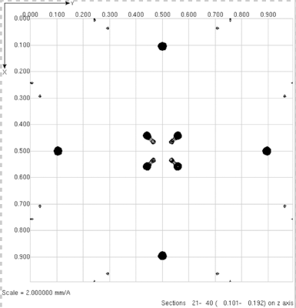
Check that this x,y,z can predict all peaks in the difference Patterson map
Combined x=0.7541 y=0.8165 z=0.1865
Solve for each u,v,w. Overlay predictions on Patterson map
If you see a peak with no prediction (+) something went wrong.
Check algebra.
If algebra is OK, then the problem could arise from an ambiguity between solutions for P4₁2₁2 and P4₃2₁2.
Swap space groups or negate x of x,y,z, and calculate Patterson predictions from –x,y,z
+
+
+
+
+
+
+
+

Slide 30
Check that this x,y,z can predict all peaks in the difference Patterson map
Combined x=-0.7541 y=0.8165 z=0.1865
Solve for each u,v,w. Overlay predictions on Patterson map
+
All major Patterson peaks will be predicted if the heavy atom coordinates are correct.
+
+
+
+
+
+
+

Slide 31
Questions?

Slide 32
In practice
Algebraic calculations would be very lengthy and tedious if there were multiple heavy atoms in the unit cell.
In practice, we use direct methods to determine the coordinates of the heavy atom.
Direct methods uses measured values of $\text{(}\text{|}\text{F}\text{PH}\text{|−|}\text{F}\text{P}\text{|}\text{)}$. It needs no phase information.
The success of the direct methods relies on the use of space-group defined relationships between phases.
Phases are restrained so that the electron density map (of the heavy atom) has discrete atom-like spheres of density (other shapes not allowed).
High resolution data (1.0 Å) is not required. 3.0 Å resolution works. The heavy atoms are so few in the cell that they are completely resolved (separated) at 3.0 Å resolution.
Duilio will tell us more about direct methods on Monday.
We will use direct methods to determine heavy atom x,y,z, and then we will verify that the coordinates predict all Patterson peaks.

