Slide 1
Our goal is to determine the heavy atom locations (x,y,z) in the asymmetric unit.
Use Difference Patterson map synthesis P(u,v,w)=$\sum_{hkl}{\text{(}\text{|}\text{F}\text{PH}\text{|−|}\text{F}\text{P}\text{|}\text{)}2 cos2π(hu+kv+lw)}$
$\text{|}\text{F}\text{P}\text{|}$ is the structure factor amplitude of the native macromolecule (P=“Parent”).
$$\text{|}\text{F}\text{PH}\text{| }\text{is} \text{the} \text{structure} \text{factor} \text{amplitude} \text{of} \text{the} \text{derivative} \text{crystal}$$
$\text{(}\text{PH}\text{="}\text{P}\text{arent}\text{ \& }\text{H}\text{eavy}$ atom).
$\text{|}\text{F}\text{PH}\text{|−|}\text{F}\text{P}\text{|}$approximates the structure factor amplitude of what type of atom?
The features in this difference Patterson map arise from what type of atom?

Slide 2
Outline of methods
We soaked Proteinase K crystals in heavy atom compounds Eu, Gd, or Hg, in hope the metals would bind to proteinase K, specifically.
In lab, we will calculate difference Patterson maps using diffraction data that we collected. Note the heights of peaks in the map.
Higher peaks mean better phasing signal.
Here in lecture, we will review how to determine the heavy atom coordinates manually (algebra) from a difference Patterson map for the specific case of proteinase K.
Now, follow the trail of clues to reveal the atomic coordinates of a Mercury derivative

Slide 3
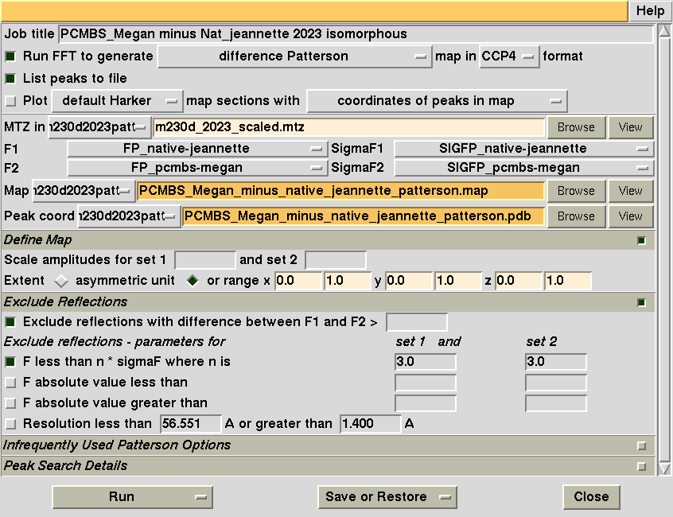
Calculate isomorphous difference Patterson map
Specify a difference Patterson map calculation:
P(u,v,w)=$\sum_{hkl}{\text{(}\text{|}\text{F}\text{P}\text{roK}\text{+}\text{H}\text{g}\text{|−|}\text{F}\text{P}\text{roK}\text{|}\text{)}2 cos2π(hu+kv+lw)}$
Specify the name of the native and derivative structure factor sets
Patterson Map extents
u_{min}, u_{max}, v_{min}, v_{max}, w_{min}, w_{max}

Slide 4
Peaks list from an isomorphous Difference Patterson Map calculated last year
P(u,v,w)=$\sum_{hkl}{\text{(}\text{|}\text{F}\text{P}\text{roK}\text{+}\text{H}\text{g}\text{|−|}\text{F}\text{P}\text{roK}\text{|}\text{)}2 cos2π(hu+kv+lw)}$
Order Height/Rms Fractional coordinates
u v w
1 377.52 0.0000 0.0000 0.0000
2 33.12 0.4415 0.5585 0.1267
3 33.12 0.4415 0.4415 0.1267
4 33.12 0.5585 0.4415 0.1267
5 33.12 0.5585 0.5585 0.1267
6 33.12 0.4415 0.4415 0.8733
7 33.12 0.5585 0.4415 0.8733
8 33.12 0.4415 0.5585 0.8733
9 33.12 0.5585 0.5585 0.8733
10 32.05 0.0081 0.5000 0.6229
11 32.05 0.5000 0.0081 0.6229
12 32.05 0.9926 0.5000 0.6229
13 32.05 0.5000 0.9926 0.6229
14 32.05 0.5000 0.9926 0.3771
15 32.05 0.5000 0.0081 0.3771
16 32.05 0.0081 0.5000 0.3771
17 31.30 0.4525 0.0586 0.2500
18 31.30 0.9414 0.4525 0.2500
19 31.30 0.4525 0.0586 0.7500
20 31.30 0.9414 0.4525 0.7500
21 31.30 0.9414 0.5475 0.2500
22 31.30 0.5475 0.0586 0.7500
23 31.30 0.9414 0.5475 0.7500
24 31.30 0.5475 0.0586 0.2500
25 31.30 0.0586 0.4525 0.2500
26 31.30 0.0586 0.5475 0.2500
27 31.30 0.4525 0.9414 0.2500
28 31.30 0.5475 0.9414 0.2500
29 31.30 0.0586 0.4525 0.7500
30 31.30 0.0586 0.5475 0.7500
Order Height/Rms Fractional coordinates
u v w
31 31.30 0.4525 0.9414 0.7500
32 31.30 0.5475 0.9414 0.7500
33 30.79 0.3954 0.4941 0.5000
34 30.79 0.6046 0.4941 0.5000
35 30.79 0.4941 0.3954 0.5000
36 30.79 0.5059 0.3954 0.5000
37 30.79 0.3954 0.5059 0.5000
38 30.79 0.6046 0.5059 0.5000
39 30.79 0.4941 0.6046 0.5000
40 30.79 0.5059 0.6046 0.5000
41 28.98 0.1060 0.5000 0.1229
42 28.98 0.8940 0.5000 0.1229
43 28.98 0.5000 0.1060 0.1229
44 28.98 0.5000 0.8940 0.1229
45 28.98 0.1060 0.5000 0.8771
46 28.98 0.5000 0.1060 0.8771
47 28.98 0.8940 0.5000 0.8771
48 28.98 0.5000 0.8940 0.8771
49 27.88 0.0470 0.9521 0.6269
50 27.88 0.9530 0.9521 0.6269
51 27.88 0.9530 0.9521 0.3731
52 27.88 0.9521 0.9530 0.3731
53 27.88 0.9521 0.0470 0.6269
54 27.88 0.0470 0.0479 0.6269
55 27.88 0.9530 0.0479 0.6269
56 27.88 0.9521 0.0470 0.3731
57 27.88 0.0470 0.0479 0.3731
58 27.88 0.9530 0.0479 0.3731
59 27.88 0.0470 0.9521 0.3731
60 27.88 0.0479 0.9530 0.3731
61 9.30 0.0000 0.0170 0.0205

Slide 5
Difference Patterson Map
Unit cell of Patterson Map
W=1.0
P(u,v,w)=$\sum_{hkl}{\text{(}\text{|}\text{F}\text{P}\text{roK}\text{+}\text{H}\text{g}\text{|−|}\text{F}\text{P}\text{roK}\text{|}\text{)}2 cos2π(hu+kv+lw)}$
W=0.9
The whole unit cell is represented as 2D sections stacked along “w”.
Some sections have peaks, some don’t.
I am confident that the heavy atom is bound because:
The peaks are strong.
All peaks shown exceed a threshold of 20 times higher than background (i.e. 20 σ).
If no heavy atom were bound, I would expect that most peaks would be under a height of 5 σ.
There are about 60 peaks in the unit cell (off origin). How many heavy atoms would this likely be in the unit cell given ~60 peaks?
W=0.8
W=0.7
W=0.6
W=0.5
W=0.4
W=0.3
w
W=0.2
v
W=0.1
u
W=0.0

Slide 6
How many Patterson peaks are expected for n atoms?
Patterson peaks arise from vectors between atoms in the unit cell.
If there is only one atom in the unit cell, how many vectors can you draw?
1 vector = the atom to itself = zero length.
Unit cell of crystal
“n” atoms | Peaks total
1 | 1
1

Slide 7
How many Patterson peaks are expected for n atoms?
Patterson peaks arise from vectors between atoms in the unit cell.
If there are two atoms in the unit cell, how many vectors can you draw?
4 vectors (2 of zero length, 2 non-zero)
Unit cell of crystal
“n” atoms | Peaks total | Peaks zero length | Peaks non-zero length
1 | 1 | 1 | 0
2 | 4 | 2 | 2
1
2

Slide 8
How many Patterson peaks are expected for n atoms?
Patterson peaks arise from vectors between atoms in the unit cell.
If there are three atoms in the unit cell, how many vectors can you draw?
9 vectors (3 of zero length, 6 non-zero)
Unit cell of crystal
“n” atoms | Peaks total | Peaks zero length | Peaks non-zero length
1 | 1 | 1 | 0
2 | 4 | 2 | 2
3 | 9 | 3 | 6
1
2
3

Slide 9
How many Patterson peaks are expected for n atoms?
Patterson peaks arise from vectors between atoms in the unit cell.
If there are four atoms in the unit cell, how many vectors can you draw?
16 vectors (4 of zero length, 12 non-zero)
Unit cell of crystal
“n” atoms | Peaks total | Peaks zero length | Peaks non-zero length
1 | 1 | 1 | 0
2 | 4 | 2 | 2
3 | 9 | 3 | 6
4 | 16 | 4 | 12
n | n² | n | n²-n
1
2
4
3
In general

Slide 10
8 atoms would be consistent with the appearance of ~60 peaks
Unit cell of crystal
5
“n” atoms | Peaks total | Peaks zero length | Peaks non-zero length
n | n² | n | n²-n
7 | 49 | 7 | 42
8 | 64 | 8 | 56
9 | 81 | 9 | 72
1
2
8
6
4
3
7

Slide 11
Patterson peak positions offer clues about the arrangement of atoms in the unit cell.
Our list of peaks from the difference Patterson map
Order Height/Rms Fractional coordinates
u v w
1 377.52 0.0000 0.0000 0.0000
2 33.12 0.4415 0.5585 0.1267
3 33.12 0.4415 0.4415 0.1267
4 33.12 0.5585 0.4415 0.1267
5 33.12 0.5585 0.5585 0.1267
6 33.12 0.4415 0.4415 0.8733
7 33.12 0.5585 0.4415 0.8733
8 33.12 0.4415 0.5585 0.8733
9 33.12 0.5585 0.5585 0.8733
10 32.05 0.0081 0.5000 0.6229
11 32.05 0.5000 0.0081 0.6229
12 32.05 0.9926 0.5000 0.6229
13 32.05 0.5000 0.9926 0.6229
14 32.05 0.5000 0.9926 0.3771
15 32.05 0.5000 0.0081 0.3771
16 32.05 0.0081 0.5000 0.3771
17 31.30 0.4525 0.0586 0.2500
18 31.30 0.9414 0.4525 0.2500
19 31.30 0.4525 0.0586 0.7500
20 31.30 0.9414 0.4525 0.7500
21 31.30 0.9414 0.5475 0.2500
22 31.30 0.5475 0.0586 0.7500
23 31.30 0.9414 0.5475 0.7500
24 31.30 0.5475 0.0586 0.2500
25 31.30 0.0586 0.4525 0.2500
26 31.30 0.0586 0.5475 0.2500
27 31.30 0.4525 0.9414 0.2500
28 31.30 0.5475 0.9414 0.2500
29 31.30 0.0586 0.4525 0.7500
30 31.30 0.0586 0.5475 0.7500
31 31.30 0.4525 0.9414 0.7500
32 31.30 0.5475 0.9414 0.7500
33 30.79 0.3954 0.4941 0.5000
34 30.79 0.6046 0.4941 0.5000
35 30.79 0.4941 0.3954 0.5000
36 30.79 0.5059 0.3954 0.5000
37 30.79 0.3954 0.5059 0.5000
38 30.79 0.6046 0.5059 0.5000
39 30.79 0.4941 0.6046 0.5000
40 30.79 0.5059 0.6046 0.5000
41 28.98 0.1060 0.5000 0.1229
42 28.98 0.8940 0.5000 0.1229
43 28.98 0.5000 0.1060 0.1229
44 28.98 0.5000 0.8940 0.1229
45 28.98 0.1060 0.5000 0.8771
46 28.98 0.5000 0.1060 0.8771
47 28.98 0.8940 0.5000 0.8771
48 28.98 0.5000 0.8940 0.8771
49 27.88 0.0470 0.9521 0.6269
50 27.88 0.9530 0.9521 0.6269
51 27.88 0.9530 0.9521 0.3731
52 27.88 0.9521 0.9530 0.3731
53 27.88 0.9521 0.0470 0.6269
54 27.88 0.0470 0.0479 0.6269
55 27.88 0.9530 0.0479 0.6269
56 27.88 0.9521 0.0470 0.3731
57 27.88 0.0470 0.0479 0.3731
58 27.88 0.9530 0.0479 0.3731
59 27.88 0.0470 0.9521 0.3731
60 27.88 0.0479 0.9530 0.3731
61 9.30 0.0000 0.0170 0.0205
62 9.30 0.0170 0.0000 0.9795
63 9.30 0.0000 0.9830 0.9795
64 9.30 0.9830 0.0000 0.0205
65 9.30 0.9830 0.0000 0.9795
66 9.30 0.0000 0.0170 0.9795
67 9.30 0.0000 0.9830 0.0205
68 8.86 0.4639 0.4639 0.8690
69 8.86 0.5361 0.4639 0.8690
70 8.86 0.4639 0.4639 0.1310
71 8.86 0.5361 0.4639 0.1310
72 8.86 0.4639 0.5361 0.1310
73 8.86 0.5361 0.5361 0.1310
74 8.86 0.4639 0.5361 0.8690
75 8.86 0.5361 0.5361 0.8690
76 8.60 0.0223 0.0223 0.0000
77 8.35 0.0145 0.9926 0.9800
78 8.35 0.9926 0.0145 0.0200
79 8.35 0.9855 0.9926 0.9800
80 8.35 0.9855 0.9926 0.0200
81 6.48 0.7929 0.9504 0.4401
82 6.48 0.7929 0.0496 0.5599
83 6.48 0.2071 0.0496 0.4401
84 6.48 0.7929 0.0496 0.4401
85 6.48 0.9504 0.2071 0.4401
86 6.48 0.9504 0.7929 0.4401
87 6.48 0.2071 0.9504 0.4401
88 6.48 0.2071 0.0496 0.5599
89 6.48 0.0496 0.2071 0.5599
90 6.48 0.0496 0.7929 0.5599
91 6.48 0.2071 0.9504 0.5599
92 6.48 0.7929 0.9504 0.5599
93 6.48 0.0496 0.2071 0.4401
94 6.48 0.0496 0.7929 0.4401
95 6.48 0.9504 0.2071 0.5599
96 6.48 0.9504 0.7929 0.5599
97 6.27 0.2927 0.0362 0.1836
98 6.27 0.2927 0.9638 0.1836
99 6.27 0.2927 0.0362 0.8164
100 6.27 0.7073 0.0362 0.8164
The coordinates (u,v,w) of a Patterson peak specify the relative position of one heavy atom to another.
For example, peak #2 (tells us that there are a pair of heavy atoms.
separated in x by 0.4415×a
separated in y by 0.5585×b
separated in z by 0.1267×c
But, it doesn’t specify the position of the atom pair relative to the origin
w
1
v
2
u
0.1267×c
0.4415×a
0.5585×b

Slide 12
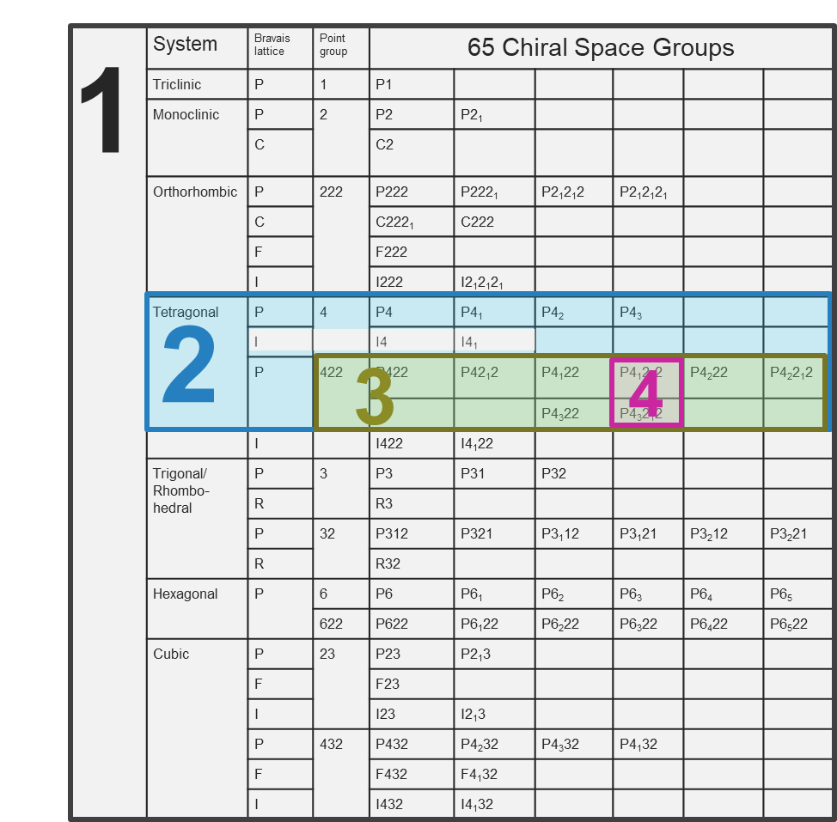
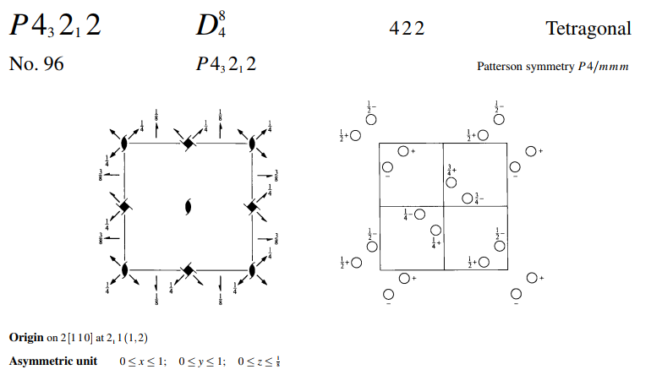
How many heavy atoms exist in the asymmetric unit?
An asymmetric unit is the smallest part of the unit cell from which the whole unit cell could be constructed by symmetry operations.
The number of asymmetric units in a unit cell is defined by the space group.
We deduced that the space group must be either P4₁2₁2 or P4₃2₁2 at the end of our data processing lab.
These space groups have 8 symmetry equivalent positions, which means there are 8 asymmetric units in the unit cell.
We estimated that the unit cell contains 8 heavy atoms.
This means there is probably only one heavy atom in the asymmetric unit.
We need to find coordinates (x,y,z) for only one heavy atom. The values of x,y,z are measured relative to the origin, defined by the space group convention.
The other 7 heavy atoms are defined by these crystallographic symmetry operators.
origin

Slide 13
Symmetry operators define the relationship between asymmetric units in a unit cell.
3
5
2
7
4
6
1
z
8
y
x
Unit cell of crystal

Slide 14
Heavy atom positions are related by these symmetry operators
½-y,½+x,¾+z
3
5
y,x,-z
2
-x,-y,½+z
7
4
½-x,½+y,¾-z
½+y,½-x,¼+z
6
1
-y,-x,½-z
x,y,z
z
8
Substitute heavy atom positions with symmetry operators
½+x,½-y,¼-z
y
x
Unit cell of crystal

Slide 15
Each pairwise difference between symmetry operators corresponds to a Patterson peak coordinate (u,v,w).
Order Height/Rms Fractional coordinates
u v w
1 377.52 0.0000 0.0000 0.0000
2 33.12 0.4415 0.5585 0.1267
3 33.12 0.4415 0.4415 0.1267
4 33.12 0.5585 0.4415 0.1267
5 33.12 0.5585 0.5585 0.1267
6 33.12 0.4415 0.4415 0.8733
7 33.12 0.5585 0.4415 0.8733
8 33.12 0.4415 0.5585 0.8733
9 33.12 0.5585 0.5585 0.8733
10 32.05 0.0081 0.5000 0.6229
11 32.05 0.5000 0.0081 0.6229
12 32.05 0.9926 0.5000 0.6229
13 32.05 0.5000 0.9926 0.6229
14 32.05 0.5000 0.9926 0.3771
15 32.05 0.5000 0.0081 0.3771
16 32.05 0.0081 0.5000 0.3771
17 31.30 0.4525 0.0586 0.2500
18 31.30 0.9414 0.4525 0.2500
19 31.30 0.4525 0.0586 0.7500
20 31.30 0.9414 0.4525 0.7500
21 31.30 0.9414 0.5475 0.2500
22 31.30 0.5475 0.0586 0.7500
23 31.30 0.9414 0.5475 0.7500
24 31.30 0.5475 0.0586 0.2500
25 31.30 0.0586 0.4525 0.2500
26 31.30 0.0586 0.5475 0.2500
27 31.30 0.4525 0.9414 0.2500
28 31.30 0.5475 0.9414 0.2500
29 31.30 0.0586 0.4525 0.7500
30 31.30 0.0586 0.5475 0.7500
½-y,½+x,¾+z
3
5
½+x-y, ½+x+y, +¼
y,x,-z
2
-x,-y,½+z
7
4
½-x,½+y,¾-z
½+y,½-x,¼+z
6
Symmetry operators enable us to write an algebraic expression to solve for x,y,z.
1
-y,-x,½-z
x,y,z
z
8
½+x,½-y,¼-z
Symm
Op# u v w
3-2) ½+x-y, ½+x+y, +¼
y
x
Unit cell of crystal

Slide 16
Each pairwise difference between symmetry operators corresponds to a Patterson peak coordinate (u,v,w).
Order Height/Rms Fractional coordinates
u v w
1 377.52 0.0000 0.0000 0.0000
2 33.12 0.4415 0.5585 0.1267
3 33.12 0.4415 0.4415 0.1267
4 33.12 0.5585 0.4415 0.1267
5 33.12 0.5585 0.5585 0.1267
6 33.12 0.4415 0.4415 0.8733
7 33.12 0.5585 0.4415 0.8733
8 33.12 0.4415 0.5585 0.8733
9 33.12 0.5585 0.5585 0.8733
10 32.05 0.0081 0.5000 0.6229
11 32.05 0.5000 0.0081 0.6229
12 32.05 0.9926 0.5000 0.6229
13 32.05 0.5000 0.9926 0.6229
14 32.05 0.5000 0.9926 0.3771
15 32.05 0.5000 0.0081 0.3771
16 32.05 0.0081 0.5000 0.3771
17 31.30 0.4525 0.0586 0.2500
18 31.30 0.9414 0.4525 0.2500
19 31.30 0.4525 0.0586 0.7500
20 31.30 0.9414 0.4525 0.7500
21 31.30 0.9414 0.5475 0.2500
22 31.30 0.5475 0.0586 0.7500
23 31.30 0.9414 0.5475 0.7500
24 31.30 0.5475 0.0586 0.2500
25 31.30 0.0586 0.4525 0.2500
26 31.30 0.0586 0.5475 0.2500
27 31.30 0.4525 0.9414 0.2500
28 31.30 0.5475 0.9414 0.2500
29 31.30 0.0586 0.4525 0.7500
30 31.30 0.0586 0.5475 0.7500
½-y,½+x,¾+z
3
5
½+x-y, ½+x+y, +¼
-½-x+y, -½-x-y, -¼
y,x,-z
2
-x,-y,½+z
7
4
½-x,½+y,¾-z
½+y,½-x,¼+z
6
Symmetry operators enable us to write an algebraic expression to solve for x,y,z.
1
-y,-x,½-z
x,y,z
z
8
½+x,½-y,¼-z
Symm
Op# u v w
3-2) ½+x-y, ½+x+y, +¼
y
x
Unit cell of crystal

Slide 17
Each pairwise difference between symmetry operators corresponds to a Patterson peak coordinate (u,v,w).
Order Height/Rms Fractional coordinates
u v w
1 377.52 0.0000 0.0000 0.0000
2 33.12 0.4415 0.5585 0.1267
3 33.12 0.4415 0.4415 0.1267
4 33.12 0.5585 0.4415 0.1267
5 33.12 0.5585 0.5585 0.1267
6 33.12 0.4415 0.4415 0.8733
7 33.12 0.5585 0.4415 0.8733
8 33.12 0.4415 0.5585 0.8733
9 33.12 0.5585 0.5585 0.8733
10 32.05 0.0081 0.5000 0.6229
11 32.05 0.5000 0.0081 0.6229
12 32.05 0.9926 0.5000 0.6229
13 32.05 0.5000 0.9926 0.6229
14 32.05 0.5000 0.9926 0.3771
15 32.05 0.5000 0.0081 0.3771
16 32.05 0.0081 0.5000 0.3771
17 31.30 0.4525 0.0586 0.2500
18 31.30 0.9414 0.4525 0.2500
19 31.30 0.4525 0.0586 0.7500
20 31.30 0.9414 0.4525 0.7500
21 31.30 0.9414 0.5475 0.2500
22 31.30 0.5475 0.0586 0.7500
23 31.30 0.9414 0.5475 0.7500
24 31.30 0.5475 0.0586 0.2500
25 31.30 0.0586 0.4525 0.2500
26 31.30 0.0586 0.5475 0.2500
27 31.30 0.4525 0.9414 0.2500
28 31.30 0.5475 0.9414 0.2500
29 31.30 0.0586 0.4525 0.7500
30 31.30 0.0586 0.5475 0.7500
½-y,½+x,¾+z
3
0.4525 0.0586 0.2500
5
½+x-y, ½+x+y, +¼
-½-x+y, -½-x-y, -¼
y,x,-z
2
-x,-y,½+z
7
4
½-x,½+y,¾-z
½+y,½-x,¼+z
6
Symmetry operators enable us to write an algebraic expression to solve for x,y,z.
1
-y,-x,½-z
x,y,z
z
8
½+x,½-y,¼-z
Symm
Op# u v w
3-2) ½+x-y, ½+x+y, +¼
y
x
Unit cell of crystal
0.4525 0.0586 0.2500

Slide 18
2-3) -½+x+y, -½-x-y, -¼
3-2) ½-x-y, ½+x+y, ¼
1-4) -½+x-y, -½+x+y, -¼
4-1) ½-x+y, ½-x-y, ¼
6-7) -½+x-y, -½-x-y, -¼
7-6) ½-x+y, ½+x+y, ¼
5-8) -½-x+y, -½+x+y, -¼
8-5) ½+x-y, ½-x-y, ¼
1-3) -½+x+y, -½-x+y, -¾
3-1) ½-x-y, ½+x-y, ¾
2-4) -½-x-y, -½+x-y, ¼
4-2) ½+x+y, ½-x+y, -¼
5-7) -½+x+y, -½+x-y, -¾
7-5) ½-x-y, ½-x+y, ¾
6-8) ½-x-y, -½-x+y, ¼
8-6) -½+x+y, ½+x-y, -¼
3-5) ½-2y, ½, -¼+2z
5-3) -½+2y, -½, ¼-2z
4-6) ½+2y, ½, -¼+2z
6-4) -½-2y, -½, ¼-2z
1-7) -½+2x, -½, -¾+2z
7-1) ½-2x, ½, ¾-2z
2-8) -½-2x, -½, ¼+2z
8-2) ½+2x, ½, -¼-2z
4-5) ½, ½-2x, ¼+2z
5-4) -½, -½+2x, -¼-2z
3-6) ½, ½+2x, ¼+2z
6-3) -½, -½-2x, -¼-2z
2-7) -½, -½-2y, -¼+2z
7-2) ½, ½+2y, ¼-2z
1-8) -½, -½+2y, -¼+2z
8-1) ½, ½-2y, ¼-2z
1-2) 2x, 2y, -½
2-1) -2x, -2y, ½
3-4) -2y, 2x, ½
4-3) 2y, -2x, -½
5-6) 2y, 2x, -½
6-5) -2y, -2x, ½
7-8) -2x, 2y, ½
8-7) 2x, -2y, -½
1-5) x-y, -x+y, 2z
5-1) -x+y, x-y, -2z
2-5) -x-y, -x-y, ½+2z
5-2) x+y, x+y, -½-2z
etc

Slide 19
Match the u,v,w with appropriate vector equation and solve for x,y,z algebraically.
Order Height/Rms Fractional coordinates
u v w
1 377.52 0.0000 0.0000 0.0000
2 33.12 0.4415 0.5585 0.1267
3 33.12 0.4415 0.4415 0.1267
4 33.12 0.5585 0.4415 0.1267
5 33.12 0.5585 0.5585 0.1267
6 33.12 0.4415 0.4415 0.8733
7 33.12 0.5585 0.4415 0.8733
8 33.12 0.4415 0.5585 0.8733
9 33.12 0.5585 0.5585 0.8733
10 32.05 0.0081 0.5000 0.6229
11 32.05 0.5000 0.0081 0.6229
12 32.05 0.9926 0.5000 0.6229
13 32.05 0.5000 0.9926 0.6229
14 32.05 0.5000 0.9926 0.3771
15 32.05 0.5000 0.0081 0.3771
16 32.05 0.0081 0.5000 0.3771
17 31.30 0.4525 0.0586 0.2500
18 31.30 0.9414 0.4525 0.2500
19 31.30 0.4525 0.0586 0.7500
20 31.30 0.9414 0.4525 0.7500
21 31.30 0.9414 0.5475 0.2500
22 31.30 0.5475 0.0586 0.7500
23 31.30 0.9414 0.5475 0.7500
24 31.30 0.5475 0.0586 0.2500
25 31.30 0.0586 0.4525 0.2500
26 31.30 0.0586 0.5475 0.2500
27 31.30 0.4525 0.9414 0.2500
28 31.30 0.5475 0.9414 0.2500
29 31.30 0.0586 0.4525 0.7500
30 31.30 0.0586 0.5475 0.7500
31 31.30 0.4525 0.9414 0.7500
32 31.30 0.5475 0.9414 0.7500
33 30.79 0.3954 0.4941 0.5000
34 30.79 0.6046 0.4941 0.5000
35 30.79 0.4941 0.3954 0.5000
36 30.79 0.5059 0.3954 0.5000
37 30.79 0.3954 0.5059 0.5000
38 30.79 0.6046 0.5059 0.5000
39 30.79 0.4941 0.6046 0.5000
40 30.79 0.5059 0.6046 0.5000
41 28.98 0.1060 0.5000 0.1229
42 28.98 0.8940 0.5000 0.1229
43 28.98 0.5000 0.1060 0.1229
44 28.98 0.5000 0.8940 0.1229
45 28.98 0.1060 0.5000 0.8771
46 28.98 0.5000 0.1060 0.8771
47 28.98 0.8940 0.5000 0.8771
48 28.98 0.5000 0.8940 0.8771
49 27.88 0.0470 0.9521 0.6269
50 27.88 0.9530 0.9521 0.6269
51 27.88 0.9530 0.9521 0.3731
52 27.88 0.9521 0.9530 0.3731
53 27.88 0.9521 0.0470 0.6269
54 27.88 0.0470 0.0479 0.6269
55 27.88 0.9530 0.0479 0.6269
56 27.88 0.9521 0.0470 0.3731
57 27.88 0.0470 0.0479 0.3731
58 27.88 0.9530 0.0479 0.3731
59 27.88 0.0470 0.9521 0.3731
60 27.88 0.0479 0.9530 0.3731
61 9.30 0.0000 0.0170 0.0205
62
Symm
Op# u v w
2-3) -½+x+y, -½-x-y, -¼
3-2) ½-x-y, ½+x+y, ¼
1-4) -½+x-y, -½+x+y, -¼
4-1) ½-x+y, ½-x-y, ¼
6-7) -½+x-y, -½-x-y, -¼
7-6) ½-x+y, ½+x+y, ¼
5-8) -½-x+y, -½+x+y, -¼
8-5) ½+x-y, ½-x-y, ¼
1-3) -½+x+y, -½-x+y, -¾
3-1) ½-x-y, ½+x-y, ¾
2-4) -½-x-y, -½+x-y, ¼
4-2) ½+x+y, ½-x+y, -¼
5-7) -½+x+y, -½+x-y, -¾
7-5) ½-x-y, ½-x+y, ¾
6-8) ½-x-y, -½-x+y, ¼
8-6) -½+x+y, ½+x-y, -¼
3-5) ½-2y, ½, -¼+2z
5-3) -½+2y, -½, ¼-2z
4-6) ½+2y, ½, -¼+2z
6-4) -½-2y, -½, ¼-2z
1-7) -½+2x, -½, -¾+2z
7-1) ½-2x, ½, ¾-2z
2-8) -½-2x, -½, ¼+2z
8-2) ½+2x, ½, -¼-2z
4-5) ½, ½-2x, ¼+2z
5-4) -½, -½+2x, -¼-2z
3-6) ½, ½+2x, ¼+2z
6-3) -½, -½-2x, -¼-2z
2-7) -½, -½-2y, -¼+2z
7-2) ½, ½+2y, ¼-2z
1-8) -½, -½+2y, -¼+2z
8-1) ½, ½-2y, ¼-2z
1-2) 2x, 2y, -½
2-1) -2x, -2y, ½
3-4) -2y, 2x, ½
4-3) 2y, -2x, -½
5-6) 2y, 2x, -½
6-5) -2y, -2x, ½
7-8) -2x, 2y, ½
8-7) 2x, -2y, -½
1-5) x-y, -x+y, 2z
5-1) -x+y, x-y, -2z
2-5) -x-y, -x-y, ½+2z
5-2) x+y, x+y, -½-2z
etc
Match the u,v,w value from Patterson map.
with the appropriate algebraic expression for u,v,w obtained by subtracting symmetry operators.

Slide 20
Match the u,v,w with appropriate vector equation and solve for x,y,z algebraically.
Order Height/Rms Fractional coordinates
u v w
17 31.30 0.4525 0.0586 0.2500
18 31.30 0.9414 0.4525 0.2500
21 31.30 0.9414 0.5475 0.2500
24 31.30 0.5475 0.0586 0.2500
25 31.30 0.0586 0.4525 0.2500
26 31.30 0.0586 0.5475 0.2500
27 31.30 0.4525 0.9414 0.2500
28 31.30 0.5475 0.9414 0.2500
19 31.30 0.4525 0.0586 0.7500
20 31.30 0.9414 0.4525 0.7500
22 31.30 0.5475 0.0586 0.7500
23 31.30 0.9414 0.5475 0.7500
29 31.30 0.0586 0.4525 0.7500
30 31.30 0.0586 0.5475 0.7500
31 31.30 0.4525 0.9414 0.7500
32 31.30 0.5475 0.9414 0.7500
11 32.05 0.5000 0.0081 0.6229
13 32.05 0.5000 0.9926 0.6229
14 32.05 0.5000 0.9926 0.3771
15 32.05 0.5000 0.0081 0.3771
43 28.98 0.5000 0.1060 0.1229
44 28.98 0.5000 0.8940 0.1229
46 28.98 0.5000 0.1060 0.8771
48 28.98 0.5000 0.8940 0.8771
10 32.05 0.0081 0.5000 0.6229
12 32.05 0.9926 0.5000 0.6229
16 32.05 0.0081 0.5000 0.3771
41 28.98 0.1060 0.5000 0.1229
42 28.98 0.8940 0.5000 0.1229
45 28.98 0.1060 0.5000 0.8771
47 28.98 0.8940 0.5000 0.8771
33 30.79 0.3954 0.4941 0.5000
34 30.79 0.6046 0.4941 0.5000
35 30.79 0.4941 0.3954 0.5000
36 30.79 0.5059 0.3954 0.5000
37 30.79 0.3954 0.5059 0.5000
38 30.79 0.6046 0.5059 0.5000
39 30.79 0.4941 0.6046 0.5000
40 30.79 0.5059 0.6046 0.5000
1 377.52 0.0000 0.0000 0.0000
2 33.12 0.4415 0.5585 0.1267
3 33.12 0.4415 0.4415 0.1267
4 33.12 0.5585 0.4415 0.1267
5 33.12 0.5585 0.5585 0.1267
6 33.12 0.4415 0.4415 0.8733
7 33.12 0.5585 0.4415 0.8733
8 33.12 0.4415 0.5585 0.8733
9 33.12 0.5585 0.5585 0.8733
49 27.88 0.0470 0.9521 0.6269
50 27.88 0.9530 0.9521 0.6269
51 27.88 0.9530 0.9521 0.3731
52 27.88 0.9521 0.9530 0.3731
53 27.88 0.9521 0.0470 0.6269
54 27.88 0.0470 0.0479 0.6269
55 27.88 0.9530 0.0479 0.6269
56 27.88 0.9521 0.0470 0.3731
57 27.88 0.0470 0.0479 0.3731
58 27.88 0.9530 0.0479 0.3731
59 27.88 0.0470 0.9521 0.3731
60 27.88 0.0479 0.9530 0.3731
61 9.30 0.0000 0.0170 0.0205
62
Symm
Op# u v w
2-3) -½+x+y, -½-x-y, -¼
3-2) ½-x-y, ½+x+y, ¼
1-4) -½+x-y, -½+x+y, -¼
4-1) ½-x+y, ½-x-y, ¼
6-7) -½+x-y, -½-x-y, -¼
7-6) ½-x+y, ½+x+y, ¼
5-8) -½-x+y, -½+x+y, -¼
8-5) ½+x-y, ½-x-y, ¼
1-3) -½+x+y, -½-x+y, -¾
3-1) ½-x-y, ½+x-y, ¾
2-4) -½-x-y, -½+x-y, ¼
4-2) ½+x+y, ½-x+y, -¼
5-7) -½+x+y, -½+x-y, -¾
7-5) ½-x-y, ½-x+y, ¾
6-8) ½-x-y, -½-x+y, ¼
8-6) -½+x+y, ½+x-y, -¼
3-5) ½-2y, ½, -¼+2z
5-3) -½+2y, -½, ¼-2z
4-6) ½+2y, ½, -¼+2z
6-4) -½-2y, -½, ¼-2z
1-7) -½+2x, -½, -¾+2z
7-1) ½-2x, ½, ¾-2z
2-8) -½-2x, -½, ¼+2z
8-2) ½+2x, ½, -¼-2z
4-5) ½, ½-2x, ¼+2z
5-4) -½, -½+2x, -¼-2z
3-6) ½, ½+2x, ¼+2z
6-3) -½, -½-2x, -¼-2z
2-7) -½, -½-2y, -¼+2z
7-2) ½, ½+2y, ¼-2z
1-8) -½, -½+2y, -¼+2z
8-1) ½, ½-2y, ¼-2z
1-2) 2x, 2y, -½
2-1) -2x, -2y, ½
3-4) -2y, 2x, ½
4-3) 2y, -2x, -½
5-6) 2y, 2x, -½
6-5) -2y, -2x, ½
7-8) -2x, 2y, ½
8-7) 2x, -2y, -½
1-5) x-y, -x+y, 2z
5-1) -x+y, x-y, -2z
2-5) -x-y, -x-y, ½+2z
5-2) x+y, x+y, -½-2z
etc
Match the u,v,w value from Patterson map.
with the appropriate algebraic expression for u,v,w obtained by subtracting symmetry operators.

Slide 21
The utility of Harker sections
A Harker section is a plane where we expect to find Patterson peaks arising from crystallographic symmetry such as rotation or screw axes.
Harker sections are indicated whenever a difference between symmetry operators defines a plane (i.e. produces a constant for one of the coordinate dimensions).
Harker sections are helpful because they can eliminate the ambiguity of assigning a Patterson peak to the correct pair of symmetry operators.
chances for an incorrect assignment would be high if we made the assignments randomly.
Incorrect assignment would lead to incorrect x,y,z coordinates.

Slide 22
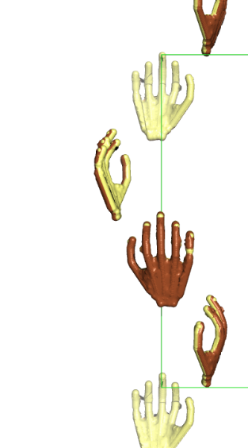
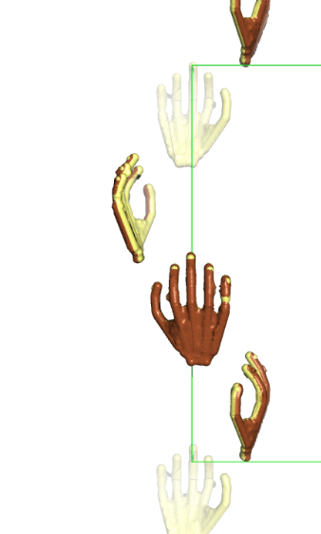
Why is there a Harker section on w=¼?
4₃
Along 4₃ axis, symmetry equivalent molecules are translated by a quarter of the unit cell.
So, vectors between successive symmetry equivalent atoms along this screw axis always have a “z” component of ¼ of the unit cell length, c.
So, w = ¼
¼
¼
¼
w
¼
v
u

Slide 23
Match the u,v,w with appropriate vector equation and solve for x,y,z algebraically.
Order Height/Rms Fractional coordinates
u v w
17 31.30 0.4525 0.0586 0.2500
18 31.30 0.9414 0.4525 0.2500
21 31.30 0.9414 0.5475 0.2500
24 31.30 0.5475 0.0586 0.2500
25 31.30 0.0586 0.4525 0.2500
26 31.30 0.0586 0.5475 0.2500
27 31.30 0.4525 0.9414 0.2500
28 31.30 0.5475 0.9414 0.2500
19 31.30 0.4525 0.0586 0.7500
20 31.30 0.9414 0.4525 0.7500
22 31.30 0.5475 0.0586 0.7500
23 31.30 0.9414 0.5475 0.7500
29 31.30 0.0586 0.4525 0.7500
30 31.30 0.0586 0.5475 0.7500
31 31.30 0.4525 0.9414 0.7500
32 31.30 0.5475 0.9414 0.7500
11 32.05 0.5000 0.0081 0.6229
13 32.05 0.5000 0.9926 0.6229
14 32.05 0.5000 0.9926 0.3771
15 32.05 0.5000 0.0081 0.3771
43 28.98 0.5000 0.1060 0.1229
44 28.98 0.5000 0.8940 0.1229
46 28.98 0.5000 0.1060 0.8771
48 28.98 0.5000 0.8940 0.8771
10 32.05 0.0081 0.5000 0.6229
12 32.05 0.9926 0.5000 0.6229
16 32.05 0.0081 0.5000 0.3771
41 28.98 0.1060 0.5000 0.1229
42 28.98 0.8940 0.5000 0.1229
45 28.98 0.1060 0.5000 0.8771
47 28.98 0.8940 0.5000 0.8771
33 30.79 0.3954 0.4941 0.5000
34 30.79 0.6046 0.4941 0.5000
35 30.79 0.4941 0.3954 0.5000
36 30.79 0.5059 0.3954 0.5000
37 30.79 0.3954 0.5059 0.5000
38 30.79 0.6046 0.5059 0.5000
39 30.79 0.4941 0.6046 0.5000
40 30.79 0.5059 0.6046 0.5000
1 377.52 0.0000 0.0000 0.0000
2 33.12 0.4415 0.5585 0.1267
3 33.12 0.4415 0.4415 0.1267
4 33.12 0.5585 0.4415 0.1267
5 33.12 0.5585 0.5585 0.1267
6 33.12 0.4415 0.4415 0.8733
7 33.12 0.5585 0.4415 0.8733
8 33.12 0.4415 0.5585 0.8733
9 33.12 0.5585 0.5585 0.8733
49 27.88 0.0470 0.9521 0.6269
50 27.88 0.9530 0.9521 0.6269
51 27.88 0.9530 0.9521 0.3731
52 27.88 0.9521 0.9530 0.3731
53 27.88 0.9521 0.0470 0.6269
54 27.88 0.0470 0.0479 0.6269
55 27.88 0.9530 0.0479 0.6269
56 27.88 0.9521 0.0470 0.3731
57 27.88 0.0470 0.0479 0.3731
58 27.88 0.9530 0.0479 0.3731
59 27.88 0.0470 0.9521 0.3731
60 27.88 0.0479 0.9530 0.3731
61 9.30 0.0000 0.0170 0.0205
62
Symm
Op# u v w
2-3) -½-x+y, -½-x-y, -¼
3-2) ½+x-y, ½+x+y, ¼
1-4) -½+x-y, -½+x+y, -¼
4-1) ½-x+y, ½-x-y, ¼
6-7) -½+x-y, -½-x-y, -¼
7-6) ½-x+y, ½+x+y, ¼
5-8) -½-x+y, -½+x+y, -¼
8-5) ½+x-y, ½-x-y, ¼
1-3) -½+x+y, -½-x+y, -¾
3-1) ½-x-y, ½+x-y, ¾
2-4) -½-x-y, -½+x-y, ¼
4-2) ½+x+y, ½-x+y, -¼
5-7) -½+x+y, -½+x-y, -¾
7-5) ½-x-y, ½-x+y, ¾
6-8) ½-x-y, -½-x+y, ¼
8-6) -½+x+y, ½+x-y, -¼
3-5) ½-2y, ½, -¼+2z
5-3) -½+2y, -½, ¼-2z
4-6) ½+2y, ½, -¼+2z
6-4) -½-2y, -½, ¼-2z
1-7) -½+2x, -½, -¾+2z
7-1) ½-2x, ½, ¾-2z
2-8) -½-2x, -½, ¼+2z
8-2) ½+2x, ½, -¼-2z
4-5) ½, ½-2x, ¼+2z
5-4) -½, -½+2x, -¼-2z
3-6) ½, ½+2x, ¼+2z
6-3) -½, -½-2x, -¼-2z
2-7) -½, -½-2y, -¼+2z
7-2) ½, ½+2y, ¼-2z
1-8) -½, -½+2y, -¼+2z
8-1) ½, ½-2y, ¼-2z
1-2) 2x, 2y, -½
2-1) -2x, -2y, ½
3-4) -2y, 2x, ½
4-3) 2y, -2x, -½
5-6) 2y, 2x, -½
6-5) -2y, -2x, ½
7-8) -2x, 2y, ½
8-7) 2x, -2y, -½
1-5) x-y, -x+y, 2z
5-1) -x+y, x-y, -2z
2-5) -x-y, -x-y, ½+2z
5-2) x+y, x+y, -½-2z
etc
I see eight obvious matches for peak #17. Which equation should I use?

Slide 24
Symmetry operator 3
-Symmetry operator 2
½-y ½+x ¾+z
-( -x -y ½+z)
u=½+x-y v=½+x+y w=¼
Plug in u and solve for x.
Plug in v and solve for y.
u v w
0.4525 0.0586 0.2500
u = ½ +x -y
0.4525 = -½ +x -y
0.9525 = x –y
Add equations
0.9525 = x –y
+(0.5856 = x +y)
1.5831= 2x
0.7691 = x
v = -½ +x +y
0.0586 = -½ +x +y
0.5856 = x +y
Subtract equations
0.9525 = x –y
-(0.5856 = x +y)
0.3669= -2y
-0.1835 = y
0.8165 = y

Slide 25
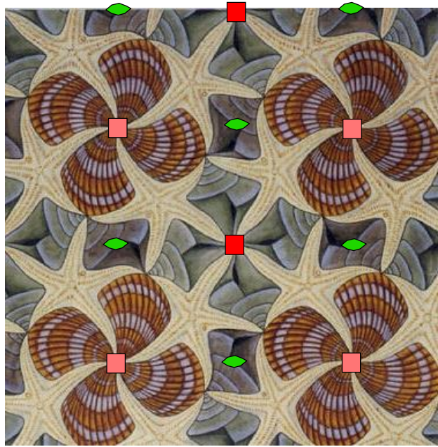
Choice of unit cell origin
X= 0.77 y=0.82
y
x

Slide 26
Choice of unit cell origin
X= 0.27 y=0.32
y
x

Slide 27
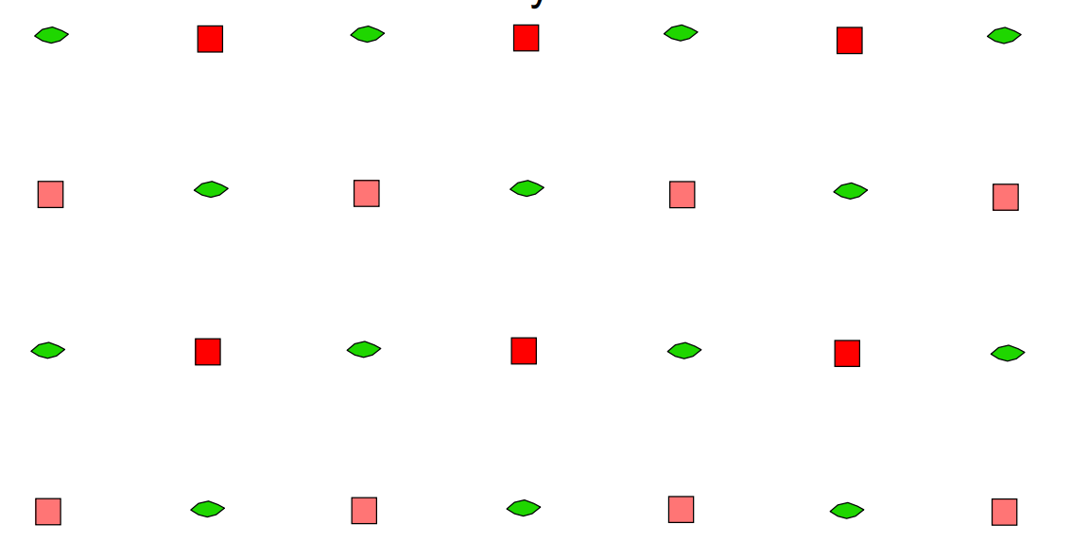
Cheshire symmetry
X= 0.27 y=0.32
y
x

Slide 28
Find another equation to solve for z.
Order Height/Rms Fractional coordinates
u v w
17 31.30 0.4525 0.0586 0.2500
18 31.30 0.9414 0.4525 0.2500
21 31.30 0.9414 0.5475 0.2500
24 31.30 0.5475 0.0586 0.2500
25 31.30 0.0586 0.4525 0.2500
26 31.30 0.0586 0.5475 0.2500
27 31.30 0.4525 0.9414 0.2500
28 31.30 0.5475 0.9414 0.2500
19 31.30 0.4525 0.0586 0.7500
20 31.30 0.9414 0.4525 0.7500
22 31.30 0.5475 0.0586 0.7500
23 31.30 0.9414 0.5475 0.7500
29 31.30 0.0586 0.4525 0.7500
30 31.30 0.0586 0.5475 0.7500
31 31.30 0.4525 0.9414 0.7500
32 31.30 0.5475 0.9414 0.7500
11 32.05 0.5000 0.0081 0.6229
13 32.05 0.5000 0.9926 0.6229
14 32.05 0.5000 0.9926 0.3771
15 32.05 0.5000 0.0081 0.3771
43 28.98 0.5000 0.1060 0.1229
44 28.98 0.5000 0.8940 0.1229
46 28.98 0.5000 0.1060 0.8771
48 28.98 0.5000 0.8940 0.8771
10 32.05 0.0081 0.5000 0.6229
12 32.05 0.9926 0.5000 0.6229
16 32.05 0.0081 0.5000 0.3771
41 28.98 0.1060 0.5000 0.1229
42 28.98 0.8940 0.5000 0.1229
45 28.98 0.1060 0.5000 0.8771
47 28.98 0.8940 0.5000 0.8771
33 30.79 0.3954 0.4941 0.5000
34 30.79 0.6046 0.4941 0.5000
35 30.79 0.4941 0.3954 0.5000
36 30.79 0.5059 0.3954 0.5000
37 30.79 0.3954 0.5059 0.5000
38 30.79 0.6046 0.5059 0.5000
39 30.79 0.4941 0.6046 0.5000
40 30.79 0.5059 0.6046 0.5000
1 377.52 0.0000 0.0000 0.0000
2 33.12 0.4415 0.5585 0.1267
3 33.12 0.4415 0.4415 0.1267
4 33.12 0.5585 0.4415 0.1267
5 33.12 0.5585 0.5585 0.1267
6 33.12 0.4415 0.4415 0.8733
7 33.12 0.5585 0.4415 0.8733
8 33.12 0.4415 0.5585 0.8733
9 33.12 0.5585 0.5585 0.8733
49 27.88 0.0470 0.9521 0.6269
50 27.88 0.9530 0.9521 0.6269
51 27.88 0.9530 0.9521 0.3731
52 27.88 0.9521 0.9530 0.3731
53 27.88 0.9521 0.0470 0.6269
54 27.88 0.0470 0.0479 0.6269
55 27.88 0.9530 0.0479 0.6269
56 27.88 0.9521 0.0470 0.3731
57 27.88 0.0470 0.0479 0.3731
58 27.88 0.9530 0.0479 0.3731
59 27.88 0.0470 0.9521 0.3731
60 27.88 0.0479 0.9530 0.3731
61 9.30 0.0000 0.0170 0.0205
62
Symm
Op# u v w
2-3) -½-x+y, -½-x-y, -¼
3-2) ½+x-y, ½+x+y, ¼
1-4) -½+x-y, -½+x+y, -¼
4-1) ½-x+y, ½-x-y, ¼
6-7) -½+x-y, -½-x-y, -¼
7-6) ½-x+y, ½+x+y, ¼
5-8) -½-x+y, -½+x+y, -¼
8-5) ½+x-y, ½-x-y, ¼
1-3) -½+x+y, -½-x+y, -¾
3-1) ½-x-y, ½+x-y, ¾
2-4) -½-x-y, -½+x-y, ¼
4-2) ½+x+y, ½-x+y, -¼
5-7) -½+x+y, -½+x-y, -¾
7-5) ½-x-y, ½-x+y, ¾
6-8) ½-x-y, -½-x+y, ¼
8-6) -½+x+y, ½+x-y, -¼
4-5) ½, ½-2x, ¼+2z
5-4) -½, -½+2x, -¼-2z
3-6) ½, ½+2x, ¼+2z
6-3) -½, -½-2x, -¼-2z
2-7) -½, -½-2y, -¼+2z
7-2) ½, ½+2y, ¼-2z
1-8) -½, -½+2y, -¼+2z
8-1) ½, ½-2y, ¼-2z
3-5) ½-2y, ½, -¼+2z
5-3) -½+2y, -½, ¼-2z
4-6) ½+2y, ½, -¼+2z
6-4) -½-2y, -½, ¼-2z
1-7) -½+2x, -½, -¾+2z
7-1) ½-2x, ½, ¾-2z
2-8) -½-2x, -½, ¼+2z
8-2) ½+2x, ½, -¼-2z
1-2) 2x, 2y, -½
2-1) -2x, -2y, ½
3-4) -2y, 2x, ½
4-3) 2y, -2x, -½
5-6) 2y, 2x, -½
6-5) -2y, -2x, ½
7-8) -2x, 2y, ½
8-7) 2x, -2y, -½
1-5) x-y, -x+y, 2z
5-1) -x+y, x-y, -2z
2-5) -x-y, -x-y, ½+2z
5-2) x+y, x+y, -½-2z
etc
I see eight obvious matches for peak 11. Which equation should I use?
Use the equation that yields the previously obtained value of “x” or “y”

Slide 29
Symmetry operator 3
-Symmetry operator 6
½-y ½+x ¾+z
-( -y -x ½-z )
u= ½ v=½+2x w= ¼+2z
u v w
0.5000 0.0081 0.6229
Plug in v, solve for x:
Plug in w, solve for z:
v = ½ + 2x
0.0081 = ½ + 2x
-0.4919 = 2x
-0.2460 = x
0.7541 = x
w = ¼ + 2z
0.6229 = ¼ + 2z
0.3729 = 2z
0.1865 = z

Slide 30
Combine answers from two Harker sections to get heavy atom x,y,z coordinates
From w=¼ x=0.7691 y=0.8165
From u=½ x=0.7541 z=0.1865
Combined x=0.7541 y=0.8165 z=0.1865
Other 7 sites in unit cell can be obtained by applying space group symmetry operations

Slide 31
Cheshire Symmetry Operators for space group P4₃2₁2
1 X, Y, Z
2 -X, -Y, Z
3 -Y, X, 1/4+Z
4 Y, -X, 1/4+Z
5 Y, X, -Z
6 -Y, -X, -Z
7 X, -Y, 1/4-Z
8 -X, Y, 1/4-Z
09 1/2+X, 1/2+Y, Z
10 1/2-X, 1/2-Y, Z
11 1/2-Y, 1/2+X, 1/4+Z
12 1/2+Y, 1/2-X, 1/4+Z
13 1/2+Y, 1/2+X, -Z
14 1/2-Y, 1/2-X, -Z
15 1/2+X, 1/2-Y, 1/4-Z
16 1/2-X, 1/2+Y, 1/4-Z
17 X, Y, 1/2+Z
18 -X, -Y, 1/2+Z
19 -Y, X, 3/4+Z
20 Y, -X, 3/4+Z
21 Y, X, 1/2-Z
22 -Y, -X, 1/2-Z
23 X, -Y, 3/4-Z
24 -X, Y, 3/4-Z
25 1/2+X, 1/2+Y, 1/2+Z
26 1/2-X, 1/2-Y, 1/2+Z
27 1/2-Y, 1/2+X, 3/4+Z
28 1/2+Y, 1/2-X, 3/4+Z
29 1/2+Y, 1/2+X, 1/2-Z
30 1/2-Y, 1/2-X, 1/2-Z
31 1/2+X, 1/2-Y, 3/4-Z
32 1/2-X, 1/2+Y, 3/4-Z

Slide 32
Check that this x,y,z can predict all peaks in the difference Patterson map
Combined x=0.7541 y=0.8165 z=0.1865
Solve for each u,v,w. Overlay predictions on Patterson map
Symm
Op# u v w
2-3) -½-x+y, -½-x-y, -¼
3-2) ½+x-y, ½+x+y, ¼
1-4) -½+x-y, -½+x+y, -¼
4-1) ½-x+y, ½-x-y, ¼
6-7) -½+x-y, -½-x-y, -¼
7-6) ½-x+y, ½+x+y, ¼
5-8) -½-x+y, -½+x+y, -¼
8-5) ½+x-y, ½-x-y, ¼
1-3) -½+x+y, -½-x+y, -¾
3-1) ½-x-y, ½+x-y, ¾
2-4) -½-x-y, -½+x-y, ¼
4-2) ½+x+y, ½-x+y, -¼
5-7) -½+x+y, -½+x-y, -¾
7-5) ½-x-y, ½-x+y, ¾
6-8) ½-x-y, -½-x+y, ¼
8-6) -½+x+y, ½+x-y, -¼
4-5) ½, ½-2x, ¼+2z
5-4) -½, -½+2x, -¼-2z
3-6) ½, ½+2x, ¼+2z
6-3) -½, -½-2x, -¼-2z
2-7) -½, -½-2y, -¼+2z
7-2) ½, ½+2y, ¼-2z
1-8) -½, -½+2y, -¼+2z
8-1) ½, ½-2y, ¼-2z
3-5) ½-2y, ½, -¼+2z
5-3) -½+2y, -½, ¼-2z
4-6) ½+2y, ½, -¼+2z
6-4) -½-2y, -½, ¼-2z
1-7) -½+2x, -½, -¾+2z
7-1) ½-2x, ½, ¾-2z
2-8) -½-2x, -½, ¼+2z
8-2) ½+2x, ½, -¼-2z
1-2) 2x, 2y, -½
2-1) -2x, -2y, ½
3-4) -2y, 2x, ½
4-3) 2y, -2x, -½
5-6) 2y, 2x, -½
6-5) -2y, -2x, ½
7-8) -2x, 2y, ½
8-7) 2x, -2y, -½
1-5) x-y, -x+y, 2z
5-1) -x+y, x-y, -2z
2-5) -x-y, -x-y, ½+2z
5-2) x+y, x+y, -½-2z
etc

Slide 33
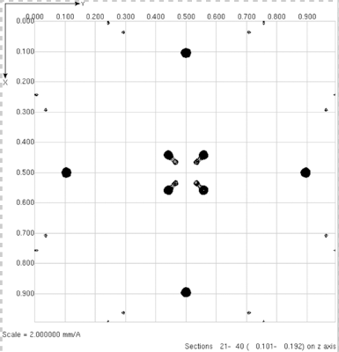
Check that this x,y,z can predict all peaks in the difference Patterson map
Combined x=0.7541 y=0.8165 z=0.1865
Solve for each u,v,w. Overlay predictions on Patterson map
If you see a peak with no prediction (+) something went wrong.
Check algebra.
If algebra is OK, then the problem could arise from an ambiguity between solutions for P4₁2₁2 and P4₃2₁2.
Swap space groups or negate x of x,y,z, and calculate Patterson predictions from –x,y,z
+
+
+
+
+
+
+
+

Slide 34
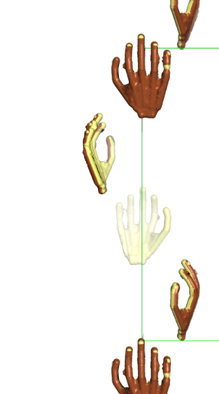
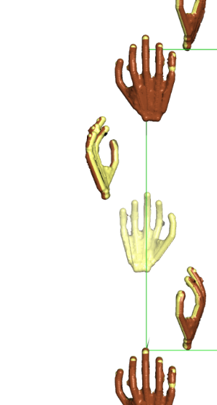
Check if x,y,z is consistent with space group P4₃2₁2 or P4₁2₁2.
There is only a 50% probability that our heavy atom coordinates (x,y,z) are consistent with space group P4₃2₁2. The remaining 50% probability is that x,y,z is consistent with space group P4₁2₁2, even though we used P4₃2₁2 symmetry operators to derive our coordinates and our algebra is faultless.
Space group P4₃2₁2 is chiral, meaning that it contains symmetry elements of a particular hand. For example, the 4₃ axis in P4₃2₁2 is a left handed screw.
Space group P4₁2₁2 is also chiral, and its symmetry elements are the mirror image of space group P4₃2₁2.
Crystals in chiral space groups P4₁2₁2 and P4₃2₁2 share the same Patterson symmetry group, P4/mmm, which is not chiral, but centrosymmetric.
All Patterson maps (including P4/mmm) are centrosymmetric because their peaks represent vectors between atoms. Every pair of atoms is connected by two vectors of equal length and opposite direction: atom1→atom2 and atom1←atom2, thereby creating centrosymmetry.
The 50% chance of space group inconsistency arises from our unavoidable dependence on a centrosymmetric map to derive coordinates in a chiral space group.
Among the 230 space groups, only 22 are chiral. How did we get so lucky to stumble one of these?
The heavy atom coordinates (x,y,z) are verified to be consistent with space group P4₃2₁2 if (x,y,z) if it can be used to successfully predict coordinates (u,v,w) of a non-Harker Patterson peak.
If prediction is unsuccessful, invert the hand of the heavy atom solution by negating x to make it compatible with P4₃2₁2.
4₁
4₃
Right hand screw
Left hand screw

Slide 35
Check that this x,y,z can predict all peaks in the difference Patterson map
Combined x=-0.7541 y=0.8165 z=0.1865
Solve for each u,v,w. Overlay predictions on Patterson map
+
All major Patterson peaks will be predicted if the heavy atom coordinates are correct.
+
+
+
+
+
+
+

Slide 36
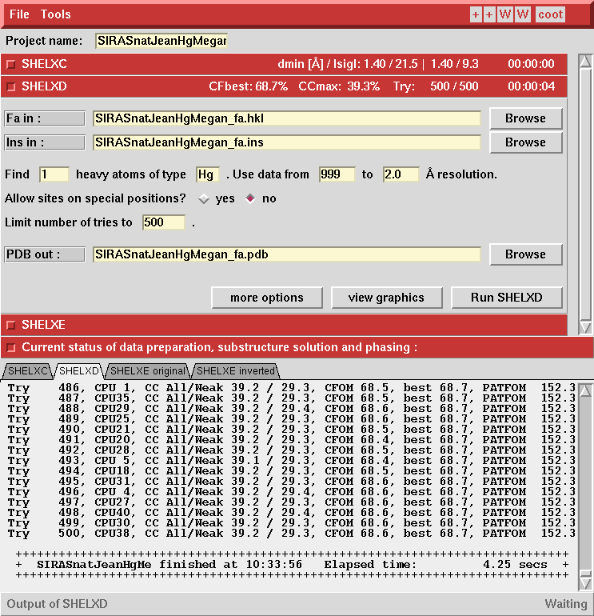
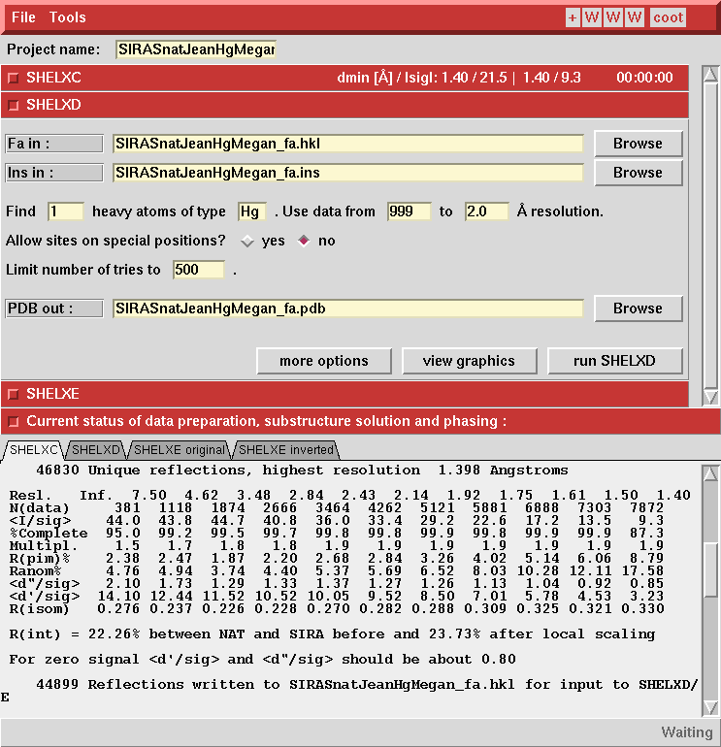
ShelxD uses direct methods to determine heavy atom x,y,z
Use 2.0 Å cutoff
Enter element
Estimate one heavy atom
Ask for 500 trials
Run ShelxD

Slide 37
Direct methods (shelxD) make it easy to determine the heavy atom coordinates.
TITL ProK PCMBS isomorphous differences in space group P4(3)2(1)2
CELL 1.54178 68.1060 68.1060 101.9890 90.000 90.000 90.000
ZERR 16.00 0.0096 0.0096 0.0204 0.000 0.000 0.000
LATT -1
SYMM -X, -Y, 0.5+Z
SYMM 0.5-Y, 0.5+X, 0.75+Z
SYMM 0.5+Y, 0.5-X, 0.25+Z
SYMM 0.5-X, 0.5+Y, 0.75-Z
SYMM 0.5+X, 0.5-Y, 0.25-Z
SYMM Y, X, -Z
SYMM -Y, -X, 0.5-Z
SFAC Hg
UNIT 8
PATS
FIND 1
MIND -3.5
NTRY 500
HKLF 3
END
Space group symmetry operators
Number of Hg atoms to find in asymmetric unit
Number of independent trials to perform

Slide 38
Direct methods output.
PSUM 103.31 PSMF Peaks: 171 53 14 13 12 12 12 12 12
Cycle 3 Peaks 99 26 5
R = 0.297, Min.fun. = 0.370, <cos> = 0.587, Ra = 0.281
x y z sof height
0.25578 0.69720 0.06393 1.000 99.90
0.20477 0.74650 0.12408 1.000 26.97
0.29138 0.75822 0.18655 1.000 5.20
Minimum distances (top row) and PSMF (bottom row)
Peak x y z self cross-vectors
99.9 0.2558 0.6972 0.0639 37.0
112.6
Use this for phasing calculation
Patterson Superposition Minimum Function (PSMF) (Buerger, 1959). Large positive numbers indicate a true solution.

Slide 39
ShelxD uses direct methods to determine heavy atom x,y,z
View graphics

Slide 40
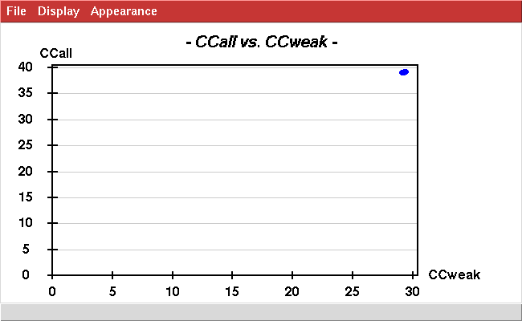
All 500 trials produced the same heavy atom substructure model
CC_{all} is the correlation coefficient between E_{obs} and E_{calc} calculated using all reflections. Higher is better.
500 independent trials produced 500 solutions with identical quality
CC_{weak} is the correlation coefficient between E_{obs} and E_{calc} calculated using only those reflections not used to locate the heavy atoms.
This is Strong!

Slide 41
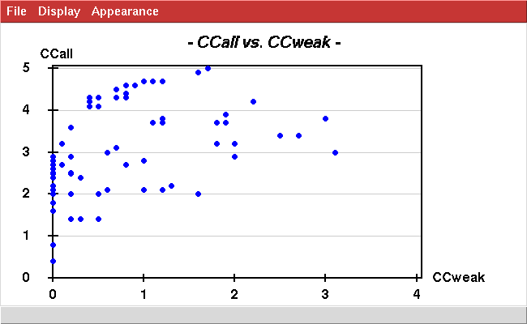
Contrast the appearance of a strong vs. weak heavy atom derivative
This plot inspires HIGH confidence that the heavy atom positions were determined correctly.
This is Strong!
This plot inspires low confidence that the heavy atom positions were determined correctly.
Poor

Slide 42
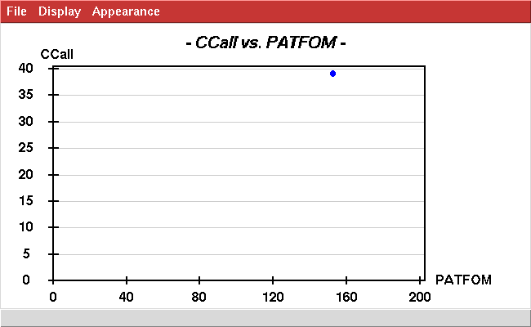
Strong heavy atom derivative
The Patterson Figure of Merit (PATFOM) is the average value of the Patterson map sampled at locations where Patterson peaks are predicted by the calculated heavy atom position. Higher is better.
correct
This is Strong!

Slide 43
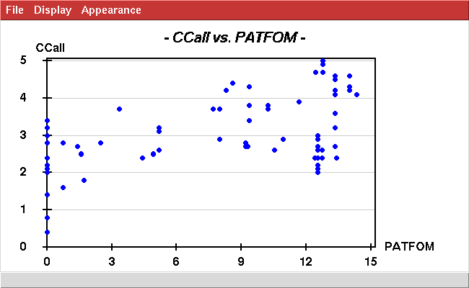
Contrast the appearance of a strong vs. weak heavy atom derivative
This plot inspires HIGH confidence that the heavy atom positions were determined correctly.
correct
This is Strong!
This plot inspires low confidence that the heavy atom positions were determined correctly.
Poor

Slide 44
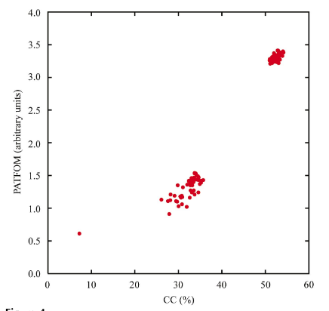
Contrast the appearance of a strong vs. weak heavy atom derivative
These plots inspire HIGH confidence that the heavy atom positions were determined correctly.
correct
correct
incorrect
This is Strong!
This plot inspires low confidence that the heavy atom positions were determined correctly.
Poor

Slide 45
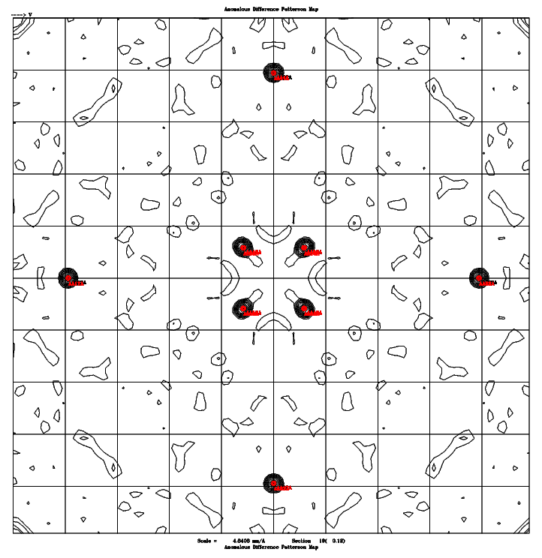
Check the agreement between ShelxD solution and Patterson map
Command to predict Patterson peak positions from x,y,z: checkpatterson.csh x y z
w=0.12
w=0.25
w=0.50
Predicted Patterson peak positions (red) match Patterson peaks (black)

Slide 46
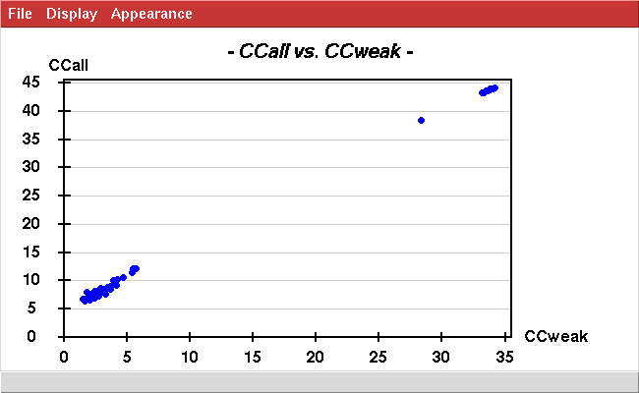
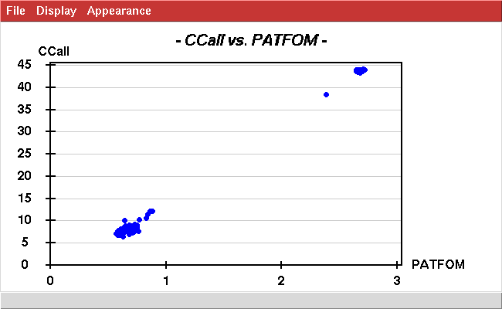
Sm-like archaeal protein (1m5q)
3 selenium sites per protein molecule.
28 proteins in the asymmetric unit
Therefore: 84 Se sites expected
correct
correct
incorrect
incorrect

Slide 47
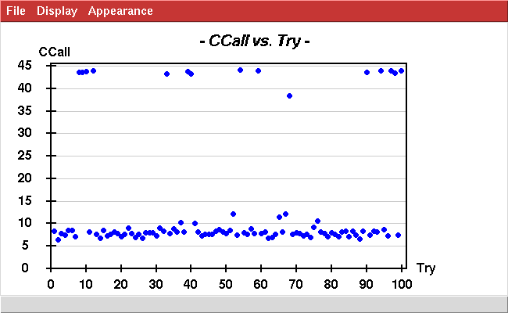
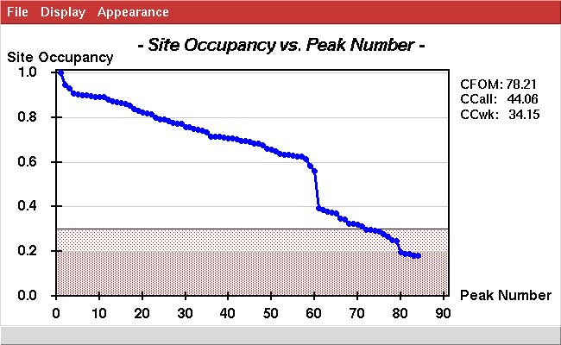
Sm-like archaeal protein (1m5q)
3 selenium sites per protein molecule.
28 proteins in the asymmetric unit
Therefore: 84 Se sites expected

Slide 48
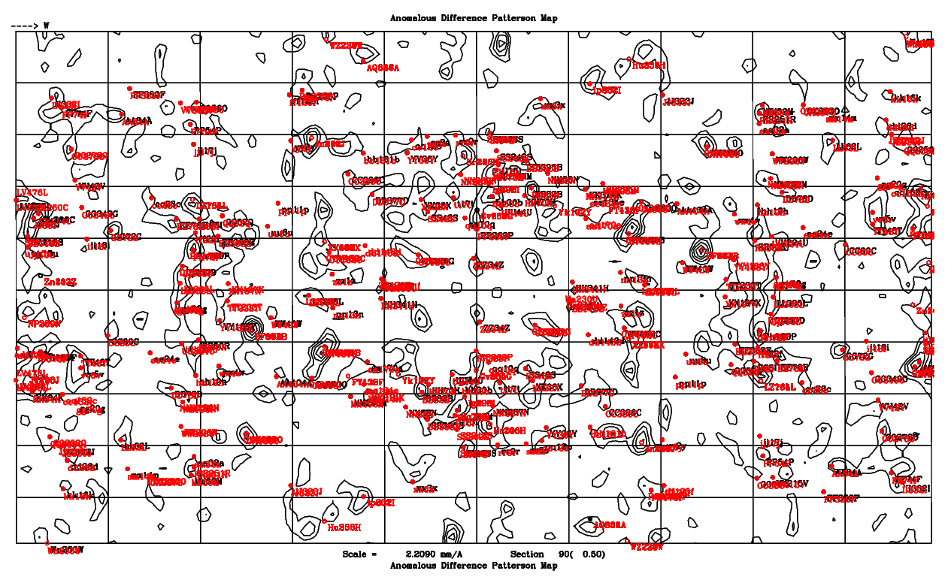
Sm-like archaeal protein (1m5q)
Predicted Patterson peaks match observed Patterson peaks, but peaks are weak.

Slide 49
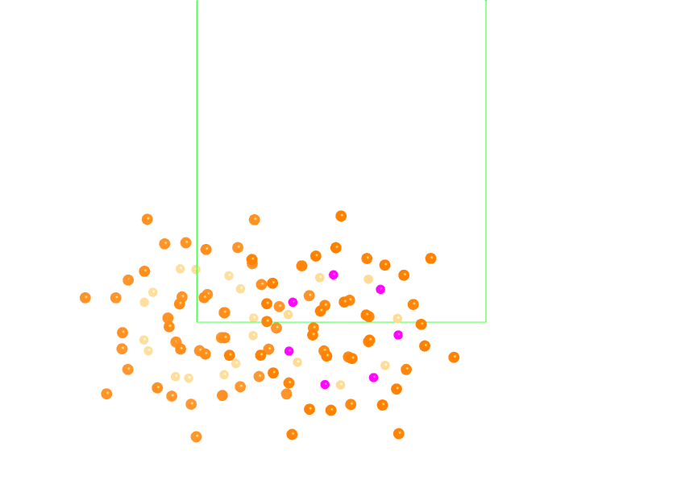
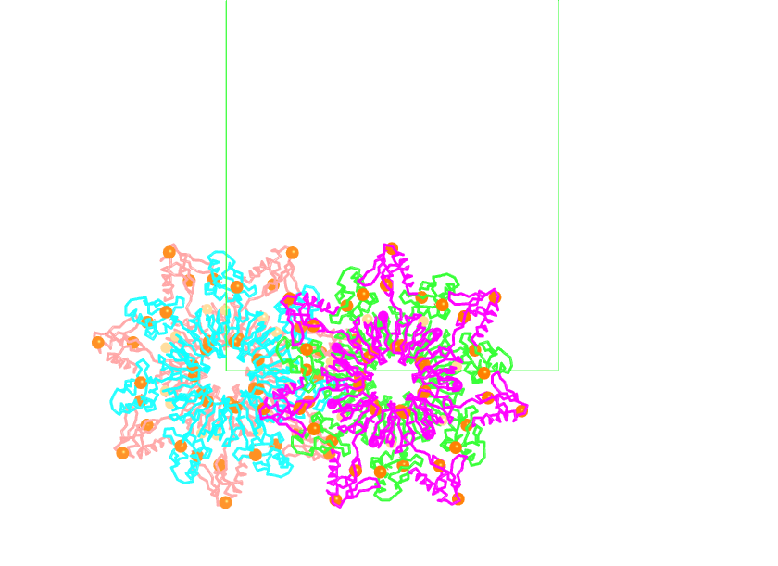
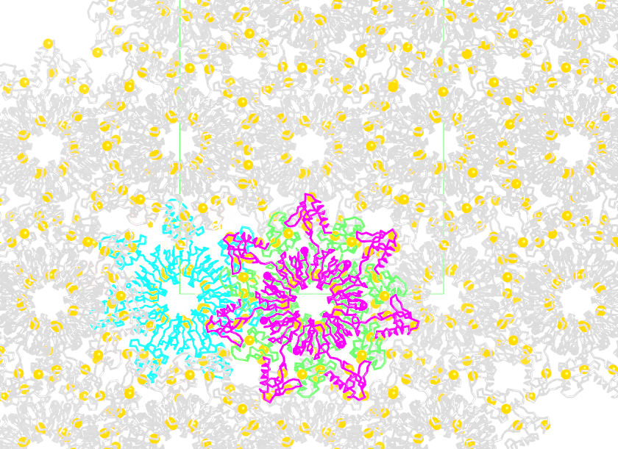
Sm-like archaeal protein (1m5q)
Se sites (spheres) in the asymmetric unit showed D7 symmetry
Cartoon ribbons of the protein structure
Crystal packing

Slide 50
Questions?
Duilio will give an introduction to the use of direct methods to solve the heavy atom substructure on Monday, Jan 27.
Phasing and Map Calculation happen a week after the Patterson lab.

Slide 51
In practice
Algebraic calculations would be very lengthy and tedious if there were multiple heavy atoms in the unit cell.
In practice, we use direct methods to determine the coordinates of the heavy atom.
Direct methods uses measured values of $\text{(}\text{|}\text{F}\text{PH}\text{|−|}\text{F}\text{P}\text{|}\text{)}$. It needs no phase information.
The success of the direct methods relies on the use of space-group defined relationships between phases.
Phases are restrained so that the electron density map (of the heavy atom) has discrete atom-like spheres of density (other shapes not allowed).
High resolution data (1.0 Å) is not required. 3.0 Å resolution works. The heavy atoms are so few in the cell that they are completely resolved (separated) at 3.0 Å resolution.
Duilio will tell us more about direct methods on Monday.
We will use direct methods to determine heavy atom x,y,z, and then we will verify that the coordinates predict all Patterson peaks.

