Slide 1
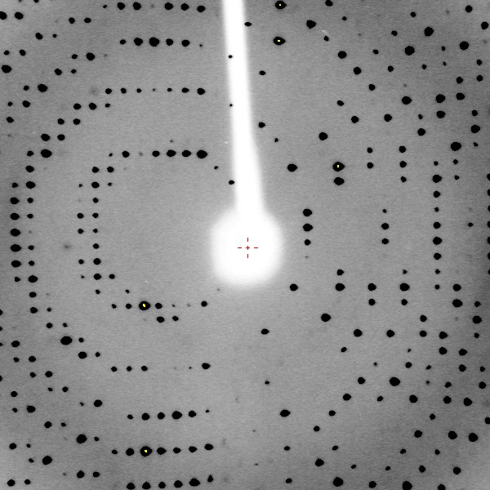
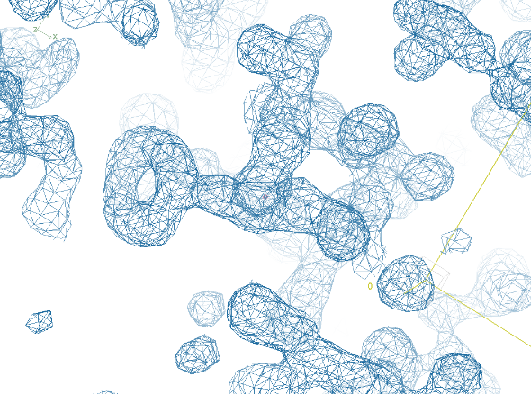
Summary of our Achievements & Goals
We want to determine structure of Proteinase K (ProK) by X-ray diffraction.
Diffraction methods have an inherent “phase problem”
To overcome the phase problem, we soaked ProK crystals in a mercury compound (derivative).
You collected X-ray diffraction data on 18 crystals.
9 students collected data on native crystals.
9 student collected data on derivative crystals.
All students will share data so everyone can work with the best native and derivative data.
Our goal today is to understand how to determine the heavy atom location of Hg (x,y,z).
It will enable us to overcome the phase problem (and see a map of the atomic structure of ProK).
ProK diffraction image
ProK electron density map

Slide 2
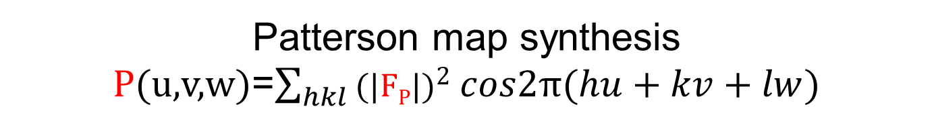
Atomic coordinates can be determined by interpreting peaks in a Patterson map.
Patterson map synthesis P(u,v,w)=$\sum_{hkl}{\text{(}\text{|}\text{F}\text{P}\text{|}\text{)}2 cos2π(hu+kv+lw)}$
Review from Thursday class:
A Patterson map is accessible to us because its calculation requires only measured diffraction intensities, no phases necessary.
We can infer atomic coordinates (x,y,z) from coordinates of Patterson peaks (u,v,w) using simple algebra.
Knowledge of the space group symmetry of the crystal is essential for correct (x,y,z) determination.

Slide 3

Atomic positions (x,y,z) are related to peak positions (u,v,w) in the Patterson map.
Space group P2
Symmetry Equivalent Positions
x,y,z
-x,y,-z
Consider an atom at (0.1, 0.2, 0.3)
Crystal Structure
(0.9, 0.2, 0.7)
z
(0.1, 0.2, 0.3)
x
(-0.1, 0.2, -0.3)

Slide 4
Each interatomic vector in the crystal produces a Patterson peak.
Space group P2
Symmetry Equivalent Positions
x,y,z
-x,y,-z
Draw a vector between each pair of atoms in the unit cell.
Translate each vector tail to the origin.
A Patterson peak occurs at each vector head.
Consider an atom at (0.1, 0.2, 0.3)
Crystal Structure
Patterson Map
(0.9, 0.2, 0.7)
z
(0.2, 0.0, 0.6)
w
(0.8, 0.0, 0.4)
(0.1, 0.2, 0.3)
x
u
(-0.8, 0.0, -0.4)

Slide 5
We can predict u,v,w from x,y,z by subtracting symmetry equivalent positions
_{Table of vectors (u,v,w)}
Space group P2
Symmetry Equivalent Positions
(1) x,y,z
(2)-x,y,-z
 | (1)x,y,z | (2)-x,y,-z
(1) x,y,z | (1)-(1) | (1)-(2)
(2)-x,y,-z | (2)-(1) | (2)-(2)
Consider an atom at (0.1, 0.2, 0.3)
Crystal Structure
Patterson Map
(0.9, 0.2, 0.7)
z
(0.2, 0.0, 0.6)
w
(0.8, 0.0, 0.4)
(0.1, 0.2, 0.3)
x
u

Slide 6
We can predict u,v,w from x,y,z by subtracting symmetry equivalent positions
_{Table of vectors (u,v,w)}
Space group P2
Symmetry Equivalent Positions
(1) x,y,z
(2)-x,y,-z
 | (1)x,y,z | (2)-x,y,-z
(1) x,y,z | (1)-(1) 0,0,0 | (1)-(2) 2x,0,2z
(2)-x,y,-z | (2)-(1) -2x,0,-2y | (2)(-2) 0,0,0
Consider an atom at (0.1, 0.2, 0.3)
Crystal Structure
Plug in x,y,z (0.1, 0.2, 0.3); solve for each u,v,w
(1)-(2)
u=2x w=2z
u=2(0.1)=0.2 w=2(0.3)=0.6
Patterson Map
(0.9, 0.2, 0.7)
z
(0.2, 0.0, 0.6)
(2)-(1)
u=-2(0.1)=-0.2 w=-2(0.3)=-0.6
u=0.8 w=0.4
w
(0.8, 0.0, 0.4)
(0.1, 0.2, 0.3)
x
(1)-(1)
u=0 w=0
u
(2)-(2)
u=0 w=0

Slide 7
We can recover x,y,z from u,v,w using the same equations, but in reverse
_{Table of vectors (u,v,w)}
Space group P2
Symmetry Equivalent Positions
(1) x,y,z
(2)-x,y,-z
 | (1)x,y,z | (2)-x,y,-z
(1) x,y,z | (1)-(1) 0,0,0 | (1)-(2) 2x,0,2z
(2)-x,y,-z | (2)-(1) -2x,0,-2y | (2)(-2) 0,0,0
Consider an atom at (0.1, 0.2, 0.3)
Crystal Structure
Plug in u,v,w (0.2, 0.0, 0.6); solve for x,y,z
(1)-(2)
u=2x w=2z
x=u/2 z=w/2
x=(0.2)/2=0.1 z=(0.6)/2=0.3
Patterson Map
(0.9, 0.2, 0.7)
z
(0.2, 0.0, 0.6)
w
(0.8, 0.0, 0.4)
(0.1, 0.2, 0.3)
x
u

Slide 8
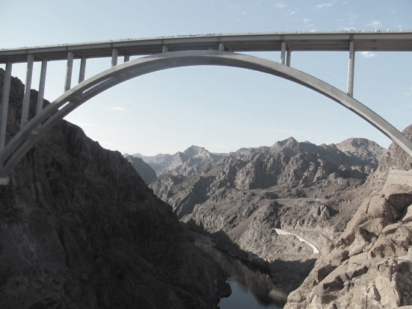
The vector table is our bridge between crystal coordinates & Patterson peaks.
Space group P2
Symmetry Equivalent Positions
x,y,z
-x,y,-z
_{Table of vectors (u,v,w)}
 | x,y,z | -x,y,-z
x,y,z | 0,0,0 | 2x,0,2z
-x,y,-z | -2x,0,-2y | 0,0,0
Consider an atom at (0.1, 0.2, 0.3)
Patterson peak prediction u=-2x, w=-2z
Crystal Structure
Patterson Map
Heavy atom structure determination x=-u/2 z=-w/2
(0.9, 0.2, 0.7)
z
(0.2, 0.0, 0.6)
w
(0.8, 0.0, 0.4)
(0.1, 0.2, 0.3)
x
u

Slide 9
Two clues are essential for recovery of (x,y,z) from Patterson peaks (u,v,w)
Space group P2
Symmetry Equivalent Positions
x,y,z
-x,y,-z
_{Table of vectors (u,v,w)}
 | x,y,z | -x,y,-z
x,y,z | 0,0,0 | 2x,0,2z
-x,y,-z | -2x,0,-2y | 0,0,0
Consider an atom at (0.1, 0.2, 0.3)
Crystal Structure
Patterson Map
Heavy atom structure determination x=-u/2 z=-w/2
(0.9, 0.2, 0.7)
z
Your identification of the space group of the crystal must be correct.
If the space group is wrong, the symbolic expression of the vectors will be wrong.
We infer the space group from the diffraction data (today in lab)
You must assign the correct vector equation to peak (u,v,w).
For example, you wouldn’t assign any of these vectors to a peak with v≠0. Why?
Concept of Harker section can help you. Let’s visualize.
(2x, 0, 2y)
w
(0.1, 0.2, 0.3)
x
u

Slide 10
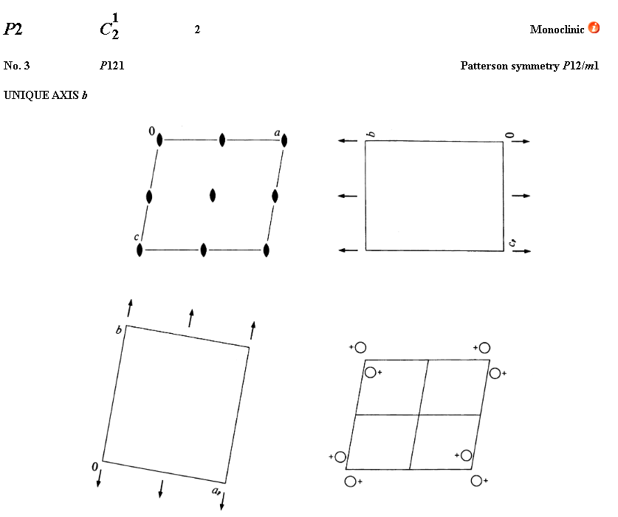
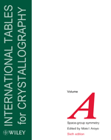
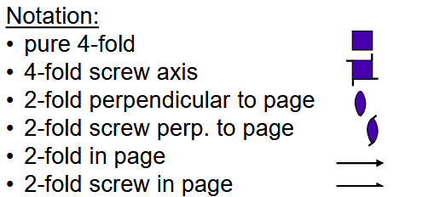

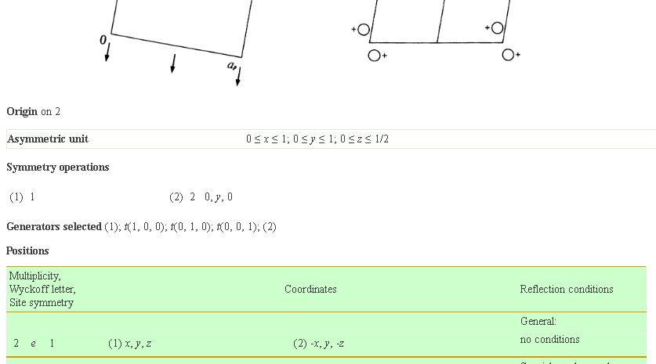
Symmetry Equivalent Positions for each space group are tabulated.
The International Tables of Crystallography Vol A. https://it.iucr.org/A/
For example, here is the entry for space group P2, which we just discussed.
These conventions/definitions are used by all crystallographic programs.
Visualizing the symmetry helps explain why Patterson peaks are expected to lay in a single plane.

Slide 11



Pure rotation axis produce Harker planes normal to the axis & intersecting the origin
z
y
z
90°
180°
120°
x
z
x
y
y
x
Space group P2
(1) x,y,z
(2) –x,y,-z
Space group P3
(1) x, y, z
(2) -y, x-y, z
(3) y-x,-x, z
Space group P4
(1) x, y, z
(2) -x, -y, z
(3) -y, x, z
(4) y, -x, z
Harker Section | V=0 | W=0 | W=0
Symmetry Equivalent Positions | Share the same y coordinate | Share the same z coordinate | Share the same z coordinate

Slide 12
The utility of Harker sections
A Harker section is a plane where we expect to find Patterson peaks arising from crystallographic symmetry such as rotation or screw axes.
Harker sections are indicated whenever a difference between symmetry operators defines a plane (i.e. produces a constant for one of the coordinate dimensions).
Harker sections are helpful because they can eliminate the ambiguity of assigning a Patterson peak to the correct pair of symmetry operators.
chances for an incorrect assignment would be high if we made the assignments randomly.
Incorrect assignment would lead to incorrect x,y,z coordinates.

Slide 13
Screw axes have rotational & translational components
Screw axes are typically denoted as N_{m}
N specifies rotation by 360°/N around screw axis
For 2₁, the rotational component is 360°/2=180°
“m” specifies translation by m/N along screw axis
For 2₁, the translational component is 1/2 of the unit cell length
All vectors between 2₁ –related symmetry equivalent positions are shifted by ½ (b), so we expect Patterson peaks on v= ½
v= ½ is a Harker section.
y
y
½(b)
½(b)
½(b)
z
x
Space group P2₁
(1) x,y,z
(2) –x,y+½,-z

Slide 14
Screw axes produce Harker planes normal to the axis & displaced from the origin
z
z
z
90°
90°
z
z
z
90°
90°
90°
x
y
y
x
y
x
Space group P4₁ (1) X,Y,Z
(2) -Y,X,1/4+Z
(3) -X,-Y,1/2+Z
(4) Y,-X,3/4+Z
Space group P4₂
(1) X,Y,Z
(2) -Y,X,1/2+Z
(3) -X,-Y,Z
(4) Y,-X,1/2+Z
Space group P4₃
(1) X,Y,Z
(2) -Y,X,3/4+Z
(3) -X,-Y,1/2+Z
(4) Y,-X,1/4+Z
Harker Section | w=¼, ½, ¾ | w=0, ½, | w=¼, ½, ¾
Symmetry Equivalent Positions | Differ by increments of ¼(c) | Differ by increments of ½ (c) | Share the same z coordinate

Slide 15
Note that 4₁ and 4₃ screw axes are mirror images of each other
z
z
z
z
x
y
x
y
Space group P4₁ (1) X,Y,Z
(2) -Y,X,1/4+Z
(3) -X,-Y,1/2+Z
(4) Y,-X,3/4+Z
Space group P4₃
(1) X,Y,Z
(2) -Y,X,3/4+Z
(3) -X,-Y,1/2+Z
(4) Y,-X,1/4+Z
Harker Section | w=¼, ½, ¾ |  | w=¼, ½, ¾
Symmetry Equivalent Positions | Differ by increments of ¼(c) |  | Share the same z coordinate

Slide 16
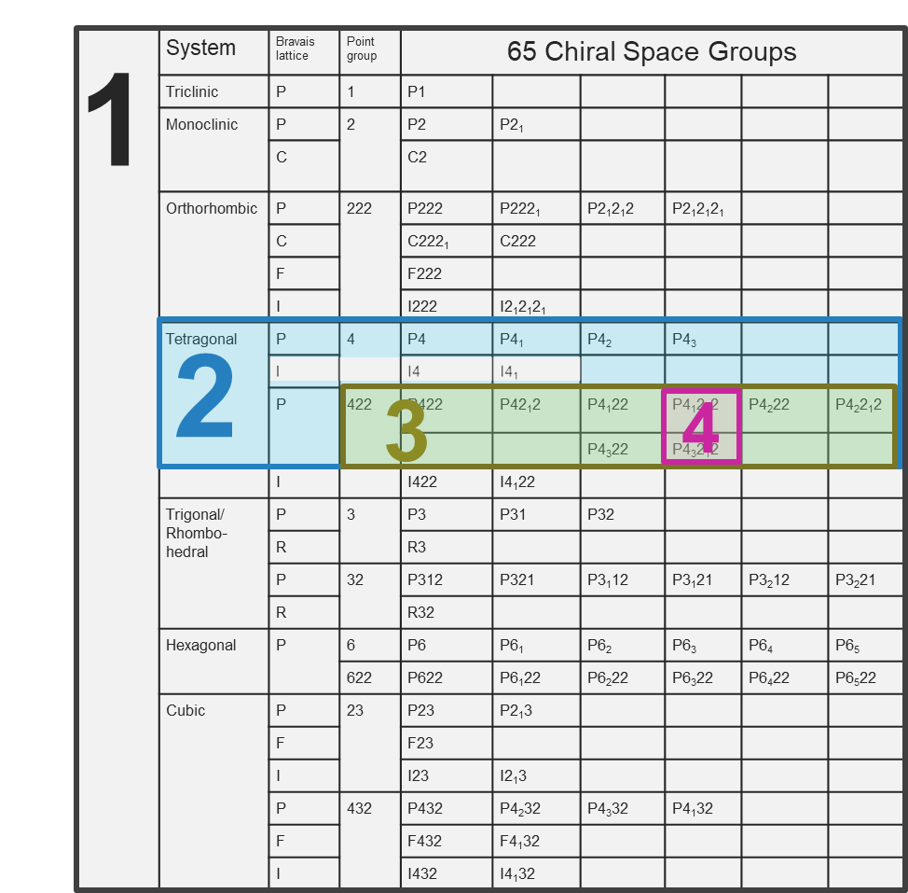
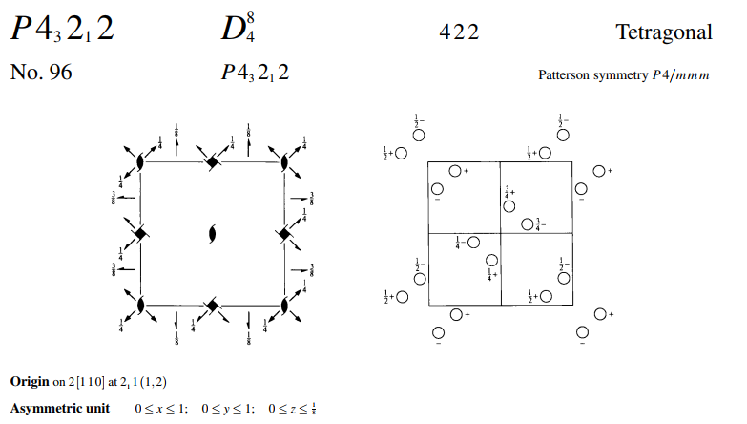

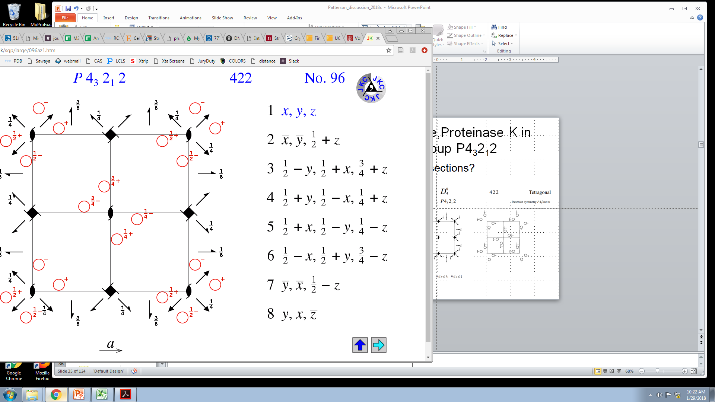
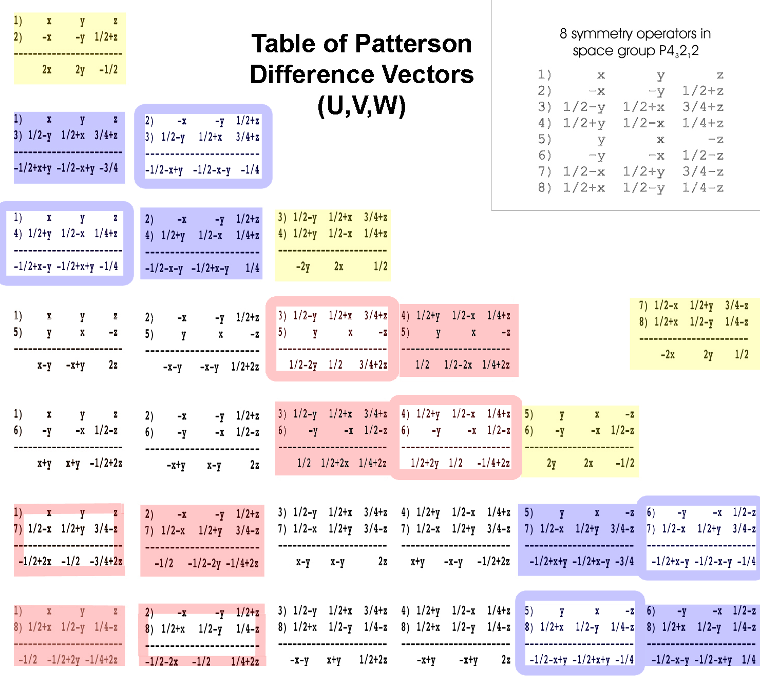
ProK crystals are in space group P4₃2₁2. What are the Harker sections?
Hints
According to IUCR convention, the 4₃ screw axis is parallel to “z”.
w=¼, ½, ¾
The 2₁ screw axes are parallel to “x” and “y”
u=½
v=½
The two-fold axis denoted by the final “2” in the space group name are diagonal.
Vectors between molecules related by this 2-fold are located in the planes u=w, and u=-w
origin

Slide 17
2-3) -½+x+y, -½-x-y, -¼
3-2) ½-x-y, ½+x+y, ¼
1-4) -½+x-y, -½+x+y, -¼
4-1) ½-x+y, ½-x-y, ¼
6-7) -½+x-y, -½-x-y, -¼
7-6) ½-x+y, ½+x+y, ¼
5-8) -½-x+y, -½+x+y, -¼
8-5) ½+x-y, ½-x-y, ¼
1-3) -½+x+y, -½-x+y, -¾
3-1) ½-x-y, ½+x-y, ¾
2-4) -½-x-y, -½+x-y, ¼
4-2) ½+x+y, ½-x+y, -¼
5-7) -½+x+y, -½+x-y, -¾
7-5) ½-x-y, ½-x+y, ¾
6-8) ½-x-y, -½-x+y, ¼
8-6) -½+x+y, ½+x-y, -¼
3-5) ½-2y, ½, -¼+2z
5-3) -½+2y, -½, ¼-2z
4-6) ½+2y, ½, -¼+2z
6-4) -½-2y, -½, ¼-2z
1-7) -½+2x, -½, -¾+2z
7-1) ½-2x, ½, ¾-2z
2-8) -½-2x, -½, ¼+2z
8-2) ½+2x, ½, -¼-2z
4-5) ½, ½-2x, ¼+2z
5-4) -½, -½+2x, -¼-2z
3-6) ½, ½+2x, ¼+2z
6-3) -½, -½-2x, -¼-2z
2-7) -½, -½-2y, -¼+2z
7-2) ½, ½+2y, ¼-2z
1-8) -½, -½+2y, -¼+2z
8-1) ½, ½-2y, ¼-2z
1-2) 2x, 2y, -½
2-1) -2x, -2y, ½
3-4) -2y, 2x, ½
4-3) 2y, -2x, -½
5-6) 2y, 2x, -½
6-5) -2y, -2x, ½
7-8) -2x, 2y, ½
8-7) 2x, -2y, -½
1-5) x-y, -x+y, 2z
5-1) -x+y, x-y, -2z
2-5) -x-y, -x-y, ½+2z
5-2) x+y, x+y, -½-2z
etc

Slide 18
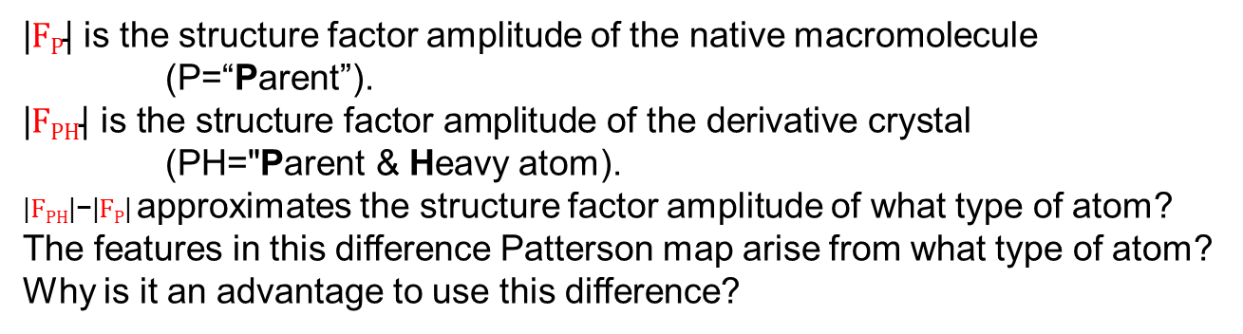
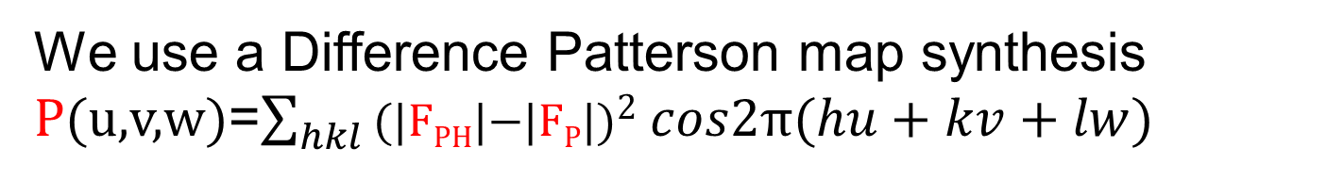
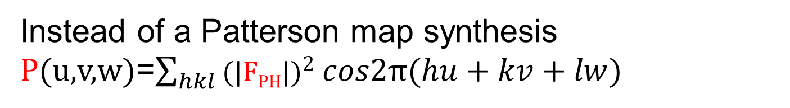
We will calculate difference Patterson maps.
Instead of a Patterson map synthesis P(u,v,w)=$\sum_{hkl}{\text{(}\text{|}\text{F}\text{P}\text{H}\text{|}\text{)}2 cos2π(hu+kv+lw)}$
We use a Difference Patterson map synthesis P(u,v,w)=$\sum_{hkl}{\text{(}\text{|}\text{F}\text{PH}\text{|−|}\text{F}\text{P}\text{|}\text{)}2 cos2π(hu+kv+lw)}$
$\text{|}\text{F}\text{P}\text{|}$ is the structure factor amplitude of the native macromolecule (P=“Parent”).
$$\text{|}\text{F}\text{PH}\text{| }\text{is} \text{the} \text{structure} \text{factor} \text{amplitude} \text{of} \text{the} \text{derivative} \text{crystal}$$
$\text{(}\text{PH}\text{="}\text{P}\text{arent}\text{ \& }\text{H}\text{eavy}$ atom).
$\text{|}\text{F}\text{PH}\text{|−|}\text{F}\text{P}\text{|}$approximates the structure factor amplitude of what type of atom?
The features in this difference Patterson map arise from what type of atom? Why is it an advantage to use this difference?

Slide 19
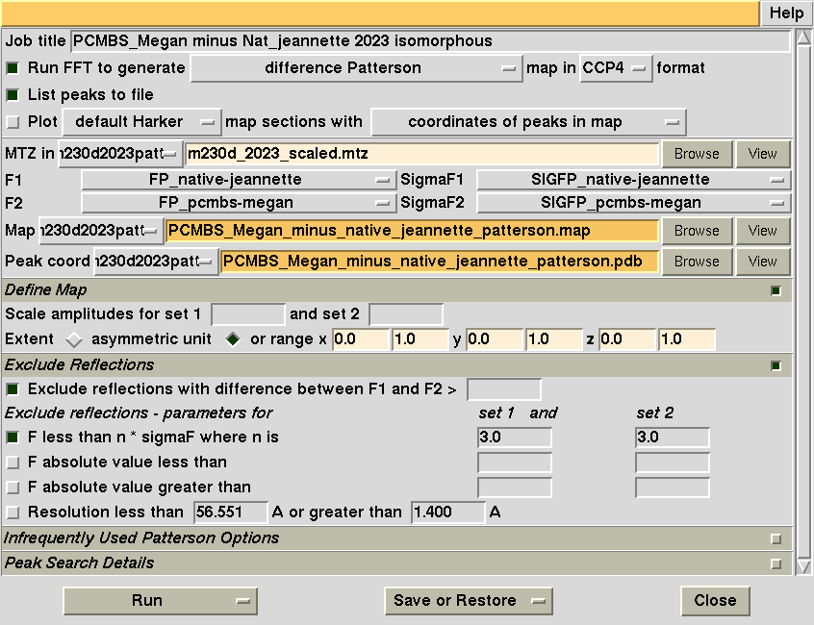
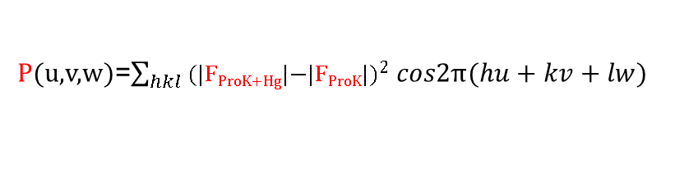
Calculate isomorphous difference Patterson map with CCP4 suite
Specify a difference Patterson map calculation:
P(u,v,w)=$\sum_{hkl}{\text{(}\text{|}\text{F}\text{P}\text{roK}\text{+}\text{H}\text{g}\text{|−|}\text{F}\text{P}\text{roK}\text{|}\text{)}2 cos2π(hu+kv+lw)}$
Specify the name of the native and derivative structure factor sets
Patterson Map extents
u_{min}, u_{max}, v_{min}, v_{max}, w_{min}, w_{max}

Slide 20
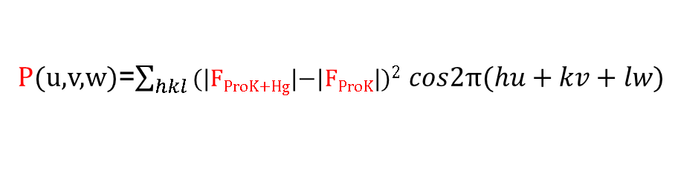
Peaks list from a previous isomorphous Difference Patterson Map
P(u,v,w)=$\sum_{hkl}{\text{(}\text{|}\text{F}\text{P}\text{roK}\text{+}\text{H}\text{g}\text{|−|}\text{F}\text{P}\text{roK}\text{|}\text{)}2 cos2π(hu+kv+lw)}$
Order Height/Rms Fractional coordinates
u v w
1 377.52 0.0000 0.0000 0.0000
2 33.12 0.4415 0.5585 0.1267
3 33.12 0.4415 0.4415 0.1267
4 33.12 0.5585 0.4415 0.1267
5 33.12 0.5585 0.5585 0.1267
6 33.12 0.4415 0.4415 0.8733
7 33.12 0.5585 0.4415 0.8733
8 33.12 0.4415 0.5585 0.8733
9 33.12 0.5585 0.5585 0.8733
10 32.05 0.0081 0.5000 0.6229
11 32.05 0.5000 0.0081 0.6229
12 32.05 0.9926 0.5000 0.6229
13 32.05 0.5000 0.9926 0.6229
14 32.05 0.5000 0.9926 0.3771
15 32.05 0.5000 0.0081 0.3771
16 32.05 0.0081 0.5000 0.3771
17 31.30 0.4525 0.0586 0.2500
18 31.30 0.9414 0.4525 0.2500
19 31.30 0.4525 0.0586 0.7500
20 31.30 0.9414 0.4525 0.7500
21 31.30 0.9414 0.5475 0.2500
22 31.30 0.5475 0.0586 0.7500
23 31.30 0.9414 0.5475 0.7500
24 31.30 0.5475 0.0586 0.2500
25 31.30 0.0586 0.4525 0.2500
26 31.30 0.0586 0.5475 0.2500
27 31.30 0.4525 0.9414 0.2500
28 31.30 0.5475 0.9414 0.2500
29 31.30 0.0586 0.4525 0.7500
30 31.30 0.0586 0.5475 0.7500
Order Height/Rms Fractional coordinates
u v w
31 31.30 0.4525 0.9414 0.7500
32 31.30 0.5475 0.9414 0.7500
33 30.79 0.3954 0.4941 0.5000
34 30.79 0.6046 0.4941 0.5000
35 30.79 0.4941 0.3954 0.5000
36 30.79 0.5059 0.3954 0.5000
37 30.79 0.3954 0.5059 0.5000
38 30.79 0.6046 0.5059 0.5000
39 30.79 0.4941 0.6046 0.5000
40 30.79 0.5059 0.6046 0.5000
41 28.98 0.1060 0.5000 0.1229
42 28.98 0.8940 0.5000 0.1229
43 28.98 0.5000 0.1060 0.1229
44 28.98 0.5000 0.8940 0.1229
45 28.98 0.1060 0.5000 0.8771
46 28.98 0.5000 0.1060 0.8771
47 28.98 0.8940 0.5000 0.8771
48 28.98 0.5000 0.8940 0.8771
49 27.88 0.0470 0.9521 0.6269
50 27.88 0.9530 0.9521 0.6269
51 27.88 0.9530 0.9521 0.3731
52 27.88 0.9521 0.9530 0.3731
53 27.88 0.9521 0.0470 0.6269
54 27.88 0.0470 0.0479 0.6269
55 27.88 0.9530 0.0479 0.6269
56 27.88 0.9521 0.0470 0.3731
57 27.88 0.0470 0.0479 0.3731
58 27.88 0.9530 0.0479 0.3731
59 27.88 0.0470 0.9521 0.3731
60 27.88 0.0479 0.9530 0.3731
61 9.30 0.0000 0.0170 0.0205

Slide 21
We will evaluate the phasing signal of each native-derivative pair
You collected X-ray diffraction data on 18 crystals.
9 students collected data on native crystals.
9 student collected data on derivative crystals.
Each student will calculate a difference Patterson map using a native data set from student x and a derivative from student y.
Over the whole class, we will aim to evaluate all combinations of native and derivative.
The peak heights obtained in the difference Patterson map are directly proportional to the phasing signal. The higher the peaks, the better the phasing will be.
Reasons why peaks might not be high
The individual data set might be comparatively weak have a low I/sigma.
Crystal size
Crystal order
The native and derivative crystals might not be isomorphous.
The whole class will share the native and derivative data that produces the highest phasing signal.

Slide 22
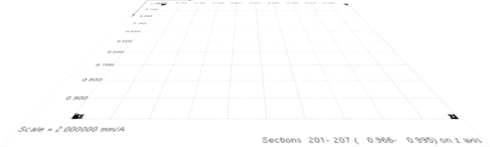
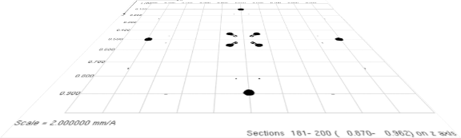
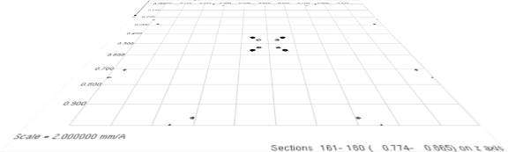
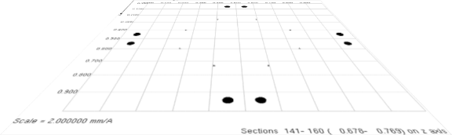
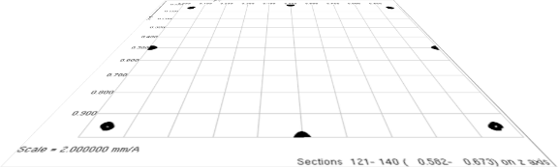
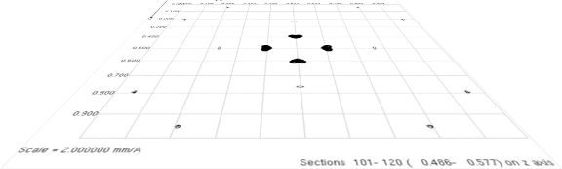
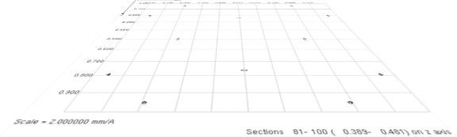
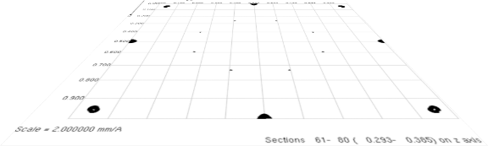
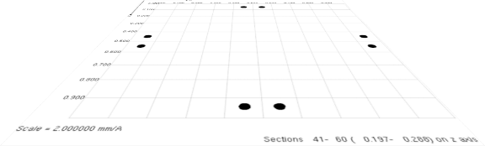
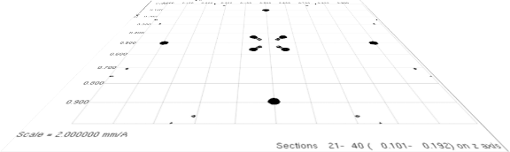
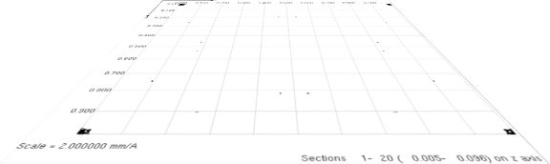
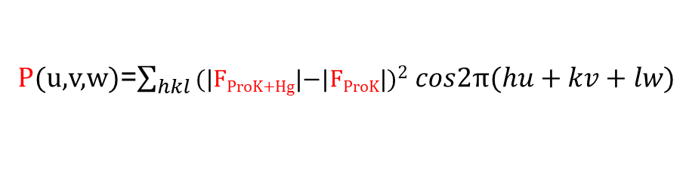
Difference Patterson Map
Unit cell of Patterson Map
W=1.0
P(u,v,w)=$\sum_{hkl}{\text{(}\text{|}\text{F}\text{P}\text{roK}\text{+}\text{H}\text{g}\text{|−|}\text{F}\text{P}\text{roK}\text{|}\text{)}2 cos2π(hu+kv+lw)}$
W=0.9
The whole unit cell is represented as 2D sections stacked along “w”.
Some sections have peaks, some don’t.
I am confident that the heavy atom is bound because:
The peaks are strong.
All peaks shown exceed a threshold of 20 times higher than background (i.e. 20 σ).
If no heavy atom were bound, I would expect that most peaks would be under a height of 5 σ.
There are about 60 peaks in the unit cell (off origin). How many heavy atoms would this likely be in the unit cell given ~60 peaks?
W=0.8
W=0.7
W=0.6
W=0.5
W=0.4
W=0.3
w
W=0.2
v
W=0.1
u
W=0.0

Slide 23
8 atoms would be consistent with the appearance of ~60 peaks
Unit cell of crystal
5
“n” atoms | Peaks total | Peaks zero length | Peaks non-zero length
n | n² | n | n²-n
7 | 49 | 7 | 42
8 | 64 | 8 | 56
9 | 81 | 9 | 72
1
2
8
6
4
3
7

Slide 24
Match the u,v,w with appropriate vector equation and solve for x,y,z algebraically.
Order Height/Rms Fractional coordinates
u v w
1 377.52 0.0000 0.0000 0.0000
2 33.12 0.4415 0.5585 0.1267
3 33.12 0.4415 0.4415 0.1267
4 33.12 0.5585 0.4415 0.1267
5 33.12 0.5585 0.5585 0.1267
6 33.12 0.4415 0.4415 0.8733
7 33.12 0.5585 0.4415 0.8733
8 33.12 0.4415 0.5585 0.8733
9 33.12 0.5585 0.5585 0.8733
10 32.05 0.0081 0.5000 0.6229
11 32.05 0.5000 0.0081 0.6229
12 32.05 0.9926 0.5000 0.6229
13 32.05 0.5000 0.9926 0.6229
14 32.05 0.5000 0.9926 0.3771
15 32.05 0.5000 0.0081 0.3771
16 32.05 0.0081 0.5000 0.3771
17 31.30 0.4525 0.0586 0.2500
18 31.30 0.9414 0.4525 0.2500
19 31.30 0.4525 0.0586 0.7500
20 31.30 0.9414 0.4525 0.7500
21 31.30 0.9414 0.5475 0.2500
22 31.30 0.5475 0.0586 0.7500
23 31.30 0.9414 0.5475 0.7500
24 31.30 0.5475 0.0586 0.2500
25 31.30 0.0586 0.4525 0.2500
26 31.30 0.0586 0.5475 0.2500
27 31.30 0.4525 0.9414 0.2500
28 31.30 0.5475 0.9414 0.2500
29 31.30 0.0586 0.4525 0.7500
30 31.30 0.0586 0.5475 0.7500
31 31.30 0.4525 0.9414 0.7500
32 31.30 0.5475 0.9414 0.7500
33 30.79 0.3954 0.4941 0.5000
34 30.79 0.6046 0.4941 0.5000
35 30.79 0.4941 0.3954 0.5000
36 30.79 0.5059 0.3954 0.5000
37 30.79 0.3954 0.5059 0.5000
38 30.79 0.6046 0.5059 0.5000
39 30.79 0.4941 0.6046 0.5000
40 30.79 0.5059 0.6046 0.5000
41 28.98 0.1060 0.5000 0.1229
42 28.98 0.8940 0.5000 0.1229
43 28.98 0.5000 0.1060 0.1229
44 28.98 0.5000 0.8940 0.1229
45 28.98 0.1060 0.5000 0.8771
46 28.98 0.5000 0.1060 0.8771
47 28.98 0.8940 0.5000 0.8771
48 28.98 0.5000 0.8940 0.8771
49 27.88 0.0470 0.9521 0.6269
50 27.88 0.9530 0.9521 0.6269
51 27.88 0.9530 0.9521 0.3731
52 27.88 0.9521 0.9530 0.3731
53 27.88 0.9521 0.0470 0.6269
54 27.88 0.0470 0.0479 0.6269
55 27.88 0.9530 0.0479 0.6269
56 27.88 0.9521 0.0470 0.3731
57 27.88 0.0470 0.0479 0.3731
58 27.88 0.9530 0.0479 0.3731
59 27.88 0.0470 0.9521 0.3731
60 27.88 0.0479 0.9530 0.3731
61 9.30 0.0000 0.0170 0.0205
62
Symm
Op# u v w
2-3) -½+x+y, -½-x-y, -¼
3-2) ½-x-y, ½+x+y, ¼
1-4) -½+x-y, -½+x+y, -¼
4-1) ½-x+y, ½-x-y, ¼
6-7) -½+x-y, -½-x-y, -¼
7-6) ½-x+y, ½+x+y, ¼
5-8) -½-x+y, -½+x+y, -¼
8-5) ½+x-y, ½-x-y, ¼
1-3) -½+x+y, -½-x+y, -¾
3-1) ½-x-y, ½+x-y, ¾
2-4) -½-x-y, -½+x-y, ¼
4-2) ½+x+y, ½-x+y, -¼
5-7) -½+x+y, -½+x-y, -¾
7-5) ½-x-y, ½-x+y, ¾
6-8) ½-x-y, -½-x+y, ¼
8-6) -½+x+y, ½+x-y, -¼
3-5) ½-2y, ½, -¼+2z
5-3) -½+2y, -½, ¼-2z
4-6) ½+2y, ½, -¼+2z
6-4) -½-2y, -½, ¼-2z
1-7) -½+2x, -½, -¾+2z
7-1) ½-2x, ½, ¾-2z
2-8) -½-2x, -½, ¼+2z
8-2) ½+2x, ½, -¼-2z
4-5) ½, ½-2x, ¼+2z
5-4) -½, -½+2x, -¼-2z
3-6) ½, ½+2x, ¼+2z
6-3) -½, -½-2x, -¼-2z
2-7) -½, -½-2y, -¼+2z
7-2) ½, ½+2y, ¼-2z
1-8) -½, -½+2y, -¼+2z
8-1) ½, ½-2y, ¼-2z
1-2) 2x, 2y, -½
2-1) -2x, -2y, ½
3-4) -2y, 2x, ½
4-3) 2y, -2x, -½
5-6) 2y, 2x, -½
6-5) -2y, -2x, ½
7-8) -2x, 2y, ½
8-7) 2x, -2y, -½
1-5) x-y, -x+y, 2z
5-1) -x+y, x-y, -2z
2-5) -x-y, -x-y, ½+2z
5-2) x+y, x+y, -½-2z
etc
Match the u,v,w value from Patterson map.
with the appropriate algebraic expression for u,v,w obtained by subtracting symmetry operators.

Slide 25
Match the u,v,w with appropriate vector equation and solve for x,y,z algebraically.
Order Height/Rms Fractional coordinates
u v w
17 31.30 0.4525 0.0586 0.2500
18 31.30 0.9414 0.4525 0.2500
21 31.30 0.9414 0.5475 0.2500
24 31.30 0.5475 0.0586 0.2500
25 31.30 0.0586 0.4525 0.2500
26 31.30 0.0586 0.5475 0.2500
27 31.30 0.4525 0.9414 0.2500
28 31.30 0.5475 0.9414 0.2500
19 31.30 0.4525 0.0586 0.7500
20 31.30 0.9414 0.4525 0.7500
22 31.30 0.5475 0.0586 0.7500
23 31.30 0.9414 0.5475 0.7500
29 31.30 0.0586 0.4525 0.7500
30 31.30 0.0586 0.5475 0.7500
31 31.30 0.4525 0.9414 0.7500
32 31.30 0.5475 0.9414 0.7500
11 32.05 0.5000 0.0081 0.6229
13 32.05 0.5000 0.9926 0.6229
14 32.05 0.5000 0.9926 0.3771
15 32.05 0.5000 0.0081 0.3771
43 28.98 0.5000 0.1060 0.1229
44 28.98 0.5000 0.8940 0.1229
46 28.98 0.5000 0.1060 0.8771
48 28.98 0.5000 0.8940 0.8771
10 32.05 0.0081 0.5000 0.6229
12 32.05 0.9926 0.5000 0.6229
16 32.05 0.0081 0.5000 0.3771
41 28.98 0.1060 0.5000 0.1229
42 28.98 0.8940 0.5000 0.1229
45 28.98 0.1060 0.5000 0.8771
47 28.98 0.8940 0.5000 0.8771
33 30.79 0.3954 0.4941 0.5000
34 30.79 0.6046 0.4941 0.5000
35 30.79 0.4941 0.3954 0.5000
36 30.79 0.5059 0.3954 0.5000
37 30.79 0.3954 0.5059 0.5000
38 30.79 0.6046 0.5059 0.5000
39 30.79 0.4941 0.6046 0.5000
40 30.79 0.5059 0.6046 0.5000
1 377.52 0.0000 0.0000 0.0000
2 33.12 0.4415 0.5585 0.1267
3 33.12 0.4415 0.4415 0.1267
4 33.12 0.5585 0.4415 0.1267
5 33.12 0.5585 0.5585 0.1267
6 33.12 0.4415 0.4415 0.8733
7 33.12 0.5585 0.4415 0.8733
8 33.12 0.4415 0.5585 0.8733
9 33.12 0.5585 0.5585 0.8733
49 27.88 0.0470 0.9521 0.6269
50 27.88 0.9530 0.9521 0.6269
51 27.88 0.9530 0.9521 0.3731
52 27.88 0.9521 0.9530 0.3731
53 27.88 0.9521 0.0470 0.6269
54 27.88 0.0470 0.0479 0.6269
55 27.88 0.9530 0.0479 0.6269
56 27.88 0.9521 0.0470 0.3731
57 27.88 0.0470 0.0479 0.3731
58 27.88 0.9530 0.0479 0.3731
59 27.88 0.0470 0.9521 0.3731
60 27.88 0.0479 0.9530 0.3731
61 9.30 0.0000 0.0170 0.0205
62
Symm
Op# u v w
2-3) -½+x+y, -½-x-y, -¼
3-2) ½-x-y, ½+x+y, ¼
1-4) -½+x-y, -½+x+y, -¼
4-1) ½-x+y, ½-x-y, ¼
6-7) -½+x-y, -½-x-y, -¼
7-6) ½-x+y, ½+x+y, ¼
5-8) -½-x+y, -½+x+y, -¼
8-5) ½+x-y, ½-x-y, ¼
1-3) -½+x+y, -½-x+y, -¾
3-1) ½-x-y, ½+x-y, ¾
2-4) -½-x-y, -½+x-y, ¼
4-2) ½+x+y, ½-x+y, -¼
5-7) -½+x+y, -½+x-y, -¾
7-5) ½-x-y, ½-x+y, ¾
6-8) ½-x-y, -½-x+y, ¼
8-6) -½+x+y, ½+x-y, -¼
3-5) ½-2y, ½, -¼+2z
5-3) -½+2y, -½, ¼-2z
4-6) ½+2y, ½, -¼+2z
6-4) -½-2y, -½, ¼-2z
1-7) -½+2x, -½, -¾+2z
7-1) ½-2x, ½, ¾-2z
2-8) -½-2x, -½, ¼+2z
8-2) ½+2x, ½, -¼-2z
4-5) ½, ½-2x, ¼+2z
5-4) -½, -½+2x, -¼-2z
3-6) ½, ½+2x, ¼+2z
6-3) -½, -½-2x, -¼-2z
2-7) -½, -½-2y, -¼+2z
7-2) ½, ½+2y, ¼-2z
1-8) -½, -½+2y, -¼+2z
8-1) ½, ½-2y, ¼-2z
1-2) 2x, 2y, -½
2-1) -2x, -2y, ½
3-4) -2y, 2x, ½
4-3) 2y, -2x, -½
5-6) 2y, 2x, -½
6-5) -2y, -2x, ½
7-8) -2x, 2y, ½
8-7) 2x, -2y, -½
1-5) x-y, -x+y, 2z
5-1) -x+y, x-y, -2z
2-5) -x-y, -x-y, ½+2z
5-2) x+y, x+y, -½-2z
etc
Match the u,v,w value from Patterson map.
with the appropriate algebraic expression for u,v,w obtained by subtracting symmetry operators.

Slide 26
Match the u,v,w with appropriate vector equation and solve for x,y,z algebraically.
Order Height/Rms Fractional coordinates
u v w
17 31.30 0.4525 0.0586 0.2500
18 31.30 0.9414 0.4525 0.2500
21 31.30 0.9414 0.5475 0.2500
24 31.30 0.5475 0.0586 0.2500
25 31.30 0.0586 0.4525 0.2500
26 31.30 0.0586 0.5475 0.2500
27 31.30 0.4525 0.9414 0.2500
28 31.30 0.5475 0.9414 0.2500
19 31.30 0.4525 0.0586 0.7500
20 31.30 0.9414 0.4525 0.7500
22 31.30 0.5475 0.0586 0.7500
23 31.30 0.9414 0.5475 0.7500
29 31.30 0.0586 0.4525 0.7500
30 31.30 0.0586 0.5475 0.7500
31 31.30 0.4525 0.9414 0.7500
32 31.30 0.5475 0.9414 0.7500
11 32.05 0.5000 0.0081 0.6229
13 32.05 0.5000 0.9926 0.6229
14 32.05 0.5000 0.9926 0.3771
15 32.05 0.5000 0.0081 0.3771
43 28.98 0.5000 0.1060 0.1229
44 28.98 0.5000 0.8940 0.1229
46 28.98 0.5000 0.1060 0.8771
48 28.98 0.5000 0.8940 0.8771
10 32.05 0.0081 0.5000 0.6229
12 32.05 0.9926 0.5000 0.6229
16 32.05 0.0081 0.5000 0.3771
41 28.98 0.1060 0.5000 0.1229
42 28.98 0.8940 0.5000 0.1229
45 28.98 0.1060 0.5000 0.8771
47 28.98 0.8940 0.5000 0.8771
33 30.79 0.3954 0.4941 0.5000
34 30.79 0.6046 0.4941 0.5000
35 30.79 0.4941 0.3954 0.5000
36 30.79 0.5059 0.3954 0.5000
37 30.79 0.3954 0.5059 0.5000
38 30.79 0.6046 0.5059 0.5000
39 30.79 0.4941 0.6046 0.5000
40 30.79 0.5059 0.6046 0.5000
1 377.52 0.0000 0.0000 0.0000
2 33.12 0.4415 0.5585 0.1267
3 33.12 0.4415 0.4415 0.1267
4 33.12 0.5585 0.4415 0.1267
5 33.12 0.5585 0.5585 0.1267
6 33.12 0.4415 0.4415 0.8733
7 33.12 0.5585 0.4415 0.8733
8 33.12 0.4415 0.5585 0.8733
9 33.12 0.5585 0.5585 0.8733
49 27.88 0.0470 0.9521 0.6269
50 27.88 0.9530 0.9521 0.6269
51 27.88 0.9530 0.9521 0.3731
52 27.88 0.9521 0.9530 0.3731
53 27.88 0.9521 0.0470 0.6269
54 27.88 0.0470 0.0479 0.6269
55 27.88 0.9530 0.0479 0.6269
56 27.88 0.9521 0.0470 0.3731
57 27.88 0.0470 0.0479 0.3731
58 27.88 0.9530 0.0479 0.3731
59 27.88 0.0470 0.9521 0.3731
60 27.88 0.0479 0.9530 0.3731
61 9.30 0.0000 0.0170 0.0205
62
Symm
Op# u v w
2-3) -½-x+y, -½-x-y, -¼
3-2) ½+x-y, ½+x+y, ¼
1-4) -½+x-y, -½+x+y, -¼
4-1) ½-x+y, ½-x-y, ¼
6-7) -½+x-y, -½-x-y, -¼
7-6) ½-x+y, ½+x+y, ¼
5-8) -½-x+y, -½+x+y, -¼
8-5) ½+x-y, ½-x-y, ¼
1-3) -½+x+y, -½-x+y, -¾
3-1) ½-x-y, ½+x-y, ¾
2-4) -½-x-y, -½+x-y, ¼
4-2) ½+x+y, ½-x+y, -¼
5-7) -½+x+y, -½+x-y, -¾
7-5) ½-x-y, ½-x+y, ¾
6-8) ½-x-y, -½-x+y, ¼
8-6) -½+x+y, ½+x-y, -¼
3-5) ½-2y, ½, -¼+2z
5-3) -½+2y, -½, ¼-2z
4-6) ½+2y, ½, -¼+2z
6-4) -½-2y, -½, ¼-2z
1-7) -½+2x, -½, -¾+2z
7-1) ½-2x, ½, ¾-2z
2-8) -½-2x, -½, ¼+2z
8-2) ½+2x, ½, -¼-2z
4-5) ½, ½-2x, ¼+2z
5-4) -½, -½+2x, -¼-2z
3-6) ½, ½+2x, ¼+2z
6-3) -½, -½-2x, -¼-2z
2-7) -½, -½-2y, -¼+2z
7-2) ½, ½+2y, ¼-2z
1-8) -½, -½+2y, -¼+2z
8-1) ½, ½-2y, ¼-2z
1-2) 2x, 2y, -½
2-1) -2x, -2y, ½
3-4) -2y, 2x, ½
4-3) 2y, -2x, -½
5-6) 2y, 2x, -½
6-5) -2y, -2x, ½
7-8) -2x, 2y, ½
8-7) 2x, -2y, -½
1-5) x-y, -x+y, 2z
5-1) -x+y, x-y, -2z
2-5) -x-y, -x-y, ½+2z
5-2) x+y, x+y, -½-2z
etc
I see eight obvious matches for peak #17. Which equation should I use?

Slide 27
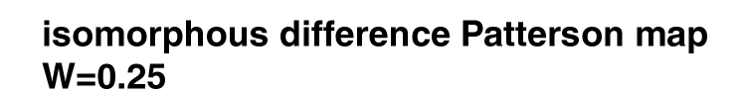
Symmetry operator 3
-Symmetry operator 2
½-y ½+x ¾+z
-( -x -y ½+z)
u=½+x-y v=½+x+y w=¼
Plug in u and solve for x.
Plug in v and solve for y.
u v w
0.4525 0.0586 0.2500
u = ½ +x -y
0.4525 = -½ +x -y
0.9525 = x –y
Add equations
0.9525 = x –y
+(0.5856 = x +y)
1.5831= 2x
0.7691 = x
v = -½ +x +y
0.0586 = -½ +x +y
0.5856 = x +y
Subtract equations
0.9525 = x –y
-(0.5856 = x +y)
0.3669= -2y
-0.1835 = y
0.8165 = y

Slide 28
Find another equation to solve for z.
Order Height/Rms Fractional coordinates
u v w
17 31.30 0.4525 0.0586 0.2500
18 31.30 0.9414 0.4525 0.2500
21 31.30 0.9414 0.5475 0.2500
24 31.30 0.5475 0.0586 0.2500
25 31.30 0.0586 0.4525 0.2500
26 31.30 0.0586 0.5475 0.2500
27 31.30 0.4525 0.9414 0.2500
28 31.30 0.5475 0.9414 0.2500
19 31.30 0.4525 0.0586 0.7500
20 31.30 0.9414 0.4525 0.7500
22 31.30 0.5475 0.0586 0.7500
23 31.30 0.9414 0.5475 0.7500
29 31.30 0.0586 0.4525 0.7500
30 31.30 0.0586 0.5475 0.7500
31 31.30 0.4525 0.9414 0.7500
32 31.30 0.5475 0.9414 0.7500
11 32.05 0.5000 0.0081 0.6229
13 32.05 0.5000 0.9926 0.6229
14 32.05 0.5000 0.9926 0.3771
15 32.05 0.5000 0.0081 0.3771
43 28.98 0.5000 0.1060 0.1229
44 28.98 0.5000 0.8940 0.1229
46 28.98 0.5000 0.1060 0.8771
48 28.98 0.5000 0.8940 0.8771
10 32.05 0.0081 0.5000 0.6229
12 32.05 0.9926 0.5000 0.6229
16 32.05 0.0081 0.5000 0.3771
41 28.98 0.1060 0.5000 0.1229
42 28.98 0.8940 0.5000 0.1229
45 28.98 0.1060 0.5000 0.8771
47 28.98 0.8940 0.5000 0.8771
33 30.79 0.3954 0.4941 0.5000
34 30.79 0.6046 0.4941 0.5000
35 30.79 0.4941 0.3954 0.5000
36 30.79 0.5059 0.3954 0.5000
37 30.79 0.3954 0.5059 0.5000
38 30.79 0.6046 0.5059 0.5000
39 30.79 0.4941 0.6046 0.5000
40 30.79 0.5059 0.6046 0.5000
1 377.52 0.0000 0.0000 0.0000
2 33.12 0.4415 0.5585 0.1267
3 33.12 0.4415 0.4415 0.1267
4 33.12 0.5585 0.4415 0.1267
5 33.12 0.5585 0.5585 0.1267
6 33.12 0.4415 0.4415 0.8733
7 33.12 0.5585 0.4415 0.8733
8 33.12 0.4415 0.5585 0.8733
9 33.12 0.5585 0.5585 0.8733
49 27.88 0.0470 0.9521 0.6269
50 27.88 0.9530 0.9521 0.6269
51 27.88 0.9530 0.9521 0.3731
52 27.88 0.9521 0.9530 0.3731
53 27.88 0.9521 0.0470 0.6269
54 27.88 0.0470 0.0479 0.6269
55 27.88 0.9530 0.0479 0.6269
56 27.88 0.9521 0.0470 0.3731
57 27.88 0.0470 0.0479 0.3731
58 27.88 0.9530 0.0479 0.3731
59 27.88 0.0470 0.9521 0.3731
60 27.88 0.0479 0.9530 0.3731
61 9.30 0.0000 0.0170 0.0205
62
Symm
Op# u v w
2-3) -½-x+y, -½-x-y, -¼
3-2) ½+x-y, ½+x+y, ¼
1-4) -½+x-y, -½+x+y, -¼
4-1) ½-x+y, ½-x-y, ¼
6-7) -½+x-y, -½-x-y, -¼
7-6) ½-x+y, ½+x+y, ¼
5-8) -½-x+y, -½+x+y, -¼
8-5) ½+x-y, ½-x-y, ¼
1-3) -½+x+y, -½-x+y, -¾
3-1) ½-x-y, ½+x-y, ¾
2-4) -½-x-y, -½+x-y, ¼
4-2) ½+x+y, ½-x+y, -¼
5-7) -½+x+y, -½+x-y, -¾
7-5) ½-x-y, ½-x+y, ¾
6-8) ½-x-y, -½-x+y, ¼
8-6) -½+x+y, ½+x-y, -¼
4-5) ½, ½-2x, ¼+2z
5-4) -½, -½+2x, -¼-2z
3-6) ½, ½+2x, ¼+2z
6-3) -½, -½-2x, -¼-2z
2-7) -½, -½-2y, -¼+2z
7-2) ½, ½+2y, ¼-2z
1-8) -½, -½+2y, -¼+2z
8-1) ½, ½-2y, ¼-2z
3-5) ½-2y, ½, -¼+2z
5-3) -½+2y, -½, ¼-2z
4-6) ½+2y, ½, -¼+2z
6-4) -½-2y, -½, ¼-2z
1-7) -½+2x, -½, -¾+2z
7-1) ½-2x, ½, ¾-2z
2-8) -½-2x, -½, ¼+2z
8-2) ½+2x, ½, -¼-2z
1-2) 2x, 2y, -½
2-1) -2x, -2y, ½
3-4) -2y, 2x, ½
4-3) 2y, -2x, -½
5-6) 2y, 2x, -½
6-5) -2y, -2x, ½
7-8) -2x, 2y, ½
8-7) 2x, -2y, -½
1-5) x-y, -x+y, 2z
5-1) -x+y, x-y, -2z
2-5) -x-y, -x-y, ½+2z
5-2) x+y, x+y, -½-2z
etc
I see eight obvious matches for peak 11. Which equation should I use?
Use the equation that yields the previously obtained value of “x” or “y”

Slide 29
Symmetry operator 3
-Symmetry operator 6
½-y ½+x ¾+z
-( -y -x ½-z )
u= ½ v=½+2x w= ¼+2z
u v w
0.5000 0.0081 0.6229
Plug in v, solve for x:
Plug in w, solve for z:
v = ½ + 2x
0.0081 = ½ + 2x
-0.4919 = 2x
-0.2460 = x
0.7541 = x
w = ¼ + 2z
0.6229 = ¼ + 2z
0.3729 = 2z
0.1865 = z

Slide 30
Combine answers from two Harker sections to get heavy atom x,y,z coordinates
From w=¼ x=0.7691 y=0.8165
From u=½ x=0.7541 z=0.1865
Combined x=0.7541 y=0.8165 z=0.1865
Other 7 sites in unit cell can be obtained by applying space group symmetry operations

Slide 31
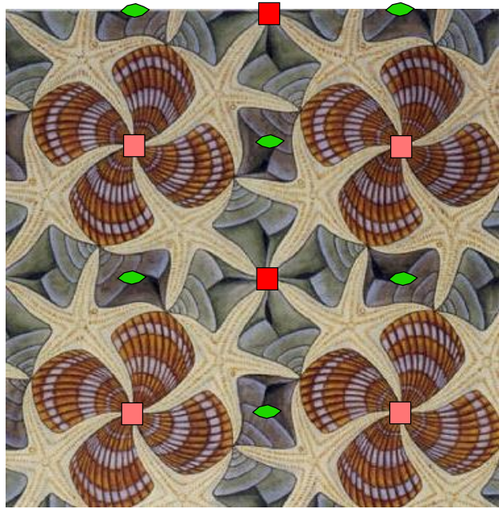
Choice of unit cell origin
X= 0.77 y=0.82
y
x

Slide 32
Choice of unit cell origin
X= 0.27 y=0.32
y
x

Slide 33


Cheshire Symmetry Operators for space group P4₃2₁2
1 X, Y, Z
2 -X, -Y, Z
3 -Y, X, 1/4+Z
4 Y, -X, 1/4+Z
5 Y, X, -Z
6 -Y, -X, -Z
7 X, -Y, 1/4-Z
8 -X, Y, 1/4-Z
09 1/2+X, 1/2+Y, Z
10 1/2-X, 1/2-Y, Z
11 1/2-Y, 1/2+X, 1/4+Z
12 1/2+Y, 1/2-X, 1/4+Z
13 1/2+Y, 1/2+X, -Z
14 1/2-Y, 1/2-X, -Z
15 1/2+X, 1/2-Y, 1/4-Z
16 1/2-X, 1/2+Y, 1/4-Z
17 X, Y, 1/2+Z
18 -X, -Y, 1/2+Z
19 -Y, X, 3/4+Z
20 Y, -X, 3/4+Z
21 Y, X, 1/2-Z
22 -Y, -X, 1/2-Z
23 X, -Y, 3/4-Z
24 -X, Y, 3/4-Z
25 1/2+X, 1/2+Y, 1/2+Z
26 1/2-X, 1/2-Y, 1/2+Z
27 1/2-Y, 1/2+X, 3/4+Z
28 1/2+Y, 1/2-X, 3/4+Z
29 1/2+Y, 1/2+X, 1/2-Z
30 1/2-Y, 1/2-X, 1/2-Z
31 1/2+X, 1/2-Y, 3/4-Z
32 1/2-X, 1/2+Y, 3/4-Z

Slide 34
Check that this x,y,z can predict all peaks in the difference Patterson map
Combined x=0.7541 y=0.8165 z=0.1865
Solve for each u,v,w. Overlay predictions on Patterson map
Symm
Op# u v w
2-3) -½-x+y, -½-x-y, -¼
3-2) ½+x-y, ½+x+y, ¼
1-4) -½+x-y, -½+x+y, -¼
4-1) ½-x+y, ½-x-y, ¼
6-7) -½+x-y, -½-x-y, -¼
7-6) ½-x+y, ½+x+y, ¼
5-8) -½-x+y, -½+x+y, -¼
8-5) ½+x-y, ½-x-y, ¼
1-3) -½+x+y, -½-x+y, -¾
3-1) ½-x-y, ½+x-y, ¾
2-4) -½-x-y, -½+x-y, ¼
4-2) ½+x+y, ½-x+y, -¼
5-7) -½+x+y, -½+x-y, -¾
7-5) ½-x-y, ½-x+y, ¾
6-8) ½-x-y, -½-x+y, ¼
8-6) -½+x+y, ½+x-y, -¼
4-5) ½, ½-2x, ¼+2z
5-4) -½, -½+2x, -¼-2z
3-6) ½, ½+2x, ¼+2z
6-3) -½, -½-2x, -¼-2z
2-7) -½, -½-2y, -¼+2z
7-2) ½, ½+2y, ¼-2z
1-8) -½, -½+2y, -¼+2z
8-1) ½, ½-2y, ¼-2z
3-5) ½-2y, ½, -¼+2z
5-3) -½+2y, -½, ¼-2z
4-6) ½+2y, ½, -¼+2z
6-4) -½-2y, -½, ¼-2z
1-7) -½+2x, -½, -¾+2z
7-1) ½-2x, ½, ¾-2z
2-8) -½-2x, -½, ¼+2z
8-2) ½+2x, ½, -¼-2z
1-2) 2x, 2y, -½
2-1) -2x, -2y, ½
3-4) -2y, 2x, ½
4-3) 2y, -2x, -½
5-6) 2y, 2x, -½
6-5) -2y, -2x, ½
7-8) -2x, 2y, ½
8-7) 2x, -2y, -½
1-5) x-y, -x+y, 2z
5-1) -x+y, x-y, -2z
2-5) -x-y, -x-y, ½+2z
5-2) x+y, x+y, -½-2z
etc

Slide 35
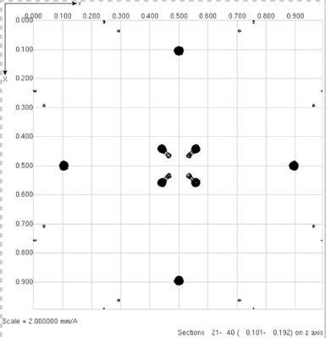
Check that this x,y,z can predict all peaks in the difference Patterson map
Combined x=0.7541 y=0.8165 z=0.1865
Solve for each u,v,w. Overlay predictions on Patterson map
If you see a peak with no prediction (+) something went wrong.
Check algebra.
If algebra is OK, then the problem could arise from an ambiguity between solutions for P4₁2₁2 and P4₃2₁2.
Swap space groups or negate x of x,y,z, and calculate Patterson predictions from –x,y,z
+
+
+
+
+
+
+
+

Slide 36
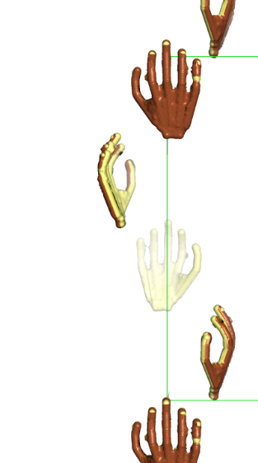
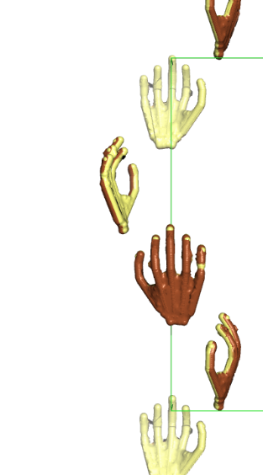
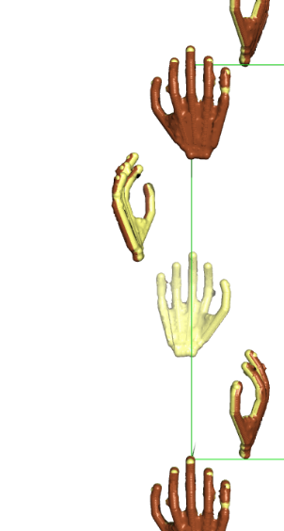
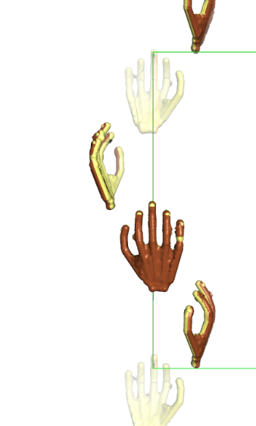
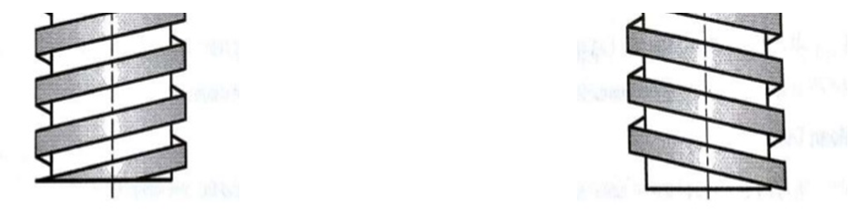
Check if x,y,z is consistent with space group P4₃2₁2 or P4₁2₁2.
There is only a 50% probability that our heavy atom coordinates (x,y,z) are consistent with space group P4₃2₁2. The remaining 50% probability is that x,y,z is consistent with space group P4₁2₁2, even though we used P4₃2₁2 symmetry operators to derive our coordinates and our algebra is faultless.
Space group P4₃2₁2 is chiral, meaning that it contains symmetry elements of a particular hand. For example, the 4₃ axis in P4₃2₁2 is a left handed screw.
Space group P4₁2₁2 is also chiral, and its symmetry elements are the mirror image of space group P4₃2₁2.
Crystals in chiral space groups P4₁2₁2 and P4₃2₁2 share the same Patterson symmetry group, P4/mmm, which is not chiral, but centrosymmetric.
All Patterson maps (including P4/mmm) are centrosymmetric because their peaks represent vectors between atoms. Every pair of atoms is connected by two vectors of equal length and opposite direction: atom1→atom2 and atom1←atom2, thereby creating centrosymmetry.
The 50% chance of space group inconsistency arises from our unavoidable dependence on a centrosymmetric map to derive coordinates in a chiral space group.
Among the 230 space groups, only 22 are chiral. How did we get so lucky to stumble one of these?
The heavy atom coordinates (x,y,z) are verified to be consistent with space group P4₃2₁2 if (x,y,z) if it can be used to successfully predict coordinates (u,v,w) of a non-Harker Patterson peak.
If prediction is unsuccessful, invert the hand of the heavy atom solution by negating x to make it compatible with P4₃2₁2.
4₁
4₃
Right hand screw
Left hand screw

Slide 37
Check that this x,y,z can predict all peaks in the difference Patterson map
Combined x=-0.7541 y=0.8165 z=0.1865
Solve for each u,v,w. Overlay predictions on Patterson map
+
All major Patterson peaks will be predicted if the heavy atom coordinates are correct.
+
+
+
+
+
+
+

Slide 38
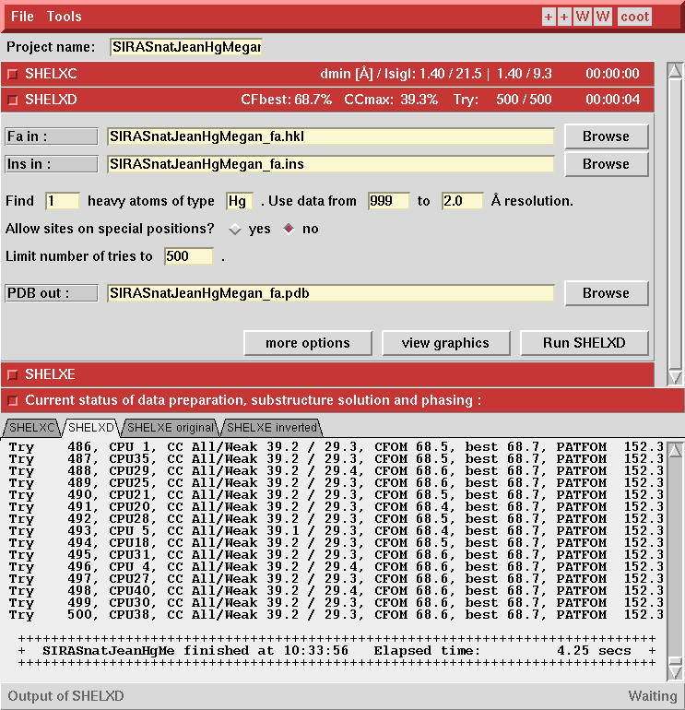
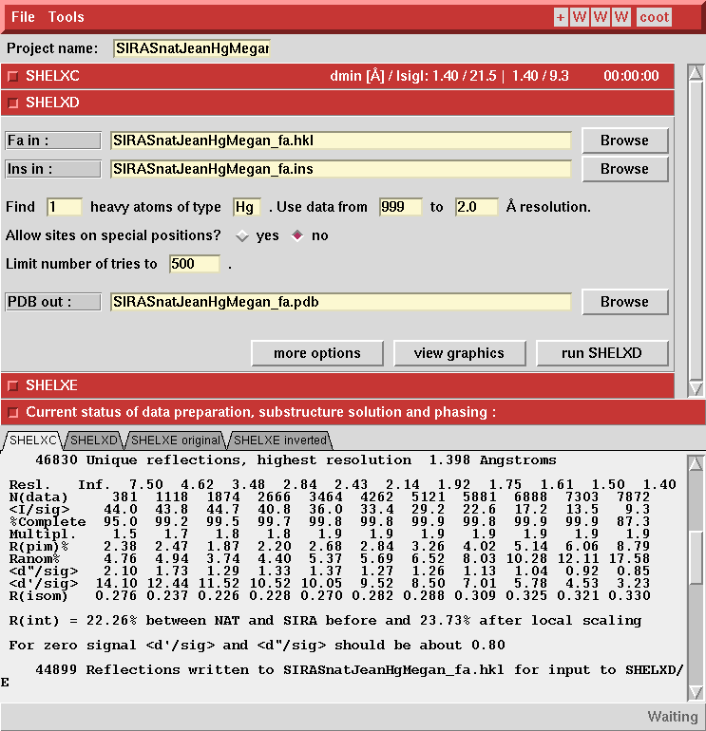
ShelxD uses direct methods to determine heavy atom x,y,z
Use 2.0 Å cutoff
Enter element
Estimate one heavy atom
Ask for 500 trials
Run ShelxD

Slide 39
Direct methods (shelxD) make it easy to determine the heavy atom coordinates.
TITL ProK PCMBS isomorphous differences in space group P4(3)2(1)2
CELL 1.54178 68.1060 68.1060 101.9890 90.000 90.000 90.000
ZERR 16.00 0.0096 0.0096 0.0204 0.000 0.000 0.000
LATT -1
SYMM -X, -Y, 0.5+Z
SYMM 0.5-Y, 0.5+X, 0.75+Z
SYMM 0.5+Y, 0.5-X, 0.25+Z
SYMM 0.5-X, 0.5+Y, 0.75-Z
SYMM 0.5+X, 0.5-Y, 0.25-Z
SYMM Y, X, -Z
SYMM -Y, -X, 0.5-Z
SFAC Hg
UNIT 8
PATS
FIND 1
MIND -3.5
NTRY 500
HKLF 3
END
Space group symmetry operators
Number of Hg atoms to find in asymmetric unit
Number of independent trials to perform

Slide 40
Direct methods output.
PSUM 103.31 PSMF Peaks: 171 53 14 13 12 12 12 12 12
Cycle 3 Peaks 99 26 5
R = 0.297, Min.fun. = 0.370, <cos> = 0.587, Ra = 0.281
x y z sof height
0.25578 0.69720 0.06393 1.000 99.90
0.20477 0.74650 0.12408 1.000 26.97
0.29138 0.75822 0.18655 1.000 5.20
Minimum distances (top row) and PSMF (bottom row)
Peak x y z self cross-vectors
99.9 0.2558 0.6972 0.0639 37.0
112.6
Use this for phasing calculation
Patterson Superposition Minimum Function (PSMF) (Buerger, 1959). Large positive numbers indicate a true solution.

Slide 41
ShelxD uses direct methods to determine heavy atom x,y,z
View graphics

Slide 42
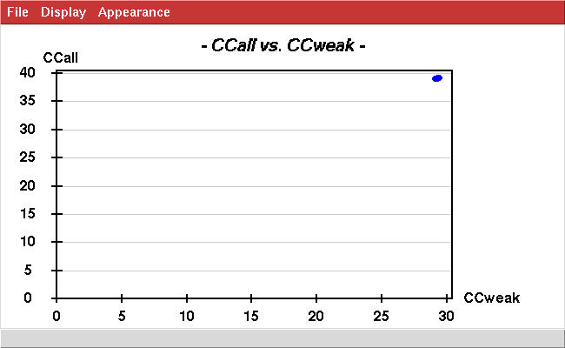
All 500 trials produced the same heavy atom substructure model
CC_{all} is the correlation coefficient between E_{obs} and E_{calc} calculated using all reflections. Higher is better.
500 independent trials produced 500 solutions with identical quality
CC_{weak} is the correlation coefficient between E_{obs} and E_{calc} calculated using only those reflections not used to locate the heavy atoms.
This is Strong!

Slide 43
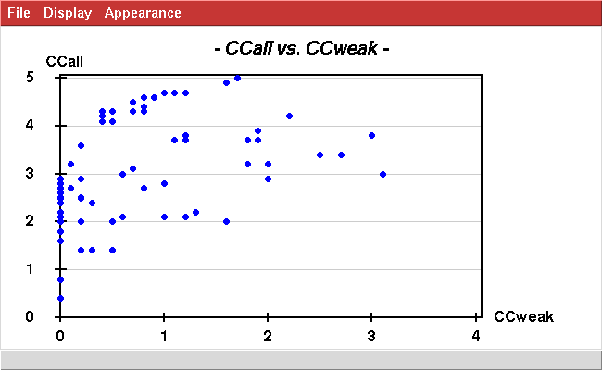
Contrast the appearance of a strong vs. weak heavy atom derivative
This plot inspires HIGH confidence that the heavy atom positions were determined correctly.
This is Strong!
This plot inspires low confidence that the heavy atom positions were determined correctly.
Poor

Slide 44
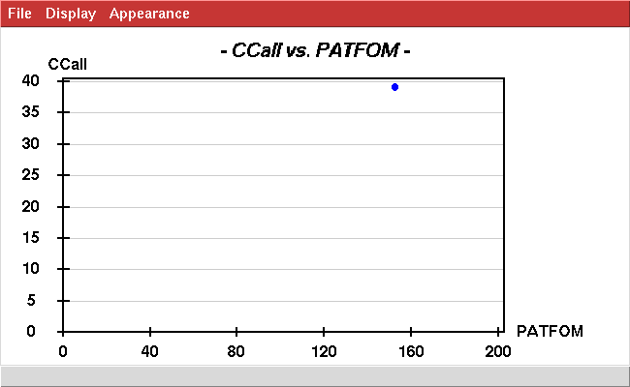
Strong heavy atom derivative
The Patterson Figure of Merit (PATFOM) is the average value of the Patterson map sampled at locations where Patterson peaks are predicted by the calculated heavy atom position. Higher is better.
correct
This is Strong!

Slide 45
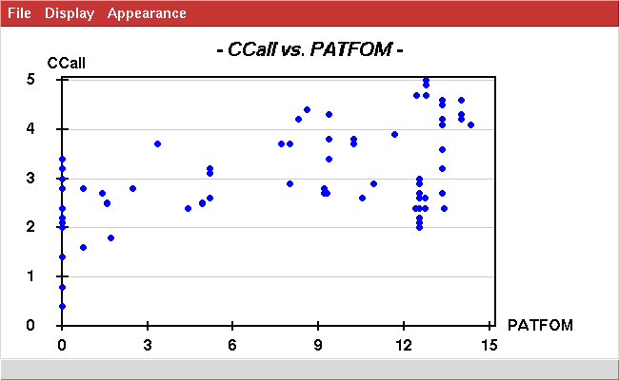
Contrast the appearance of a strong vs. weak heavy atom derivative
This plot inspires HIGH confidence that the heavy atom positions were determined correctly.
correct
This is Strong!
This plot inspires low confidence that the heavy atom positions were determined correctly.
Poor

Slide 46
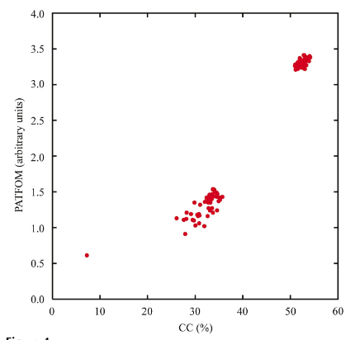
Contrast the appearance of a strong vs. weak heavy atom derivative
These plots inspire HIGH confidence that the heavy atom positions were determined correctly.
correct
correct
incorrect
This is Strong!
This plot inspires low confidence that the heavy atom positions were determined correctly.
Poor

Slide 47
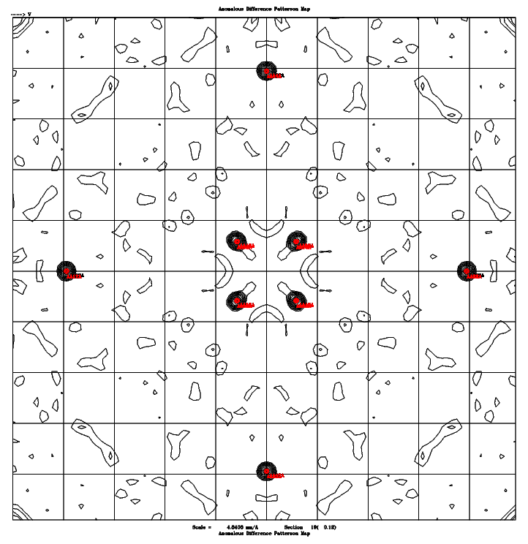
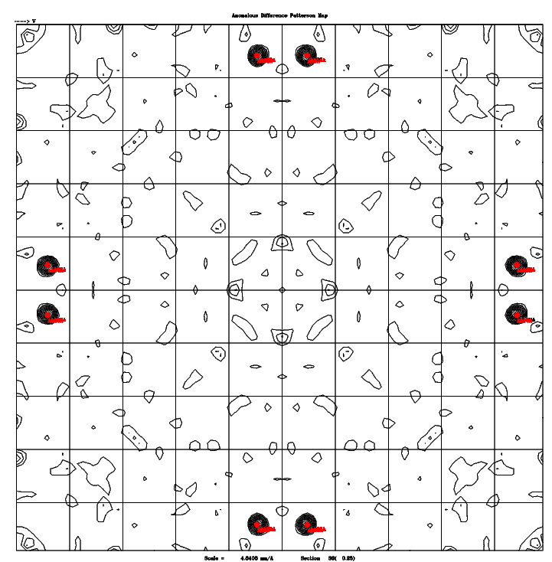
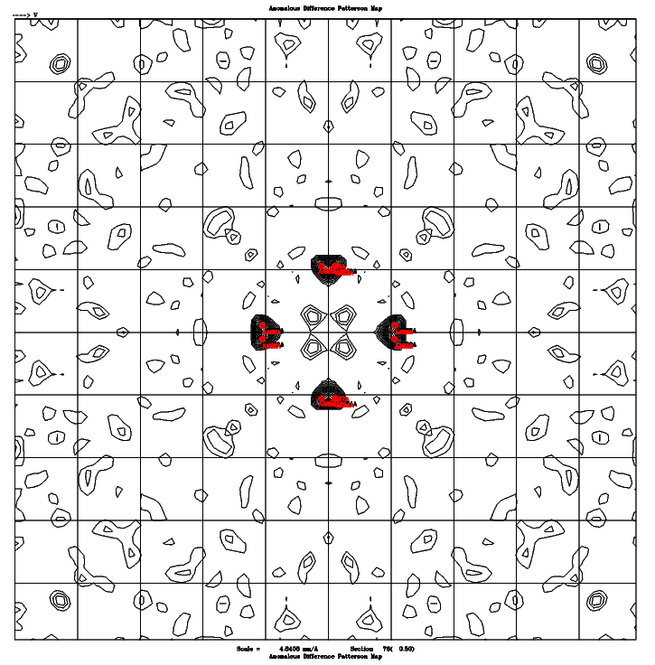
Check the agreement between ShelxD solution and Patterson map
Command to predict Patterson peak positions from x,y,z: checkpatterson.csh x y z
w=0.12
w=0.25
w=0.50
Predicted Patterson peak positions (red) match Patterson peaks (black)

Slide 48
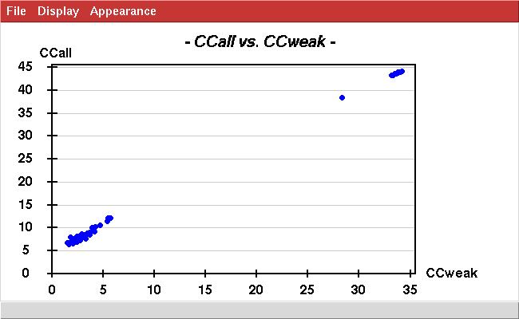
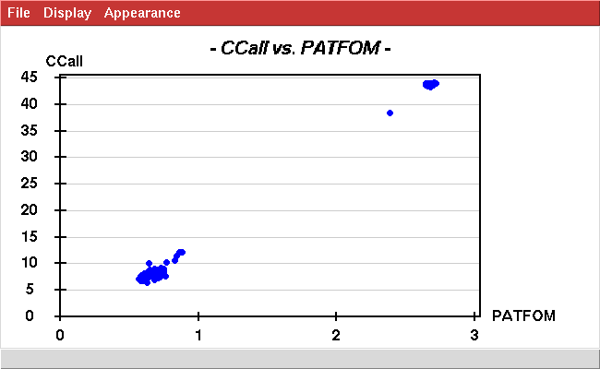
Sm-like archaeal protein (1m5q)
3 selenium sites per protein molecule.
28 proteins in the asymmetric unit
Therefore: 84 Se sites expected
correct
correct
incorrect
incorrect

Slide 49


Sm-like archaeal protein (1m5q)
3 selenium sites per protein molecule.
28 proteins in the asymmetric unit
Therefore: 84 Se sites expected

Slide 50

Sm-like archaeal protein (1m5q)
Predicted Patterson peaks match observed Patterson peaks, but peaks are weak.

Slide 51



Sm-like archaeal protein (1m5q)
Se sites (spheres) in the asymmetric unit showed D7 symmetry
Cartoon ribbons of the protein structure
Crystal packing

Slide 52
Questions?
Duilio will give an introduction to the use of direct methods to solve the heavy atom substructure on Tues, Jan 27.
Phasing and Map Calculation happen at the end of next week’s Patterson lab.

