Slide 1
Our goal is to compute an experimental electron density map of proteinase K this week
Fourier synthesis
ρ(xyz)=Σ |F_{hkl}| cos2π(hx+ky+lz -α_{hkl})
^{hkl}
1) To obtain the phases α_{hkl} we collected diffraction intensities from crystals of Proteinase K in the absence and presence of heavy atom compounds (i.e. native and derivatives).
2) The choice of phase for each reflection can be guided by two types of equations:
a) One relates native to derivative structure factor amplitudes for reflection h,k,l, and requires measurements of “isomorphous differences”
b) One relates derivative structure factor h,k,l to –h,-k,-l, and requires measurements of “anomalous differences”
3) These two types of equations can be combined.

Slide 2
SIR phasing uses differences between measurements of |F_{P (h,k,l)}| and |F_{PH(h,k,l)}| (i.e. isomorphous differences)
SIR
F_{P (h,k,l)} = F_{PH(h,k,l)}-f_{H(h,k,l)}

Slide 3
SAD phasing uses differences between measurements of |F_{PH(h,k,l)}| and |F_{PH(-h,-k,-l)}| (i.e. anomalous differences)
SAD
?
F_{P (h,k,l)} = F_{PH(h,k,l)}-f_{H(h,k,l)}
*
*
F_{P (h,k,l)} = F_{PH(-h,-k,-l)}-f_{H(-h,-k,-l)}

Slide 4
SIRAS phasing uses a combination of isomorphous and anomalous intensity measurements
SIR
SAD
SIRAS
F_{P (h,k,l)} = F_{PH(h,k,l)}-f_{H(h,k,l)}
?
F_{P (h,k,l)} = F_{PH(h,k,l)}-f_{H(h,k,l)}
F_{P (h,k,l)} = F_{PH(h,k,l)}-f_{H(h,k,l)}
*
*
*
*
F_{P (h,k,l)} = F_{PH(-h,-k,-l)}-f_{H(-h,-k,-l)}
F_{P (h,k,l)} = F_{PH(-h,-k,-l)}-f_{H(-h,-k,-l)}

Slide 5
Our equation for f predicts that |F_{PH (HKL)} | will change length at different λ and that measuring these “dispersive differences” will be useful for phasing.
f = f_{o} + Δf’(λ) + iΔf”(λ)
Form factor of heavy atom
Normal
scattering
factor.
Real correction factor (absorption)
Imaginary correction factor.
Dispersive differences—Differences in reflection intensities due to a change in X-ray wavelength.

Slide 6
Dispersive differences give a new constraint on the choice of phase for each additional λ.
F_{P} = F_{PH(λl)} -f_{H} _{(λ1)}
F_{P} = F_{PH(λ2)} -f_{H} _{(λ2)}
F_{P} = F_{PH(λn)} - f_{H} _{(λn)}
...
Measure new |F_{PH(λ)}| at each λ
Three phase triangles eliminate phase ambiguity:

Slide 7
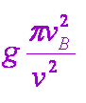
Correction factors are largest near ν=ν_{B} .
f_{H} = f_{o}+ Δf’ + iΔf”
f_{H} = f_{o}+ + i
ν = frequency incident photon
ν_{B} = Bohr frequency of oscillating e⁻ (related to electronic transition, ΔE)
g = total oscillator strength for electron.
R.W. James, The Optical Principles of Diffraction of X-rays (1948).
The REAL COMPONENT becomes negative near v= ν_{B}.
The IMAGINARY COMPONENT becomes large and positive near ν= ν_{B}.
Δf’
ν−>
After dampening correction
Δf”
ν=ν_{B}
ν=ν_{B}
Values of f_{o,} Δf’, and Δf” for any element and wavelength can be retrieved from a table.
http://skuld.bmsc.washington.edu/scatter/

Slide 8
Choose λ values to maximize certainty of phase choice. Diversify f_{H} vectors to maximize displacement between F_{PH} circles.
|F_{PH(hkl)λ1}|
|F_{PH(hkl)λ1}|
|F_{PH (-h-k-l) λ1}|*
|F_{PH (-h-k-l) λ1}|*
f_{H λ1(-)}
f_{H λ1(-)}
f_{H λ2 (-)}
f_{H λ1(+)}
f_{H λ1(+)}
f_{H λ2(+)}
f_{H λ2(+)}
f_{H λ2 (-)}
|F_{PH(hkl)λ2} |
|F_{PH(hkl)λ2} |
|F_{PH(-h-k-l)λ2}|*
|F_{PH(-h-k-l)λ2}|*
Wise choice
Poor choice

Slide 9
Each λ produces a different f’ and f”, hence a different f_{H} amplitude and phase.
4.0
3.0
1.8
2.0
peak
high remote
low remote
inflection
Se
-0.5
-0.3
-3.0
-8.0
f_{H( λ )} =|f_{o} + Δf’(λ) + iΔf”(λ)| e^{2πi(hx}_{H}^{+ky}_{H}^{+lz}_{H}⁾
f_{H}(low remote)
f_{H}(inflection)
f_{H}(peak)
f_{H}(high remote)
f”
f”
f”
f”
f’
f’
f’
f’
fo
fo
fo
fo

Slide 10
A MAD experiment (using two wavelengths)
Protein+Heavy atom
crystal
Heavy atom
substructure
Calculate f_{H (hkl)}
And f_{H (-h-k-l)}
At λ1 and λ2
Interpret
peaks
Anomalous
Difference
Patterson Map
Include correction for anomalous scattering: Δf’(λ) and Δf”(λ)
Crystal
Space
diffraction
λ_{peak}
λ_{inflection}
Graph
Reciprocal
Space
H K L FPH_{λ1}- FPH_{λ1}+ FPH_{λ2}+ FPH_{λ2}-
1 1 1 707.8 712.4 730.8 717.6
1 1 2 733.6 695.3 813.9 805.3
1 1 3 444.5 456.2 296.1 312.5
1 1 4 575.8 564.7 527.4 518.3
1 1 5 827.8 805.4 759.6 766.3
1 1 6 349.8 354.2 375.6 358.9
1 1 7 359.4 390.8 300.5 286.6
1 1 8 362.5 411.2 396.7 411.5
1 2 0 73.8 132.3 149.8 159.8
P=ΣΣΣ(|F_{PH}|_{hkl}-|F_{PH}|_{-h-k-l})²e ^{2πi(hx+ky+lz)}
|F_{PHλ1}|₁₁₁
|F_{PHλ1}|₋₁₋₁₋₁*
|F_{PHλ2}|₁₁₁
|F_{PHλ2}|₋₁₋₁₋₁*
*f_{Hλ1(-1-1-1)}
f_{Hλ2(111)}
f_{Hλ1(111)}
*f_{Hλ2(-1-1-1)}

Slide 11
A MAD experiment with two wavelengths
λ₁
imaginary
F_{P(hkl)} = F_{PH (h k l)λ1} -f_{H} _{( h k l)λ1}
F_{P(hkl)} = F_{PH (-h-k-l)λ1}* -f_{H (-h-k-l)λ1}*
|F_{PHλ2}|₁₁₁
*f_{Hλ1(-1-1-1)}
real
f_{Hλ2(111)}
|F_{PHλ1}|₋₁₋₁₋₁*
f_{Hλ1(111)}
*f_{Hλ2(-1-1-1)}
λ₂
|F_{PHλ1}|₁₁₁
F_{P (hkl)} = F_{PH (h k l)λ2} -f_{H} _{( h k l)λ2}
|F_{PHλ2}|₋₁₋₁₋₁*
F_{P (hkl)} = F_{PH (-h-k-l)λ2}* -f_{H} _{(-h-k-l)λ2}*

Slide 12
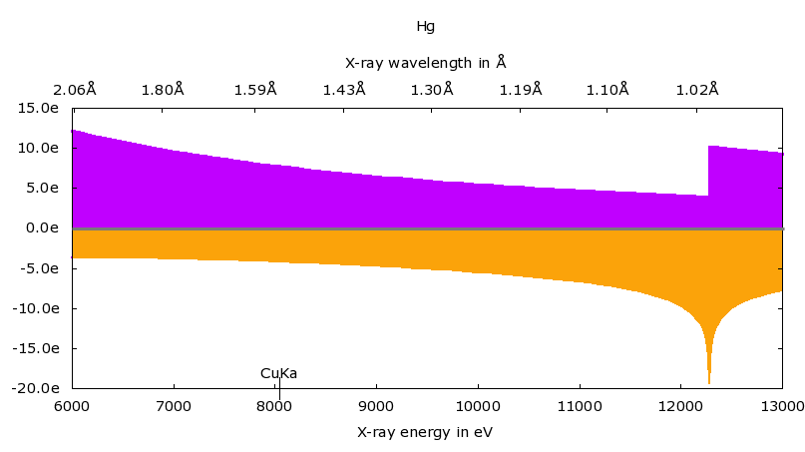
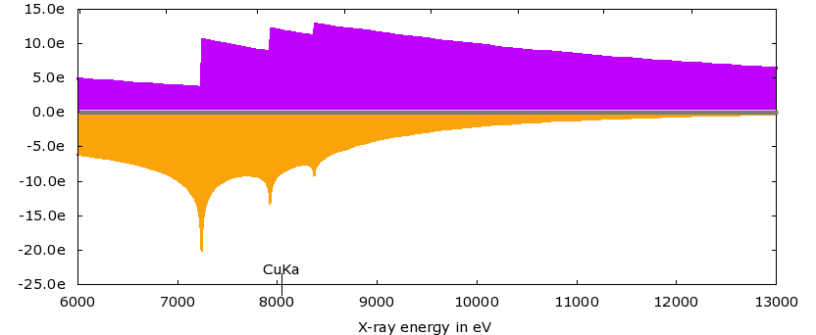
Hg & Gd have strong anomalous scattering signal even in-house (λ=1.54 Å)
f”
7.8e⁻
-4.1e⁻
f’
f”
12.0e⁻
-9.4e⁻
f’
Our in-house x-ray wavelength =1.54 Å = 8keV

Slide 13
What phasing options are available using the data we collected in house?
PCMBS (Hg)
Yes | No
X
Isomorphous
Anomalous
Dispersive
F_{P(hkl)}= F_{PHg (hkl)} - f_{Hg(hkl)}
X
F_{P(hkl)}= F_{PHg(-h-k-l)}* - f_{Hg(-h-k-l)}*
X
F_{P(hkl)}= F_{PHg(hkl)λn} - f_{Hg(hkl)λn}
For Lanthanides (Gd or Eu)
Yes | No
X
Isomorphous
Anomalous
Dispersive
F_{P(hkl)}= F_{P·La (hkl)} - f_{La(hkl)}
X
F_{P(hkl)}= F_{P·La (-h-k-l)}* - f_{La(-h-k-l)}*
F_{P(hkl)}= F_{P·Gd (hkl)λn} - f_{Gd(hkl)λn}
How many circles to draw for each reflection?
X

Slide 14
The strategy best suited for our circumstances is SIRAS phasing.
PCMBS (Hg)
Isomorphous
Anomalous
Dispersive
F_{P(hkl)}= F_{PHg (hkl)} - f_{Hg(hkl)}
F_{P(hkl)}= F_{PHg(-h-k-l)}* - f_{Hg(-h-k-l)}*
F_{P(hkl)}= F_{PHg(hkl)λn} - f_{Hg(hkl)λn}
OR
For Lanthanides (Gd or Eu)
Isomorphous
Anomalous
Dispersive
F_{P(hkl)}= F_{P·La (hkl)} - f_{La(hkl)}
F_{P(hkl)}= F_{P·La (-h-k-l)}* - f_{La(-h-k-l)}*
F_{P(hkl)}= F_{P·Gd (hkl)λn} - f_{Gd(hkl)λn}

Slide 15
The strategy best suited for our circumstances is SIRAS phasing.
MIRAS phasing would be most powerful but it requires isomorphism among 3 crystals. That is difficult to achieve.
SAD phasing would eliminate difficulties attaining isomorphism, but leaves an ambiguity in choice of phase.
SIRAS is a good compromise. It resolves the phase ambiguity and requires isomorphism between 2 (not 3) crystals.

Slide 16
Are these crystals isomorphous?
native
Eu,Gd
Hg

Slide 17
154 combinations of native and derivative data sets possible
11 Native data sets
14 heavy atom derivatives
0 = native-daniel
1 = native-diana
2 = native-duilio
3 = native-elena
4 = native-james
5 = native-janet
6 = native-jeannette
7 = native-juan
8 = native-sawaya
9 = native-scott
10 = native-shruti
11 = eu-adrian
12 = eu-sarah
13 = eu-sol
14 = gd-katherine
15 = gd-morgan
16 = gd-reece
17 = pcmbs-andres
18 = pcmbs-aubrey
19 = pcmbs-cameron
20 = pcmbs-inkyu
21 = pcmbs-jongsuk
22 = pcmbs-kylie
23 = pcmbs-marissa
24 = pcmbs-nicole
Each student will evaluate one of the 154 difference Patterson maps. Narrow down choices from anomalous difference Patterson.

Slide 18
Calculate anomalous difference Patterson maps to find which data sets have the strongest binding.
P(uvw)=Σ (|F_{PH(h,k,l)}|-|F_{PH(-h,-k,-l)}|)² cos2π(hx+ky+lz -α_{hkl})
set α_{hkl}=0
^{hkl}

Slide 19
Anomalous difference Patterson peak heights indicate which data sets might have best phasing power
peak height u v w derivative data
21.93 sigma 0.0588 0.4525 0.2501 pcmbs-cameron.frac
21.90 sigma 0.4520 0.0592 0.2500 pcmbs-jongsuk.frac
17.87 sigma 0.0593 0.4540 0.2502 pcmbs-kylie.frac
9.25 sigma 0.0586 0.4534 0.2499 pcmbs-andres.frac
9.10 sigma 0.0565 0.4520 0.2498 pcmbs-marissa.frac
6.56 sigma 0.5000 0.5000 0.2545 eu-adrian.frac
5.47 sigma 0.4797 0.5000 0.2455 eu-sol.frac
4.58 sigma 0.0314 0.0000 0.2455 gd-reece.frac
4.53 sigma 0.5000 0.1731 0.2498 gd-katherine.frac
4.30 sigma 0.1943 0.0000 0.2455 pcmbs-aubrey.frac
3.90 sigma 0.3940 0.0000 0.2511 eu-sarah.frac
3.74 sigma 0.0000 0.3739 0.2455 pcmbs-inkyu.frac
3.67 sigma 0.0107 0.1741 0.2545 pcmbs-nicole.frac
3.53 sigma 0.2946 0.0000 0.2509 gd-morgan.frac

Slide 20
We gathered all your structure factor measurements into one file
11 = eu-adrian
12 = eu-sarah
13 = eu-sol
14 = gd-katherine
15 = gd-morgan
16 = gd-reece
17 = pcmbs-andres
18 = pcmbs-aubrey
19 = pcmbs-cameron
20 = pcmbs-inkyu
21 = pcmbs-jongsuk
22 = pcmbs-kylie
23 = pcmbs-marissa
24 = pcmbs-nicole
6 Lanthanide
derivatives
0 = native-daniel
1 = native-diana
2 = native-duilio
3 = native-elena
4 = native-james
5 = native-janet
6 = native-jeannette
7 = native-juan
8 = native-sawaya
9 = native-scott
10 = native-shruti
11 Native
data sets
8 Mercury
derivatives
m230d_2024_scaled.mtz

Slide 21
Each line in the composite data file corresponds to one reflection h,k,l
H
K
L
FreeR_flag
FP_native-thalia
SIGFP_native-thalia
FP_native-Jeannette
SIGFP_native-Jeannette
FP_native-ericp
SIGFP_native-ericp
FP_eu-Jason
SIGFP_eu-Jason
D_eu-Jason
SIGD_eu-Jason
FP_eu-Shervin
SIGFP_eu-Shervin
D_eu-Shervin
SIGD_eu-Shervin
FP_gd-justin
SIGFP_gd-justin
D_gd-justin
SIGD_gd-justin
FP_gd-Theodosia
SIGFP_gd-Theodosia
D_gd-Theodosia
SIGD_gd-Theodosia
FP_gd-angela
SIGFP_gd-angela
D_gd-angela
SIGD_gd-angela
FP_pcmbs-aadhishre
SIGFP_pcmbs-aadhishre
D_pcmbs-aadhishre
SIGD_pcmbs-aadhishre
FP_pcmbs-evan
SIGFP_pcmbs-evan
D_pcmbs-evan
SIGD_pcmbs-evan
FP_pcmbs-lenka
SIGFP_pcmbs-lenka
D_pcmbs-lenka
SIGD_pcmbs-lenka
FP_pcmbs-nico
SIGFP_pcmbs-nico
D_pcmbs-nico
SIGD_pcmbs-nico
FP_pcmbs-Shelby
SIGFP_pcmbs-Shelby
D_pcmbs-Shelby
SIGD_pcmbs-Shelby
FP_pcmbs-Shervin
SIGFP_pcmbs-Shervin
D_pcmbs-Shervin
SIGD_pcmbs-Shervin
FP_pcmbs-tyler
SIGFP_pcmbs-tyler
D_pcmbs-tyler
SIGD_pcmbs-tyler
FP_pcmbs-megan
SIGFP_pcmbs-megan
D_pcmbs-megan
SIGD_pcmbs-megan
FP_pmsf-fay
SIGFP_pmsf-fay
2 1 1 18.00 16.43 0.89 182.87 0.62 70.74 1.24 211.55 3.75 -4.34 7.51 265.11 2.44 0.34 4.88 448.60 9.46 -1.42 16.22 288.00 2.48 6.32 4.97 269.17 1.14 7.83 2.29 358.12 1.90 1.28 3.80 397.79 3.96 39.11 7.93 285.77 2.08 -49.07 4.15 356.27 6.53 -27.43 13.06 155.14 2.28 -1.75 4.55 230.49 4.24 2.57 8.47 298.73 2.46 -21.24 4.93 214.39 2.93 -18.06 5.85 367.43 4.32
2 1 2 5.00 300.44 6.67 304.74 1.09 293.64 2.62 313.33 4.12 -63.24 8.24 317.38 1.37 -32.26 2.74 361.88 7.07 -25.78 12.12 346.12 2.95 -12.01 5.89 258.05 1.10 -41.28 2.21 374.12 1.87 -18.13 3.74 390.79 3.90 -19.65 7.80 394.43 2.50 29.70 5.00 350.56 6.48 18.59 12.97 180.36 2.37 -33.55 4.74 274.95 4.50 -3.85 8.99 340.59 2.31 38.76 4.62 211.78 2.93 -11.87 5.86 483.48 4.58
2 1 3 0.00 738.70 6.70 649.10 1.84 671.04 4.44 747.37 9.43 64.05 18.85 676.77 2.51 36.56 5.03 749.69 11.88 2.02 20.38 735.56 5.99 30.26 11.98 672.03 2.70 49.72 5.40 776.91 3.95 29.20 7.89 752.53 9.63 35.67 19.26 961.39 6.07 67.54 12.14 957.29 15.51 75.65 31.03 635.15 7.04 31.68 14.08 728.74 9.56 58.94 19.12 998.01 6.20 87.26 12.40 799.75 7.36 -1.50 14.72 750.40 6.90
2 1 4 16.00 460.59 4.18 368.82 1.00 416.17 2.40 573.82 7.09 -1.90 14.17 431.32 1.61 -3.08 3.22 630.73 9.63 5.39 16.54 609.57 4.86 -5.83 9.72 431.56 1.71 -2.33 3.41 556.84 2.83 4.47 5.66 569.72 5.68 -5.69 11.36 662.54 4.05 -19.00 8.09 691.51 11.57 -8.32 23.14 300.75 3.26 -5.87 6.51 452.05 6.12 -18.52 12.24 626.20 3.34 -13.53 6.69 422.47 3.63 -6.35 7.26 674.32 5.87
2 1 5 9.00 422.10 3.31 413.04 1.12 386.31 2.23 490.86 6.06 25.60 12.12 418.68 1.56 5.35 3.12 569.74 8.48 4.48 14.56 518.78 3.93 6.49 7.87 356.76 1.41 15.10 2.82 507.94 2.63 -0.59 5.27 480.29 5.04 1.49 10.08 675.91 4.06 1.10 8.12 768.02 11.48 3.24 22.96 276.61 3.09 10.04 6.17 522.35 7.29 5.13 14.58 694.67 3.71 0.44 7.42 547.12 4.69 -7.52 9.38 560.48 5.30
2 1 6 6.00 43.41 1.11 76.89 0.89 44.37 0.80 140.38 1.84 -21.12 3.68 52.34 0.73 -11.72 1.45 175.20 2.82 12.85 4.85 42.85 0.78 -8.89 1.56 77.70 0.57 -28.65 1.13 183.28 0.98 -4.38 1.97 137.82 1.21 -15.94 2.42 113.07 0.83 -11.12 1.66 147.38 2.76 0.76 5.52 87.32 2.51 12.07 5.02 37.92 3.53 -11.94 7.06 109.42 0.65 -11.80 1.30 77.11 2.34 24.27 4.69 259.05 2.52
2 1 7 11.00 498.33 3.35 336.44 0.98 363.20 1.94 644.81 7.96 23.96 15.92 362.83 1.37 10.01 2.73 406.71 6.12 14.01 10.53 581.77 4.34 14.11 8.67 399.32 1.58 13.24 3.16 418.52 2.37 7.43 4.74 387.29 3.08 2.68 6.17 417.06 2.79 7.24 5.57 471.10 6.94 6.60 13.87 328.71 3.89 10.00 7.78 389.68 5.59 8.57 11.18 395.19 2.12 0.64 4.23 365.70 3.08 1.59 6.15 376.76 3.80
2 1 8 10.00 453.79 2.61 379.35 1.15 378.21 2.03 453.17 5.59 23.88 11.19 371.12 1.39 18.11 2.79 407.30 6.43 15.68 11.07 463.29 3.46 12.72 6.92 383.41 1.52 14.08 3.04 336.34 2.01 20.18 4.02 323.40 2.59 8.37 5.19 191.99 1.67 32.30 3.34 278.38 4.65 22.22 9.29 400.24 4.31 20.70 8.62 291.32 3.91 -2.83 7.82 176.45 0.98 44.06 1.97 250.91 2.65 8.57 5.31 383.75 3.74
2 1 9 1.00 784.65 4.49 668.87 1.77 681.55 3.38 901.36 11.13 10.29 22.27 707.61 2.63 7.81 5.27 769.05 13.00 -20.14 22.41 795.40 5.93 -3.61 11.86 706.41 2.79 8.84 5.57 744.34 4.82 2.86 9.64 701.56 5.93 31.71 11.86 717.37 4.31 6.47 8.62 813.97 14.69 8.28 29.38 644.23 6.83 0.42 13.67 717.64 9.72 31.18 19.45 736.65 3.93 10.72 7.86 756.13 6.68 20.36 13.36 735.14 7.16
2 1 10 4.00 964.93 5.52 810.33 2.13 825.84 4.10 1058.62 13.09 -33.47 26.18 839.53 3.12 -19.54 6.24 760.57 11.54 -8.34 19.91 945.94 7.05 -17.37 14.11 886.92 3.50 -30.08 6.99 789.50 4.82 -11.54 9.64 784.40 6.23 -14.20 12.45 668.22 4.09 4.49 8.17 719.17 10.99 14.05 21.98 912.80 9.50 -8.16 19.00 829.03 10.77 -1.01 21.54 657.48 3.51 -0.08 7.03 826.83 7.30 1.50 14.60 834.00 8.40
2 1 11 8.00 311.34 1.75 290.47 0.95 276.86 1.41 410.02 5.19 -18.20 10.39 259.03 1.02 -5.72 2.05 286.39 4.41 -11.94 7.62 378.18 2.83 -12.33 5.66 244.32 1.00 -0.79 2.01 277.94 1.77 -9.85 3.53 250.73 2.02 -14.30 4.04 356.70 2.15 -15.48 4.29 357.24 5.29 -29.14 10.59 246.49 3.00 0.44 6.00 270.16 3.97 -19.74 7.93 359.61 1.93 -17.60 3.87 312.46 2.79 -31.51 5.58 296.82 2.99
2 1 12 1.00 487.27 2.72 549.41 1.50 515.65 2.57 480.63 5.94 -6.23 11.88 532.51 1.99 -7.02 3.99 440.24 6.71 1.10 11.62 398.84 2.98 -2.36 5.97 470.16 1.86 -7.44 3.73 527.93 3.33 -2.75 6.65 495.06 3.98 7.68 7.96 445.93 2.68 -10.11 5.36 414.74 6.22 -9.46 12.45 547.30 5.66 -3.18 11.32 506.10 7.00 -32.08 14.01 503.93 2.70 -7.25 5.39 519.23 4.36 -32.78 8.72 412.86 4.02
2 1 13 10.00 342.66 2.00 403.55 1.19 395.03 1.99 294.78 3.82 -6.60 7.65 403.29 1.53 -1.31 3.06 382.49 5.74 2.68 9.94 262.65 1.98 -1.44 3.96 358.48 1.44 -11.05 2.88 395.80 2.50 -2.18 5.00 379.41 3.02 2.49 6.03 379.66 2.29 -46.28 4.58 354.13 5.19 -44.69 10.38 347.83 4.10 -18.41 8.19 341.96 4.52 -37.37 9.03 369.20 2.00 -63.97 3.99 335.80 3.09 -37.80 6.18 372.91 3.76
2 1 14 14.00 500.76 2.79 422.36 1.23 437.78 2.20 570.56 7.05 -1.41 14.10 447.65 1.69 9.25 3.38 463.40 6.91 16.69 12.00 521.48 3.89 -5.24 7.79 515.04 2.04 9.42 4.08 462.05 2.91 -3.80 5.83 462.41 3.56 4.03 7.12 458.14 2.76 32.09 5.52 454.49 6.61 25.19 13.22 420.80 4.91 16.80 9.81 438.34 5.89 -5.95 11.78 466.16 2.50 31.01 5.00 425.81 3.77 11.66 7.55 408.88 4.00
2 1 15 19.00 364.78 2.05 317.54 1.06 337.80 1.71 447.44 5.56 -11.88 11.11 339.07 1.31 -9.44 2.62 403.34 6.04 -11.68 10.51 429.81 3.21 -5.44 6.42 372.89 1.50 -20.53 3.00 402.96 2.62 -7.13 5.25 377.96 2.92 3.66 5.84 346.11 2.13 39.95 4.26 322.08 4.81 21.52 9.61 316.41 3.73 -22.77 7.46 314.29 4.52 -5.50 9.03 346.53 1.88 39.14 3.76 301.13 2.92 12.74 5.83 405.52 4.08
2 1 16 4.00 501.13 2.80 542.49 1.51 571.44 2.85 375.05 4.66 -11.90 9.33 550.05 2.07 -4.81 4.13 511.24 7.76 -7.53 13.53 328.55 2.46 -8.63 4.93 562.34 2.26 -10.12 4.53 547.64 3.55 -2.89 7.11 532.59 4.42 17.54 8.83 440.91 2.70 9.74 5.39 369.99 5.49 10.03 10.97 515.22 5.66 14.76 11.33 498.01 6.75 0.43 13.49 457.19 2.45 9.34 4.91 460.27 4.06 10.38 8.12 583.13 5.87
2 1 17 19.00 341.81 1.95 445.14 1.31 408.49 2.06 441.73 5.50 -9.89 11.01 448.74 1.70 3.07 3.40 343.14 5.19 15.51 9.06 436.72 3.26 1.94 6.53 396.34 1.68 -12.22 3.36 329.22 2.15 2.51 4.31 336.65 2.52 -8.05 5.04 176.30 1.14 25.45 2.27 175.96 3.01 17.99 6.02 422.91 4.78 -4.31 9.56 311.15 4.33 3.00 8.65 158.48 1.05 24.36 2.10 277.86 2.78 16.05 5.56 297.91 3.12
2 1 18 18.00 349.08 1.99 429.38 1.29 418.19 2.11 260.99 3.37 -4.73 6.73 390.60 1.50 9.38 3.00 315.05 4.76 5.12 8.34 207.37 1.62 -6.73 3.23 370.37 1.54 13.71 3.08 354.14 2.32 3.98 4.64 359.87 2.68 0.50 5.37 358.02 2.21 13.07 4.42 320.54 4.82 6.79 9.64 393.74 4.56 -36.74 9.13 378.30 5.26 -14.67 10.51 349.32 1.90 22.08 3.80 401.95 3.53 2.45 7.05 305.85 3.20
2 1 19 5.00 173.95 1.28 191.88 1.20 195.03 1.13 228.06 3.15 7.64 6.29 190.13 0.95 26.14 1.91 180.39 3.03 9.63 5.32 150.27 1.37 12.86 2.75 194.59 1.00 36.78 1.99 198.61 1.36 14.76 2.73 171.81 1.38 13.40 2.77 443.94 2.93 30.24 5.87 416.08 6.10 5.44 12.21 143.07 4.02 15.90 8.04 253.65 3.88 11.16 7.77 485.41 2.61 35.97 5.22 416.74 3.65 18.70 7.31 241.92 2.54
2 1 20 16.00 321.71 1.88 392.09 1.25 413.28 2.10 272.20 3.43 10.28 6.86 407.87 1.56 6.89 3.13 387.61 5.84 6.20 10.27 252.32 1.93 -5.90 3.87 357.77 1.55 11.24 3.10 409.23 2.67 7.13 5.35 419.02 3.23 6.52 6.45 482.59 2.91 16.80 5.82 438.48 6.42 1.55 12.84 265.30 3.59 2.40 7.18 386.69 5.46 5.21 10.92 486.16 2.62 20.36 5.23 354.88 3.26 10.00 6.52 401.60 4.04
2 1 21 1.00 135.18 1.50 124.69 1.59 120.93 1.19 279.37 3.63 4.41 7.26 104.70 1.11 -3.67 2.22 201.43 3.75 -5.12 6.61 242.55 1.88 -2.48 3.76 105.93 0.96 -12.31 1.92 117.56 1.03 -0.81 2.07 98.80 1.03 -0.91 2.05 265.94 1.67 19.42 3.33 306.53 4.69 5.01 9.38 95.35 5.87 -2.72 11.74 111.61 3.53 -8.34 7.05 306.24 1.68 22.99 3.37 214.33 2.91 21.62 5.82 163.19 1.63
2 1 22 9.00 600.53 3.36 377.86 1.26 339.70 1.76 289.60 3.67 10.42 7.35 381.33 1.48 -9.02 2.97 658.23 9.92 -11.53 17.55 274.11 2.11 1.64 4.21 371.61 1.53 -24.99 3.06 555.74 3.61 0.62 7.23 463.19 3.69 -4.44 7.37 616.19 3.71 -3.12 7.41 578.38 8.42 -19.03 16.83 308.06 3.94 -18.01 7.88 405.48 5.37 -11.68 10.74 495.41 2.67 -8.62 5.33 316.13 3.13 1.76 6.26 371.66 3.63
2 1 23 3.00 523.14 2.95 540.57 1.57 580.58 2.91 867.61 10.73 21.44 21.46 537.55 2.11 2.95 4.21 534.31 8.14 8.85 14.44 970.64 7.24 10.42 14.49 503.77 2.08 13.23 4.17 551.79 3.59 8.48 7.18 538.40 4.33 -3.34 8.66 484.99 2.98 14.62 5.96 422.12 6.24 28.34 12.48 610.83 6.83 1.84 13.66 526.57 6.81 3.85 13.63 506.00 2.72 14.51 5.45 568.79 4.83 11.94 9.67 570.23 5.75
2 1 24 15.00 687.83 3.84 696.40 1.92 699.20 3.49 443.55 5.52 3.11 11.04 693.32 2.60 4.96 5.20 669.69 10.54 -13.99 18.75 339.77 2.59 -0.44 5.17 708.27 2.80 7.40 5.61 713.65 4.63 10.57 9.27 656.61 5.06 -1.40 10.13 549.45 3.37 27.32 6.75 596.35 8.72 21.91 17.44 707.19 7.45 32.61 14.91 637.18 8.23 21.28 16.46 511.13 2.76 27.63 5.51 627.17 5.28 19.44 10.57 673.52 6.56
2 1 25 15.00 393.96 2.29 170.29 1.48 172.23 1.27 721.82 8.94 7.97 17.88 141.36 1.08 -3.78 2.17 487.76 7.94 30.92 14.17 665.37 4.97 0.91 9.94 156.38 1.01 7.08 2.02 354.65 2.35 -2.53 4.69 255.06 1.94 -3.76 3.87 460.57 2.79 -14.48 5.58 378.89 6.12 -7.58 12.24 281.64 3.93 1.59 7.85 158.40 3.51 -11.19 7.01 435.53 2.36 -20.83 4.72 83.03 6.40 0.91 12.80 76.06

Slide 22
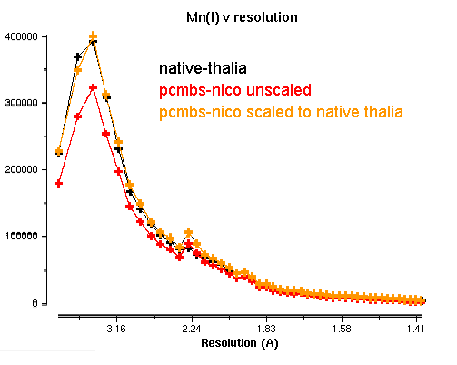
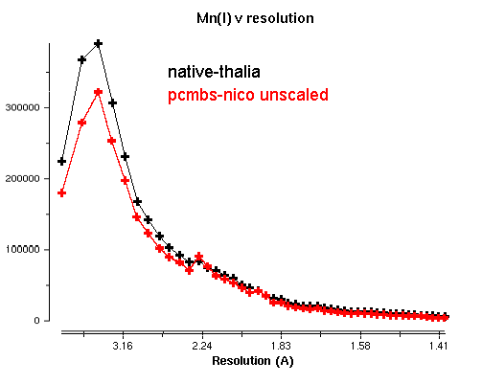
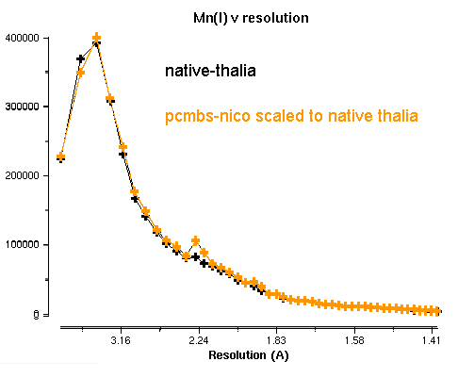
All data sets were scaled to native-daniel
Data set | I/σ overall
native daniel | 39
pcmbs-inkyu | 10
Fit curves using two parameters,
a constant, k
an exponential, B.
What is the consequence of neglecting scaling?

Slide 23
Calculate isomorphous difference Patterson maps to find heavy atom locations.
Patterson map synthesis
P(uvw)=Σ (|F_{PH}|-|F_{P}|)² cos2π(hx+ky+lz -α_{hkl})
set α_{hkl}=0
^{hkl}
What are these values, where do they come from?

Slide 24
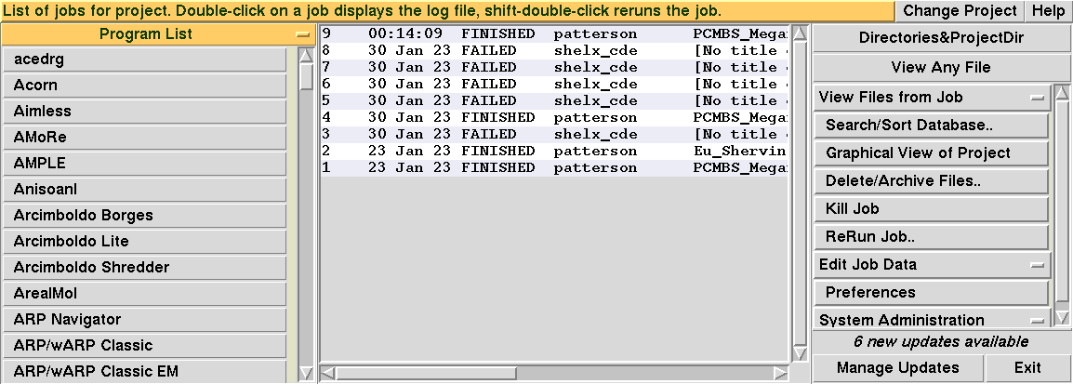
Use ccp4i interface to calculate difference Patterson maps
Scroll down Program List to find FFT for Patterson

Slide 25
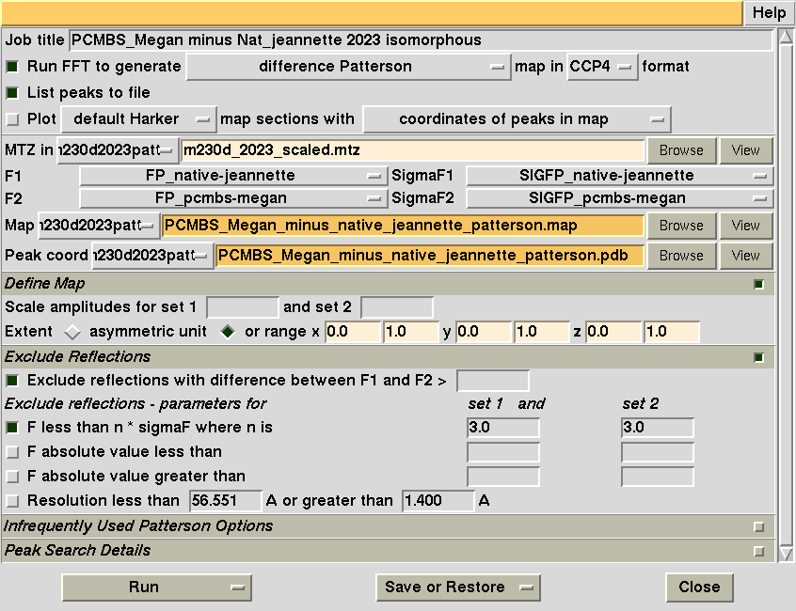
The task window for Patterson will pop up. Enter title & data file
Enter title
Browse to select m230d_2024_scaled.mtz

Slide 26
Duilio and I assigned one difference map to each student

Slide 27
Select native |F_{P}|
Change F1 to select native assigned to you

Slide 28
Select derivative |F_{PH} |
Change F2 to select derivative assigned to you

Slide 29
Select directory for map output. Enter title for map.
Enter appropriate title for Patterson map output.

Slide 30
Select directory for map output. Enter title for map.
Enter extent for u_{min}, u_{max}, v_{min}, v_{max}, w_{min}, w_{max}

Slide 31
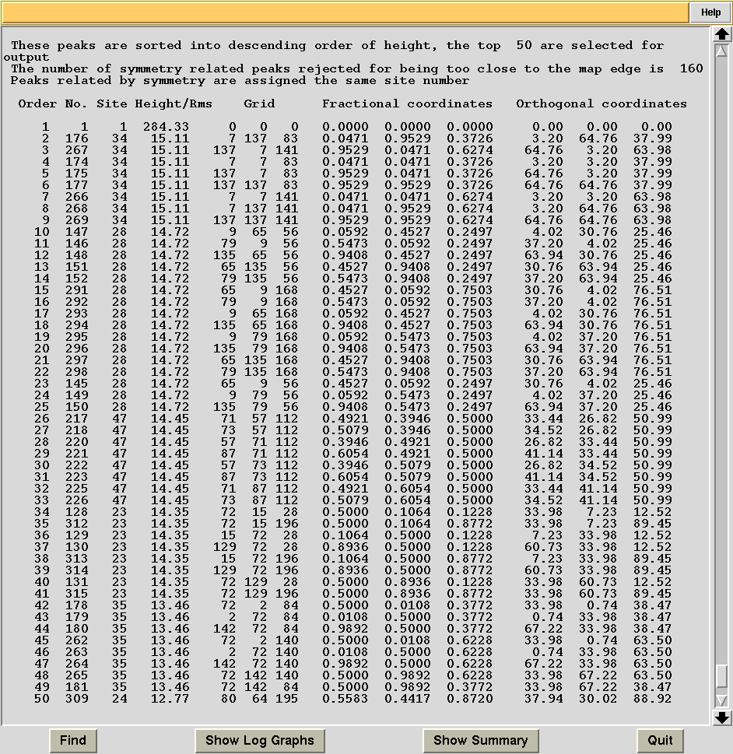
We will get a list of difference Patterson peaks in the unit cell.

Slide 32
Find the highest peak on the w=0.25 section
U=0.25

Slide 33
Find the highest peak on the w=0.25 section
Note peak height and enter it in spreadsheet
U=0.25

Slide 34
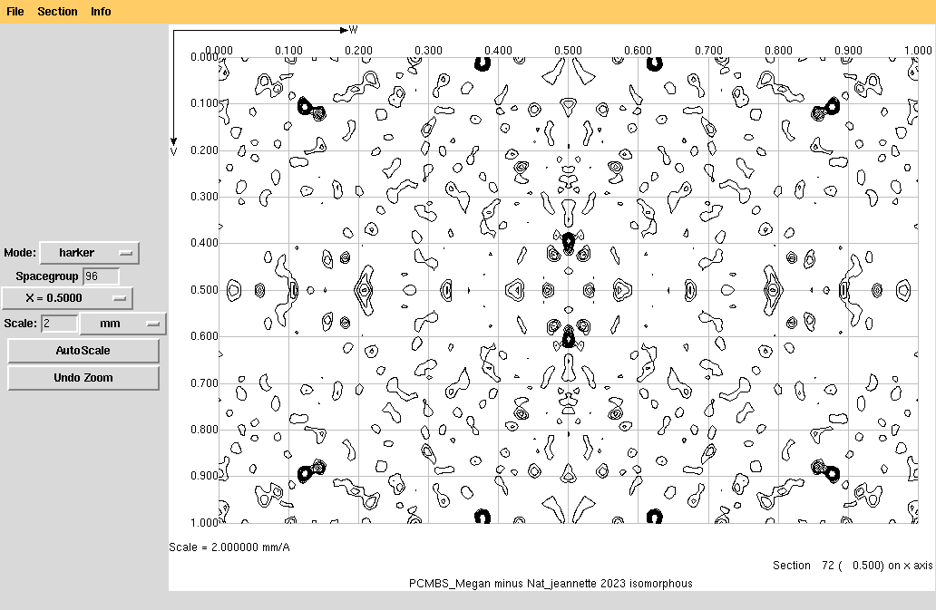
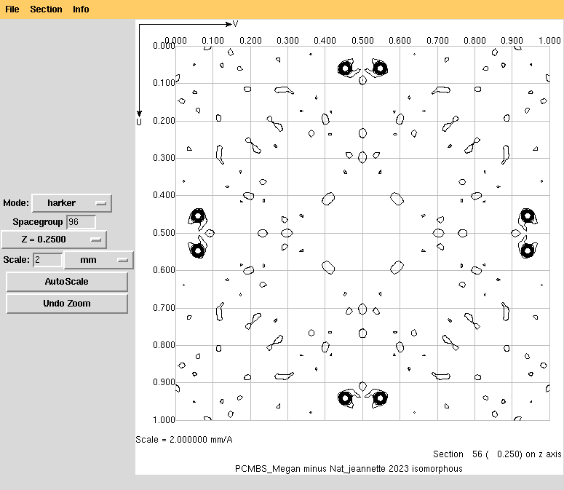
View difference Patterson maps with the program mapslicer
Visually verify the peaks are strong and sharp and located on Harker sections

Slide 35
Now, use direct methods to determine coordinates of heavy atom. And then calculate phases for F_{P} using SIRAS method.

Slide 36
Evidence that we have strong anomalous signal
W=¼
W=¼
(|F_{Native(EricP)}|-|F_{PCMBS(EricP)}|)²
(F_{PCMBS( h k l)} -F_{PCMBS(-h-k-l)})²
EricP

Slide 37
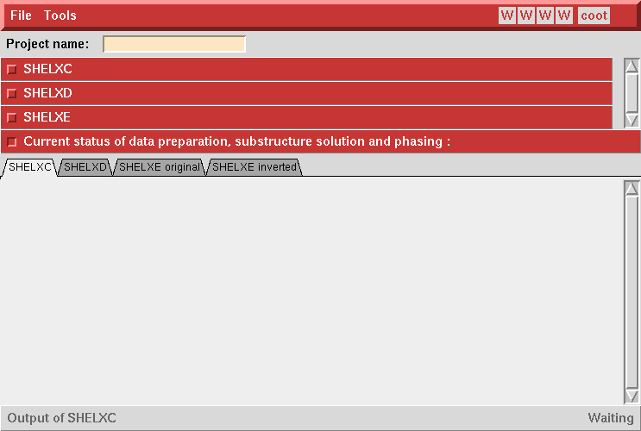
Enter a short title with no spaces
Continue to Use the native and derivative assigned to you

Slide 38
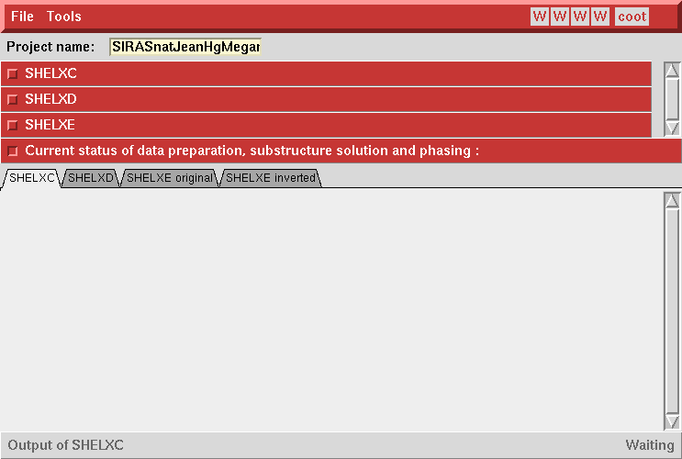
Use HKL2MAP to determine Heavy atom x,y,z and calculate phases using SIRAS
And then, click SHELXC

Slide 39
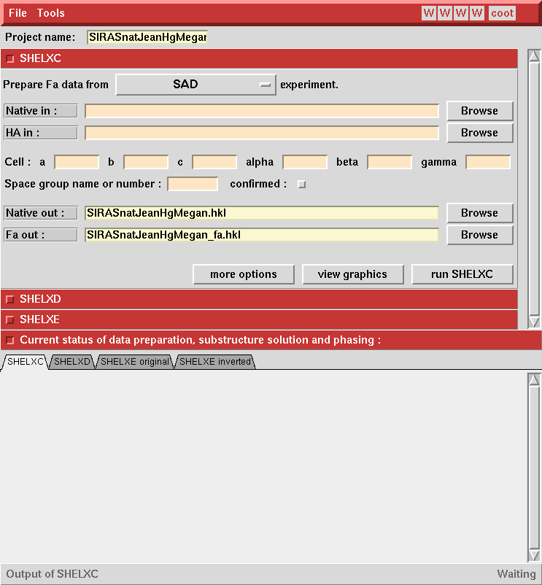
Enter native and derivative data (.sca format)
Browse for native_Jeannette
Browse for pcmbs_Megan

Slide 40
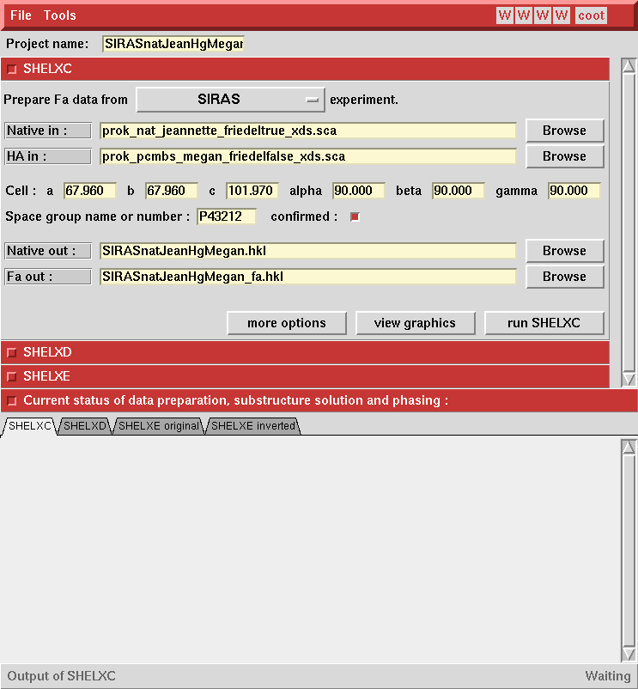
Confirm space group and run SHELXC
confirm
Run SHELXC

Slide 41
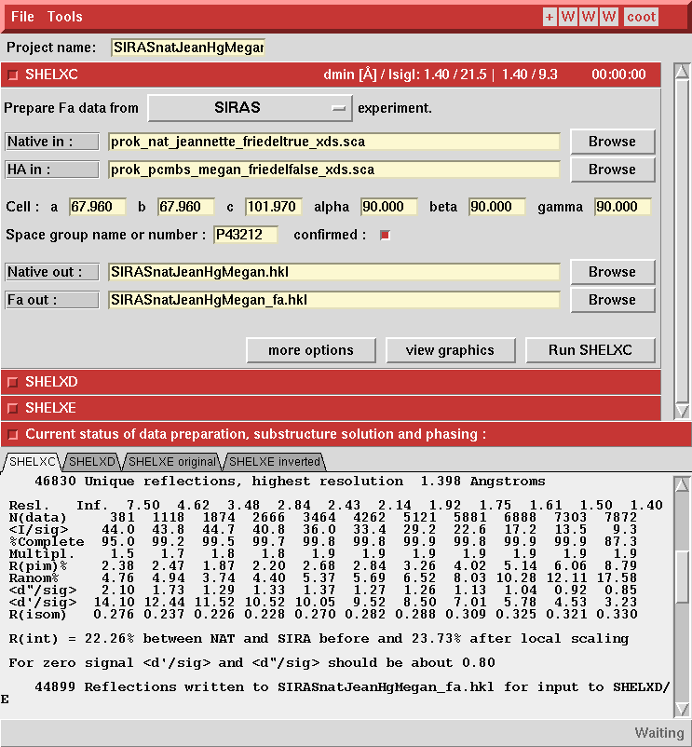
ShelxC estimates isomorphism

Slide 42
ShelxC estimates isomorphism
R_{isom} < 35% indicates isomorphism is good
d”>1.0 indicates strong anomalous signal

Slide 43
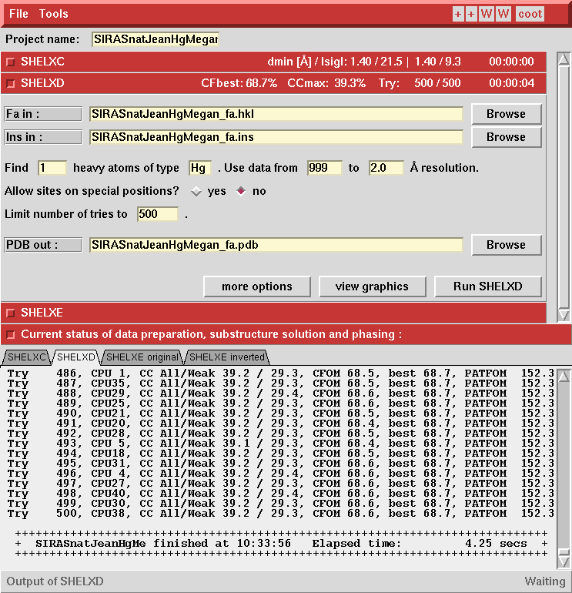
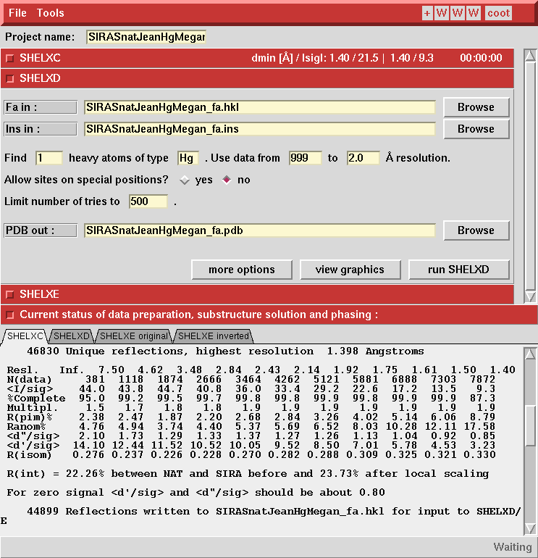
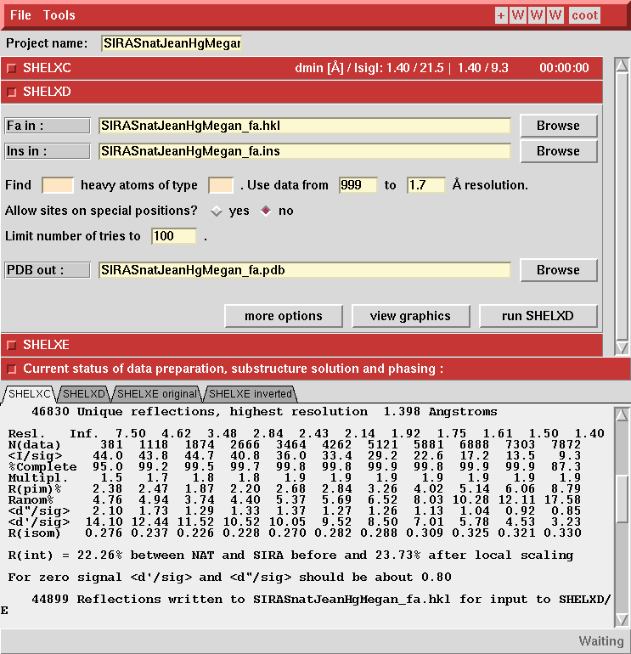
ShelxD uses direct methods to determine heavy atom x,y,z

Slide 44
ShelxD uses direct methods to determine heavy atom x,y,z
Use 2.0 Å cutoff
Enter element
Estimate one heavy atom
Ask for 500 trials
Run ShelxD

Slide 45
ShelxD uses direct methods to determine heavy atom x,y,z
View graphics

Slide 46
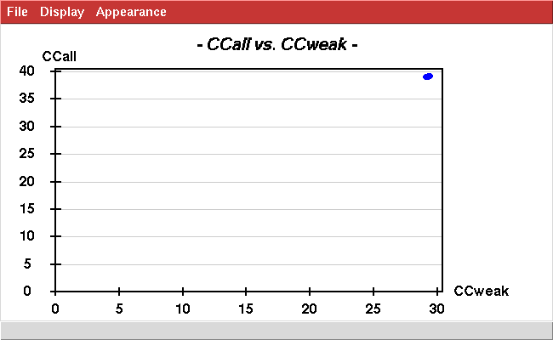
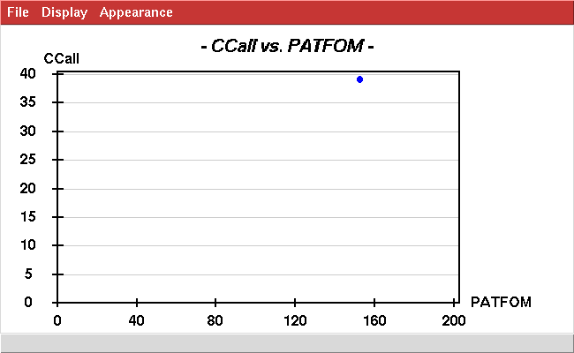
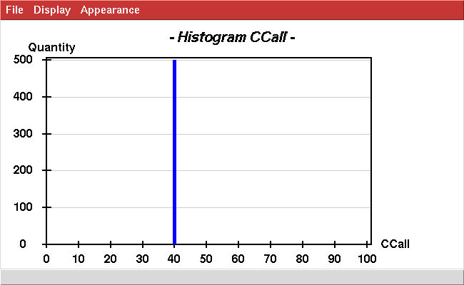
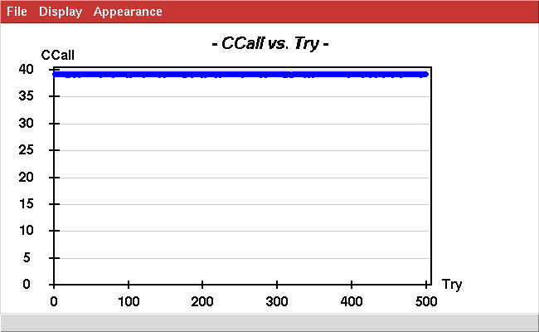
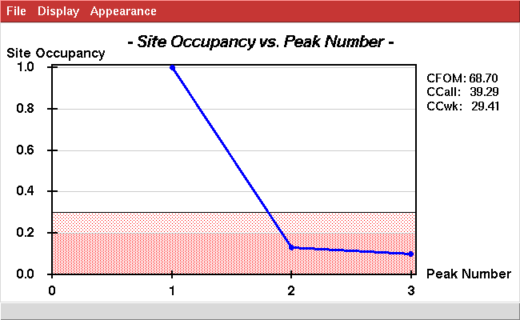
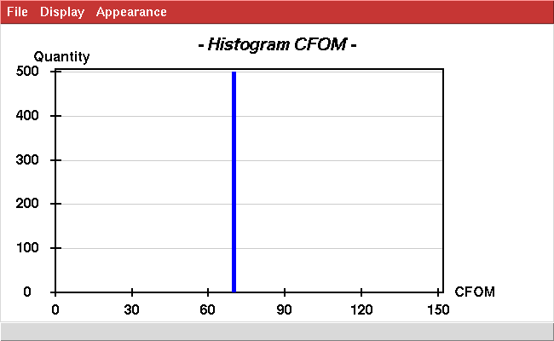
All 500 trials produced the same heavy atom substructure model
Great!

Slide 47
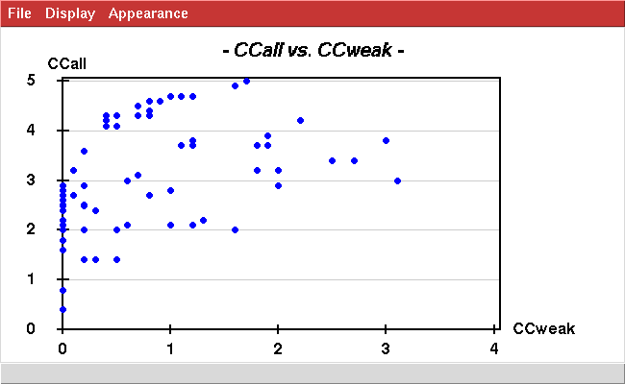
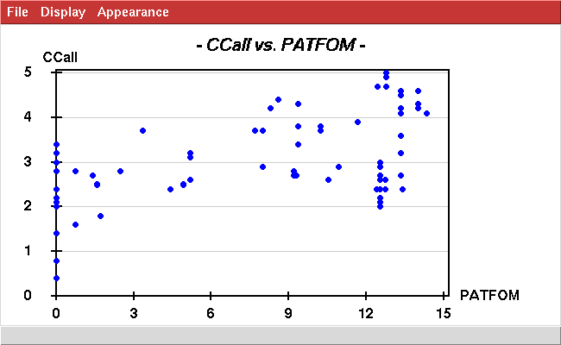
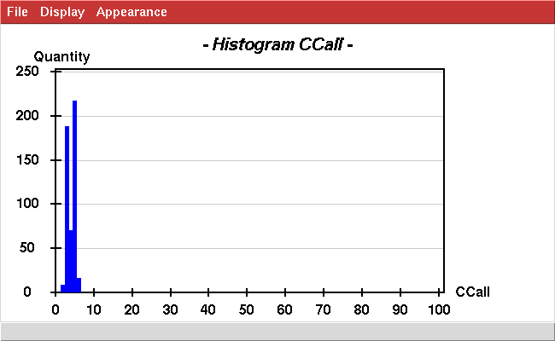
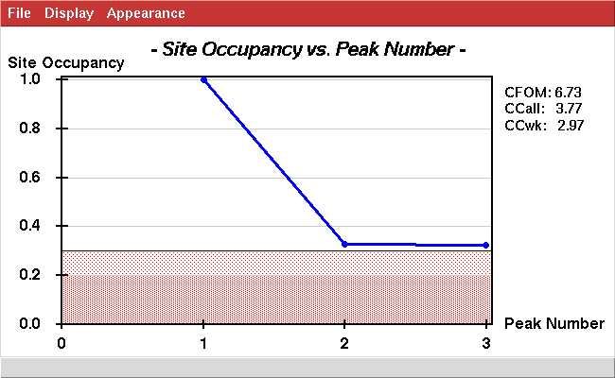
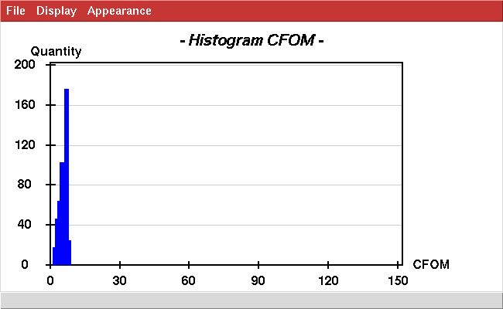
Contrast with poor heavy atom derivative
Not great

Slide 48
Verify heavy atom coordinates explain all Patterson peaks
SIRASnatJeanHgMegan_fa.res
REM Best SHELXD solution: CC 39.28 CC(weak) 29.39 CFOM 68.67
REM
TITL sirasJB_Megan_fa.ins SIRAS in P43212
CELL 0.98000 67.96 67.96 101.97 90.00 90.00 90.00
LATT -1
SYMM 1/2-Y, 1/2+X, 3/4+Z
SYMM -X, -Y, 1/2+Z
SYMM 1/2+Y, 1/2-X, 1/4+Z
SYMM 1/2-X, 1/2+Y, 3/4-Z
SYMM Y, X, -Z
SYMM 1/2+X, 1/2-Y, 1/4-Z
SYMM -Y, -X, 1/2-Z
SFAC HG
UNIT 256
HG01 1 0.255119 0.697151 0.063709 1.0000 0.2
HG02 1 0.197517 0.742317 -0.063921 0.1317 0.2
HG03 1 0.253120 0.796547 0.063623 0.1025 0.2
HKLF 3
END
checkmypatt.com x y z patterson.map
checkmypatt.com 0.255 0.697 0.063 PCMBS_Megan_minus_native_jeannette_patterson.map

Slide 49
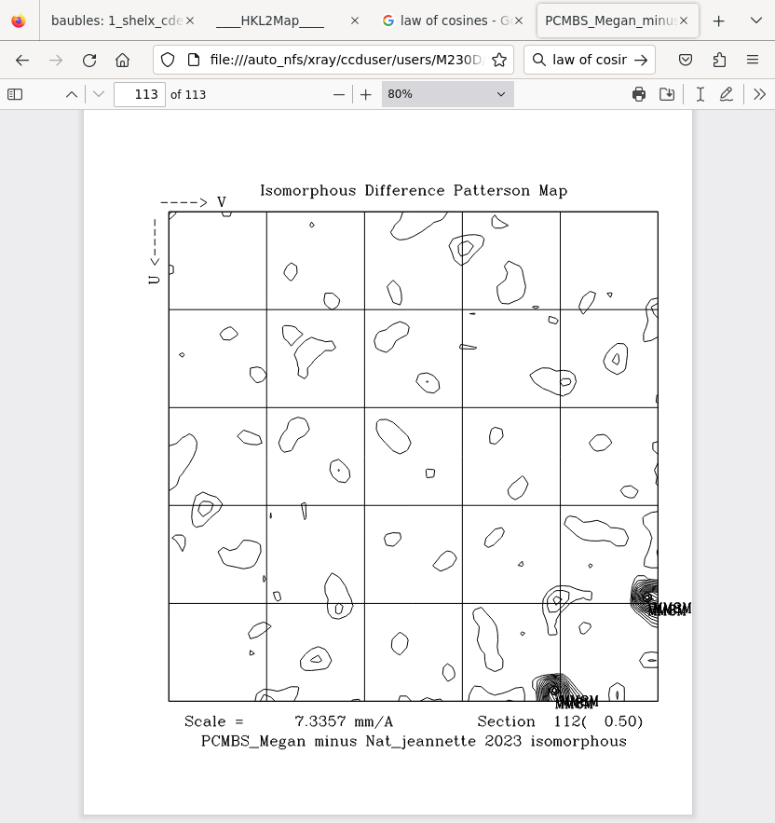
Verify all Patterson peaks are predicted (labeled).

Slide 50
Calculate an experimental electron density map of proteinase K using SIRAS phases
Fourier synthesis
ρ(xyz)=Σ |F_{hkl}| cos2π(hx+ky+lz -α_{hkl})
^{hkl}
best
Where do these values come from?
We will calculate isomorphous difference Patterson maps from the diffraction data you collected and determine if heavy atoms are bound by looking for peaks on Harker sections.
We will determine the heavy atom coordinates (x,y,z) using direct methods and verify the heavy atom coordinates (x,y,z) accurately predict the observed difference Patterson peak positions (u,v,w).
We will calculate |F^{best}| & phases α using isomorphous replacement and anomalous scattering (SIRAS), calculate an electron density map, and then improve the map by density modification.
We will examine the map and start building an atomic model to fit the map.

Slide 51
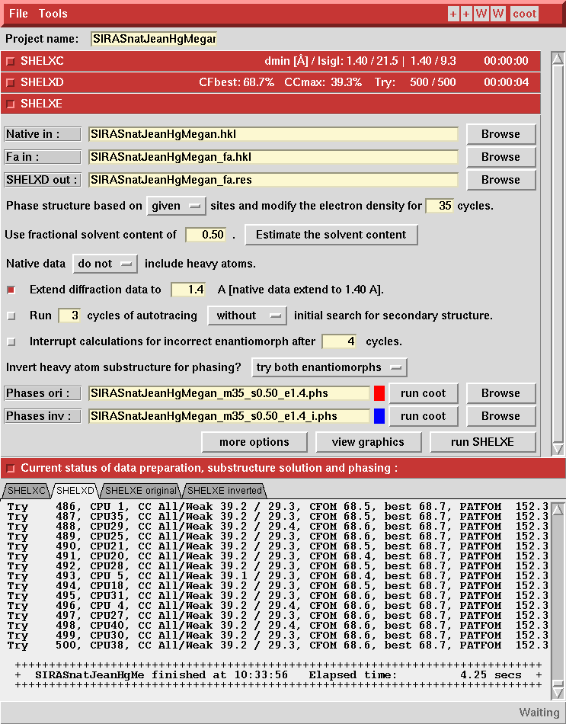
Calculate phases using SIRAS

Slide 52
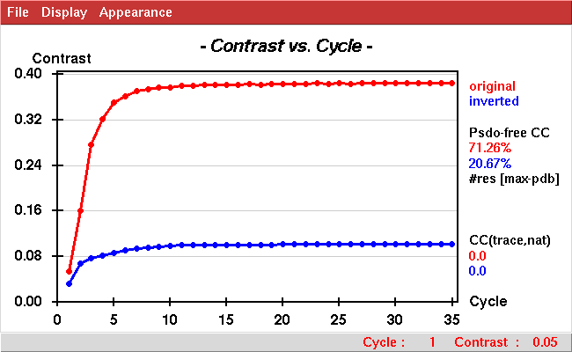
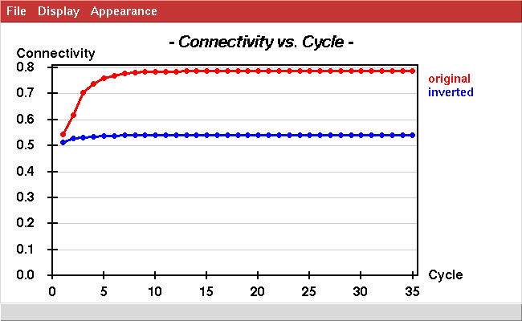
Clear indication original hand is correct.

Slide 53
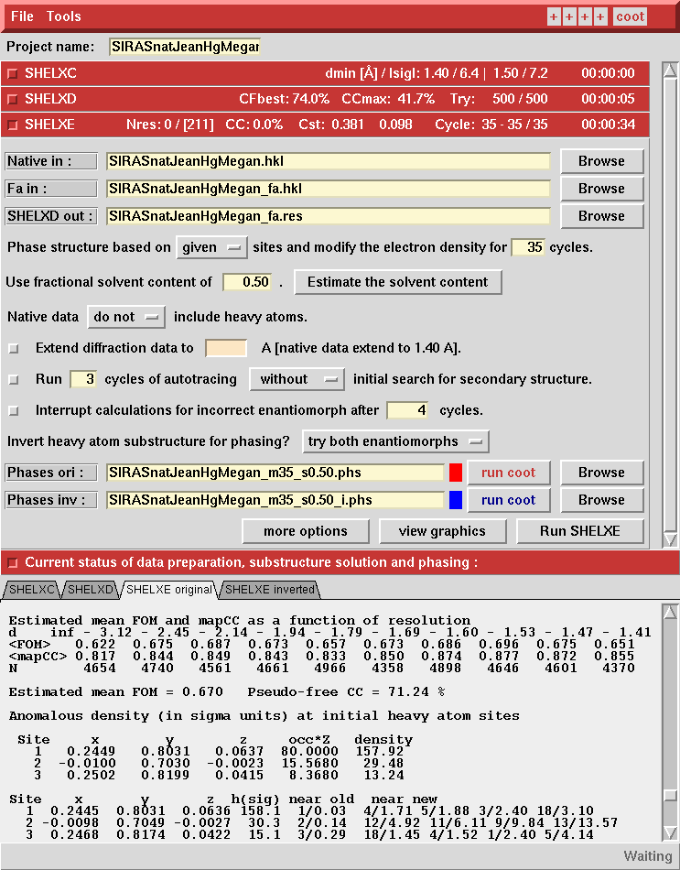
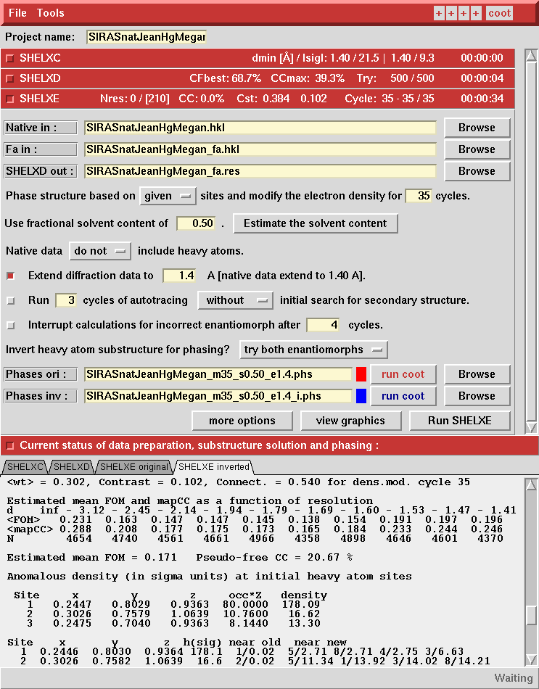
Original hand
Inverted hand

Slide 54
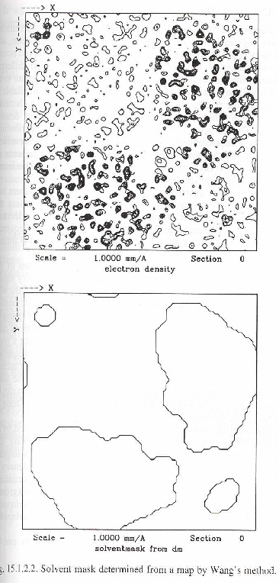
Density modification
A) Solvent flattening.
Calculate an electron density map.
If ρ<threshold, -> solvent
If ρ>threshold -> protein
Build a mask
Set density value in solvent region to a constant (low).
Transform flattened map to structure factors
Combine modified phases with original phases.
Iterate

Slide 55
Density modification in ShelxE

Slide 56
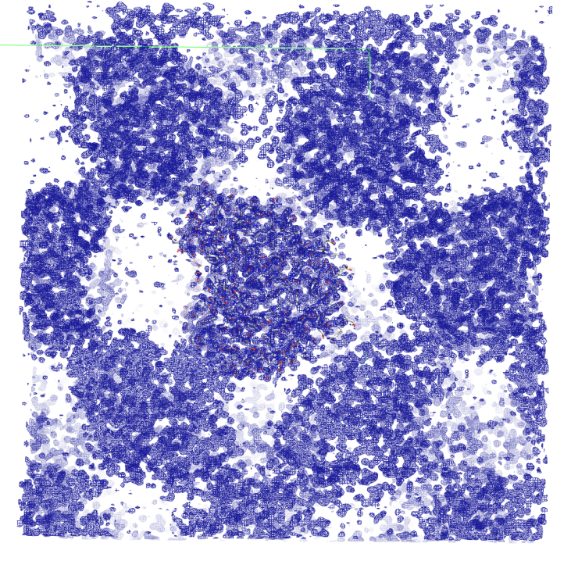
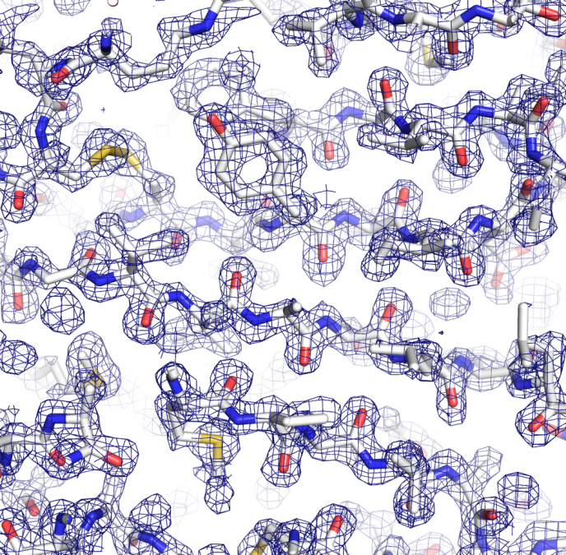
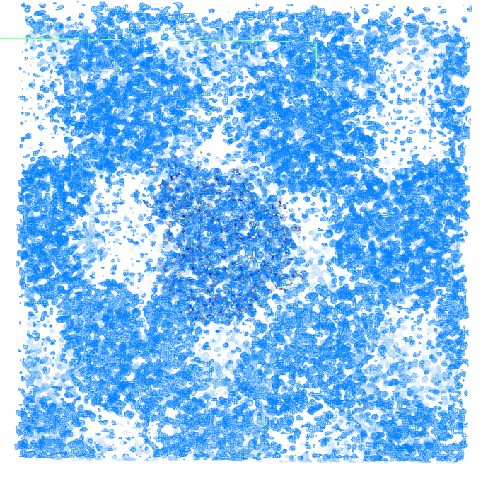
SIR SIRAS MIRAS

Slide 57
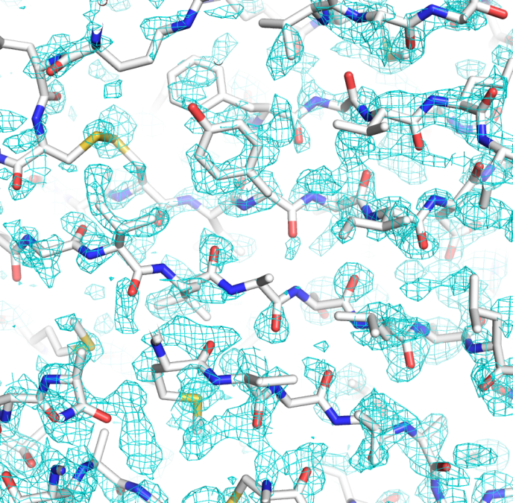
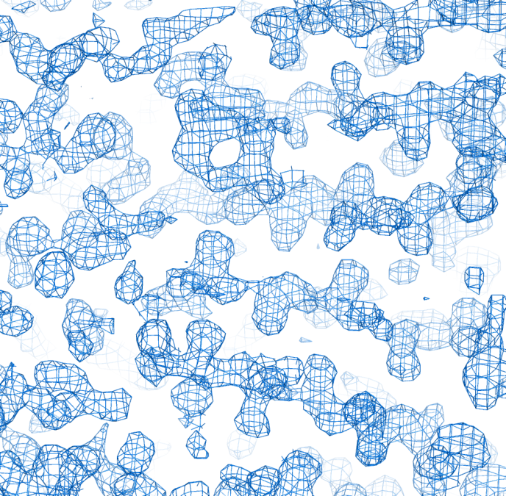
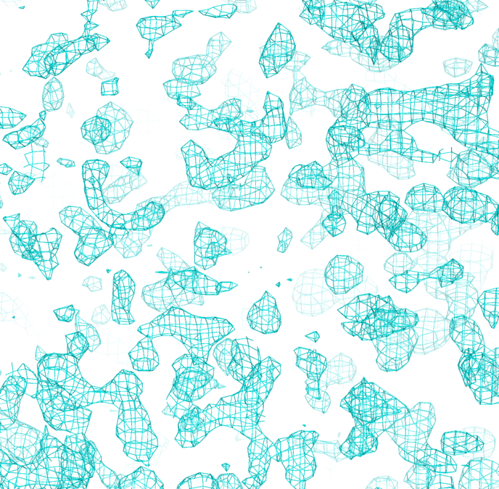
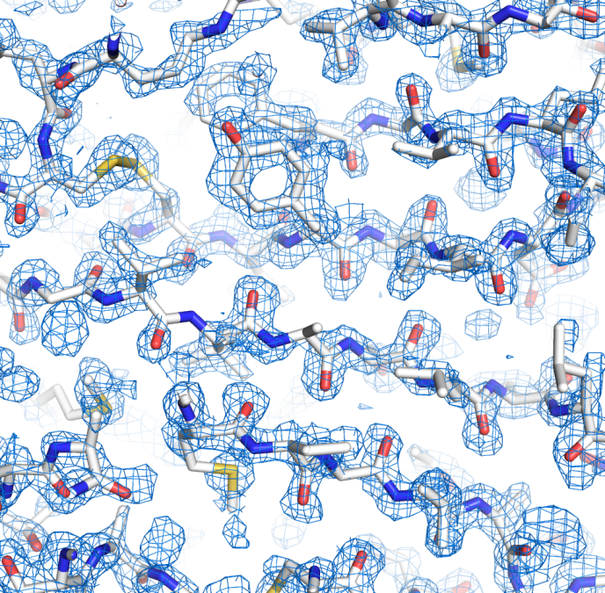
SIR SIRAS MIRAS

Slide 58
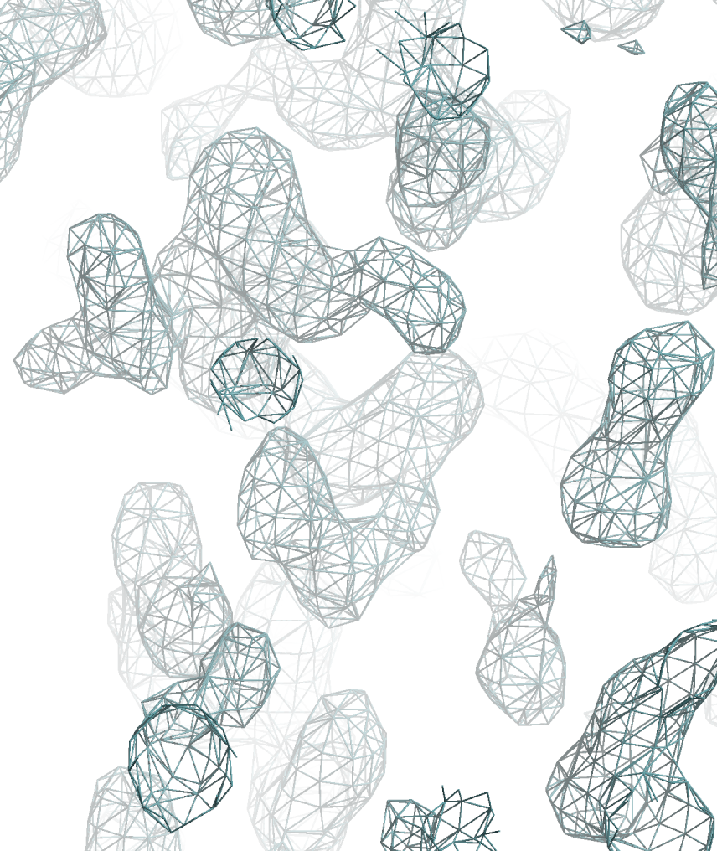
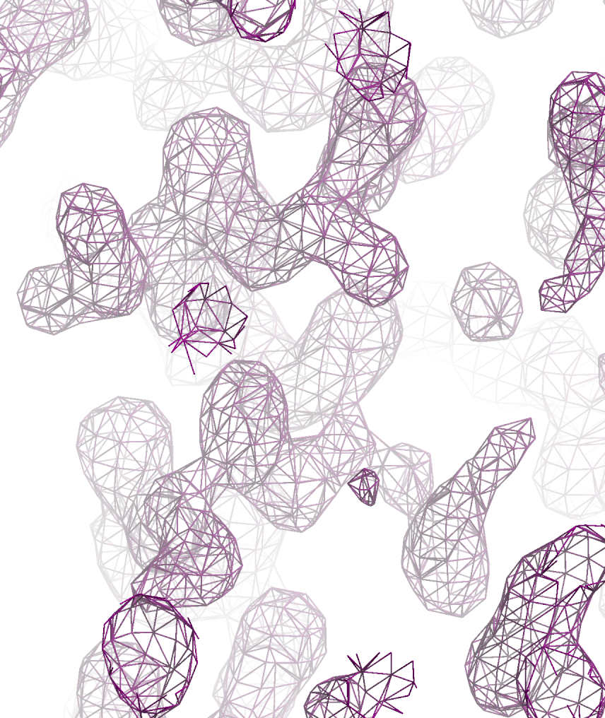
MIR phased map + Solvent Flattening + Histogram Matching
MIRAS phased map

Slide 59
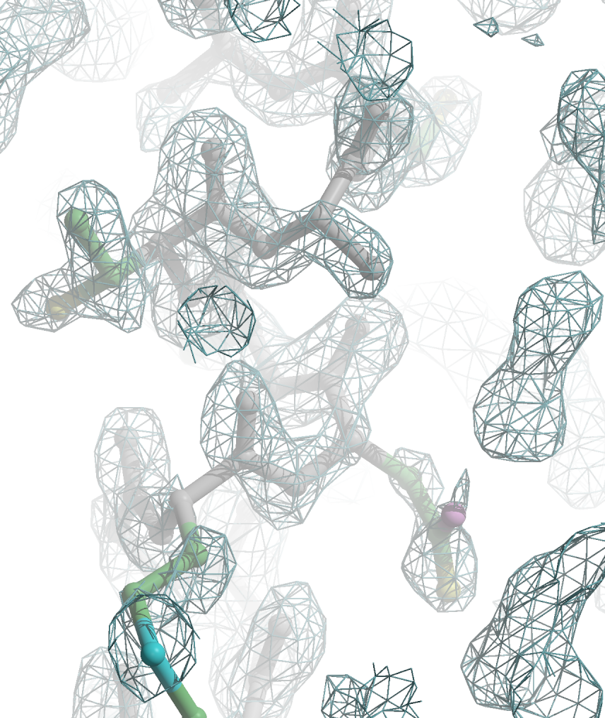
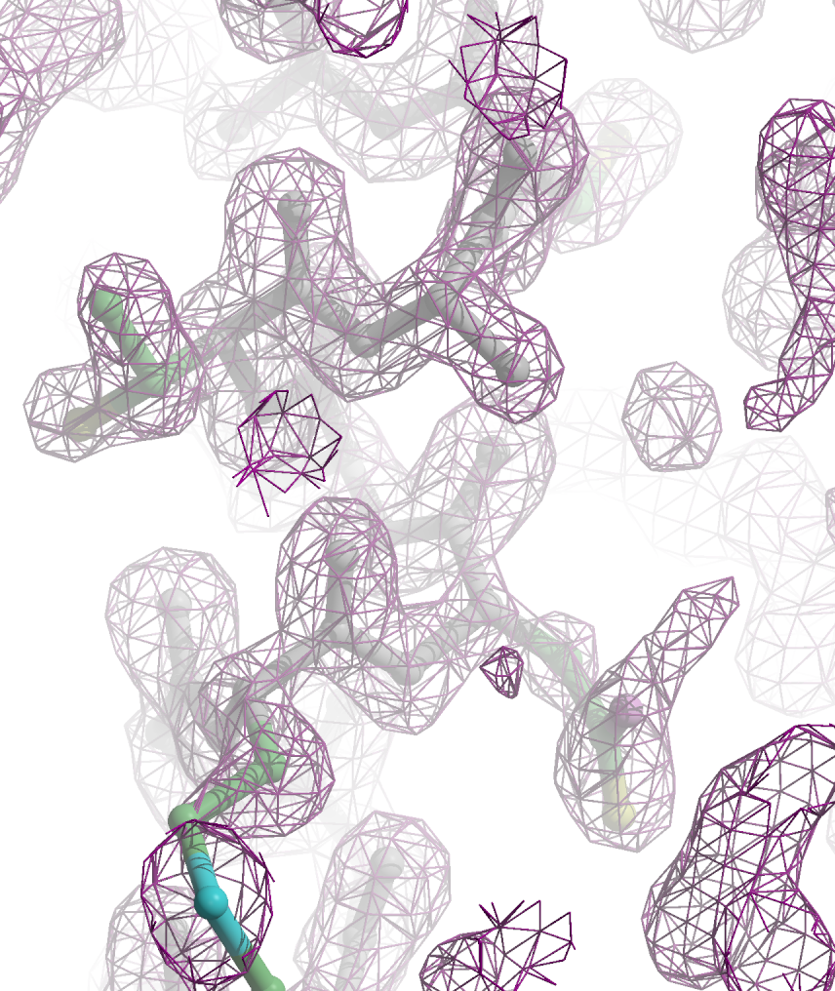
MIRAS phased map
MIR phased map + Solvent Flattening + Histogram Matching

Slide 60
It’s time for Model Building

Slide 61
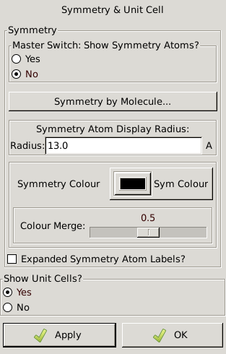
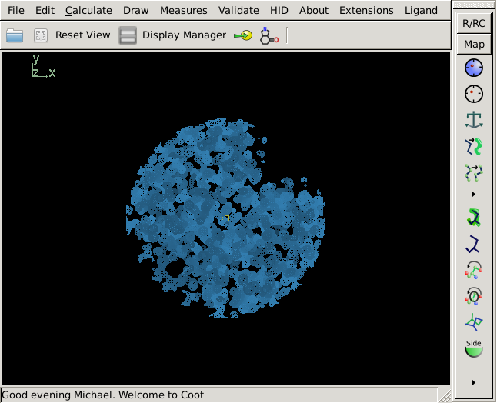
Display unit cell outline
Blah1
Blah2
Blah3
Cell & Symmetry
Blah5
Blah6
Blah7

Slide 62
Open “display manager”

Slide 63
Display skeleton

Slide 64
Hide map, search for helix

Slide 65
Be able to recognize a helix from different perspectives
90º
Viewed down helical axis
Viewed perpendicular to
helical axis

Slide 66
The hole through the center of a helix is the most distinctive feature of α-helix density.
Viewed down helical axis
Often it is easier to recognize helical density when viewed down the helical axis due to the distinctive hole through the center of the helix.
Viewed perpendicular to
helical axis

Slide 67
Translate helix center to screen center (pink box)
To translate
in x or y

Slide 68
Zoom and center skeleton helix
Small pink box marks center of screen

Slide 69
Rotate View (90°)to look down helix axis and re-center helix
Small pink box marks center of screen

Slide 70
Helix directionality
C-terminus
Protein models are always numbered from N-terminus to C-terminus as shown here. So it is easy to tell the directionality of a helix.
But, electron density isn’t labeled with residue numbers.
What structural features are present in the electron density map to help you determine which direction to place the helix?
Backbone
oxygens
10
9
8
7
6
5
4
Backbone
nitrogens
3
2
1
N-terminus

Slide 71
Return to original view. Turn on map. Which direction is the C-term of helix pointed?

Slide 72
Calculate->Other Modeling Tools Place Helix Here.

Slide 73
Saving first set of coordinates.
File menu
Save coordinates
Select which coordinate set you want to save.
1 Helix
Auto suggestion:
Helix-coot-0.pdb
Change to:
sawaya-coot-0.pdb
1
version number

Slide 74
Save coordinates frequently
1) Every 5 minutes.
2) When you have done some modeling that you are especially pleased with.
3) When you are fear that the next step is going to destroy your previous work.

Slide 75
Begin by illustrating SIR Phasing with PCMBS (Hg)
Isomorphous Differences
F_{P(hkl)}=F_{P·Hg (hkl)} - f_{Hg(hkl)}
We will focus on the reflection h=9, k=2, l=1 reflection as an example
We measured |F_{P}| and |F_{P·Hg}|.
How do we graph these quantities in complex plane?
How did we obtain the coordinates of Hg?
How do we obtain f_{Hg(hkl)}?

Slide 76
SIR Phasing
F_{P}=F_{P·Hg}(+) - f_{Hg}(+)
H K L |F_{P}| |F_{PH} (+)| |F_{PH} (-)| |F_{PH} (+)| |F_{PH} (-)|
9 2 1 486 586 611 536 499
Imaginary axis
500
|F_{P} |
250
Real axis
-500
-250
250
500
-250
-500

Slide 77
SIR Phasing
F_{P}=F_{P·Hg}(+) - f_{Hg}(+)
H K L |F_{P}| |F_{PH} (+)| |F_{PH} (-)| |F_{PH} (+)| |F_{PH} (-)|
9 2 1 486 586 611 536 499
Hg coordinates (x,y,z) from Patterson =(0.197, 0.755, 0.935)
Imaginary axis
500
|F_{P} |
250
Real axis
-500
-250
250
500
-250
-500

Slide 78
SIR Phasing
F_{P}=F_{P·Hg}(+) - f_{Hg}(+)
H K L |F_{P}| |F_{PH} (+)| |F_{PH} (-)| |F_{PH} (+)| |F_{PH} (-)|
9 2 1 486 586 611 536 499
Hg coordinates (x,y,z) from Patterson =(0.197, 0.755, 0.935)
Imaginary axis
500
+
f_{Hg}=(f_{Hg}+f’+if”)[e^{2πi*(h(x)+k(y)+l(z))}+
e^{2πi*(h(-x)+k(-y)+l(½+z))}+
e^{2πi*(h(½-y)+k(½+x)+l(¾+z)}+
e^{2πi*(h(½+y)+k(½-x)+l(¼+z)}+
e^{2πi*(h(½-x)+k(½+y)+l(¾-z)}+
e^{2πi*(h(½+x)+k(½-y)+l(¼-z)}+
e^{2πi*(h(y)+k(x)+l(-z)}+
e^{2πi*(h(-y)+k(-x)+l(½-z)}]
|F_{P} |
250
Real axis
-500
-250
250
500
-250
-500
f’ and f” are anomalous scattering corrections specific for wavelength used.
f_{Hg} is a real number proportional to the number of e- in Hg

Slide 79
SIR Phasing
F_{P}=F_{P·Hg}(+) - f_{Hg}(+)
H K L |F_{P}| |F_{PH} (+)| |F_{PH} (-)| |F_{PH} (+)| |F_{PH} (-)|
9 2 1 486 586 611 536 499
Imaginary axis
500
|F_{P} |
|f_{Hg}|=282
α_{Hg}=58°
250
Real axis
-500
-250
250
500
282
f_{Hg}(+)
-
58°
-250
-500

Slide 80
SIR Phasing
F_{P}=F_{P·Hg}(+) - f_{Hg}(+)
H K L |F_{P}| |F_{PH} (+)| |F_{PH} (-)| |F_{PH} (+)| |F_{PH} (-)|
9 2 1 486 586 611 536 499
Imaginary axis
500
|F_{P} |
250
Real axis
-500
-250
250
500
-f_{Hg}(+)
-250
-500
Let’s look at the quality of the phasing statistics up to this point.
|F_{P·Hg}(+)|

Slide 81
SIR Phasing
H K L |F_{P}| |F_{PH} (+)| |F_{PH} (-)| |F_{PH} (+)| |F_{PH} (-)|
9 2 1 486 586 611 536 499
Which of the following graphs best represents the phase probability distribution, P(α)?
Imaginary axis
500
a)
b)
c)
|F_{P} |
P(α)
250
0 90 180 270 360
Real axis
-500
-250
250
500
-f_{Hg}(+)
P(α)
-250
0 90 180 270 360
-500
P(α)
|F_{P·Hg}(+)|
0 90 180 270 360
α (degrees)

Slide 82
SIR Phasing
H K L |F_{P}| |F_{PH} (+)| |F_{PH} (-)| |F_{PH} (+)| |F_{PH} (-)|
9 2 1 486 586 611 536 499
The phase probability distribution, P(α) is sometimes shown as being wrapped around the phasing circle.
Imaginary axis
500
|F_{P} |
P(α)
250
0 90 180 270 360
α (degrees)
Real axis
-500
-250
250
500
-f_{Hg}(+)
90
-250
180
0
-500
|F_{P·Hg}(+)|
270

Slide 83
SIR Phasing
H K L |F_{P}| |F_{PH} (+)| |F_{PH} (-)| |F_{PH} (+)| |F_{PH} (-)|
9 2 1 486 586 611 536 499
Which of the following is the best choice of F_{p}?
Imaginary axis
90
500
a)
b)
c)
90
|F_{P} |
180
0
270
180
0
Real axis
90
-500
500
180
0
270
270
-500
90
|F_{P·Hg}(+)|
180
0
270
Radius of circle is approximately |F_{p}|

Slide 84
SIR Phasing
H K L |F_{P}| |F_{PH} (+)| |F_{PH} (-)| |F_{PH} (+)| |F_{PH} (-)|
9 2 1 486 586 611 536 499
Imaginary axis
best F_{P} = |F_{p}|e^{iα}•P(α)dα
500
90
|F_{P} |
α
180
0
Real axis
Sum of probability weighted vectors F_{p}
Usually shorter than F_{p}
-500
500
270
-500
|F_{P·Hg}(+)|

Slide 85
SIR Phasing
H K L |F_{P}| |F_{PH} (+)| |F_{PH} (-)| |F_{PH} (+)| |F_{PH} (-)|
9 2 1 486 586 611 536 499
Imaginary axis
best F_{P} = |F_{p}|e^{iα}•P(α)dα
500
90
α
|F_{best} |
180
0
Real axis
Sum of probability weighted vectors F_{p}
Usually shorter than F_{p}
-500
500
270
-500
|F_{P·Hg}(+)|

Slide 86
SIR Phasing
H K L |F_{P}| |F_{PH} (+)| |F_{PH} (-)| |F_{PH} (+)| |F_{PH} (-)|
9 2 1 486 586 611 536 499
Which of the following is the best approximation to the Figure Of Merit (FOM) for this reflection?
Imaginary axis
500
90
1.00
2.00
0.20
-0.20
|F_{best} |
180
0
Real axis
-500
500
270
-500
|F_{P·Hg}(+)|
FOM=|F_{best}|/|F_{P}|
Radius of circle is approximately |F_{p}|

Slide 87
SIR Phasing
Which phase probability distribution would yield the most desirable Figure of Merit?
c)
500
90
|F_{best} |
a)
b)
180
0
-500
500
0
0
+
+
270
+
270
90
90
270
180
180
-500
FOM=0.0
FOM=0.9
FOM=0.2

Slide 88
SIRAS Phasing
F_{P}=F_{P·Hg}(+) - f_{Hg}(+)
H K L |F_{P}| |F_{PH} (+)| |F_{PH} (-)| |F_{PH} (+)| |F_{PH} (-)|
9 2 1 486 586 611 536 499
Imaginary axis
500
|F_{P} |
250
Real axis
-500
-250
250
500
-f_{Hg}(+)
-250
-500
|F_{P·Hg}(+)|

Slide 89
SIRAS Phasing
F_{P}=F_{P·Hg}(+) - f_{Hg}(+)
F_{P}=F_{P·Hg}(-)* - f_{Hg}(-)*
H K L |F_{P}| |F_{PH} (+)| |F_{PH} (-)| |F_{PH} (+)| |F_{PH} (-)|
9 2 1 486 586 611 536 499
Imaginary axis
500
|F_{P} |
|f_{Hg}|=282
α_{Hg}*=48°
250
Real axis
-500
-
-250
250
500
-f_{Hg}(+)
f_{Hg}(-)*
282
48°
-250
-500
|F_{P·Hg}(+)|

Slide 90
SIRAS Phasing
F_{P}=F_{P·Hg}(+) - f_{Hg}(+)
F_{P}=F_{P·Hg}(-)* - f_{Hg}(-)*
H K L |F_{P}| |F_{PH} (+)| |F_{PH} (-)| |F_{PH} (+)| |F_{PH} (-)|
9 2 1 486 586 611 536 499
Imaginary axis
500
|F_{P} |
|F_{P·Hg}(-)|
250
Real axis
-500
-250
250
500
-f_{Hg}(-)*
-f_{Hg}(+)
-250
-500
|F_{P·Hg}(+)|

Slide 91
SIRAS
Isomorphous differences
Anomalous differences
Imaginary axis
500
|F_{P} |
|F_{P·Hg}(-)|
250
Real axis
-500
-250
250
500
-f_{Hg}(-)*
-f_{Hg}(+)
P(α)
-250
0 90 180 270 360
α (degrees)
Which P(α) corresponds to SIR?
Which P(α) corresponds to SIRAS?
-500
|F_{P·Hg}(+)|

