Slide 1
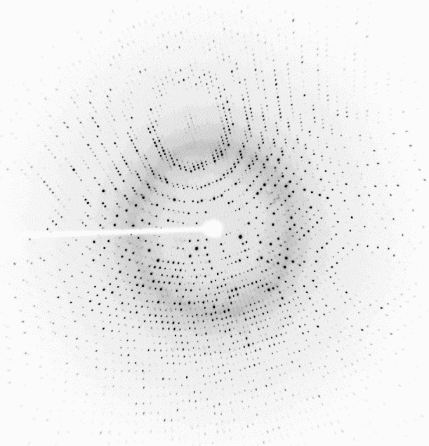
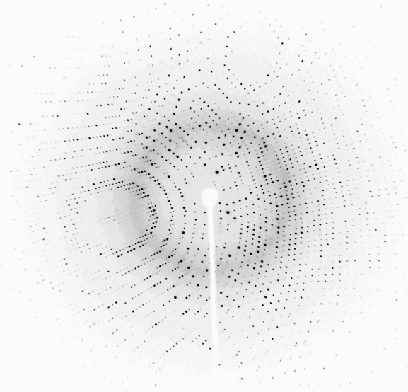
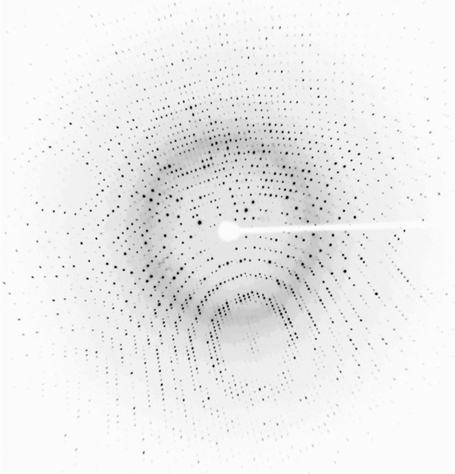
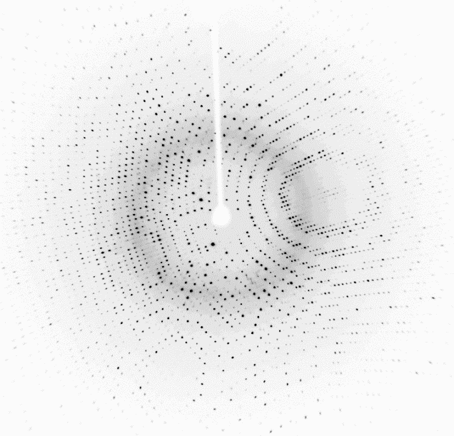
Data Reduction Goals
From a series of diffraction images, obtain a file containing the intensity (I_{hkl}) and standard deviation (σ(I_{hkl})) for each reflection, hkl.
716
Final intensities
717
Set of 720 images.
Each image covers 0.5°
718
H K L I σ
0 0 4 3295.4 174.0
0 0 8 482.1 28.7
0 0 12 9691.0 500.7
0 0 16 1743.9 67.4
0 0 20 5856.0 221.0
0 0 24 14066.5 436.2
0 0 28 9936.3 311.7
0 0 36 8409.8 273.4
0 0 40 790.5 32.8
0 0 44 103.4 18.4
. . . . .
. . . . .
. . . . .
37 7 0 28.5 16.2
37 7 1 110.1 10.9
37 7 2 337.4 13.3
37 7 3 98.5 10.6
37 7 4 25.9 10.7
719
Index
Integrate
Merge
720
13,000 Mb
2 Mb

Slide 2
Determine the space group of the crystal by process of elimination.
1
System | Bravais lattice | Point group | 65 Chiral Space Groups
Triclinic | P | 1 | P1
Monoclinic | P | 2 | P2 | P2₁
 | C |  | C2
Orthorhombic | P | 222 | P222 | P222₁ | P2₁2₁2 | P2₁2₁2₁
 | C |  | C222₁ | C222
 | F |  | F222
 | I |  | I222 | I2₁2₁2₁
Tetragonal | P | 4 | P4 | P4₁ | P4₂ | P4₃
 | I |  | I4 | I4₁
 | P | 422 | P422 | P42₁2 | P4₁22 | P4₁2₁2 | P4₂22 | P4₂2₁2
 |  |  |  |  | P4₃22 | P4₃2₁2
 | I |  | I422 | I4₁22
Trigonal/ Rhombo-hedral | P | 3 | P3 | P31 | P32
 | R |  | R3
 | P | 32 | P312 | P321 | P3₁12 | P3₁21 | P3₂12 | P3₂21
 | R |  | R32
Hexagonal | P | 6 | P6 | P6₁ | P6₂ | P6₃ | P6₄ | P6₅
 |  | 622 | P622 | P6₁22 | P6₂22 | P6₃22 | P6₄22 | P6₅22
Cubic | P | 23 | P23 | P2₁3
 | F |  | F23
 | I |  | I23 | I2₁3
 | P | 432 | P432 | P4₂32 | P4₃32 | P4₁32
 | F |  | F432 | F4₁32
 | I |  | I432 | I4₁32
65 chiral space groups: ProK is made of L-amino acids. Only 65 of the 230 space groups support chiral motifs.
14 Bravais lattices: find best fit of to diffraction pattern.
Point group symmetry: find best fit to reflection intensity pattern. Rotational symmetry in the diffraction pattern infers rotational symmetry in the crystal.
Pure rotation or screw axis: discern by examining systematic absences.
2
3
4

Slide 3
Learn how to judge the quality of data collection statistics.

Slide 4
Indexing
2,0,0
3,0,-1
4,0,-2
Assign an h,k,l coordinate to each reflection of the first image.
Indices h,k,l are coordinates of the reflections, analogous to how atom positions are described by coordinates x,y,z.
5,0,-3
5,0,-4
5,0,-5
4,0,-6
3,0,-7
2,0,-7
1,0,-8
0,0,-8
-1,0,-8

Slide 5
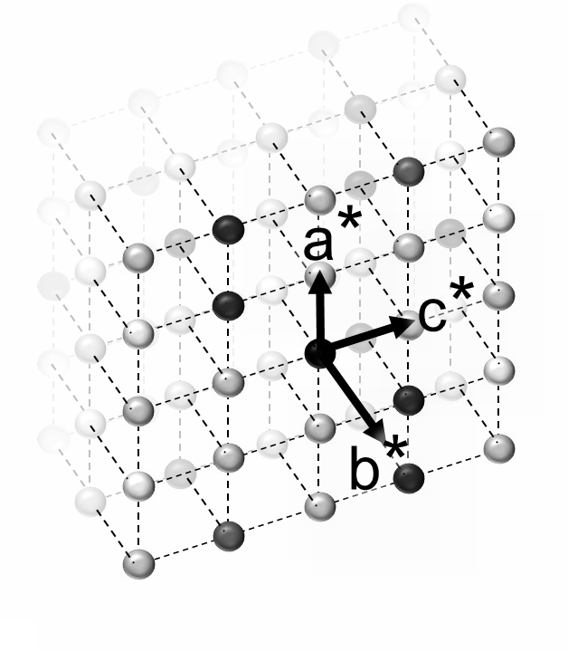
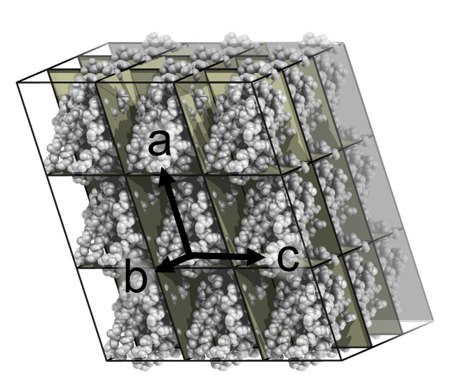
Understand the relationship between the crystal, the reciprocal lattice and the diffraction pattern
Crystal
Reciprocal Lattice
Diffraction Pattern
Fourier
Transform
Diffraction
Experiment
Unit cell lengths a, b, c
Atom coordinates x, y, z
Reciprocal cell lengths a*, b*, c*
Reflection coordinates h, k, l
Goal of data reduction is to measure intensity at each lattice point, h,k,l.
A 2D projection of a 3D reciprocal lattice
Notes:
In our diffraction experiment, we are trying to measure the Fourier transform of the crystal. The Fourier transform of a crystal is a reciprocal lattice where each lattice point contains a spot with index hkl and amplitude F, corresponding to the transform of the motif. We measure intensity. F_{hkl}= SQRT(I_{hkl})

Slide 6
Ewald’s sphere of reflection
Simulated Data Collection
Reciprocal
lattice
Crystal
X-ray beam
Diffracted rays
Detector

Slide 7
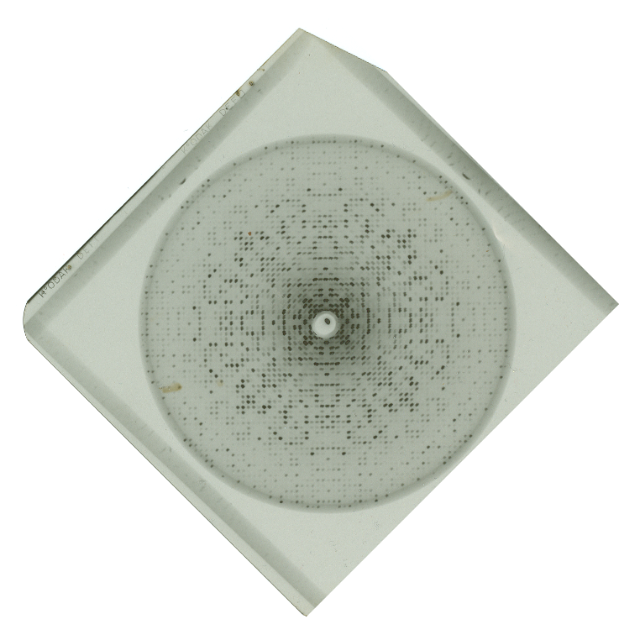
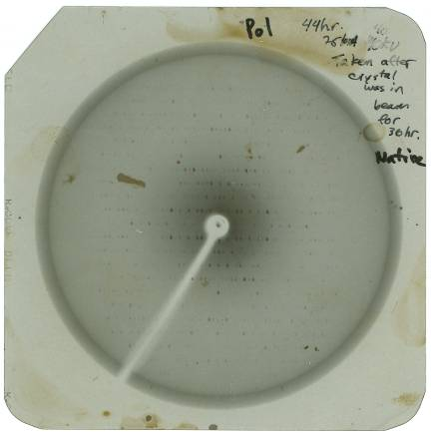
Indexing is conceptually simple with precession photographs
Provides an undistorted view of one plane of the reciprocal lattice
Taken in early 1990s.

Slide 8
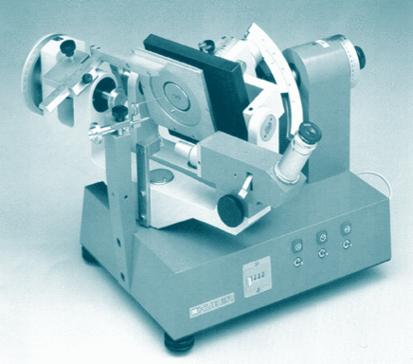
Buerger Precession Camera

Slide 9
How to Index by Inspection
Recall that spots are arrayed on a reciprocal lattice.
Count how many steps the given reflection is displaced from the origin.
h=Number of steps of a*.
k=Number of steps of b*.
l=Number of steps of c*.

Slide 10
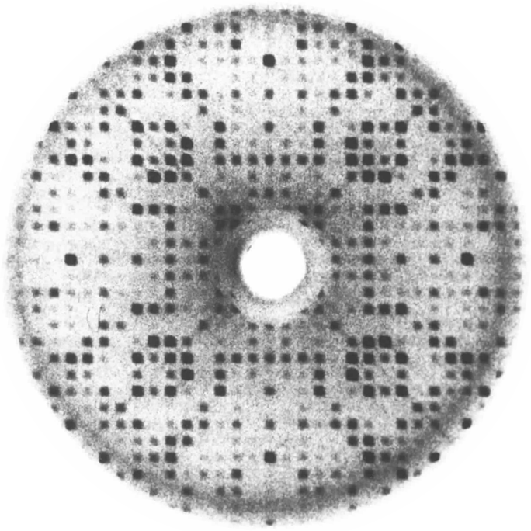
Index the reflection circled in cyan.
What pieces of information are required to index this reflection?
1) Define lattice points
2) Define a*,b*, c* direction & length
3) Locate origin.

Slide 11
Mark lattice points with red circles.
Note the spacing between reflections is periodic.
Draw evenly spaced lines through the spots to define the spacings a* & b*

Slide 12
Draw evenly spaced lines thru spots
Lines must intercept every spot on film.
Choose widest possible spacing that accounts for all spots.

Slide 13
Draw evenly spaced lines thru spots
A wider reciprocal spacing gives smaller (better) real cell spacing.
Draw another set of evenly spaced lines at 90° or 120°, if possible.

Slide 14
This 2D net represents one plane of the reciprocal lattice

Slide 15
Weak reflections not detected previously can be predicted at lattice points. Note: we didn’t need to identify the position of every spot to get the lattice.

Slide 16
Locate origin of reciprocal lattice
Origin is located where direct x-ray beam intercepts image. To see it, briefly remove beam-stop.

Slide 17
Origin is defined. Now, label a* & b*
b*
What is the index of the spot?
b*
a*
a*

Slide 18
Reflection h,k,l is 3,8,0
3rd column on the right side of the origin.
8th row above the origin
b*
b*
b*
b*
b*
b*
b*
b*
b*
a*
a*
a*
a*

Slide 19
Which Bravais Lattice fits this pattern?
a* and b* have the same length.
They are perpendicular to each other.
b*
b*
a*
a*

Slide 20
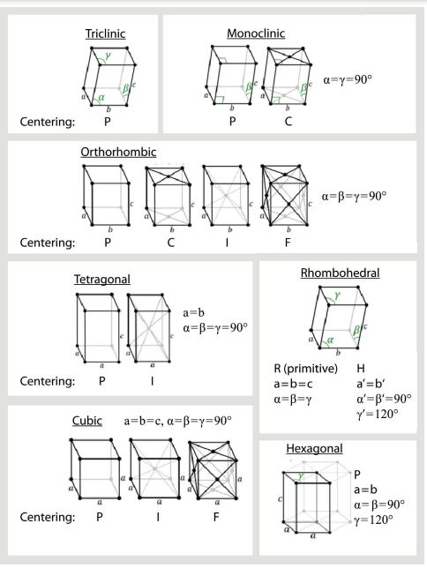
Which Bravais Lattice fits this pattern?
a=b and γ=90°

Slide 21
Next, index spots on an oscillation image.
This is easy!
But, what about this?

Slide 22
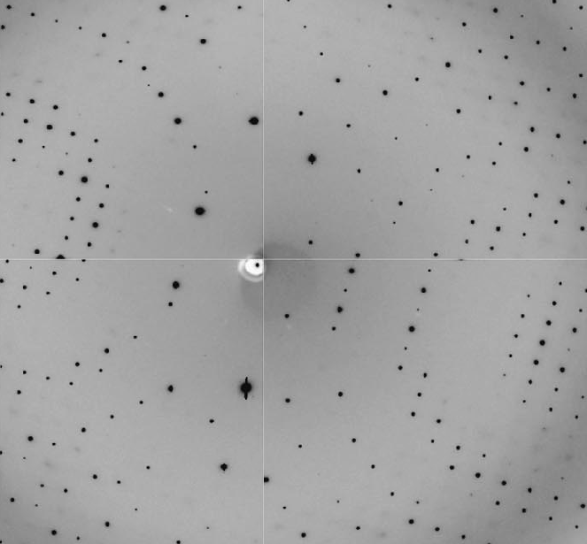
Challenges in indexing an oscillation image
Orientation of reciprocal cell vectors a*, b*, c* are not aligned with film edges— the orientation of the crystal in the loop is arbitrary.
Can’t see symmetry in the pattern..
Multiple planes of the reciprocal lattice are in view, not just a single plane.
The oscillation image is a 2D projections of a 3D lattice—a dimension of depth is lost.
Oscillation image.

Slide 23
2D diffraction image is a projection from a 3D reciprocal lattice.
a*
b*
c*
detector
In an undistorted view of the reciprocal lattice, recorded reflections would reside on the surface of a sphere, not a plane.

Slide 24
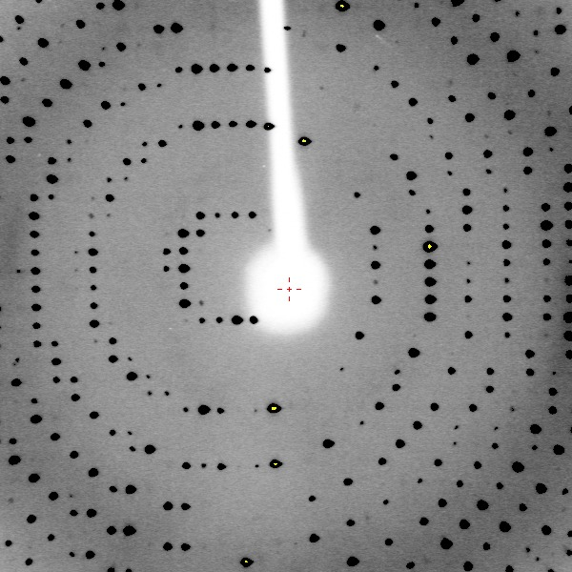
A distortion-corrected representation of the reflections a single image reveals all 6 unit cell parameters

Slide 25
Restored depth of the diffraction pattern is evident from an orthogonal view

Slide 26
Need a program that can automatically identify spot positions, interpret crystal orientation, and unit cell dimensions.

Slide 27
Automatic indexing algorithm explained
Kabsch, W. (1988a) Automatic Indexing of Rotation Diffraction Patterns. J. Appl. Cryst. 21, 67–72.

Slide 28
Locate spot positions with COLSPOT
XDS.INP file specifies automatic indexing instructions
!====================== JOB CONTROL PARAMETERS ===============================
JOB= ALL !XYCORR INIT COLSPOT IDXREF DEFPIX INTEGRATE CORRECT
!====================== GEOMETRICAL PARAMETERS ===============================
ORGX=1506.23 ORGY=1503.91 !Detector origin (pixels). Calibrated by DC 03/01/2019
DETECTOR_DISTANCE=-74 !(mm)
ROTATION_AXIS= 0.0 1.0 0.0
OSCILLATION_RANGE=0.5 !degrees (>0)
X-RAY_WAVELENGTH=1.5418 !Angstrom
INCLUDE_RESOLUTION_RANGE=100.0 1.4
!==================== SELECTION OF DATA IMAGES ==============================
NAME_TEMPLATE_OF_DATA_FRAMES=i/prok_gd_angela????.osc DIRECT RAXIS
DATA_RANGE= 1 720 !First and last diffraction images collected
BACKGROUND_RANGE=1 4 !First and last data image for background
SPOT_RANGE= 1 10 !First and last data image number for finding spots
SPOT_RANGE= 171 180 !First and last data image number for finding spots
!============================================================================

Slide 29
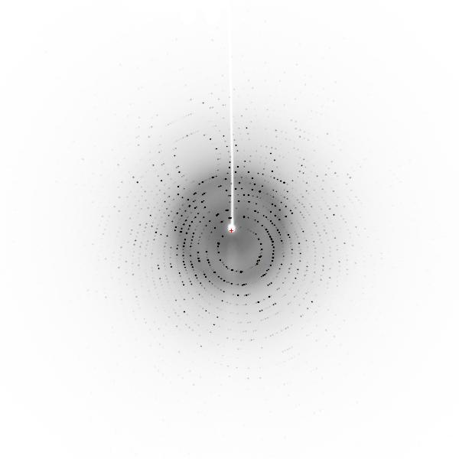
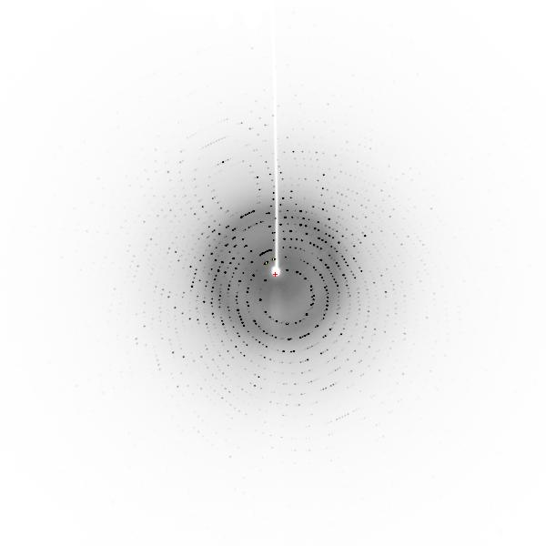
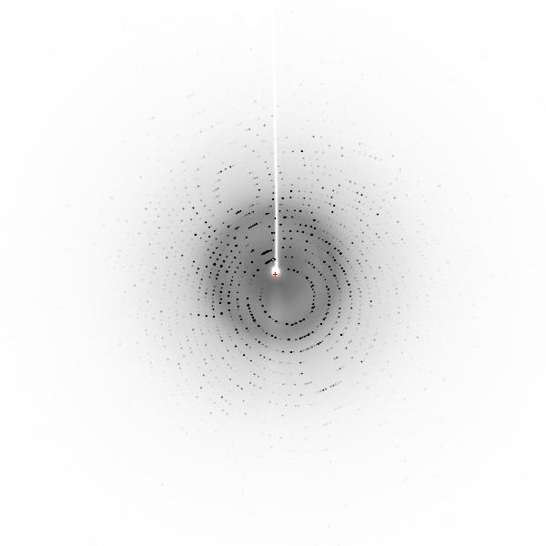
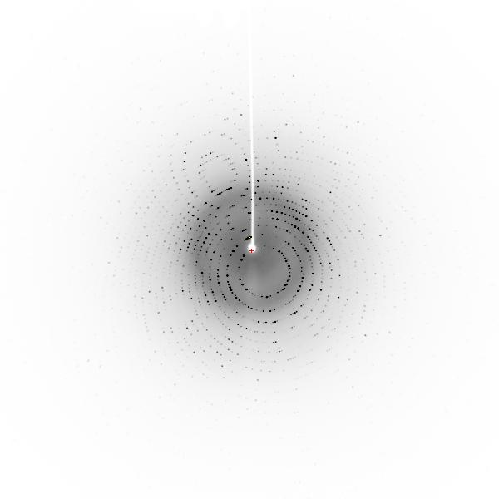
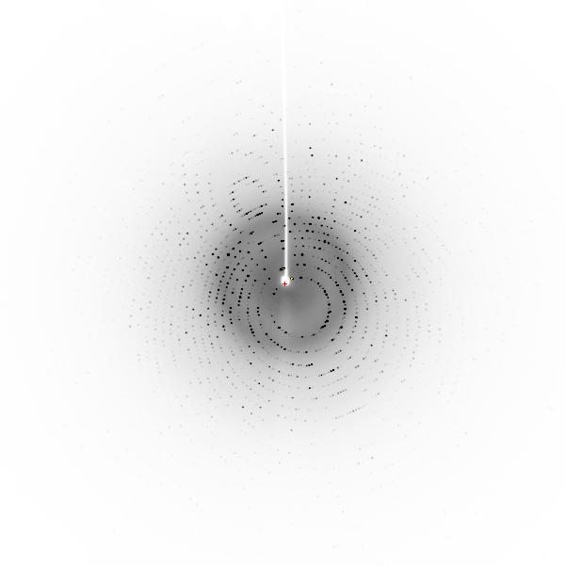
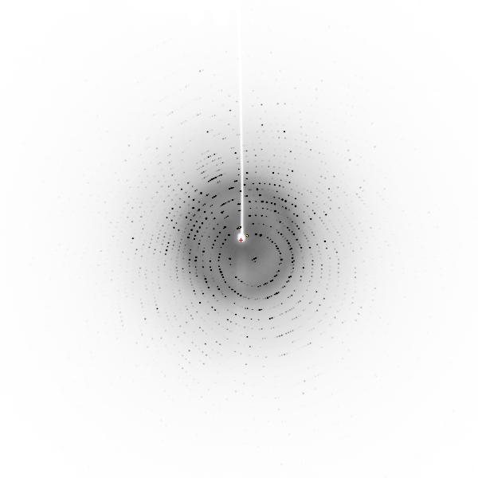
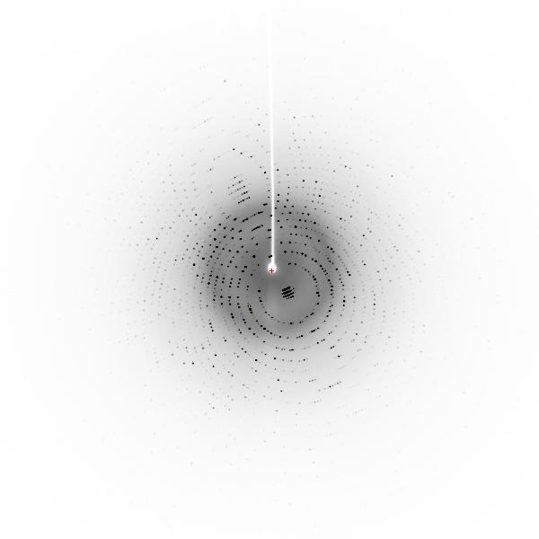
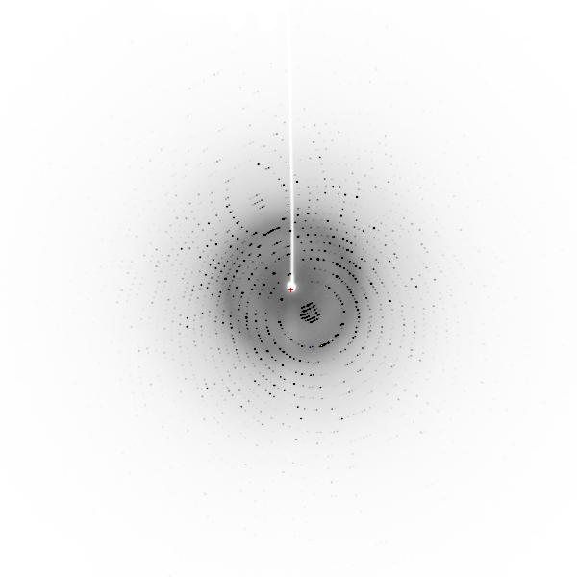
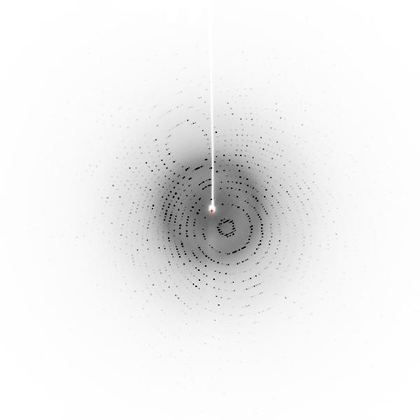
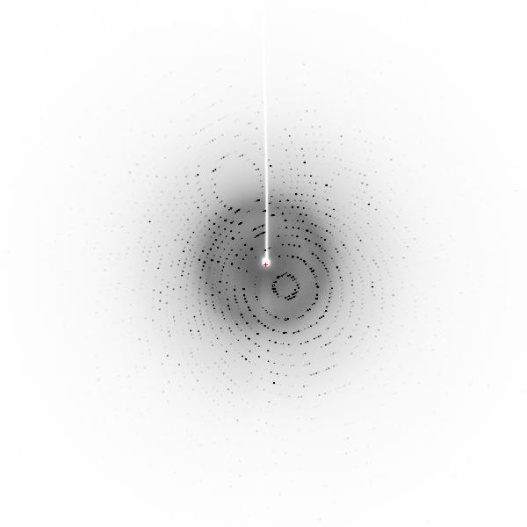
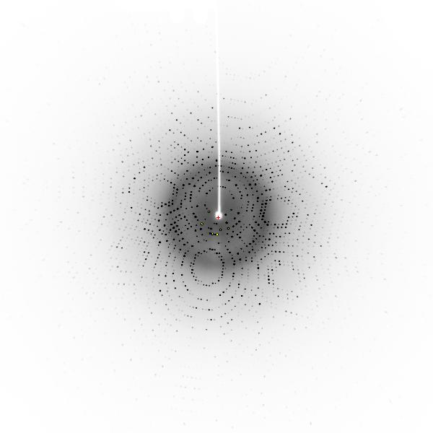
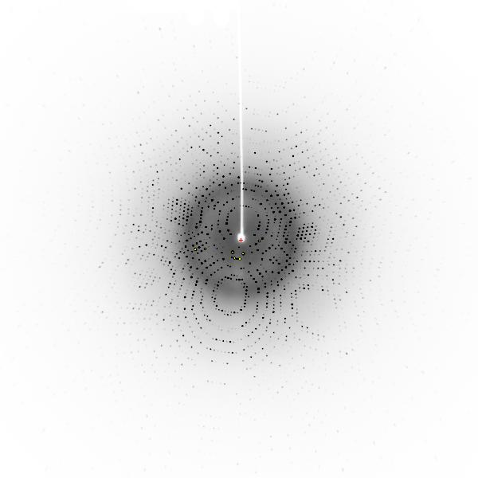
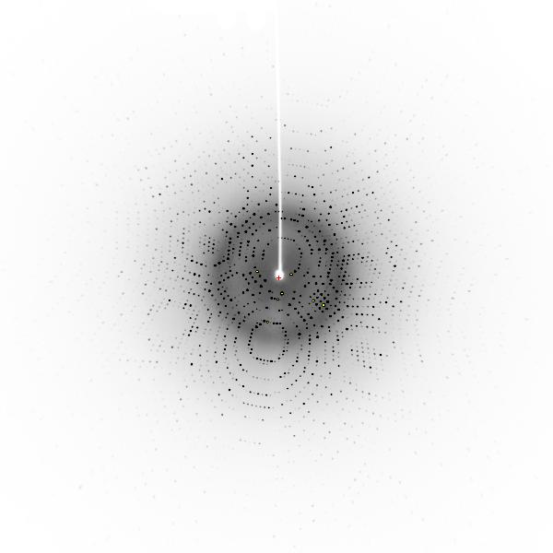
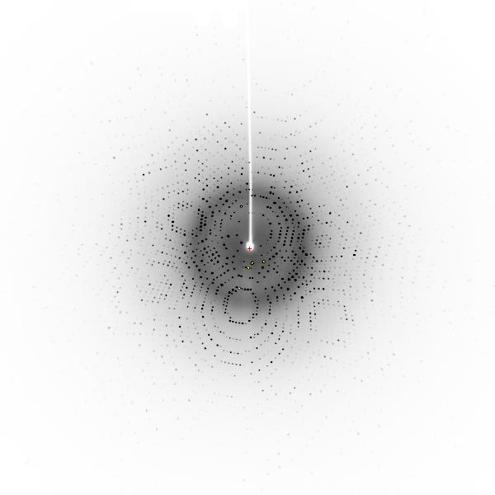
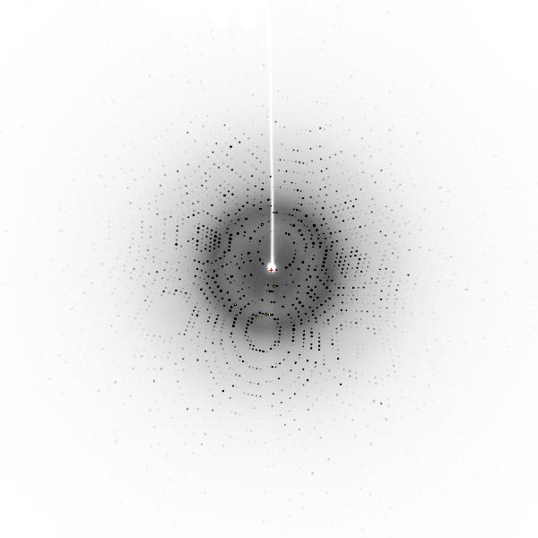
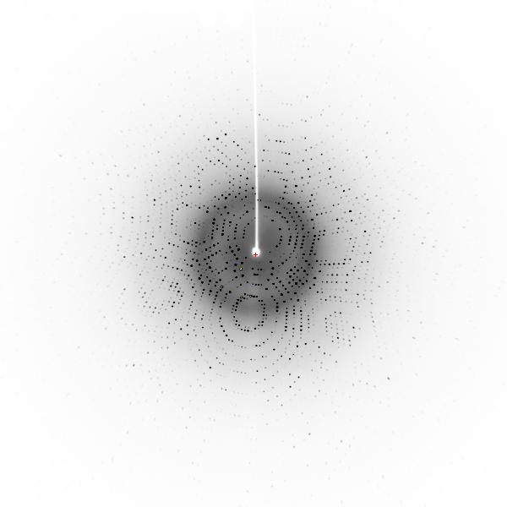
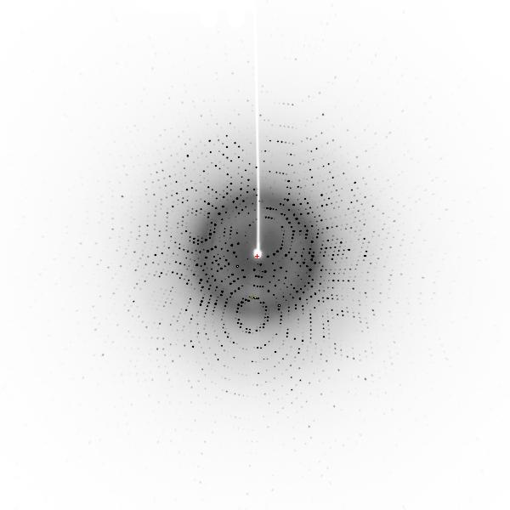
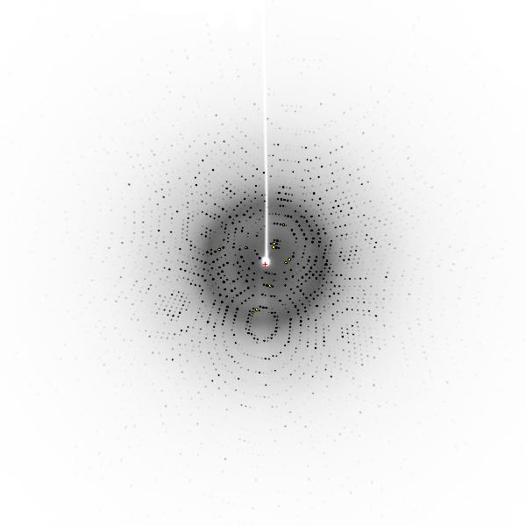
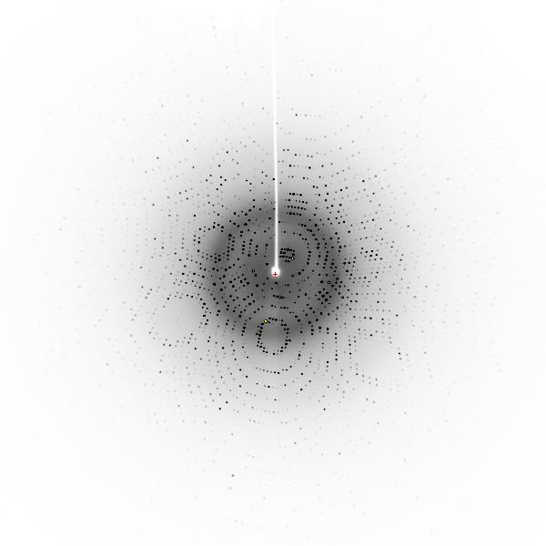
001 002 003 004 005
006 007 008 009 010
171 172 173 174 175
176 177 178 179 180

Slide 30
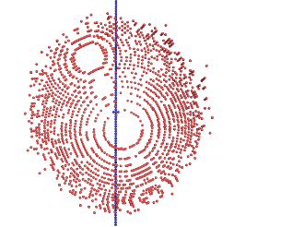
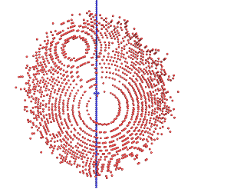
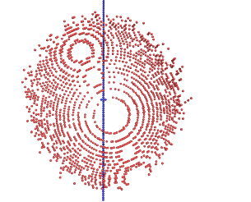
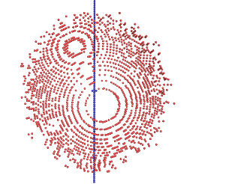
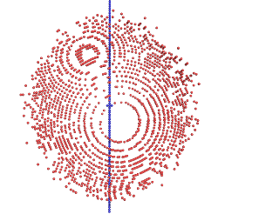
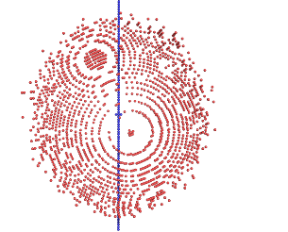
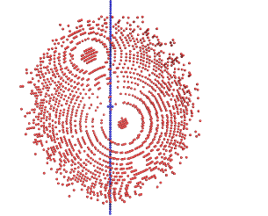
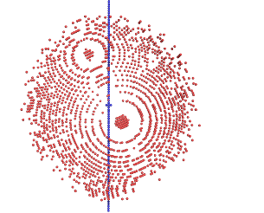
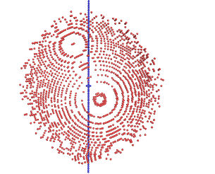
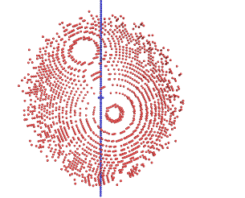
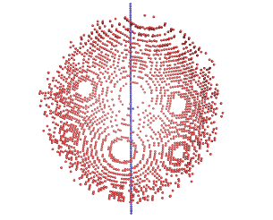
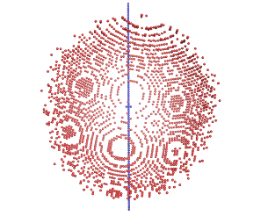
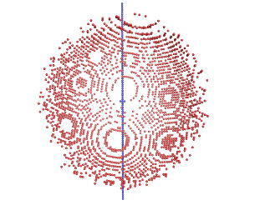
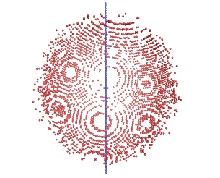
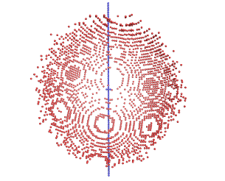
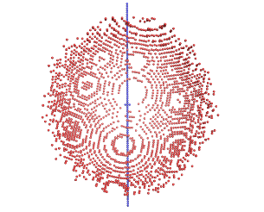
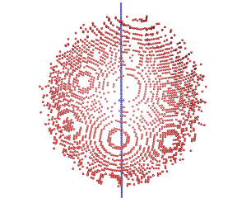
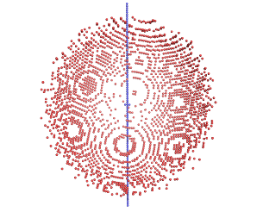
001 002 003 004 005
006 007 008 009 010
171 172 173 174 175
176 177 178 179 180

Slide 31
001 002 003 004 005
006 007 008 009 010
171 172 173 174 175
176 177 178 179 180

Slide 32
SPOT.XDS
Spot position intens-
X Y phi ity
1504.01 1378.41 173.66 4537.
1526.45 1409.21 172.51 4485.
1499.41 1575.97 3.49 4395.
1499.77 1247.89 175.02 4004.
1482.28 1251.21 175.64 3430.
1460.42 1235.69 178.37 3111.
1515.65 1235.92 4.29 2099.
1516.82 1246.26 175.68 2043.
1494.83 1721.10 5.95 2002.
1460.63 1751.46 173.68 1935.
1496.21 1889.74 173.68 1869.
1536.70 1371.16 178.43 1775.
1509.20 1578.62 5.50 1705.
1520.18 1374.85 177.59 1695.
1480.15 1261.73 3.54 1664.
1471.50 1863.84 7.45 1649.
1470.76 1382.48 171.31 1644.
1500.62 1680.58 6.31 1643.
1563.73 1808.92 2.41 1613.
1460.22 1420.42 171.54 1604.
1472.21 1173.36 7.24 1589.
1510.04 1148.16 5.10 1539.
1448.42 1257.31 173.54 1534.
1511.90 1318.37 173.95 1452.
1560.73 1612.72 178.46 1448.
1532.31 1222.84 173.71 1417.
1491.13 1159.51 6.08 1363.
1551.09 1095.47 176.33 1360.
1574.56 1223.31 1.50 1278.
1510.01 1802.89 5.71 1266.
1548.82 1523.06 5.03 1213.
1426.96 1242.19 174.81 1210.
NUMBER OF DIFFRACTION SPOTS LOCATED 25118
IGNORED BECAUSE OF SPOT CLOSE TO UNTRUSTED REGION 13
WEAK SPOTS OMITTED 22
NUMBER OF DIFFRACTION SPOTS ACCEPTED 25083

Slide 33
Reciprocal Lattice 3D reconstruction using images 1-10 & 171-180
25083 spots
Spindle axis
Spindle axis
001
001, 002
001, 002, 003
001, 002, 003, 004
001, 002, 003, 004, 005
001, 002, 003, 004, 005, 006
001, 002, 003, 004, 005, 006, 007
001, 002, 003, 004, 005, 006, 007, 008
001, 002, 003, 004, 005, 006, 007, 008, 009
001, 002, 003, 004, 005, 006, 007, 008, 009, 010
001, 002, 003, 004, 005, 006, 007, 008, 009, 010
171
001, 002, 003, 004, 005, 006, 007, 008, 009, 010
171, 172
001, 002, 003, 004, 005, 006, 007, 008, 009, 010
171, 172, 173
001, 002, 003, 004, 005, 006, 007, 008, 009, 010
171, 172, 173, 174
001, 002, 003, 004, 005, 006, 007, 008, 009, 010
171, 172, 173, 174, 175,
001, 002, 003, 004, 005, 006, 007, 008, 009, 010
171, 172, 173, 174, 175, 176
001, 002, 003, 004, 005, 006, 007, 008, 009, 010
171, 172, 173, 174, 175, 176, 177
001, 002, 003, 004, 005, 006, 007, 008, 009, 010
171, 172, 173, 174, 175, 176, 177, 178
001, 002, 003, 004, 005, 006, 007, 008, 009, 010
171, 172, 173, 174, 175, 176, 177, 178, 179
001, 002, 003, 004, 005, 006, 007, 008, 009, 010
171, 172, 173, 174, 175, 176, 177, 178, 179, 180
001
001, 002
001, 002, 003
001, 002, 003, 004
001, 002, 003, 004, 005
001, 002, 003, 004, 005, 006
001, 002, 003, 004, 005, 006, 007
001, 002, 003, 004, 005, 006, 007, 008
001, 002, 003, 004, 005, 006, 007, 008, 009
001, 002, 003, 004, 005, 006, 007, 008, 009, 010
001, 002, 003, 004, 005, 006, 007, 008, 009, 010
171
001, 002, 003, 004, 005, 006, 007, 008, 009, 010
171, 172
001, 002, 003, 004, 005, 006, 007, 008, 009, 010
171, 172, 173, 174
001, 002, 003, 004, 005, 006, 007, 008, 009, 010
171, 172, 173, 174, 175,
001, 002, 003, 004, 005, 006, 007, 008, 009, 010
171, 172, 173, 174, 175, 176
001, 002, 003, 004, 005, 006, 007, 008, 009, 010
171, 172, 173, 174, 175, 176, 177
001, 002, 003, 004, 005, 006, 007, 008, 009, 010
171, 172, 173, 174, 175, 176, 177, 178
001, 002, 003, 004, 005, 006, 007, 008, 009, 010
171, 172, 173, 174, 175, 176, 177, 178, 179
001, 002, 003, 004, 005, 006, 007, 008, 009, 010
171, 172, 173, 174, 175, 176, 177, 178, 179, 180
001, 002, 003, 004, 005, 006, 007, 008, 009, 010
171, 172, 173

Slide 34
Draw vectors between reciprocal lattice points. For simplicity, only points from image 8 are shown.

Slide 35
Vectors of same length & direction are grouped together
65 vectors like this:

Slide 36
Vectors of same length & direction are grouped together
53 vectors like this:

Slide 37
Algorithm for best choice of a*, b*, c*
Difference vector clusters are accumulated in a 3D histogram. These vectors represent all candidate reciprocal lattice vectors. For example:
Choose the shortest three linear independent real-space lattice vectors forming a right-handed set.
# COORDINATES OF VECTOR CLUSTER FREQUENCY CLUSTER INDICES
1 -0.0026247 0.0170582-0.0027500 2025. 0.99 -0.00 -0.99
2 -0.0060520-0.0130311 0.0026847 1878. -1.00 0.00 0.01
3 -0.0086356 0.0040538-0.0000834 1832. -0.00 -0.00 -0.99
4 -0.0034720-0.0301176 0.0054258 1536. -1.99 0.00 1.00
5 -0.0052358 0.0342473-0.0054914 1414. 2.00 -0.00 -1.99
6 -0.0015319 0.0195839 0.0114708 1380. 1.00 0.99 -1.00
7 0.0045649 0.0325816 0.0088457 1372. 2.00 1.00 -1.00
. . . . . . . .
60 0.0044282-0.0816564 0.0136375 685. -5.00 -0.00 4.00

Slide 38
Choose the lattice of highest symmetry and quality of fit<10
LATTICE- BRAVAIS- QUALITY UNIT CELL CONSTANTS (ANGSTROEM & DEGREES)
CHARACTER LATTICE OF FIT a b c alpha beta gamma
* 44 aP 0.0 68.2 68.4 102.9 90.1 90.2 90.1
* 31 aP 0.7 68.2 68.4 102.9 90.1 89.8 89.9
* 33 mP 1.4 68.2 68.4 102.9 90.1 90.2 90.1
* 34 mP 3.2 68.2 102.9 68.4 90.1 90.1 90.2
* 35 mP 3.3 68.4 68.2 102.9 90.2 90.1 90.1
* 32 oP 3.9 68.2 68.4 102.9 90.1 90.2 90.1
* 14 mC 5.5 96.5 96.7 102.9 89.9 90.2 89.8
* 10 mC 6.3 96.5 96.7 102.9 90.1 90.2 90.2
* 13 oC 6.9 96.5 96.7 102.9 89.9 90.2 89.8
* 11 tP 7.6 68.2 68.4 102.9 90.1 90.2 90.1
37 mC 248.2 216.5 68.2 68.4 90.1 90.1 71.8
36 oC 248.9 68.2 216.5 68.4 89.9 90.1 108.2
28 mC 249.2 68.2 216.5 68.4 90.1 90.1 71.8
39 mC 251.8 152.8 68.2 102.9 90.2 90.1 63.6
29 mC 251.8 68.2 152.8 102.9 90.1 90.2 63.6
41 mC 251.9 216.8 68.4 68.2 90.1 90.2 71.6
38 oC 252.4 68.2 152.8 102.9 89.9 90.2 116.4
40 oC 252.6 68.2 216.5 68.4 89.9 90.1 108.2
30 mC 252.9 68.2 216.5 68.4 90.1 90.1 71.8
12 hP 256.1 68.2 68.4 102.9 90.1 90.2 90.1

Slide 39
Choose the lattice of highest symmetry and quality of fit<10
LATTICE- BRAVAIS- QUALITY UNIT CELL CONSTANTS (ANGSTROEM & DEGREES)
CHARACTER LATTICE OF FIT a b c alpha beta gamma
* 44 aP 0.0 68.2 68.4 102.9 90.1 90.2 90.1
* 31 aP 0.7 68.2 68.4 102.9 90.1 89.8 89.9
* 33 mP 1.4 68.2 68.4 102.9 90.1 90.2 90.1
* 34 mP 3.2 68.2 102.9 68.4 90.1 90.1 90.2
* 35 mP 3.3 68.4 68.2 102.9 90.2 90.1 90.1
* 32 oP 3.9 68.2 68.4 102.9 90.1 90.2 90.1
* 14 mC 5.5 96.5 96.7 102.9 89.9 90.2 89.8
* 10 mC 6.3 96.5 96.7 102.9 90.1 90.2 90.2
* 13 oC 6.9 96.5 96.7 102.9 89.9 90.2 89.8
* 11 tP 7.6 68.2 68.4 102.9 90.1 90.2 90.1
37 mC 248.2 216.5 68.2 68.4 90.1 90.1 71.8
36 oC 248.9 68.2 216.5 68.4 89.9 90.1 108.2
28 mC 249.2 68.2 216.5 68.4 90.1 90.1 71.8
39 mC 251.8 152.8 68.2 102.9 90.2 90.1 63.6
29 mC 251.8 68.2 152.8 102.9 90.1 90.2 63.6
41 mC 251.9 216.8 68.4 68.2 90.1 90.2 71.6
38 oC 252.4 68.2 152.8 102.9 89.9 90.2 116.4
40 oC 252.6 68.2 216.5 68.4 89.9 90.1 108.2
30 mC 252.9 68.2 216.5 68.4 90.1 90.1 71.8
12 hP 256.1 68.2 68.4 102.9 90.1 90.2 90.1
aP
mP
mC
oP
oC
oI
oF
hR
tP
tI
hP
cP
cI
cF

Slide 40
***** INDEXING OF OBSERVED SPOTS IN SPACE GROUP # 1 *****
17548 OUT OF 25072 SPOTS INDEXED. (about 70%)
LATTICE- BRAVAIS- QUALITY UNIT CELL CONSTANTS (ANGSTROEM & DEGREES)
CHARACTER LATTICE OF FIT a b c alpha beta gamma
* 44 aP 0.0 68.2 68.4 102.9 90.1 90.2 90.1
* 31 aP 0.7 68.2 68.4 102.9 90.1 89.8 89.9
* 33 mP 1.4 68.2 68.4 102.9 90.1 90.2 90.1
* 34 mP 3.2 68.2 102.9 68.4 90.1 90.1 90.2
* 35 mP 3.3 68.4 68.2 102.9 90.2 90.1 90.1
* 32 oP 3.9 68.2 68.4 102.9 90.1 90.2 90.1
* 14 mC 5.5 96.5 96.7 102.9 89.9 90.2 89.8
* 10 mC 6.3 96.5 96.7 102.9 90.1 90.2 90.2
* 13 oC 6.9 96.5 96.7 102.9 89.9 90.2 89.8
* 11 tP 7.6 68.2 68.4 102.9 90.1 90.2 90.1
37 mC 248.2 216.5 68.2 68.4 90.1 90.1 71.8
36 oC 248.9 68.2 216.5 68.4 89.9 90.1 108.2
28 mC 249.2 68.2 216.5 68.4 90.1 90.1 71.8
39 mC 251.8 152.8 68.2 102.9 90.2 90.1 63.6
29 mC 251.8 68.2 152.8 102.9 90.1 90.2 63.6
41 mC 251.9 216.8 68.4 68.2 90.1 90.2 71.6
38 oC 252.4 68.2 152.8 102.9 89.9 90.2 116.4
40 oC 252.6 68.2 216.5 68.4 89.9 90.1 108.2
30 mC 252.9 68.2 216.5 68.4 90.1 90.1 71.8
12 hP 256.1 68.2 68.4 102.9 90.1 90.2 90.1
tP
tI

Slide 41
Integration for image 004
001 002 003 004 005 006 007 008 009 010
001 002 003 004 005 006 007 008 009 010
1) Draw boundaries of each reflection
2) Sum the intensities recorded on each pixel within boundary.
3) Repeat for each spot on each image.

Slide 42
Integration for first 10 images
001 002 003 004 005 006 007 008 009 010
001 002 003 004 005 006 007 008 009 010
001 002 003 004 005 006 007 008 009 010
001 002 003 004 005 006 007 008 009 010
001 002 003 004 005 006 007 008 009 010
001 002 003 004 005 006 007 008 009 010
001 002 003 004 005 006 007 008 009 010
001 002 003 004 005 006 007 008 009 010
001 002 003 004 005 006 007 008 009 010
001 002 003 004 005 006 007 008 009 010
001 002 003 004 005 006 007 008 009 010
001 002 003 004 005 006 007 008 009 010
001 002 003 004 005 006 007 008 009 010
001 002 003 004 005 006 007 008 009 010
001 002 003 004 005 006 007 008 009 010
001 002 003 004 005 006 007 008 009 010
001 002 003 004 005 006 007 008 009 010
001 002 003 004 005 006 007 008 009 010
001 002 003 004 005 006 007 008 009 010
001 002 003 004 005 006 007 008 009 010
1) Draw boundaries of each reflection
2) Sum the intensities recorded on each pixel within boundary.
3) Repeat for each spot on each image.

Slide 43
Output integrated intensities
INTEGRATE.HKL file has 1,238,805 lines from this 1.4 Å data set ProK
!UNIT_CELL_CONSTANTS= 67.918 67.918 102.177 90.000 90.000 90.000
! H, K, L, IOBS, SIGMA, XCAL, YCAL, ZCAL, RLP, PEAK,CORR,MAXC,XOBS, YOBS, ZOBS, ALF0,BET0,ALF1,BET1,PSI,ISEG
-47 -11 -7 2.545E+02 2.788E+02 2995.1 2344.0 604.8 1.38699 77.12746 4 33 2978.5 2336.6 605.0 45.91 0.07 -29.44 66.81 -118.54 1
-47 -11 -6 1.002E+03 3.147E+02 22.1 2318.8 94.9 1.39114 78.49145 10 32 29.5 2311.6 95.0 31.25 0.09 -151.27 66.62 95.30 1
-47 -11 -6 1.366E+02 2.771E+02 2994.8 2329.0 603.0 1.39049 79.95720 4 29 2987.3 2329.6 603.1 45.91 0.07 -29.01 66.72 -118.77 1
-47 -11 -5 1.872E+03 3.339E+02 21.5 2304.4 93.7 1.39492 92.47218 23 35 25.3 2304.5 93.7 31.25 0.09 -151.71 66.54 94.48 1
-47 -11 -5 1.204E+03 2.971E+02 2995.5 2314.6 601.1 1.39429 78.44115 15 30 2986.6 2311.4 601.0 45.91 0.07 -28.57 66.64 -118.99 1
-47 -11 -4 6.058E+02 3.242E+02 20.0 2290.6 92.4 1.39900 96.87422 12 77 27.5 2290.6 92.4 31.25 0.09 -152.15 66.47 93.68 1
-47 -11 -4 4.104E+02 2.919E+02 2992.3 2298.0 599.2 1.39845 80.31631 6 31 2982.4 2288.8 598.7 111.48 0.07 -28.13 66.51 -119.18 1
-47 -11 -3 2.735E+03 3.281E+02 17.5 2277.3 91.2 1.40337 95.48840 30 34 19.2 2279.0 91.4 31.25 0.09 -152.59 66.42 92.90 1
-47 -11 -3 9.144E+02 3.109E+02 2994.8 2284.8 597.4 1.40283 75.93009 17 32 2983.7 2282.7 597.4 111.48 0.07 -27.69 66.46 -119.37 1
-47 -11 -2 3.644E+02 2.749E+02 14.1 2264.4 89.9 1.40808 92.92796 6 35 19.6 2264.0 89.8 31.81 0.09 -153.04 66.39 92.13 1 -47 -11 .-47 -11 -1 1.441E+03 2.964E+02 9.7 2252.0 88.6 1.41308 87.63616 23 33 14.4 2252.3 88.7 32.14 0.09 -153.48 66.36 91.39 1
-47 -11 0 3.293E+02 2.450E+02 4.4 2240.0 87.3 1.41836 80.78474 7 31 12.0 2236.6 87.0 32.14 0.09 -153.93 66.36 90.67 1
-47 -10 -9 1.047E+03 3.427E+02 22.3 2316.5 100.7 1.39148 81.59772 16 32 23.3 2318.8 100.7 27.88 0.08 -151.33 66.60 97.62 1
-47 -10 -9 1.153E+02 2.993E+02 2994.5 2326.5 608.7 1.39095 80.67455 4 31 2987.2 2325.2 608.4 45.91 0.07 -28.94 66.70 -116.36 1
-47 -10 -8 4.724E+03 3.767E+02 25.0 2300.6 99.5 1.39410 96.97063 44 49 24.9 2301.0 99.2 31.13 0.08 -151.77 66.48 96.75 1
-47 -10 -8 2.220E+03 3.363E+02 2992.0 2310.8 606.8 1.39349 84.59594 24 33 2988.1 2309.9 606.5 45.91 0.07 -28.51 66.58 -116.63 1
-47 -10 -7 6.914E+03 3.802E+02 26.6 2285.5 98.3 1.39692 99.42799 57 56 29.5 2287.8 98.5 31.25 0.09 -152.20 66.37 95.90 1
-47 -10 -7 3.098E+03 3.250E+02 2990.5 2295.6 604.9 1.39632 86.71242 35 35 2985.3 2294.3 604.7 45.91 0.07 -28.08 66.47 -116.87 1
-47 -10 -6 1.589E+03 2.980E+02 27.3 2271.0 97.1 1.40004 99.54026 16 32 29.5 2272.9 97.1 31.25 0.09 -152.63 66.28 95.07 1
-47 -10 -6 9.778E+02 3.015E+02 2989.9 2281.0 603.0 1.39944 87.42934 11 33 2984.9 2278.8 602.7 45.91 0.07 -27.65 66.38 -117.11 1
-47 -10 -5 1.086E+03 3.186E+02 27.1 2257.0 95.8 1.40345 99.49097 13 33 23.1 2258.3 95.7 31.25 0.09 -153.06 66.20 94.25 1
-47 -10 -5 7.046E+02 3.209E+02 2990.2 2267.0 601.2 1.40285 86.86985 8 33 2986.2 2270.9 601.7 45.91 0.07 -27.22 66.30 -117.33 1
-47 -10 -4 5.056E+03 3.658E+02 25.9 2243.5 94.6 1.40716 99.29475 48 45 27.0 2247.1 94.5 31.25 0.09 -153.50 66.14 93.46 1
-47 -10 -4 2.003E+03 3.387E+02 2986.7 2250.9 599.3 1.40664 89.14124 26 34 2985.0 2252.7 599.2 111.36 0.07 -26.79 66.17 -117.53 1
-47 -10 -3 8.050E+02 3.299E+02 23.8 2230.4 93.3 1.41117 98.79202 16 44 24.0 2225.9 92.9 31.25 0.09 -153.93 66.09 92.69 1
-47 -10 -3 7.560E+02 3.407E+02 2988.8 2237.9 597.5 1.41066 86.07878 7 31 2984.3 2240.7 597.5 111.48 0.07 -26.35 66.12 -117.73 1
-47 -10 -2 3.435E+03 3.298E+02 20.8 2217.9 92.0 1.41550 97.47218 30 44 23.3 2220.1 92.1 31.25 0.09 -154.37 66.05 91.93 1
-47 -10 -2 1.502E+03 3.296E+02 2991.9 2225.3 595.7 1.41499 81.04167 19 38 2987.7 2223.9 595.6 111.48 0.07 -25.91 66.08 -117.92 1
-47 -10 -1 1.185E+03 3.234E+02 16.8 2205.7 90.7 1.42013 94.89558 14 34 23.3 2203.6 91.0 31.25 0.09 -154.81 66.03 91.20 1
-47 -10 0 4.880E+02 3.137E+02 11.8 2193.8 89.4 1.42512 90.43126 12 35 17.5 2193.4 89.6 32.13 0.09 -155.26 66.02 90.47 1
-47 -10 1 7.198E+02 2.775E+02 6.1 2182.4 88.1 1.43037 82.80218 15 34 14.4 2180.9 88.0 32.14 0.09 -155.70 66.03 89.77 1
-47 -9 -11 1.625E+04 5.170E+02 16.5 2302.1 105.2 1.39783 89.53320 83 75 18.8 2303.5 105.5 27.87 0.08 -151.85 66.58 99.11 1
-47 -9 -10 3.139E+03 3.181E+02 21.4 2285.6 104.0 1.39940 97.73439 28 45 23.9 2286.7 104.1 27.87 0.08 -152.27 66.43 98.22 1
-47 -9 -10 1.502E+03 2.902E+02 2994.5 2294.9 610.6 1.39895 79.06115 25 34 2985.4 2292.3 610.5 56.07 0.07 -27.99 66.52 -114.47 1
-47 -9 -9 1.269E+03 3.169E+02 25.2 2269.7 102.8 1.40127 99.12431 15 33 24.9 2272.3 102.7 27.87 0.08 -152.69 66.30 97.34 1
-47 -9 -9 3.660E+02 3.163E+02 2991.9 2279.6 608.7 1.40076 84.73209 6 31 2980.7 2278.0 608.8 45.91 0.07 -27.58 66.40 -114.75 1
-47 -9 -8 3.405E+02 2.993E+02 28.1 2254.4 101.6 1.40342 99.61732 5 36 33.8 2251.4 101.8 27.87 0.08 -153.12 66.17 96.49 1
-47 -9 -8 5.246E+02 3.242E+02 2989.1 2264.3 606.9 1.40292 88.66219 7 31 2979.4 2256.8 606.8 45.91 0.07 -27.15 66.27 -115.01 1

Slide 44
Intensity weighted reciprocal lattice, sectioned along c*, cutoff at 8 Å resolution for clarity
L=-8
L=-7
L=-6
L=-10
L=-9
L=-12
L=-11
L=-5
L=-4
L=-3
L=-2
L=-1
L=-0
L=+1
L=+2
L=+3
L=+4
L=+5
L=+6
L=+7
L=+8
L=+9
L=+10
L=+11
L=+12

Slide 45
Intensity weighted reciprocal lattice, sectioned along c*, cutoff at 8 Å resolution for clarity
L=+1
L=+2
L=-1
L=-0
L=+3
L=-2
L=+4
L=-3
L=+5
L=-5
L=-4
L=+6
L=-6
L=-7
L=+7
L=-8
L=+8
L=-9
L=+9
L=-10
L=+10
L=-11
L=+11
L=-12
L=+12

Slide 46
Primitive Tetragonal lattices allow point group symmetries 4 or 422. Which fits our diffraction pattern?
System | Bravais lattice | Point group | 65 Chiral Space Groups
Triclinic | P | 1 | P1
Monoclinic | P | 2 | P2 | P2₁
 | C |  | C2
Orthorhombic | P | 222 | P222 | P222₁ | P2₁2₁2 | P2₁2₁2₁
 | C |  | C222₁ | C222
 | F |  | F222
 | I |  | I222 | I2₁2₁2₁
Tetragonal | P | 4 | P4 | P4₁ | P4₂ | P4₃
 | I |  | I4 | I4₁
 | P | 422 | P422 | P42₁2 | P4₁22 | P4₁2₁2 | P4₂22 | P4₂2₁2
 |  |  | P4₃22 | P4₃2₁2
 | I |  | I422 | I4₁22
Trigonal/ Rhombo-hedral | P | 3 | P3 | P31 | P32
 | R |  | R3
 | P | 32 | P312 | P321 | P3₁12 | P3₁21 | P3₂12 | P3₂21
 | R |  | R32
Hexagonal | P | 6 | P6 | P6₁ | P6₂ | P6₃ | P6₄ | P6₅
 |  | 622 | P622 | P6₁22 | P6₂22 | P6₃22 | P6₄22 | P6₅22
Cubic | P | 23 | P23 | P2₁3
 | F |  | F23
 | I |  | I23 | I2₁3
 | P | 432 | P432 | P4₂32 | P4₃32 | P4₁32
 | F |  | F432 | F4₁32
 | I |  | I432 | I4₁32
4
422

Slide 47
Point group 4
Point group 422
4-fold symmetry
4-fold symmetry &
perpendicular 2-folds
P422
P4
H, K,L
-H,-K,L
-K, H,L
K,-H,L
-H, K,-L
H,-K,-L
K, H,-L
-K,-H,-L

Slide 48
What rotational symmetry do you see?
90° rotational symmetry

Slide 49
2-fold rotation on vertical axis
This rotation axis coincides with a mirror plane.

Slide 50
2-fold axis in the plane appears as a mirror
Mirror-related spots are equidistant from vertical mirror plane

Slide 51
2-fold axis in the plane appears as mirror
Mirror-related spots are equidistant from horizontal mirror plane

Slide 52
How many symmetry copies of this reflection do you see?
What are their indices?
3,8,0

Slide 53
8 symmetry equivalents
b*
What are the symmetry operators that relate these reflections?
3,8,0
a*
Notes:
Here it is easy to guess the symmetry operations. We see the integers 3 and 8 appearing in all the symmetry equivalent h,k,l values, but they differ in +/- sign, and sometimes 3 and 8 swap positions. (i.e. sometimes 3 is the h value, sometimes 3 is the k value. In this case, we get the symmetry operators by replacing all instances of 3 with “h” and all instances of 8 with “k”.

Slide 54
8 symmetry equivalents
b*
What are the symmetry operators that relate these reflections?
-3,8,0
3,8,0
-8, 3,0
8,3,0
a*
-8,-3,0
8,-3,0
-3,-8,0
3,-8,0
Notes:
Here it is easy to guess the symmetry operations. We see the integers 3 and 8 appearing in all the symmetry equivalent h,k,l values, but they differ in +/- sign, and sometimes 3 and 8 swap positions. (i.e. sometimes 3 is the h value, sometimes 3 is the k value. In this case, we get the symmetry operators by replacing all instances of 3 with “h” and all instances of 8 with “k”.

Slide 55
Symmetry operators in reciprocal space
b*
422
h, k,0
-h, k,0
h,-k,0
-h,-k,0
k, h,0
-k, h,0
k,-h,0
-k,-h,0
-h,k,0
h,k,0
-3,8,0
3,8,0
k,h,0
-8, 3,0
8,3,0
-k, h,0
a*
-8,-3,0
-k,-h,0
k,-h,0
8,-3,0
-3,-8,0
3,-8,0
-h,-k,0
h,-k,0
Notes:
Here it is easy to guess the symmetry operations. We see the integers 3 and 8 appearing in all the symmetry equivalent h,k,l values, but they differ in +/- sign, and sometimes 3 and 8 swap positions. (i.e. sometimes 3 is the h value, sometimes 3 is the k value. In this case, we get the symmetry operators by replacing all instances of 3 with “h” and all instances of 8 with “k”.

Slide 56
Benefit of determining the point group symmetry of our data set.
Accuracy of intensity values will improve if we average together the values of symmetry-related reflections (i.e. merging).
But, we must discern the correct rotational symmetry laws that relate lattice points (point group symmetry. It would be convenient to quantify how well the pattern obeys a certain point group symmetry→R_{merge}.

Slide 57
j observations of the reflection 30 22 6
Discrepancy
between symmetry related reflections
j | H | K | L | I
1 | 30 | 22 | 6 | 550
2 | -30 | -22 | 6 | 500
3 | 30 | -22 | -6 | 543
?
H, K, L=
-H,-K, L=
H,-K,-L
R_{merge}= Σ|I_{j}-<I>|
ΣI_{j}
<I>= (550 + 500 + 543) / 3
= 531
Σ|I_{j}-<I>| = |550-531|+|500-531|+|543-531|
= 19 + 31 + 12
= 62
ΣI_{j} = 550 + 500 + 543
= 1593
R_{merge} = 62/1593 = 0.039 = 3.9%

Slide 58
What R_{merge} is expected for these 2 data sets if we assume P4 symmetry?
Point group 4
Point group 422
R_{merge P4} <20%
R_{merge P4}<20%

Slide 59
What R_{merge} is expected for these 2 data sets if we assume 422 symmetry?
Point group 4
Point group 422
R_{merge P422} >50%
R_{merge P422}<20%

Slide 60
Merge symmetry-related measurements
Plane L=0
b*
Plane L=0
b*
-K,H,L
K, H,-L
-H, K,-L
H,K,L
a*
a*
true?
H, K, L=
-K, H, L=
-H, K, L=
K,-H, L=
K, H,-L=
-H, K,-L=
-K,-H,-L=
H,-K,-L=
Asymmetric unit of reciprocal space.
-H,-K,L
H,-K, -L
-K,-H,-L
K, -H,L
Average together intensity values of reflections related by these reciprocal space symmetry operators.

Slide 61
Statistics are analyzed as a function of resolution (N shells).
Discrepancy between symmetry related reflections (R_{merge} or R_{sym}) increases with higher resolution. Why?
Shell | R_{merge}
100-5.0Å | 0.04
5.0-3.0Å | 0.06
3.0-2.0Å | 0.08
2.0-1.7Å | 0.15
Overall | 0.07

Slide 62
SIGNAL TO NOISE RATIO (I/σ)
Average I/σ decreases with increasing resolution
Conservatives would say high resolution shells with I/σ <2 should be discarded.
Shell | I/σ_{Ι}
100-5.0 Å | 20.0
5.0-3.0 Å | 10.0
3.0-2.0 Å | 7.0
2.0-1.7 Å | 3.0
Overall | 8.2

Slide 63
Correlation Coefficient (CC_{½})
CC_{½} measures the correlation between symmetry-related halves of the unmerged data set.
CC_{½} decreases with increasing resolution.
Diederichs & Karplus say resolution shells with CC _{½} > 0.30 have usable information content.
Shell | CC _{½}
100-5.0 Å | 0.99
5.0-3.0 Å | 0.99
3.0-2.0 Å | 0.97
2.0-1.7 Å | 0.55
Overall | 0.98

Slide 64
COMPLETENESS?
What percentage of reciprocal
Lattice was measured for a given
Resolution limit?
Better than 90% I hope.
Shell | completeness
100-5.0Å | 99.9%
5.0-3.0Å | 95.5%
3.0-2.0Å | 89.0%
2.0-1.7Å | 85.3%
Overall | 92.5%
Missing wedges of data.

Slide 65
Assignment

Slide 66
The End

Slide 67
Each circle corresponds to a different reciprocal lattice plane
Start indexing process using reflections within the same plane and lying near the origin.

Slide 68
What are some reasons why indexing might be inaccurate or unreliable?
Coordinates (X,Y) for the spot position
The wavelength of the incident radiation
Coordinates (X,Y) of the direct beam
The orientation of the unit cell axes with respect to the laboratory axes (φψκ).
Unit cell parameters
a,b,c, α,β,γ

Slide 69
Determine unit cell length “b” Standard detector geometry
2d•sinθ = nλ
2b•sinθ = λ
b = λ/(2•sinθ)
0,-1 reflection
1,0,0
D_{b}*=2.0 mm
crystal
b*
θ
θ
1/λ
X-ray beam
(0,0,0)
origin of reciprocal lattice,
Also known as
x-beam, y-beam
b
D_{CF}=80 mm
tan2θ = D_{b}/D_{CF}
θ = ½•arctan(D_{b}/D_{CF})
b = λ/(2•sin(½•arctan(D_{b}/D_{CF}))
b = 1.54Å /(2•sin(½•arctan(2.0mm/80mm))
b = 61.6 Å
FILM

Slide 70
Systematic Absences
21, 0, 0, -55.6, 37.6, -1.5
22, 0, 0, 767.9, 44.4, 17.3
23, 0, 0, -59.1, 32.5, -1.8
24, 0, 0, 44461.4, 869.0, 51.2
25, 0, 0, 105.9, 38.5, 2.8
26, 0, 0, 1704.0, 68.0, 25.1
27, 0, 0, -11.4, 32.1, -0.4
28, 0, 0, 3235.7, 92.9, 34.8
29, 0, 0, 6.3, 45.5, 0.1
30, 0, 0, 4327.6, 151.7, 28.5
31, 0, 0, -54.7, 39.3, -1.4
32, 0, 0, 1293.9, 52.7, 24.6
33, 0, 0, 36.4, 44.3, 0.8
34, 0, 0, 3211.6, 124.8, 25.7
35, 0, 0, -57.0, 39.2, -1.5
36, 0, 0, 15.1, 38.0, 0.4
37, 0, 0, 8.2, 33.7, 0.2
38, 0, 0, -39.2, 35.6, -1.1
39, 0, 0, 59.1, 38.8, 1.5
40, 0, 0, 2202.7, 68.2, 32.3
41, 0, 0, -5.4, 35.4, -0.2
42, 0, 0, 2128.8, 67.0, 31.8
43, 0, 0, 16.1, 31.0, 0.5
44, 0, 0, 1088.4, 47.0, 23.2
45, 0, 0, 32.0, 29.9, 1.1
46, 0, 0, 341.3, 34.6, 9.9
47, 0, 0, -38.6, 31.0, -1.2
48, 0, 0, 387.8, 60.4, 6.4
============== 0 k 0 reflections ==============
h k l I sigma I/sigma
============== 0 0 l reflections ==============
h k l I sigma I/sigma
0, 0, 2, -8.6, 1.8, -4.8
0, 0, 3, 12.1, 12.8, 0.9
0, 0, 5, 19.4, 12.1, 1.6
0, 0, 6, 43.8, 18.6, 2.4
0, 0, 7, 19.5, 15.5, 1.3
0, 0, 8, 23681.6, 497.1, 47.6
0, 0, 9, 22.1, 21.3, 1.0
0, 0, 10, 66.2, 33.8, 2.0
To reveal the pattern of systematic absences to students in our data processing labs this week, I wrote a script called "absences.com" . (/joule2/programs/lx_bin/absences.com)
Just type "absences.com" followed by the name of the scalepack file, like this:
absences.com prok_pcmbs_jonathan_screen.sca
And the script will display the intensities and I/sigmas for axial reflections. The pattern of absences becomes very clear. For this to work, we must process the data in P422 (not P43212), so both strong and weak reflections are reported:
SAYRE:process_denzo[267] absences.com prok_pcmbs_jonathan_screen.sca
Data_set = prok_pcmbs_jonathan_screen.sca
=============== h 0 0 reflections ==============
h k l I sigma I/sigma
1, 0, 0, -1.6, 0.3, -5.3
3, 0, 0, 67.7, 7.6, 8.9
4, 0, 0, 40995.8, 601.8, 68.1
5, 0, 0, 3.0, 11.8, 0.3
6, 0, 0, 10600.2, 160.8, 65.9
7, 0, 0, 3.3, 16.1, 0.2
8, 0, 0, 3918.5, 65.0, 60.3
9, 0, 0, 17.2, 18.3, 0.9
10, 0, 0, 10876.2, 170.6, 63.8
11, 0, 0, 19.5, 20.0, 1.0
12, 0, 0, 121996.0, 1913.0, 63.8
13, 0, 0, 17.2, 25.3, 0.7
14, 0, 0, 116394.0, 1708.0, 68.1
15, 0, 0, -22.3, 26.2, -0.9
16, 0, 0, 16599.7, 259.0, 64.1
17, 0, 0, -75.9, 34.3, -2.2
18, 0, 0, 108.0, 33.6, 3.2
19, 0, 0, 30.7, 31.0, 1.0
20, 0, 0, 2312.2, 59.0, 39.2

Slide 73
Diffracted intensities arise as if reflecting from families of planes --William Bragg.
(0,1) planes
Xrays
Crystal
Detector
(1,1) planes
(2,1) planes
(3,1) planes
b
(0,2) planes
a
(1,2) planes
(2,2) planes
(3,2) planes

Slide 74
What are the chances of observing reflections from all these planes in a single orientation?
Excellent
Zero
(0,1) planes
Xrays
Crystal
Detector
(1,1) planes
(2,1) planes
(3,1) planes
b
(0,2) planes
a
(1,2) planes
(2,2) planes
(3,2) planes

Slide 75
The planes must be oriented w.r.t the X-ray beam such that the difference in path length of each scattered ray is nλ.
Xrays
Crystal
Detector
(1,1) planes
2dsinθ
b
a
Difference in path lengths is not nλ.
Scattered waves are out of phase.
Total destructive interference.
(1,1) reflection not observed in this crystal orientation.

Slide 76
Sphere of reflection shows the relationship between Bragg plane (HKL) and location of reflection (HKL) on detector
Reciprocal Lattice
1/λ
Xrays
Crystal
Detector
b*
a*
b
a

Slide 77
(0,1) Bragg planes produce (0,1) reciprocal lattice point
RECIPROCAL LATTICE
Xrays
Crystal
Detector
(0,1)
length=1/d_{0,1}
b*
a*
b
a
(0,1) planes

Slide 78
(1,1) Bragg planes produce (1,1) reciprocal lattice point
RECIPROCAL LATTICE
Xrays
Crystal
(1,1)
Detector
(0,1)
length=1/d_{1,1}
b*
a*
b
a
(1,1) planes

Slide 79
(2,1) Bragg planes produce (2,1) reciprocal lattice point
RECIPROCAL LATTICE
Xrays
Crystal
(2,1)
Detector
(1,1)
(0,1)
length=1/d_{2,1}
b*
a*
b
a
(2,1) planes

Slide 80
(3,1) Bragg planes produce (3,1) reciprocal lattice point
RECIPROCAL LATTICE
(3,1)
Xrays
Crystal
(2,1)
Detector
(1,1)
(0,1)
length=1/d_{3,1}
b*
a*
b
a
(3,1) planes

Slide 81
(0,2) Bragg planes produce (0,2) reciprocal lattice point
RECIPROCAL LATTICE
(0,2)
(3,1)
Xrays
Crystal
(2,1)
Detector
length=1/d_{0,2}
(1,1)
(0,1)
b*
a*
b
a
(0,2) planes

Slide 82
(1,2) Bragg planes produce (1,2) reciprocal lattice point
RECIPROCAL LATTICE
(1,2)
(0,2)
(3,1)
Xrays
Crystal
(2,1)
Detector
length=1/d_{1,2}
(1,1)
(0,1)
b*
a*
b
a
(1,2) planes

Slide 83
(2,2) Bragg planes produce (2,2) reciprocal lattice point
RECIPROCAL LATTICE
(2,2)
(1,2)
(0,2)
(3,1)
Xrays
Crystal
(2,1)
Detector
length=1/d_{2,2}
(1,1)
(0,1)
b*
a*
b
a
(2,2) planes

Slide 84
(3,2) Bragg planes produce (3,2) reciprocal lattice point
RECIPROCAL LATTICE
(3,2)
(2,2)
(1,2)
(0,2)
(3,1)
Xrays
Crystal
(2,1)
Detector
length=1/d_{3,2}
(1,1)
(0,1)
b*
a*
b
a
(3,2) planes

Slide 85
And so on... to fill out reciprocal lattice.
In this crystal orientation Which reflections will appear on the detector?
RECIPROCAL LATTICE
(3,2)
(2,2)
(1,2)
(0,2)
(3,1)
(-1,2)
(2,1)
Xrays
Crystal
(-2,2)
(1,1)
Detector
(-3,2)
(0,1)
(3,0)
(-1,1)
(2,0)
(-2,1)
(-3,1)
b*
(1,0)
(-1,0)
a*
(3,-1)
(-2,0)
(2,-1)
b
(-3,0)
(1,-1)
a
(0,-1)
(-1,-1)
(3,-2)
(-2,-1)
(2,-2)
(-3,-1)
(1,-2)
(0,-2)
(-1,-2)
(-2,-2)
(-3,-2)

Slide 86
What operation must we perform to the crystal in order to observe the (1,1) reflection?
RECIPROCAL LATTICE
Xrays
Crystal
(1,1)
Detector
33°
b*
a*
b
a
(1,1) planes

Slide 87
Rotate crystal to observe (1,1) reflection.
RECIPROCAL LATTICE
(1,1) reflection is located here!
Xrays
Crystal
(1,1)
Detector
b
b*
a
a*
(1,1) planes

Slide 88
A crystal rotation that brings the reciprocal lattice point (HKL) in contact with sphere of reflection, satisfies Bragg’s Law for reflection (HKL).
RECIPROCAL LATTICE
(1,1) reflection is located here!
Xrays
Crystal
(1,1)
Detector
d*
}
d*/2 = 1/λ•sinθ
θ
b
1/λ
b
2d•sinθ = λ
a
a
(1,1) planes

Slide 89
Indexing - We observe the location of a reflection on the detector. Which set of Bragg planes produced it?
RECIPROCAL LATTICE
There is a reflection located here!
What is it’s index?
Xrays
Crystal
(1,1)
Detector
b*
a*
b
b
a
a
(1,1) planes
How many increments of a* and b* is this point from the origin?
d*=ha*+ kb*+ lc*

Slide 90
We collected a series of images, each covering 1° rotation. Here we rotate 15° per image.
RECIPROCAL PLANE
X,Y
1/λ
Xrays
Crystal
Detector
D_{CF}
5°

Slide 91
We collected a series of exposure while crystal rotates.
RECIPROCAL PLANE
Xrays
Crystal
Detector
13°

Slide 92
We collected a series of exposure while crystal rotates.
RECIPROCAL PLANE
Xrays
Crystal
Detector
15°

Slide 93
Map onto reciprocal lattice
RECIPROCAL LATTICE
Image rotation
0-15°
Xrays
Crystal

Slide 94
Map onto reciprocal lattice
RECIPROCAL LATTICE
Image rotation
0-15°
15-30°
Xrays
Crystal

Slide 95
Map onto reciprocal lattice
RECIPROCAL LATTICE
Image rotation
0-15°
15-30°
30-45°
Xrays
Crystal

Slide 96
Map onto reciprocal lattice
RECIPROCAL LATTICE
Image rotation
0-15°
15-30°
30-45°
45-60°
Xrays
Crystal

Slide 97
Map onto reciprocal lattice
RECIPROCAL LATTICE
Image rotation
0-15°
15-30°
30-45°
45-60°
60-75°
Xrays
Crystal

Slide 98
Map onto reciprocal lattice
RECIPROCAL LATTICE
Image rotation
0-15°
15-30°
30-45°
45-60°
60-75°
75-90°
Xrays
Crystal

Slide 99
Map onto reciprocal lattice
RECIPROCAL LATTICE
Image rotation
0-15°
15-30°
30-45°
45-60°
60-75°
75-90°
90-105°
Xrays
Crystal

Slide 100
Map onto reciprocal lattice
RECIPROCAL LATTICE
Image rotation
0-15°
15-30°
30-45°
45-60°
60-75°
75-90°
Xrays
Crystal
b*
a*
b
a

Slide 101
Map onto reciprocal lattice
RECIPROCAL LATTICE
(3,2)
Image rotation
0-15°
15-30°
30-45°
45-60°
60-75°
75-90°
(2,2)
(1,2)
(0,2)
(3,1)
(-1,2)
(2,1)
Xrays
Crystal
(-2,2)
(1,1)
(-3,2)
(0,1)
(3,0)
(-1,1)
(2,0)
(-2,1)
(-3,1)
b*
(1,0)
(-1,0)
a*
(3,-1)
(-2,0)
(2,-1)
b
(-3,0)
(1,-1)
a
(0,-1)
(-1,-1)
(3,-2)
(-2,-1)
(2,-2)
(-3,-1)
(1,-2)
(0,-2)
(-1,-2)
(-2,-2)
(-3,-2)

Slide 102
Map onto reciprocal lattice
RECIPROCAL LATTICE
Xrays
Crystal
b*
a*
b
a

Slide 103
Wave 1 travels 2dsinθ=λ farther than wave 2 and interferes constructively with it because it is in phase In general: 2d_{hkl}sinθ_{hkl}=nλ
wave 2
λ
wave 1
incident angle
reflected angle
θ
θ
atomic
plane
θ
θ
λ
d
n=1
d
atomic
plane
d sin θ

Slide 104
Reflections are observable from a set of Bragg planes only when radiation paths differ by integer multiples of λ. 2d_{hkl}sinθ_{hkl}=nλ = Bragg’s Law
X-ray
Source
reflection
a
b
(0,1) Bragg Planes
Detector
Crystal

Slide 105
Determine unit cell length “b” Precession camera geometry (undistorted)
2d•sinθ = nλ
2b•sinθ = λ
b = λ/(2•sinθ)
(0,-1,0) reflection
1,0,0
D_{b}*=1.99 mm
crystal
b*
θ
θ
1/λ
X-ray beam
(0,0,0)
origin of reciprocal lattice,
Also known as
x-beam, y-beam
b
D_{CF}=80 mm
b*/1/ λ = D_{b}/D_{CF}
b* = D_{b}/D_{CF}•1/ λ
b = λ • D_{CF} / D_{b}
b = 1.54Å • 80mm/1.99mm
b = 61.6 Å
FILM

