Slide 1
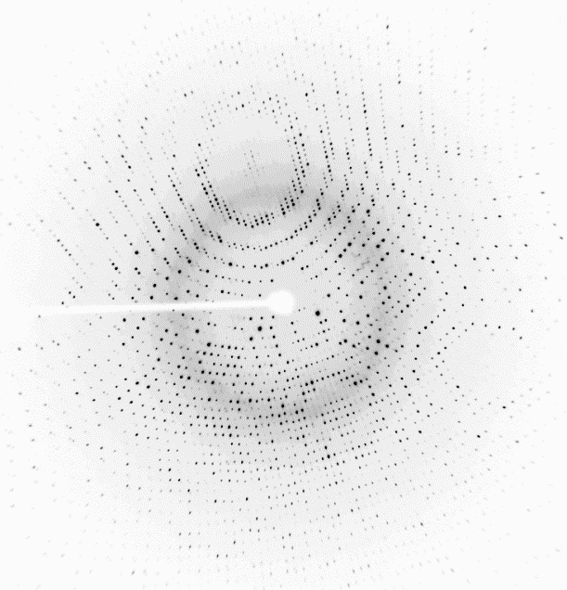
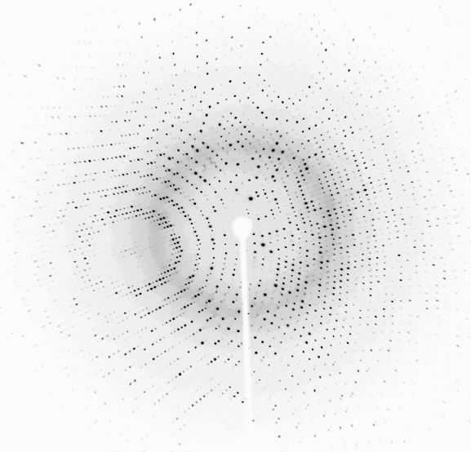
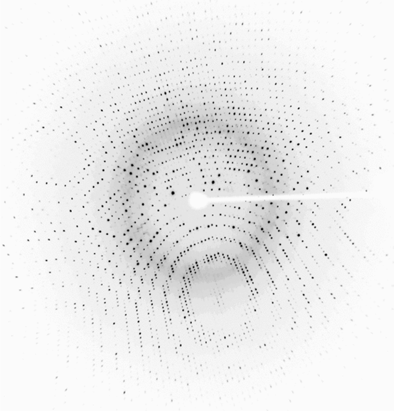
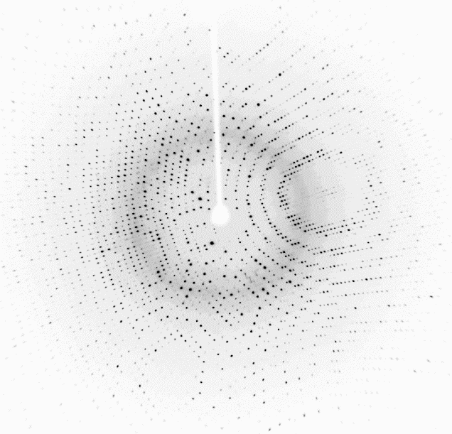
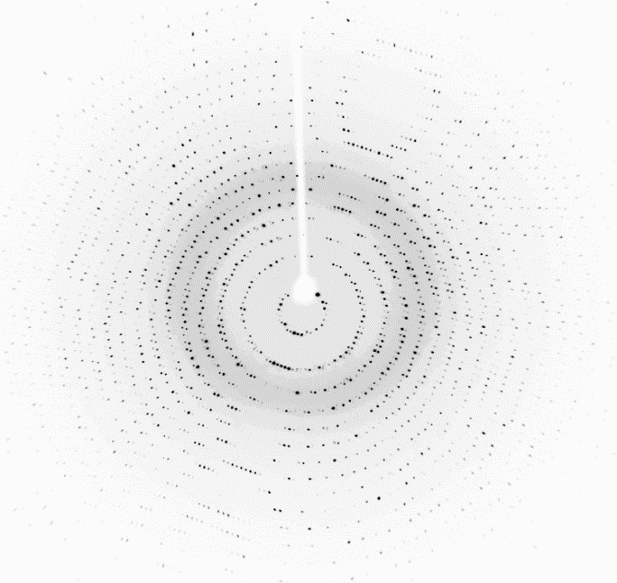
Data Reduction Goals
From a series of diffraction images, measure reflection intensities (I_{hkl}) and standard deviation (σ_{hkl}) for each reflection, hkl. Store the values in a file.
716
Final intensities
717
Set of 720 images.
Each image covers 0.5°
718
H K L I σ
0 0 4 3295.4 174.0
0 0 8 482.1 28.7
0 0 12 9691.0 500.7
0 0 16 1743.9 67.4
0 0 20 5856.0 221.0
0 0 24 14066.5 436.2
0 0 28 9936.3 311.7
0 0 36 8409.8 273.4
0 0 40 790.5 32.8
0 0 44 103.4 18.4
. . . . .
. . . . .
. . . . .
37 7 0 28.5 16.2
37 7 1 110.1 10.9
37 7 2 337.4 13.3
37 7 3 98.5 10.6
37 7 4 25.9 10.7
719
Index
Integrate
Merge
720
13,000 Mb
2 Mb

Slide 2
Summary: Space group determination is a stepwise process of elimination.
System | Bravais lattice | Point group | 65 Chiral Space Groups*
Triclinic | P | 1 | P1
Monoclinic | P | 2 | P2 | P2₁
 | C |  | C2
Orthorhombic | P | 222 | P222 | P222₁ | P2₁2₁2 | P2₁2₁2₁
 | C |  | C222₁ | C222
 | F |  | F222
 | I |  | I222 | I2₁2₁2₁
Tetragonal | P | 4 | P4 | P4₁ | P4₂ | P4₃
 | I |  | I4 | I4₁
 | P | 422 | P422 | P42₁2 | P4₁22 | P4₁2₁2 | P4₂22 | P4₂2₁2
 |  |  |  |  | P4₃22 | P4₃2₁2
 | I |  | I422 | I4₁22
Trigonal/ Rhombo-hedral | P | 3 | P3 | P31 | P32
 | R |  | R3
 | P | 32 | P312 | P321 | P3₁12 | P3₁21 | P3₂12 | P3₂21
 | R |  | R32
Hexagonal | P | 6 | P6 | P6₁ | P6₂ | P6₃ | P6₄ | P6₅
 |  | 622 | P622 | P6₁22 | P6₂22 | P6₃22 | P6₄22 | P6₅22
Cubic | P | 23 | P23 | P2₁3
 | F |  | F23
 | I |  | I23 | I2₁3
 | P | 432 | P432 | P4₂32 | P4₃32 | P4₁32
 | F |  | F432 | F4₁32
 | I |  | I432 | I4₁32
Identify Bravais lattice: examine geometrical arrangement of reflections (e.g. primitive tetragonal).
Identify point group symmetry of reflection intensities: examine the rotational symmetry in the pattern of reflection intensities (e.g. 4 vs 422).
Distinguish between rotation or screw axis symmetry: examine systematic absences in reflection intensities (e.g. P422 vs. P4₁2₁2
Distinguish handedness, if option exists (e.g. P4₁2₁2 vs P4₃2₁2)
1
2
3
4
*There are 230 space groups, but we eliminate the 165 space groups that contain mirror symmetry (incompatible with ProK which contains only L-amino acids). We only consider only the 65 chiral space groups.

Slide 3
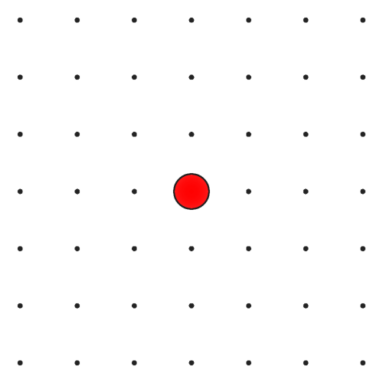
To recognize point group symmetry, it helps to map I_{hkl} onto the reciprocal lattice
L=0
Measured intensities
-3,3,0 | -2,3,0 | -1,3,0 | 0,3,0 | 1,3,0 | 2,3,0 | 3,3,0
-3,2,0 | -2,2,0 | -1,2,0 | 0,2,0 | 1,2,0 | 2,2,0 | 3,2,0
-3,1,0 | -2,1,0 | -1,1,0 | 0,1,0 | 1,1,0 | 2,1,0 | 3,1,0
-3,0,0 | -2,0,0 | -1,0,0 | 0,0,0 | 1,0,0 | 2,0,0 | 3,0,0
-3,-1,0 | -2,-1,0 | -1,-1,0 | 0,-1,0 | 1,-1,0 | 2,-1,0 | 3,-1,0
-3,-2,0 | -2,-2,0 | -1,-2,0 | 0,-2,0 | 1,-2,0 | 2,-2,0 | 3,-2,0
-3,-3,0 | -2,-3,0 | -1,-3,0 | 0,-3,0 | 1,-3,0 | 2,-3,0 | 3,-3,0
H K L I
0 1 0 4.59
0 2 0 4636.43
0 3 0 5.55
0 4 0 1728.90
1 0 0 0.21
1 -1 0 584.47
1 1 0 584.72
1 2 0 393.90
1 -2 0 394.05
1 3 0 460.68
1 -3 0 460.81
1 4 0 260.80
1 -4 0 260.85
2 0 0 4628.98
2 1 0 392.21
2 -1 0 395.99
2 2 0 7157.78
2 -2 0 7157.88
2 -3 0 541.43
2 3 0 545.41
2 -4 0 679.78
2 4 0 679.90
3 0 0 0.58
Color reciprocal lattice points according to reflection intensities
b*
a*
the reciprocal lattice

Slide 4
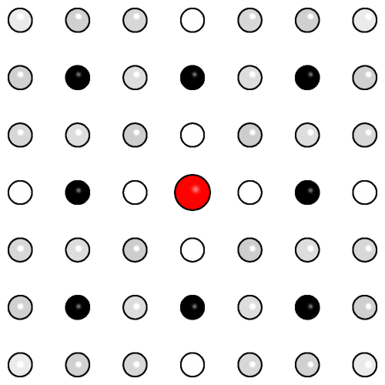
It’s easy to recognize point group symmetry when I_{hkl} is mapped to the reciprocal lattice
L=0
Measured intensities
-3,3,0 | -2,3,0 | -1,3,0 | 0,3,0 | 1,3,0 | 2,3,0 | 3,3,0
-3,2,0 | -2,2,0 | -1,2,0 | 0,2,0 | 1,2,0 | 2,2,0 | 3,2,0
-3,1,0 | -2,1,0 | -1,1,0 | 0,1,0 | 1,1,0 | 2,1,0 | 3,1,0
-3,0,0 | -2,0,0 | -1,0,0 | 0,0,0 | 1,0,0 | 2,0,0 | 3,0,0
-3,-1,0 | -2,-1,0 | -1,-1,0 | 0,-1,0 | 1,-1,0 | 2,-1,0 | 3,-1,0
-3,-2,0 | -2,-2,0 | -1,-2,0 | 0,-2,0 | 1,-2,0 | 2,-2,0 | 3,-2,0
-3,-3,0 | -2,-3,0 | -1,-3,0 | 0,-3,0 | 1,-3,0 | 2,-3,0 | 3,-3,0
H K L I
0 1 0 4.59
0 2 0 4636.43
0 3 0 5.55
0 4 0 1728.90
1 0 0 0.21
1 -1 0 584.47
1 1 0 584.72
1 2 0 393.90
1 -2 0 394.05
1 3 0 460.68
1 -3 0 460.81
1 4 0 260.80
1 -4 0 260.85
2 0 0 4628.98
2 1 0 392.21
2 -1 0 395.99
2 2 0 7157.78
2 -2 0 7157.88
2 -3 0 541.43
2 3 0 545.41
2 -4 0 679.78
2 4 0 679.90
3 0 0 0.58
Color reciprocal lattice points according to reflection intensities
b*
a*
the “intensity-weighted reciprocal lattice

Slide 5
4-fold symmetry is evident around c*
L=0
-3,3,0 | -2,3,0 | -1,3,0 | 0,3,0 | 1,3,0 | 2,3,0 | 3,3,0
-3,2,0 | -2,2,0 | -1,2,0 | 0,2,0 | 1,2,0 | 2,2,0 | 3,2,0
-3,1,0 | -2,1,0 | -1,1,0 | 0,1,0 | 1,1,0 | 2,1,0 | 3,1,0
-3,0,0 | -2,0,0 | -1,0,0 | 0,0,0 | 1,0,0 | 2,0,0 | 3,0,0
-3,-1,0 | -2,-1,0 | -1,-1,0 | 0,-1,0 | 1,-1,0 | 2,-1,0 | 3,-1,0
-3,-2,0 | -2,-2,0 | -1,-2,0 | 0,-2,0 | 1,-2,0 | 2,-2,0 | 3,-2,0
-3,-3,0 | -2,-3,0 | -1,-3,0 | 0,-3,0 | 1,-3,0 | 2,-3,0 | 3,-3,0
90° rotation around the origin (red) leaves the pattern unchanged (invariant).
This representation of the diffraction intensities offers a distortion-free view of the diffraction pattern.
It can be extended to 3D by including additional section with L>0 and L<0.
b*
a*
the “intensity-weighted reciprocal lattice

Slide 6
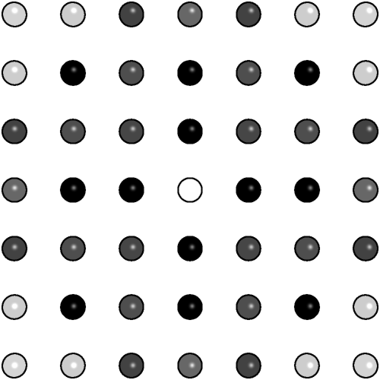
L=1
The L=1 section shown here lays on top of the L=0 section.
-3,3,1 | -2,3,1 | -1,3,1 | 0,3,1 | 1,3,1 | 2,3,1 | 3,3,1
-3,2,1 | -2,2,1 | -1,2,1 | 0,2,1 | 1,2,1 | 2,2,1 | 3,2,1
-3,1,1 | -2,1,1 | -1,1,1 | 0,1,1 | 1,1,1 | 2,1,1 | 3,1,1
-3,0,1 | -2,0,1 | -1,0,1 | 0,0,1 | 1,0,1 | 2,0,1 | 3,0,1
-3,-1,1 | -2,-1,1 | -1,-1,1 | 0,-1,1 | 1,-1,1 | 2,-1,1 | 3,-1,1
-3,-2,1 | -2,-2,1 | -1,-2,1 | 0,-2,1 | 1,-2,1 | 2,-2,1 | 3,-2,1
-3,-3,1 | -2,-3,1 | -1,-3,1 | 0,-3,1 | 1,-3,1 | 2,-3,1 | 3,-3,1
b*
a*
the “intensity-weighted reciprocal lattice

Slide 7
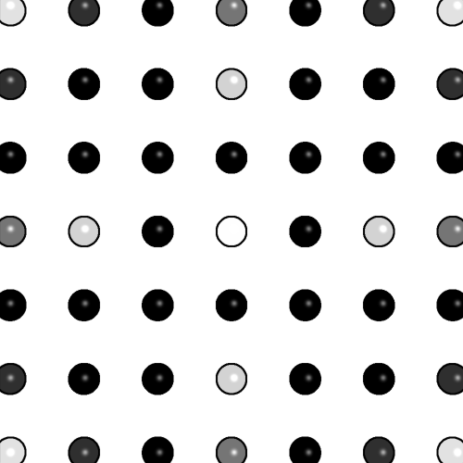
L=2
-3,3,2 | -2,3,2 | -1,3,2 | 0,3,2 | 1,3,2 | 2,3,2 | 3,3,2
-3,2,2 | -2,2,2 | -1,2,2 | 0,2,2 | 1,2,2 | 2,2,2 | 3,2,2
-3,1,2 | -2,1,2 | -1,1,2 | 0,1,2 | 1,1,2 | 2,1,2 | 3,1,2
-3,0,2 | -2,0,2 | -1,0,2 | 0,0,2 | 1,0,2 | 2,0,2 | 3,0,2
-3,-1,2 | -2,-1,2 | -1,-1,2 | 0,-1,2 | 1,-1,2 | 2,-1,2 | 3,-1,2
-3,-2,2 | -2,-2,2 | -1,-2,2 | 0,-2,2 | 1,-2,2 | 2,-2,2 | 3,-2,2
-3,-3,2 | -2,-3,2 | -1,-3,2 | 0,-3,2 | 1,-3,2 | 2,-3,2 | 3,-3,2
The L=2 section shown here lays on top of the L=1 section.
b*
a*
the “intensity-weighted reciprocal lattice

Slide 8
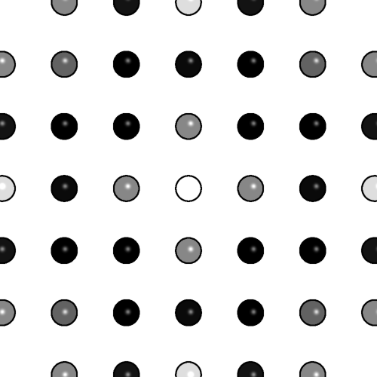
L=3
-3,3,3 | -2,3,3 | -1,3,3 | 0,3,3 | 1,3,3 | 2,3,3 | 3,3,3
-3,2,3 | -2,2,3 | -1,2,3 | 0,2,3 | 1,2,3 | 2,2,3 | 3,2,3
-3,1,3 | -2,1,3 | -1,1,3 | 0,1,3 | 1,1,3 | 2,1,3 | 3,1,3
-3,0,3 | -2,0,3 | -1,0,3 | 0,0,3 | 1,0,3 | 2,0,3 | 3,0,3
-3,-1,3 | -2,-1,3 | -1,-1,3 | 0,-1,3 | 1,-1,3 | 2,-1,3 | 3,-1,3
-3,-2,3 | -2,-2,3 | -1,-2,3 | 0,-2,3 | 1,-2,3 | 2,-2,3 | 3,-2,3
-3,-3,3 | -2,-3,3 | -1,-3,3 | 0,-3,3 | 1,-3,3 | 2,-3,3 | 3,-3,3
The L=3 section shown here lays on top of the L=2 section, etc.
b*
a*
the “intensity-weighted reciprocal lattice

Slide 9
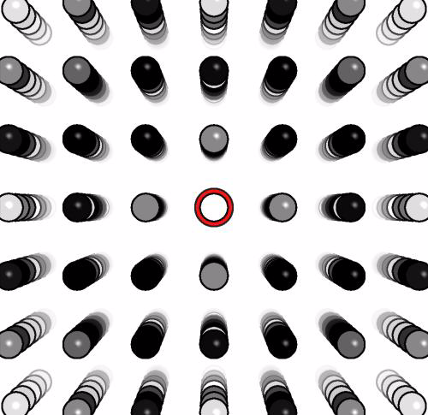
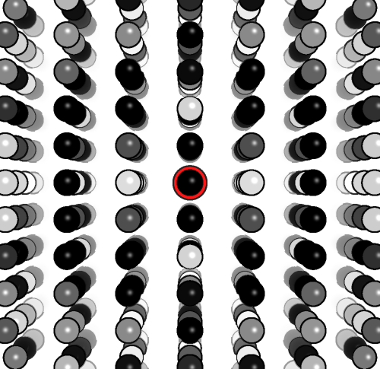
Rotate lattice to view down b*
What rotational symmetry is evident around the b* axis?
c*
a*
a*
a*
the “intensity-weighted reciprocal lattice

Slide 10
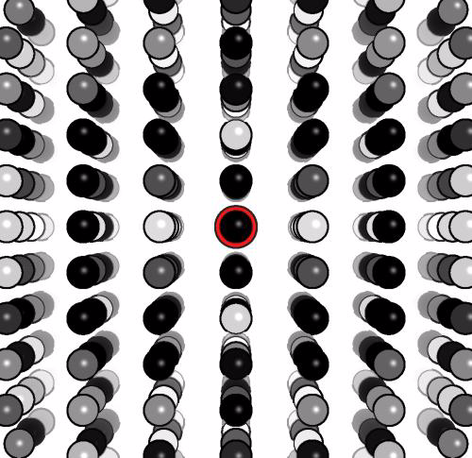
Rotate lattice to view down a*
What rotational symmetry is evident around the a* axis?
So, what is the point group?
c*
b*
Conclusion: The intensity-weighted reciprocal lattice is the truest representation of crystal diffraction. It will help us understand indexing and assign a space group.

Slide 11
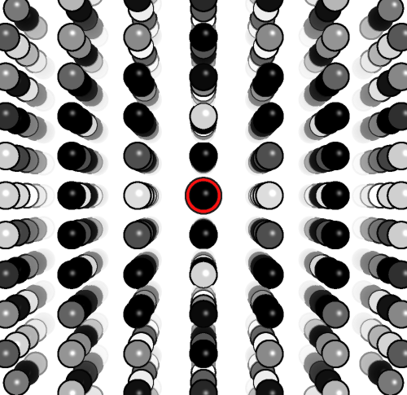
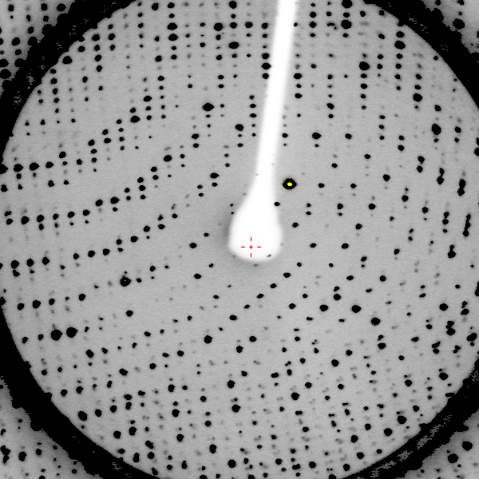
1) Why does our diffraction image look so sliced up?
2) How do we map I_{hkl} back to a 3D lattice?
If reflections really do reside on a 3D lattice…
0.5° Oscillation image collected by Esmeralda

Slide 12
Review Data Collection
Let’s review the geometry of data collection so that we can conceptualize how to index reflections.
Watch this simulated data collection video:
  Collect 90° of data in 18 images (5° wedges)
  XrayView software.

Slide 13
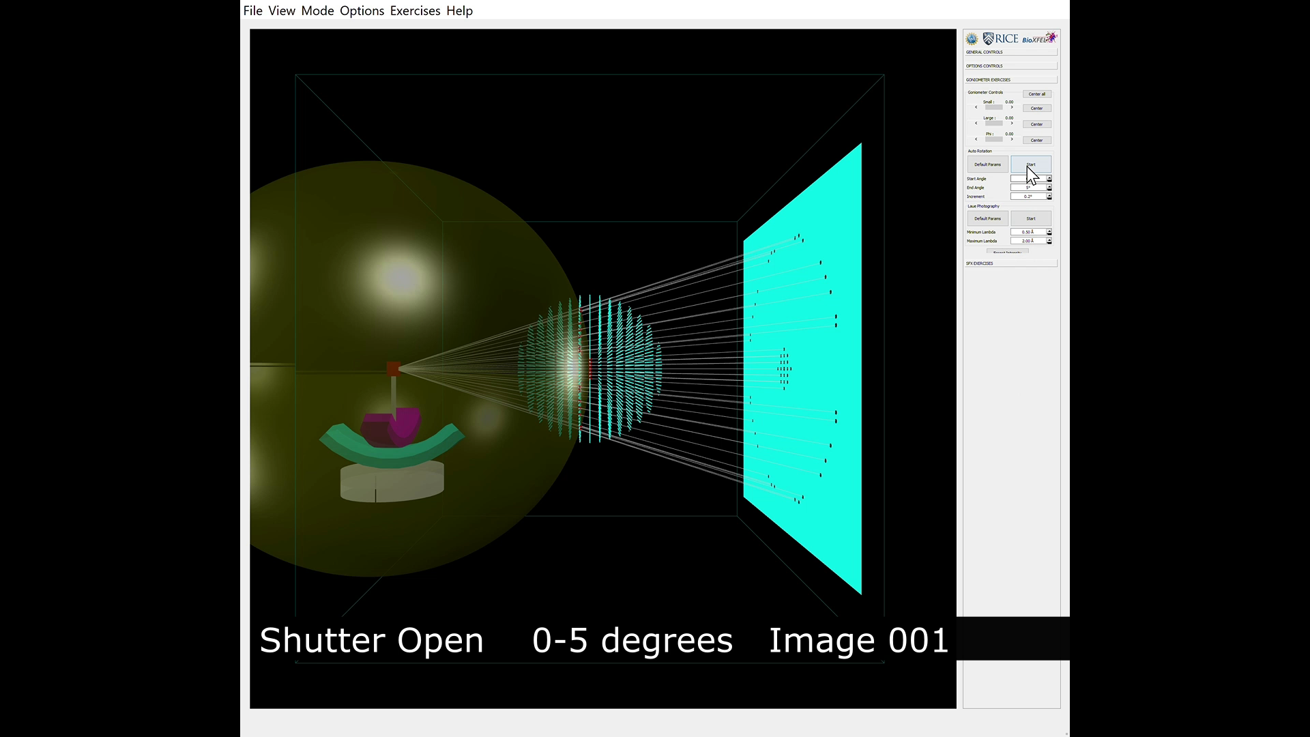
Ewald’s sphere of reflection
Simulated Data Collection
Reciprocal
lattice
Crystal
X-ray beam
Diffracted rays
Detector

Slide 14
Indexing an oscillation image appear challenging
The reciprocal lattice is only partly represented. You see only those reflections that obey Bragg’s Law during a small rotation.
The reciprocal lattice is distorted. You see a 2D projections of a 3D lattice—a dimension of depth is lost.
Orientation of reciprocal cell vectors a*, b*, c* are not necessarily aligned with film edges— the orientation of the crystal in the loop is arbitrary.
The concept of Ewald’s sphere will help us.
0.5° Oscillation image collected by Esmeralda

Slide 15
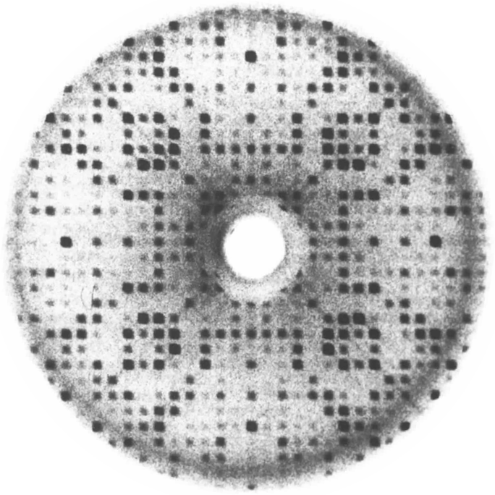
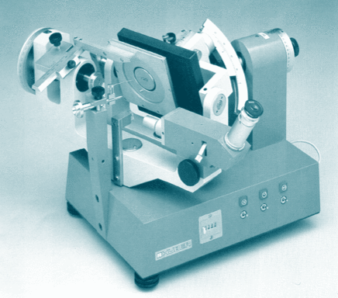
You can Index by Inspection from a precession photo
Recall that spots are arrayed on a reciprocal lattice.
Count how many steps the given reflection is displaced from the origin.
  h=Number of steps of a*.
  k=Number of steps of b*.
  l=Number of steps of c*.
Precession Photograph
Buerger Precession Camera

Slide 16
Index the reflection circled in cyan.
What pieces of information are required to index this reflection?
1) Define lattice points
2) Define a*,b*, c* direction & length
3) Locate origin.

Slide 17
Mark lattice points with red circles.
Note the spacing between reflections is periodic.
Draw evenly spaced lines through the spots to define the spacings a* & b*

Slide 18
Draw evenly spaced lines thru spots
A wider reciprocal spacing gives smaller (better) real cell spacing.
Draw another set of evenly spaced lines at 90° or 120°, if possible.

Slide 19
90˚ is most simplifying choice

Slide 20
Locate origin of reciprocal lattice
Origin is located where direct x-ray beam intercepts image. To see it, briefly remove beam-stop.

Slide 21
Origin is defined. Now, label a* & b*
b*
What is the index of the spot?
b*
a*
a*

Slide 22
Reflection h,k,l is 3,8,0
3rd column on the right side of the origin.
8th row above the origin
b*
b*
b*
b*
b*
b*
b*
b*
b*
a*
a*
a*
a*

Slide 23
Which Bravais Lattice fits this pattern?
a* and b* have the same length.
They are perpendicular to each other.
b*
b*
a*
a*

Slide 24
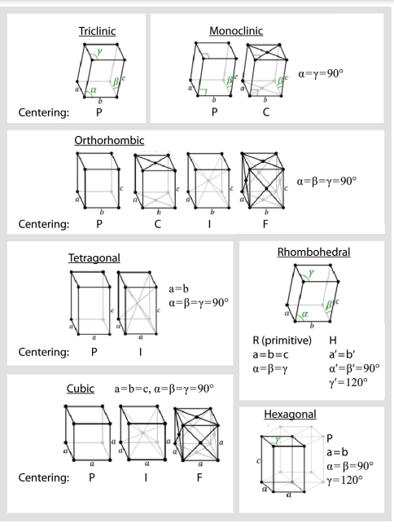
Which Bravais Lattice fits this pattern?
a=b and γ=90°
Find the highest symmetry lattice that is consistent with the observed dimensions

Slide 25
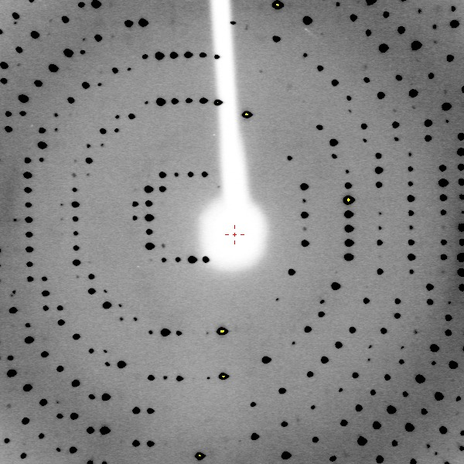
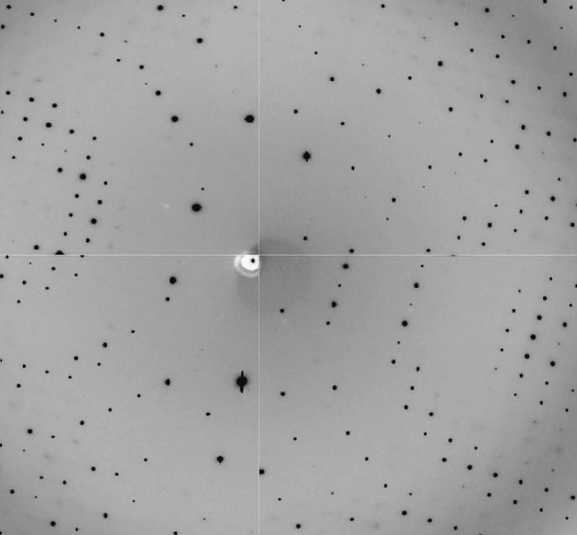
Next, index spots on an oscillation image.
This is easy!
But, what about this?
Confusing! 3D reciprocal lattice projected on 2D detector.

Slide 26
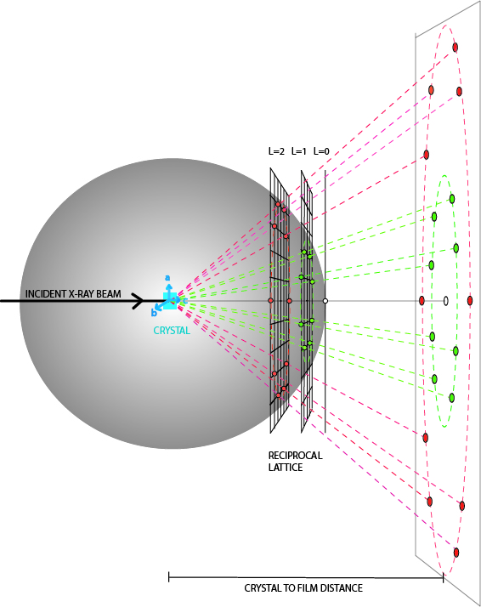
Use Ewald Sphere construction to map 2D spots back to 3D reciprocal lattice.
a*
b*
c*
detector
In an undistorted view of the reciprocal lattice, recorded reflections would reside on the surface of a sphere, not a plane.

Slide 27
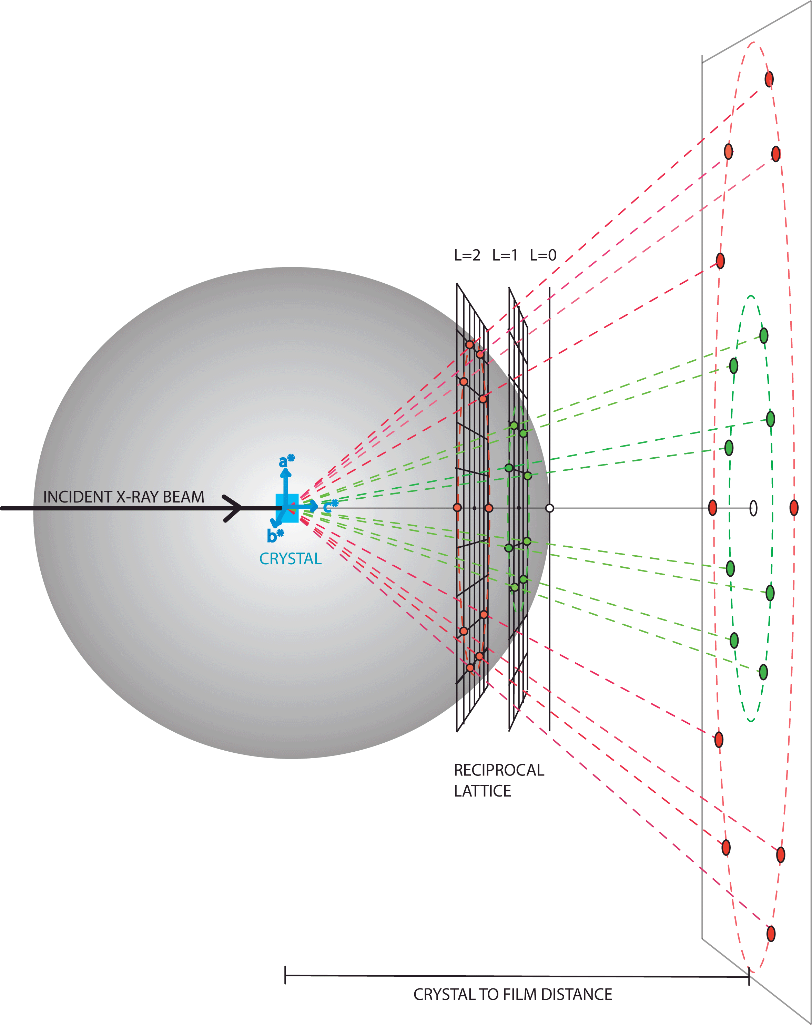
For a given spot on the film, we need to trace the diffracted ray back to the reciprocal lattice point (h,k,l)
What’s the h,k,l of this spot?
The answer is HKL=3,2,2
3 lattice points in a* direction
a*
b*
c*
2 lattice points in b* direction
What parameters must be
defined to complete this construction?

Slide 28
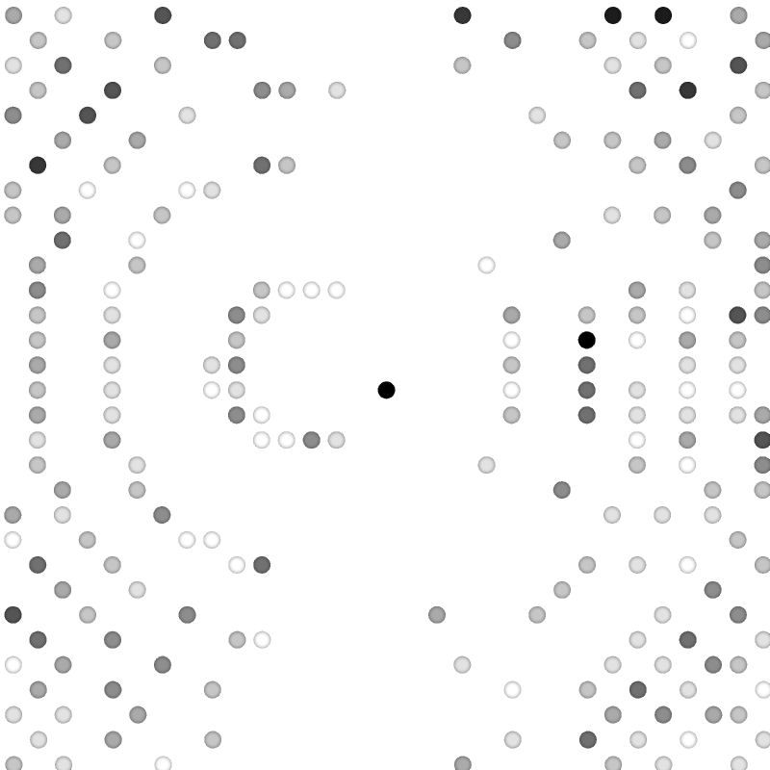
A distortion-corrected representation of the reflections a single image reveals all 6 unit cell parameters

Slide 29
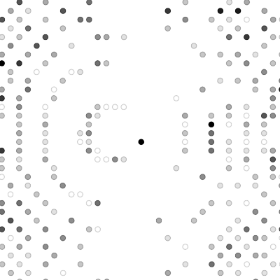
Restored depth of the diffraction pattern is evident from an orthogonal view

Slide 30
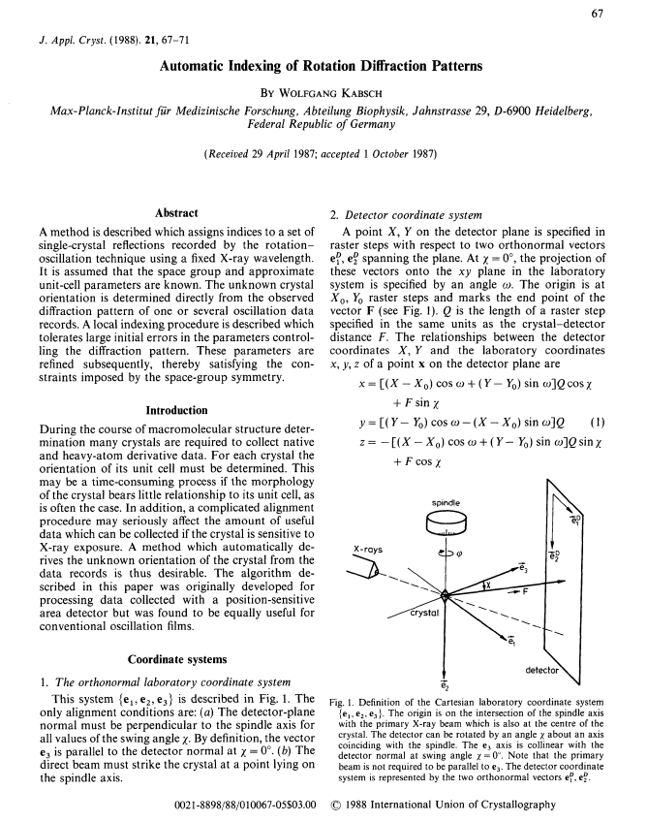
The automatic indexing algorithm in XDS can automatically identify spot positions, interpret crystal orientation, and unit cell dimensions.
Kabsch, W. (1988a) Automatic Indexing of Rotation Diffraction Patterns. J. Appl. Cryst. 21, 67–72.

Slide 31
Locate spot positions with COLSPOT
XDS.INP file specifies automatic indexing instructions
!====================== JOB CONTROL PARAMETERS ===============================
JOB= ALL !XYCORR INIT COLSPOT IDXREF DEFPIX XPLAN INTEGRATE CORRECT
!====================== GEOMETRICAL PARAMETERS ===============================
ORGX=1506.23 ORGY=1503.91 !Detector origin (pixels). Calibrated by DC 03/01/2019
DETECTOR_DISTANCE=-74 !(mm)
ROTATION_AXIS= 0.0 1.0 0.0
OSCILLATION_RANGE=0.5 !degrees (>0)
X-RAY_WAVELENGTH=1.5418 !Angstrom
INCLUDE_RESOLUTION_RANGE=100.0 1.4
!==================== SELECTION OF DATA IMAGES ==============================
NAME_TEMPLATE_OF_DATA_FRAMES=i/prok_pcmbs_esmeralda????.osc DIRECT RAXIS
DATA_RANGE= 1 720 !First and last diffraction images collected
BACKGROUND_RANGE=1 4 !First and last data image for background
SPOT_RANGE= 1 10 !First and last data image number for finding spots
SPOT_RANGE= 171 180 !First and last data image number for finding spots
!============================================================================

Slide 32
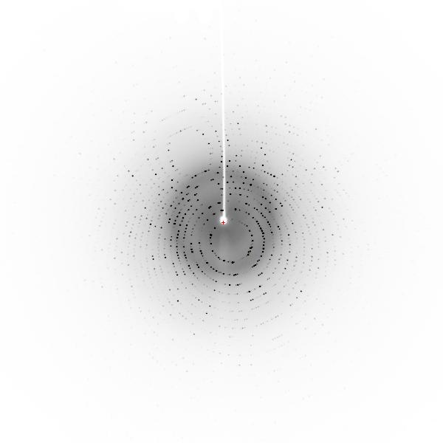
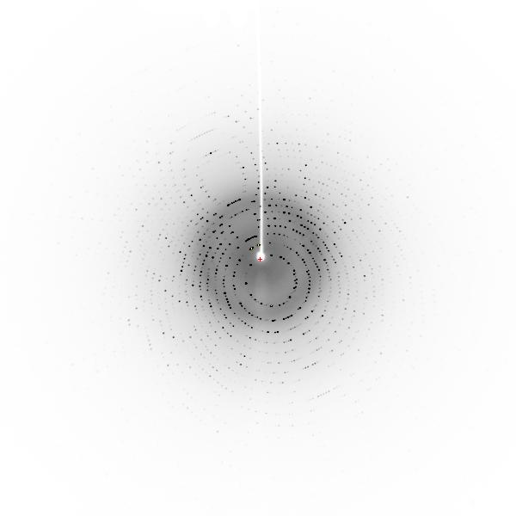
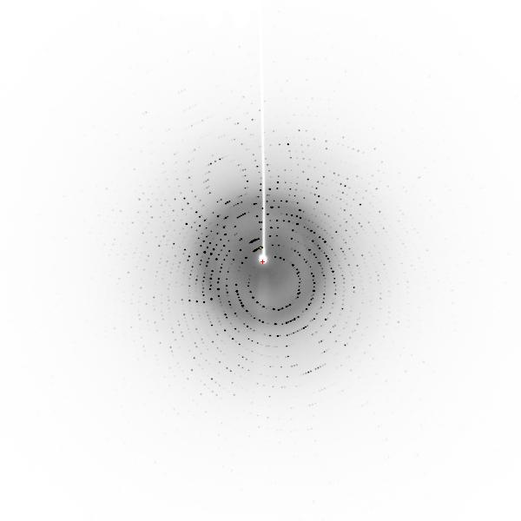
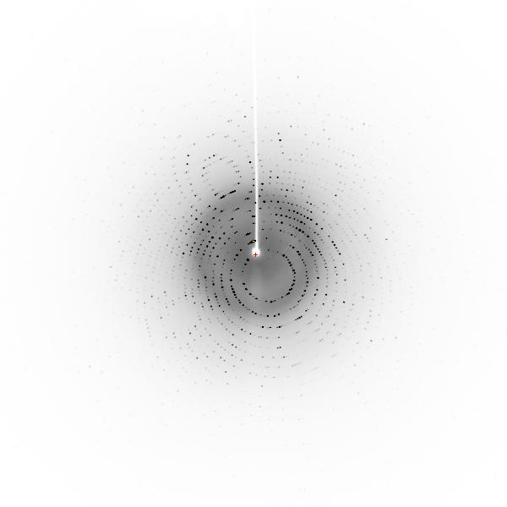
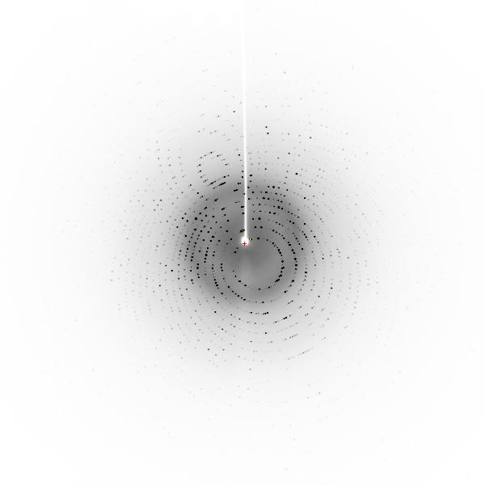
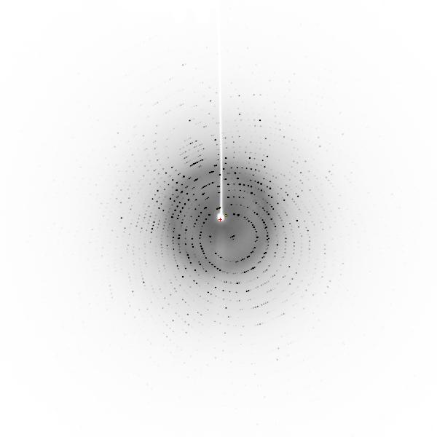
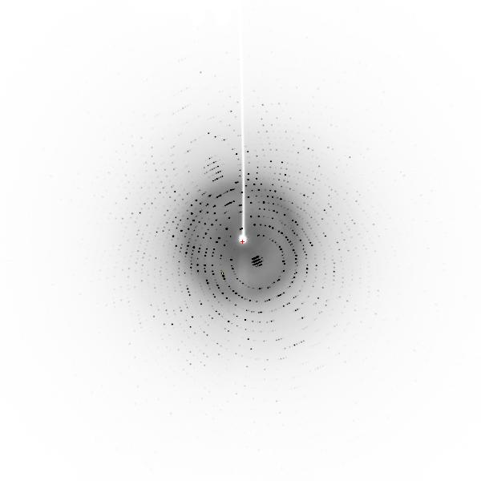
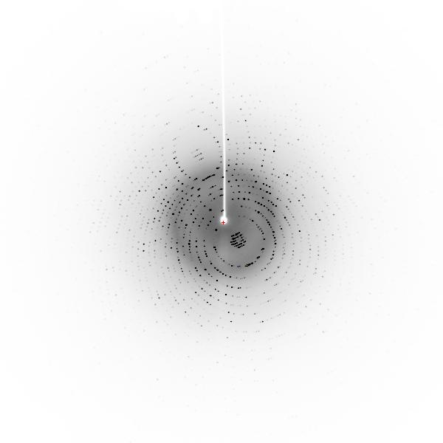
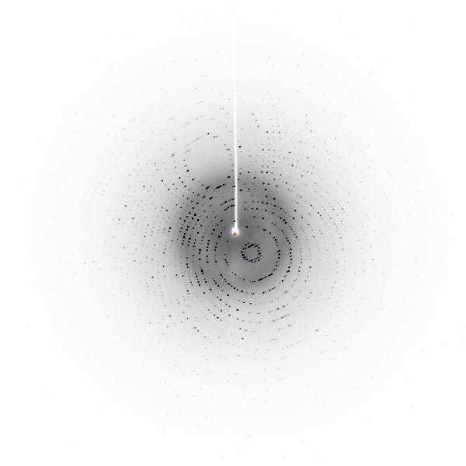
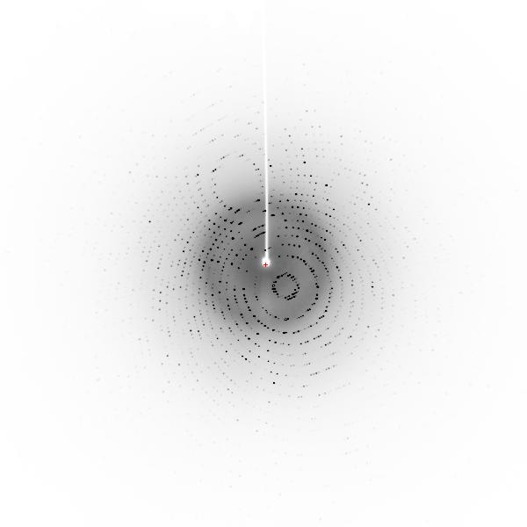
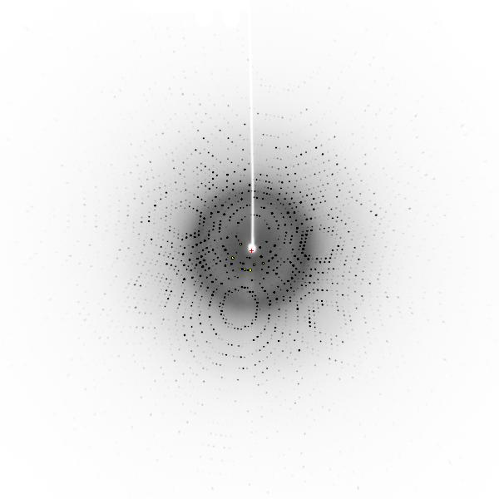
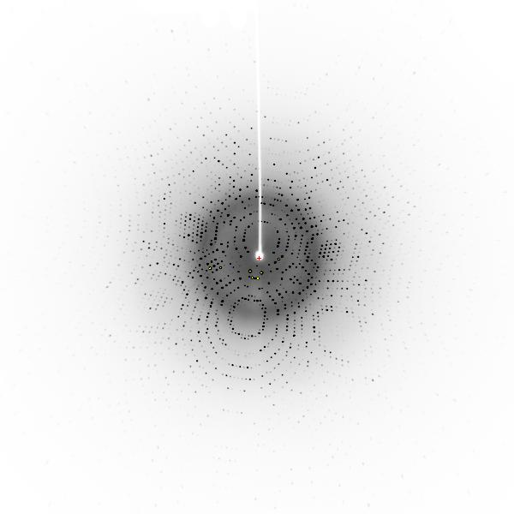
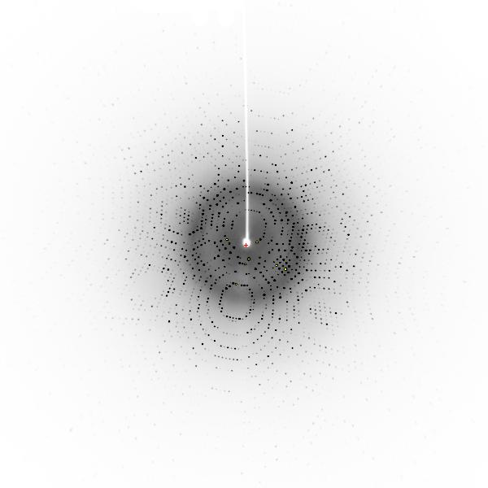
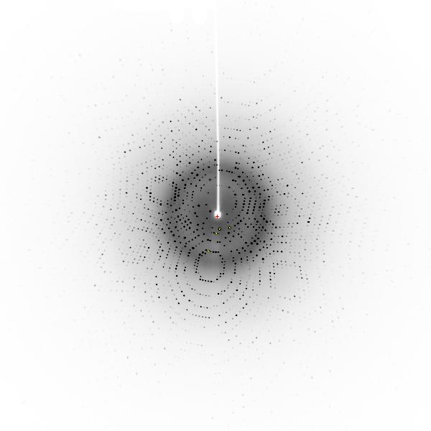
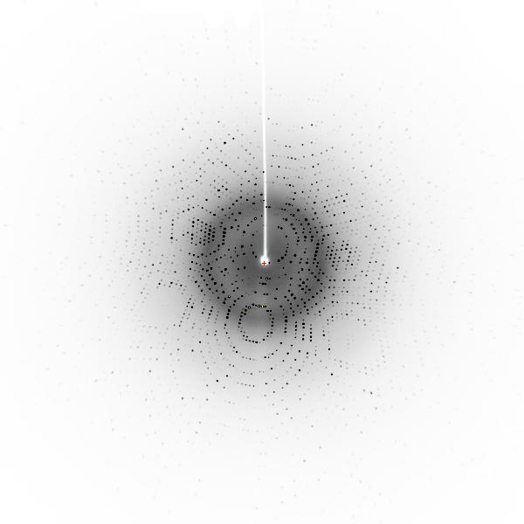
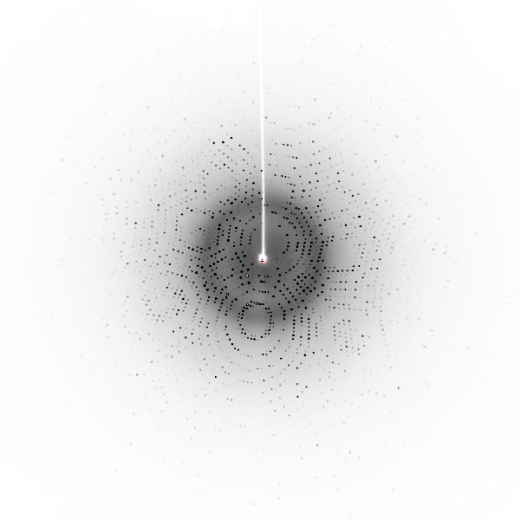
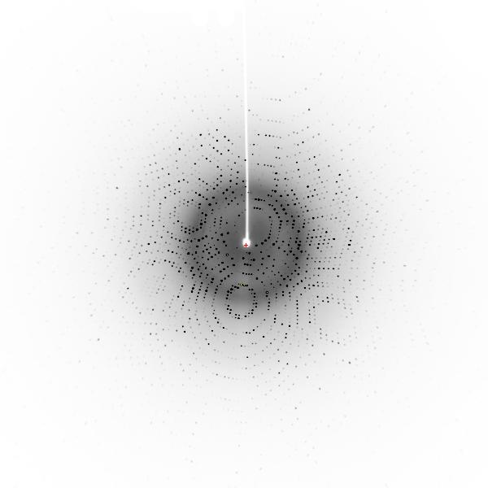

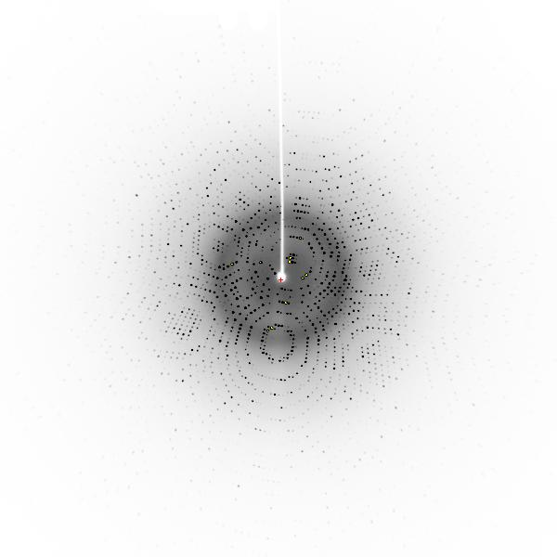
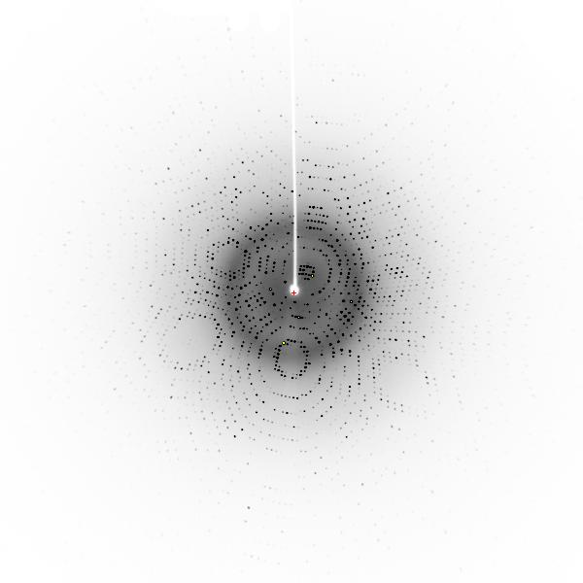
001 002 003 004 005
006 007 008 009 010
171 172 173 174 175
176 177 178 179 180

Slide 33
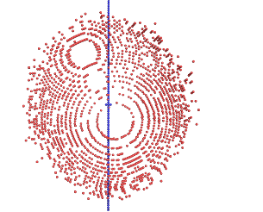
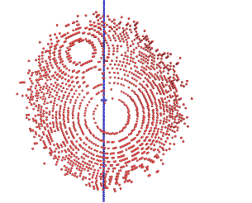
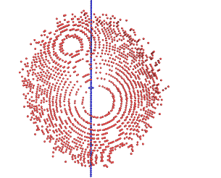
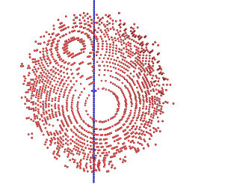
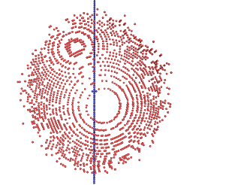















001 002 003 004 005
006 007 008 009 010
171 172 173 174 175
176 177 178 179 180

Slide 34
001 002 003 004 005
006 007 008 009 010
171 172 173 174 175
176 177 178 179 180

Slide 35
SPOT.XDS
Spot position intens-
X Y phi ity
1504.01 1378.41 173.66 4537.
1526.45 1409.21 172.51 4485.
1499.41 1575.97 3.49 4395.
1499.77 1247.89 175.02 4004.
1482.28 1251.21 175.64 3430.
1460.42 1235.69 178.37 3111.
1515.65 1235.92 4.29 2099.
1516.82 1246.26 175.68 2043.
1494.83 1721.10 5.95 2002.
1460.63 1751.46 173.68 1935.
1496.21 1889.74 173.68 1869.
1536.70 1371.16 178.43 1775.
1509.20 1578.62 5.50 1705.
1520.18 1374.85 177.59 1695.
1480.15 1261.73 3.54 1664.
1471.50 1863.84 7.45 1649.
1470.76 1382.48 171.31 1644.
1500.62 1680.58 6.31 1643.
1563.73 1808.92 2.41 1613.
1460.22 1420.42 171.54 1604.
1472.21 1173.36 7.24 1589.
1510.04 1148.16 5.10 1539.
1448.42 1257.31 173.54 1534.
1511.90 1318.37 173.95 1452.
1560.73 1612.72 178.46 1448.
1532.31 1222.84 173.71 1417.
1491.13 1159.51 6.08 1363.
1551.09 1095.47 176.33 1360.
1574.56 1223.31 1.50 1278.
1510.01 1802.89 5.71 1266.
1548.82 1523.06 5.03 1213.
1426.96 1242.19 174.81 1210.
NUMBER OF DIFFRACTION SPOTS LOCATED 25118
IGNORED BECAUSE OF SPOT CLOSE TO UNTRUSTED REGION 13
WEAK SPOTS OMITTED 22
NUMBER OF DIFFRACTION SPOTS ACCEPTED 25083

Slide 36

Draw vectors between reciprocal lattice points.
For simplicity, only points from image 8 are shown.

Slide 37

Vectors of same length & direction are grouped together
65 vectors like this:

Slide 38
Vectors of same length & direction are grouped together
53 vectors like this:

Slide 39
Algorithm for best choice of a*, b*, c*
Difference vector clusters are accumulated in a 3D histogram. These vectors represent all candidate reciprocal lattice vectors. For example:
Choose the shortest three linear independent real-space lattice vectors forming a right-handed set.
# COORDINATES OF VECTOR CLUSTER FREQUENCY CLUSTER INDICES
1 -0.0026247 0.0170582-0.0027500 2025. 0.99 -0.00 -0.99
2 -0.0060520-0.0130311 0.0026847 1878. -1.00 0.00 0.01
3 -0.0086356 0.0040538-0.0000834 1832. -0.00 -0.00 -0.99
4 -0.0034720-0.0301176 0.0054258 1536. -1.99 0.00 1.00
5 -0.0052358 0.0342473-0.0054914 1414. 2.00 -0.00 -1.99
6 -0.0015319 0.0195839 0.0114708 1380. 1.00 0.99 -1.00
7 0.0045649 0.0325816 0.0088457 1372. 2.00 1.00 -1.00
. . . . . . . .
60 0.0044282-0.0816564 0.0136375 685. -5.00 -0.00 4.00

Slide 40
Choose the lattice of highest symmetry and quality of fit<10
LATTICE- BRAVAIS- QUALITY UNIT CELL CONSTANTS (ANGSTROEM & DEGREES)
CHARACTER LATTICE OF FIT a b c alpha beta gamma
* 44 aP 0.0 68.2 68.4 102.9 90.1 90.2 90.1
* 31 aP 0.7 68.2 68.4 102.9 90.1 89.8 89.9
* 33 mP 1.4 68.2 68.4 102.9 90.1 90.2 90.1
* 34 mP 3.2 68.2 102.9 68.4 90.1 90.1 90.2
* 35 mP 3.3 68.4 68.2 102.9 90.2 90.1 90.1
* 32 oP 3.9 68.2 68.4 102.9 90.1 90.2 90.1
* 14 mC 5.5 96.5 96.7 102.9 89.9 90.2 89.8
* 10 mC 6.3 96.5 96.7 102.9 90.1 90.2 90.2
* 13 oC 6.9 96.5 96.7 102.9 89.9 90.2 89.8
* 11 tP 7.6 68.2 68.4 102.9 90.1 90.2 90.1
37 mC 248.2 216.5 68.2 68.4 90.1 90.1 71.8
36 oC 248.9 68.2 216.5 68.4 89.9 90.1 108.2
28 mC 249.2 68.2 216.5 68.4 90.1 90.1 71.8
39 mC 251.8 152.8 68.2 102.9 90.2 90.1 63.6
29 mC 251.8 68.2 152.8 102.9 90.1 90.2 63.6
41 mC 251.9 216.8 68.4 68.2 90.1 90.2 71.6
38 oC 252.4 68.2 152.8 102.9 89.9 90.2 116.4
40 oC 252.6 68.2 216.5 68.4 89.9 90.1 108.2
30 mC 252.9 68.2 216.5 68.4 90.1 90.1 71.8
12 hP 256.1 68.2 68.4 102.9 90.1 90.2 90.1

Slide 41
Choose the lattice of highest symmetry and quality of fit<10
LATTICE- BRAVAIS- QUALITY UNIT CELL CONSTANTS (ANGSTROEM & DEGREES)
CHARACTER LATTICE OF FIT a b c alpha beta gamma
* 44 aP 0.0 68.2 68.4 102.9 90.1 90.2 90.1
* 31 aP 0.7 68.2 68.4 102.9 90.1 89.8 89.9
* 33 mP 1.4 68.2 68.4 102.9 90.1 90.2 90.1
* 34 mP 3.2 68.2 102.9 68.4 90.1 90.1 90.2
* 35 mP 3.3 68.4 68.2 102.9 90.2 90.1 90.1
* 32 oP 3.9 68.2 68.4 102.9 90.1 90.2 90.1
* 14 mC 5.5 96.5 96.7 102.9 89.9 90.2 89.8
* 10 mC 6.3 96.5 96.7 102.9 90.1 90.2 90.2
* 13 oC 6.9 96.5 96.7 102.9 89.9 90.2 89.8
* 11 tP 7.6 68.2 68.4 102.9 90.1 90.2 90.1
37 mC 248.2 216.5 68.2 68.4 90.1 90.1 71.8
36 oC 248.9 68.2 216.5 68.4 89.9 90.1 108.2
28 mC 249.2 68.2 216.5 68.4 90.1 90.1 71.8
39 mC 251.8 152.8 68.2 102.9 90.2 90.1 63.6
29 mC 251.8 68.2 152.8 102.9 90.1 90.2 63.6
41 mC 251.9 216.8 68.4 68.2 90.1 90.2 71.6
38 oC 252.4 68.2 152.8 102.9 89.9 90.2 116.4
40 oC 252.6 68.2 216.5 68.4 89.9 90.1 108.2
30 mC 252.9 68.2 216.5 68.4 90.1 90.1 71.8
12 hP 256.1 68.2 68.4 102.9 90.1 90.2 90.1
aP
mP
mC
oP
oC
oI
oF
hR
tP
tI
hP
cP
cI
cF

Slide 42


Integration of intensity for a reflection (image 004)
001 002 003 004 005 006 007 008 009 010
001 002 003 004 005 006 007 008 009 010
1) Draw boundaries of each reflection
2) Sum the intensities recorded on each pixel within boundary.
3) Repeat for each spot on each image.

Slide 43


















Intensity of this reflection is spread over the first 10 images
001 002 003 004 005 006 007 008 009 010
001 002 003 004 005 006 007 008 009 010
001 002 003 004 005 006 007 008 009 010
001 002 003 004 005 006 007 008 009 010
001 002 003 004 005 006 007 008 009 010
001 002 003 004 005 006 007 008 009 010
001 002 003 004 005 006 007 008 009 010
001 002 003 004 005 006 007 008 009 010
001 002 003 004 005 006 007 008 009 010
001 002 003 004 005 006 007 008 009 010
001 002 003 004 005 006 007 008 009 010
001 002 003 004 005 006 007 008 009 010
001 002 003 004 005 006 007 008 009 010
001 002 003 004 005 006 007 008 009 010
001 002 003 004 005 006 007 008 009 010
001 002 003 004 005 006 007 008 009 010
001 002 003 004 005 006 007 008 009 010
001 002 003 004 005 006 007 008 009 010
001 002 003 004 005 006 007 008 009 010
001 002 003 004 005 006 007 008 009 010
1) Draw boundaries of each reflection
2) Sum the intensities recorded on each pixel within boundary.
3) Repeat for each spot on each image.

Slide 44
Merging is next

Slide 45
Output integrated intensities
INTEGRATE.HKL file has 1,238,805 lines from this 1.4 Å data set ProK
!UNIT_CELL_CONSTANTS= 67.918 67.918 102.177 90.000 90.000 90.000
! H, K, L, IOBS, SIGMA, XCAL, YCAL, ZCAL, RLP, PEAK,CORR,MAXC,XOBS, YOBS, ZOBS, ALF0,BET0,ALF1,BET1,PSI,ISEG
-47 -11 -7 2.545E+02 2.788E+02 2995.1 2344.0 604.8 1.38699 77.12746 4 33 2978.5 2336.6 605.0 45.91 0.07 -29.44 66.81 -118.54 1
-47 -11 -6 1.002E+03 3.147E+02 22.1 2318.8 94.9 1.39114 78.49145 10 32 29.5 2311.6 95.0 31.25 0.09 -151.27 66.62 95.30 1
-47 -11 -6 1.366E+02 2.771E+02 2994.8 2329.0 603.0 1.39049 79.95720 4 29 2987.3 2329.6 603.1 45.91 0.07 -29.01 66.72 -118.77 1
-47 -11 -5 1.872E+03 3.339E+02 21.5 2304.4 93.7 1.39492 92.47218 23 35 25.3 2304.5 93.7 31.25 0.09 -151.71 66.54 94.48 1
-47 -11 -5 1.204E+03 2.971E+02 2995.5 2314.6 601.1 1.39429 78.44115 15 30 2986.6 2311.4 601.0 45.91 0.07 -28.57 66.64 -118.99 1
-47 -11 -4 6.058E+02 3.242E+02 20.0 2290.6 92.4 1.39900 96.87422 12 77 27.5 2290.6 92.4 31.25 0.09 -152.15 66.47 93.68 1
-47 -11 -4 4.104E+02 2.919E+02 2992.3 2298.0 599.2 1.39845 80.31631 6 31 2982.4 2288.8 598.7 111.48 0.07 -28.13 66.51 -119.18 1
-47 -11 -3 2.735E+03 3.281E+02 17.5 2277.3 91.2 1.40337 95.48840 30 34 19.2 2279.0 91.4 31.25 0.09 -152.59 66.42 92.90 1
-47 -11 -3 9.144E+02 3.109E+02 2994.8 2284.8 597.4 1.40283 75.93009 17 32 2983.7 2282.7 597.4 111.48 0.07 -27.69 66.46 -119.37 1
-47 -11 -2 3.644E+02 2.749E+02 14.1 2264.4 89.9 1.40808 92.92796 6 35 19.6 2264.0 89.8 31.81 0.09 -153.04 66.39 92.13 1 -47 -11 .-47 -11 -1 1.441E+03 2.964E+02 9.7 2252.0 88.6 1.41308 87.63616 23 33 14.4 2252.3 88.7 32.14 0.09 -153.48 66.36 91.39 1
-47 -11 0 3.293E+02 2.450E+02 4.4 2240.0 87.3 1.41836 80.78474 7 31 12.0 2236.6 87.0 32.14 0.09 -153.93 66.36 90.67 1
-47 -10 -9 1.047E+03 3.427E+02 22.3 2316.5 100.7 1.39148 81.59772 16 32 23.3 2318.8 100.7 27.88 0.08 -151.33 66.60 97.62 1
-47 -10 -9 1.153E+02 2.993E+02 2994.5 2326.5 608.7 1.39095 80.67455 4 31 2987.2 2325.2 608.4 45.91 0.07 -28.94 66.70 -116.36 1
-47 -10 -8 4.724E+03 3.767E+02 25.0 2300.6 99.5 1.39410 96.97063 44 49 24.9 2301.0 99.2 31.13 0.08 -151.77 66.48 96.75 1
-47 -10 -8 2.220E+03 3.363E+02 2992.0 2310.8 606.8 1.39349 84.59594 24 33 2988.1 2309.9 606.5 45.91 0.07 -28.51 66.58 -116.63 1
-47 -10 -7 6.914E+03 3.802E+02 26.6 2285.5 98.3 1.39692 99.42799 57 56 29.5 2287.8 98.5 31.25 0.09 -152.20 66.37 95.90 1
-47 -10 -7 3.098E+03 3.250E+02 2990.5 2295.6 604.9 1.39632 86.71242 35 35 2985.3 2294.3 604.7 45.91 0.07 -28.08 66.47 -116.87 1
-47 -10 -6 1.589E+03 2.980E+02 27.3 2271.0 97.1 1.40004 99.54026 16 32 29.5 2272.9 97.1 31.25 0.09 -152.63 66.28 95.07 1
-47 -10 -6 9.778E+02 3.015E+02 2989.9 2281.0 603.0 1.39944 87.42934 11 33 2984.9 2278.8 602.7 45.91 0.07 -27.65 66.38 -117.11 1
-47 -10 -5 1.086E+03 3.186E+02 27.1 2257.0 95.8 1.40345 99.49097 13 33 23.1 2258.3 95.7 31.25 0.09 -153.06 66.20 94.25 1
-47 -10 -5 7.046E+02 3.209E+02 2990.2 2267.0 601.2 1.40285 86.86985 8 33 2986.2 2270.9 601.7 45.91 0.07 -27.22 66.30 -117.33 1
-47 -10 -4 5.056E+03 3.658E+02 25.9 2243.5 94.6 1.40716 99.29475 48 45 27.0 2247.1 94.5 31.25 0.09 -153.50 66.14 93.46 1
-47 -10 -4 2.003E+03 3.387E+02 2986.7 2250.9 599.3 1.40664 89.14124 26 34 2985.0 2252.7 599.2 111.36 0.07 -26.79 66.17 -117.53 1
-47 -10 -3 8.050E+02 3.299E+02 23.8 2230.4 93.3 1.41117 98.79202 16 44 24.0 2225.9 92.9 31.25 0.09 -153.93 66.09 92.69 1
-47 -10 -3 7.560E+02 3.407E+02 2988.8 2237.9 597.5 1.41066 86.07878 7 31 2984.3 2240.7 597.5 111.48 0.07 -26.35 66.12 -117.73 1
-47 -10 -2 3.435E+03 3.298E+02 20.8 2217.9 92.0 1.41550 97.47218 30 44 23.3 2220.1 92.1 31.25 0.09 -154.37 66.05 91.93 1
-47 -10 -2 1.502E+03 3.296E+02 2991.9 2225.3 595.7 1.41499 81.04167 19 38 2987.7 2223.9 595.6 111.48 0.07 -25.91 66.08 -117.92 1
-47 -10 -1 1.185E+03 3.234E+02 16.8 2205.7 90.7 1.42013 94.89558 14 34 23.3 2203.6 91.0 31.25 0.09 -154.81 66.03 91.20 1
-47 -10 0 4.880E+02 3.137E+02 11.8 2193.8 89.4 1.42512 90.43126 12 35 17.5 2193.4 89.6 32.13 0.09 -155.26 66.02 90.47 1
-47 -10 1 7.198E+02 2.775E+02 6.1 2182.4 88.1 1.43037 82.80218 15 34 14.4 2180.9 88.0 32.14 0.09 -155.70 66.03 89.77 1
-47 -9 -11 1.625E+04 5.170E+02 16.5 2302.1 105.2 1.39783 89.53320 83 75 18.8 2303.5 105.5 27.87 0.08 -151.85 66.58 99.11 1
-47 -9 -10 3.139E+03 3.181E+02 21.4 2285.6 104.0 1.39940 97.73439 28 45 23.9 2286.7 104.1 27.87 0.08 -152.27 66.43 98.22 1
-47 -9 -10 1.502E+03 2.902E+02 2994.5 2294.9 610.6 1.39895 79.06115 25 34 2985.4 2292.3 610.5 56.07 0.07 -27.99 66.52 -114.47 1
-47 -9 -9 1.269E+03 3.169E+02 25.2 2269.7 102.8 1.40127 99.12431 15 33 24.9 2272.3 102.7 27.87 0.08 -152.69 66.30 97.34 1
-47 -9 -9 3.660E+02 3.163E+02 2991.9 2279.6 608.7 1.40076 84.73209 6 31 2980.7 2278.0 608.8 45.91 0.07 -27.58 66.40 -114.75 1
-47 -9 -8 3.405E+02 2.993E+02 28.1 2254.4 101.6 1.40342 99.61732 5 36 33.8 2251.4 101.8 27.87 0.08 -153.12 66.17 96.49 1
-47 -9 -8 5.246E+02 3.242E+02 2989.1 2264.3 606.9 1.40292 88.66219 7 31 2979.4 2256.8 606.8 45.91 0.07 -27.15 66.27 -115.01 1

Slide 46













Intensity weighted reciprocal lattice, sectioned along c*, cutoff at 8 Å resolution for clarity
L=-8
L=-7
L=-6
L=-10
L=-9
L=-12
L=-11
L=-5
L=-4
L=-3
L=-2
L=-1
L=-0
L=+1
L=+2
L=+3
L=+4
L=+5
L=+6
L=+7
L=+8
L=+9
L=+10
L=+11
L=+12

Slide 47






Intensity weighted reciprocal lattice, sectioned along c*, cutoff at 8 Å resolution for clarity
L=+1
L=-1
L=+2
L=-2
L=+3
L=-3
L=-4
L=+4
L=+5
L=-5
L=+6
L=-6
L=-0
L=+7
L=-7
L=+8
L=-8
L=+9
L=-9
L=+10
L=-10
L=-11
L=+11
L=-12
L=+12

Slide 48


Determine the point group symmetry of our intensity-weighted reciprocal lattice.
System | Bravais lattice | Point group | 65 Chiral Space Groups
Triclinic | P | 1 | P1
Monoclinic | P | 2 | P2 | P2₁
 | C |  | C2
Orthorhombic | P | 222 | P222 | P222₁ | P2₁2₁2 | P2₁2₁2₁
 | C |  | C222₁ | C222
 | F |  | F222
 | I |  | I222 | I2₁2₁2₁
Tetragonal | P | 4 | P4 | P4₁ | P4₂ | P4₃
 | I |  | I4 | I4₁
 | P | 422 | P422 | P42₁2 | P4₁22 | P4₁2₁2 | P4₂22 | P4₂2₁2
 |  |  | P4₃22 | P4₃2₁2
 | I |  | I422 | I4₁22
Trigonal/ Rhombo-hedral | P | 3 | P3 | P31 | P32
 | R |  | R3
 | P | 32 | P312 | P321 | P3₁12 | P3₁21 | P3₂12 | P3₂21
 | R |  | R32
Hexagonal | P | 6 | P6 | P6₁ | P6₂ | P6₃ | P6₄ | P6₅
 |  | 622 | P622 | P6₁22 | P6₂22 | P6₃22 | P6₄22 | P6₅22
Cubic | P | 23 | P23 | P2₁3
 | F |  | F23
 | I |  | I23 | I2₁3
 | P | 432 | P432 | P4₂32 | P4₃32 | P4₁32
 | F |  | F432 | F4₁32
 | I |  | I432 | I4₁32

Slide 49

What rotational symmetry do you see?
90° rotational symmetry around axis normal to this plane.
L=0

Slide 50
2-fold rotation around vertical axis
L=0

Slide 51
How many symmetry copies of this reflection do you see?
L=0
3,7,0

Slide 52
8 symmetry equivalents
L=0
What are their indices?
3,7,0

Slide 53
Is this symmetry consistent with point group 422?
L=0
-3,7,0
3,7,0
-7,3,0
7,3,0
-7,-3,0
7,-3,0
-3,-7,0
3,-7,0

Slide 54
Reciprocal lattice symmetry operators of point group 422
L=0
point group 422
1) h, k,0
2)-h, k,0
3) h,-k,0
4)-h,-k,0
5) k, h,0
6)-k, h,0
7) k,-h,0
8)-k,-h,0
h,k,0
-h,k,0
3,7,0
-3,7,0
7,3,0
-k,h,0
k,h,0
-7,3,0
-k,-h,0
k,-h,0
-7,-3,0
7,-3,0
-3,-7,0
3,-7,0
-h,-k,0
h,-k,0

Slide 55

The last step in data reduction is merging.
We can improve our estimate of the intensity of reflection h,k,l by averaging (merging) the intensities of all its symmetry-related reflections.
We quantify how well the pattern obeys a certain point group symmetry by calculating R_{merge}.
These match
the sym-ops of
point group 422
1) h, k,0
2)-h, k,0
3) h,-k,0
4)-h,-k,0
5) k, h,0
6)-k, h,0
7) k,-h,0
8)-k,-h,0

Slide 56

Merge symmetry-related measurements
Plane L=0
b*
Plane L=0
b*
-K,H,L
K, H,-L
-H, K,-L
H,K,L
a*
a*
true?
H, K, L=
-K, H, L=
-H, K, L=
K,-H, L=
K, H,-L=
-H, K,-L=
-K,-H,-L=
H,-K,-L=
Asymmetric unit of reciprocal space.
-H,-K,L
H,-K, -L
-K,-H,-L
K, -H,L
Average together intensity values of reflections related by these reciprocal space symmetry operators.

Slide 57
j observations of the reflection 30 22 6
Discrepancy
between symmetry related reflections
j | H | K | L | I
1 | 30 | 22 | 6 | 550
2 | -30 | -22 | 6 | 500
3 | 30 | -22 | -6 | 543
?
H, K, L=
-H,-K, L=
H,-K,-L
R_{merge}= Σ|I_{j}-<I>|
ΣI_{j}
<I>= (550 + 500 + 543) / 3
= 531
Σ|I_{j}-<I>| = |550-531|+|500-531|+|543-531|
= 19 + 31 + 12
= 62
ΣI_{j} = 550 + 500 + 543
= 1593
R_{merge} = 62/1593 = 0.039 = 3.9%

Slide 58

If the point group were truly “4”, then R_{merge} would be low in point group “4” but high in “422”
Point group 4
Point group 4
R_{merge P4} <20%
R_{merge P422} >50%
Red indicates worst R_{merge} outliers

Slide 59

Statistics are analyzed as a function of resolution (N shells).
Discrepancy between symmetry related reflections (R_{merge} or R_{sym}) increases with higher resolution. Why?
Shell | R_{merge}
100-5.0Å | 0.04
5.0-3.0Å | 0.06
3.0-2.0Å | 0.08
2.0-1.7Å | 0.15
Overall | 0.07

Slide 60
Correlation Coefficient (CC_{½})
CC_{½} measures the correlation between symmetry-related halves of the unmerged data set.
CC_{½} decreases with increasing resolution.
Diederichs & Karplus say resolution shells with CC _{½} > 0.30 have usable information content.
Shell | CC _{½}
100-5.0 Å | 0.99
5.0-3.0 Å | 0.99
3.0-2.0 Å | 0.97
2.0-1.7 Å | 0.55
Overall | 0.98

Slide 61
SIGNAL TO NOISE RATIO (I/σ)
Average I/σ decreases with increasing resolution
Conservatives would say high resolution shells with I/σ <2 should be discarded.
Shell | I/σ_{Ι}
100-5.0 Å | 20.0
5.0-3.0 Å | 10.0
3.0-2.0 Å | 7.0
2.0-1.7 Å | 3.0
Overall | 8.2

Slide 62
COMPLETENESS?
What percentage of reciprocal
Lattice was measured for a given
Resolution limit?
Better than 90% I hope.
Shell | completeness
100-5.0Å | 99.9%
5.0-3.0Å | 95.5%
3.0-2.0Å | 89.0%
2.0-1.7Å | 85.3%
Overall | 92.5%
Missing wedges of data.

Slide 63

Prepare a table of data collection statistics & learn to evaluate quality.

Slide 64
Assignment

Slide 65
The End

