Slide 1
Note for 2019
If you get positive peaks on the sulfurs after phenix.refine, try setting all the B-factors to a constants, such as 5.00 Å² or 40.00 Å². Then, refine with phenix again. The resulting fo-fc will have no residual peaks on Sulfur atoms.

Slide 2
Perform your first round of refinement …many other rounds to follow
On one line, type the following:
Your best coordinates of native proteinase K
phenix.refine yourcoords.pdb m230d_2019_scaled.mtz refinement.input.xray_data.labels="FP_native-jeannette SIGFP_native-jeannette“ output.prefix=native-round1
Advance to higher round numbers for subsequent refinement rounds
While this job runs, we will discuss refinement procedures and goals.

Slide 3
Products of refinement
R_{work}
R_{free}
Geometric quality stats
native-round1_001.pdb
native-round1_001.mtz
← Indicates discrepancy between model and data (Fobs and Fcalc).
← Same as above, but unbiased.
← Indicates deviation from ideal geometry.
← Refined coordinates.
← Structure factors with updated phases.
Σ|F_{obs}-F_{calc}|
Σ|F_{obs}|
R=
hkl
hkl

Slide 4
Why R_{free} is necessary
Our goal is to obtain an atomic model that accurately represents the molecule.
Obtaining a match between F_{calc} and F_{obs} is neccessary, but insufficient.
With poorer map resolution, the number of incorrect models that can fit the data increases.
Danger of overfitting.
Analogy to fitting a curve to a Bradford assay calibration points
Absorbance measurements are analogous to intensity measurements.
The equations are “models”.
Absorbance
Concentration
y=a*x + b
y=a*x⁴ + bx³ + cx² + dx + e

Slide 5
Why R_{free} is necessary
The more data you collect, the more incorrect models you can eliminate.
Here, we see the 4th order polynomial is obviously incorrect and resulted from overfitting with too little data.
Absorbance
Concentration
y=a*x + b
y=a*x⁴ + bx³ + cx² + dx + e

Slide 6
Products of refinement
R_{work}
R_{free}
Geometric quality stats
native-round1_001.pdb
native-round1_001.mtz
← Indicates discrepancy between model and data (Fobs and Fcalc).
← Same as above, but unbiased.
← Indicates deviation from ideal geometry.
← Refined coordinates.
← Structure factors with updated phases.

Slide 7
What to do with this info
R_{work}
R_{free}
Geometric quality stats
native-round1_001.pdb
native-round1_001.mtz
← Note it’s value. It should decrease in subsequent rounds.
← Note it’s value. Maintain R_{free} < R_{work}+5%
← Note values. RMSD bonds <0.02 Å. RMSD angles < 2.5°
← Load in COOT.
← Load in COOT. Calculate and view improved map (new phases). Adjust coordinates to fit the improved map. Write out revised coordinates. Begin refinement round 2.

Slide 8
What to expect in the refined coordinates and new maps
R_{work}quality stats
native-round1_001.pdb
native-round1_001.mtz
← Changes to the structure (a.k.a. “the model”) will be small, barely noticeable. But, the output model will have greatly improved geometry and fit to data providing the input structure was within the radius of convergence of refinement.
2F_{obs}-F_{calc} map will have clearer features.
F_{obs}-F_{calc} map will highlight the errors in your current model

Slide 9
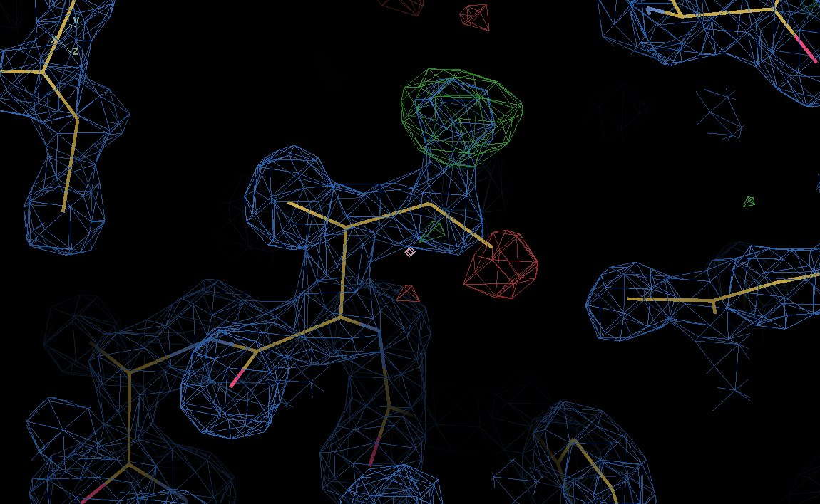
F_{o}-F_{c} Difference Fourier map
ρ(x,y,z)=1/V*Σ|F_{obs}-F_{calc}|e^{-2πi(hx+ky+lz-φ}_{calc}⁾
Here, F_{obs} = FP_native_jeannette.
F_{calc} are calculated from the current model of the protein.
Positive contours correspond to features present in the crystal that are not in the current model.
Negative contours correspond to features present in the native structure that should be removed from the current model.
Address all peaks in the difference Fourier map greater than 5 sigma.

Slide 10
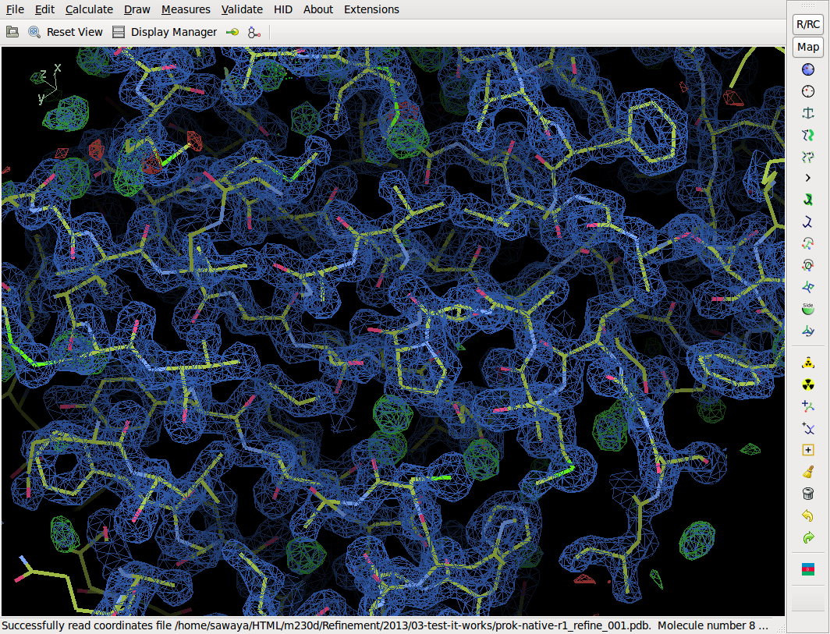
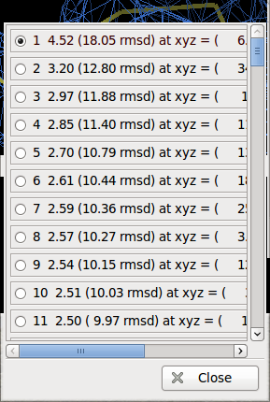
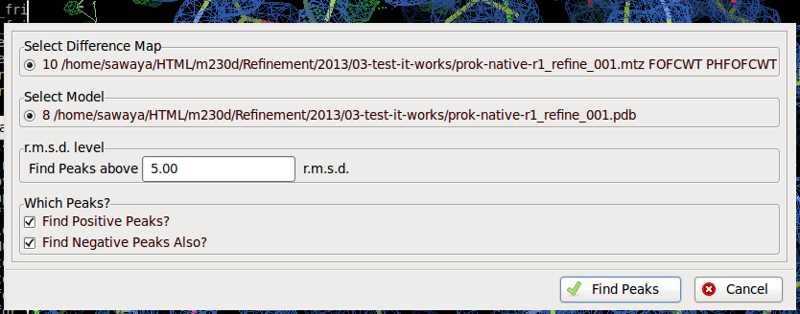
Get a sorted list of F_{obs}-F_{calc} peaks
Ramachandran plot
Kleywegt plot
Incorrect Chiral Volumes
Unmodeled Blobs
Difference Map peaks
Check/Delete Waters
Geometry Analysis
Peptide Omega Analysis
Rotamer Analysis
Density Fit Analysis
Probe Clashes
NCS differences
Pukka Puckers
Alignment vs. PIR

Slide 11
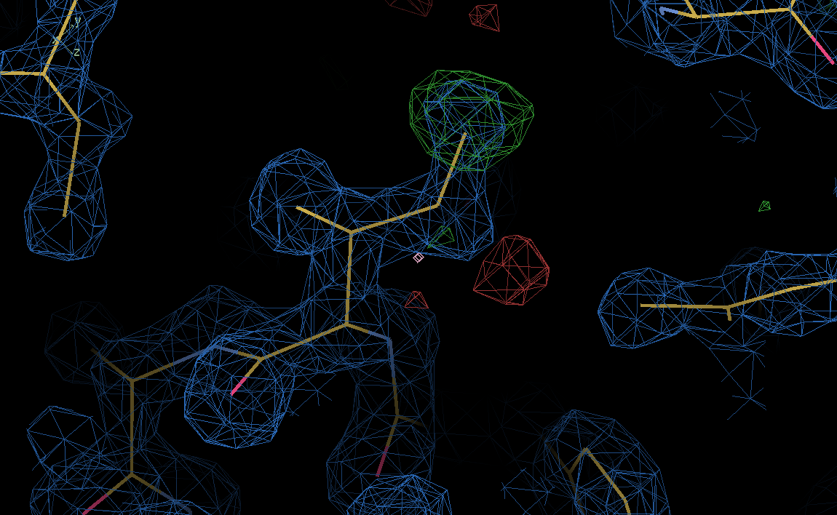
F_{obs}-F_{calc} reveals errors in model
Positive density
Negative density
Real Space Refine and drag
Or Autofit Rotamer

Slide 12
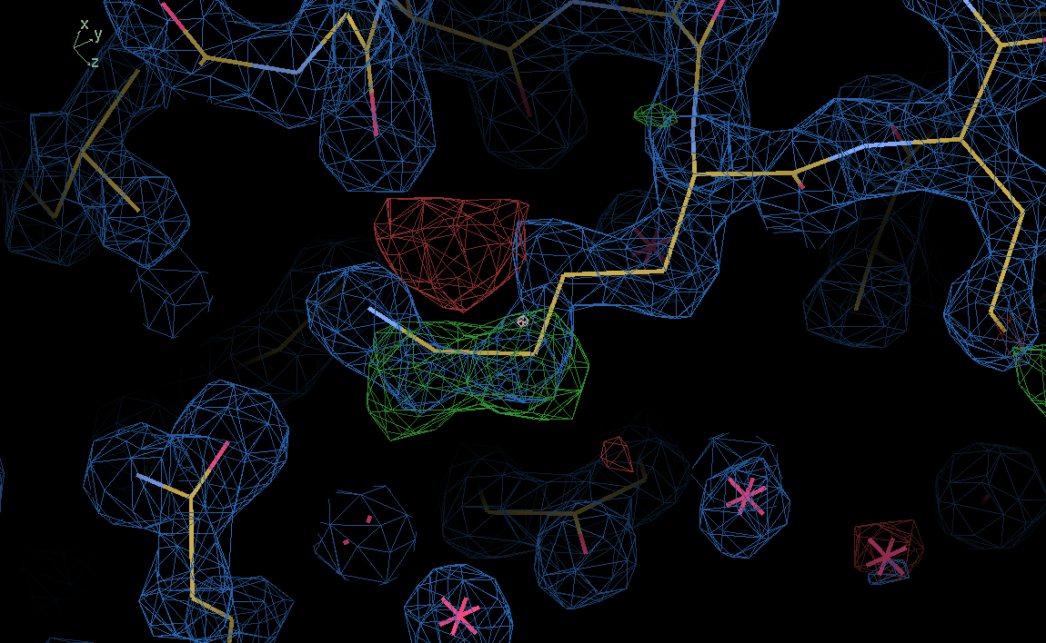
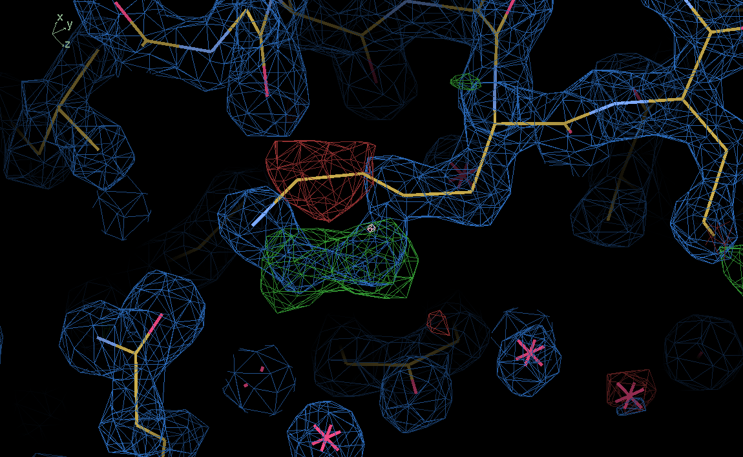
F_{obs}-F_{calc} reveals errors in model
Real Space Refine and drag
Or Autofit Rotamer

Slide 13
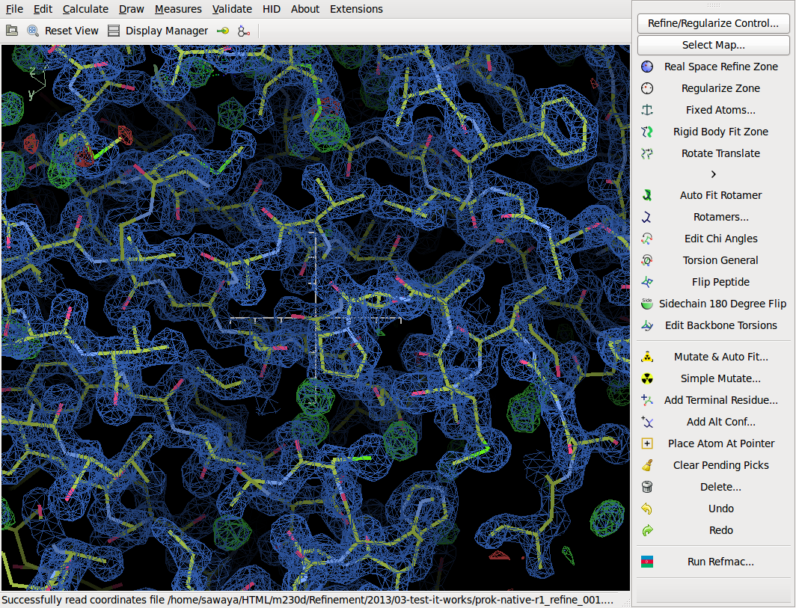
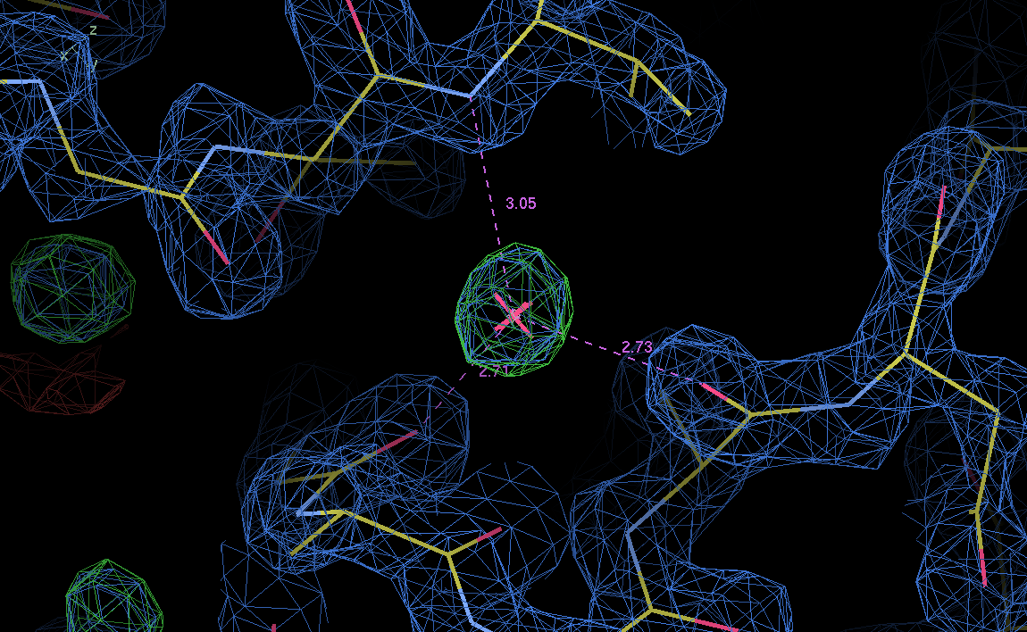

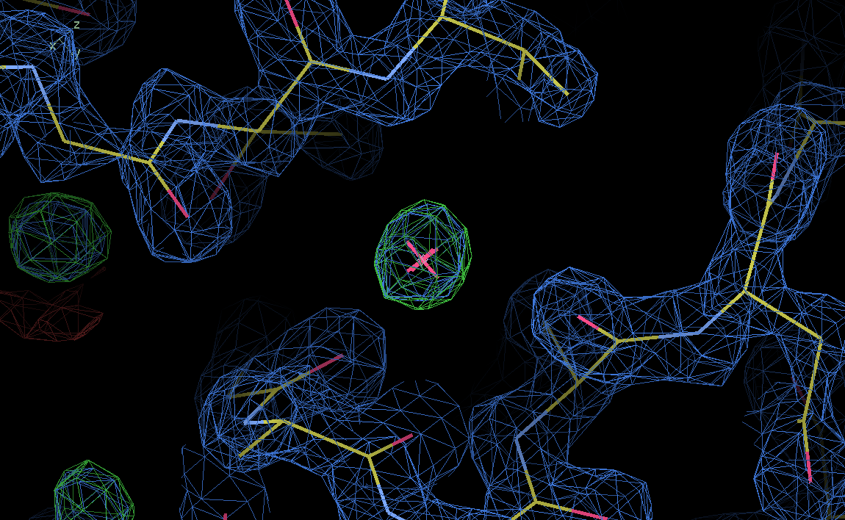
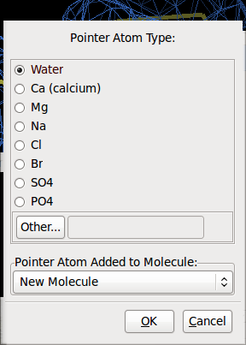
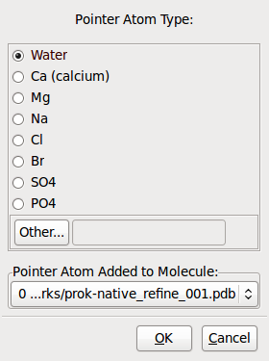
water

Slide 14
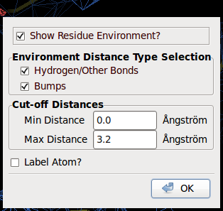
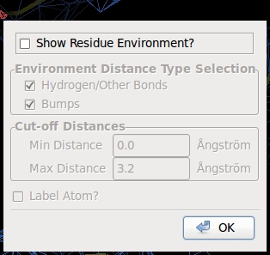
water

Slide 15
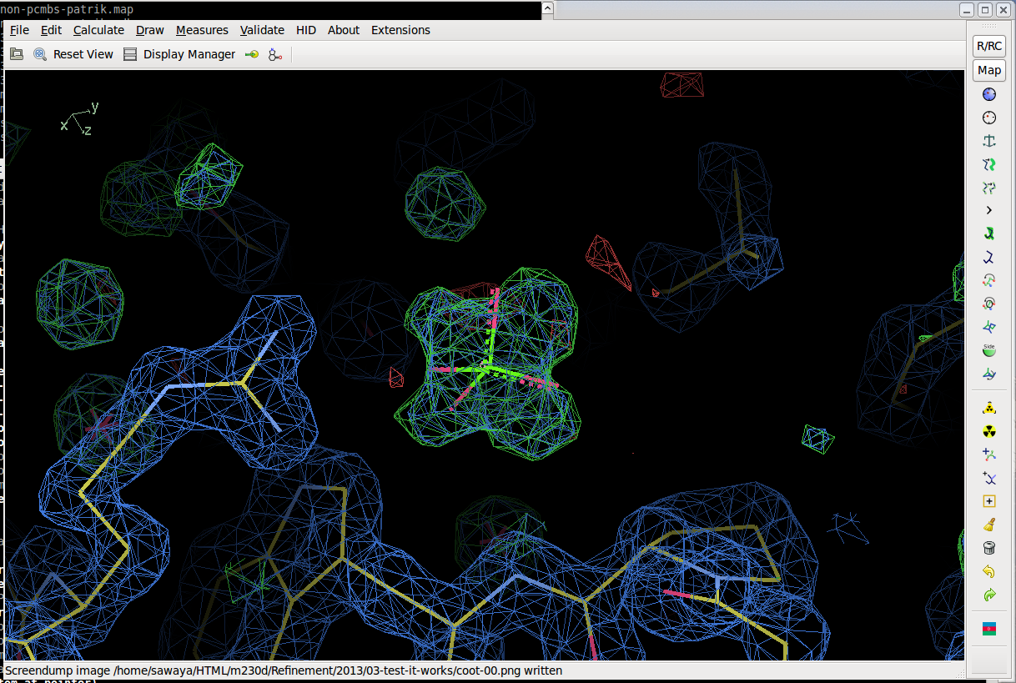
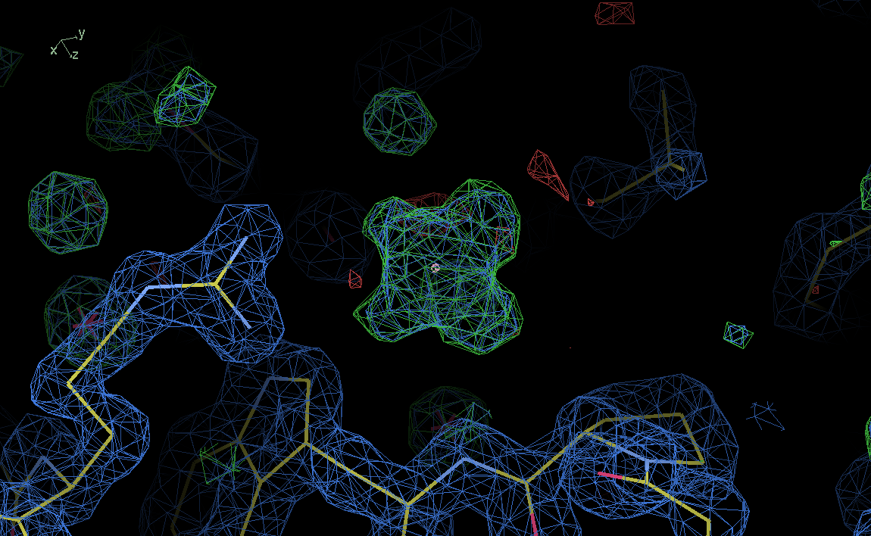
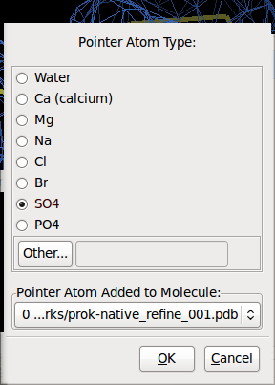
Other solvent

Slide 16

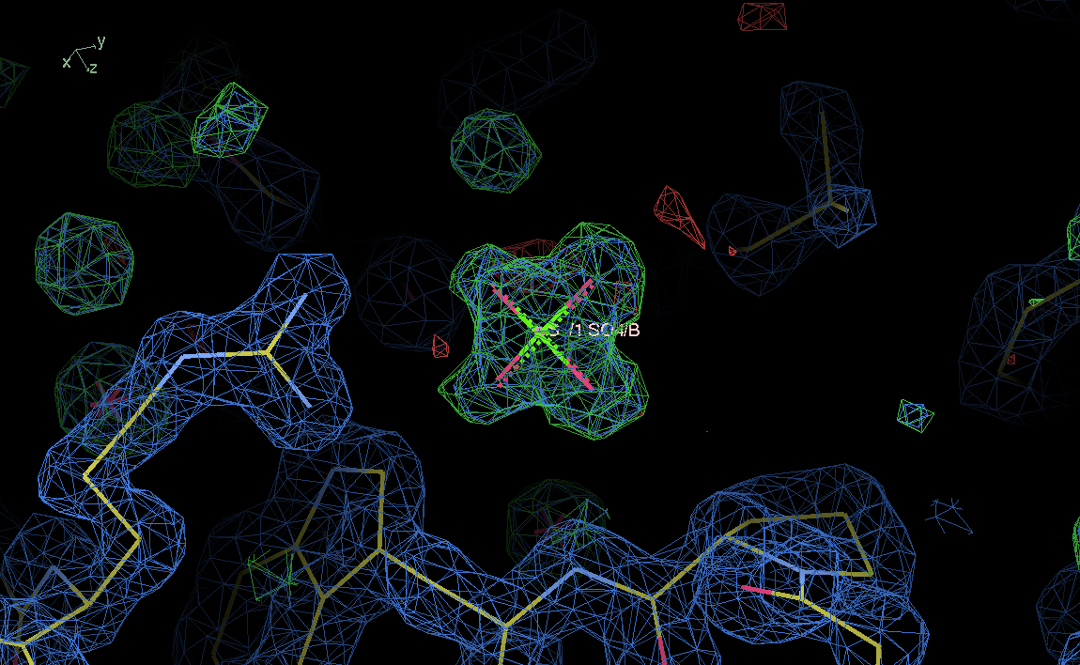
Other solvent

Slide 17
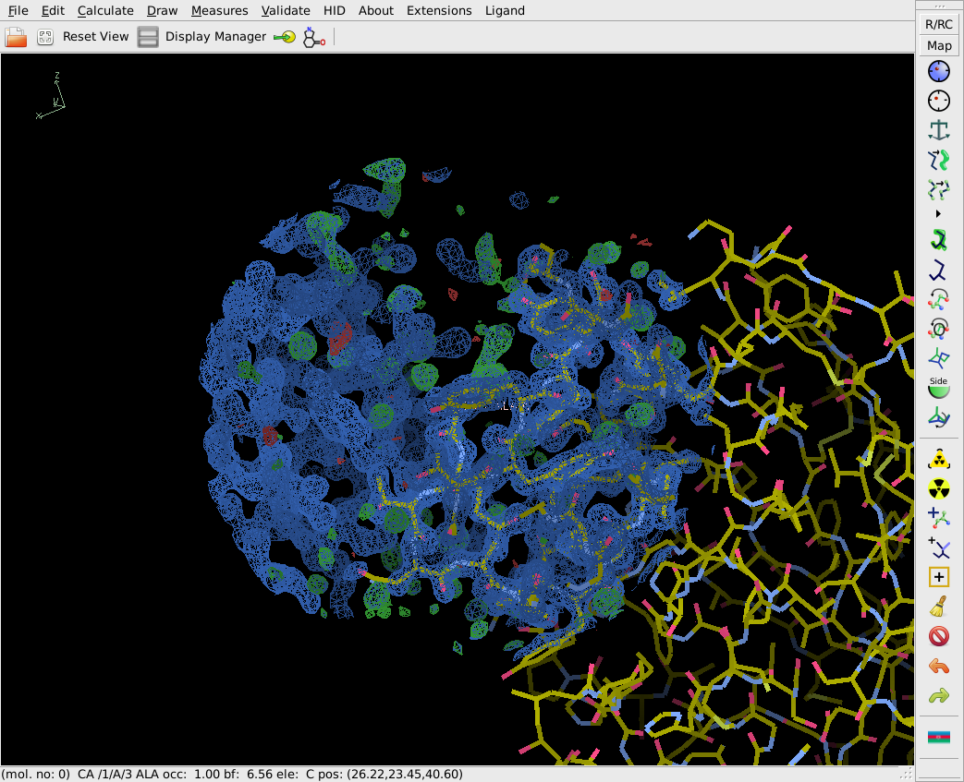
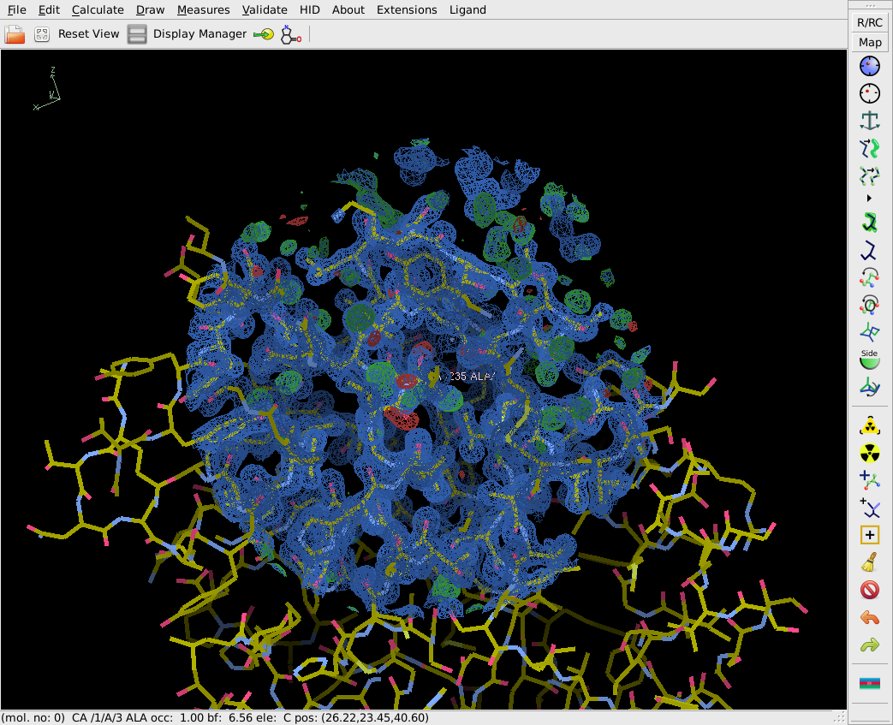
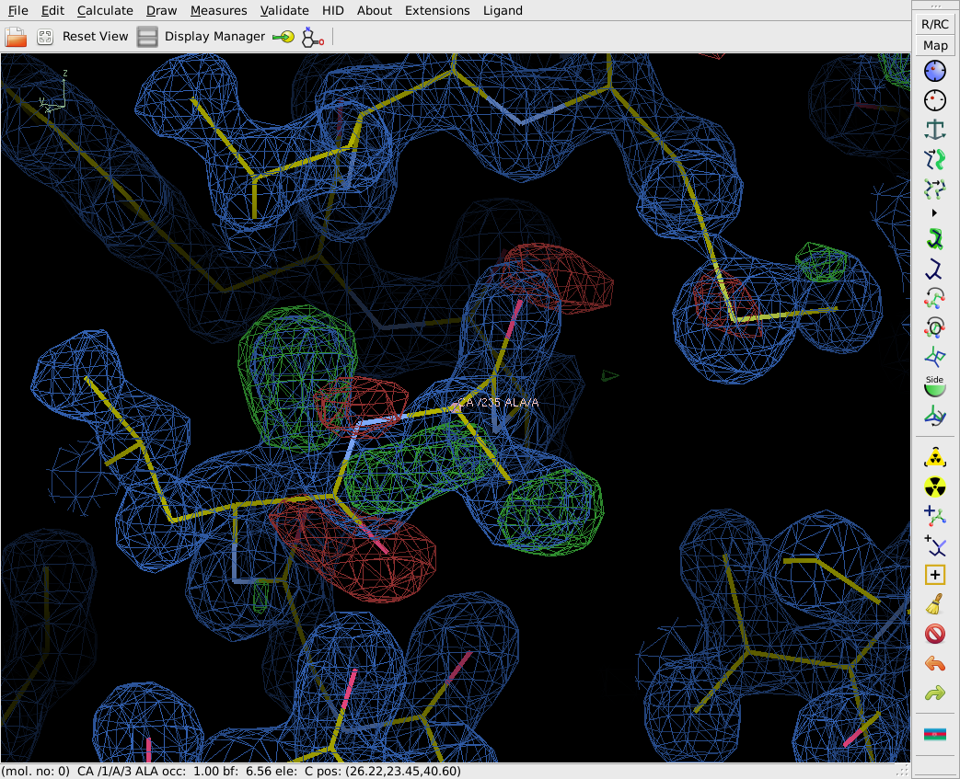

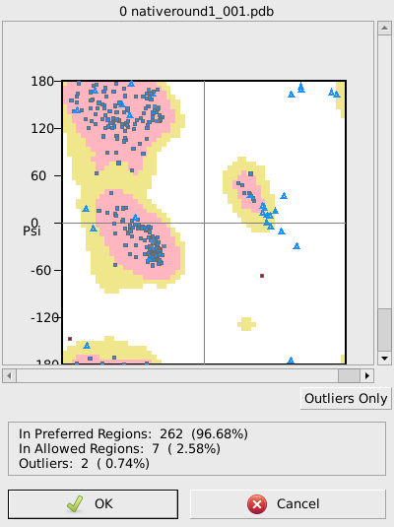
Fix Ramchandran Outliers
Ramachandran plot
Kleywegt plot
Incorrect Chiral Volumes
Unmodeled Blobs
Difference Map peaks
Check/Delete Waters
Geometry Analysis
Peptide Omega Analysis
Rotamer Analysis
Density Fit Analysis
Probe Clashes
NCS differences
Pukka Puckers
Alignment vs. PIR
235 A Ala

Slide 18
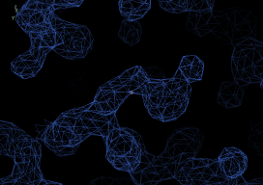
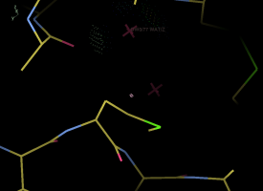
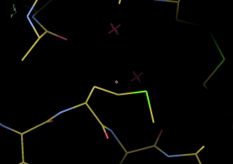
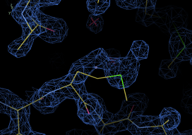
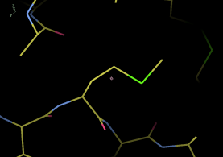
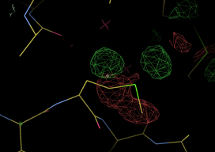
Structure Refinement Schematic
Automatic Refinement
|F_{obs-native} |
|F_{obs-GdCl3} |
α_{obs}
Move atoms to
Fit
|F_{obs}|
Σ|F_{obs}-F_{calc}|
Σ|F_{obs}|
|F_{obs-PCMBS} |
|F_{calc}|^{out}
|F_{calc} |^{in}
α_{calc}
|F_{calc} |^{in}
Reciprocal Space
FT (Coot)
FT (Phenix)
FT (Coot)
FT (Phenix)
Real Space
2F_{obs}-F_{calc}
map
experimental map
coordinates
(name-coot-83.pdb)
coordinates
(native-round1_001.pdb)
coordinates
(native-round1_001-coot.pdb)
Build atoms to
Fit Map
F_{obs}-F_{calc}
map
Manual Refinement
Manual Refinement

Slide 19
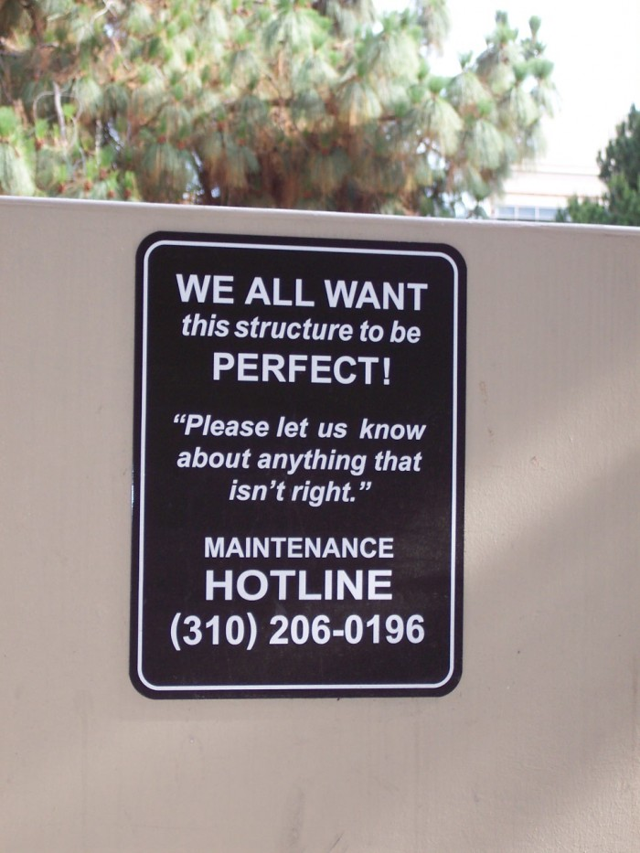
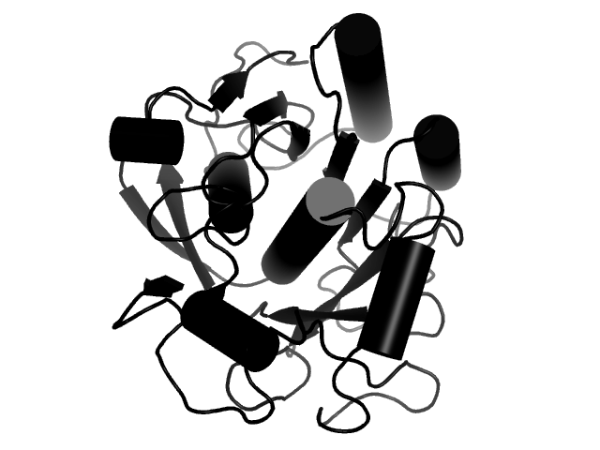
email sawaya@mbi.ucla.edu

Slide 20
Validation statistics
Biased | Unbiased (Cross validation)
R_{work} | R_{free}
RMSD from ideal bond lengths and angles | Report the number of Ramachandran outliers
 | Verify3D score
 | Errat score

Slide 21
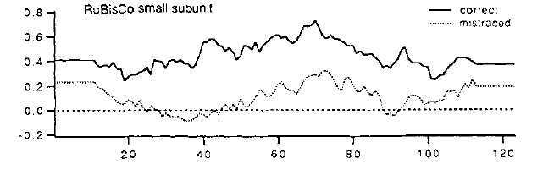
Verify 3D plot
Indicates if the sequence has been improperly threaded through the density.
It measures the compatibility of a model with its sequence.
Evaluate for each residue in the structure:
Surface area buried
(2) Fraction of side-chain area covered by polar atoms
(3) Local secondary structure
and compare to ideal library values for each amino acid type.
Correct trace
Backwards trace
Report the fraction of residues with score greater than 0.2

Slide 22
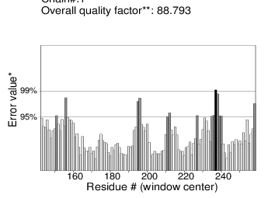
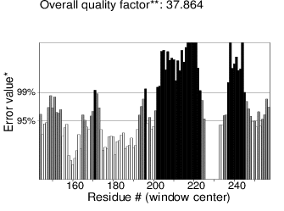
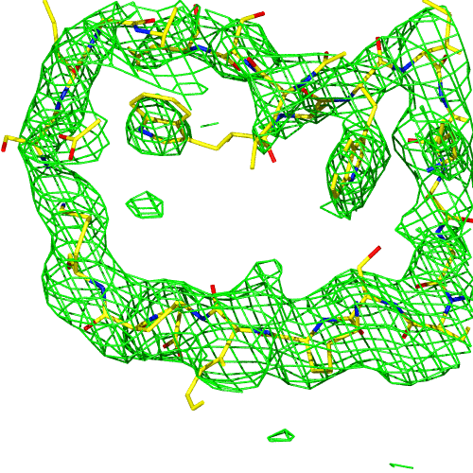
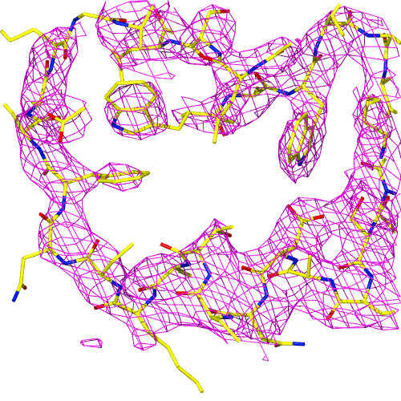
ERRAT examines distances between non-bonded atoms. Reports the deviations of C-C, C-N, C-O, N-N, N-O, O-O distances from distributions characteristic of reliable structures.

Slide 23
BACKBONE AMIDE
O
N
H

Slide 24
BAD
BACKBONE AMIDE
O
N
2.8 Å
H
H
N
O
H
Asn

Slide 25
GOOD
BACKBONE AMIDE
O
N
2.8 Å
H
H
O
N
H
Asn

Slide 26
Refinement
Refinement is the process of improving an atomic model so as to resemble the true structure.
Refinement cannot be completed in one session—experimental phases are not good enough to reveal all structural features at once. In fact, experimental phases are routinely abandoned when model is >65% complete. Phases are adopted from the model—more accurate than experimental phases.
Refinement is preformed in iterations (rounds). Phases will improve stepwise as we eliminate errors from the model. Corrections in one part of the model will improve entire map→Improved map will reveal new features to include in your model. Bootstrapping procedure. Ends when no new features observed.
  Tools to fit the atoms to a map.
    Manual Refinement with Coot.
  Tools to improve model’s agreement with |F_{obs}|.
    Automated refinement with Phenix
  Tools to indicate which atoms are inconsistent with |F_{obs}|.
    R factor
    Difference Fourier map.
  Tools to indicate atoms which deviate from ideal geometry.
    Saves server
Σ|F_{obs}-F_{calc}|
Σ|F_{obs}|
hkl
hkl

Slide 27
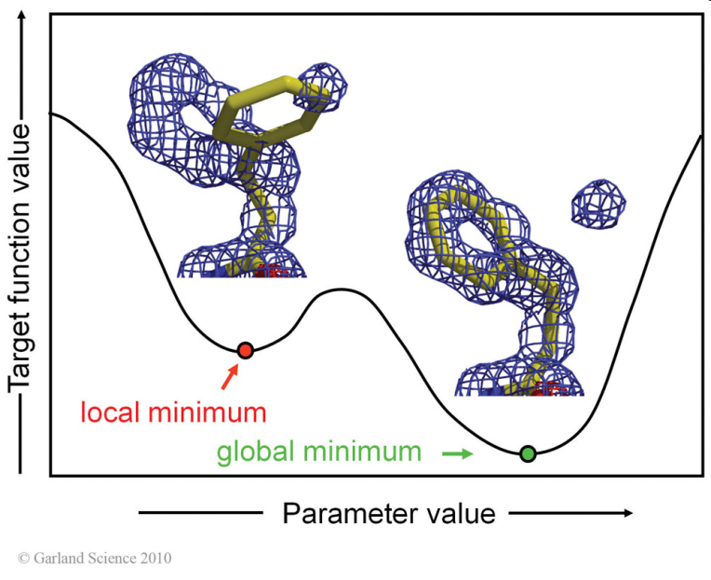
Compare & Contrast Refinement Algorithms
Manual
Coot
Real Space refinement
Local region
Large radius of convergence
Automatic
Phenix
Reciprocal Space refinement
All coordinates
Small radius of convergence
Torsion angle Cα-Cβ

Slide 28
Importance of the geometric restraints in boosting the
Data to Parameter Ratio
PARAMETERS
Each atom has 4 parameters (variables) to refine:
x coordinate
y coordinate
z coordinate
B factor
In proteinase K there are approximately 2000 atoms to refine.
This corresponds to
2000*4= 8000 variables.
DATA
At 2.5 Å resolution we have 8400 observations (data points) (Fobs).
Warning: with 8000 variables and only 8400 observations a perfect fit can be obtained irrespective of the accuracy of the model. (overfitting)
At 1.4 Å resolution we have 48,000 observations. About 6 observations per variable. Less chance of overfitting.
Adding stereochemical restraints is equivalent to adding observations

Slide 29
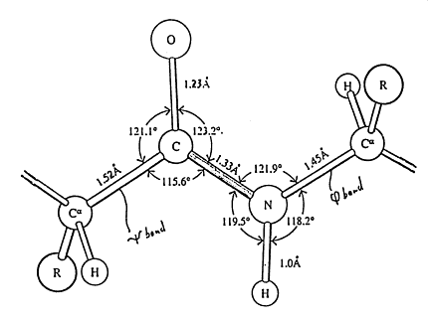
Geometry
Monitor RMS Deviations
  from ideal bond lengths
    (We want RMSD less than or equal to 0.02 Å)
  From ideal bond angles
    (We want RMSD less than or equal to 2.0°).

Slide 30
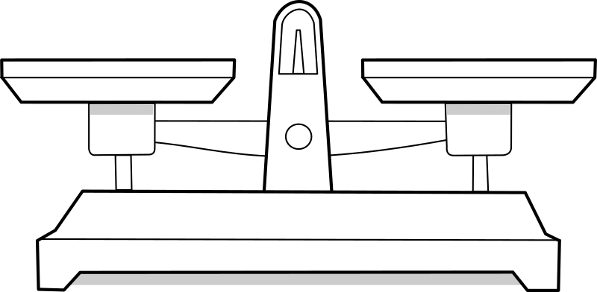
Automated Refinement
Two TERMS:
E_{total} = E_{data}(w_{data})+ E_{geometry}
w_{data} is a weight to shift the balance.
E_{geometry} minimizes deviation from:
ideal bond lengths
ideal bond angles
planarity (for aromatics)
& repels Van der Waals overlaps.
E_{data} minimizes discrepancy between |F_{obs}| & |F_{calc}|.

Slide 31
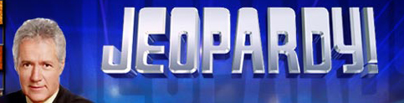

Jeopardy clue:
The appearance of the atomic model when stereochemical restraints are not included in crystallographic refinement.
E_{total} =E_{stereochemistry} + w_{data*}E_{data}
What is spaghetti, Alex?

Slide 32
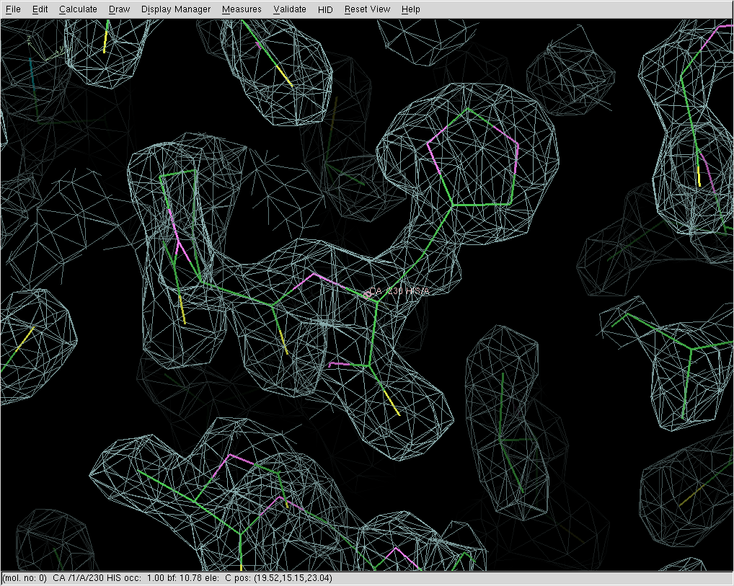
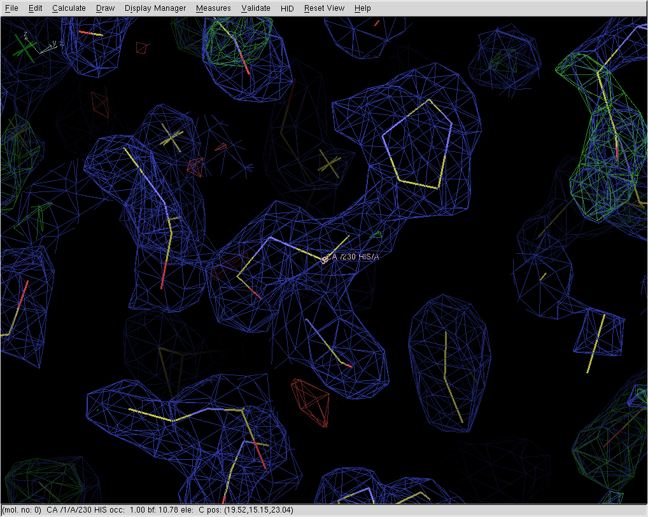
restrained not restrained

Slide 33

2nd Jeopardy clue:
The value of the R-factor resulting when stereochemical restraints are not included in crystallographic refinement.
E_{total} =E_{stereochemistry} + w_{data}E_{data}
What is zero, Alex?

Slide 34
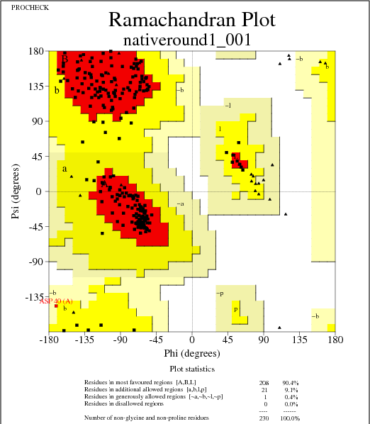
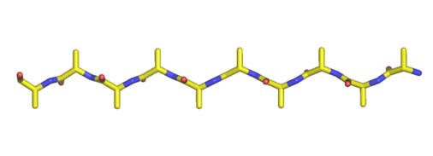
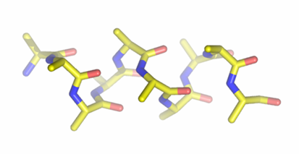
Ramachandran plot offers a means of Cross Validation.
β-sheet
α-helix
Residues in most favored regions 208 90.4%
Residues in additional allowed reg 21 9.1%
Residues in generously allowed reg 1 0.4%
Residues in disallowed regions 0 0.0%
Notes:
Side chains of neighboring residues point in different directions. Avoid steric clash.

Slide 35
Native Structure Refinement
Automated Refinement—Round 1
  Phenix
  R_{work} and R_{free} for your model.
Validate the structure with web server
  Do this now.
  Type “procheck nativeround1_001.pdb 1.5”
  Type “evince nativeround1_001_01.ps”
  Report Ramachandran statistics on spreadsheet.
Manual Refinement
  correct errors with Coot
Automated Refinement– Round 2
  Phenix
  Report R_{work} and R_{free} for your model on spreadsheet.
Awards

Slide 36
Native Structure Refinement
Automated Refinement—Round 1
  Phenix
  R_{work} and R_{free} for your model.
Validate the structure with web server
  Do this now.
  Google search “UCLA saves”
  Report Ramachandran statistics on spreadsheet.
Manual Refinement
  correct errors with Coot
Automated Refinement– Round 2
  Phenix
  Report R_{work} and R_{free} for your model on spreadsheet.
Awards

Slide 37
Refinement procedure for native structure
On one line, type the following:
Your best coordinates of native proteinase K
phenix.refine yourcoords.pdb m230d_2018_scaled.mtz refinement.input.xray_data.labels="FP_native-kyle SIGFP_native-kyle“ output.prefix=nativeround1
COMPLETED
COMPLETED
Report Ramachandran statistics in spreadsheet.
NOW
Then, address difference map peaks:
coot nativeround1_001.pdb nativeround1_001.mtz
NEXT
NOW
Pause here for 25 minutes for manual refinement with coot.

Slide 38
At 6:15 PM stop building. Save coordinates.
Start 2nd round of automated refinement of the native structure
On one line, type the following:
Coordinates of native protein after last round of model building
phenix.refine nativeround1_001-coot-#.pdb m230d_2017_scaled.mtz refinement.input.xray_data.labels="FP_native-cris SIGFP_native-cris“ output.prefix=nativeround2
Report Rwork and Rfree, RMSD bonds and angles in the spreadsheet.

Slide 39
Plan for later today: Solve structure of ProK-inhibitor complex
Methoxysuccinyl-Ala-Ala-Pro-Val-chloromethyl ketone
O
O
O
Ala-Ala-Pro-Val–
H
O
F
O
Cl
ProK
active site
Ser225

Slide 40
Plan for later today: Solve structure of ProK-inhibitor complex
Covalent complex
O
O
O
Ala-Ala-Pro-Val–
O
F
O
Cl
ProK
active site
Ser225

Slide 41
The benefit of isomorphism
ρ(x,y,z)=1/V*Σ|F_{inhibitor}-F_{native}|e^{-2πi(hx+ky+lz-φ}_{calc}⁾
amplitudes: Use |F_{inhibitor}-F_{native}| data measured earlier in the course
phases: phases from native proteinase K structure φ_{calc}.
protein | a (Å) | b (Å) | c (Å) | α | β | γ
ProK | 67.7 | 67.7 | 101.8 | 90° | 90° | 90°
ProK+inhibitor | 68.0 | 68.0 | 102.4 | 90° | 90° | 90°
R_{iso}=21.3%
What is maximum possible R_{iso}?
What is minimum possible R_{iso}?
Why don’t we have to use Heavy atoms?
Why don’t we have to use Molecular Replacement?

Slide 42
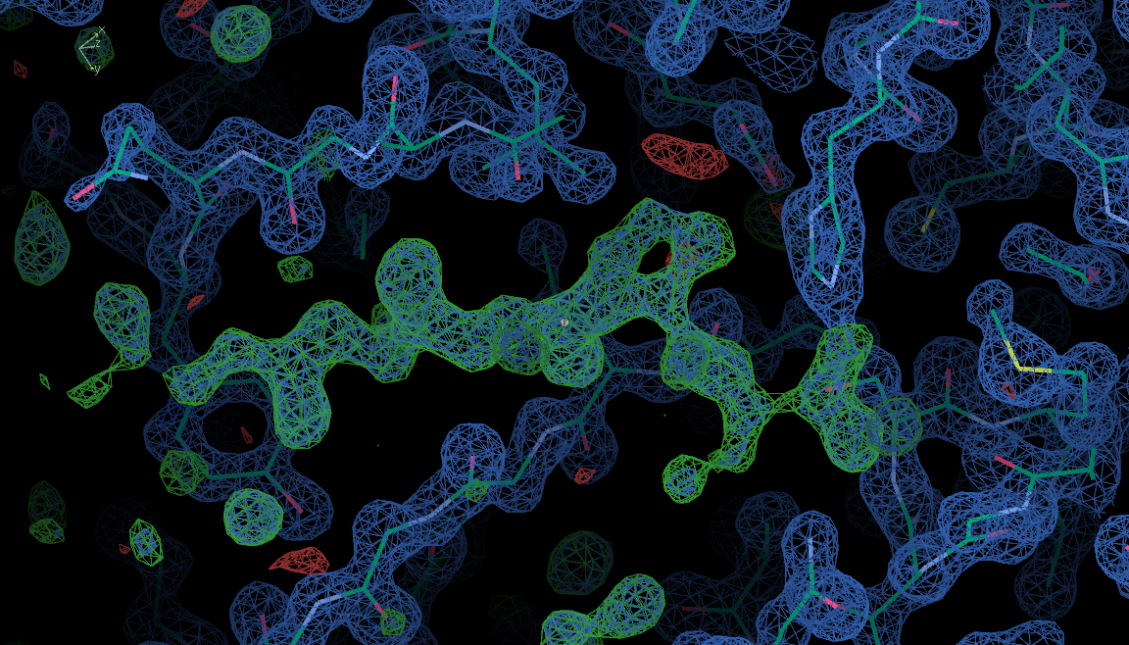

F_{o}-F_{c} Difference Fourier map
ρ(x,y,z)=1/V*Σ|F_{inhibitor}-F_{native}|e^{-2πi(hx+ky+lz-φ}_{calc}⁾
Here, F_{inhibitor} is the observed structure factors of the protein-inhibitor complex.
F_{native} is calculated from the model of the native protein after a few cycles of automated refinement.
Positive contours correspond to atoms in the inhibitor complex that are not in the native structure.
Negative contours correspond to atoms present in the native structure that should be removed in the inhibitor complex.
After model building, do more automated refinement and then validate.
Choose File menu→ Get Monomer→ type PRO

Slide 43
Goals for Later Today
Automated Refinement—Round 1
  Phenix
  R_{work} and R_{free} for your model.
Manual Refinement
  Build inhibitor
Automated Refinement– Round 2
  Phenix
  Note R_{work} and R_{free} for your model t.
Go forth wielding the tools of X-ray crystallography and discover the secrets of other biological macromolecules.

Slide 44
Refinement procedure for inhibitor structure
On one line, type the following:
Your best coordinates of native proteinase K
phenix.refine nativeround2_001.pdb m230d_2018_scaled.mtz refinement.input.xray_data.labels="FP_inhibitor-fay SIGFP_inhibitor-fay “ output.prefix=inhibitorround1
Then, address difference map peaks:
coot inhibitorround1_001.pdb inhibitorround1_001.mtz

Slide 45
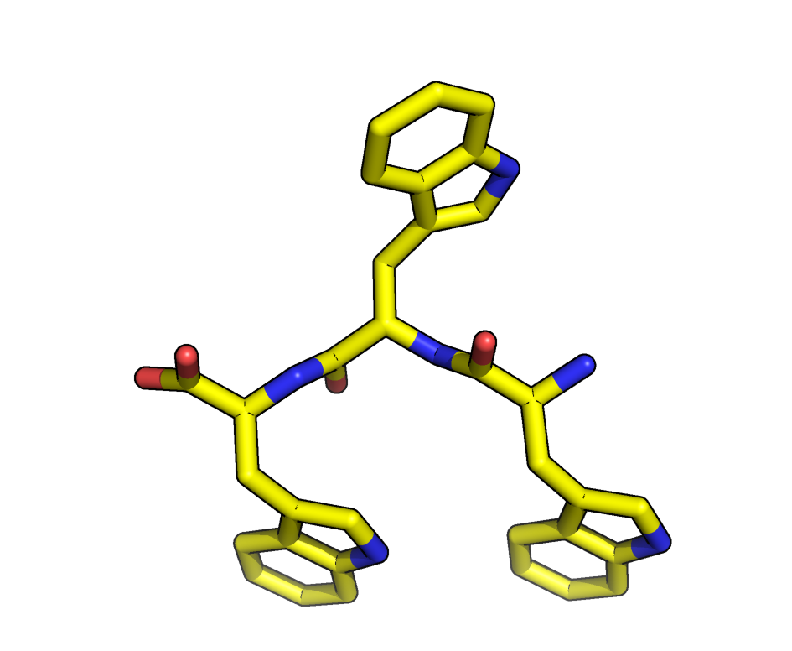
Peptide bond
O
CA
N-terminus
C-terminus
N
C
CA

Slide 46
Peptide bond
C
N
CA
N-terminus
C-terminus
CA
O

Slide 47
Main chain torsion angles
ψ
φ
psi
phi
CA
C
N

Slide 48
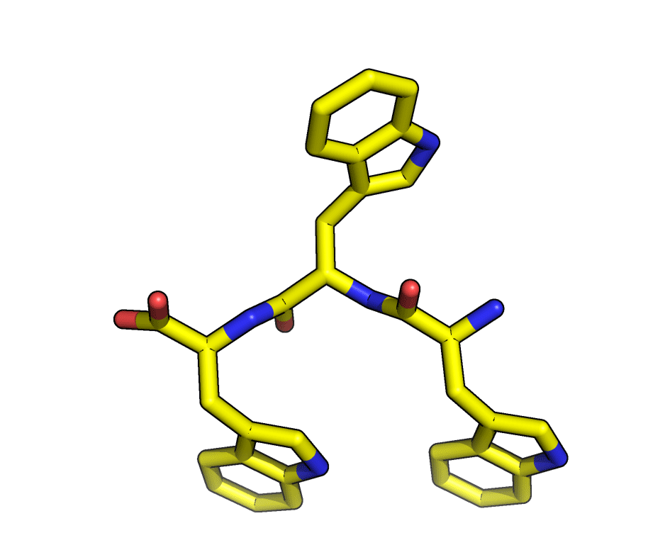
Peptide bond
ψ
φ
psi
phi
CA

Slide 49
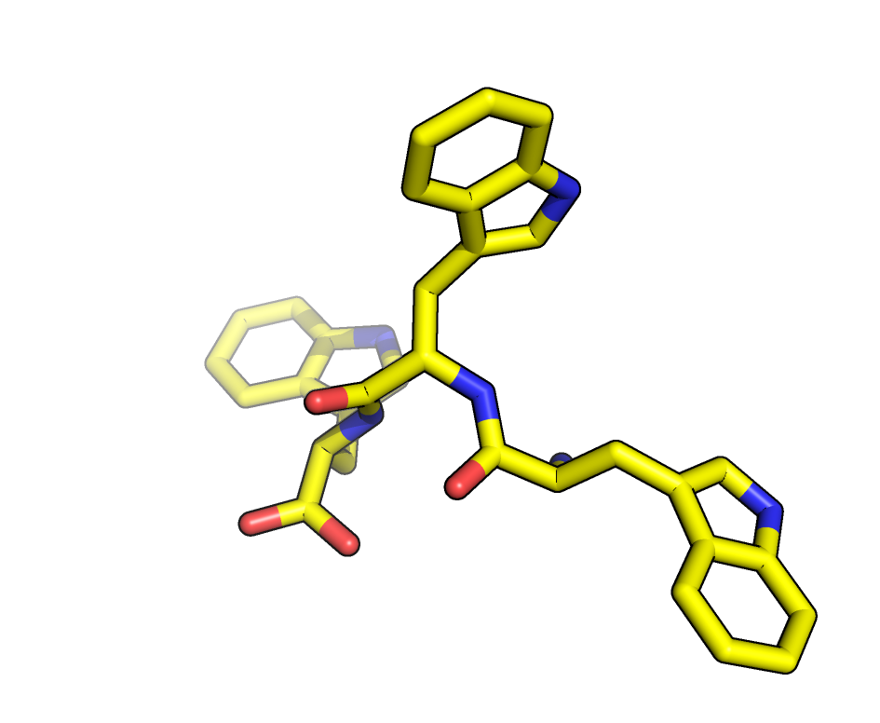
Peptide bond
ψ
φ
psi
phi
CA

Slide 50
Stop Here
Now, use COOT to correct errors in Phenix refined model:
  coot pmsf1_001.pdb pmsf1_001.mtz
Run Phenix after COOT
  phenix.refine pmsf1_001-coot-#.pdb m230d_2016_scaled2.mtz refinement.input.xray_data.labels="FP_pmsf-lingrong SIGFP_pmsf-lingrong“ PMS.cif output.prefix=pmsf2 pmsf.edits

Slide 51
Submit coordinates to SAVS server
Google for “UCLA SAVES”
Continue with discussion on solving the ProK-inhibitor complex structure.

Slide 52
4 Key Concepts
When to use isomorphous difference Fourier to solve the phase problem.
How to interpret an Fo-Fc Difference Fourier map.
Expected values of RMS deviation from ideal geometry
methods of cross-validation

Slide 53
Validate protein structure by Running SAVES server
grep -v hex prok-native_refine_001.pdb >prok-pmsf.pdb

Slide 54
Name _______________________
Refinement statistics | Proteinase K native | Proteinase K-PMSF
Resolution
Molecules in asymmetric unit | 1
Solvent content (%) | 36.3
Matthews coefficient (Å³/Da) | 1.9
Number of reflections used
R_{work}
R_{free}
RMSD Bond lengths
RMSD Bond angles
Ramachandran plot: favored
Ramachandran plot: allowed
Ramachandran plot: generously allowed
Ramachandran plot: outliers
Number of atoms: protein
Number of atoms: solvent
Errat overall quality factor
percentage with Verify3D score>0.2

Slide 55
Cis vs. Trans peptide
R
O
O
Cα
peptide plane
peptide plane
C
N
C
N
Cα
Cα
Cα
LOTS OF FREEDOM!
Steric
CLASH
R
R
R

Slide 56
Cis OK with glycine or proline
O
O
peptide plane
peptide plane
C
N
C
N
Cα
Cα
Cα
Cα
H
R
R
Steric hindrance equivalent
for cis or trans.

Slide 57
Steric hindrance equivalent for cis or trans proline
O
O
peptide plane
Cα
Cβ
peptide plane
Cδ
Cγ
C
N
C
N
Cγ
Cβ
Cα
Cδ
Cα
Cα
R
R
.

Slide 58
Think about how to get the students to work in unison. Difficult to show details of getting difference map peaks list unless they are doing it as you talk.
Make sure the student’s coordinates are in one file, not split over two.
We copied the native file to each person's directory for use in refinement.
Never got to the inhibitor complex.
Saves server failed when multiple students overburdened it. Procheck only reported one residue.
Phenix did not run. Had to use refmac5. time wasted for merging water and glycerol molecules. Make sure students add ligands to the working pdb file (not new pdb file). If they add glycerol, use the extensions menu so coordinates go in right pdb.
Next year: reserve room for 3 hours. Specify a meeting time in the class schedule.
~/HTML/m230d/Refinement/2015/

